Slide 1
Donna independent school district
2017-2018 Budget Kick-off Meeting
Wednesday March 22, 2017 3:00 pm donna isd board room

Slide 2
agenda
Sign In, Meet & Greet
Purpose & Scope
Budget Committee Members
Budget Process Overview
Evaluation
  Revenues
  Expenditures
Planning
  District Improvement Plan
  District Goals
  Comprehensive Needs Assessment
  ADA Projections
Budget Calendar
Campus On-Site Visits
Next Meeting
Questions & Comments

Slide 3
Purpose & scope
PURPOSE
Planning for the new school year is key to the success of our students and we need your help in order to create a strategic plan to ensure the needs of the district are identified and addressed.
SCOPE
The Budget Committee will meet periodically to discuss issues such as defining district goals, budget for expenditures and capital projects among other important items.

Slide 4
Budget committee
Core team
Leadership
Maricela Valdez, Chief Financial Officer
Sandra Martinez, Finance Director
Gerardo Cavazos, Accounting Supervisor
Nydia Rodriguez, Accountant
Abraham Gallegos, Accountant
Rigo Garcia, Accountant
Fernando Castillo
  Superintendent of Schools
Velma Rangel
  Chief Academic Officer for Special Programs
Javier Villanueva
  Asst. Superintendent of Human Resources

Slide 5
Budget committee

Slide 6
Budget process overview
PLANNING
PREPARATION
EVALUATION
Prior year Evaluation drives current year Planning to ensure efficient Preparation of next year’s budget

Slide 7
Planning
What do we want to accomplish?
  Campus Needs
  District Goals
How are we going to accomplish it?
  Communication & Feedback
  Historical & Current Information
  Define Goals & Objectives
  Prioritize
PLANNING
PREPARATION
EVALUATION

Slide 8
Preparation
PLANNING
PREPARATION
EVALUATION
Preparation consists of:
  Allocate Budget Resources
    Campus Needs
    District Goals
  Board Approval & Adoption

Slide 9
Evaluation
PLANNING
PREPARATION
EVALUATION
What were the outcomes?
    Effectiveness of Budget
    Budget Changes & Amendments
Were district goals met?
    Examine how funds were expended
    Drives next year’s planning phase

Slide 10
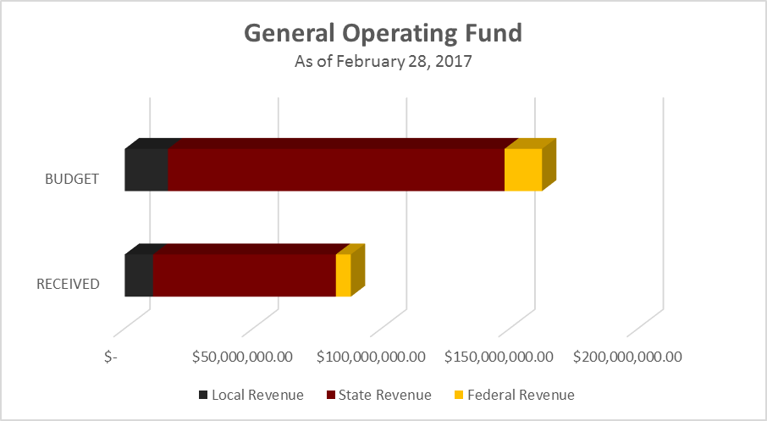
Evaluation: fy 2017 REVENUES
$ 162,546,647
$ 88,050,374
54%
Notes:
Nydia

Slide 11
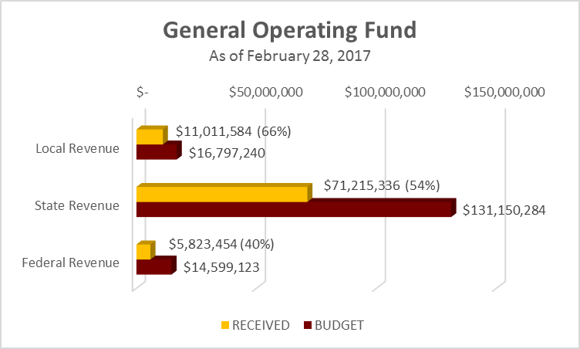
Evaluation: fy 2017 REVENUES
(continued)
Local Revenues
  Taxes
  Sales (Athletics, Food, etc)
  Other Sources
State Revenues
  TEA
  Other State Organizations
Federal Revenues
  Food Service
  Other Organizations
Notes:
Nydia

Slide 12
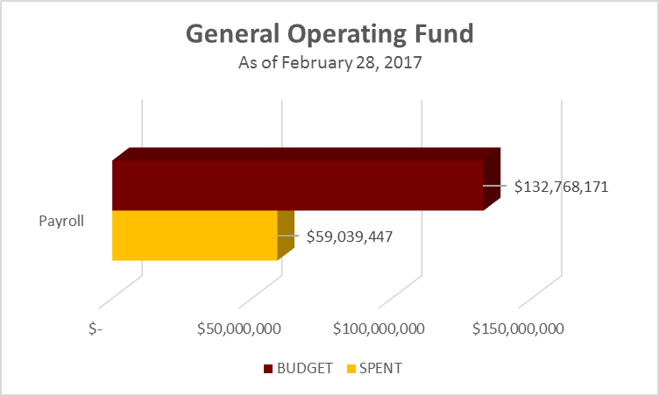
Evaluation: fy 2017 expenditures payroll cost
Payroll costs account for 80% of overall Expenditures
44%
Notes:
Nydia

Slide 13
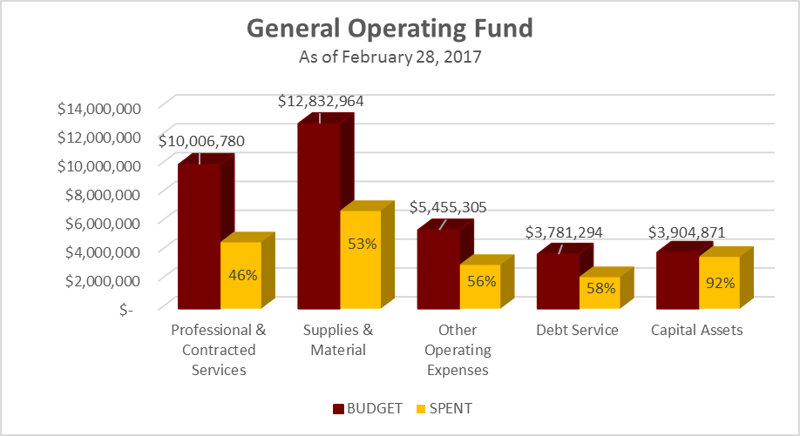
Evaluation: fy 2017 expenditures other cost
Capital Assets-92%
  Portables
  HVAC
  Paving of Parking Lots
Notes:
Nydia

Slide 14
Planning: District Improvement Plan
Mission Statement
The mission of Donna ISD is to ensure academic excellence for all students through a rigorous and supportive learning environment that provides a quality education in accordance with state and national standards.
VISION
We envision being an exemplary school district staffed with highly qualified individuals working collaboratively to graduate college-ready students who will be a powerful force for positive change in our community.
Notes:
AB

Slide 15
Planning: 2018 district goals
Goal 1: Create an inviting educational climate that enhances learning and academic performance for all students so that they may excel in all areas of education and meet state and federal passing standards.
Goal 2: Provide students and all stakeholders with a safe and nurturing school environment that supports academic success.
Goal 3: Continue to follow sound fiscal and managerial practices to provide a highly qualified staff, appropriate resources, technology, and well-maintained facilities to promote increased student achievement.
Goal 4: Collaborate with parents, community members, and staff to promote continuous success for all student through and effective planning and advisory process.
Notes:
AB

Slide 16
Comprehensive needs assessment
A comprehensive evaluation plan to identify the school’s strengths and weaknesses.
The CNA drives the CIP which influences the budget.
Step 1: Review the purpose and outcomes for conducting the CNA
Step 2: Establish committees for each area
Step 3: Determine which types of data will be collected and analyzed by committee to develop the school profile
Step 4: Determine areas of priority and summarize strengths and weaknesses
Step 5: Connect the CNA to the district/campus improvement plan development and review process.
*Clearly outline funding source
Notes:
AB

Slide 17
Comprehensive needs assessment
Identifying Data Sources
Demographics
Student Achievement
School Culture and Climate
Staff Quality, Recruitment and Retention
Curriculum, Instruction and Assessment
Family and Community Involvement
School Context and Organization
Technology
Notes:
AB

Slide 18
ADA PROJECTIONS
*2016-2017 Data Current as of 4th Six Weeks
*2017-2018 Data is a Projection based on 2017 ADA

Slide 19
Budget calendar: Major Activities
April 10, 2017-Tentative Board Budget Workshop I
April 17, 2017-Budget meeting with Principals and Directors
April 18, 2017-Tentative Budget Committee Meeting II
April 24, 2017-Budget meeting with Athletics, Fine Arts & Auxiliary Directors
May 10, 2017-Budget Freeze
May 17, 2017-Tentative Budget Committee Meeting III
May 19, 2017 Budget Worksheet Drafts are Due
May 26, 2017-Comprehensive Needs Assessment Due
June 13, 2017-Tentative Board Budget Workshop II: Preliminary Budget
August 8, 2017-Tentative Board Budget Workshop III: Near Final Budget
August 23, 2017-Public Meeting to discuss Budget and Tax Rate
August 30, 2017-TEA Budget Adoption Deadline

Slide 20
Budget calendar: upcoming activities
April 17, 2017-Budget meeting with Principals and Directors
April 24, 2017-Budget meeting with Athletics, Fine Arts & Auxiliary Directors
May 10, 2017-Budget Freeze
May 19, 2017 Budget Worksheet Drafts are Due
May 26, 2017-Comprehensive Needs Assessment Due

Slide 21
Campus On-site visits
Purpose of on-site visits
To identify risk exposures in regards to cash handling and monitor compliance among the district for student activity policies and procedures
These on-site visits are to help safe guard the employees of the district and its integrity
Scope of the Visits
Examination of documents; Fundraisers and sponsor forms (if applicable)
Observation of interaction with sponsors
Money handling: receiving and storing
Bank deposit procedure
Bank deposit cash vault difference
Appropriate signatures, dual signatures
Notes:
Rigo

Slide 22
Campus On-site visits
Findings are communicated with Principal and secretary/bookkeeper, a discussion of what should be done to avoid them in the future
Follow-Up Visits
Provide back up for bank discrepancies
Will be more detailed
Have questionnaires
Current findings have been minimal
Forthcoming Visits may include:
Review of fix assets and inventory
CNP-Food sales spot checks
Notes:
Rigo

Slide 23
Next meeting
Date: Monday April 18, 2017
Time: 3:00 pm
Place: Donna ISD Board Room
Discussion points
  Update on ADA Projection
  Federal Revenues and Expenditures
  Preliminary Budget Allocations
  Salaries

Slide 24
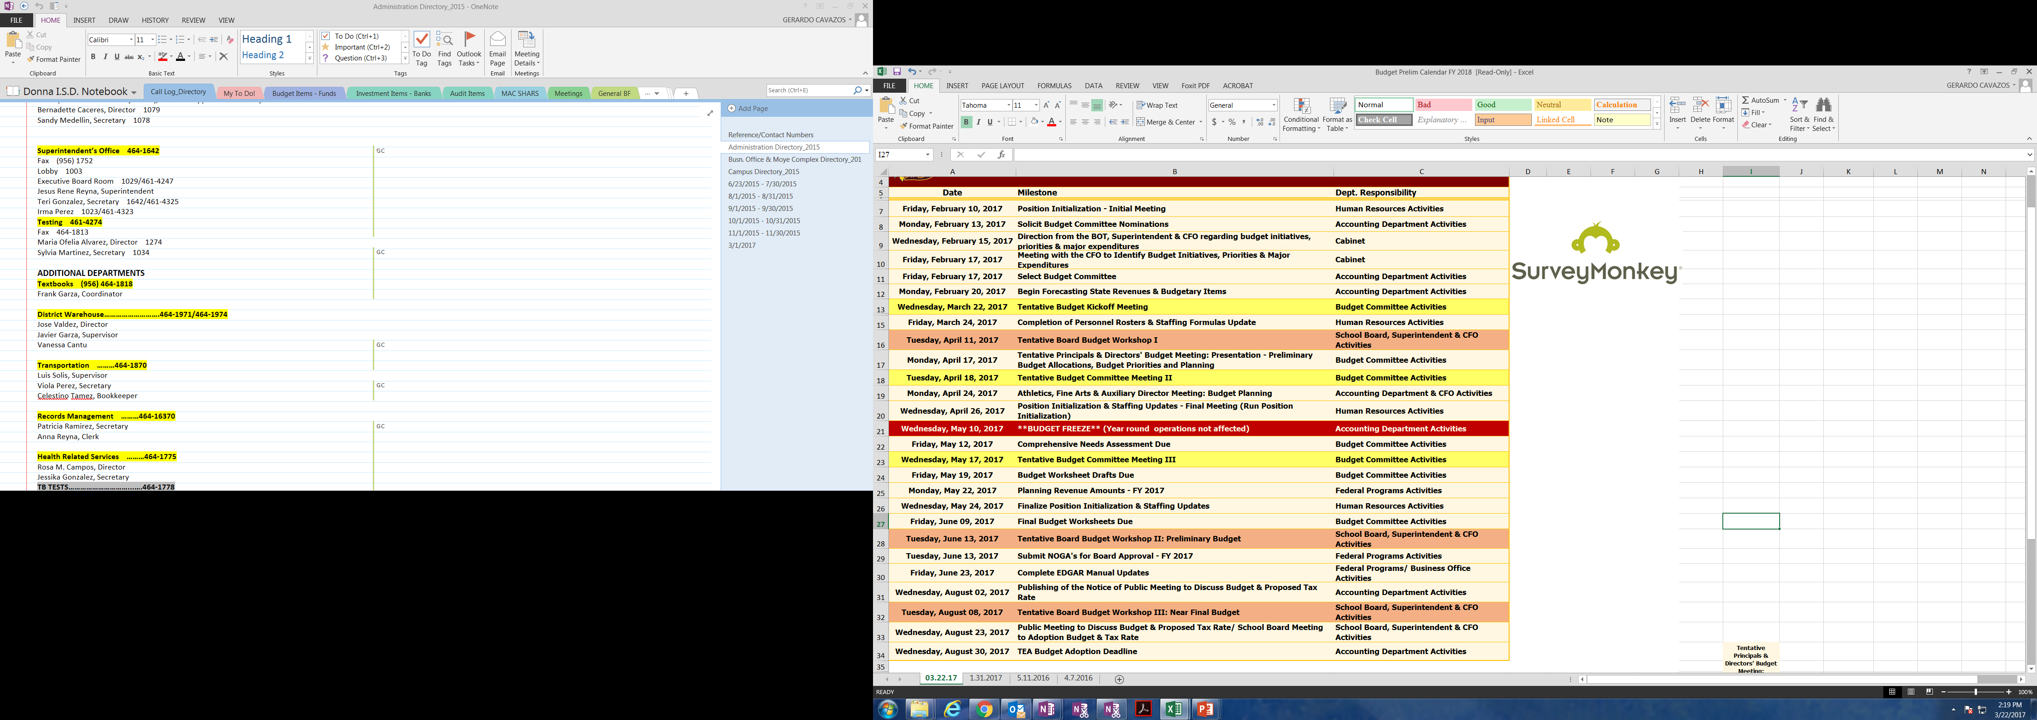
Question & comments

