Slide 1
Technology Integration Grant
Sipayik Elementary School
Maine Learning Technology Initiative
Enhancing STEM Education Through Innovative Technology
Grant Amount: $8,165.50
Presentation to School Committee
Contract Period: July 1, 2025 - December 19, 2025

Slide 2
Grant Overview & Purpose
Maine Department of Education
Contract #20250626000000003266
Total Award: $8,165.50
Project
Project Goals:
Integrate
Integrate technology seamlessly into the curriculum
Develop
Develop STEM skills through hands-on learning
Enhance
Enhance problem-solving and critical thinking
Connect
Connect learning to weather, climate, and environmental studies
Support
Support cross-curricular integration
Benefit
Benefit students across all grade levels

Slide 3
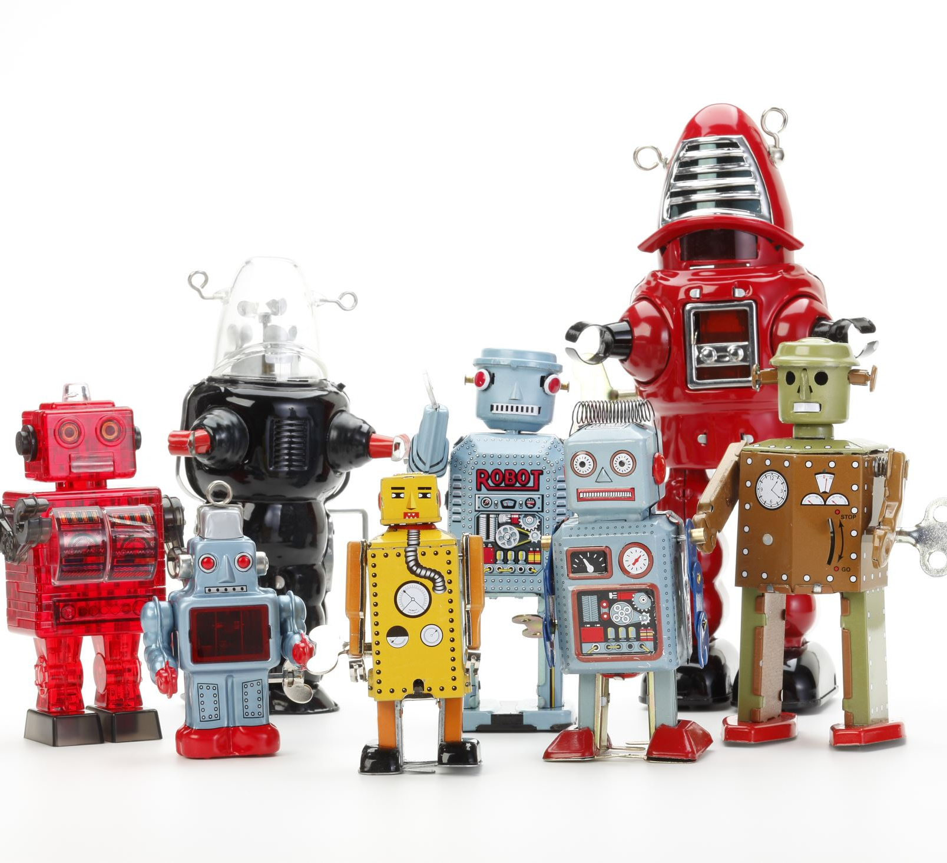
Marty Robot V2
Class Pack (10 units)
$4,316.50
STEM Classroom Bundle
PocketLab Sensors & Equipment
$3,849.00

Slide 4
What's Included in STEM Bundle
10 PocketLab Voyager 2 Sensors
10 PocketLab Thermo Sensors
3 PocketLab Air Sensors
10 External Temperature Probes
10 Silicone Cases
2 Five-Port USB Chargers
13 USB Cables
1 Protective Storage Case
1 Notebook Pro Annual Subscription
Professional Training Included

Slide 5
Educational Impact & Benefits
10: Programmable Robots
23+: Scientific Sensors
📚 Cross-Curricular Learning
Integrate Math, Science, History, and Language Arts through technology-enhanced projects
🌍 Environmental Studies
Weather monitoring, climate data collection, and environmental awareness projects
🧠 Critical Thinking
Problem-solving through coding, robotics, and scientific experimentation
👥 Collaborative Learning
Team-based projects that develop communication and cooperation skills

Slide 6
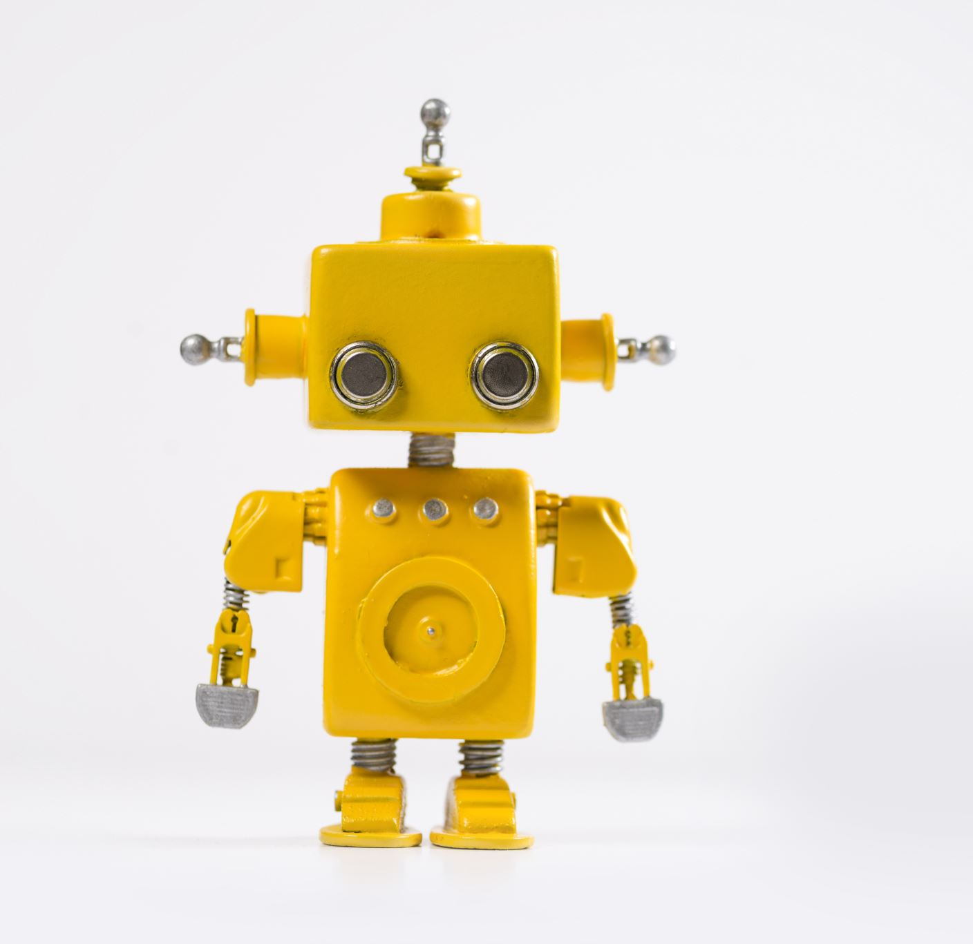
Marty the Robot - Coding & Robotics
🤖
Marty Robot V2 Class Pack
$4,316.50
Programming Languages
Scratch Jr. (Visual blocks)
Scratch (Intermediate)
Python (Advanced)
Robot Capabilities
Walking & Dancing
Sensor Integration
Sound & Movement
Interactive Programming
Learning Outcomes
Computational Thinking
Problem Solving
Creative Expression
Collaborative Projects

Slide 7

🔬
Professional-Grade Science Equipment
$3,849.00
Real-World Science Applications:
🌡️ Weather & Climate
Temperature monitoring
Air quality measurement
Environmental data collection
Climate change studies
⚗️ Scientific Method
Hypothesis testing
Data collection & analysis
Experimental design
Scientific reporting
📊 Data Science
Graph creation
Trend analysis
Digital documentation
Presentation skills

Slide 8

Summary & Next Steps
This $8,165.50 investment will transform STEM education at Sipayik Elementary School, providing students with cutting-edge technology tools that prepare them for future academic and career success.
🎯 Project Goals
Seamless technology integration
Enhanced STEM learning
Cross-curricular connections
Environmental awareness
📋 Requirements
Project implementation
Evidence submission
Sharing best practices
Professional development
🚀 Expected Outcomes
Increased student engagement
Improved STEM skills
Enhanced problem-solving
Future-ready learning

