Slide 1

Pike County School Corporation
March 2026

Slide 2


PCSC
Rural District
PK-12
County-wide
Largest
employer

Slide 3
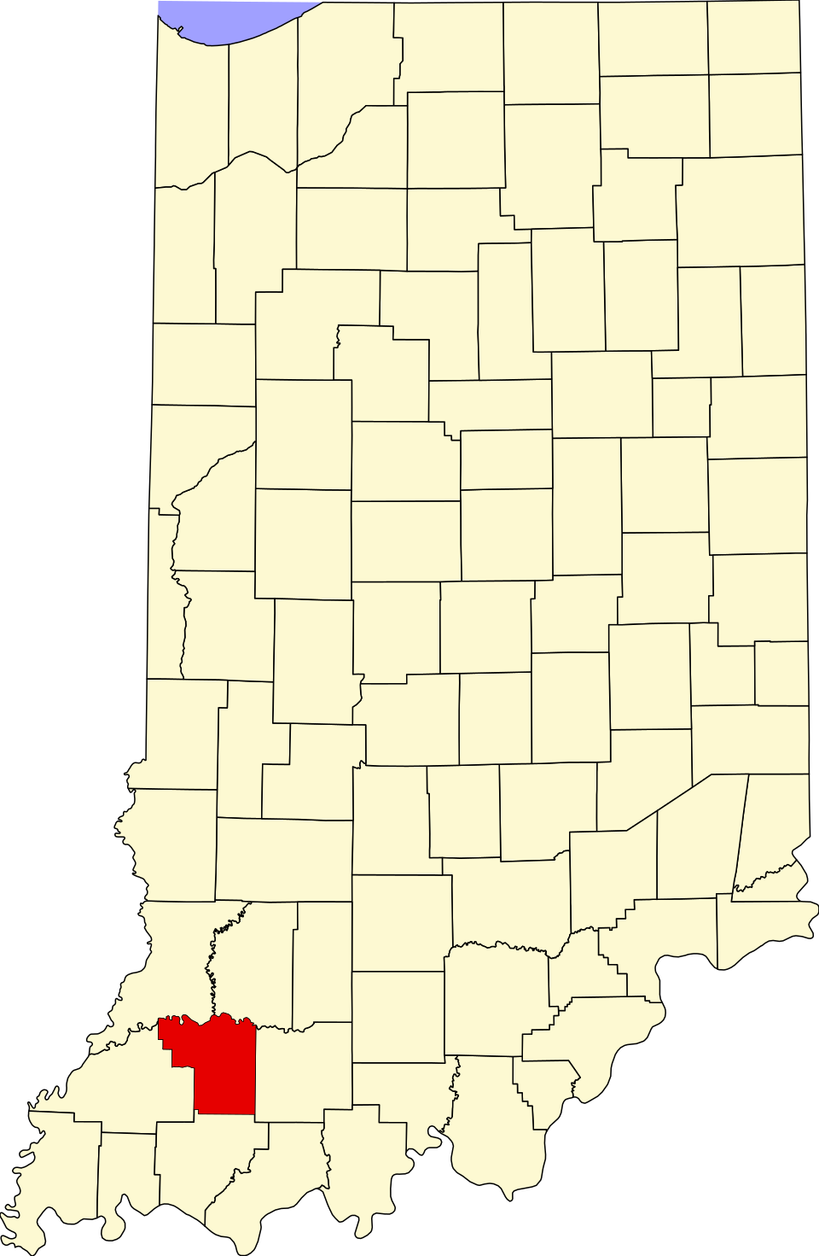
Pike County, Indiana
Pike County
Located in SW Indiana
Exit 46 on I-69
Population: 12,250
Density: 36.65/sq mi
Area: 341.09 sq mi
Industry – Farming & Power Generation
Former Home of Hoosier Energy Power Generating Station
AES Petersburg (IPL) Power Generating Station
New: Solar Fields, Battery Storage, Gas Turbines
Current Economic struggles have impacted school district
Largest Employer: PCSC

Slide 4
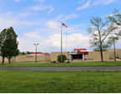
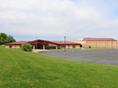
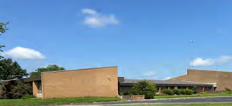
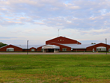
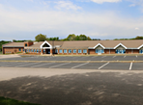
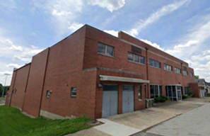
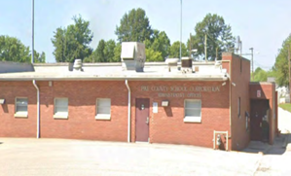
Pike County School Corporation
Pike County School Corporation
Rural School District
IHSAA – 2A School
Pike Central HS (9-12)
Pike Central MS (6-8)
Petersburg ES (PK-5)
Winslow ES (PK-5)
Alternative School (9-12) - OPG Bldg
Central Office
Otwell ES – Vacant
Pike Central HS
Pike Central MS
Otwell Elementary
Petersburg Elementary
Winslow Elementary
Old Petersburg HS Gym (OPG)
Central Office

Slide 5
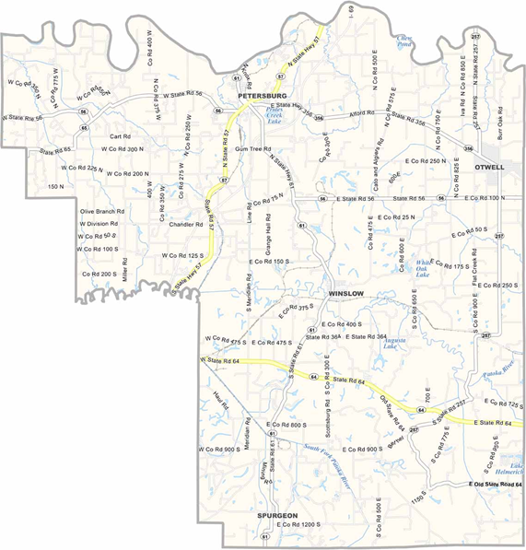

Pike County School Corporation
Petersburg – PES, CO, Alternative School
Winslow – WES
SR 61 & SR 56 – PCHS/PCMS
Otwell – Formerly OES; vacant building
Residents North of Dividing Line – PES
Residents South of Dividing Line – WES
Students are allowed to attend outside the assigned “school district” but transportation is not provided by PCSC.
PES, CO & OPG
PCHS PCMS
Dividing Line PES/WES
WES

Slide 6
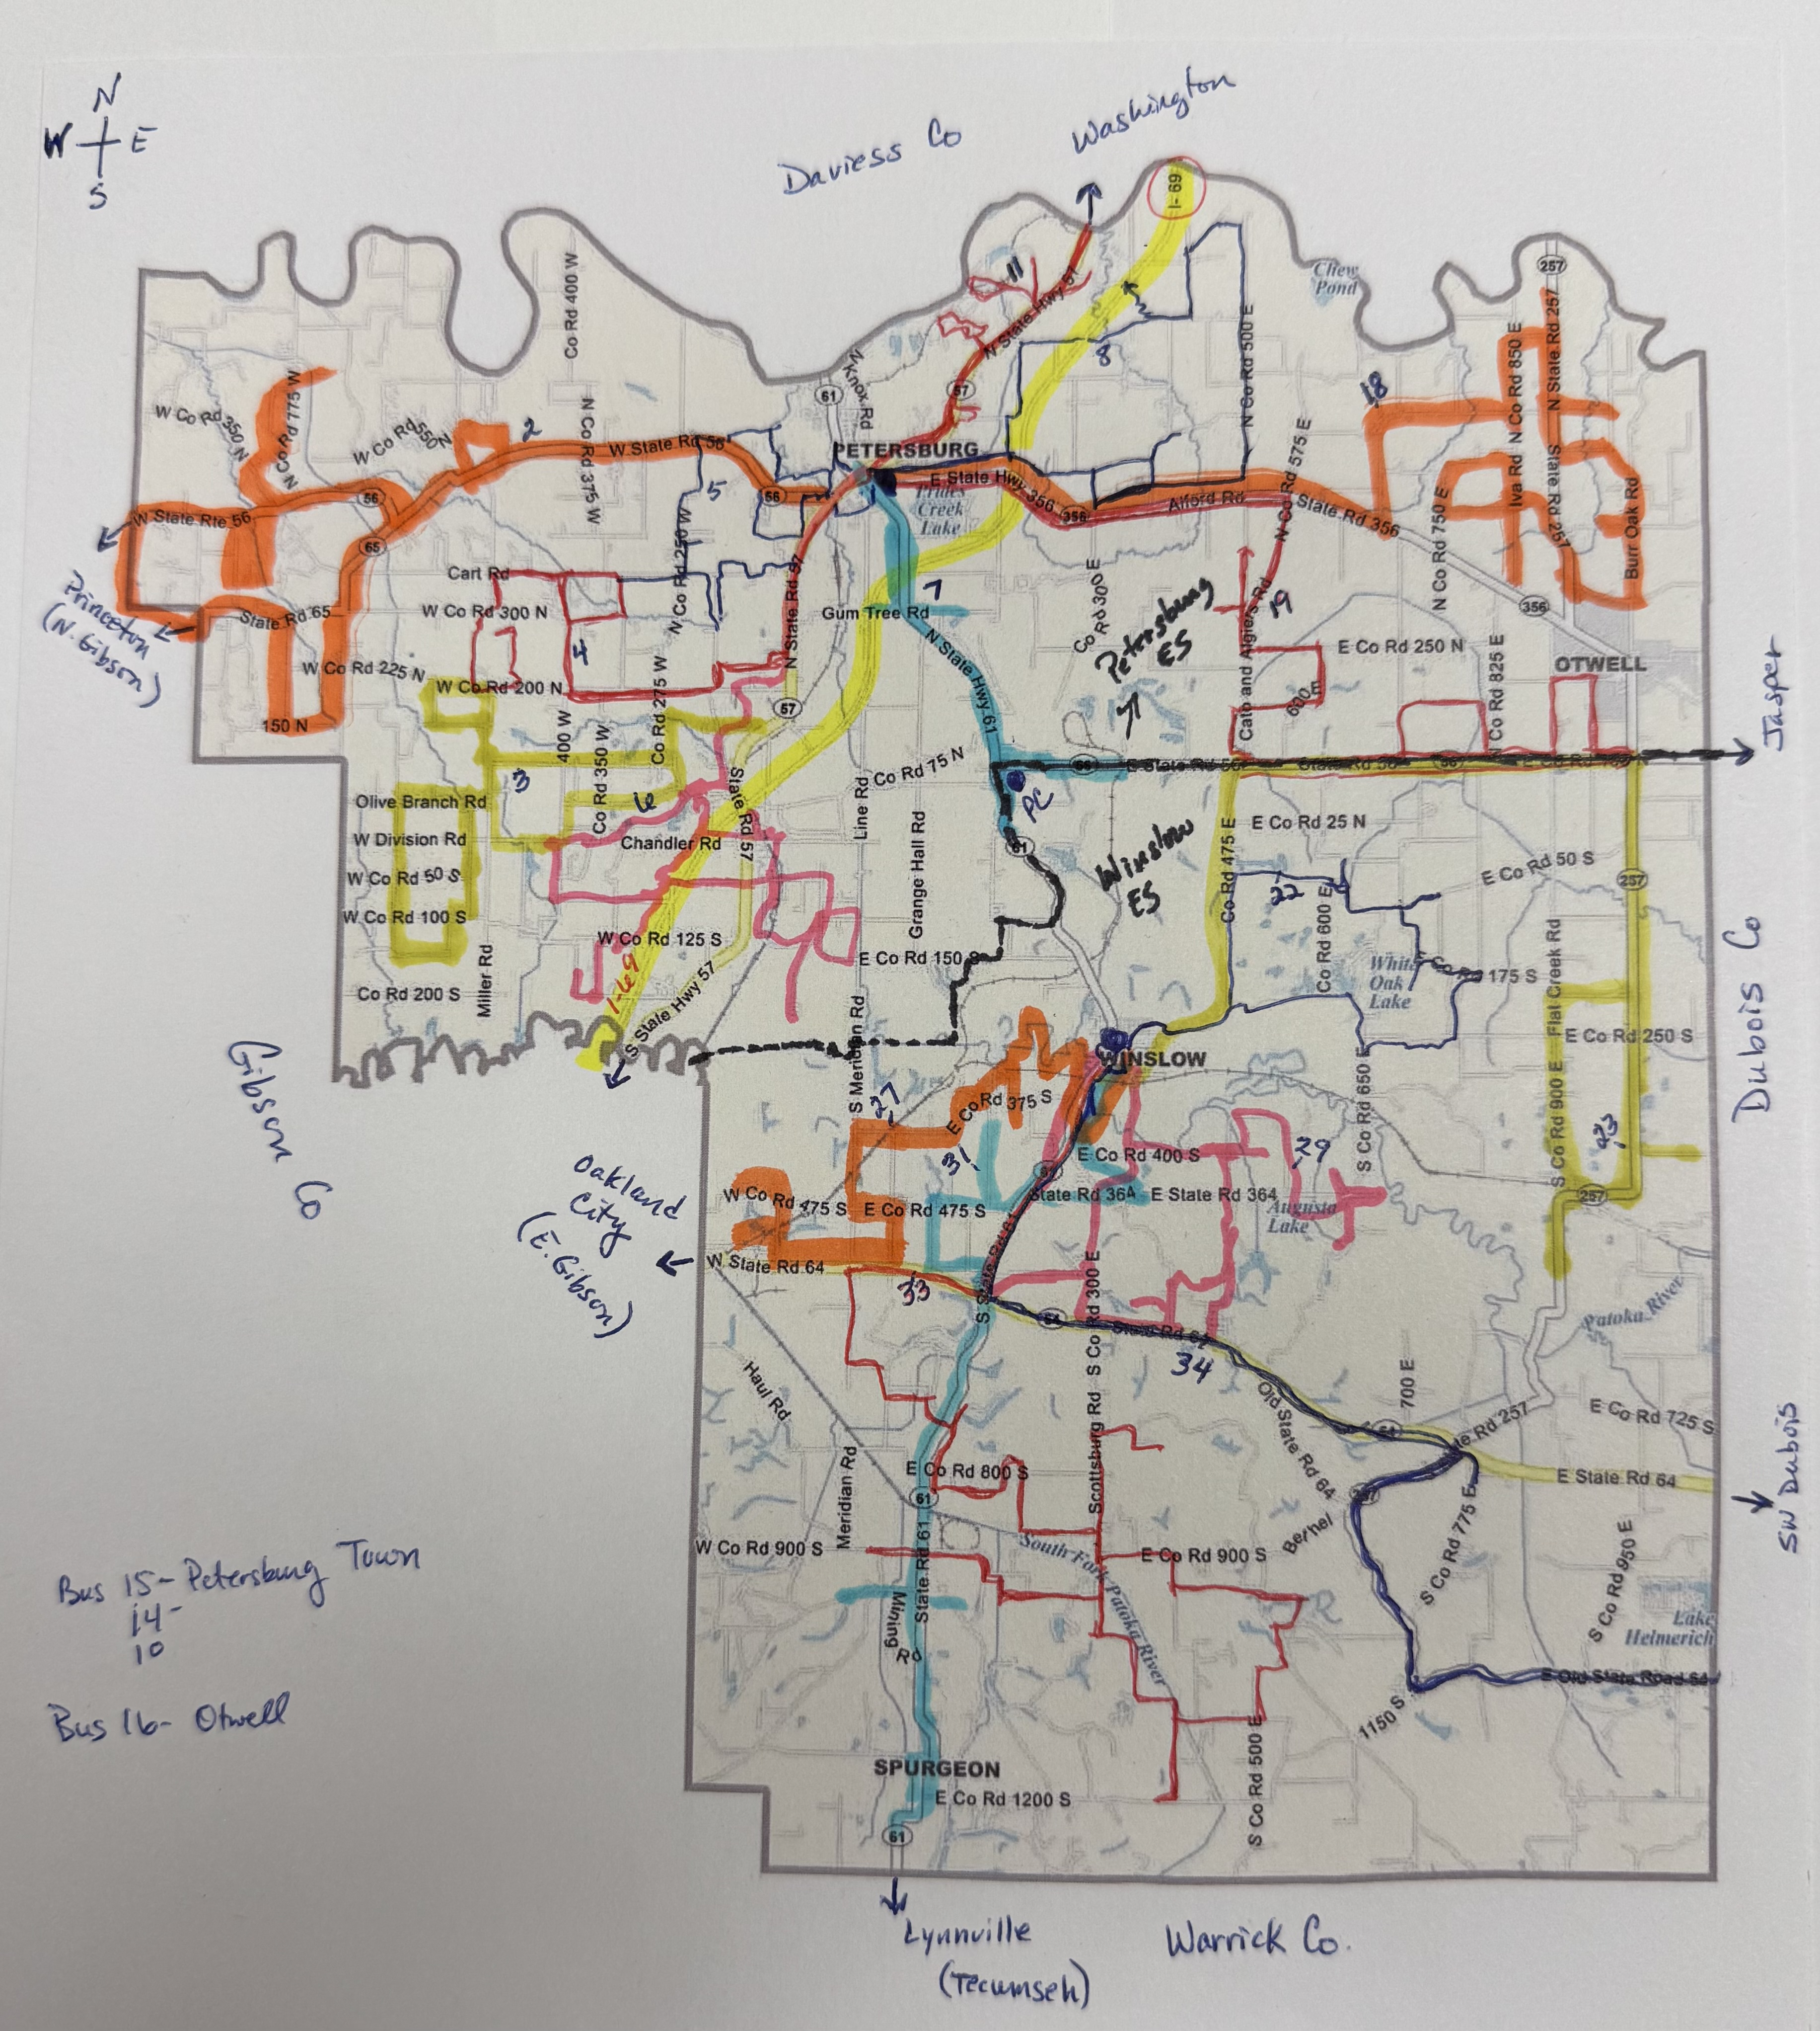
Transportation
Transportation
Travel 965 miles @ day
Transport ≈ 800 students
Avg Travel Time: 87 minutes
  Shortest Route: 58 min
  Longest Route: 114 min
24 Bus Routes
6 SE Bus Routes
1 Bus Mechanic
County Road Info
  551 miles of road in Pike Co
  247 miles are paved
  284 miles are gravel
Notes:
Show Bus Routes

Slide 7
Enrollment
Information

Slide 8
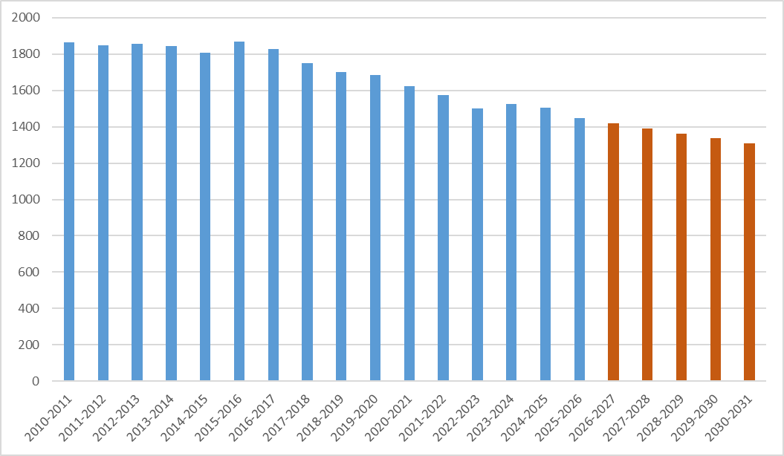
Enrollment Data
Otwell Elem Closed
Hoosier Energy Closed
Charter School Opened
AES Shuts Down Unit 1
AES Shuts Down Unit 2
AES
Changes
Year ADM
2010-2011 1865
2015-2016 1868
2020-2021 1622
Hybrid Learning
2025-2026 1447
2030-2031 1309
Notes:
2026 thru 2031 projected annual ADM with 2% decrease
Dec 2014 – Frank E Ratts Generating Station closed; demolition of the facility in late 2016 – early 2017 also impacted local AV
Otwell Elem – 120 students; closed in June 2016; community was upset and proceeded to form a charter school
AES information - # employees, 4 units

Slide 9

Out-of-County Transfer Data
$2,950,740 Uncaptured funding for PCSC (2024-2025)
Transfers Out of County
  221 – Parent Choice/Public Transfers
    Clarksville CSC
    SW Dubois CSC
    Greater Jasper CS
    East Gibson SC
    Union SC
  4 – Other/Public Transfer
  151 – Charter/Public Transfer
    Otwell Miller Academy
    Indiana Connections Academy
  14 – Choice Scholarship/Non-Public Transfer
Knox Co
Daviess Co
Dubois Co
Gibson Co
Warrick Co
Notes:
Top 5 listed – 168 students
Charter – 105 (OMA), 25 (Indiana Connections Academy)

Slide 10
Transfers to Adjacent School Districts
South Knox – 15 mi
Washington Comm – 13 mi
Knox Co
Daviess Co
Proximity to Neighboring Districts
  Hazelton to Petersburg – 16 mi
  Spurgeon to Winslow – 10 mi
  Stendal to Winslow – 14 mi
  Otwell to Petersburg – 11 mi
Virtual/Online Programs
Charter School Created in Otwell
  Opened 2018-2019
  K-5
  Provides Bus Transportation
Petersburg
North Gibson – 12 mi
Otwell
PC
Charter School
Greater Jasper
Comm – 6.7 mi
Gibson Co
Winslow
Dubois Co
East Gibson – 11 mi
SW Dubois – 8 mi
Warrick Co
Warrick Co (Tecumseh) – 8.6 mi
Notes:
Top 5 listed – 168 students
Charter – 105 (OMA), 25 (Indiana Connections Academy)

Slide 11
Facility NEeds

Slide 12
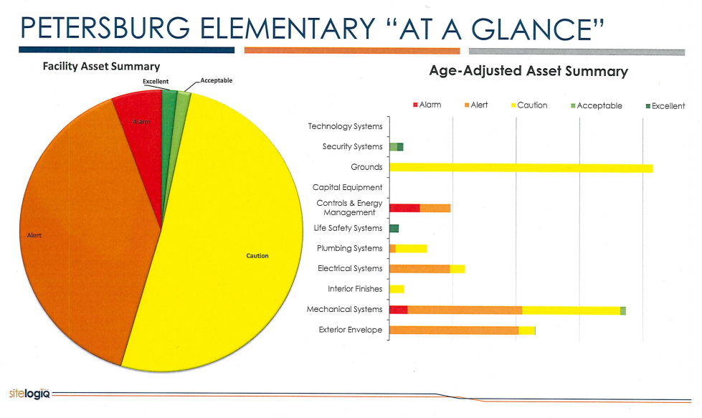
Facility Needs
Facilities Study completed in 2023 by SiteLogIQ
High Priority Needs - $5,300,000

Slide 13
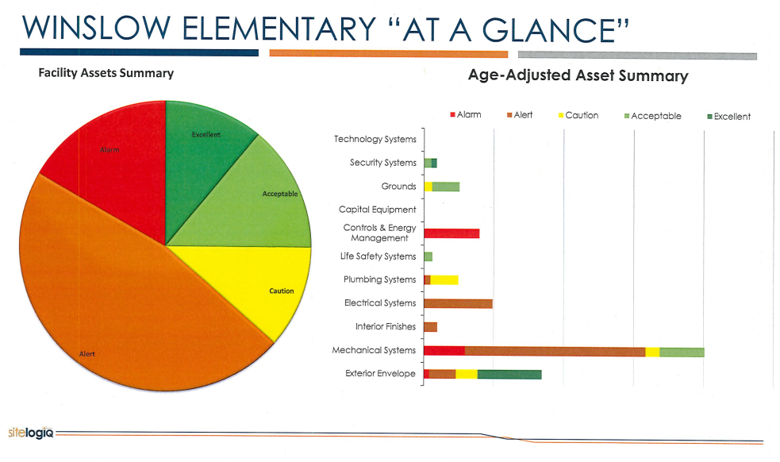
Facility Needs
Facilities Study completed in 2023 by SiteLogIQ
High Priority Needs - $5,300,000

Slide 14
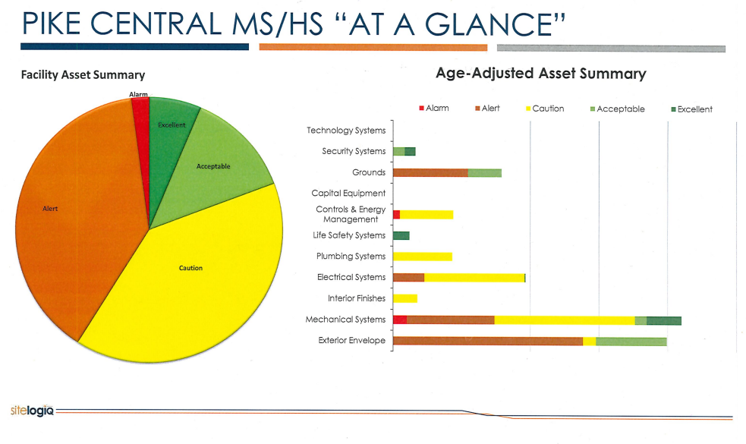
Facility Needs
Facilities Study completed in 2023 by SiteLogIQ
High Priority Needs - $6,800,000

Slide 15
Priority Facility Needs
  PC Auditorium & Gym Roofs - $250,000
  PES Roof – $200,000
  Carpeting- $400,000
  Wall Covering/Painting - $150,000
  PES Parking Area– $250,000
  Exterior Brick & Tuckpointing - $175,000
  ADA Ramp (Stage) - $180,000
Cafeteria Equipment - $85,000
Restroom Renovations (PCHS) - $746,000
Interior Plumbing – $450,000
Wastewater Treatment Facility - $905,000
Replace Football Concessions - $675,000
Athletic Fencing - $140,000
Outside Bleachers - $108,434
Tennis Courts - $113,000
Track – $114,500

Slide 16
Financial
Information

Slide 17
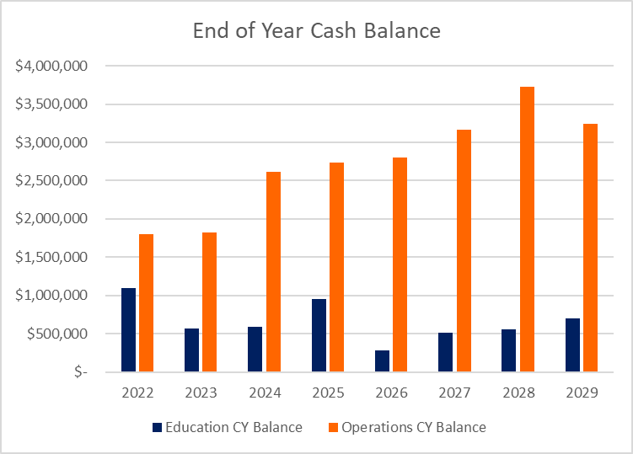
Financial Information

Slide 18
Budget Information
Year Assessed Value Tax Rate
2022 623,879,773 1.2710
2023 693,316,063 1.1971
2024 715,243,583 1.1222
2025 805,748,671 1.1640
2026 883,098,616 1.0998
With AV increasing, property owners have experienced lower tax rates
1.1640
1.2710
1.1971
1.0998
Notes:
AV increases are due to solar field developments, battery storage facility, housing improvements

Slide 19
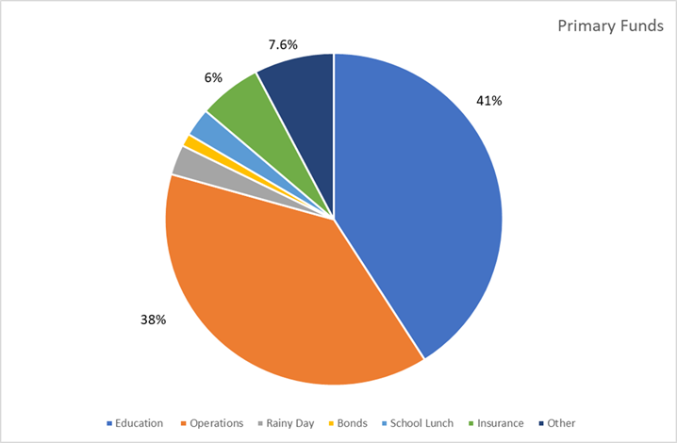
Budget Information
65% rule – PCSC expends 77.92%
PCSC meets Funding Floor 2025
PCSC does not meet minimum teacher salary defined by SB 146

Slide 20
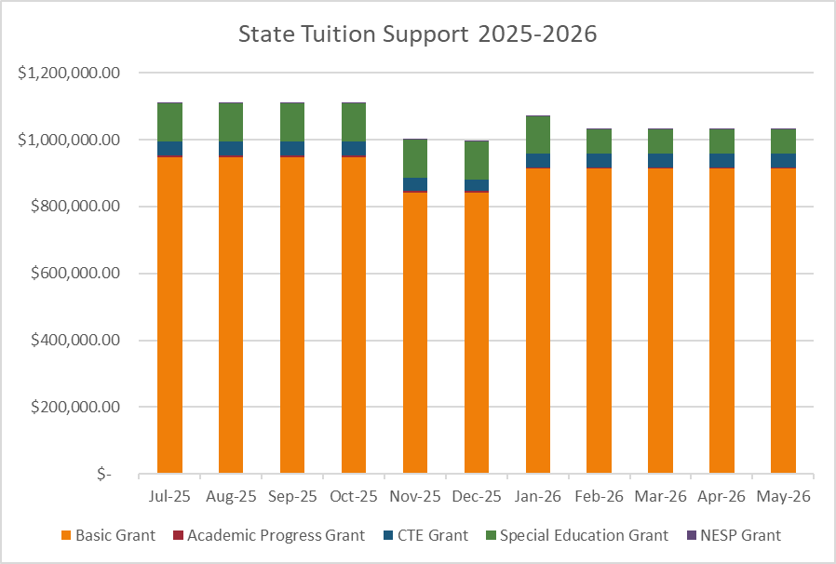
Budget Information – State Tuition
Education Fund
ADM (Basic Grant)
Academic Progress Grant
Special Education Grant
CTE Grant
NESP Grant
Increase Revenue
Reduce Expenditures
Right-size Adjustments Needed
CEP School District – 44.3%
Notes:
Basic Grant – 86%
Special Education – 10%
CTE – 4%
APG & NESP - < 1%

Slide 21
SEA 1 (2025) Implications for Schools
Debt Service Rate
  Any school with debt service tax rate over $0.70 will be required to place debt issues on referendum ballot; may lessen a school’s borrowing capacity due to rate constraints
  Debt service rate may be < .70 one year and > .70 the following year due to NAV
  Increases the likelihood that a school will need a capital referendum to fund projects which could increase taxpayer rate if at property tax cap
Assessed Value Changes
  Changes to Homesteads, Farmland and 2% properties, and Commercial properties may create a need for schools to increase their tax rate significantly to generate the same levy, due to the decrease in net assessed value
  May increase circuit breaker loss for schools
  May cause current referendums to generate less revenue than expected due to lower AV
  Lower NAV will reduce schools’ general obligation bond capacity

Slide 22
SEA 1 (2025) - Implications for Schools
Operations Fund
  Max Levy Growth Quotient (MLGQ) is capped at 4% in 2026.
  Schools will have to share revenue from the operations fund beginning in 2028
Referendum
  All referendums must be held on a general election; timing requirement may impact renewal as well as new referendums
  Schools will be required to share with charter schools after Jan 1, 2027, if a school has the greater of 100 students or 2% of spring ADM attending non-virtual charter schools
General Obligation Bonds
  Limitations will be in place on certain general obligation (GO) bond issuances

Slide 23
SEA 1 (2025) – Implications for Schools
Levy Appeals
  Phases out tax levy appeals for AV growth and bus/transportation levy
  Schools that have increased transportation costs will not be able to qualify for a levy appeal
Credits
  Homeowners Credit and Over 65 Credit will be applied proportionally to all tax funds
LIT Revenue
  Schools can no longer receive Local Income Tax Revenue as of 2028
Budget Process
  Requires that a school have a decrease in tax rate for each year there was an increase in NAV
  Requires additional steps and hearings for budget process if the levy exceeds the prior year

Slide 24

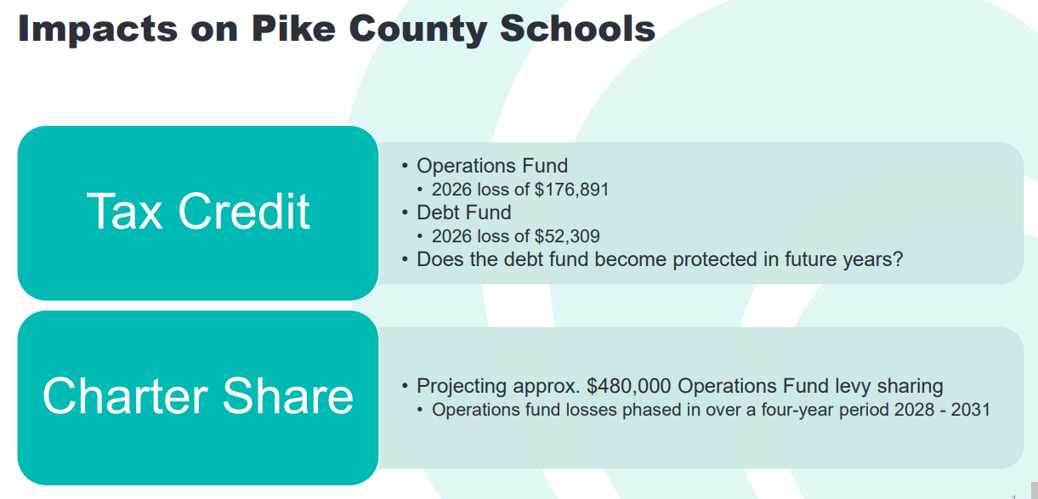
SEA 1 (2025) – Implications for PCSC

Slide 25
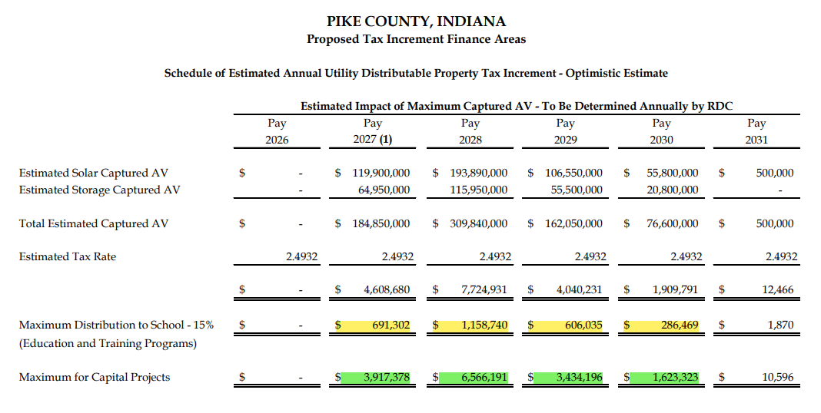
Budget Information –TIF
2 current AES projects eligible to be designated as a TIF project
5 year proposal
Max 15% distribution
Additional funds possible if joint project for “community good”
TIF Established – Dec 2025
Notes:
Currently working with county officials on a resolution to share captured revenue to the school corporation.
Maximum distribution is 15%
Capital funds may be used for a joint project agreed to by both groups (school & county)

Slide 26
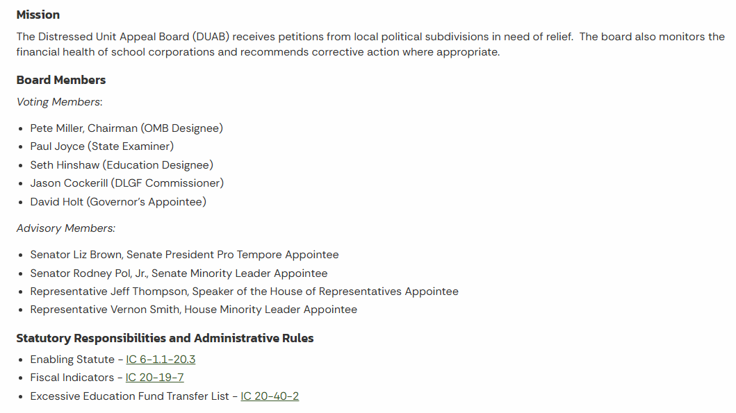
Distressed Unit Appeal Board (DUAB)
Notes:
Edit this slide – key points

Slide 27
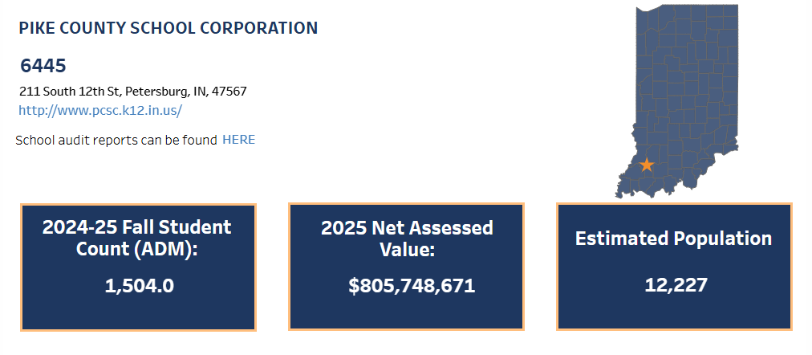
DUAB Fiscal Indicators – Basic Information
Notes:
Edit this slide – key points

Slide 28
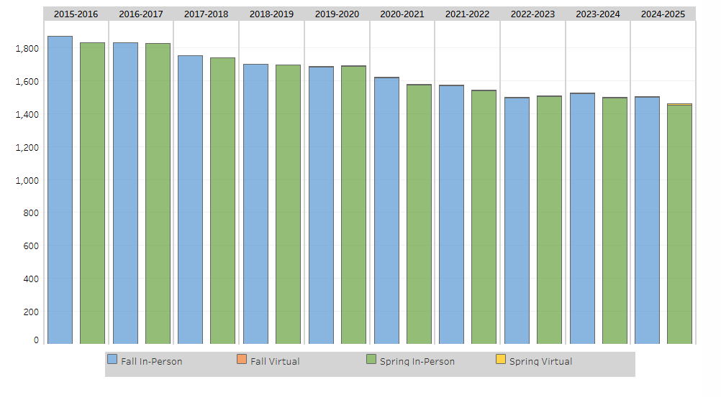
DUAB Fiscal Indicators - ADM
Notes:
The number of students enrolled in a school on “count day”. There is a Fall count day and a Spring count day, but the Spring date has not always affected funding. Fall - formerly Sept 15, it’s now Oct 1 (since 2024). Spring – February. The State Board of Education sets the dates.
Differentiation between in-person and virtual enrollment began with the 2019-2020 school year.

Slide 29
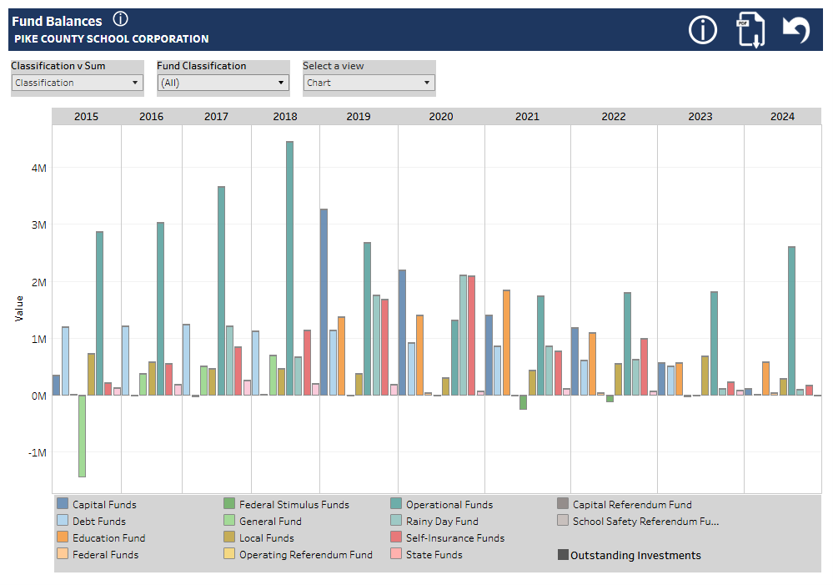
DUAB Fiscal Indicators – Fund Balances
Notes:
Fund Balances as of December 31 of the year noted

Slide 30
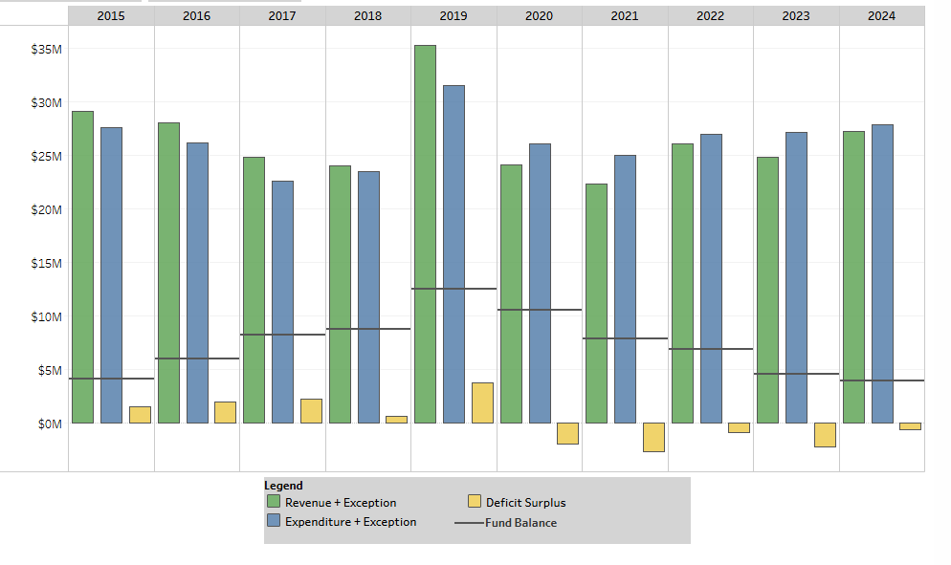
DUAB Fiscal Indicators – Annual Deficit/Surplus
Notes:
Comparison of revenue to expenditures on a calendar year basis, including whether the school corporation had an operating deficit or surplus for that year.

Slide 31
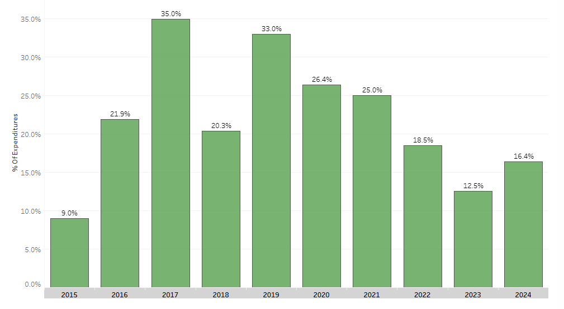
DUAB Fiscal Indicators – Fund Balance as % of Expenditures
Notes:
Considers the ability of the school corporation to maintain operations in the event of delays in revenue by utilizing existing fund balance to fund operations. Fund balances considered for this metric includes the Education Fund, Operating Referendum Fund, Operation Fund and Rainy Day Fund

Slide 32
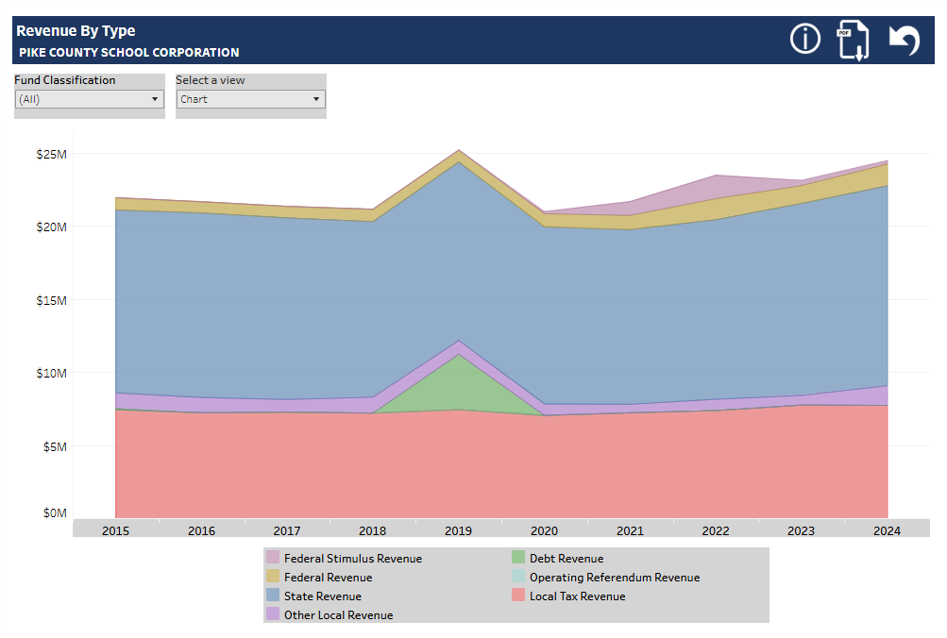
DUAB Fiscal Indicators – Revenue by Type
Notes:
Local tax revenue includes: property tax, income tax, and other taxes as applicable. Other local revenue includes rental income and sale of property.
Debt revenue includes bond and loan proceeds.
State revenue includes tuition support and other grants received form the State.
Federal revenue includes grant funding received from the Federal government (food service, ESSER, Title grants, etc.)

Slide 33
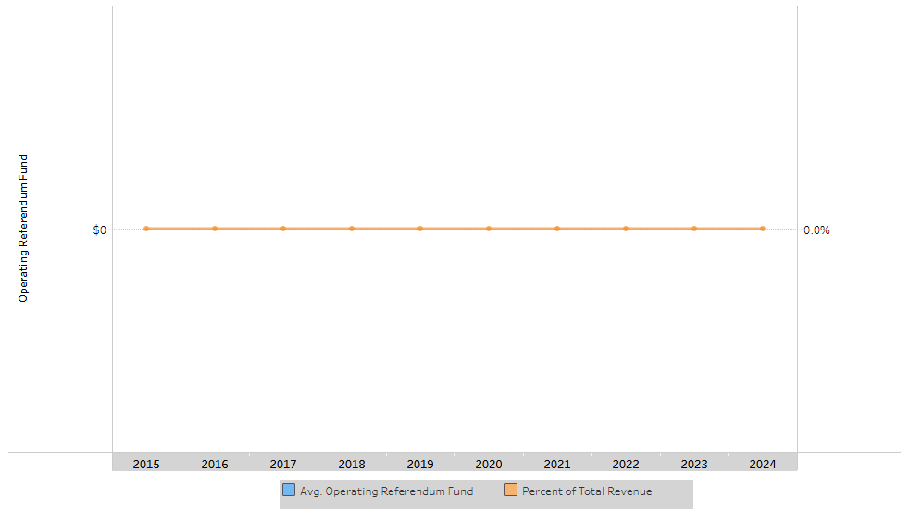
DUAB Fiscal Indicators – Operating Referendum
Notes:
Edit this slide – key points

Slide 34
DUAB Corrective Action Plan
Notified – October 21, 2025
Began weekly meetings – November 3, 2025
Superintendent
Treasurer
School Board President or Designee
Develop a Corrective Action Plan to submit to DUAB (90 days) – submitted January 20, 2026
Present to DUAB – March 3, 2026
Will be notified in April 2026 if plan is approved
Will be given time to implement plan – 4-5 year plan
Notes:
The assignment of a Corrective Action Plan is a confidential plan as defined by statute. We are not obligated to share this publicly. As a school corporation, we feel the need to be transparent to our community.

Slide 35
Action Plan
For
Right-Sizing

Slide 36
Phase 0 – Steps Already Taken (2025-2026)
Attrition of positions
Wages frozen – Certified Staff effective 2025-2026
Wages frozen – Administration effective 2024-2025
Wages frozen – Noncertified Staff effective 2024-2025
Adjusted mileage reimbursement rate – reduced from 0.79 to 0.40
Develop & Promote Virtual School option- increase ADM
$7569 per student x 10 students
Develop Policies for Debt, Investment, Budget (working with CCHA)
Moved from 2-tier Health Insurance plan to 4-tier Health Insurance plan (CBA 2025-2026)
Reviewed current Contracted Services agreements for cost-efficiency

Slide 37
Phase 1 – Steps for 2026-2027
Early Retirement Incentive
Reduce Administrative Contracts (Education)
Reduce Administrative Contracts (Operations)
Attrition of positions
Reduce Technology/Software expenses
Sale vacant building – Otwell
Consider Referendum Options – Fall 2026
Develop & Implement Marketing Plan- increase ADM
Est $7967 per student x 10 students

Slide 38
Phase 1 – Steps for 2026-2027
Reduce Extended Contracts (defined in CBA)
Suspend 3% TRF/PERF employer contribution (defined in CBA)
Suspend 401(a) contributions (defined in CBA)
Suspend VEBA contributions (defined in CBA)
Adjust Health Insurance Premiums - 5% to 2% (defined in CBA)
Ensure self-insurance fund balance is sufficient

Slide 39
Questions?

