Slide 1

Pike County School Corporation
May 2026

Slide 2


education fund

Slide 3
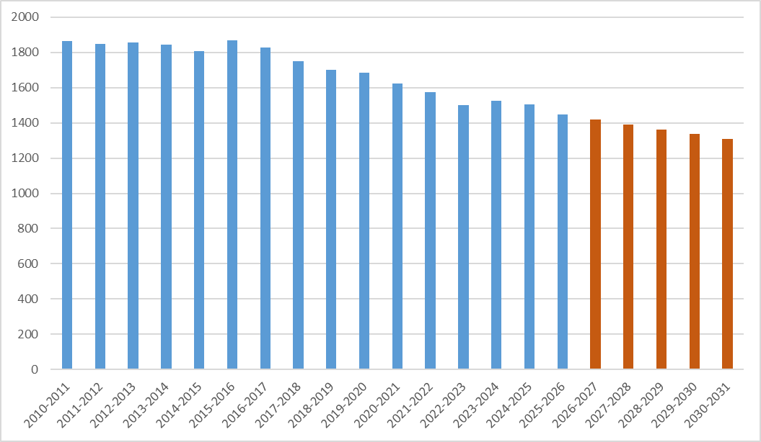
Enrollment Data
Otwell Elem Closed
Hoosier Energy Closed
Charter School Opened
AES Shuts Down Unit 1
AES Shuts Down Unit 2
AES Reduction in Force
Year ADM
2010-2011 1865
2015-2016 1868
2020-2021 1622
Hybrid Learning
2025-2026 1447
2030-2031 1309

Slide 4
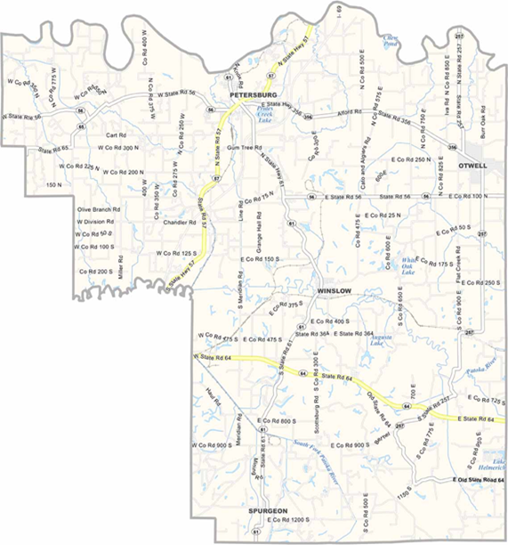
Out-of-County Transfer Data
$2,950,740 Uncaptured funding for PCSC (2024-2025)
Transfers Out of County
  221 – Parent Choice/Public Transfers
    Clarksville CSC
    SW Dubois CSC
    Greater Jasper CS
    East Gibson SC
    Union SC
  4 – Other/Public Transfer
  151 – Charter/Public Transfer
    Otwell Miller Academy
    Indiana Connections Academy
  14 – Choice Scholarship/Non-Public Transfer
Knox Co
Daviess Co
Dubois Co
Gibson Co
Warrick Co
Notes:
Top 5 listed – 168 students
Charter – 105 (OMA), 25 (Indiana Connections Academy)

Slide 5
Transfers to Adjacent School Districts
South Knox – 15 mi
Washington Comm – 13 mi
Knox Co
Daviess Co
Proximity to Neighboring Districts
  Hazelton to Petersburg – 16 mi
  Spurgeon to Winslow – 10 mi
  Stendal to Winslow – 14 mi
  Otwell to Petersburg – 11 mi
Virtual/Online Programs
Charter School Created in Otwell
  Opened 2018-2019
  K-5
  Provides Bus Transportation
Petersburg
North Gibson – 12 mi
Otwell
PC
Charter School
Greater Jasper
Comm – 6.7 mi
Gibson Co
Winslow
Dubois Co
East Gibson – 11 mi
SW Dubois – 8 mi
Warrick Co
Warrick Co (Tecumseh) – 8.6 mi
Notes:
Top 5 listed – 168 students
Charter – 105 (OMA), 25 (Indiana Connections Academy)

Slide 6
Financial information

Slide 7
Budget Information
Year Assessed Value Tax Rate
2022 623,879,773 1.2710
2023 693,316,063 1.1971
2024 715,243,583 1.1222
2025 805,748,671 1.1640
2026 883,098,616 1.0998
With AV increasing, property owners have experienced lower tax rates
1.1640
1.2710
1.1971
1.0998
Notes:
AV increases are due to solar field developments, battery storage facility, housing improvements

Slide 8
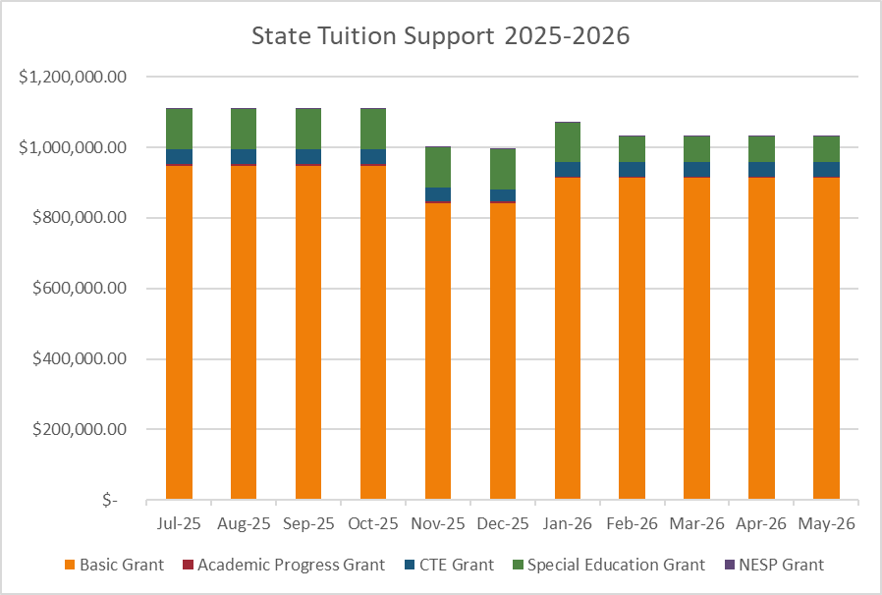
Budget Information – State Tuition
Education Fund
ADM (Basic Grant) – 86%
Academic Progress Grant - < 1%
Special Education Grant – 10%
CTE Grant – 4 %
NESP Grant - < 1%
Increase Revenue
Reduce Expenditures
Right-size Adjustments Needed
CEP School District – 44.3%
Notes:
Basic Grant – 86%
Special Education – 10%
CTE – 4%
APG & NESP - < 1%

Slide 9
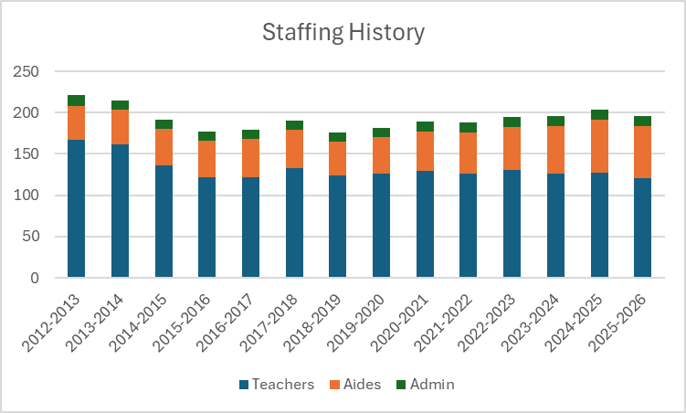
Education Fund – Staffing Trend
June 2016 – Otwell Elem closed;
anticipated loss of 100 students;
RIF of staff
August 2016 – Enrollment did not
decrease; hired back staff
Consideration is given to enrollment and statute requirements before filling any staff vacancies.
  Specialists
  Computer Science
  Graduation Pathways
Notes:
2019 Added elementary Reading Specialists & Interventionists – Title 1 funds
2019 Added elementary Computer Science teachers
2020-2021 – Virtual option
2021 Added Math Specialists & Interventionists
Added SE teachers and instructional assistants as needed to meet needs

Slide 10
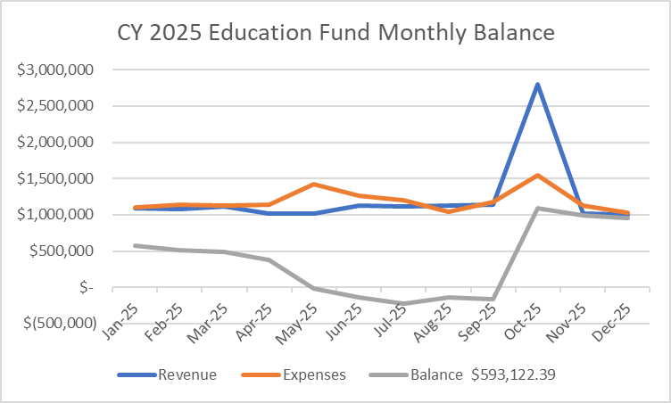
Budget Information – Education Fund
3 pay months – spike in Expenses
Ops to Ed Transfer – October
$1,694,109
State Tuition Changes from projected
Jan & July - Exp = Rev
Reports impacting Funding
  Oct - ADM
  Nov – CTE
  Dec – SE
  Feb - ADM
Notes:
Without Ops to Ed transfer – Oct revenue would have been $1,111,276.84

Slide 11
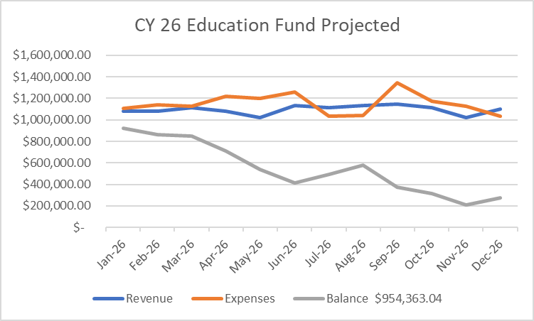
Budget Information –
Education Fund Projections
Monitor State Tuition Support Categories:
Basic Grant
Academic Progress Grant
CTE Grant
NESP Grant
Special Education Grant
3 pay months
Ops to Ed transfer

Slide 12
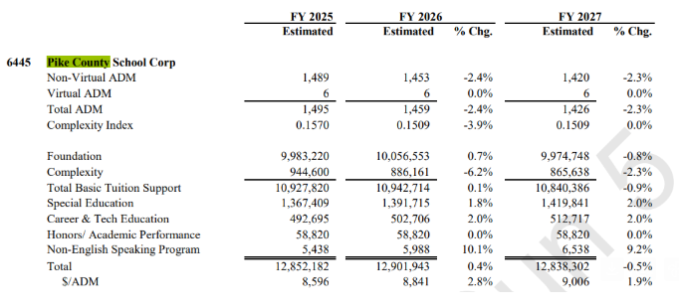
LSA Projections
3% Enrollment Decline
Complexity Index
Subgroups
Curricular materials funding impact - $217,950
% change = 0.8% IF enrollment was 1489 but ADM dropped as well
Notes:
Edit this slide – key points

Slide 13
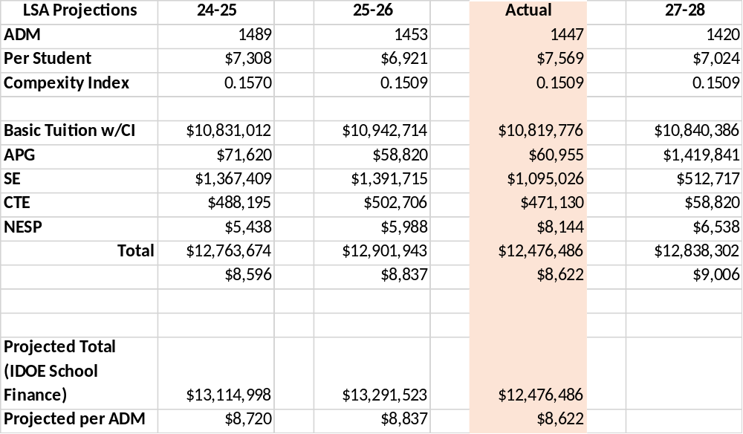
Budget Information – Education Fund
Reports impacting Funding
  Oct - ADM
  Nov – CTE
  Dec – SE
  Feb - ADM
Notes:
Without Ops to Ed transfer – Oct revenue would have been $1,111,276.84

Slide 14
Funding – Legislative Impact
Curricular Materials Expense - no reimbursement
2% based on stable ADM
  loss of 0.86% (2026) & loss of 0.94% (2027)
Loss of $434,000 – Enrollment
CTE Funding changes
SE funding changes
Academic Funding – AHD, THD, Core 40

Slide 15
Funding – Options
Increase enrollment
      Marketing campaign
Reduce expenses
Staffing
Salary & Benefits
Programs
Operating referendum
Consolidation or Reconfiguration
Best use of Space & Resources

Slide 16
SEA 1 (2025) – Implications for Schools
Impacts to Operations & Debt Service
  Levy Appeals
  Credits
  LIT Revenue
  Budget
Indirect Impact to Education (ability to transfer to Education)

Slide 17
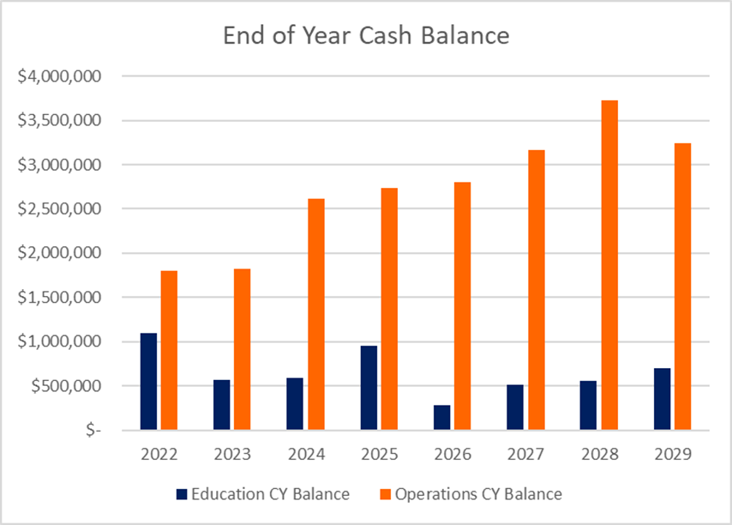
Financial Summary & Projections
Notes:
Add Graph/Summary

Slide 18
Questions?

