Slide 1

Pike County School Corporation
April 2026

Slide 2


Operations
Fund

Slide 3
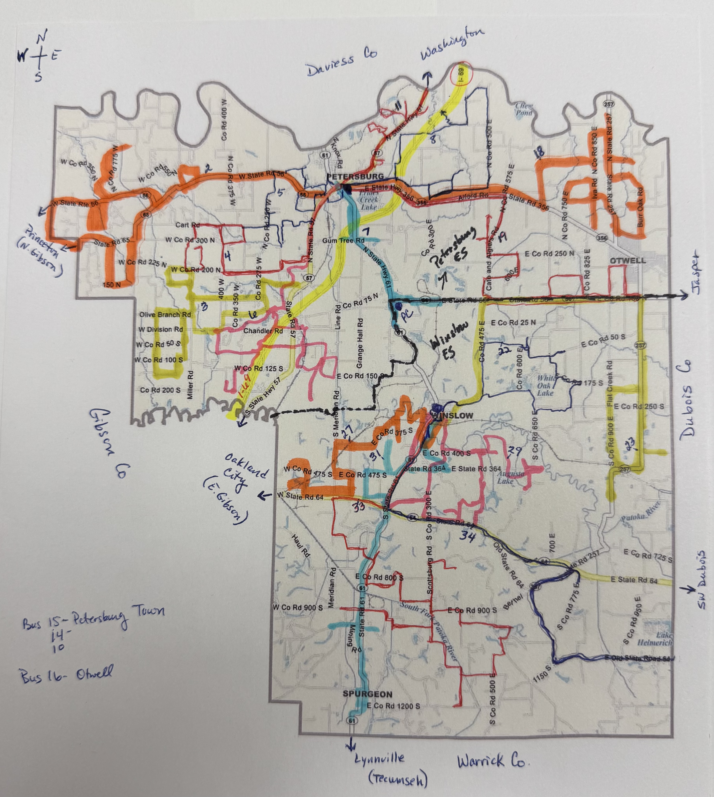
Transportation
Transportation
Travel 965 miles @ day
Transport ≈ 800 students
Avg Travel Time: 87 minutes
  Shortest Route: 58 min
  Longest Route: 114 min
24 Bus Routes
6 SE Bus Routes
1 Bus Mechanic
County Road Info
  551 miles of road in Pike Co
  247 miles are paved
  284 miles are gravel
Notes:
Show Bus Routes

Slide 4
Transportation
Bus Purchases
2025 Lease
  13 buses
2026 Lease
  17 buses
Activity Buses
  4 buses
Other Vehicles
School Van
School Car
Maintenance Vehicles
Equipment
Notes:
Show Bus Routes

Slide 5
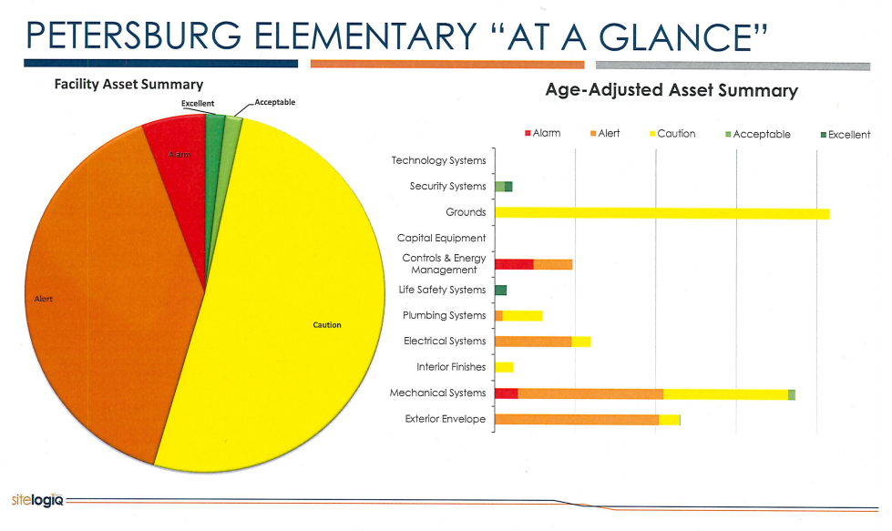
Facility Needs
Facilities Study completed in 2023 by SiteLogIQ
High Priority Needs - $5,300,000

Slide 6
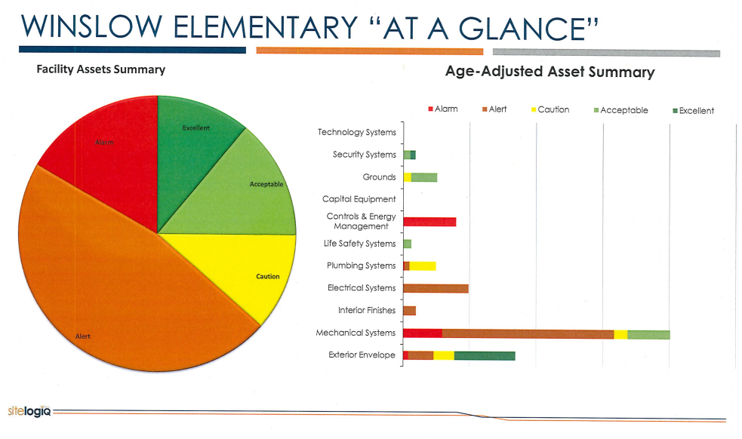
Facility Needs
Facilities Study completed in 2023 by SiteLogIQ
High Priority Needs - $5,300,000

Slide 7
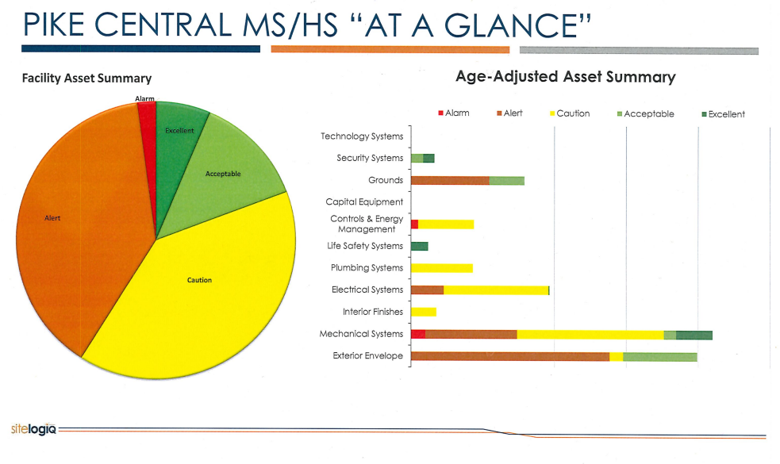
Facility Needs
Facilities Study completed in 2023 by SiteLogIQ
High Priority Needs - $6,800,000

Slide 8
Priority Facility Needs
  PES Roof – $200,000
  Carpeting- $400,000
  Wall Covering/Painting - $150,000
  PES Parking Area– $250,000
  Exterior Brick & Tuckpointing - $175,000
  ADA Ramp (Stage) - $180,000
Cafeteria Equipment - $85,000
Restroom Renovations (PCHS) - $746,000
Interior Plumbing – $450,000
Wastewater Treatment Facility - $905,000
Replace Football Concessions - $675,000
Athletic Fencing - $140,000
Outside Bleachers - $108,434
Tennis Courts - $113,000
Track – $114,500

Slide 9
Financial
Information

Slide 10
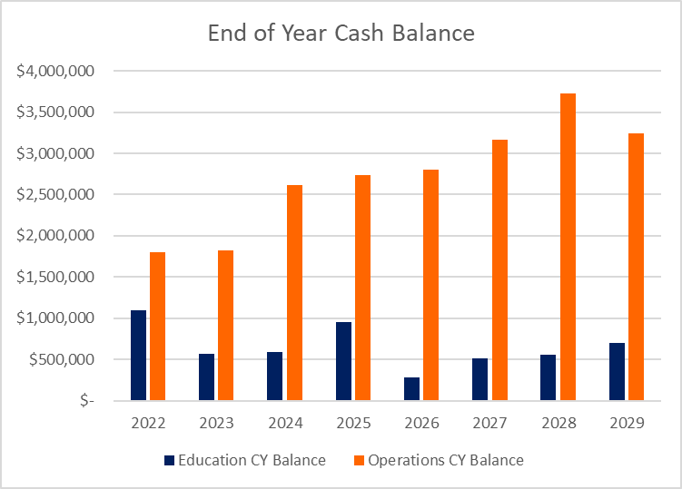
Financial Information

Slide 11
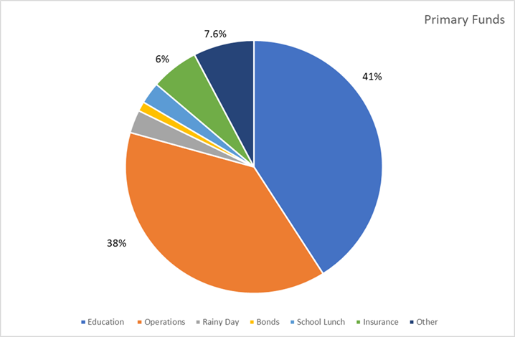
Budget Information

Slide 12
Budget Information
Year Assessed Value Tax Rate
2022 623,879,773 1.2710
2023 693,316,063 1.1971
2024 715,243,583 1.1222
2025 805,748,671 1.1640
2026 883,098,616 1.0998
With AV increasing, property owners have experienced lower tax rates
Operations Funding Sources –
Property Tax
FIT
CVET
License Excise Tax
1.1640
1.2710
1.1971
1.0998
Notes:
AV increases are due to solar field developments, battery storage facility, housing improvements

Slide 13
Budget Information
Year Assessed Value Tax Rate
2022 623,879,773 1.2710
2023 693,316,063 1.1971
2024 715,243,583 1.1222
2025 805,748,671 1.1640
2026 883,098,616 1.0998
With AV increasing, property owners have experienced lower tax rates
When preparing the budget, we use 65% - 75% of AV
Circuit Breaker Impact (Property Tax Caps)
$1,569,300 - increase of 3.9% from 2025
1% Homesteads
2% Rental/Agriculture
3% Business
AV x Rate = Levy
Determine Amount of Levy Needed
Example $6,200,000
Levy = Tax Rate
AV
6,200,000 = 0.0108
574,014,100
Notes:
AV increases are due to solar field developments, battery storage facility, housing improvements

Slide 14
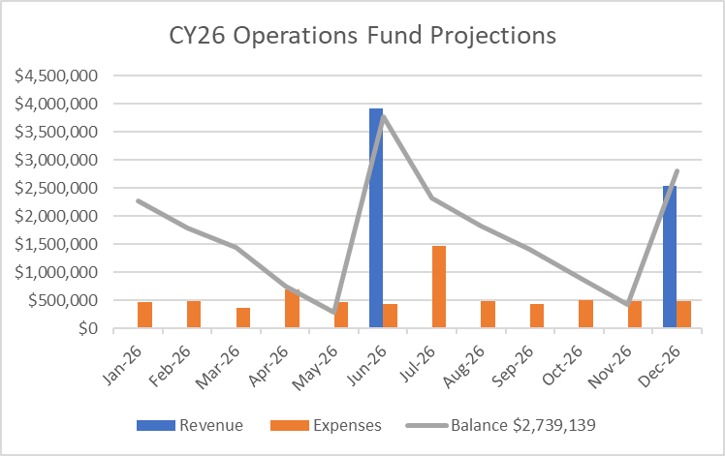
Budget Information –
Operations Fund Projections
Mirrors 2025 Operations Fund
Property Tax Revenue
June & December
May consider Ops to Ed Transfers
if necessary

Slide 15
SEA 1 (2025) Implications for Schools
Assessed Value Changes
  Changes to Homesteads, Farmland and 2% properties, and Commercial properties may create a need for schools to increase their tax rate significantly to generate the same levy, due to the decrease in net assessed value
  May increase circuit breaker loss for schools
  May cause current referendums to generate less revenue than expected due to lower AV
  Lower NAV will reduce schools’ general obligation bond capacity
Operations Fund
  Max Levy Growth Quotient (MLGQ) is capped at 4% in 2026.
  Schools will have to share revenue from the operations fund beginning in 2028

Slide 16
SEA 1 (2025) - Implications for Schools
Referendum
  All referendums must be held on a general election; timing requirement may impact renewal as well as new referendums - Nov 2026 or Nov 2028
  Ballot question must be submitted by Aug 1
  Question must note the median value of a home in the district to the nearest $50,000 and must reference the amount of increase for that home
  Question is to state purpose of funding
  Schools will be required to share with charter schools after Jan 1, 2027, if a school has the greater of 100 students or 2% of spring ADM attending non-virtual charter schools
General Obligation Bonds
  Limitations will be in place on certain general obligation (GO) bond issuances
  Cooling-off period required

Slide 17

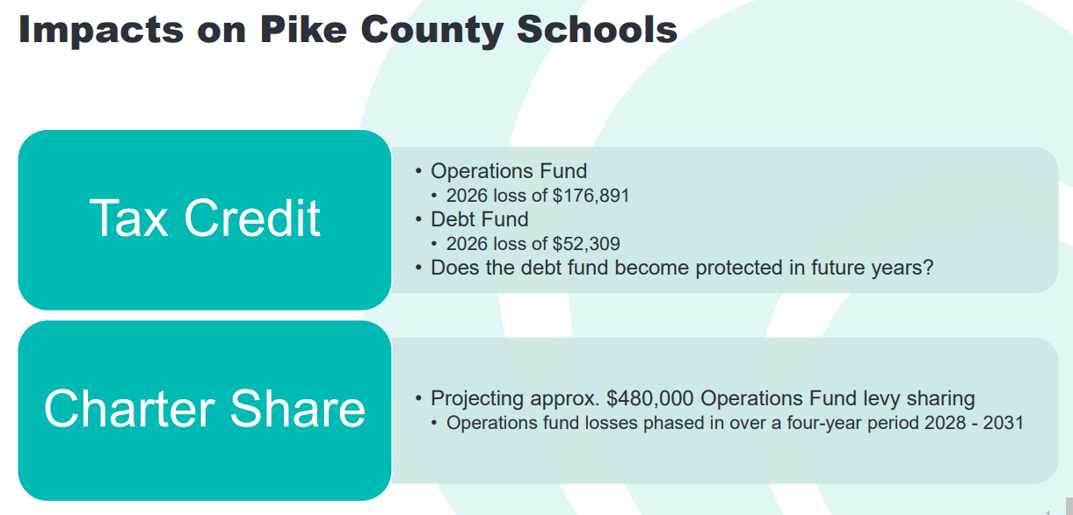
SEA 1 (2025) – Implications for PCSC

Slide 18
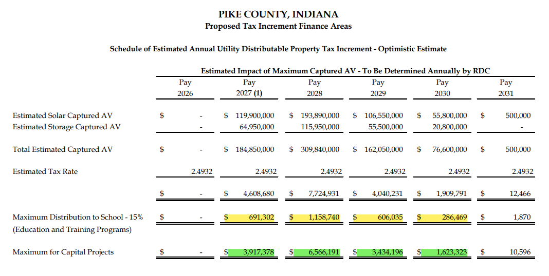
Budget Information –TIF
2 current AES projects eligible to be designated as a TIF project
5 year proposal
Max 15% distribution
Additional funds possible if joint project for “community good”
TIF Established – Dec 2025
Notes:
Edit this slide – key points

Slide 19
Capital Projects
Building Upgrades – GO Bond, Rainy Day, Operations
  HS Bleachers 2019
  Pool 2020
  Auditorium 2022
  WES Roof 2022
  PES Gym Roof 2025
  Pike Central Roof Coating 2021
  Electrical Panel Replacement 2024
  HVAC Replacements 2021-2025
  Fire Panel Replacements 2019-2022
  Parking Lots 2021

Slide 20
Safety Projects
Safety– GO Bond, Rainy Day, Secured School Safety Grant, Operations
  SROs 2014
  BallistiGlass 2020
  NetTalon 2018-2021
  ZeroEyes 2022
  Radio System Upgrades 2022
  Reinforced Doors 2021
  Lock protection – classroom doors 2023
  Security cameras 2022
  Bus Cameras 2020, 2021, 2025
  Bus Lease 2020, 2021, 2025, 2026

Slide 21
Questions?

