Slide 1

VISD Course Selection
2020-2021

Slide 2

Course Selection
Health and Speech Classes:
Day I: Counselors Presentation
  Career and Technical Education
  High School
Day II-V: Individual guidance/selection with H.S. Counselors
Verification sheets mailed home
Return course changes before the deadline

Slide 3
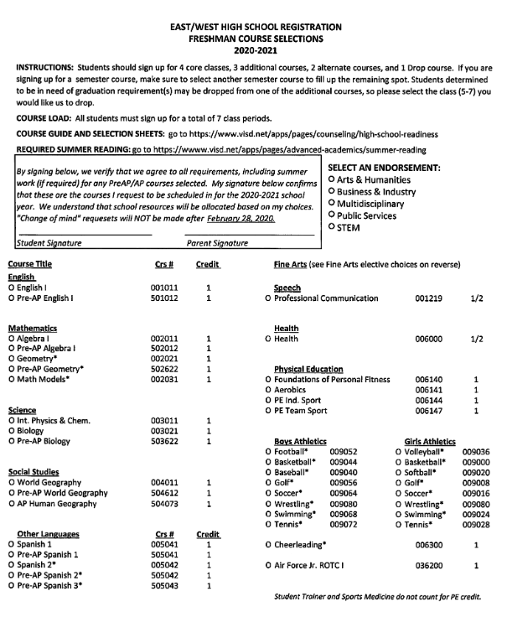
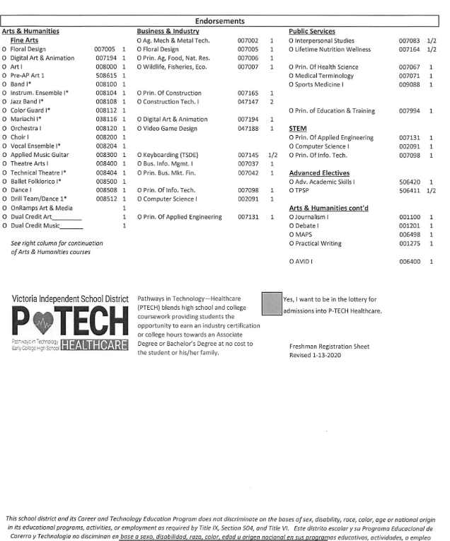
Course Selection Sheet
7 classes
2 alt.

Slide 4

Schedule Changes
Page 11
All students are given the opportunity to select their courses for the next school year during the course selection process. The master schedule is designed and staffing decisions are made in order to accommodate the students’ requests. Schedule changes can result in overcrowding of classes, which reduces teacher availability for addressing individual student needs.
Schedule changes will be made for the following reasons:
  Course for graduation is not scheduled
  Already have credit for a course
  School error
Notes:
Exceptions may also be a student who changes a sport. Students may move from football to soccer which are offered two different periods of the day.

Slide 5
Schedule Changes
Page 11
Level Changes:
Before any level schedule changes (i.e. a Pre-AP/AP course to a regular course) are considered, the following interventions and/or strategies are required:
  Schedule parent-teacher conference
  Attend class daily
  Complete eligible missing assignments
  Attend tutorials before and/or after school
The grades earned at the previous level of the course will transfer with the student to the new course. Failure to complete required summer assignments will not be considered for a schedule change. Approval from principal is required for a schedule change.
Notes:
We want to ensure that we have supported the student in the Pre-AP or AP course before considering a move. Just because a student needs tutoring in an advanced course does not mean he/she is not capable of completing the course.

Slide 6
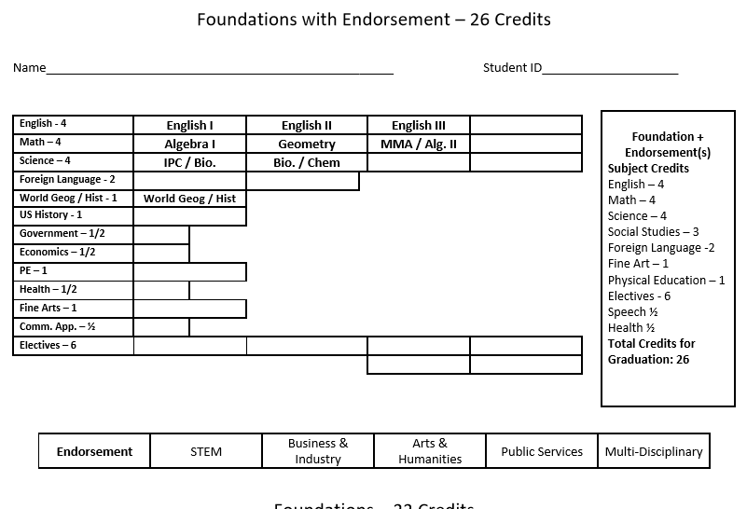
Page 10

Slide 7

ATTENDANCE FOR CREDITS
The Texas Education Code 25.092
A student must be present 90 percent of the days the class is offered.
Students in attendance at least 75 percent but less than 90 percent of the days may be given credit if he/she completes a plan approved by the school’s principal.

Slide 8
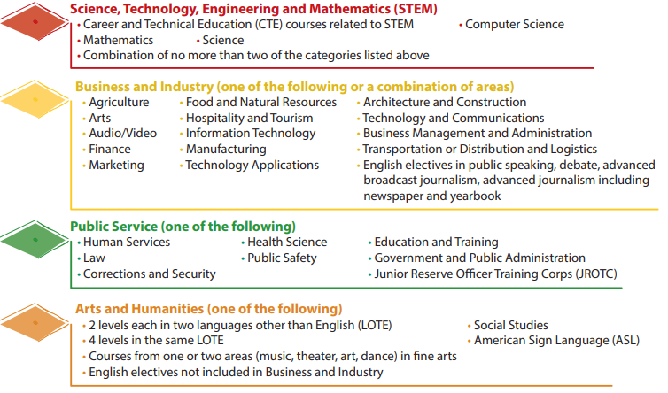

Endorsements
Page 13
For all endorsement options, completion of the Foundation High School Plan including 4 Math, 4 Science, and 2 additional electives is required.
Notes:
Example: STEM: If a student completes calculus, which would be at least 5 math credits, then he/she will receive a STEM endorsement.

Slide 9
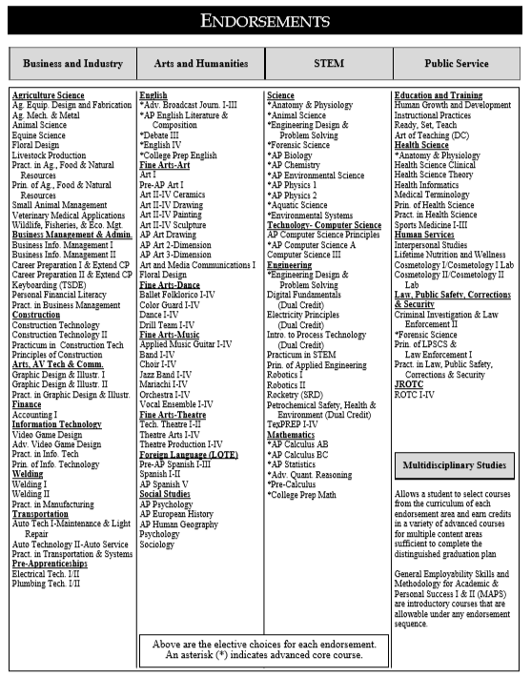

Page 12
Students may earn more than one endorsement
All 5 Endorsements
In VISD

Slide 10

Enhancements
Additionally, a student may earn the Distinguished Level of Achievement and/or a Performance Acknowledgment for outstanding performance. The Distinguished Level of Achievement must be earned to be admitted to a Texas public university under the Top 10 percent automatic admission law. Senate Bill 175, allows The University of Texas at Austin to limit automatic admission to 75 percent of the university’s enrollment capacity designated for first-time resident undergraduate students.
Distinguished Level of Achievement
• Foundation Program requirements
• 4 credits in math including algebra II
• 4 credits in science
• at least one endorsement
Page 8
& 27
Notes:
This is required to graduate in the top 10% for automatic admission

Slide 11

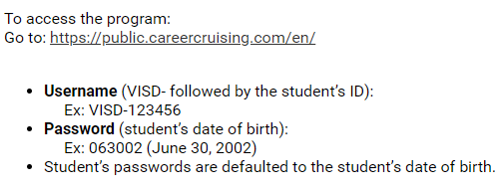


Interest Inventory
Page 14-15

Slide 12
Performance Acknowledgments
Page 16
• Bilingualism and biliteracy
Dual credit courses
• PSAT, ACT’s Plan, SAT or ACT
• Advanced placement exams
• Earning a nationally or internationally recognized
business or industry certification or license

Slide 13

GPA and Class Rank
Page 27
Grade Point Average (GPA)- Begins the first semester of a student’s freshmen year.
Rank- is a mathematical summary of a student's academic record as compared with other students in the class
Weighted Courses:
  1.15 for Advanced Placement Courses, Dual Credit, OnRamps Dual Enrollment, AAS, TPSP
  1.10 for any Pre-AP Courses and Adv. Science Courses
  1.0 for all other ranked courses

Slide 14
Don’t forget about the multiplier!
Pre-AP:
10% multiplier (1.10)
AP, Dual Credit, Dual Enrollment:
15% multiplier (1.15)
Grade | Pre-AP | AP/DC/DE**
95 | 105 | 109
90 | 99 | 104
85 | 94 | 98
80 | 88 | 92
75 | 83 | 86
70 | 77 | 81
65* | 72 | 75
*Grade of 70 without the multiplier is required to earn credit
**Only the high school average from a dual enrollment course is weighted.

Slide 15
GPA EXEMPTION
Page 19
This option is available to juniors and seniors who wish to take a course that is not needed to meet graduation requirements. To qualify for the GPA exemption for the third or fourth year course, the student must have an overall “A” average in the prerequisite courses for the 3rd and 4th year course for which he/she is seeking an exemption.
• Junior students may receive a GPA exemption for only one course their junior year.
• Full-year courses will be exempted for 1.0 credits only.
• Senior students who have not used the GPA exemption during their junior year would qualify for two exemptions during their senior year as long as prerequisites are met.

Slide 16

Advanced Academics
Page 19
Dual Credit and OnRamps can provide potential College Credit
UIL Waiver: Grade between 65-69
AP Academy: AP Honors Academy or AP Academy Scholar
Advanced Placement Exams

Slide 17
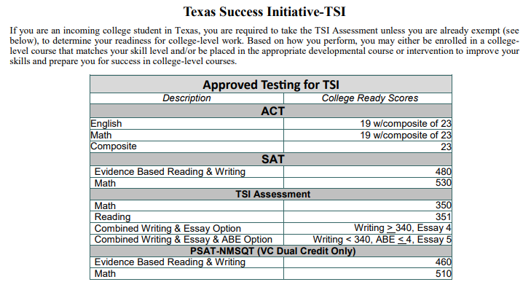
Dual Credit
Page 23-25
Information Session: March 11, at 5:30pm,
VC Student Center

Slide 18

Free or Reduced Lunch Form
How would you like….
Free or discounted ACT/SAT testing fees
Free or discounted college or technical school admissions
Scholarships
Discounted summer camps
Free/discounted daycare/afterschool care
It is strongly recommended that all families fill out the National School Lunch Program application; you just might qualify for all of the above.

Slide 19
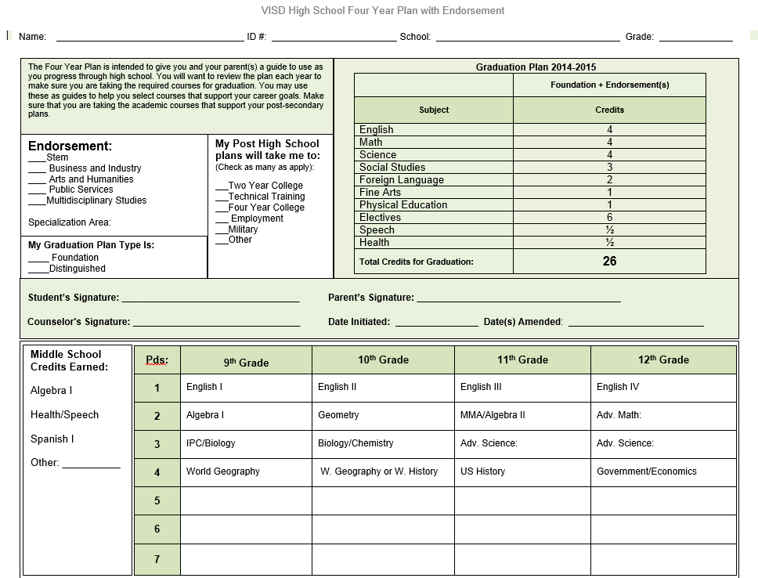
Page 9
Notes:
All 8th graders will complete their 4 year plan at course selection. It is important for the parent to review and sign it.

Slide 20
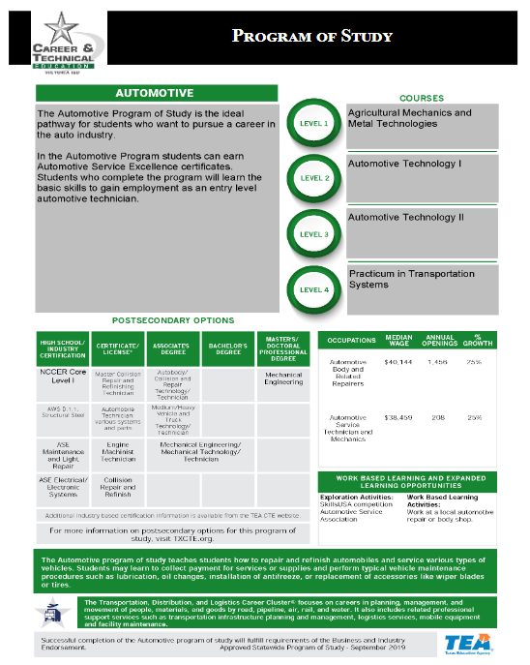
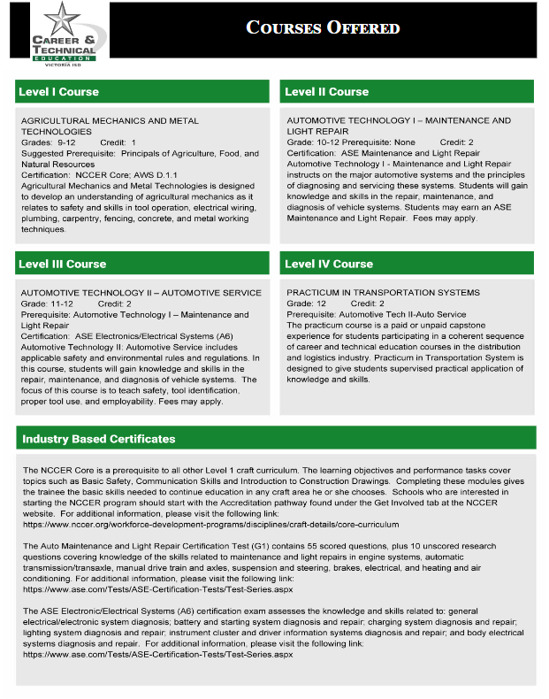
Programs of Study
Page 39-77

Slide 21
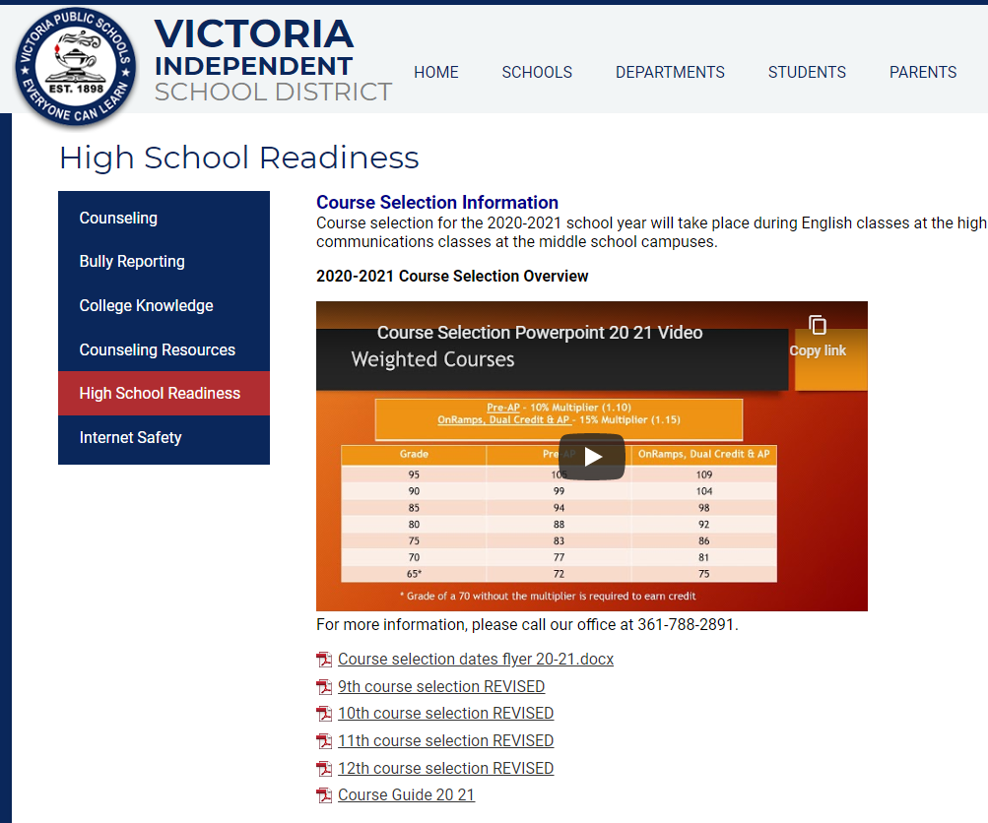

Resources
Parents
Counseling
High School Readiness
www.visd.net

Slide 22
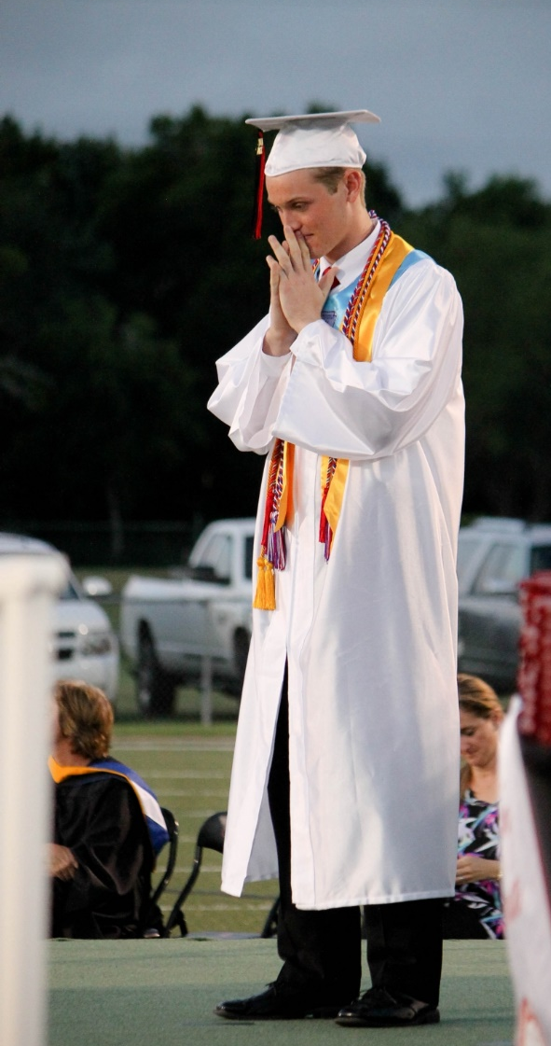
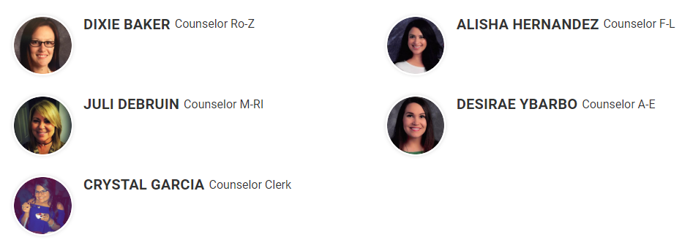



Questions?
Phone Number :788-2830
dixie.baker@visd.net
alisha.hernandez@visd.net
juli.debruin@visd.net
desirae.ybarbo@visd.net
CARS Center
crystal.garcia@visd.net
josh.loomis@visd.net
alexis.vega@visd.net

