Slide 1
WARRIOR VOLLEYBALL
Elite athletes WITH integrity, academic responsibility, confidence, discipline, accountability, mental toughness, Pride & Humility, leadership, selflessness

Slide 2
Contact information
Varsity head coach: Alysia Hill alysia.hill@visd.net
Assistant Varsity coach: jon stoltenberg jon.stoltenberg@visd.net
Junior varsity coach: jenna lamb jenna.lamb@visd.net
Freshman coach: Garrett gomez garrett.gomez@visd.net
Female west athletic coordinator: Sandra jimenez sandra.jimenez@visd.net
Principal: Paul fleener paul.fleener@visd.net
VISD athletic director: Spencer gantt spencer.gantt@visd.net

Slide 3

Spring League Volleyball
February – May
Play with your west warrior team or
school team

Slide 4

Sports physical
Doctors will be volunteering their time to perform physical exams for Victoria I.S.D. The medical history form must be completed and printed before seeing the doctor(s).
female exams: TBD
male exams: TBD
All RankOne on-line forms must be completed before trying out for any UIL sport or activity. https://www.rankonesport.com
More information will be given on a later date. Contact West Athletic Trainers for any questions. ronald.davis@visd.net or brigid.milchiling@visd.net

Slide 5
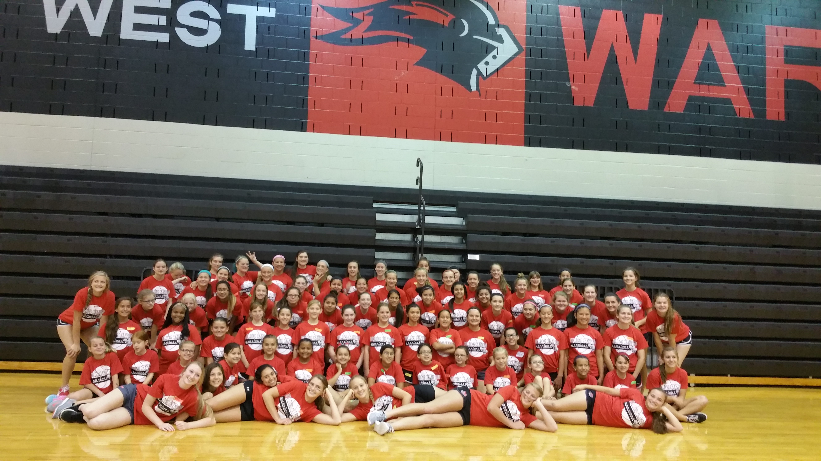
Volleyball summer camp: building champions
Dates are to be determined
Incoming 9th graders: tbd
Grades for incoming 3rd – 8th graders: Tbd

Slide 6

Strength & conditioning camp
June through july
Monday –Thursday only
7:30 – 9:30 a.m.
FREE CAMP
More information about S&C will be given at a later date

Slide 7

Summer league volleyball
June & july
play- - play- - play!
Prepare - - prepare - - prepare!

Slide 8

Warrior Volleyball tryouts
August 1st – 2nd
*Must have a physical and all UIL online paperwork completed.

Slide 9
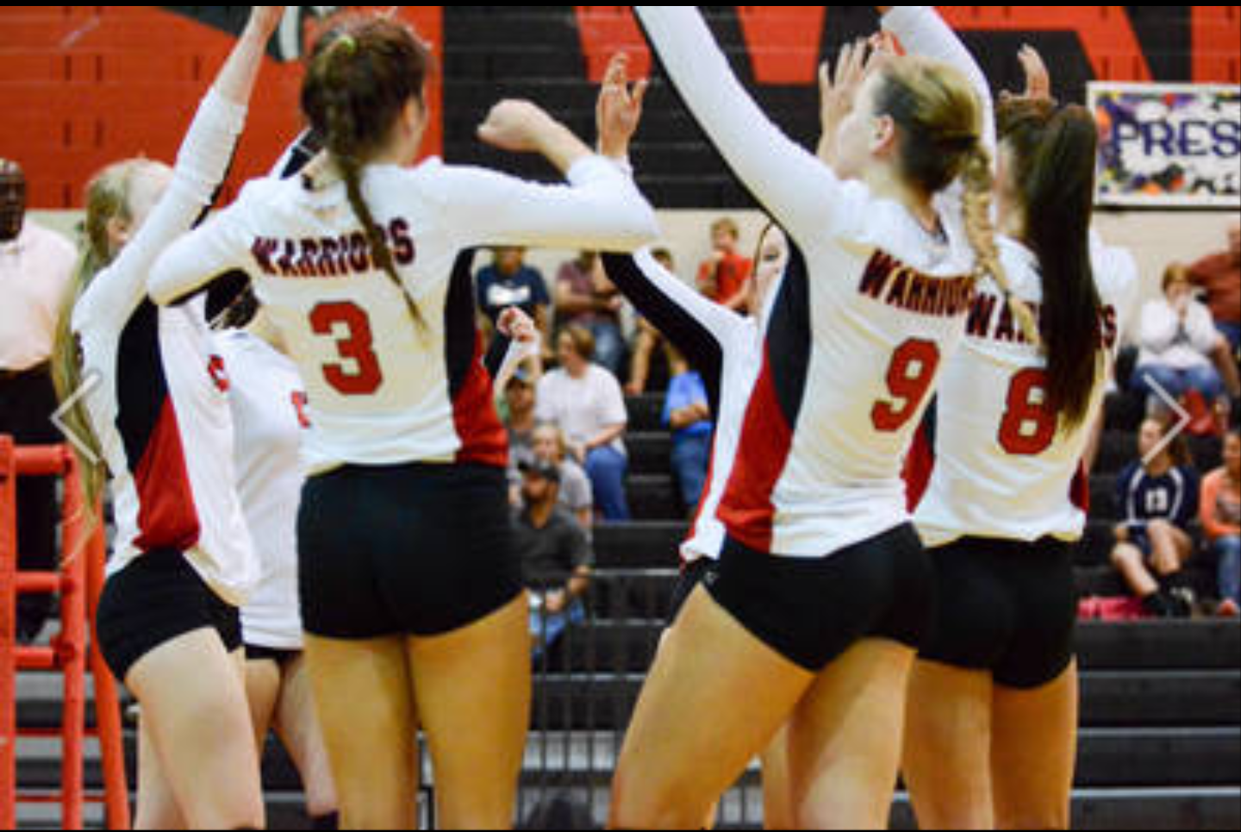
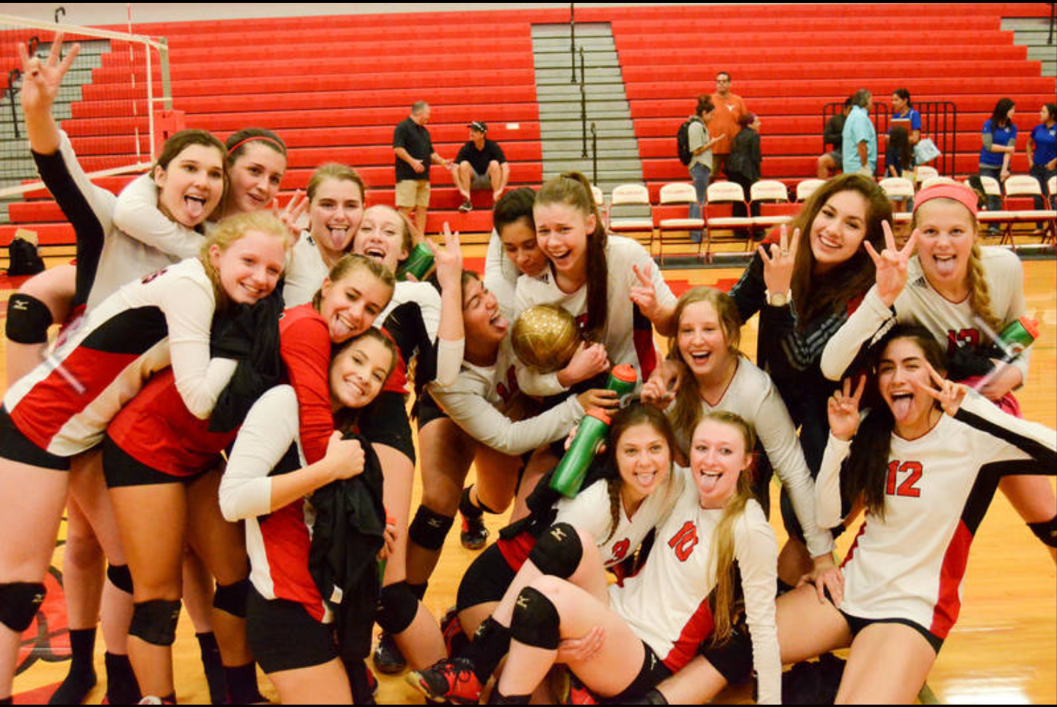
We are warrior strong!

Slide 10
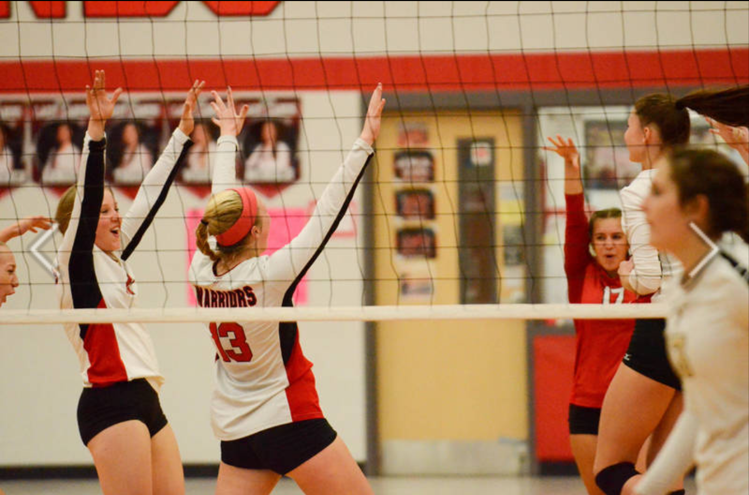
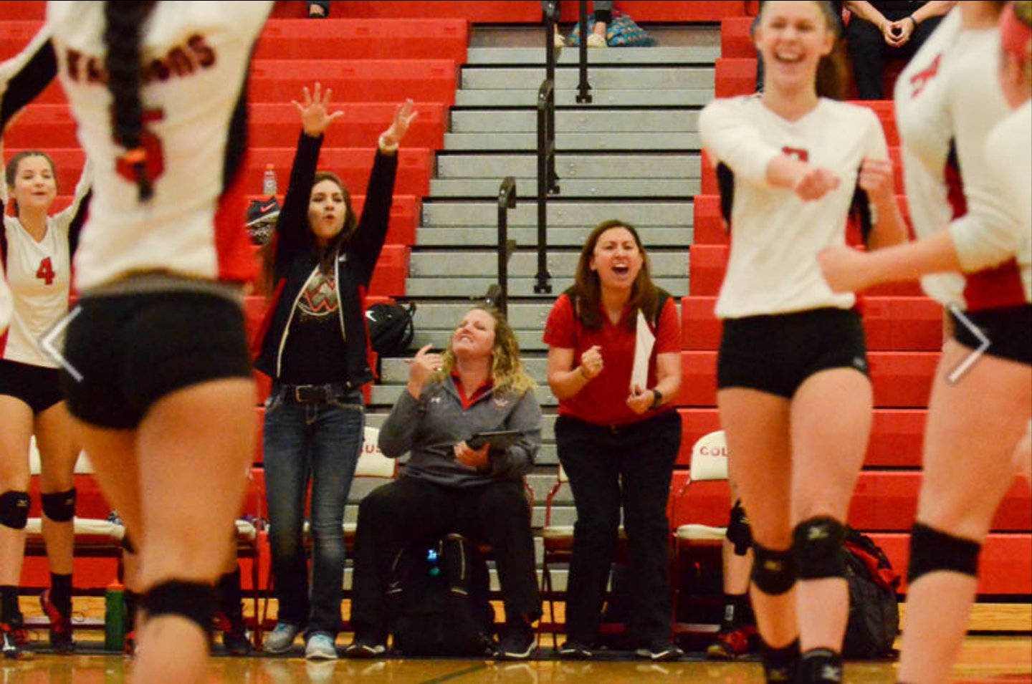
CELEBRATE what you’ve accomplished, but raise the bar a little higher each time you succeed.

Slide 11

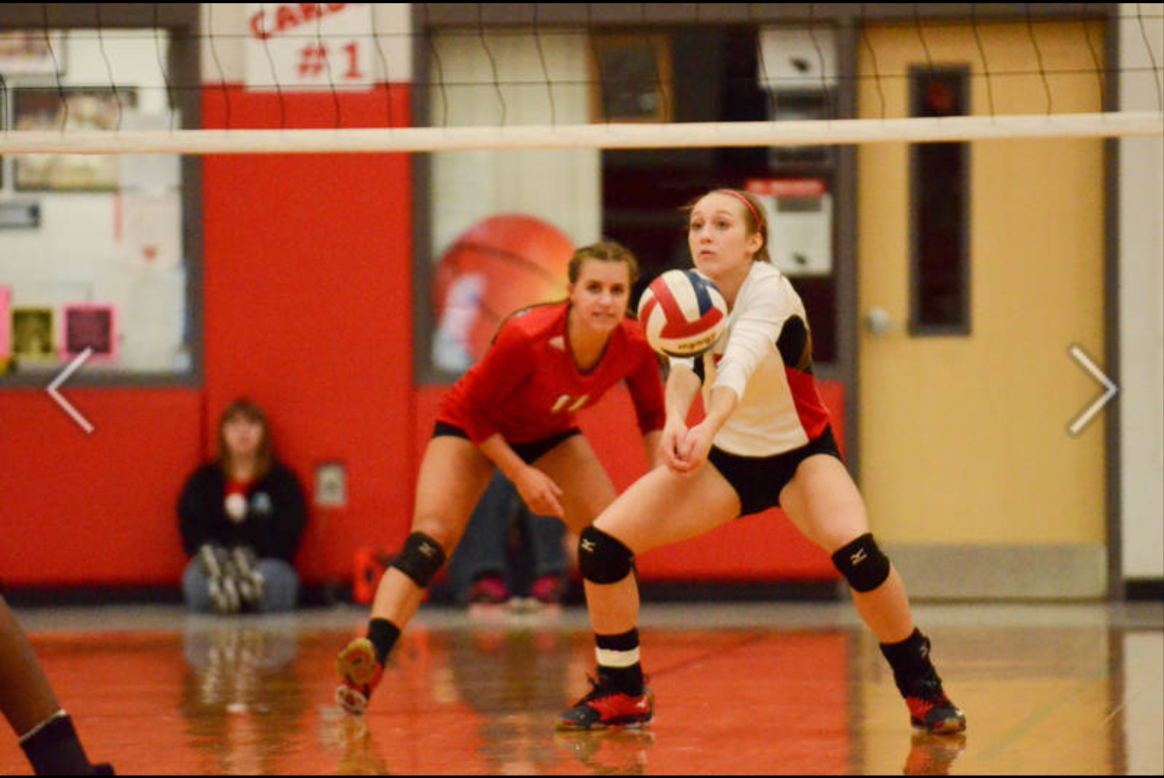
INTEGRITY

Slide 12

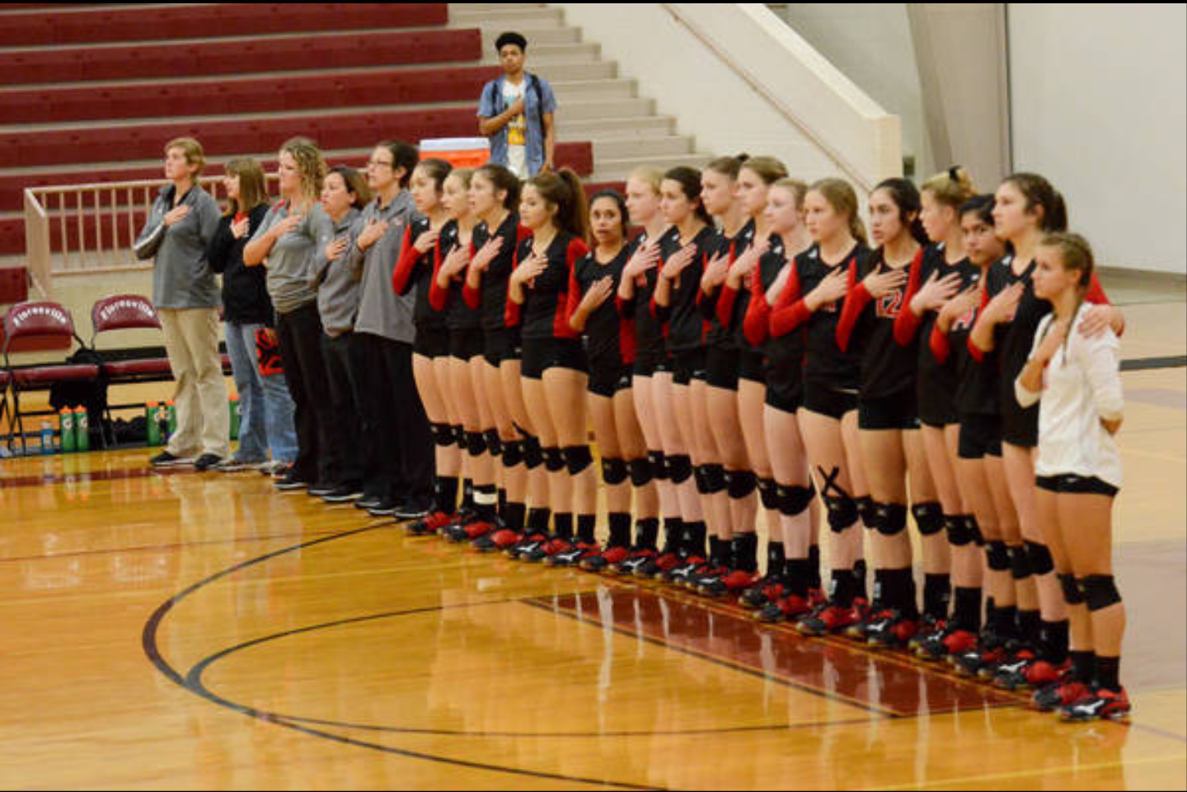
Academic responsibility

Slide 13

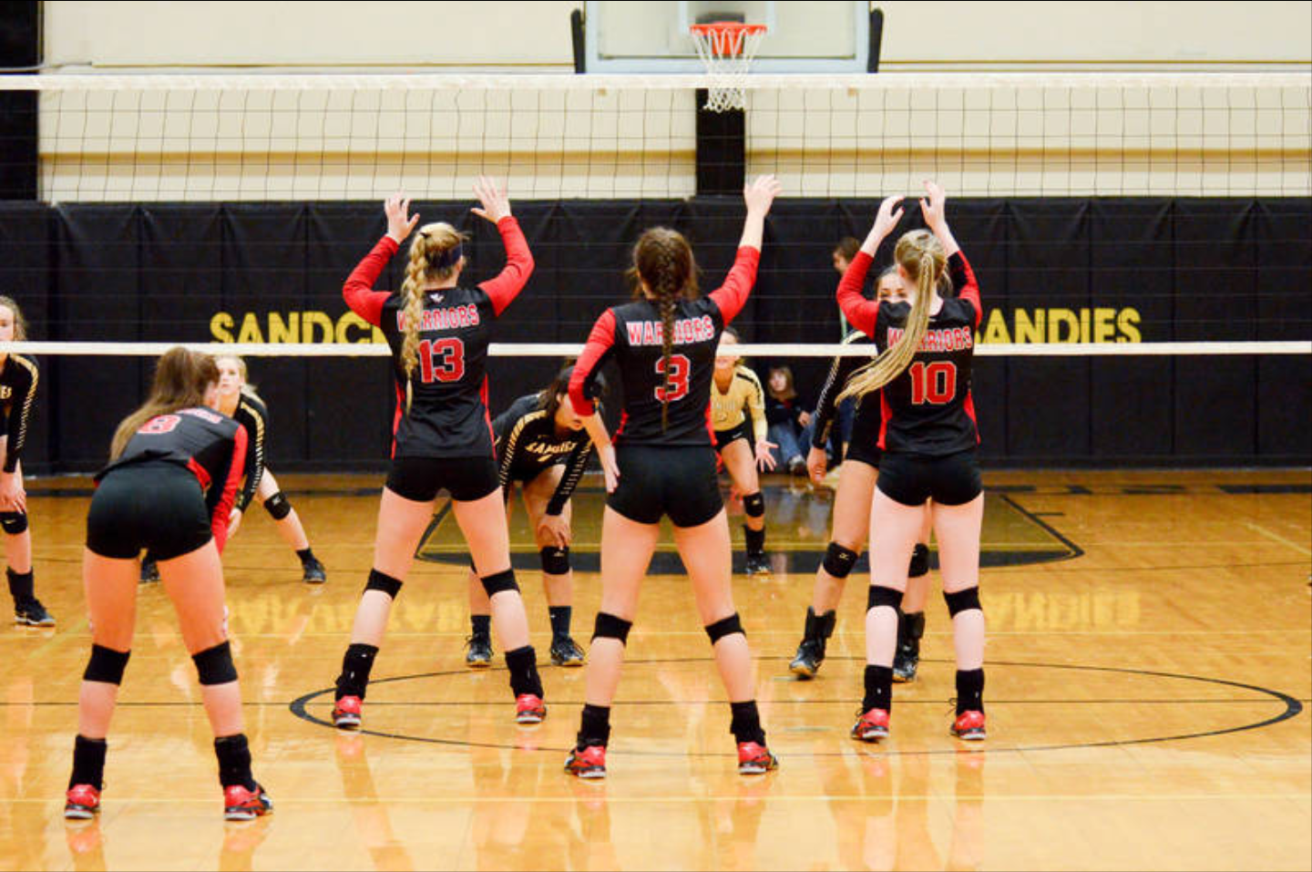
confidence

Slide 14
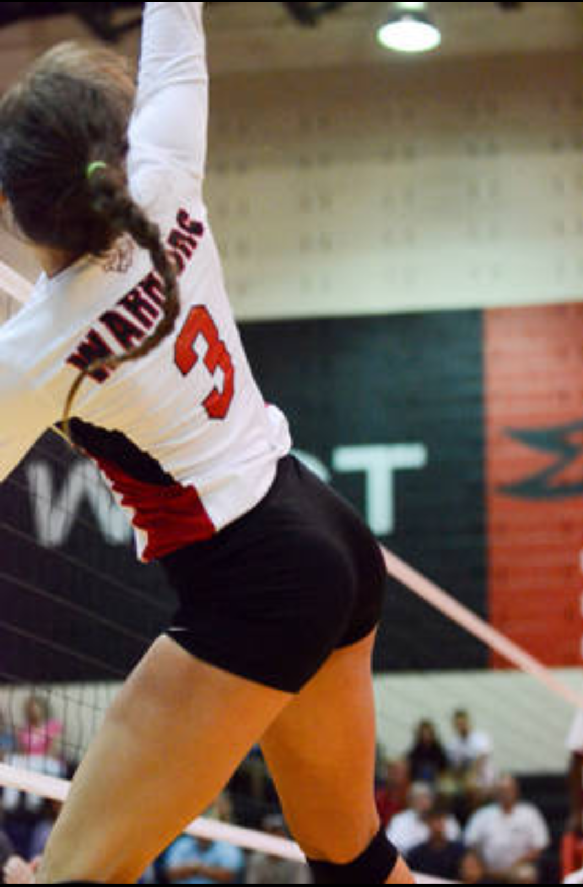
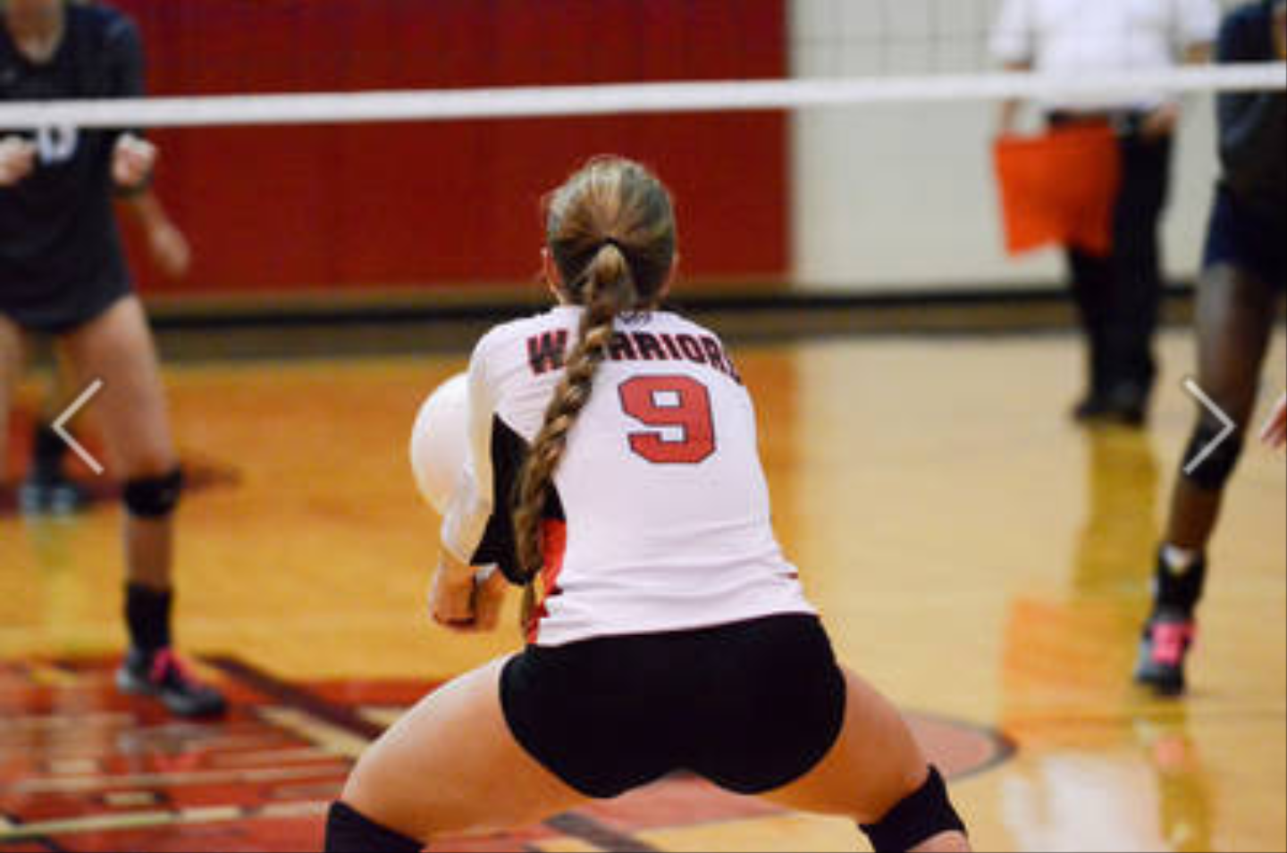

Mental toughness

Slide 15
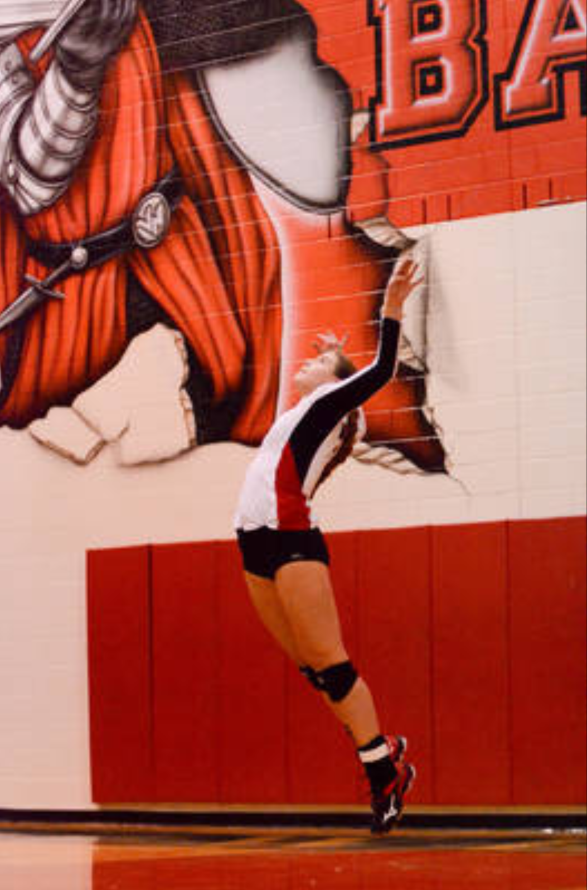
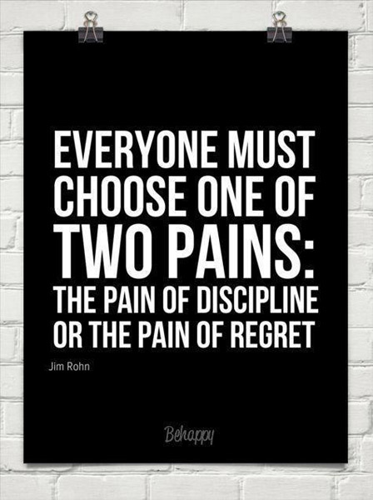
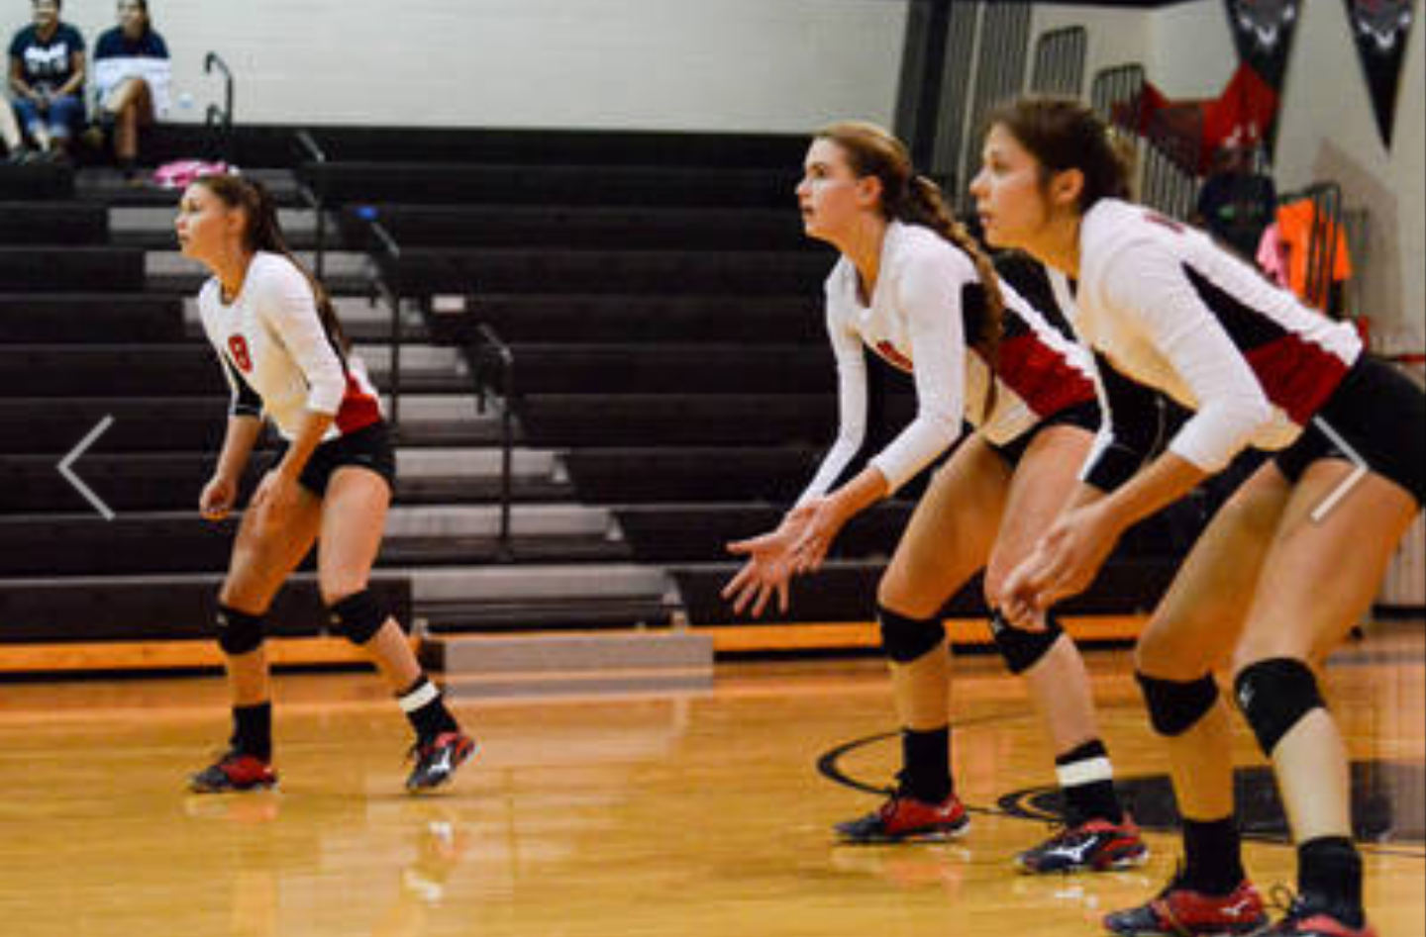
discipline

Slide 16
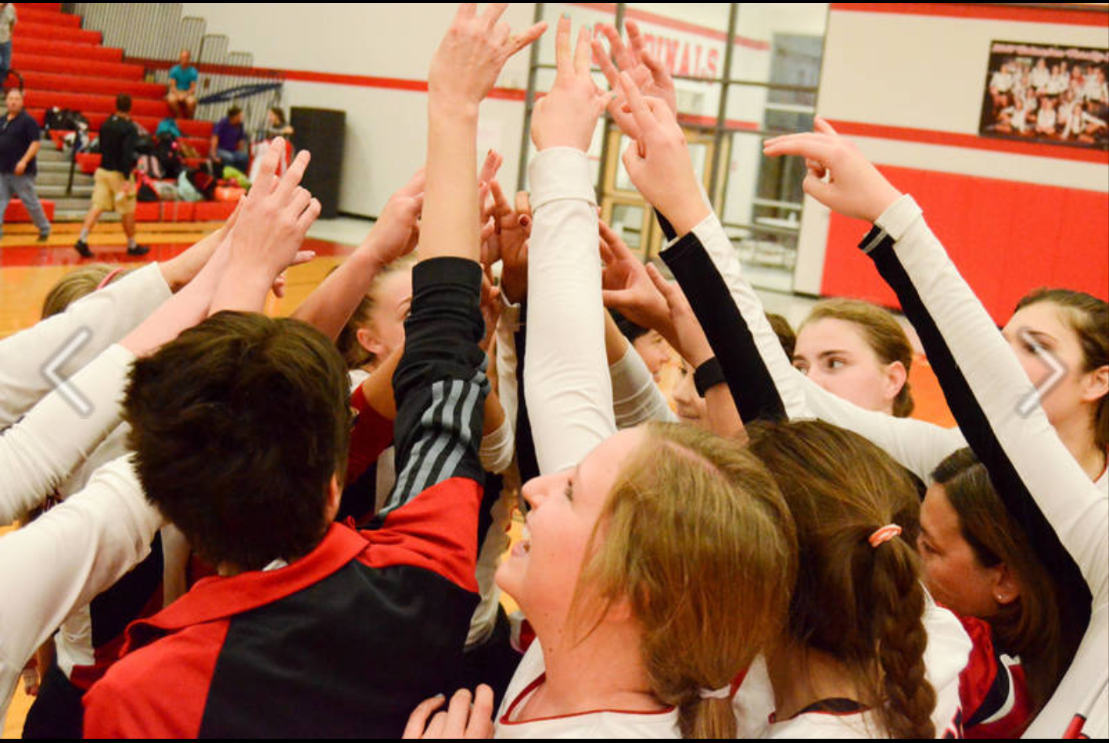
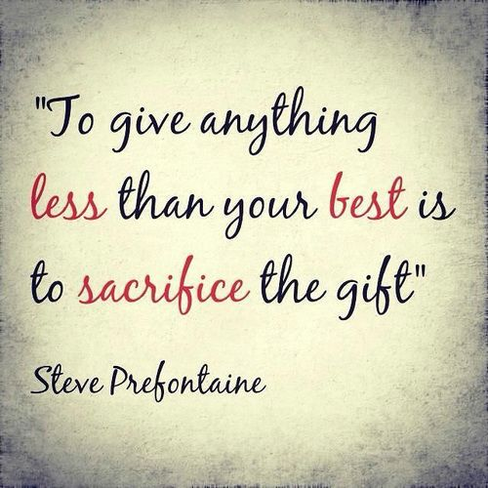
selflessness

Slide 17
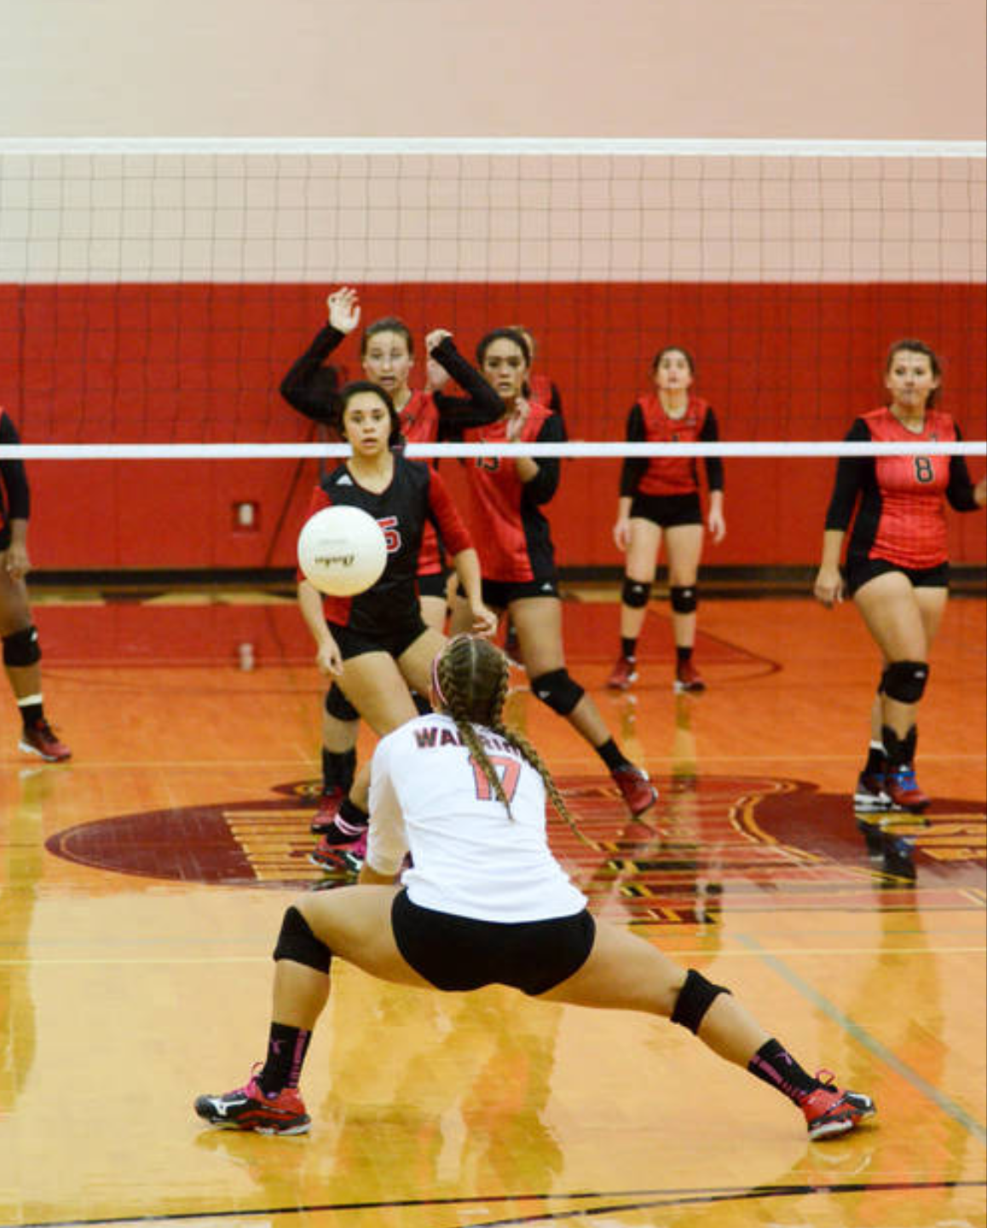

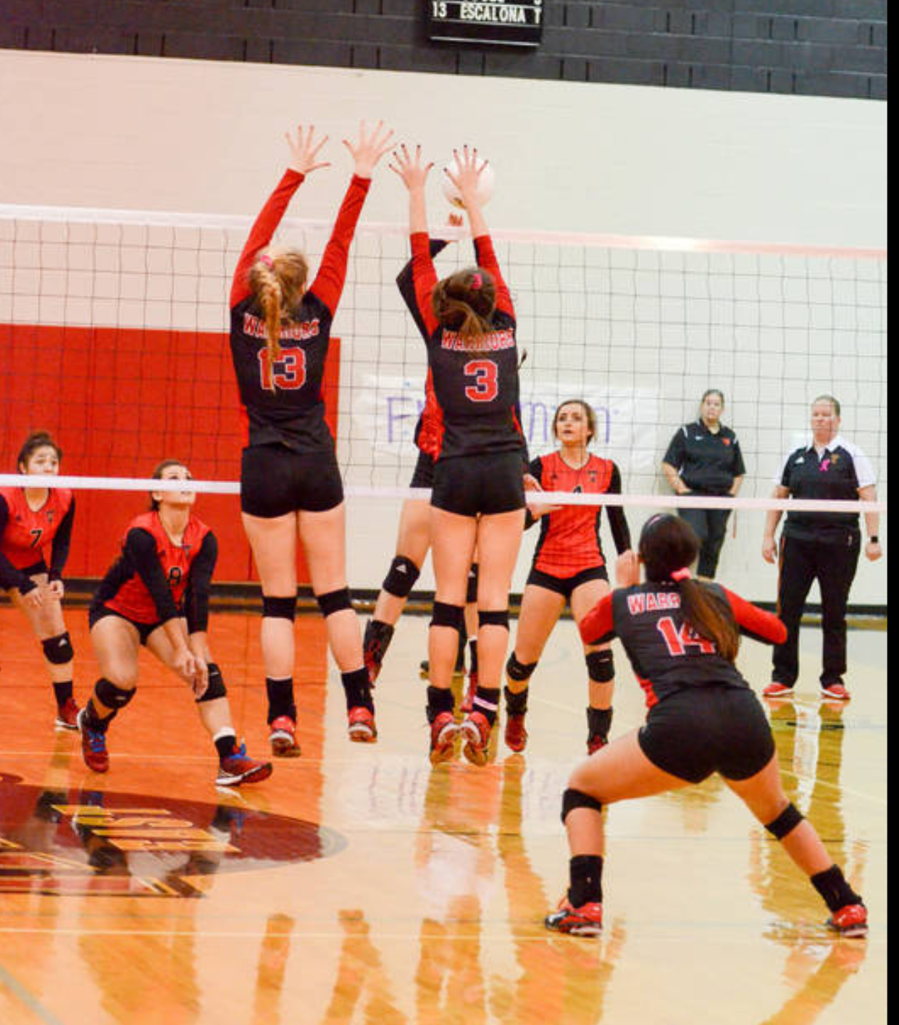
Accountability

Slide 18

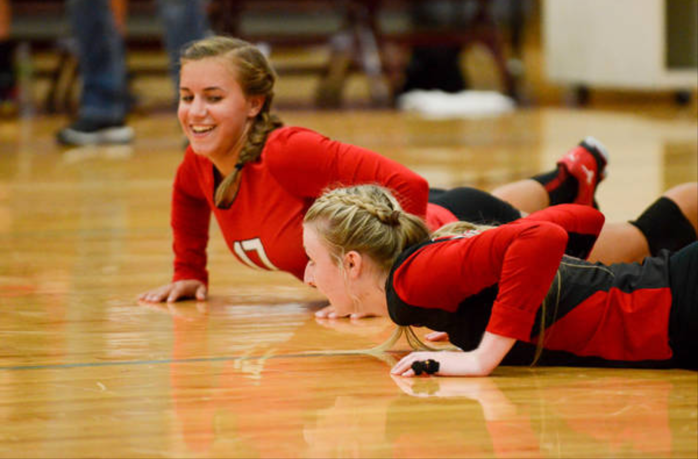
Pride & humility

Slide 19
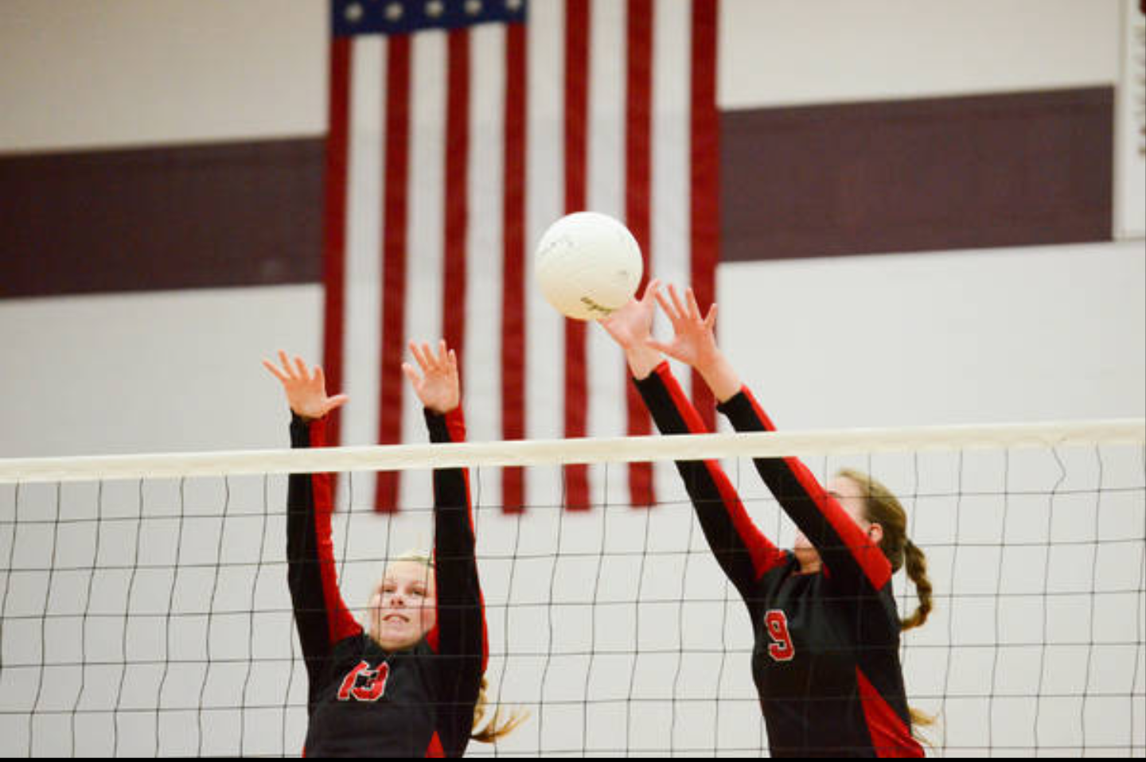

leadership

Slide 20

Warrior strong!
We are

