Slide 1
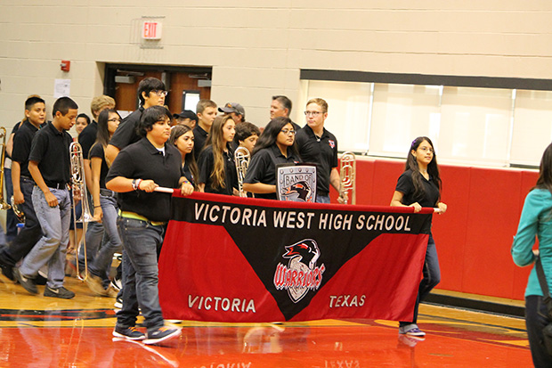
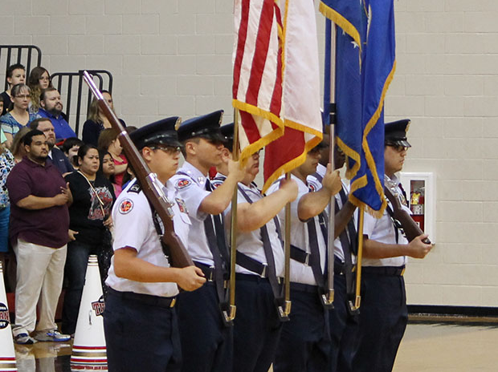


Advanced Academics
& Dual Credit
Notes:
Would You Rather?
… be invisible or able to read minds?
… dissect a pig or read a novel?
… play sports or argue a court case?
… go to a small college or a larger university?
… work a math problem or study the Civil War?
… be a doctor, engineer or writer?
We’re going to tell you about the Victoria ISD opportunities that match some of your interests.

Slide 2
College readiness
Pre-AP Courses
English*- English I, English II
Math -Algebra 1, Geometry, Algebra 2, Precalculus
Social Studies –World Geography
Science – Biology, Chemistry
Foreign Language – Spanish I & Spanish II
Advanced Courses
Advanced Academic Skills & TPSP (1/2 credit, AP weight)
Forensic Science, Animal Science, Anatomy & Physiology, Engineering Design & Problem Solving (Pre-AP weight)
Notes:
Intro Pre-AP courses – English requires summer reading
Discuss weighting, GPA, class rank
Advanced courses weighted as Pre-AP

Slide 3
College readiness
Advanced Placement Courses
English* –English Language & Composition (English 3), English Literature & Composition (English 4)
Math – Calculus AB, Calculus BC, Statistics, Computer Science, Computer Science Principles
Social Studies – World History, US History, Government & Politics, Macroeconomics, Psychology, European History, Human Geography
Science – Biology, Chemistry, Physics, Environmental Science
Fine Arts – Art History, Studio Art: 2D Design, Studio Art: 3D Design, Studio Art: Drawing
Foreign Language – Spanish Language & Culture
All students enrolled in AP courses will take the corresponding AP exam.
Notes:
Mention that the school district pays for the AP exam and the potential for college credit.

Slide 4
Don’t forget about the multiplier!
Pre-AP – 10% multiplier (1.10)
AP – 15% multiplier (1.15)
Grade | Pre-AP | AP
95 | 105 | 109
90 | 99 | 104
85 | 94 | 98
80 | 88 | 92
75 | 83 | 86
70 | 77 | 81
65* | 72 | 75
* Grade of 70 without the multiplier is required to earn credit

Slide 5
AP Credit at Texas Universities
AP Score | University | Credit
3 | Texas A&M | HIST 104
 | Texas State University | HIST 2311 OR 2312
 | University of Texas | HIS 301F OR 301G
 | UTSA | HIS 2123 OR 2133
 | University of Houston | HIST 2361
 | Rice University | HIST 107
2020 – VISD students saved over $695,000
Data based on the average public university cost per hour from http://www.collegeforalltexans.com/apps/collegecosts.cfm?Type=1&Level=1
Notes:
AP exams are reported on a 5 point scale:
reported on a 5 point scale:
5 – extremely well qualified
4 – well qualified (most colleges will take)
3 – qualified (college credit at many schools)
2 – college ready (no credit but can succeed in the college class)
1 – no recommendation
Data based on the average public university cost per hour from http://www.collegeforalltexans.com/apps/collegecosts.cfm?Type=1&Level=1 (Average resident cost/30 times the number of AP tests (*3) that scored a 3+)

Slide 6



What to expect...
More reading, writing and analysis
Homework = important exposure and practice
Faster pace
You will…
Be challenged
Experience struggles
Learn important, transferable skills
See improvement with effort
Notes:
Students will be reading and writing more – with analysis. They should expect to take notes and revisit them often.
Homework (especially reading) is critical preparation and practice. Students will need multiple exposures to content and this is one of the most important. It allows them to process information in class more effectively and means the information in class will make more sense. As a result, students better understand more complex material.
Homework is not always graded, but is always important.
The course may move at a faster pace than students are used to if this is their first AP course.
You will be challenged and may struggle more often – which means you are learning! In AP courses, we are not only learning about the content – but are also learning important skills that will transfer to other classes and to success in college. (Note taking, study skills, writing and providing evidence to back it up, critical reading, etc.)
Improvement will happen – but it takes practice and effort! You will be expected to work hard in AP classes, but it will pay off. Sometimes, growth is slower than you expect. Be sure to look for growth when you experience struggles. If a grade is lower than you expect, talk to your teacher and consider your effort. If you worked hard and still came up short, we need to change what you’re doing. We want to be sure you’re working hard at the right things.

Slide 7
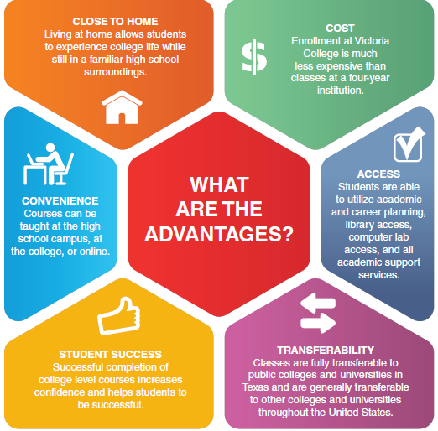
Dual Credit Offerings
How do I apply for Admission to Victoria College?
Complete an admissions application at www.ApplyTexas.org
Provide appropriate college readiness scores to the Admissions & Records Office.
Provide proof of meningitis vaccination (if required)
Provide an official high school or home school transcript.
What is Dual Credit Enrollment?
Dual Credit Enrollment is an educational program designed to enable high school students to enroll in college courses and receive both college and high school credits for the same course.
Page 16-18 of the Course Guide
Notes:
Page 17 of the course selection guide

Slide 8
Dual Credit Opportunities
VISD is committed to expanding dual credit opportunities for students
A partnership with Victoria College and VISD Education Foundation will help to reduce financial barriers
100 dual credit classes at a cost of $50 per semester/per campus will be allotted to juniors and seniors
Unused slots will be available to sophomores and freshmen
Criteria will be determined to distribute funds

Slide 9
TSI Assessment
To be TSI complete:
Math 350
Reading 351
Writing either (350 multiple choice with Essay score of 5) or (363 multiple choice with Essay score of 4)
Students can sign up to take the TSI through Victoria College. The cost of the exams is $30.00.
Students need to have a valid state ID in order to take the exam.

Slide 10

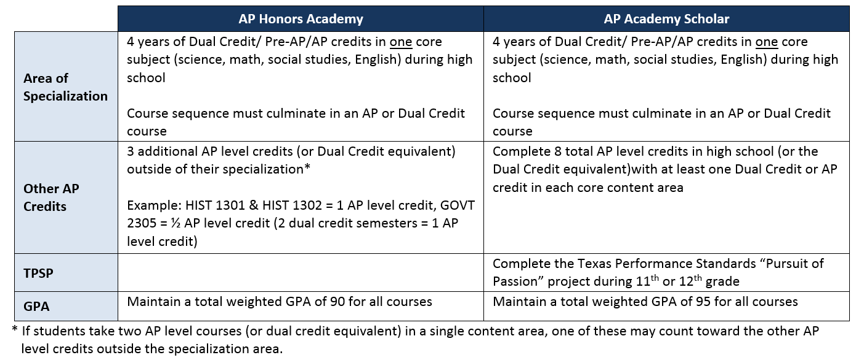
AP Academy
Increase participation in AP & Dual Credit courses
Increase focus on college readiness and completion of college ready course sequences
Improve performance of students in Pre-AP, AP & Dual Credit courses
Ensure AP & Dual Credit enrollment reflects the diversity of the overall student body
Notes:
The AP Academy represents the commitment of VISD to build an AP and Dual Credit enrollment that is reflective of the diversity seen in our student body. This begins with recruiting, retaining and supporting students in PreAP courses.
Students have the opportunity to graduate as part of the AP Academy or as an AP Academy Scholar by taking advanced course sequences that culminate in an AP or Dual Credit course and maintaining a certain weighted average.
This year’s (2019-20) Seniors are the first to receive the AP Academy Awards at graduation.

Slide 11

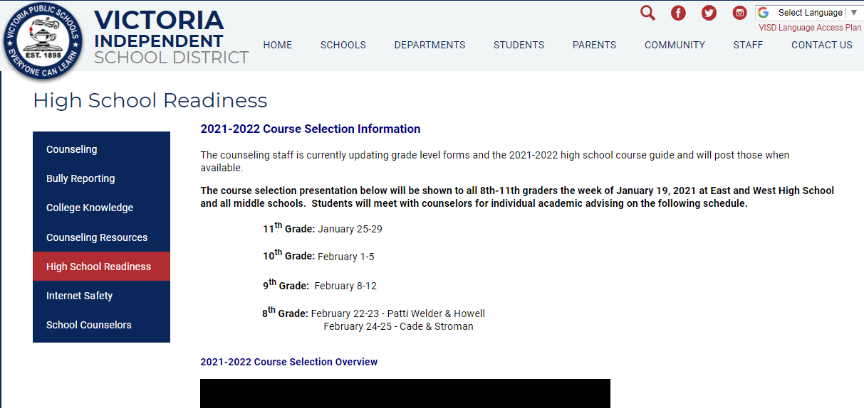
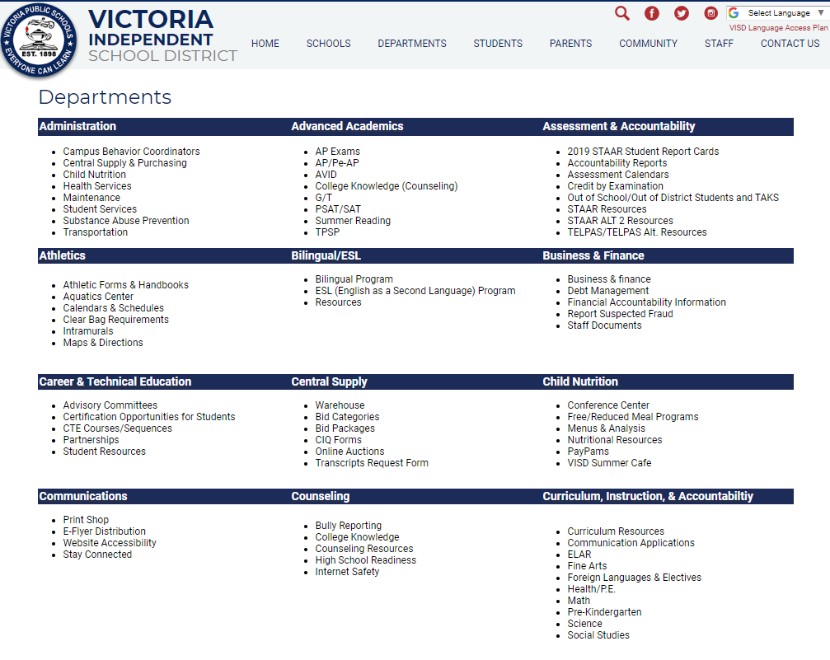
Resources

