Slide 1


Slide 2

  Student Birthdays
  10/30: Justin Bravo, Kayla Butler, Paiyslee Hagele & Makenzlee Farrell
  10/31: McKinley Peacock,
  Zaryiah Tanner & Garrett Rogers

Slide 3


Slide 4


Slide 5


Slide 6


Slide 7


Slide 8


vs. Armuchee
NOV 2nd
JV Boys - 4:30
V Girls – 5:30
V Boys – 6:30
@ AMS

Slide 9
@ Eastbrook
NOV 3rd
JV Girls - 4:30
V Girls - 5:30

Slide 10
vs. Chattooga
NOV 9th
JV Girls - 4:30
V Girls – 5:30
V Boys – 6:30
@ AMS

Slide 11
@ Unity
NOV 10th
V Girls - 4:30
JV Boys - 5:30
V Boys – 6:30

Slide 12



NOV 12 @ 4:30 p.m.
vs. Cass/Red Bud/Eastbrook
@ AMS

Slide 13
@ Eastbrook
NOV 12th
JV Boys - 4:30
V Boys - 5:30

Slide 14


Slide 15
NOV 17 @ 4:30 p.m.
vs. New Hope/Gordon Lee
@ Northwest HS

Slide 16


Slide 17


Slide 18


Slide 19


Slide 20
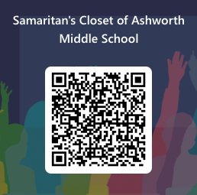

Need hygiene items, clothing or food?
Scan a QR code and submit a request.
Items will be delivered in Homeroom.

Slide 21

Ashworth is a "Safe Place" for Youth in Crisis.
Safe Place is a national organization for youth under the age of 18, that are experiencing homelessness or who may be in crisis. The program is designed to provide a young person who is homeless with immediate shelter, resources and other basic needs.

