Slide 1

2025-26 Enrollments & Facilities Report
A planning study to document membership and trends and facility capacities, to forecast future enrollments and anticipate facility needs.
Presented to the Board of Education
April 30, 2026
Prepared by: Tina Thorpe, Chief Financial Officer and
Clark Wyatt, Director of Facilities & Maintenance

Slide 2
Tab 1: Membership & Population Trends
Tab 2: Long Range Planning
Tab 3: Appendix

Slide 3
2025 Residential Building Permits by Elementary School Attendance Area

Slide 4
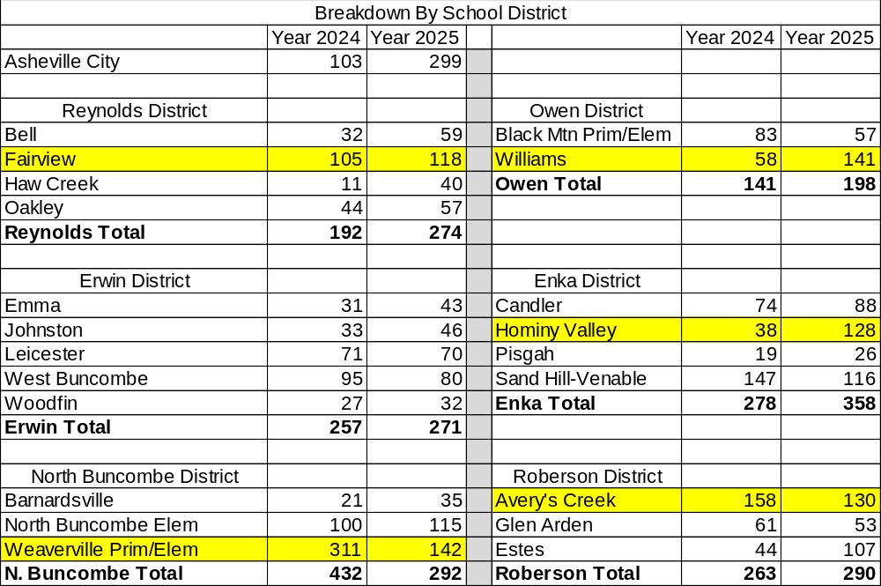

Residential Single and Multi-Family Building Permits by School District

Slide 5
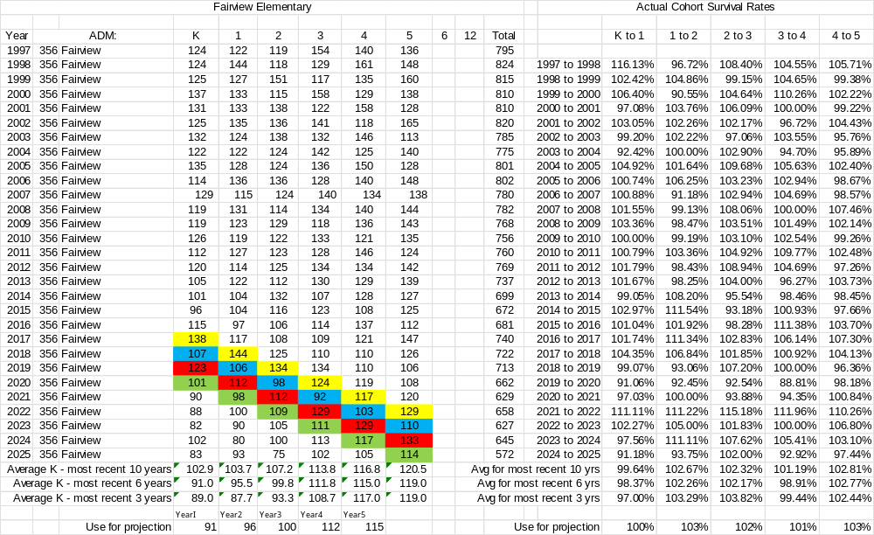
Membership Projections Methodology

Slide 6
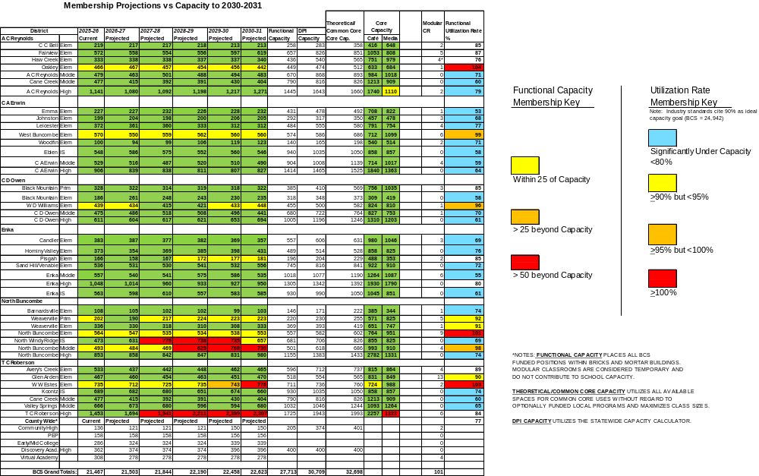
Membership Projections vs. Capacity
*Haw Creek Elementary School modulars serve BCSVA and
Pre-School EC Program

Slide 7

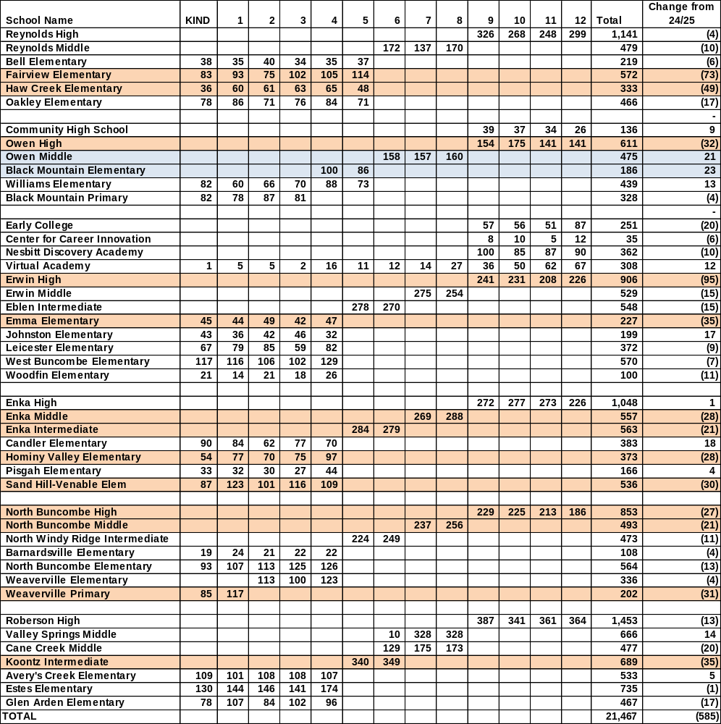
Membership: 2025 vs. 2024 Best 1 of 2
Key
Large Loss >20
Large Gain >20

Slide 8
BCS 14-Year ADM
Decline in membership pre-Covid to
21-22 = 1,626
Decline in membership 24-25 to 25-26 = 585
post Hurricane Helene

Slide 9
Statewide 14-Year Average ADM Trend

Slide 10
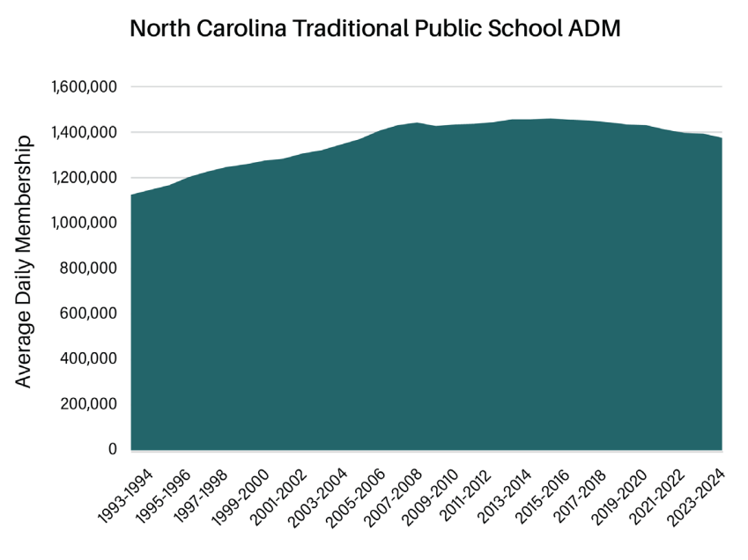
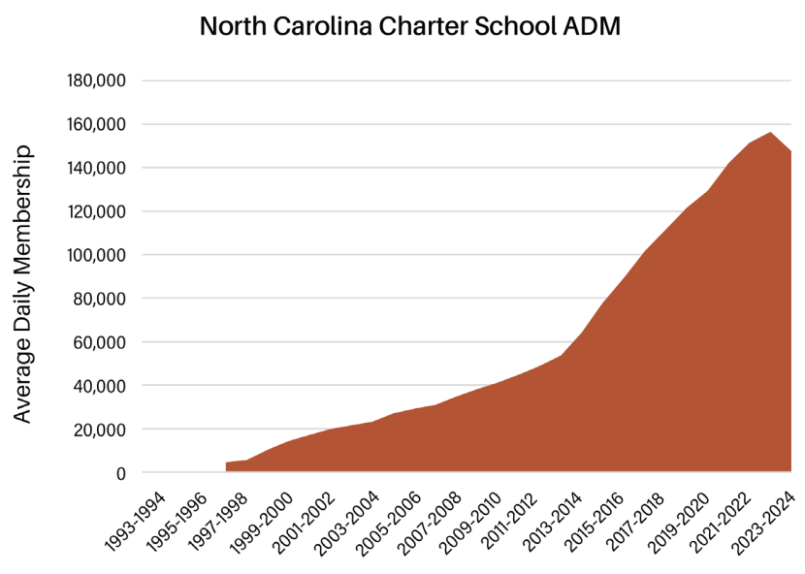
ADM Trends in Traditional Public Schools and Charter Schools
Source: https://ncnewsline.com/wp-content/uploads/2025/09/DECLINING-ENROLLMENT-REPORT-2025-single-page-view-11.pdf

Slide 11
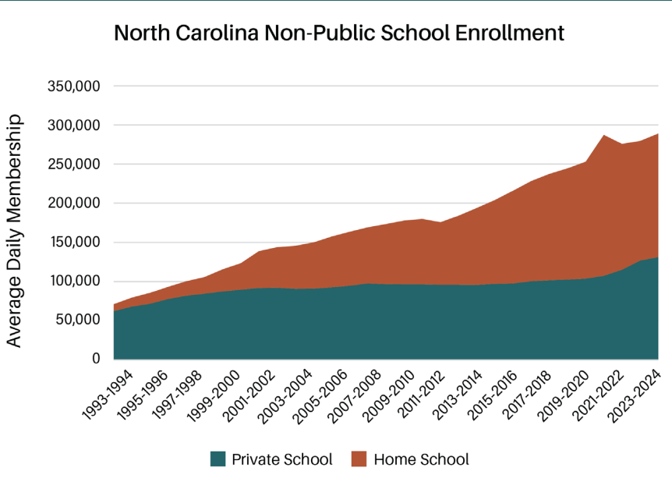
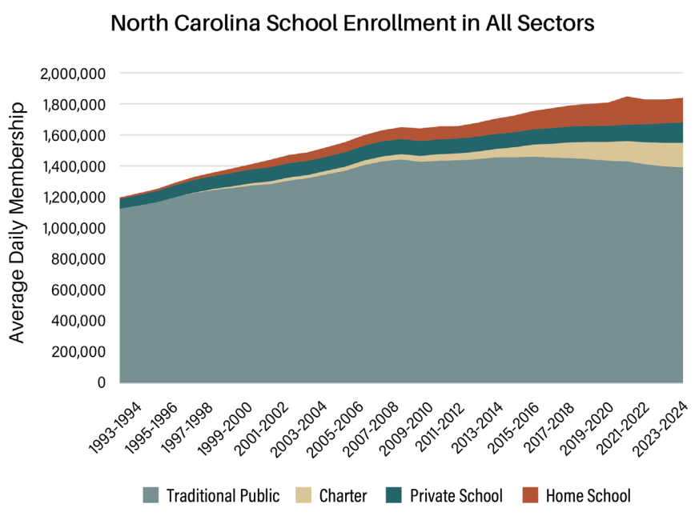
NC School Enrollment Trends
Source: https://ncnewsline.com/wp-content/uploads/2025/09/DECLINING-ENROLLMENT-REPORT-2025-single-page-view-11.pdf

Slide 12
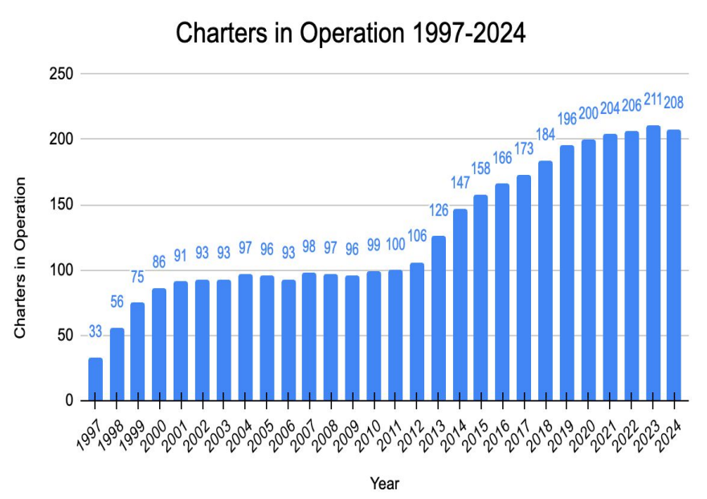
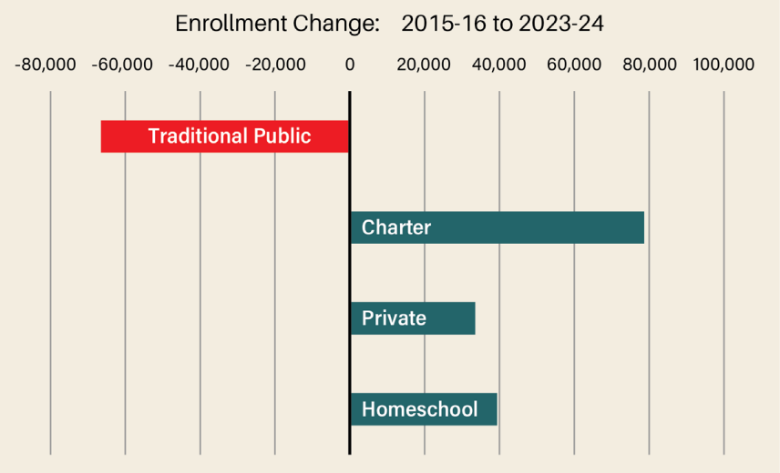
Charter School Trends
Source: https://ncnewsline.com/wp-content/uploads/2025/09/DECLINING-ENROLLMENT-REPORT-2025-single-page-view-11.pdf
Source: NCDPI 2024 North Carolina Charter Schools Annual Report

Slide 13
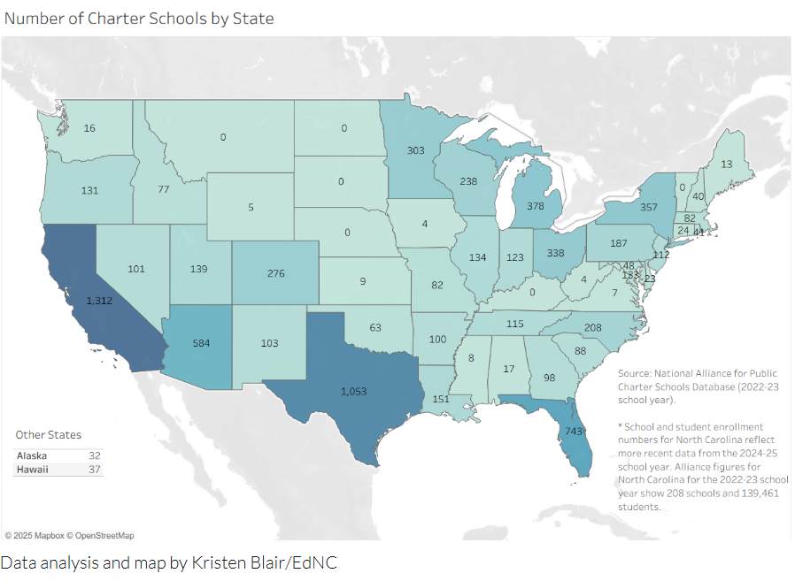
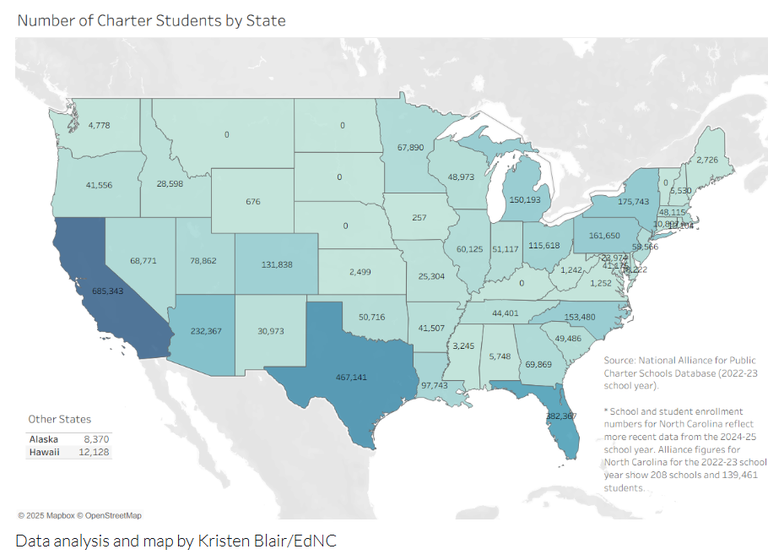
Number of Charter Schools and Enrollment by State

Slide 14
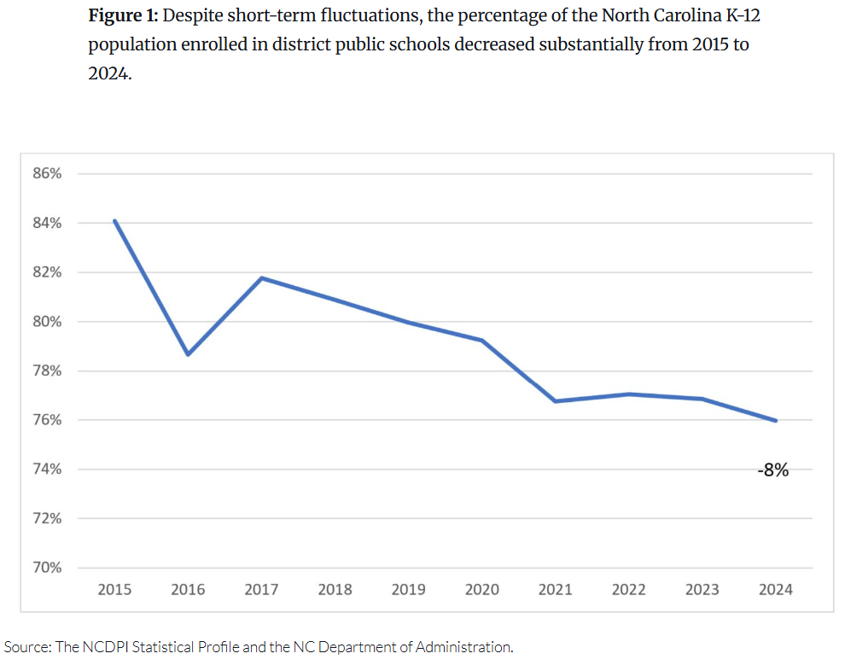
NC K-12 Public School Enrollment

Slide 15
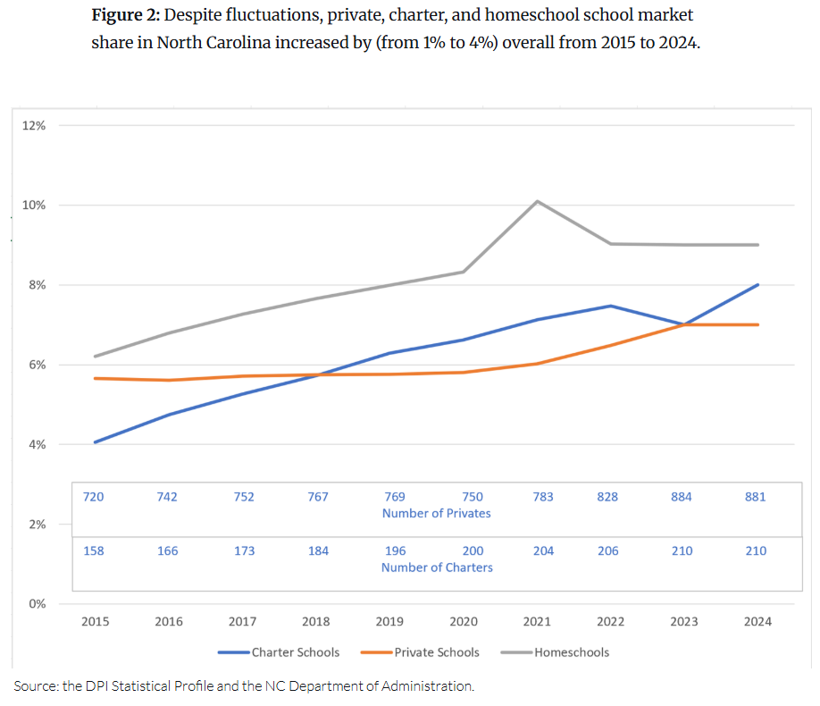
NC Charter Schools, Private Schools and Home Schools Enrollment

Slide 16
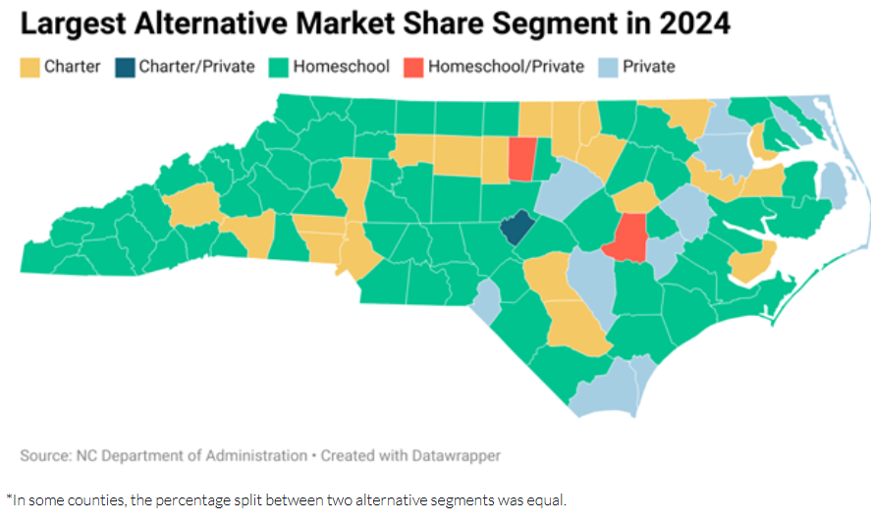
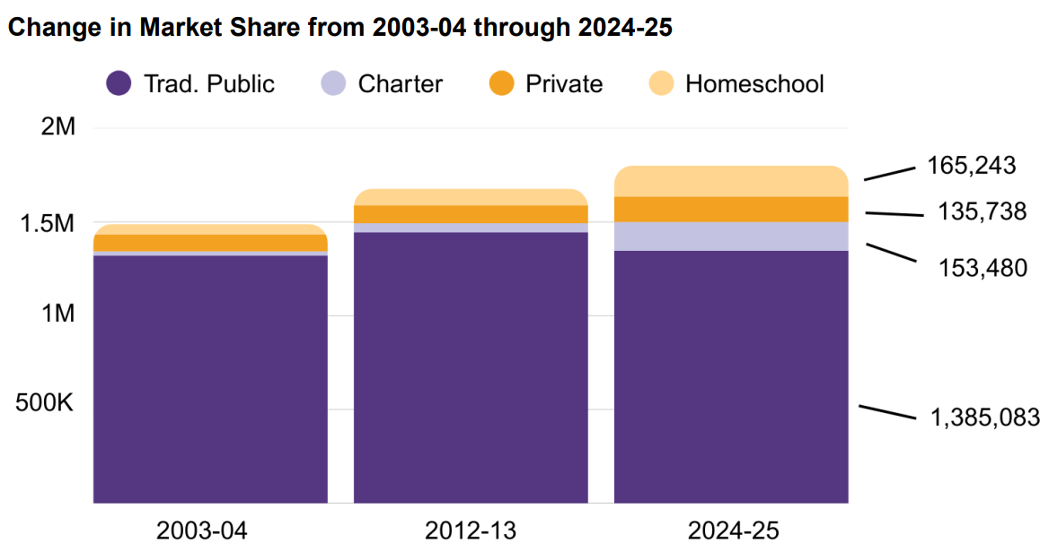
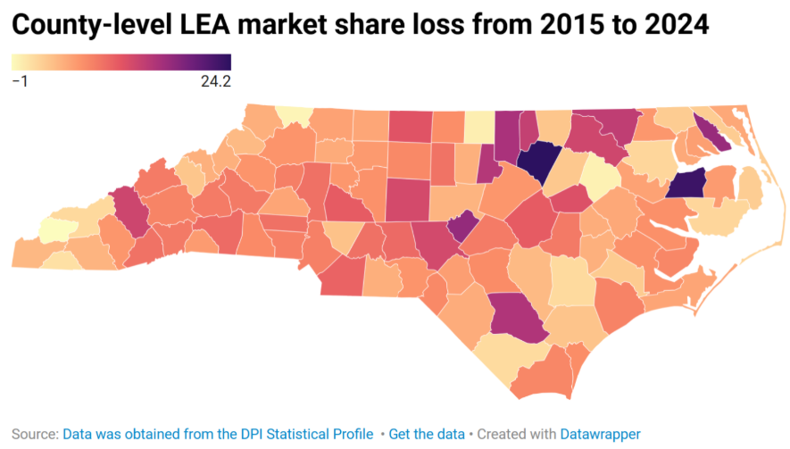
Market Share Information
Source: https://publicschoolsfirstnc.org/wp-content/uploads/2025/10/NC-Public-Ed-at-a-Glance.pdf

Slide 17
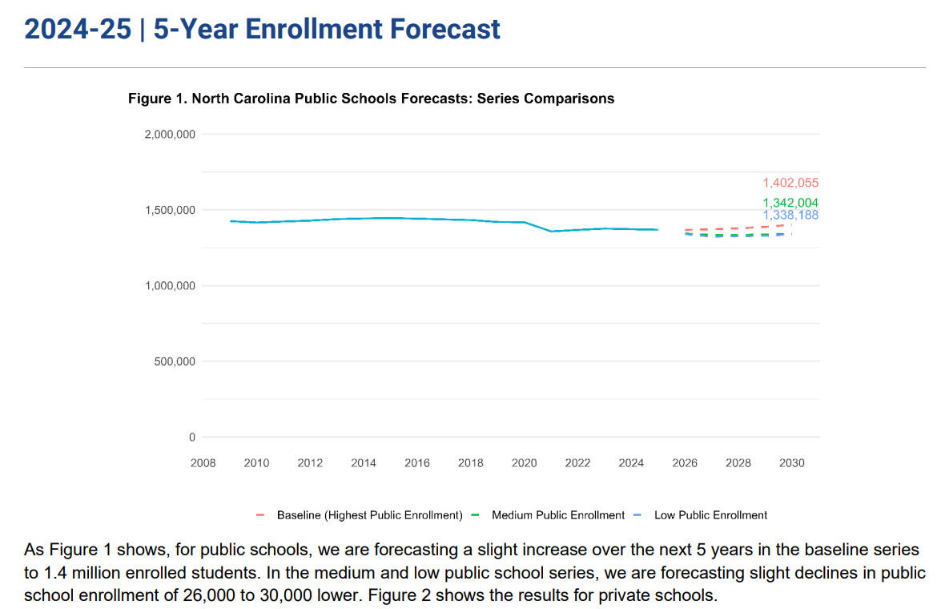
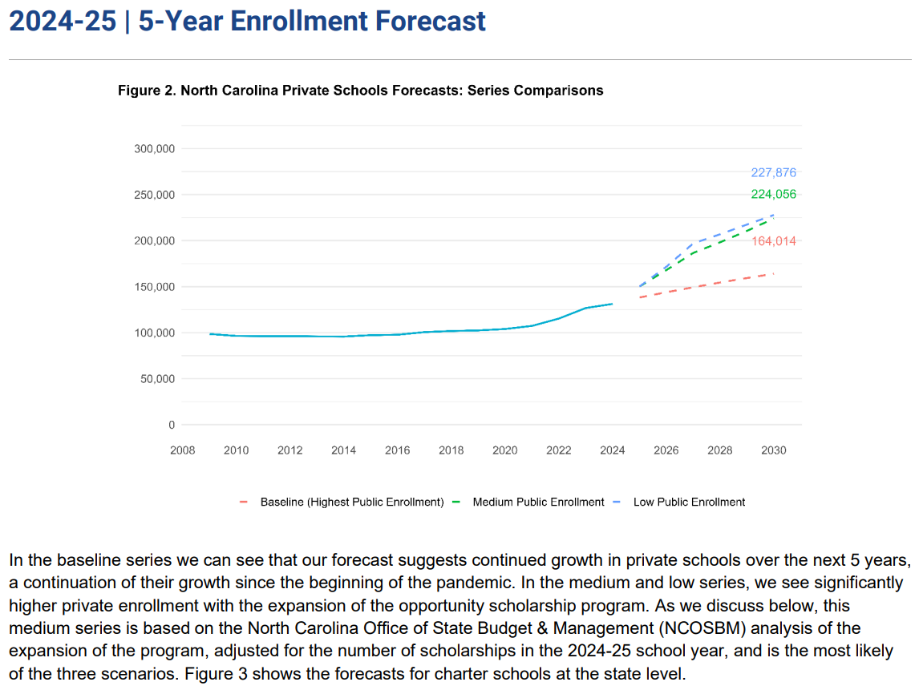
NCDPI 5-Year Enrollment Forecast
Source: NCDPI 2024-25 Enrollment Forecast: 5 Year, Submitted By: Carolina Demography at the Carolina Population Center, UNC-CH And Demographic Analytics Advisors

Slide 18
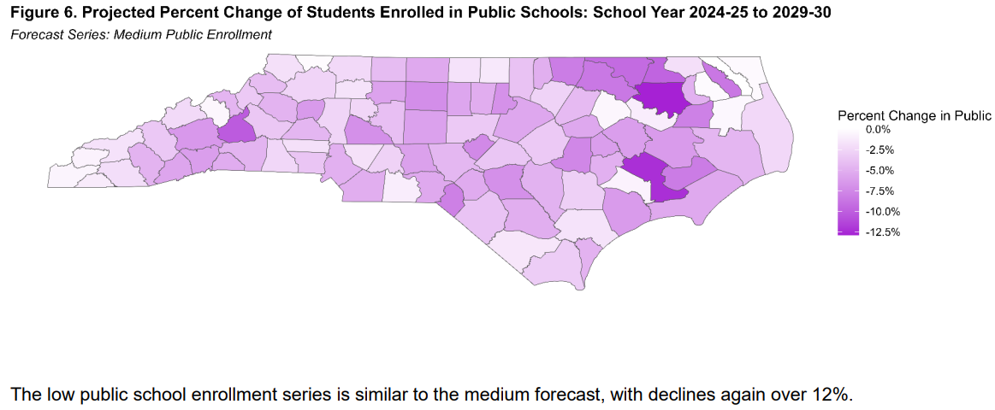
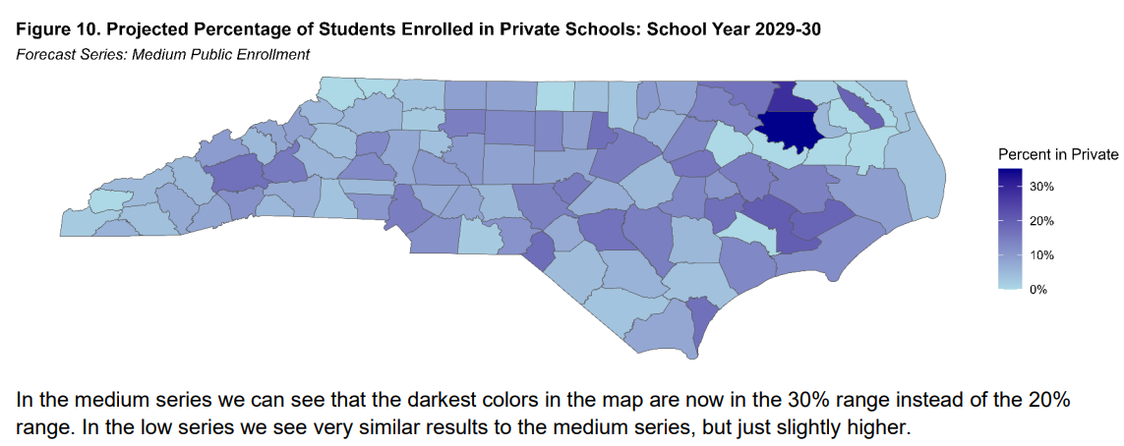
NCDPI 5-Year Enrollment Forecast
Source: NCDPI 2024-25 Enrollment Forecast: 5 Year, Submitted By: Carolina Demography at the Carolina Population Center, UNC-CH And Demographic Analytics Advisors

Slide 19
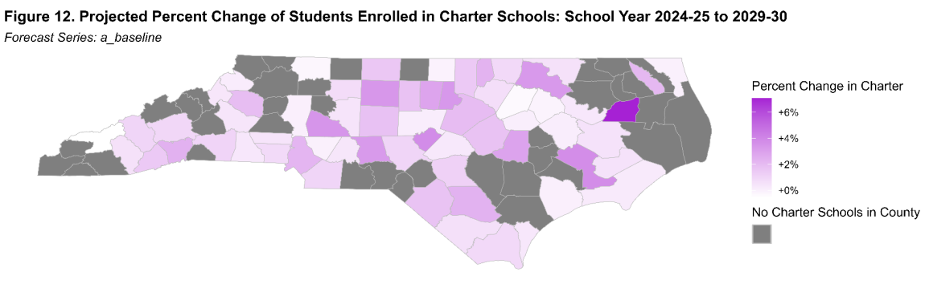
NCDPI 5-Year Enrollment Forecast
Source: NCDPI 2024-25 Enrollment Forecast: 5 Year, Submitted By: Carolina Demography at the Carolina Population Center, UNC-CH And Demographic Analytics Advisors

Slide 20
2025-26 Transfers Out of Buncombe County Schools
School | Charter | Private/Parochial | Home School | City | Online | Totals
 | # of Transfers | # of Transfers | # of Transfers | # of Transfers | # of Transfers
Avery’s Creek ES | 10 (1 Art. 5 Fern. 4 Inv.) | 3 |  | 4 | 1 | 18
Barnardsville
BCCI |  |  |  |  | 2 | 2
Bell ES | 1 (1 Art.) |  |  |  |  | 1
Black Mtn. ES | 3 (3 Art.) |  |  |  |  | 3
Black Mtn. PS
Candler ES |  |  | 7 |  |  | 7
Cane Creek MS | 6 (3 Art. 1 Fern. 2 Frank.) | 9 | 7 | 1 |  | 23
Community HS
Early College |  |  |  | 1 | 2 | 3
Eblen IS | 6 (3 Frank. 1 Inv. 2 PEAK) | 1 | 2 | 2 | 1 | 12
Emma ES | 4 (1 Fern. 3 MCPM) | 4 | 1 | 1 |  | 10
Enka HS | 10 (6 Frank. 1 Inv.) | 2 | 6 | 2 | 14 | 34
Enka IS | 8 (1 F. Del. 5 Frank. 2 Inv.) | 2 |  |  |  | 10
Enka MS | 19 (8 Frank. 11 Inv.) | 3 | 9 | 1 | 3 | 35
Erwin HS | 1 (1 Frank.) | 2 | 1 | 3 | 23 | 30
Erwin MS
Estes ES | 2 (1 Fern. 1 Inv.) | 4 |  | 1 |  | 7
Fairview ES | 5 (2 Art. 1 Ever. 1 Fern. 1 Inv.) |  | 1 |  |  | 6
Glen Arden ES | 10 (1 Ever. 6 Fern. 1 Inv. 2 PEAK) | 3 |  |  |  | 13
Haw Creek ES | 9 (2 Ever. 1 Fern. 3 MCPM, 1 Frank. 2 Inv.) |  |  | 1 |  | 10
Hominy Valley ES | 7 (1 Ever. 2 Fern. 3 Inv. 1 ShiRock) | 1 |  |  |  | 8
Johnston ES | 1 (1 Inv.) |  | 1 | 7 |  | 9
Koontz IS | 12 (2 Fern. 1 F. Del. 9 Frank.) | 17 | 2 | 2 | 1 | 34
Leicester ES | 1 (1 Art.) | 1 | 7 | 2 | 2 | 13
Middle College
N. Buncombe ES | 1 (1 Ever.) | 1 | 3 | 1 |  | 6
N. Buncombe HS |  | 2 | 3 | 1 | 7 | 13
N. Buncombe MS |  |  | 7 |  |  | 7
N. Windy Ridge IS | 7 (2 Art. 4 Frank. 1 Inv.) | 5 | 4 |  | 1 | 17
Nesbitt Discovery HS |  |  | 1 | 1 |  | 2
Oakley ES |  | 1 |  |  |  | 1
Owen HS |  | 1 | 2 | 1 | 1 | 5
Owen MS | 7 (5 Art. 1 Ever. 1 Inv.) | 4 | 4 | 2 |  | 17
Pisgah ES | 1 (1 Inv.) | 1 |  |  |  | 2
Reynolds HS
Reynolds MS | 8 (1 Art. 1 Ever. 5 Frank. 1 Inv.) | 5 | 5 | 1 | 2 | 21
Roberson HS | 2 (1 Fern. 1 Frank.) | 5 | 13 | 3 | 7 | 30
Sand Hill-Venable ES | 7 (3 PEAK 4 Inv.) | 4 |  | 2 | 1 | 14
Valley Springs MS | 3 (2 F. Del. 1 Inv.) | 1 | 2 | 2 | 1 | 9
Virtual Academy | 14 (1 Ever. 2 Fern. 6 Frank. 5 Inv.) |  |  | 1 |  | 15
Weaverville ES
Weaverville PS |  |  | 2 |  |  | 2
West Buncombe ES | 5 (1 Art. 3 Inv. 1 MCPM) | 1 |  |  |  | 6
Williams ES | 2 (2 Art.) |  |  | 1 |  | 3
Woodfin ES |  |  |  | 2 |  | 2
Total # Transferred | 172 | 83 | 90 | 46 | 69 | 460
Highest Transfers Out
Frank. = Franklin School of Innov.
Inv. = Invest Collegiate-Imagine
F. Del. = Francine Delaney New School
Ever. = Evergreen Community
Art. = ArtSpace
Fern. = Fern Leaf Community Charter
PEAK = Asheville PEAK Academy
MCPM = Mountain City Public Montessori
ShiRock=Shining Rock Classical Academy

Slide 21
2025-26 Transfers Into Buncombe County Schools
School | Charter | Private/Parochial | Home School | City | Online | Totals
 | # of Transfers | # of Transfers | # of Transfers | # of Transfers | # of Transfers
Avery’s Creek ES |  | 1 |  | 3 |  | 4
Barnardsville
Bell ES | 7 (3 PEAK 2 Fern. 2 Inv.) |  | 1 |  |  | 8
Black Mtn. ES | 4 (1 ShiRock 1 Inv. 1 Ever. 1 Art.) | 2 |  |  |  | 6
Black Mtn. PS
Candler ES |  |  | 3 |  |  | 3
Cane Creek MS | 2 (1 Ever. 1 Frank.) | 7 | 5 | 1 |  | 15
Community HS
Early College
Eblen IS |  |  | 7 |  |  | 7
Emma ES |  | 1 |  |  |  | 1
Enka HS | 11 (7 Frank. 4 Inv.) | 11 | 11 | 4 | 3 | 40
Enka IS
Enka MS | 4 (3 Frank. 1 Inv.) | 3 | 1 | 2 |  | 10
Erwin HS | 6 (4 Frank. 2 Inv.) | 7 | 2 | 2 |  | 17
Erwin MS
Estes ES | 2 (1 Ever. 1 Inv.) | 5 |  |  |  | 7
Fairview ES |  | 3 | 7 |  |  | 10
Glen Arden ES | 2 (2 Fern.) | 1 | 1 |  |  | 4
Haw Creek ES
Hominy Valley ES | 2 (2 Inv.) | 4 | 4 |  |  | 10
Johnston ES |  |  |  | 1 |  | 1
Koontz IS | 4 (2 Inv. 1 Fern. 1 Art.) | 3 | 2 | 4 |  | 13
Leicester ES | 1 (1 Inv.) | 3 | 6 |  |  | 10
Middle College
N. Buncombe ES |  | 4 | 3 |  |  | 7
N. Buncombe HS | 2 (1 Inv. 1 Frank.) | 2 | 3 |  |  | 7
N. Buncombe MS |  | 1 |  |  |  | 1
N. Windy Ridge IS |  | 2 |  | 2 |  | 4
Nesbitt Discovery HS | 17 (7 Art. 5 Inv. 2 Frank. 2 F. Del. 1 Ever.) | 6 | 5 |  |  | 28
Oakley ES
Owen HS | 16 (15 Art. 1 Ever.) | 5 | 3 |  | 1 | 25
Owen MS | 10 (8 Art. 2 Ever.) | 2 | 3 | 1 |  | 16
Pisgah ES
Reynolds HS
Reynolds MS | 18 (5 Art. 5 Inv. 3 PEAK 3 Ever. 1 Frank. 1 Fern) | 4 | 6 |  |  | 28
Roberson HS | 11 (6 Inv. 2 Ever. 1 Fern. 1 Frank. 1 Lake Lure) | 22 | 8 | 4 |  | 45
Sand Hill-Venable ES |  | 3 | 1 | 2 |  | 6
Valley Springs MS | 4 (4 Inv.) | 9 | 3 |  |  | 16
Virtual Academy
Weaverville ES
Weaverville PS |  |  |  | 2 |  | 2
West Buncombe ES
Williams ES
Woodfin ES
Total # Transferred | 123 | 111 | 85 | 28 | 4 | 351
Frank. = Franklin School of Innov.
Inv. = Invest Collegiate-Imagine
F. Del. = Francine Delaney New School
Ever. = Evergreen Community
Art. = ArtSpace
Fern = Fern Leaf Community Charter
PEAK = Asheville PEAK Academy
Lake Lure = Lake Lure Classical Academy
ShiRock = Shining Rock Classical Academy
Highest Transfers Into BCS

Slide 22
Student Transfer Destinations
2024-2025
2025-2026

Slide 23
Grade Level of Transfers
2024-2025
2025-2026

Slide 24
Student Transfer Destinations by Grade Level

Slide 25
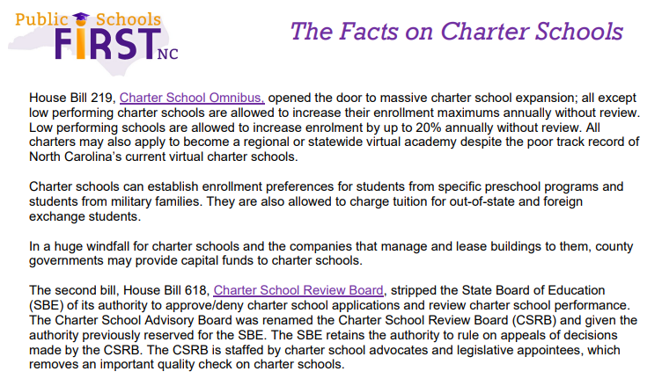
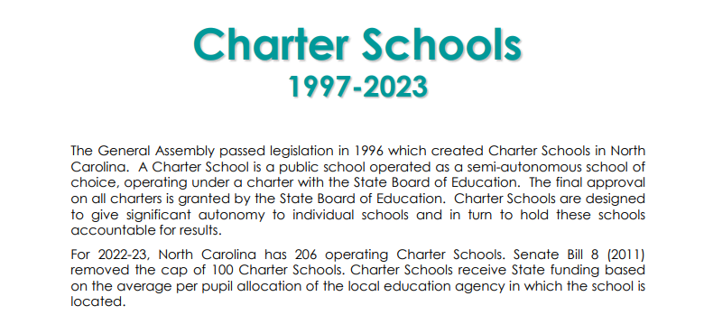
State Budget Cap for Charter School ADM
House Bill 219 became effective 08/16/2023
House Bill 618 became effective 08/16/2023

Slide 26

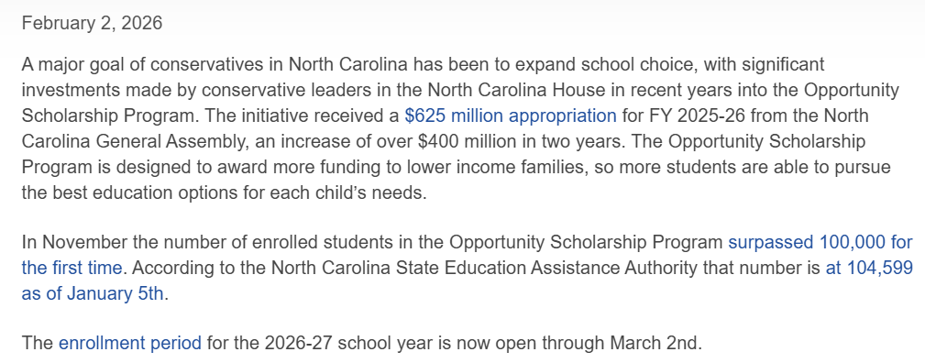
Voucher Information
Source: https://carolinaleader.com/opportunity-scholarship-enrollment-window-opens-for-2026-27-school-year/

Slide 27
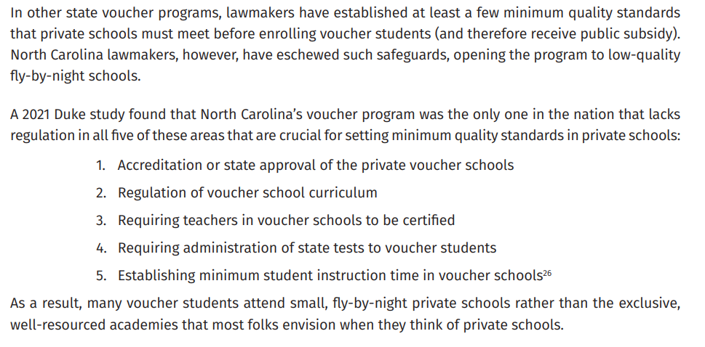
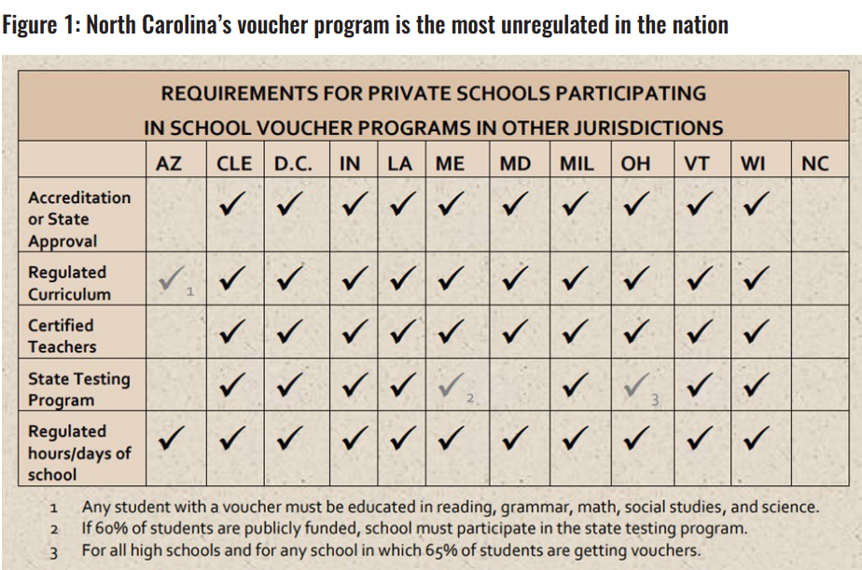
Voucher Information
Source: https://www.ncjustice.org/wp-content/uploads/2024/05/VOUCHER-REPORT-2024-NCJC.pdf

Slide 28
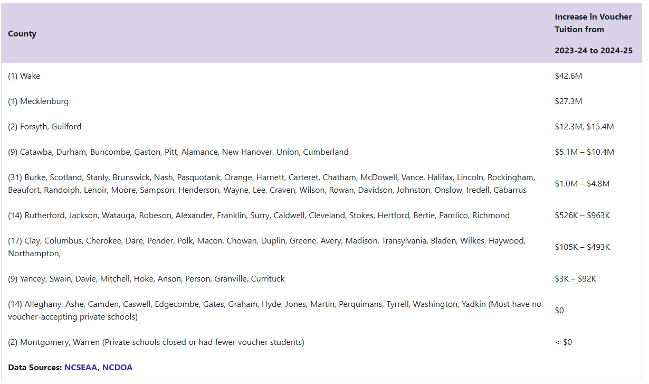
Voucher Information
Source: https://publicschoolsfirstnc.org/resources/fact-sheets/increase-in-taxpayer-funded-tuition-vouchers-to-private-schools-2023-24-to-2024-25/

Slide 29
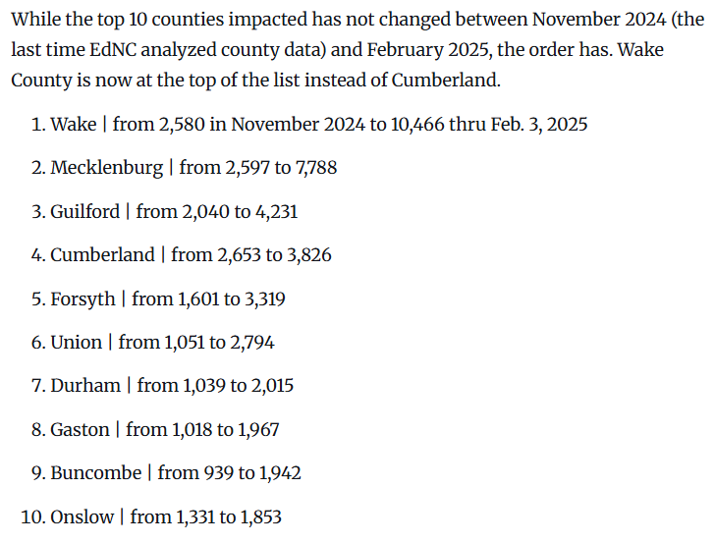
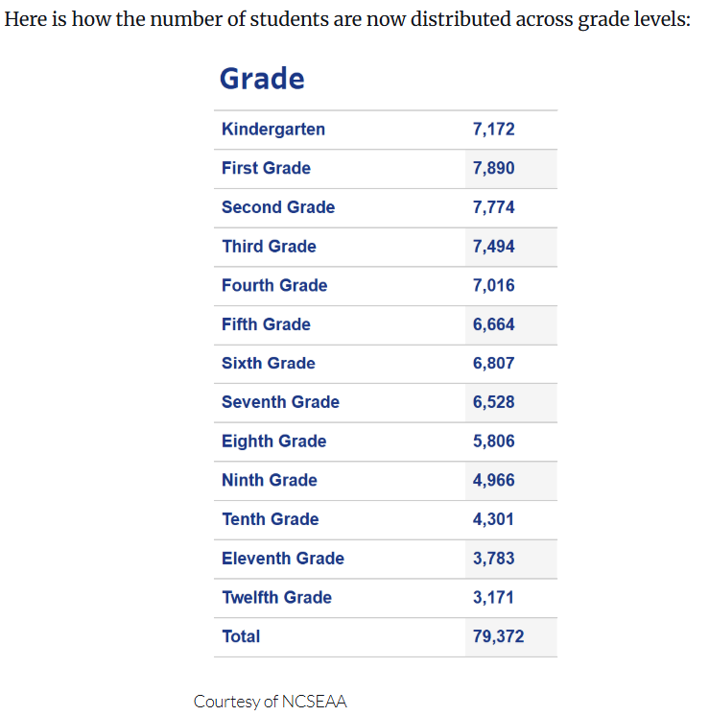
Voucher Information
Source: https://www.ednc.org/as-25-26-applications-open-big-bump-in-number-of-vouchers-first-seen-in-data/

Slide 30
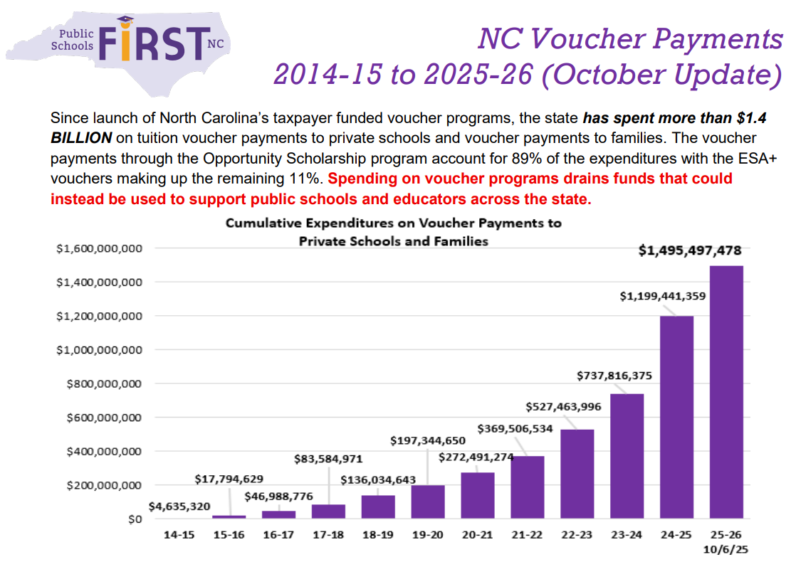
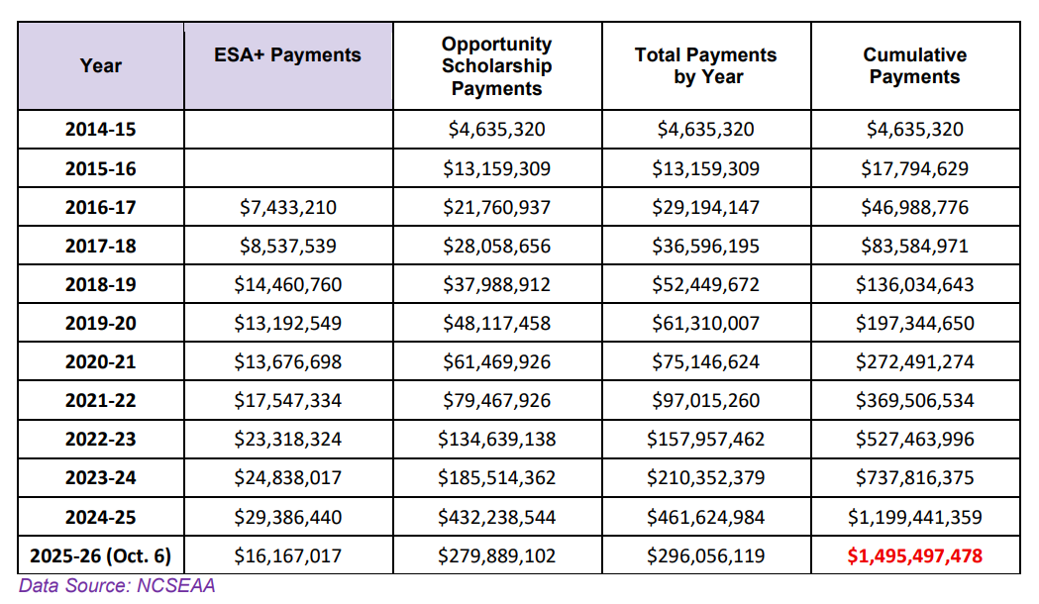
Voucher Information
Source: https://publicschoolsfirstnc.org/wp-content/uploads/2025/10/10.2025_Voucher-Payments-2014-2025-Oct_1pg-1.pdf

Slide 31
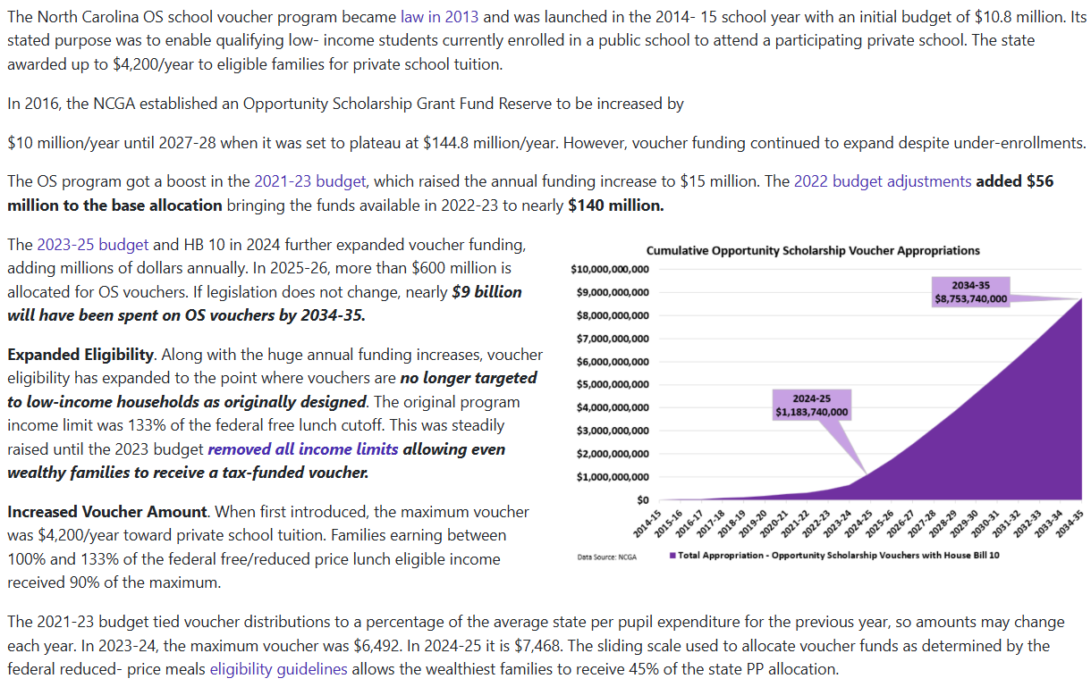
Voucher Information

Slide 32

Voucher Payments Schedule
Source: https://k12.ncseaa.edu/media/zxhl0yxy/august-2025-os-overview.pdf

Slide 33
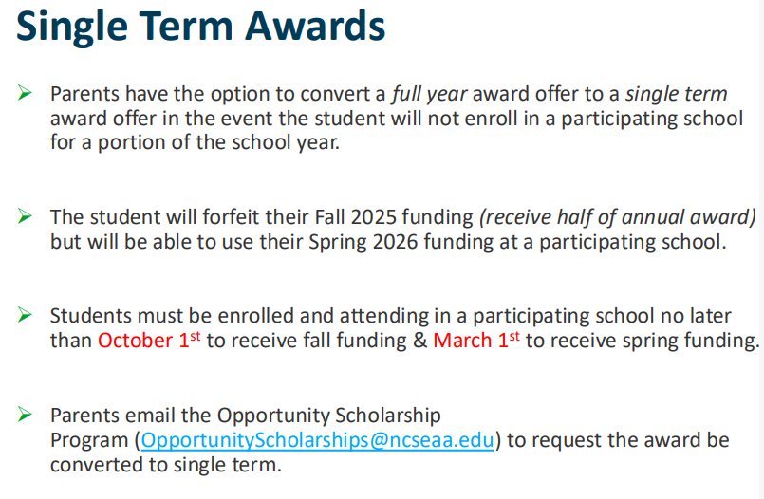
Voucher Payments Schedule
Source: https://k12.ncseaa.edu/media/zxhl0yxy/august-2025-os-overview.pdf

Slide 34
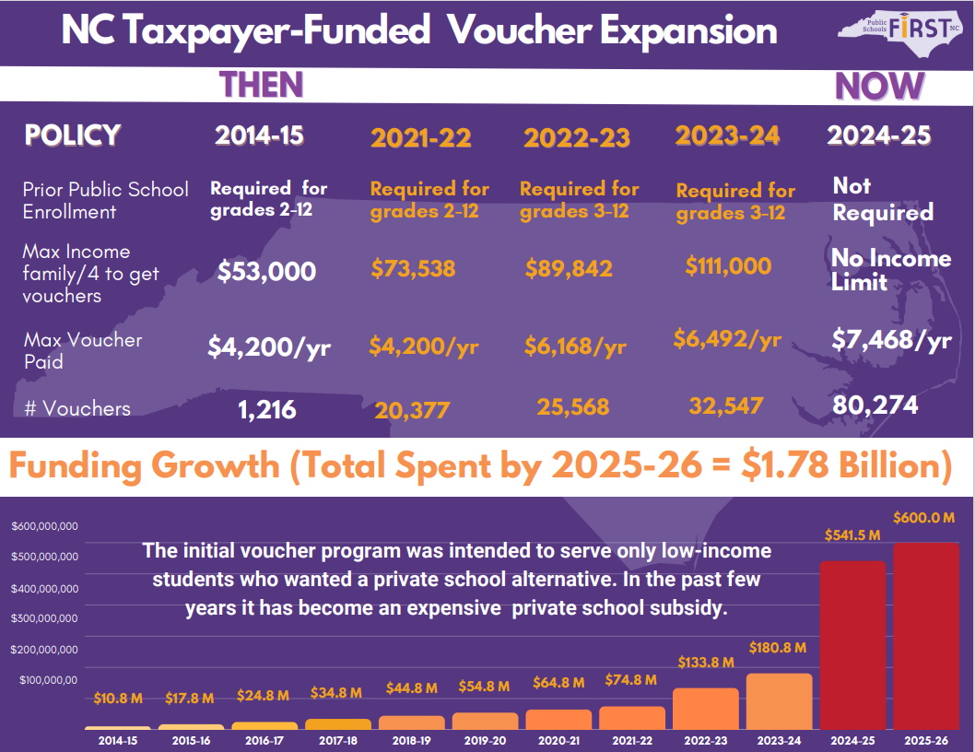
Voucher Information
Source: https://publicschoolsfirstnc.org/wp-content/uploads/2025/10/2025.4-Voucher-Expansion-1page.-FINAL-purple-background-1.pdf

Slide 35
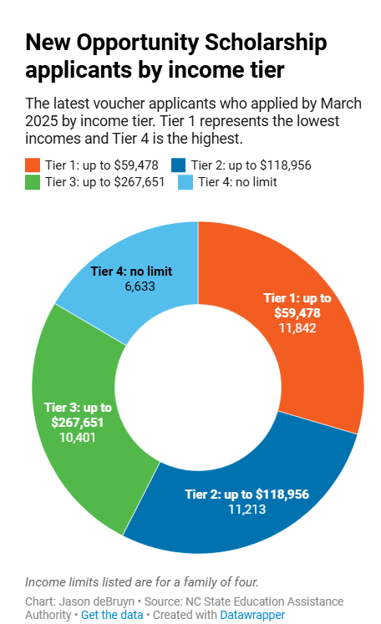
Voucher Information

Slide 36
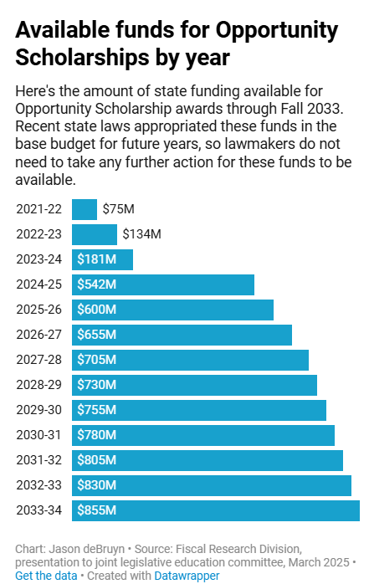
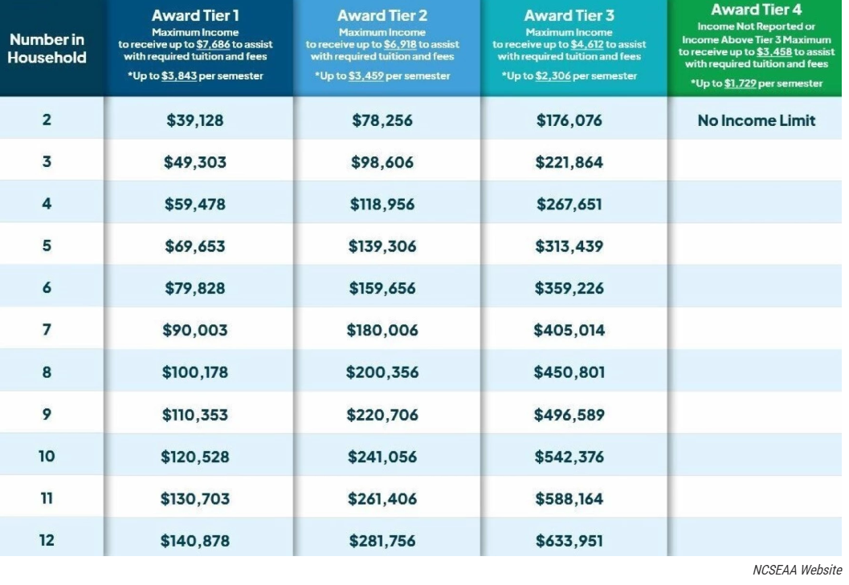
Voucher Information

Slide 37
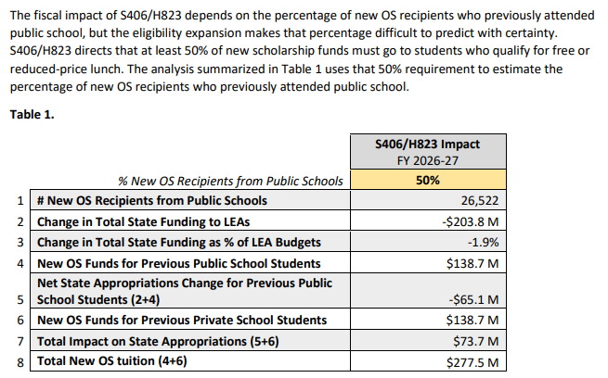
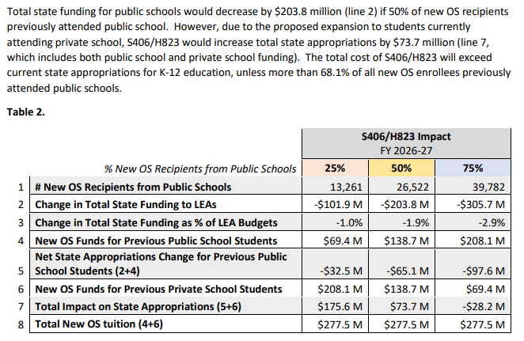
Voucher Information
On the Horizon:
HB823 was referred to the Committee on Rules, Calendar and Operations of the House on 05/07/2024
S406 was Re-referred to the Committee on Appropriations/Base Budget on 04/26/2023
Source: https://governor.nc.gov/documents/files/osbm-s406-h823-impact-analysis/open

Slide 38
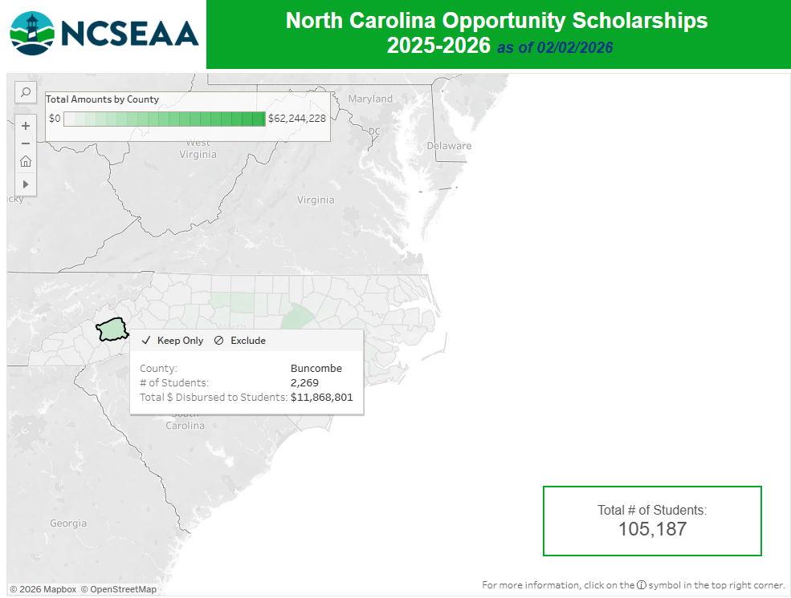
Source: https://www.ncseaa.edu/opportunity-scholarship-summary-of-data/

Slide 39
Virtual Charter Schools 11-Year ADM
Note: 2019-20 change in management at NC Cyber Academy

Slide 40
New Charter Schools for 2025-26
GO BIG Charlotte (Mecklenburg County)
Agape Achievement Academy (Cumberland County)
Honor Preparatory School (Mecklenburg County)
North Oak Academy (Durham County)
Carolina Achieve (Alamance County)
Sledge Institute (Henderson County)
Triad International Studies Academy (Guilford County)
Liberty Charter Academy (Guilford County)
Nalanda Academy (Wake County)
Anderson Academy (Forsyth County)
Source: https://chartercoalition.org/2025/04/18/ten-new-charter-schools-are-expected-to-open-for-2025-26/

Slide 41
New Charter Schools for 2026-27
Centerpoint Classical Academy (Guilford County)
Granite Charter (Chatham County)
Warren Young Explorer’s School (Warren County)
NC Connections Academy (Remote Statewide)
Legacy Traditional Schools (Forsyth County)
Bettis Academy (Wake County)
Source: https://www.thecentersquare.com/north_carolina/article_04c266ca-d357-11ef-8240-0b6163097f74.html

Slide 42
Buncombe County Charter Schools Approved to Add Remote Component
ArtSpace Charter (Planning Year 25-26, Open 26-27)
Franklin School of Innovation (Approved February 2026, Open 26-27, Grades 9-12)

Slide 43
Tab 1: Membership & Population Trends
Tab 2: Long Range Planning
Tab 3: Appendix

Slide 44

Maintenance & Facilities
Long-Range Planning
Strategic alignment of enrollment, funding, and capital projects ensures that every capital investment directly supports instructional goals, enhances student safety, and maintains long-term fiscal responsibility.

Slide 45
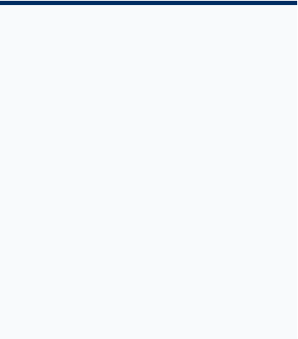

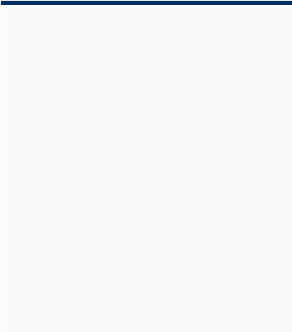



BALANCING URGENT VS. LONG-TERM NEEDS
Urgent Responses
Long-Range Planning
Stakeholder Synergy
Critical HVAC failures, roofing leaks, and immediate life-safety repairs handled through rapid maintenance workflows.
Multi-year CIP (Capital Improvement Plan) focused on total cost of ownership and 5-year growth horizons.
Internal department collaboration and external community advisory groups guiding prioritization.

Slide 46
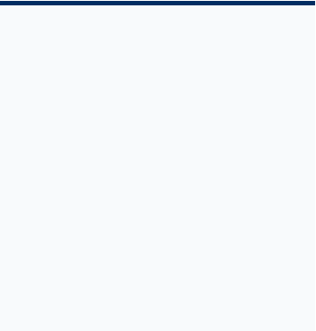
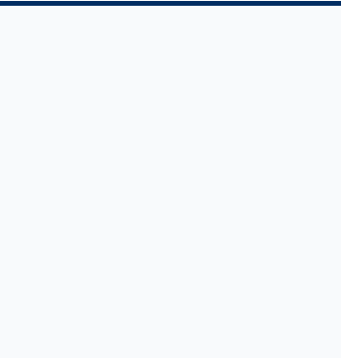
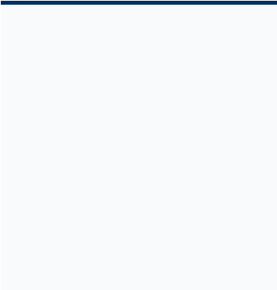



KEY PLANNING DRIVERS
Enrollment Trends
Funding Sources
Facility Condition & Capacity
Analyzing historical data and future projections to anticipate geographic shifts and capacity requirements across the district.
Synchronizing projects with available funding sources
Continuous verification of functional capacity through studies and site-specific audits.

Slide 47

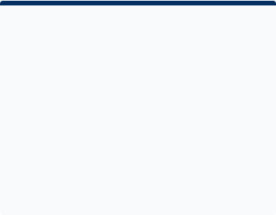
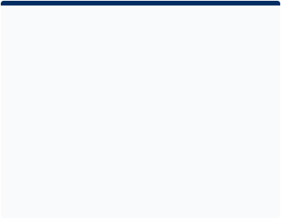
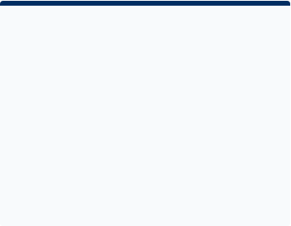



PRIORITIZATION FRAMEWORK
based on Board Policy 9030: Facility Construction
Safety, Health, and Regulatory Compliance (ADA & Security)
Instructional Space Modernization & Additions
Asset Preservation (Roofs, HVAC, Exterior Envelopes)

Slide 48






HOW PRIORITIES ARE BUILT
Long-Range Plan
Internal Stakeholders
External Stakeholders
We work together with internal and external partners and use data checks to create a clear and useful Capital Improvement Plan (CIP).
Principals, Teachers Central Office Staff, Maintenance/Facilities Teams, Security Staff
Parents, Community Groups, Industry Professionals, County Officials

Slide 49
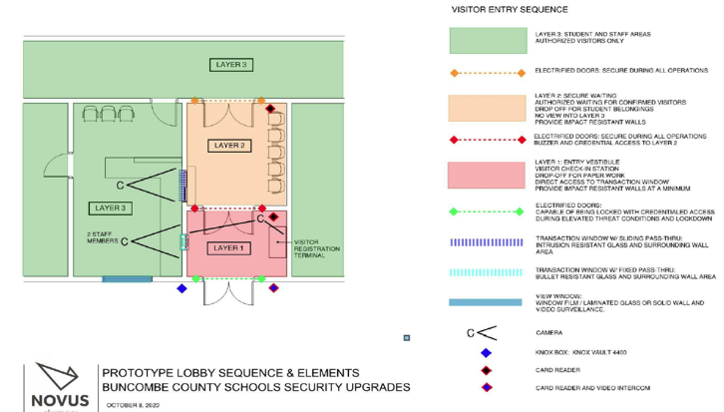
SECURITY & LOBBY HARDENING
2019 External Audit Results
Building on our collaborative prioritization framework, we integrated results from a professional assessment to define hardening goals for all campuses.
80% Completion: Safety window film on all exterior glass.
Lobby Upfits: 28 schools remaining with vestibule "check-in" zones to screen visitors.

Slide 50


ADDITIONS & RENOVATIONS
WD WILLIAMS ELEMENTARY SCHOOL
Renovation Scope is Developed Through Collaboration
Planning is guided by input from internal stakeholders and external partners. Projects are developed based on identified needs rather than assumptions, ensuring alignment with actual facility conditions and capacity requirements. The process remains flexible throughout planning, allowing adjustments as new data, constraints, or opportunities emerge.
The image on the left reflects the original concept drawing, while the photo on the right shows the project’s actual conditions. Together, they illustrate how project needs and outcomes can evolve over time and inform planning adjustments.

Slide 51

NEW FACILITY: GLEN ARDEN
Strategic response to the Skyland/South Buncombe population surge based on external capacity study.
Full Replacement: New building to replace aging footprint and address capacity needs.
Modular Elimination: Moving all students into a single secure structure.

Slide 52


ADVANCE PLANNING PIPELINE
N. Buncombe Middle
Erwin & Enka High
Elective space capacity and regional growth.
Addressing open concept layouts and incorporating ADA improvements to better support functionality, accessibility, and modern facility standards.

Slide 53
End
2025-26 Enrollments & Facility Needs Report

Slide 54
Tab 1: Membership & Population Trends
Tab 2: Long Range Planning
Tab 3: Appendix
Membership Trends
Building Permits & Development

Slide 55
AC Reynolds District Membership Trends

Slide 56
CA Erwin District Membership Trends

Slide 57
CD Owen District Membership Trends

Slide 58
Enka District Membership Trends
Enka I/S Opens

Slide 59
North Buncombe District Membership Trends

Slide 60
TC Roberson District Membership Trends

Slide 61

Asheville City & Charter School Membership
*These are statewide charter schools, new for the 2015-16 school year, these numbers are statewide totals.
North Carolina Cyber Academy was formerly named NC Connections Academy.
**Asheville PEAK Academy was new for the 2021-22 school year.
***Mountain City Public Montessori was new for the 2023-24 school year.
****Pine Springs Preparatory Academy is a statewide charter school, new for the 2024-25 school year, these numbers are statewide numbers.

Slide 62

Mid-Year Graduate Data

Slide 63

Buncombe County & Asheville City Schools
Gains/Losses – 14 Year Span

Slide 64
Buncombe County Population
Buncombe County Population. U.S. Census Bureau, Resident Population in Buncombe County, NC [NCBUNC1POP], retrieved from FRED, Federal Reserve; https://fred.stlouisfed.org/series/NCBUNC1POP, March 9, 2026.

Slide 65
Asheville Population, retrieved from https://worldpopulationreview.com/us-cities/north-carolina/asheville#:~:text=Asheville%20is%20a%20city%20located,population%20of%2094%2C575%20in%202020., March 9, 2026.

Slide 66
Buncombe County Historic Population
Buncombe County Population, retrieved from https://worldpopulationreview.com/us-counties/nc/buncombe-county-population, March 9, 2026.

Slide 67

US Census Bureau Population Estimates Methodology

Slide 68
63% of births in Buncombe County are attending Buncombe County Schools

Slide 69
BCS, ACS & Charter Schools Historical Kindergarten Membership Compared to Births SY 2013-14 to SY 2028-29
Birth
Year

Slide 70


2025-26 Charter School Details for NC Counties
Notes:
This report is by county, so county and city school numbers are combined for counties that have both county and city schools.
Number of Students in Charter Schools does not include students in the two statewide charter schools.

Slide 71


5-Year ADM by NC County

Slide 72
Tab 1: Membership & Population Trends
Tab 2: Long Range Planning
Tab 3: Appendix
Membership Trends
Building Permits & Development

Slide 73
8-Year Building Permit Trends

Slide 74

Buncombe County GIS Development Mapper

Slide 75
Major Subdivisions With Impacted Buncombe County Schools
MAJOR SUBDIVISION | ADDRESS | SCHOOLS | PROPOSED NUMBER OF LOTS OR UNITS
Focus Homes Proposed Subdivision | Mallard Run Drive | Avery's Creek ES, CTKIS, VSMS, TCRHS | 28
Glenn Bridge Major Subdivision - Phase 2 | 1948 Brevard Road | Avery's Creek ES, CTKIS, VSMS, TCRHS | 5
The Oaks | 122 Fairmont Road | Candler ES, EIS, EMS, EHS | 14
Ramble Biltmore Block P - Major Subdivision | 416 Ramble Way | Estes ES, CTKIS, VSMS, TCRHS | 14
Ramble Biltmore Forest - Block H - Phase 2 | 395 Ramble Way | Estes ES, CTKIS, VSMS, TCRHS | 6
Christ School Subdivision | 248 Christ School Road | Glen Arden ES, CTKIS, CCMS, TCRHS | 25
Christ School Townhomes Major Subdivision | 33 Christ School Road | Glen Arden ES, CTKIS, CCMS, TCRHS | 84
Pinners Cove | Pinners Cove Road | Glen Arden ES, CTKIS, CCMS, TCRHS | 269
Woodland Trace | Queen Road | Hominy Valley ES, EIS, EMS, EHS | 18
Woodland Trace | Queen Road | Hominy Valley ES, EIS, EMS, EHS | 18
Old Charlotte Doran Subdivision | 107 Old Charlotte Hwy | Oakley ES, ACRMS, ACRHS | 221
Pleasant Grove Major Subdivision | 9 Pleasant Grove Road | Weaverville PS/ES, NWRIS, NBMS, NBHS | 40
Rydele Heights | Aiken Road | Weaverville PS/ES, NWRIS, NBMS, NBHS | 12
Rydele Heights-Pocket B | Aiken Road | Weaverville PS/ES, NWRIS, NBMS, NBHS | 8
Sherwood Subdivision | 237 New Salem Road | Williams ES, CDOMS, CDOHS | 17
Sherwood Subdivision | 243 New Salem Road | Williams ES, CDOMS, CDOHS | 17
Biltmore Park Apartments | Schenck Pkwy | Estes ES, CTKIS, VSMS, TCRHS | 359
Rivers Edge Apartments | 101 Sumner Drive | Avery’s Creek ES, CTKIS, VSMS, TCRHS | 180
Clayton Crossing | 7 Moon Haven Way | Avery’s Creek ES, CTKIS, VSMS, TCRHS | 70
Altitude Multifamily | 97 Clayton Road | Avery’s Creek ES, CTKIS, VSMS, TCRHS | 114
Central Park Multifamily | 455 Mills Gap Road | Glen Arden ES, CTKIS, CCMS, TCRHS | 208
The Lofts at Swannanoa (Senior Living) | 2236 US 70 Hwy | Williams ES, CDOMS, CDOHS | 52
The Apex at Brevard | 2055 Brevard Road | Avery’s Creek ES, CTKIS, VSMS, TCRHS | 197
MHO Pentland Hills | Pentland Hills Drive | West Buncombe ES, JPEIS, CAEMS, CAEHS | 69
Wilderness Ridge Condos | Reeves Cove Road | Hominy Valley ES, EIS, EMS, EHS | 74

Slide 76
2025 New Major Subdivisions With Impacted Buncombe County Schools
MAJOR SUBDIVISION | ADDRESS | SCHOOLS | PROPOSED NUMBER OF LOTS OR UNITS
Oakmoss Mobile Home Park | 14 Oakmoss Lane | Emma ES, JPEIS, CAEMS, CAEHS | 13
Beacon Ridge Multifamily | US 70 Hwy | Black Mountain PS/ES, CDOMS, CDOHS | 170
2544 Hendersonville Road Development | 2544 Hendersonville Rd. | Avery’s Creek ES, CTKIS, VSMS, TCRHS | 22
Old County Home Road Development | 415 Old County Home Rd. | West Buncombe ES, JPEIS, CAEMS, CAEHS | 159
Case Cove Road Development | Case Cove Rd. | Hominy Valley ES, EIS, EMS, EHS | 35
Emma Road Townhomes | 815 Emma Rd. | Emma ES, JPEIS, CAEMS, CAEHS | 107
220 Ledbetter Road Development | 220 Ledbetter Rd. | Avery’s Creek ES, CTKIS, VSMS, TCRHS | 29

Slide 77
END APPENDIX

