Slide 1


BCS Strategic Plan Highlight
From Strategy to Success:
Elevating Multilingual Learner Outcomes
May 7, 2026

Slide 2


Slide 3
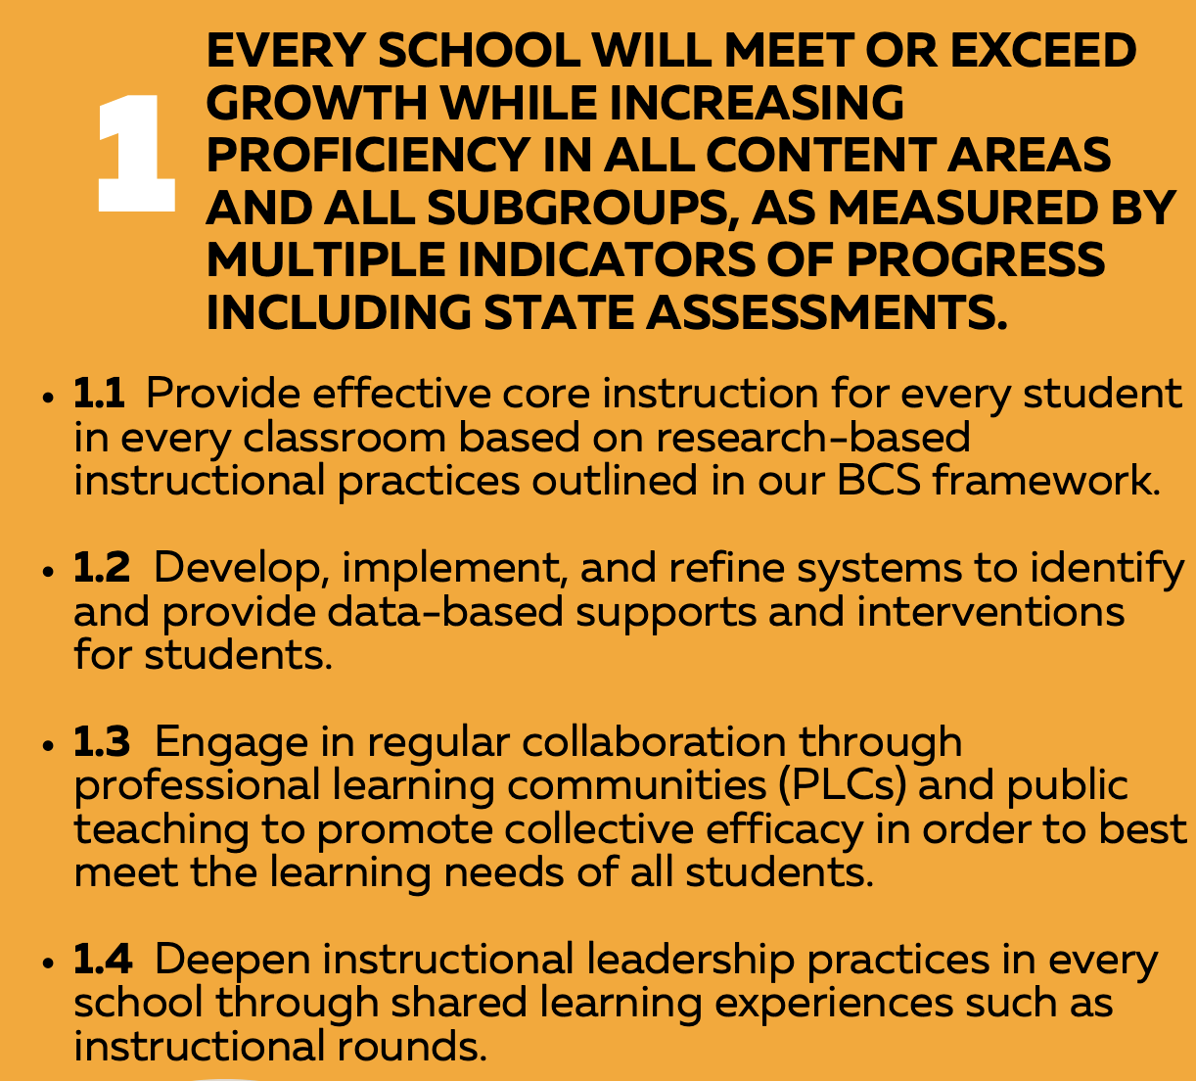

Strategic Plan Goal 1

Slide 4

"Goals are good for setting a direction, but systems are best for making progress." — James Clear

Slide 5
Terminology
Learner Designations:
English Learner (EL) - Federal
Multilingual Learner (ML) - State of NC
Other Relevant Terms:
English as a Second Language (ESL) - the class, the teacher, the program
Sheltered Instruction - A class comprised of ML students all learning core content with language support
Co-Teaching - Class that is co-instructed with a Content Teacher and an ESL Teacher

Slide 6
Sub-Categories of ML Students
Since Kindergarten: Entered in “K”
At Risk due to not meeting Annual Progress Indicator:
Long Term: Have not exited ML status based on their trajectory (5-7 years)
Bridging: Students with higher English language scores, are successful in the classroom and are near exiting ML status
Newcomers: New to the U.S. 1st-12 Grades
Students with Interrupted Formal Education (SIFE)
Students with Limited Interrupted Formal Education (SLIFE)

Slide 7
DEMOGRAPHICS

Slide 8
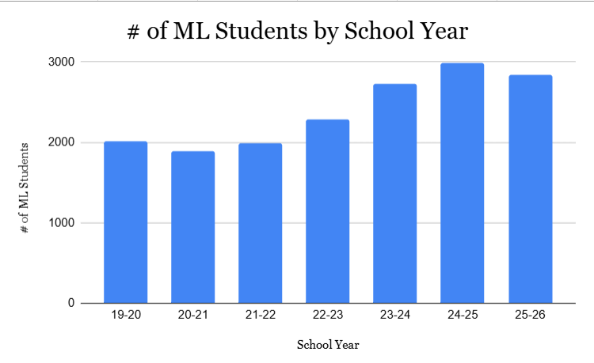
BCS ML Student Population Growth

Slide 9
BCS Students/MLs/NOMs
Total students: 21,118
Total MLs: 2843/13%
National Origin Minority (NOM): 4,592/22%
(Students who have a language other than English spoken in the home)

Slide 10
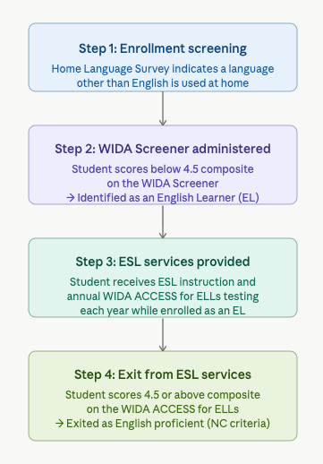
ML Identification and Exiting

Slide 11
45 Schools
42 ESL Teachers
1-3 ESL Teachers per School
Split between schools
Full time at one school
ML Teachers
ML Coaches
Christine Basulto - Enka/Owen
Karie Gregory - Erwin/North Buncombe
Tsianina Tovar - Reynolds/Roberson/JES

Slide 12
ML Totals By Districts
Erwin
Enka
North
Buncombe
Owen
Reynolds
Roberson
790 MLs
621 MLs
257 MLs
204 MLs
230 MLs
709 MLs
ML students enrolled in ALL BCS Schools

Slide 13
Languages
61 languages - Top 5 below
Language | All Students (NOMs) | Current MLs
Spanish | 3284 | 2,161
Ukrainian | 252 | 185
Russian | 189 | 117
Romanian/Moldovan | 84 | 40
Vietnamese | 28 | 12

Slide 14
United States | 1,422
Mexico | 353
Ukraine | 189
Honduras | 163
El Salvador | 131
Guatemala | 130
Columbia | 56
Venezuela | 39
Moldova | 23
Russia | 22
Top 10 Countries of Origin

Slide 15
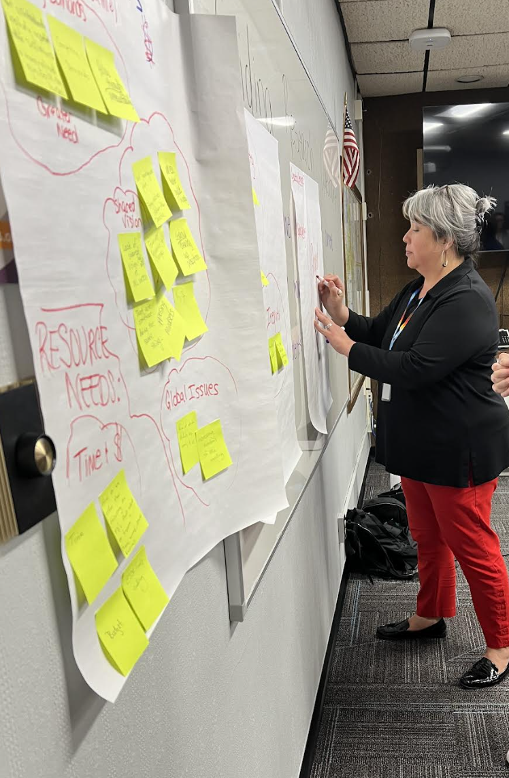
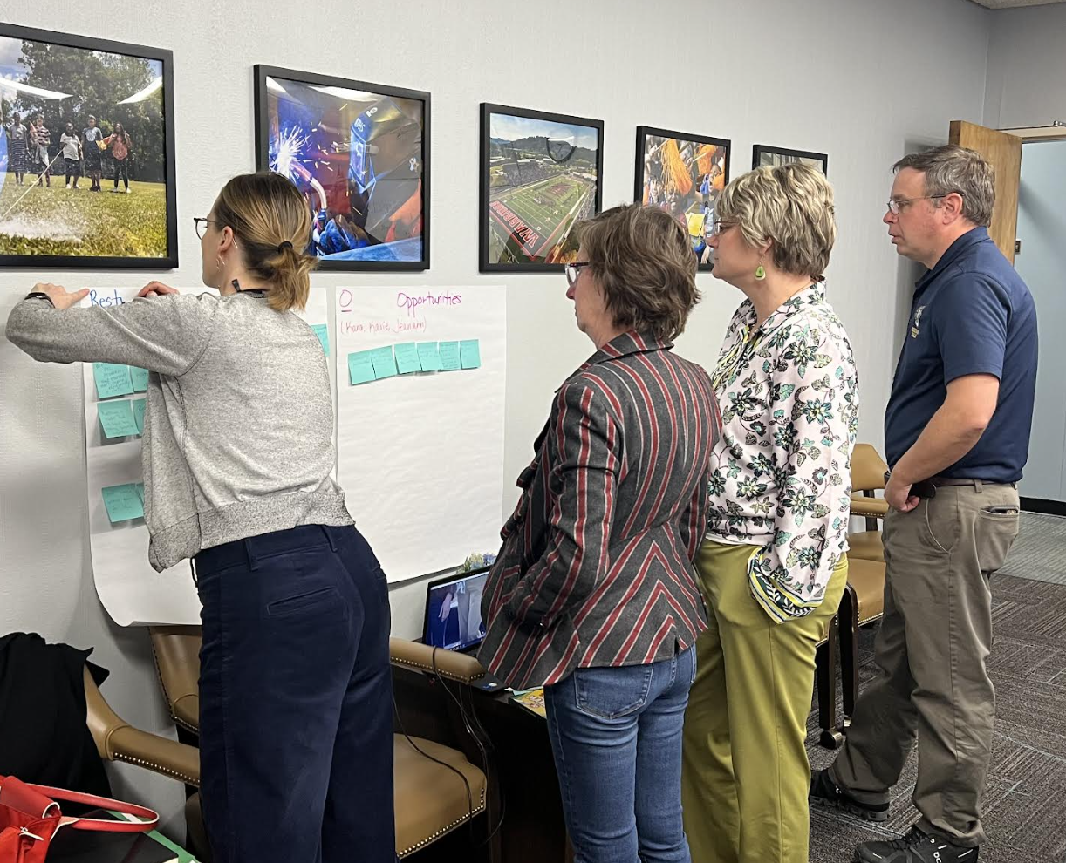
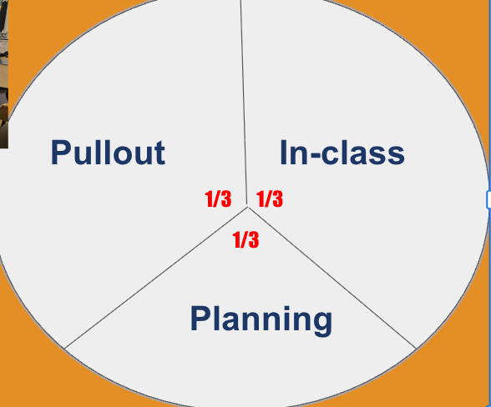
ESL Program Restructuring Timeline
Began ESL Program Evaluation
“Theory of Change” Work
RTI International conducted an ESL program evaluation in response to the rapid increase in ML numbers.
2020-2021
2024-2026
2019-2020
2023-2024
Restructured the ESL teacher’s role
District ML Action Team Created
School-Wide ML Plans developed
Teacher Certification Training
Sheltered and Co-teaching Classes
Project GLAD and SIOP Trainings
ML Parent Events at all Schools
Collaboration with Core Instruction (K-6)
ESL Teachers/Tutors funded

Slide 16
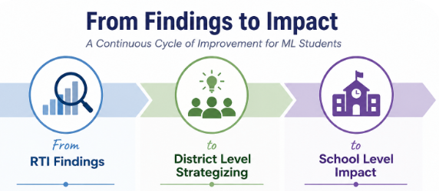

Slide 17
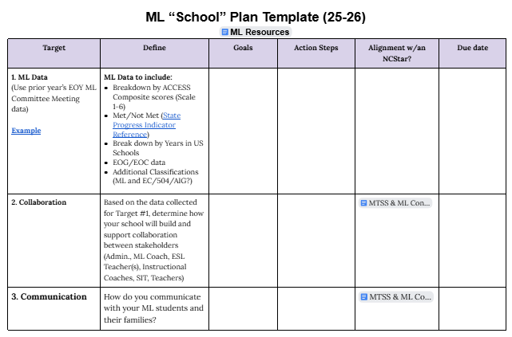

Slide 18
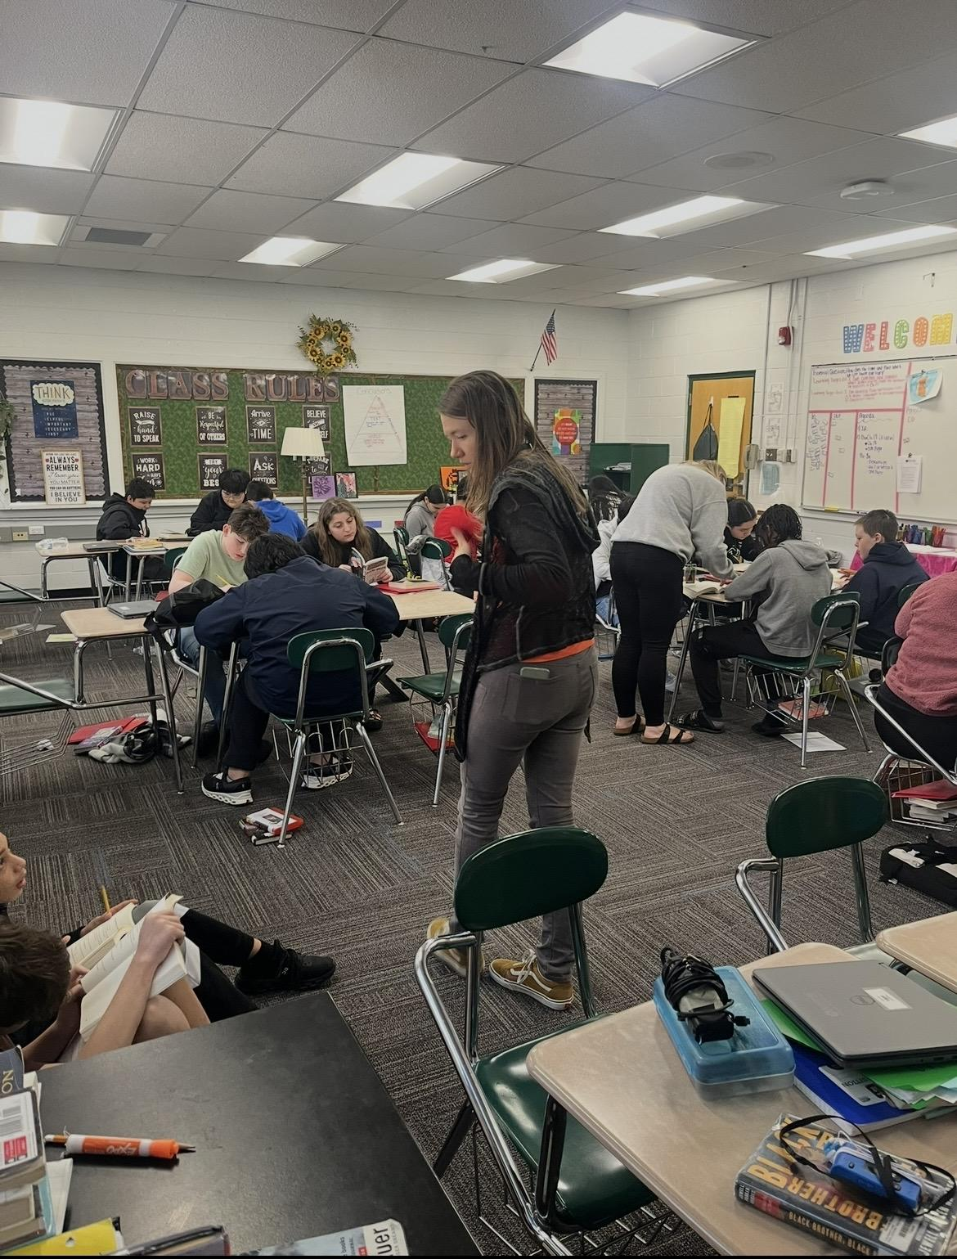
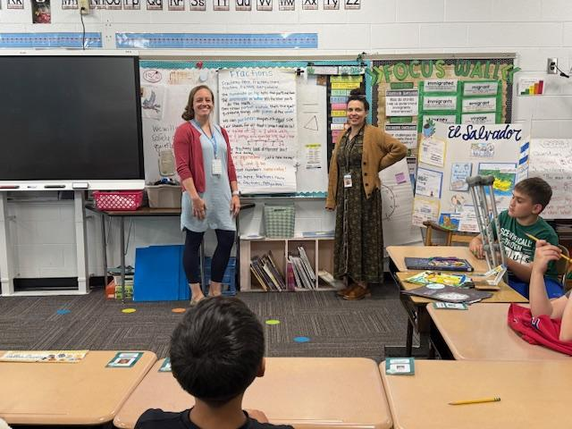
Digging Into DATA Improves Student Learning
Matching the Service Model to Student Needs (ESL Classes/Co-Teaching/Sheltered Instruction)
Supporting the Core
Goal Setting
Notes:
Meeting Instructional Needs:
Secondary - Adoption & Implementation of ESL Curriculum (Newcomer to Advanced)
Continued support of K-6 ELA Curriculum in ESL Classes in addition to Newcomer classes
Ensuring a Student Centered Service Model - From Pull-out model to “Peace Sign”
ESL Classes
Sheltered Instruction
Co-Teaching
Building Teacher Capacity to Improve Student Outcomes - GLAD, SIOP, & Language Acquisition

Slide 19
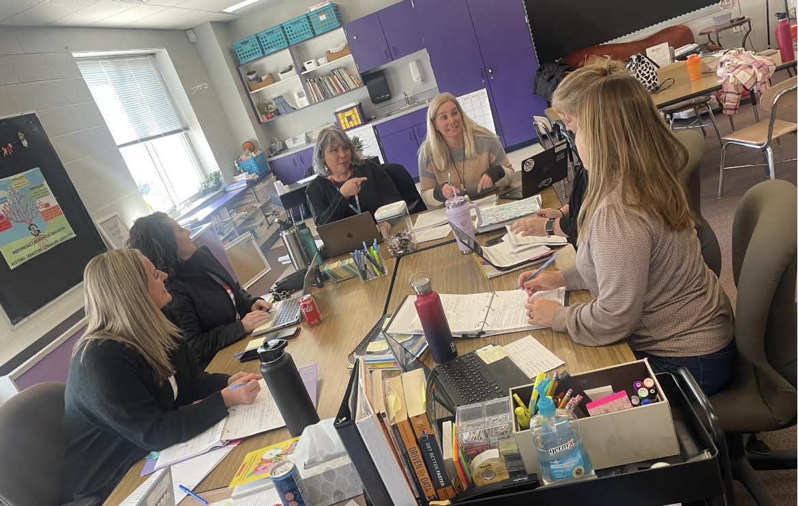
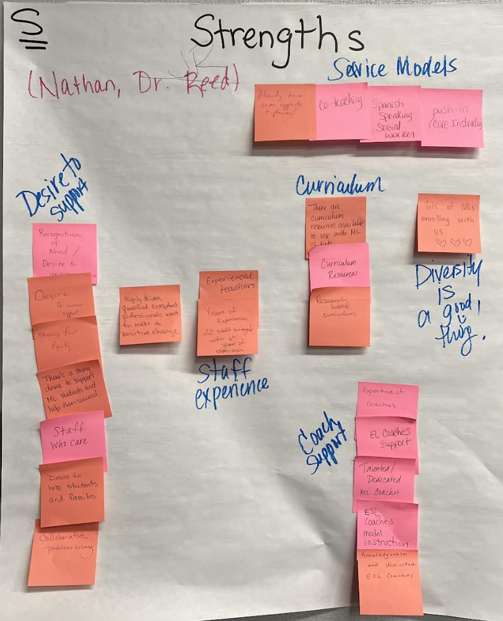
COLLABORATING Improves Student Learning
District ML Action Team Meetings
Strategic Partnerships within BCS
Inclusion of ESL Coaches and Teachers
in Professional Learning Communities, MTSS, SIT and other school level committees
Notes:
Internal:
District ML Action Team Meetings - Associate Superintendent, Principals, APs, C & I, ML Coaches, Core & ESL Teacher
Strategic Partnerships within BCS - ML Coaches collaborate with C & I Team, Instructional Coaches, Title 1 Leads, Literacy Focus Team, & Federal Programs Team on a monthly basis
District ML Parent Meetings
March 2025 - Over 100 ML parents representing all six districts
February 2026 - ML PAC Meeting
September 2026 - New to BCS ML Parent Meeting
Community Based
District ML Parent Meetings - Organized by ESL Teacher - site based support from MEP & Community Organizations (UNETE, United Way)

Slide 20
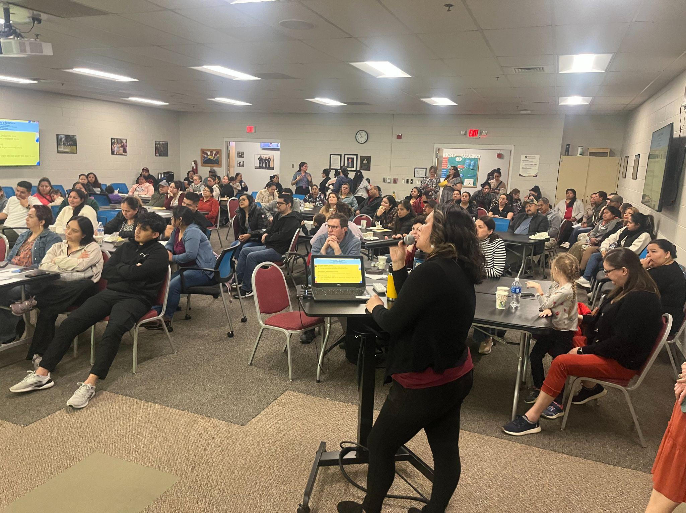
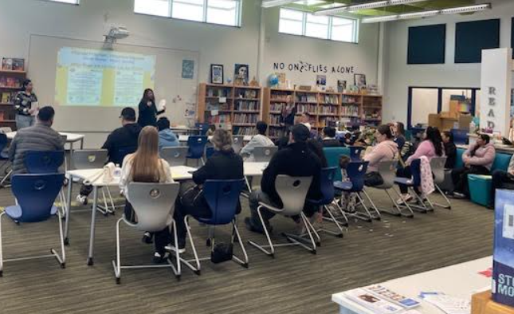
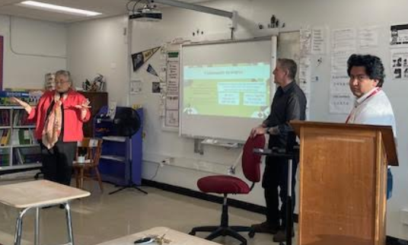
COMMUNICATION Improves Student Learning
District ML Parent Meetings
School Based ML Parent Meetings
Community Groups
Notes:
District ML Parent Meetings
March 2025 - Over 100 ML parents representing all six districts
February 2026 - ML PAC Meeting
September 2026 - New to BCS ML Parent Meeting
Community Based
District ML Parent Meetings - Organized by ESL Teacher - site based support from MEP & Community Organizations (UNETE, United Way)

Slide 21
Student Improvement (Comparing 23-24 & 24-25)
122% increase in number of MLs that Exited
ACCESS
  ML Progress Indicator Met Designation increased from 28.1 to 32.4
Grade 3–8 Reading Proficiency - from 11.8 to 12.7
Grade 9–12 Proficiency - from 13.4 to 14.8
Notes:
District Level Funding Supported Teacher Training
130 BCS employees trained in SIOP (Sheltered Instruction Observation Protocol) last two years
650 teachers participated in ML Coaching (1:1, PLCs, large groups)
2 ML Coaches being trained as GLAD trainers
Funding of ESL Tutors resulted in increased service to Newcomers
BCS ML Coach on State Level MTSS Committee
Cycle of Continuous Improvement through ML School Plans

Slide 22

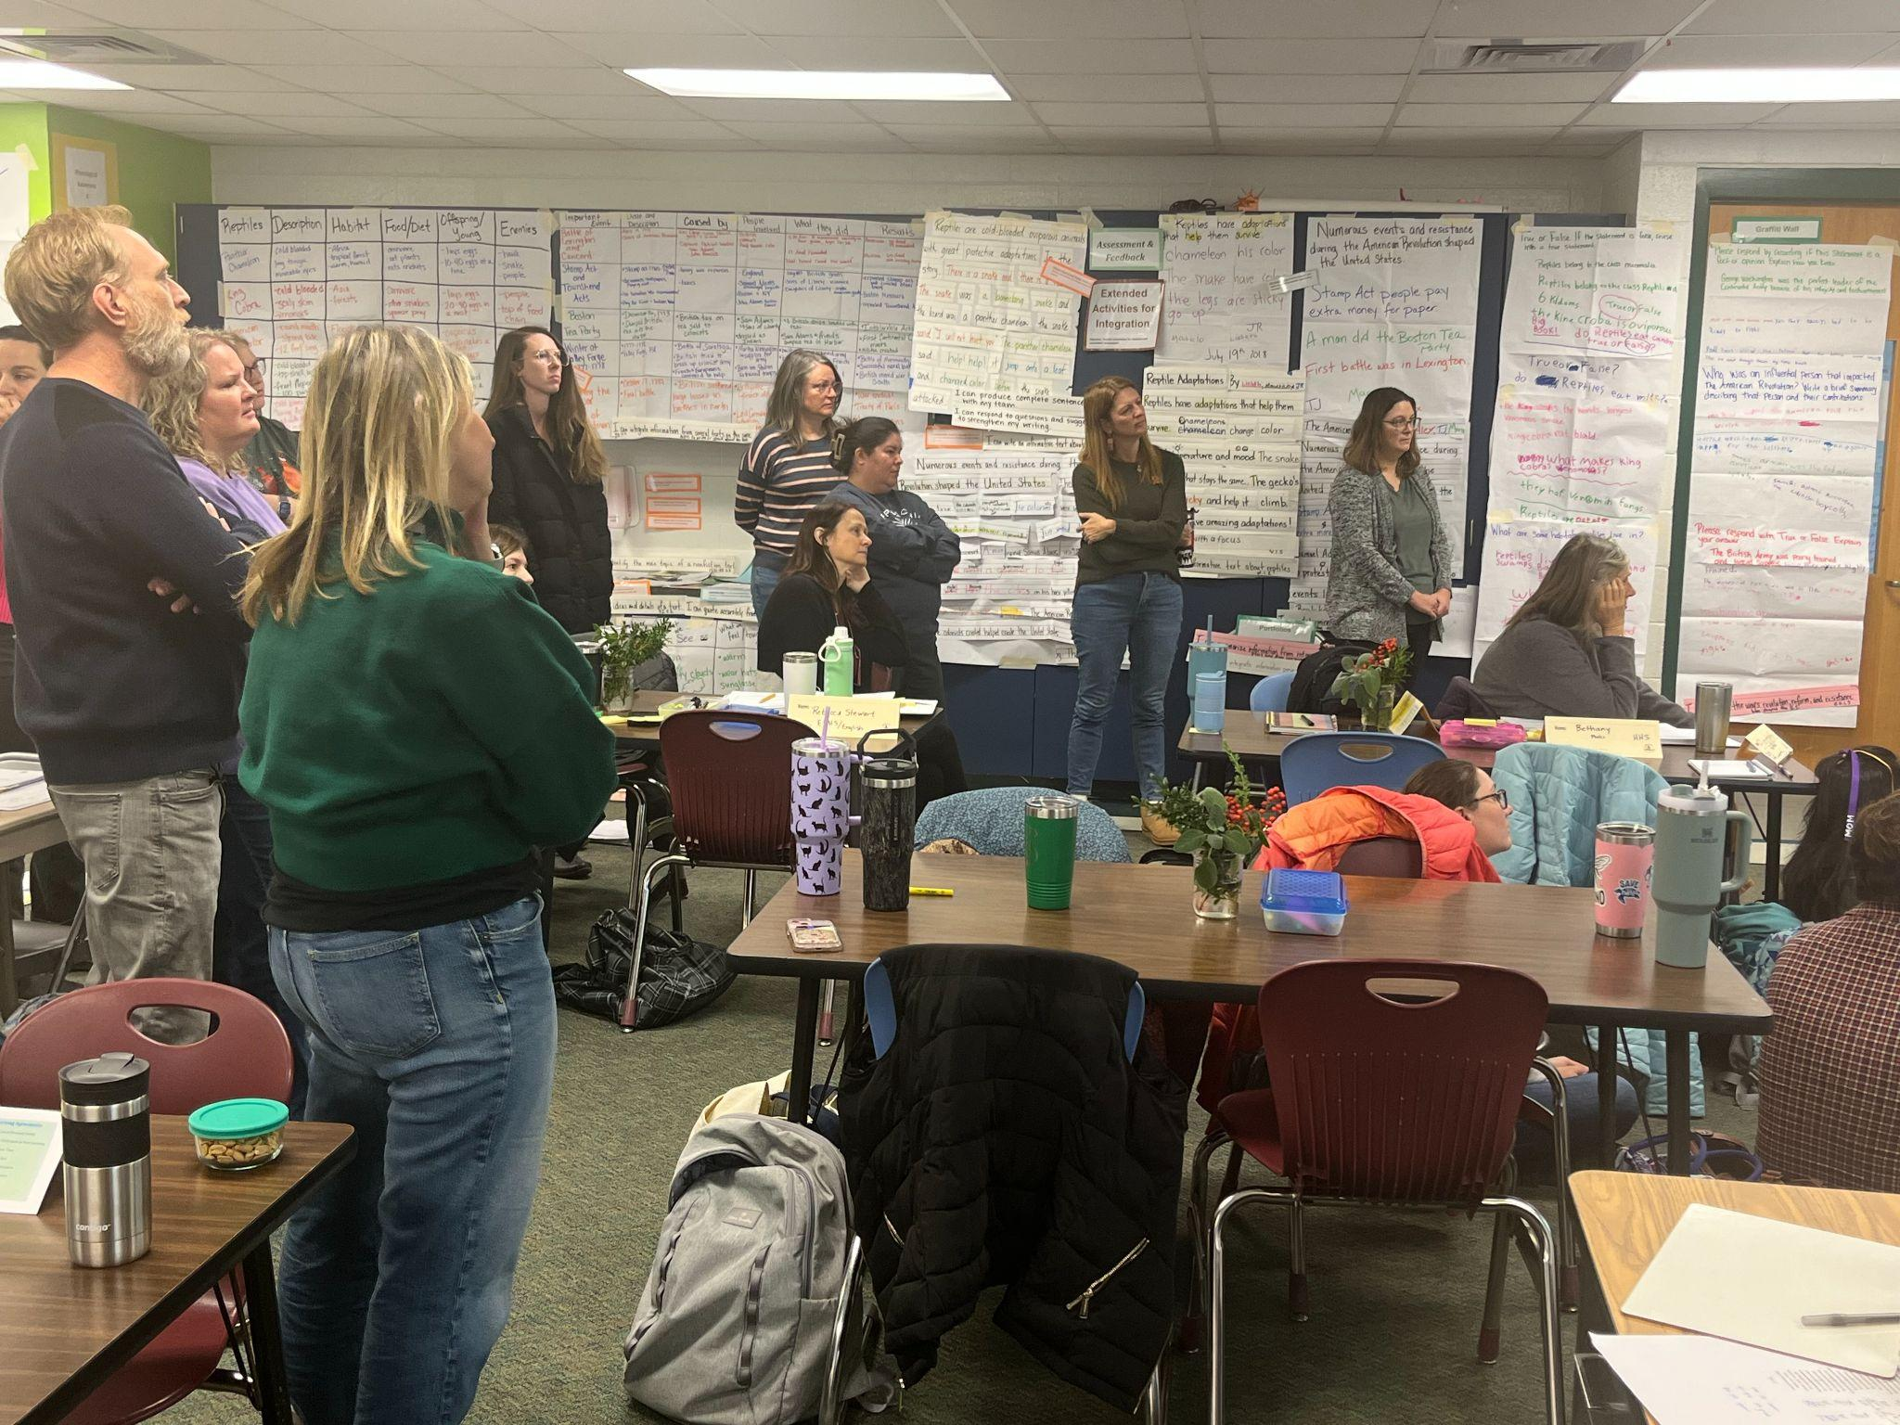
More to Celebrate!
BCS Involvement in
State Level MTSS Committee
District Level Funding has Supported:
ESL Tutors
GLAD Trainers
SIOP (Sheltered Instruction
Observation Protocol) Training
School Level work with ML Coaches

Slide 23
"Goals are good for setting a direction, but systems are best for making progress." — James Clear

