Slide 1
Wirt County Schools
Calendar Public Hearing
Academic Year 2026-2027

Slide 2
Things to consider…
WVBE Policy 3234
WV School Calendar Guidance
Office of Finance timelines
WVGSA/WVASA Windows

Slide 3
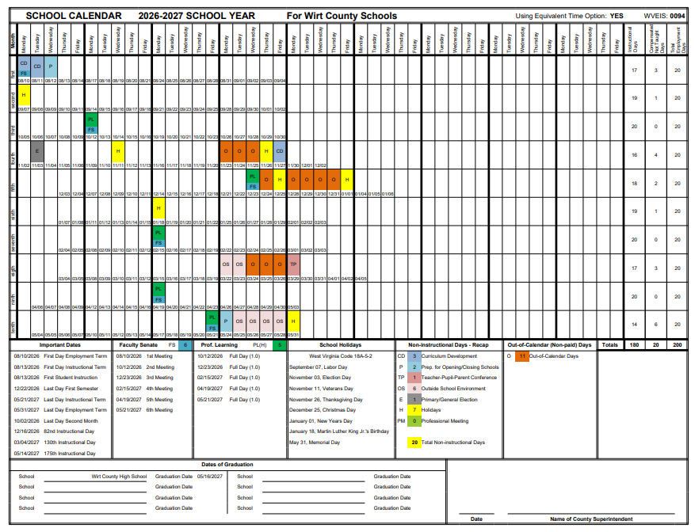
Version 1

Slide 4
Version 1
Starts 8/10 and Ends 5/31
1st Semester ends 12/22
OS days: 2 with breaks and 4 at the end
Graduation 5/14 or after (Sunday would be 5/16)
11 O days

Slide 5
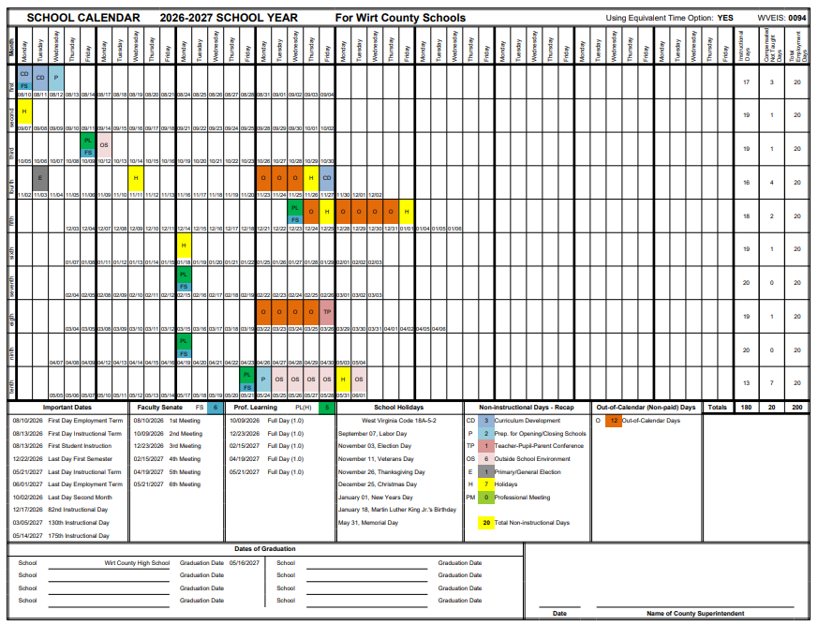
Version 2

Slide 6
Version 2
Starts 8/10 and Ends 6/1
1st Semester ends 12/22
OS days: 1 with break and 5 at the end
Graduation 5/14 or after (Sunday would be 5/16)
12 O days

Slide 7
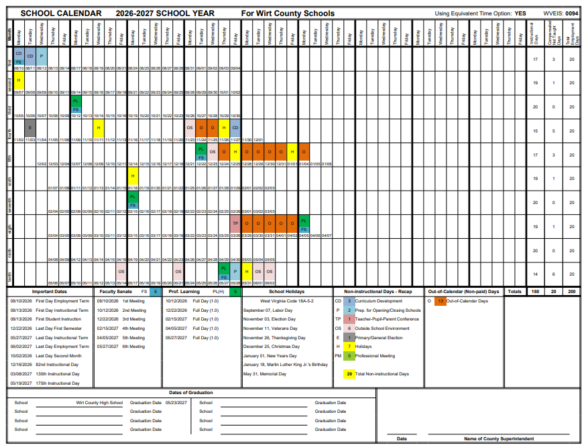
Version 3

Slide 8
Version 3
Starts 8/10 and Ends 6/2
1st Semester ends 12/22
OS days: 2 with breaks, 2 on Friday’s, and 2 at the end
Graduation 5/19 or after (Sunday would be 5/23)
13 O days

Slide 9
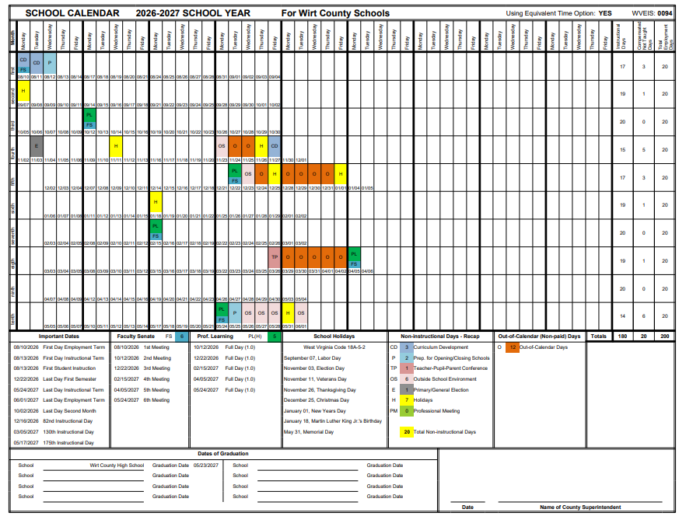
Version 4

Slide 10
Version 4
Starts 8/10 and Ends 6/1
1st Semester ends 12/22
OS days: 2 with breaks and 4 at the end
Graduation 5/17 or after (Sunday would be 5/23)
12 O days

Slide 11
Questions

