Slide 1

School Year 2026-2027
McNulty Elementary School Continuation Plan
Working Together for Student Success
A Message from Principal Tina O'Brien

Slide 2
Demonstrable Improvement Indicators (DIIs)
Demonstrable Improvement Indicators (DIIs) are specific, measurable performance targets set by the New York State Education Department (NYSED) to track school progress and ensure continuous growth.
CORE SUBJECTS
INSTRUCTION
CULTURE & CLIMATE
Teaching Practice
Evaluating classroom decisions, curriculum implementation, and embedded professional development.
Academic Growth
Measurable targets on state and local assessments to ensure all students reach proficiency (26/27 school Year)
Local Indicators
Building a safe, supportive environment and driving strong attendance outcomes.
ELA DII Target
87.4%
Teacher Practice & Decisions DII
Local Indicator 1:
Social Emotional Learning & Climate
Math DII
92.6%
DTSDE Alignment
• Tenet 3: Curriculum Dev
• Tenet 4: Teacher Practice
• Walkthrough Audits
Local Indicator 2:
Walkthroughs & PD
87.1%
June Absenteeism Goal (from 42%)
30%
Science DII Target

Slide 3
Plan Overview & Key Pillars
The McNulty Elementary Continuation Plan outlines our strategic roadmap to ensure academic excellence, foster student engagement, and build strong community partnerships.
PILLAR 1
PILLAR 2
PILLAR 3
Targeted Growth & Attendance
Addressing chronic absenteeism by building strong school-to-home communication and establishing proactive family support systems.
Active Learning Vision
Fostering vibrant classroom environments centered on clear teacher expectations, high student engagement, and foundational literacy.
Core Classroom Strategies
Emphasizing academic discourse and productive struggle to build resilience, critical thinking, and deeper conceptual understanding.
Notes:
Additional coaching has been put into place, more time with teachers in their extra instructional time, embedded support for classroom and tier 1 instruction.

Slide 4
Key Areas for Growth
Our school community is built on dedicated staff, active programs, and a caring environment. To better serve our learners, we are focusing on key areas for growth.
Our Greatest Challenge
42% Our goal for June 2027 is 30%
Chronic Absenteeism Rate
We are focusing on improving consistent daily attendance to support student success.
Academic Priorities
Academically, we are working to strengthen foundational literacy skills, math problem-solving, and critical thinking.
School-to-Home Communication
We recognize the need for clearer, more consistent communication to ensure every family is informed and engaged in their child's success.
Notes:
Small wins: We had 36% come to open house in 2025 and we had 37% for 2026. PTA meeting we had 3 out of total people were families last year in September. 2026 we had 9 out of 18 of families come in September.

Slide 5
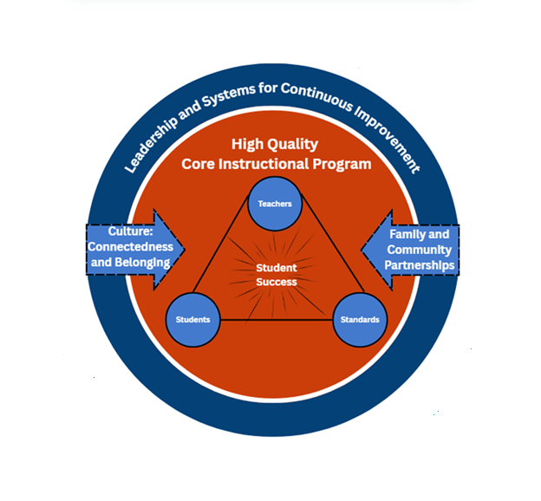
Classroom Vision & Active Learning
In every McNulty classroom, we expect vibrant, active learning.
Teacher Expectations
Teachers clearly communicate learning goals, model thinking, and frequently check for understanding while providing timely, specific feedback to help students grow.
Student Engagement
Students actively talk through ideas, explain their thinking using academic language, and work collaboratively in pairs or groups.
Our Ultimate Goal
We want our students to take pride in their growth, ask higher-level questions, and confidently tackle challenging tasks to reach their full potential.
Continuous Improvement Framework

Slide 6

Core Classroom Strategies
STRATEGY 1
Academic Discourse
STRATEGY 2
Productive Struggle
Increasing Student Talking & Explanation
Classrooms will actively prioritize structured academic discussions among peers to boost student engagement and comprehension.
Key Implementation Elements:
"Accountable Talk" Stems: Guiding students to articulate and justify their thinking clearly.
Flexible Group Seating: Arranging spaces to foster collaborative peer dialogue.
Supporting Independent Thinking
Allowing students to attempt challenging tasks independently and work through problems before receiving direct teacher assistance.
Student Process Steps:
1. Attempt complex challenges independently.
2. Think through problems & explain work.
Builds student resilience, independent thinking, and deeper conceptual understanding.
Notes:
Small groups are happening in the classrooms to hone in on student needs. We are working on strengthening our tier 1 instruction with common language and professional development.

Slide 7
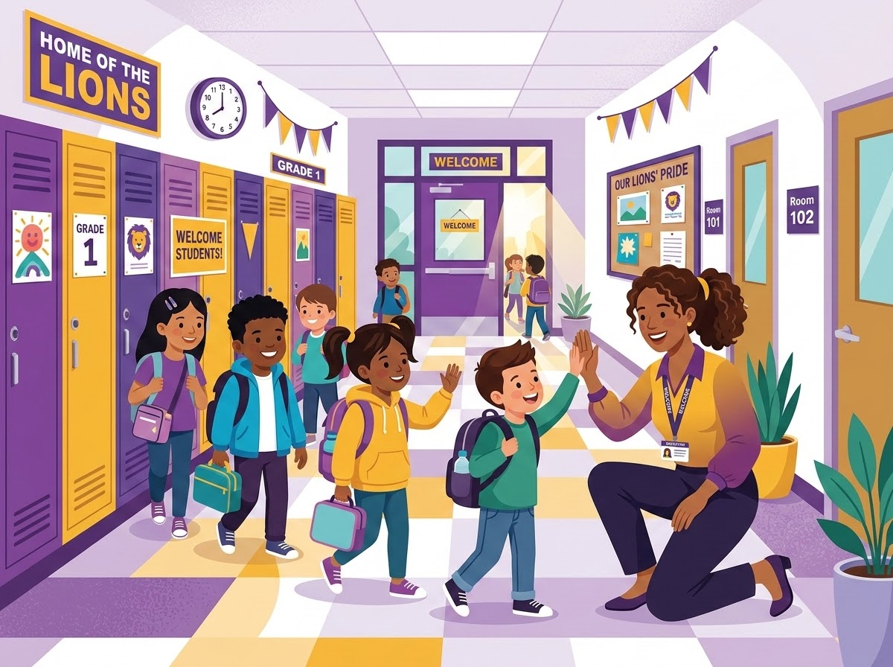
Building a Culture of Attendance & Belonging
Tiered Attendance Support
Our multi-tiered support model provides targeted, individualized help for families to remove barriers and ensure regular school attendance.
Relationship-Based Routines
Every day starts with intentional connection, featuring structured morning meetings and consistent adult check-ins to build trust.
Celebrating Growth & Jumpers
We publicly recognize attendance progress and celebrate "threshold jumpers" to foster pride, encouragement, and community spirit.
"Consistent attendance is vital for learning. Every child deserves a welcoming environment where they feel valued."
Notes:
Making our morning meetings with students meaningful. Having late slips have a positive message about we are so happy that students are here.

Slide 8

Deepening Family & Community Partnerships
Student-Led Academic Events
Our Family Engagement Team will coordinate quarterly student-led academic and social events to celebrate student achievements together and deepen our school community ties.
Multilingual Outreach
We are systematizing routines for multilingual, multimodal communication. Beyond ParentSquare, our Family Liaison leads outreach via translated paper flyers and phone banks for clear, accessible invites.
Inclusive Celebrations & Shared Resources
Committed to ensuring every family feels included and supported through meaningful events, direct engagement, and multi-channel communication across our school community.

Slide 9

Get Involved in Our Community
Your partnership is essential to our students' success. Here is how you can get involved:
Student Showcases: Attend our quarterly student-led showcases to see your child's learning in action.
Join Teams: Consider joining the Community Engagement Team (CET) or the PTA.
Daily Support: Help us track and support your child's daily attendance progress, and communicate with us using your preferred channels.
Questions or Want to Get Involved?
Please reach out to our Family Liaison or contact us directly:Dr. Rad nrad@gasd.org
Principal Tina O'Brien: tobrien@gasd.org

