Slide 1

State of the School District– Millersburg Area
Lee Christine Bzdil
January 23, 2025

Slide 2

Entry Plan Summary
Objective: Listen, Learn, and Observe:
Listen, observe, communicate
Work with the Administrative team & other stakeholder groups to gather and review key data
Analyze the data to highlight trends in strengths and needs
Focus priorities w/ action steps
Notes:
To review, the objective of my first few months on the job was to listen, observe, and learn about the key structures of the district as well as our strengths and needs. I meet regularly with the administrative team and met with various stakeholders to gather and review data which then becomes the basis of our action plan.

Slide 3

Part 1 – Analyze the Data
District climate staff survey
Millersburg community survey
Professional Development needs assessment
Curriculum Inventory/needs
New employee survey
High school student athletics survey – May ‘24
High school student survey – May ‘24
Attendance and discipline reports
Financial data
Achievement/Test scores
Comprehensive plan
Notes from observations, communications, and meetings
Notes:
Here is a listing of much of the data that was gathered and reviewed. I asked administrators to develop several surveys to gather anecdotal data, I looked at attendance and discipline data, financial information, and student achievement/performance data.

Slide 4
School District Climate Staff Survey:
72 Respondents
“Communication has gotten so much better compared to last year.”
“…Problems have been taken care of right away instead of being pushed to the side. People are treated professionally and the overall mental health and well being of the faculty is improving. The leadership has changed and the whole dynamic has changed in a positive way. Thank you!!!!”
“We have a large number of teachers who are dedicated to knowing their students as individuals… I believe our current admin team is working toward fostering a community focused on comradery and support…
“Overall, I feel things are much improved from the past few years. Again, I truly thank you for the new leadership and that is the key to continued growth and success in the future! Our voices and concerns are heard, and we are all working together to help our students!
Strengths of our district’s climate:
New Administrators
Family feel (relationships w/ students & staff)
Community involvement
A lot of activities including band, sports, & archery
Small size
Traditions
Solid education
Great students
Caring staff
PTO
Notes:
So, the first survey was of staff related to the climate/morale of the district. As you can see, we had 72 respondents and here is a list of the identified strengths of the district with some quotes.
Read list then highlight many comments on improved communication and addressing problems head on.

Slide 5
School District Climate Staff Survey: 72 R
“Listen to the experience of veteran staff… More instructional time, not less. We need to make learning more engaging. We expect too much of building level administrators… which prevents them from getting into classrooms, hallways, and lunch periods where their presence is vital.”
“Special education services and processes. Admin in the special education department don't seem to work with the teachers. Neighboring districts have co-op, building trades, agriculture, family and consumer sciences, we are very lacking.”
“More students are coming to school with greater needs. We need more positions. Special Education is a major area of concern. New faculty and staff need to be trained on how to appropriately handle situations. We need to continue to make wise financial decisions to best suit the District's needs.”
“Communication between buildings. Consistency between buildings. Discipline. Recognizing that all subjects are important not just those that are tested.”
Needs of our district’s climate:
More staff
Improved communication
Improve middle school café behavior
High school schedule
Course offerings
Policy improvement
Morale and respect
Collaboration between regular and special education teachers
Technology support & wifi reliability
More support for Admin which will enable better support to staff
More consistent discipline/consequences
Time for Teaming
Staff retention initiatives
More teacher input into decisions
Improve organization
Notes:
Within the same staff survey, numerous challenges were identified related to the district’s culture or morale.
Read list. Staff comments focused on improvements for special education, more training for staff and a desire for consistency across buildings. “These are needs I have observed as well. It was a challenging and seemingly unstable start to the year with three new principals working together and separately to develop goals/initiatives for their buildings along with a new Superintendent.”

Slide 6
School District Climate Staff Survey
“Millersburg is working to get kids back from CCA. Millersburg needs to really think outside the box in terms of how to off-set the appeal of CCA to our students. First and foremost, we need to give them back the classes that they enjoyed most when they were here: shop, automotive, architecture, metals, home ec classes, etc... Then we need to re-think how our on-line academy can compete more with CCA. Maybe we should re-purpose some teachers to be on-line, live, teachers for the district academy. Also, I believe that we should market Millersburg School District, just like CCA markets themselves - Give the kids and parents that "FOMO" feeling (Fear of Missing Out).”
“I feel that this year started filled with chaos and uncertainty, we had new schedules, new admin, new building, new programs, and not much input or preparation.”
Notes:
I really appreciated this response suggesting that we need to think outside of the box to market our Online academy to compete with outside cyber programs. Survey responses from early October foreshadowed the work that Mr. Garcia has been doing with the Online Academy.

Slide 7
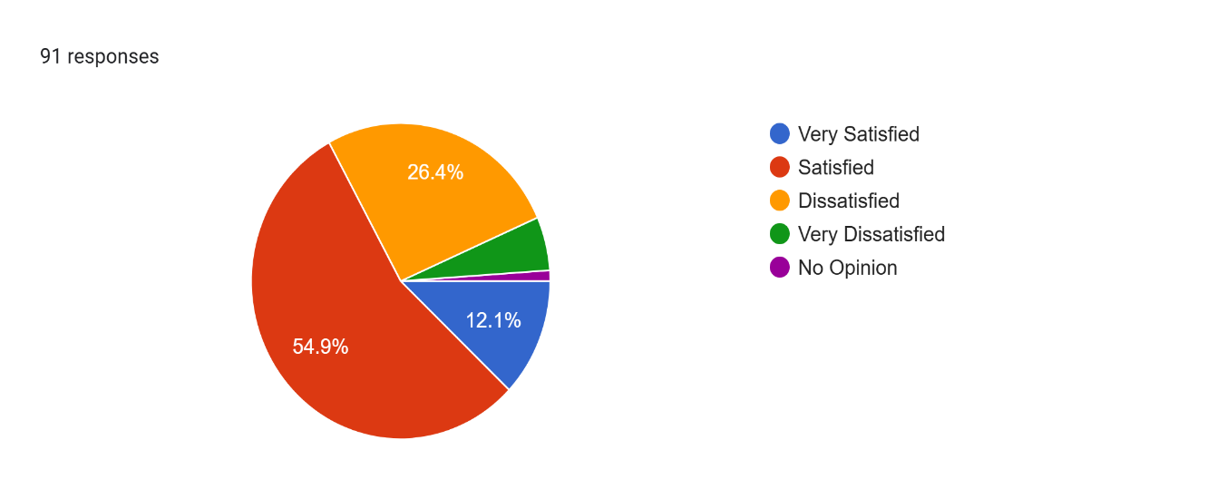
Millersburg Community Survey:
91 Respondents
Best qualities of MASD:
Select staff
Small size/community feel
District supports the community
Staff live and work here
Variety of sport/club offerings
Willingness to take feedback/input
Relationships focused
New leadership
Traditions & school spirit
Attempts to address student mental health needs
Scholarship opportunities
The district is the hub of the community
Caring teachers and support to staff
Alumni involvement
Inclusive special education services
New gifted coach
One campus
Music department
Safety
Emphasis on character & community building
New Elementary building
Focus on social/emotional well being
How satisfied are you with the overall quality of the Millersburg ASD?
Notes:
The next survey was sent out to all parents and other community members to gauge their opinions on the district’s current operations. You can see that we had 91 respondents and 67% of them noted being either satisfied or very satisfied with the overall quality of the district. I’ve also listed the responses of the best qualities of the district. Read 3 from list, and so on. Pause

Slide 8
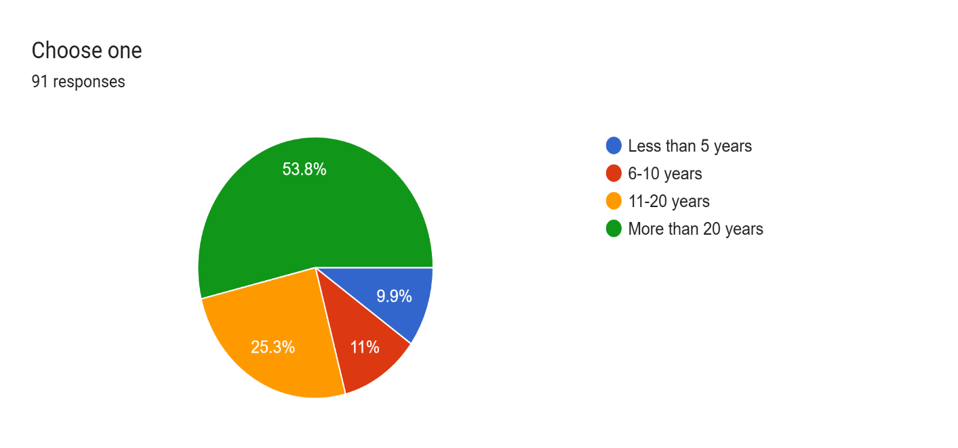
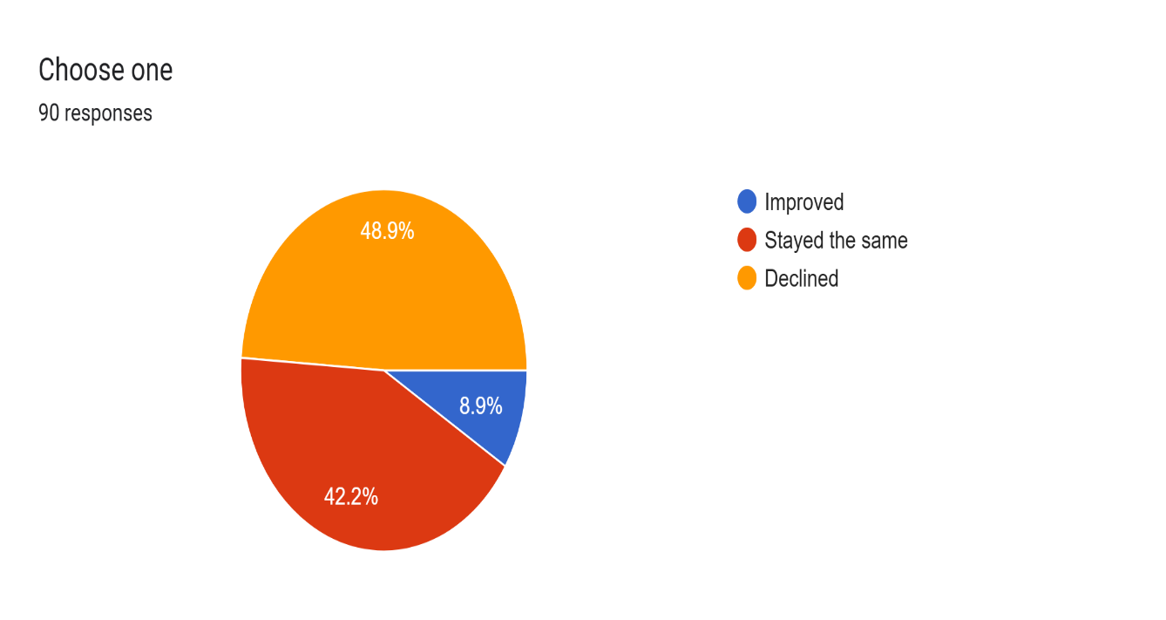
Millersburg Community Survey: 91 Respondents
For how long have you lived in the district?
During the time you have lived here, do you think the quality of education has improved, stayed the same, or declined?
Notes:
This slide shows the length of time that respondents of this survey have lived in the district. You can see that 79% have been here for more than 10 years, and 90% have lived here for more than 6 years. During the time that respondents have lived in the district, only 8.9% feel that the quality of education has improved, while 48.9% believe it has declined. We know that work is needed for Millersburg to not only build back to the quality education of years past, but to catapult our school district to a new standard of excellence in education.

Slide 9
What are things about MASD that you would change?
Poor communication w/ parents
No football/ no more co-op sports
Handling of bullying behaviors
Administration
Not a DC Tech member district
Poor attitudes
Secondary schedules
Return of Shop and Home Ec.
More academic rigor
Less online learning in class
Sports nutrition for athletes
Improve social/emotional learning
Improve Gifted Ed
Improve technology support
Less required credits
Need for innovation
Lack of consistency in staff and Admin
Inadequate delivery of Spec Ed
Crossing guard
More electives
Ability grouping
More co-op work opportunities
Better athletic facilities
Teacher accountability
Dual enrollment
Experiential learning
Improve notification about threats
Improve cleanliness of facilities
Notes:
Here is a lengthy list of suggested changes to be made, coming out of the community survey. Read a few and pause…

Slide 10
Professional Development Needs Survey: 62 Respondents
Top Needs: student engagement strategies, social emotional learning, classroom management, trauma-informed teaching, & curriculum work
Top Needs - technology: Microsoft suite, Google suite, Artificial Intelligence, SMART notebook/Epson tools
Other suggestions: co-teaching, First Aid/CPR, crisis management, observe other teachers, Aimsweb, safety - signs of drug use, social media threats, math and reading stations, child psychology, self regulation, integrating arts, grant writing, differentiation, stress management
Curriculum Materials Inventory
Major Need Areas
  Science
  Social Studies
  Strategic Intervention Package for reading and math K - 12
Notes:
Next, we conducted a Professional Development needs survey of staff. With 62 respondents, the top needs were: (read). Top needs specifc to technology training were (read).
We also conducted a curriculum inventory and found major needs for new science and social studies curriculum materials, as well as a K – 12 strategic intervention package for teaching/remediation of reading and math skills.

Slide 11

New Employee Survey: 6 Respondents
Four out of six employees feel valued and ranked MASD as a 5-star employer.
One employee’s current role does not align with the job as described to her.
Regarding appropriate training to perform the job, responses ranged from 2 – 5 stars.
Comments:
  -“I recommend that new staff meet weekly with their supervisor.”
  -“Two stars for training because my teacher has not directed/taught me how to manage behaviors.”
  -“I feel we’re on our way to greatness. One bite at a time. We just need to stay the course.”
Notes:
Another data tool surveyed newly hired staff on their experience coming into Millersburg. Of 6 respondents, 4 ranked Millersburg ASD as a 5 star employer. Multiple staff highlighted a need for further training. I appreciated the optimism of one respondent, “I feel we’re on our way to greatness, one bite at a time…” I agree!

Slide 12
HS Athletics survey: approx. 40 Respondents
Sample (players):
  Soccer – 17 Track - 4
  Archery – 4 Football - 3
  Baseball – 4 Golf - 3
  Basketball – 4 Band - 2
27.3% of athletes rated the overall experience as “excellent” while13.6% rated the experience “poor”.
29.5% of athletes ranked coaches as “excellent” related to support of the athlete while 11.4% ranked “poor” in support.
79.1% of athletes felt that their coach(es) effectively taught or enhanced their skill.
Notes:
Ms Sandusky shared data with me from two surveys conducted last spring among high school students. This one, related to extra curricular activities, had about 40 respondents. While you can see there was a similar split between positive and negative experiences and coach support, overall 79% of players felt that their coaches effectively taught or enhanced their skills. Other extracurricular data has been reviewed including player numbers over time, state of facilities, coaching, and the hiring process.

Slide 13
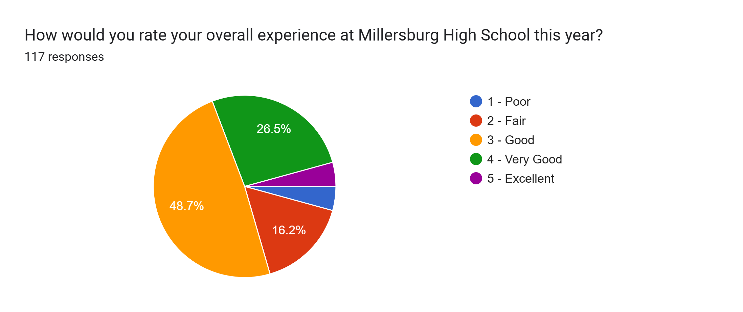
HS End of year survey (May 2024): 117 Respondents
Notes:
The 2nd survey of high school students that was conducted last spring looks at overall experience and support of high school students. Of 117 respondents, 48.7% rated their experience as good, with an additional 31% rating their overall experience at the high school as very good or excellent.

Slide 14
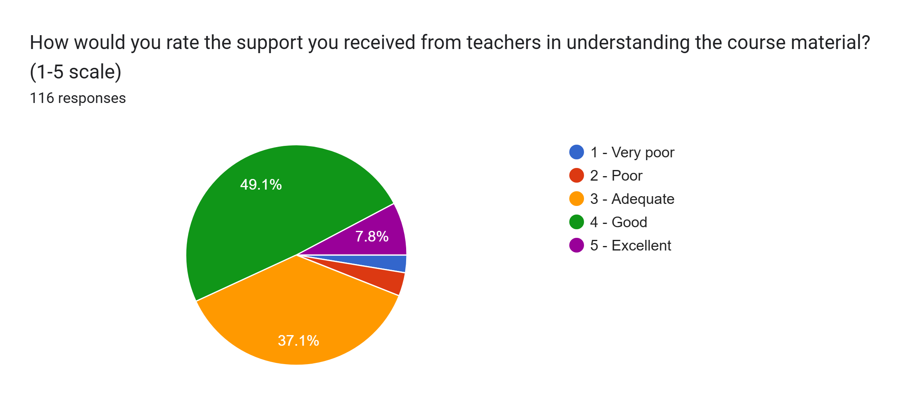
HS End of year survey (May 2024): 117 Respondents
Notes:
Here you see that 86% of students felt at least adequately supported by teachers in understanding content, last school year.

Slide 15
HS End of year survey (May 2024): 117 Respondents
How would you describe the overall culture and atmosphere of Millersburg HS?
Positive – 55, Negative – 23, neutral or idk - 9
  “I personally love our school and enjoy that because we are such a small school you can create a relationship with everyone and get to know everyone.”
  “The overall culture and atmosphere of Millersburg HS is very kind and fun to be around.”
  It’s not worst, but there is definitely a lot of room for improvement.”
  “We have a close school but our spirit lacks.”
  “It is okay. I don’t always feel comfortable in school because of some of the things that people say.”
  “Terrible.”
Notes:
55 students described the overall culture of the Millersburg HS specifically positively, while 23 students felt there was a negative atmosphere. Several students expanded on their ranking with statements like these – its ok, but there is room for growth. Others said the culture of the high school is good or fun and some others made statements like, it is lacking or terrible. We plan to survey students again this spring to see if there have been any changes in opinions and to drill down further into reasons students respond the way that they do.

Slide 16
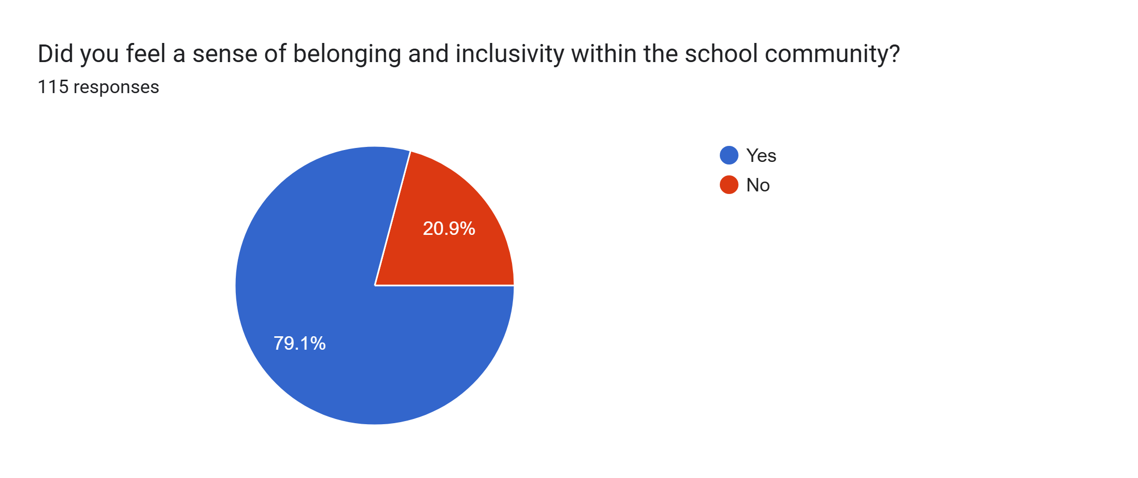
HS End of year survey (May 2024): 117 Respondents
Notes:
Here you see that the majority of students felt a sense of belonging at the high school last year. It will be important to understand why others did not. Ideally every single student should feel welcome and comfortable in their school setting for optimal learning to occur.

Slide 17
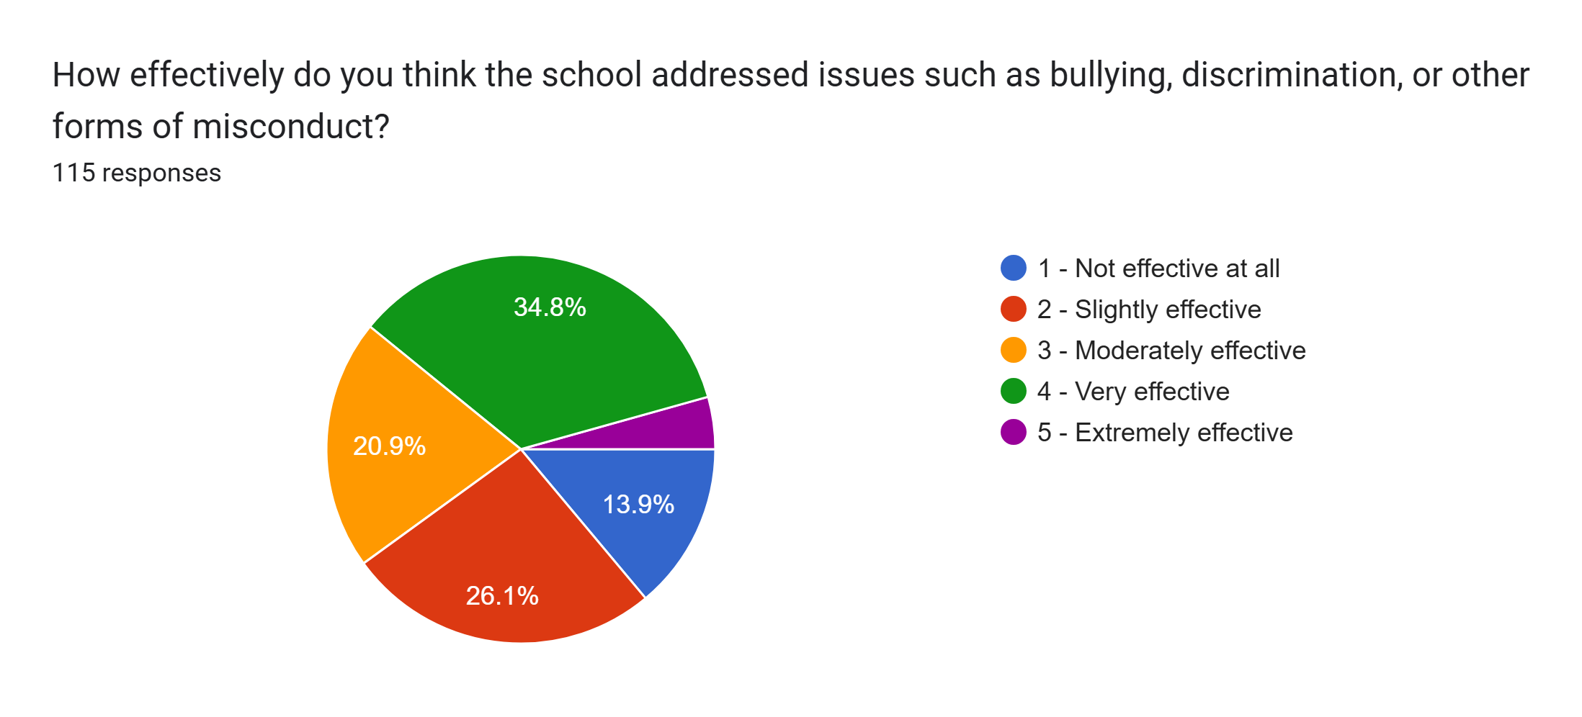
HS End of year survey (May 2024): 117 Respondents
Notes:
When asked how effectively students felt the high school addressed behaviors such as bullying or misconduct, students were relatively split across the board. However, the majority of respondents, about 60% felt that the issues were at least addressed with moderate efficacy.

Slide 18

Attendance & Discipline Data
Attendance:
 | 22-23 | 23-24 | 24-25
Elementary | 94.70% | 93% | 95%
Middle School | 94.20% | 95.10% | 93.80%
High School | 90.30% | 93.60% | 93.70%
Discipline:
 | 22-23 | 23-24 | 24-25
In-School Suspensions | 29 | 11 | 12
Out of School Suspensions | 13 | 3 | 10
Total Incidents | 42 | 14 | 22
Referrals to Law Enforcement | 2 | 4 | 4
Notes:
Another piece of data to consider in long term planning for the district is attendance. We have very good attendance rates overall. There are a few outlier truancy concerns that we are working to address.
Additionally, discipline data plays a role in strategic planning particularly for understanding the overall culture of the school district and morale of staff and students. From my experience we have minimal large scale discipline concerns of ISS, OSS, or referral to law enforcement. You may notice that our discipline data seems skewed with last year’s numbers. This may have been due in part changing building administrators and interim coverage. Numbers for the current school year to date seem to be trending like year 22-23.

Slide 19

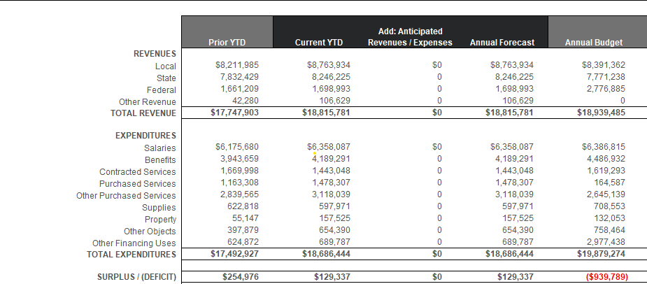
School Year 2023-24
2023-24
Actuals
In 2023-24, Revenues exceeded Expenditures by $129,337
Notes:
Here is the budget status report from the close of the 23-24 school year prior to my Superintendency. The year concluded with $129,337 to the good.

Slide 20
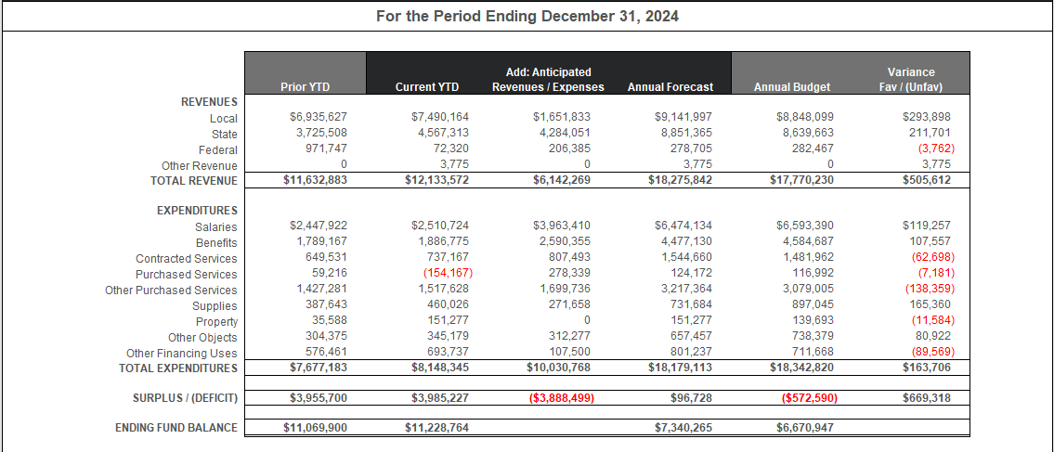
Actuals through 12-31-24 and 6 months of projected amounts based on historical trends
2024-25 end of year projection indicates revenues will exceed expenditures by $96,728 (please note this is a projection only at this point)
Notes:
And for comparison, here is the projected budget status for the close of this school year. I share this basic financial information to note that business and fiscal operations of the district are always in the forefront of long range planning. We are projected to close this school year positively.

Slide 21
Comprehensive Plan Work
Strengths:
  Millersburg High School's Keystone ELA Proficient/Advanced percentage equals 84.1 %
  Millersburg High School's 5-Year Graduation Cohort Score is 96.5%
  Over a three-year period (2020/21 school year through 2022/23) the elementary school's third, fourth and fifth grades math scores were in the first or second quartile of performance, as compared to all school districts in the state (Exception:2021-22 fifth grade math scores were in the third quartile)
  Over a three-year period (2020/21 school year through 2022/23) the middle school's eighth grade science scores were in the first or second quartile of performance, as compared to all school districts in the state.
Notes:
The Comprehensive Plan required of each school district, by the state, is used to develop long range goals and action steps. With our plan being due this spring, the work lends itself to the culmination of my data collection and action planning for the future of the school district. The next several slides show highlighted strengths and challenges of the district as well as goals, determined by the Comprehensive Plan Stakeholder committee. Much of this data is pulled from the same information that Mr. Lyter shared this evening.
Read slides.

Slide 22
Comprehensive Plan Work
Challenges:
  The high school's Keystone Algebra Percent Proficient or Advanced Score is 11.1 %.
  The middle school's PSSA Math Percent Proficient or Advanced Score is 26.1 %.
  The middle school's PSSA ELA Percent Proficient or Advanced Score is 45.9 %.
  Support schools in implementing evidence-based instructional strategies and programs to ensure all students have access to rigorous, standards-aligned instruction - emerging.

Slide 23
Comprehensive Plan Work
Goals:
  Given more instructional time at the mid level, a strategic intervention package, and focus on a standards aligned curriculum, Millersburg Area School District will raise Keystone Algebra scores to 65% proficient levels as demonstrated by the 2026-2027 school year scores.
  Given additional instructional time, a strategic intervention package, and a focus on a standards aligned curriculum Millersburg Area School District will improve performance, with 60% of students scoring proficient or advanced on Middle School level Math PSSAs as demonstrated in 2026-2027 scores.
Notes:
Within the Comprehensive Plan these two goals are separated into 4-5 separate areas. I have simply combined them here to be… read. So, the focus is on adding instructional time, aligning our curriculum to state standards, and implementation of a strategic intervention package for teaching and remediation of reading and math skills, K – 12.

Slide 24
Comprehensive Plan Work
Goals continued:
  Given more instructional time, a strategic intervention package, and a focus on a standards aligned curriculum Millersburg Area School District will improve Middle School ELA PSSA performance to at least 60% of students scoring proficient or advanced as demonstrated in the 2026-2027 school year scores.
Notes:
As you can see, the goals of the Comprehensive Plan focus primarily on need for growth in Keystone Algebra and Mid level Math and ELA.

Slide 25
Anecdotal Notes/Observations
Board member Perspectives
Administrator Perspectives
Borough/Community Engagement
Notes:
In addition to all of the formal data that has been collected and reviewed, I have gained valuable insight about the district and the wishes of the community from individual meetings and conversations with board members, the administrators, and various community and borough communications and engagements.

Slide 26

Part 2 – Goals & Action Steps
5 Goals:
Raise achievement
Decrease outside cyber enrollments
Improve Special Education continuum of supports
Improve extra-curricular programming
Improve District climate & culture
Notes:
During my entrance to Millersburg, these overarching themes were presented in conversations and expressed through components of the interview process.
My Superintendent evaluation rubric emphasizes 5 goal areas of district oversight including Business operations, Human Resources, Student learning & achievement, Climate & culture, and Communication & Engagement which serves as a complimentary overlay to the needs identified through this data review and the Comprehensive plan.
I have kept these 5 goal areas at the forefront of my work and try to consider them every day in all of the work that we do. Then read them. I keep a slip of paper above my keyboard with these goals and were written and remain in the DO Conference room where we hold our Administration meetings.

Slide 27

General Strategies for Success
Lead efforts to collectively monitor student achievement through professional learning communities.
MTSS work, RE & SE teacher collaborative time, Admin team data reviews
Create a pervasive culture of achievement.
Working w/ our Principals and teachers to shift our mindset , raise expectations, & expect greatness at all levels from every student
Students need self-discipline, self-control, and confidence.
Setting norms, lunchroom procedures, involving staff and students in setting procedures, approval processes, establishing accountability measures
Collaborate with local businesses and organizations with common mission of student success.
Plans to work with administration on community engagement
Notes:
During my interview process I shared these general strategies for success (on the left) and I have noted to the right, initiatives that we put in place to carry out the strategies. As you can see, we have hit the ground running this year.

Slide 28
Goal: Raise Student Achievement
Increase instructional time in Middle School (24-25 SY)
Align all curriculum to state standards (complete by 25-26 SY)
Purchase new science, then social studies curriculum & provide staff training (25-26 SY)
Purchase K – 12 strategic intervention program for reading and math & provide staff training (25-26 SY)
Implement data teaming meetings & continued growth of our MTSS programs (24-25 SY)
Full implementation of Restorative Practices (25-26 SY)
Notes:
Let’s take a closer look at each identified goal and the pathway to achieve them. Read through.
RP is a framework in which staff and students are taught how to build and maintain positive relationships. The framework focuses on high levels of accountability and high support. Within RP, issues and behaviors are addressed head on, supporting a positive inclusive culture in which students can thrive. Our plans to implement RP next school year will include all staff training, practice of key skills and ongoing coaching, as well as a behavior matrix that aligns with our code of conduct and a restorative space where students and staff can process community harm.

Slide 29
Goal: Decrease Outside Cyber Enrollments
Employment of full-time Online Academy Coordinator (24-25 SY)
Create an online community (24-25 SY)
Streamline procedures and practices (ongoing)
Innovate – seeking a platform with live instruction (24-25 SY)
Offer high quality support, i.e. home visits, provide academic support in person (ongoing)
Implementation of Work-based learning program (25 – 26 SY)

Slide 30
Goal: Improve Special Education
Implementation of a Special Education Procedure Manual with accountability system to maintain compliance (24-25 SY)
Provide timely communication, planning, and feedback to staff (ongoing)
Realign administration of the department (24-25 SY)
Provide regular and special education staff training on meeting needs of diverse learners (25-26 SY)
Provide paraprofessional training (25-26 SY)
Purchase K-12 Strategic Intervention Packages for reading and math (25-26 SY)
Recruit highly qualified staff with expertise with particular populations (24-25 SY - ongoing)
Notes:
Note co-teaching.
Last bullet – Speech and Autism. Would like to employ our own school psychologist and reduce the cost of our purchased services. Return students to district programming by creating a robust continuum of supports in house.

Slide 31
Goal: Improve Extracurricular programming
Co-op sports committee (24-25 SY - ongoing)
Provide coach training in Restorative Practices (25-26 SY)
Accountability for sportsmanship (ongoing)
Increased oversight of extracurricular activities (ongoing)
Review of music and arts programs and scheduling issues (24-25 SY)
Innovate/expand on program offerings including more arts (25-26 SY/ongoing)
Work with community to expand on rec leagues and build feeder programs (25-26 SY)
Notes:
Music and arts – look to bring in local artists or musicians, implement after school arts activities or clubs. Basically looking to be able to provide every opportunity possible to our students. If they can imagine it, we will work to provide it. Nurture minds and relationships through expanded extracurricular offerings.

Slide 32
Goal: Improve District Climate & Culture
Trauma-informed strategies for educators (1/17/25)
Big Brothers, Big Sisters mentor program (24- 25 SY)
Implement Move-up Day (24-25 SY)
Provide team building activities (25-26 SY)
Provide training to all staff in Restorative Practices (25-26 SY)
Full implementation of RP – Behavior Matrix & Restorative classroom (by 26-27 SY)
High accountability & high support for staff and students (ongoing)
Provide parent workshops (25-26 SY - ongoing)
Implement family involvement activities (25-26 SY - ongoing)
Partner w/ the Borough & Historical Society for service-learning projects (24-25 SY)

Slide 33
Part 3- Communication & Timeline
A synopsis of the process and findings will be shared with families and serve as a directional map.
The information including a call to action will be presented to the faculty and staff via faculty meetings, daily interactions, and a series of emails and Professional Development.

Slide 34

Remainder of 24-25 SY:
Utilizing Spec Ed supports & Curriculum work
Admin training - Restorative Practices leadership training
Summer ‘25:
Safe Crisis Management & Curriculum work
August ‘25:
Team building & Convocation
Restorative Practices (RP)
New curricular materials
Google & Microsoft training
Data work & Safety training
Remainder of 25-26 SY:
Data work, curriculum work, RP coaching, & training on differentiation strategies
Notes:
Here is a list of topics and planned Professional Development across 2 – 3 years. Note PCCD grant funds to cover summer teacher training and materials for SCM and RP.

Slide 35
Burn Bright Millersburg!
“Catch on fire with enthusiasm and people will come for miles to watch you burn!”
Notes:
I shared this quote at our convocation. I want people to talk about Millersburg ASD. I want people at the CAIU and neighboring districts to be struck by the magnitude of innovative and amazing work and the traction that we gain as a school district and community. I have a vision of Millersburg ASD burning so brightly that it can be seen from across the river, up and down Rts 15 and 147, to Tri-Valley and Perry County. I want every student and staff member to catch on fire with enthusiasm for who we are and what we do at Millersburg!

