Slide 1

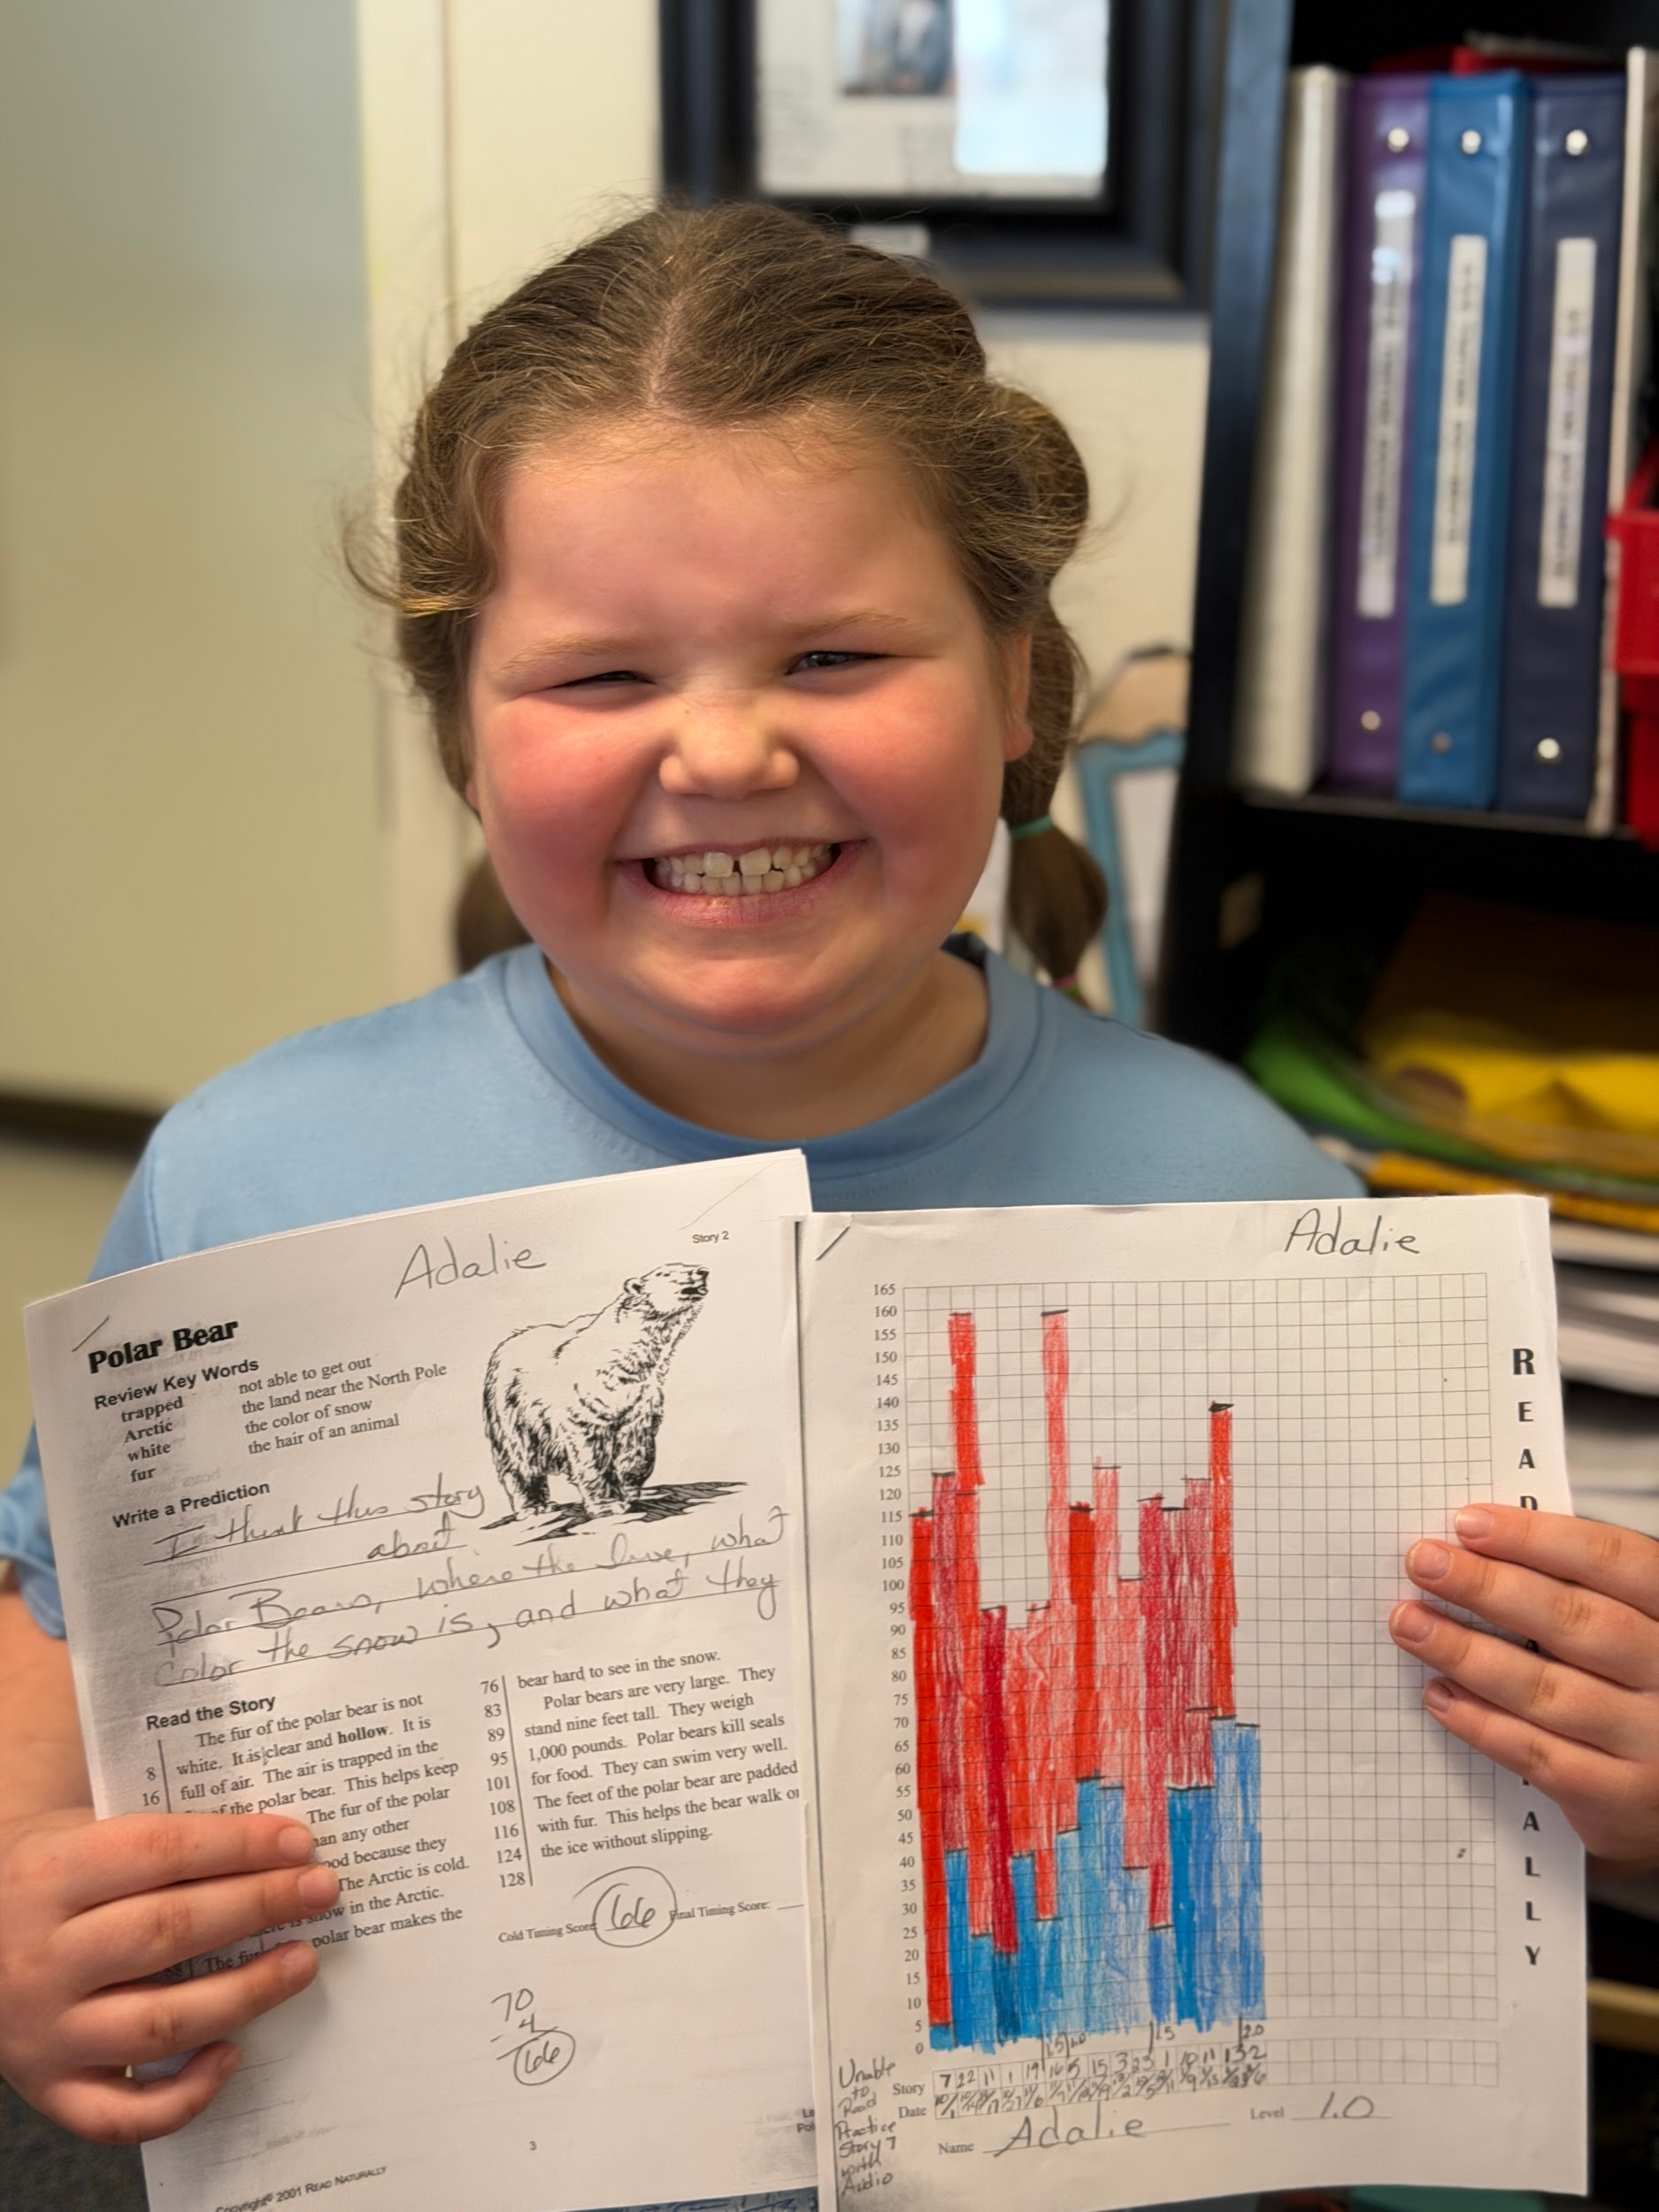
The Falcon News
Auger’s Accounts: Curiosity, community, and discovery in K/1
Thursday we celebrated a major milestone—the 100th day of school! The K/1 classroom was filled with excitement as students proudly brought in collections of 100 items, ranging from pom-poms and chenille stems to wooden shapes and beans. After exploring each other's collections and sharing observations, we worked on putting together their art pieces to showcase their creativity and celebrate this special number. Throughout the day, students rotated through nine interactive stations designed to bring the number 100 to life. Activities included reading 100 books together, building structures with 100 cups, matching numbers on a Hershey Kiss 100s chart, solving 100s chart puzzles, creating with 100 pattern blocks, flipping a coin 100 times and tracking the results, writing 100 words, rolling dice to race to 100, and constructing with 100 toothpicks and 100 playdough balls. The joy, focus, and stamina shown by our young learners were remarkable.
Our literacy work this week connected beautifully with the 100th day celebration as well as Groundhog Day!. We read several themed books, including Groundhog Day by Betsy Lewin, Rocket’s 100th Day of School by Tad Hills, The Night Before the 100th Day of School by Natasha Wing, Miss Bindergarten Celebrates the 100th Day of Kindergarten by Joseph Slate, and Jake’s 100th Day of School by Lester L. Laminack. We also read the Scholastic News article Home in a Hole, which supported our exploration of Groundhog Day and sparked lively discussion about animal habitats, hibernation, and whether spring is on the way.
In math, February’s Number Corner routines continue to highlight the magic of 100 while reinforcing key concepts through hands-on exploration. Students celebrated their 10th Decade Day by meeting the number 100 on our Number Path, practicing forward and backward counting, and solidifying the idea that 10 tens make one hundred. Computational fluency workouts will continue to help build mental math skills as students practice adding three or more numbers using strategies like making tens, using doubles or near doubles, and spotting friendly combinations. On the Calendar Grid, we’re exploring triangles and quadrilaterals—using geoboards to test for congruence and learning that orientation doesn’t change a shape’s identity. With our Calendar Collector, students spin numbers 1–10 and add Unifix cubes to a growing weekly collection, building understanding of tens and ones and preparing for regrouping work ahead. Meanwhile, our “Days in School” routine has expanded to a second 100-frame, offering continued opportunities to group and count by 5s, 10s, 25s, and 50s—foundational for strong number sense and place value. Across all these routines, students are practicing core concepts: making 10 in different ways, using doubles and near doubles, identifying and comparing 2D shapes, counting by groups, recognizing congruence, and adding with multiple addends.. February is off to a fantastic start, and our K/1 learners continue to impress us with their enthusiasm, perseverance, and joyful curiosity!
Feb. 6th, 2026
🌟 Student Spotlight 🌟
This is the smile of a proud gal and it’s not even because she’s this week’s Student Spotlight!
Adalie is beaming with pride because she has been putting in the time and effort, and is seeing improvement in her reading! She just got bumped up another level in Read Naturally because of all of her hard work!
Her growth mindset mantra is “You got this, you’ve got this.” She’s the first to tell you that her self talk is really nice and it helps.
The Principal’s Post:
Keeping you current with SVS news
Thank you to all the families who attended Parent-Teacher conferences. We are so proud of your students and love the opportunity to share what they have been working on with you. Together we can celebrate their successes and work together to help them grow.
We look forward to celebrating kindness in our school community with a Valentine’s swap on February 13th. Since Valentine’s Day is celebrated as a whole-school family, students are encouraged to bring valentines to share with all members of our school community.
Families are invited to join us for a FAMILY STEM Night on February 17th for an evening of hands-on learning, creativity, and fun. Pizza will be served at 5:00 and then at 5:30 we’ll transition into our STEM activities with WMSI (White Mountain Science Institute). We hope to see you there!

Slide 2
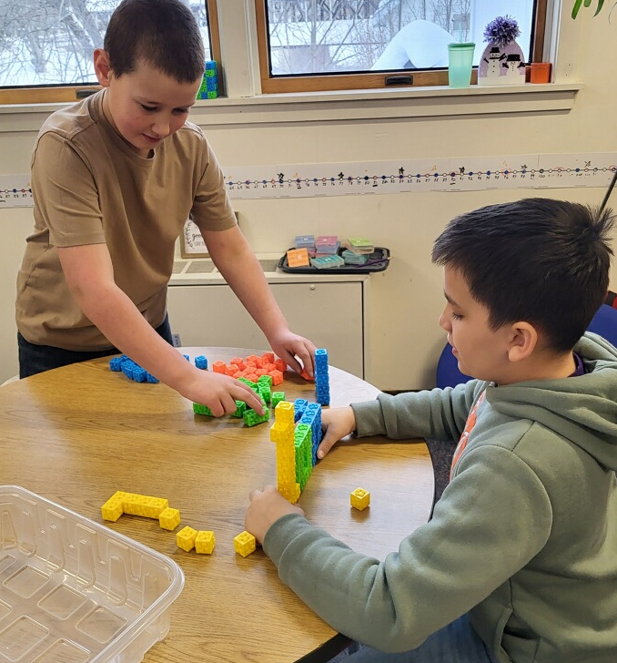
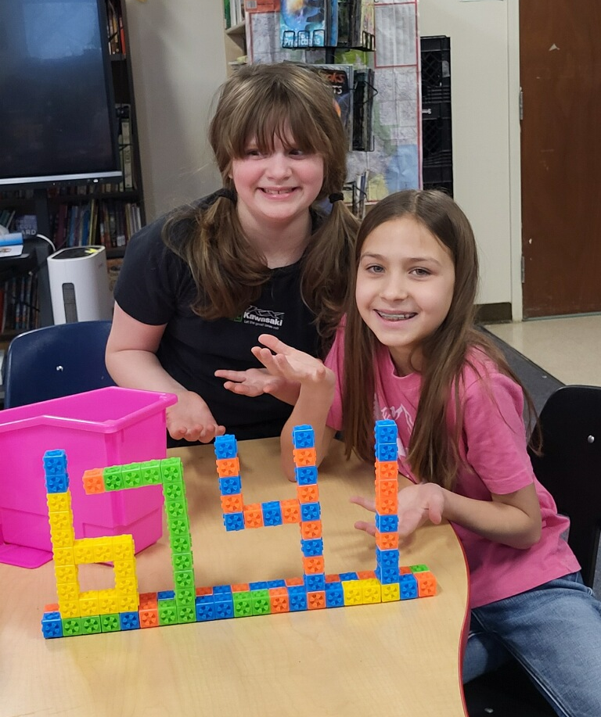
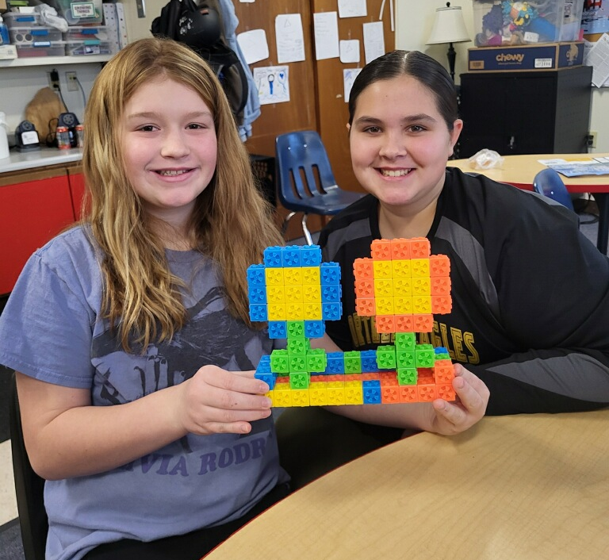
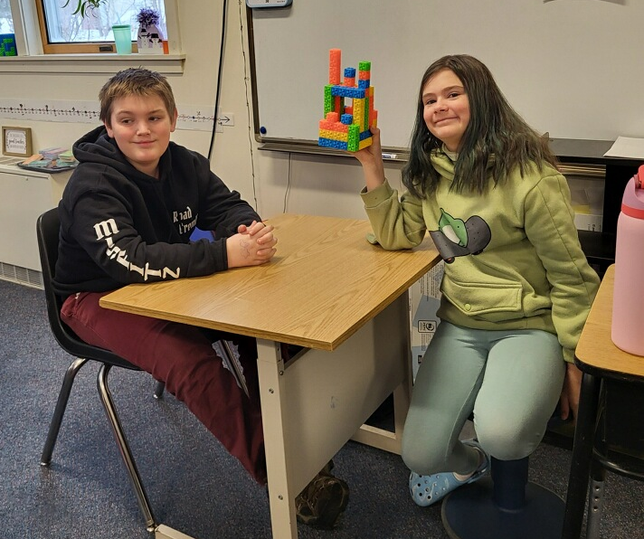

The Jewell Journal: News from ⅔
This week, our students jumped into the excitement of Season 3 of Steve Wyborney’s Leaping Numbers. Each day, the classroom transforms into a hub of mathematical mystery as students watch two new pattern videos to uncover the day's hidden number. They are diligently tracking these discoveries on their Mystery Pattern Catcher sheets, where a larger, secondary pattern is slowly beginning to reveal itself. The anticipation is building as everyone tries to be the first to solve the ultimate mystery by Day 21!
In science, we have been traveling back in time through our new unit on fossils. Students are discovering how fossils provide a unique window into the ancient animals and habitats of our planet. This week included an extra special "Show and Tell" bonus, where students got an up-close look at a massive piece of fossilized wood, authentic arrowheads, and a collection of rocks and minerals sourced from our very own Coos County, as well as Ohio, Arizona, and Oregon. Through a hands-on activity called Fossil Dig, students also used paper models to explore how layers of rock hold clues to the past, identifying traits that reveal what local environments looked like millions of years ago. We also stepped into the role of Dinosaur Detectives, analyzing fossil data to help paleoartists create accurate drawings by comparing prehistoric traits to those of modern animals.
The prehistoric fun continues into next week as we conclude the unit with a look at fossilized tracks. In an activity titled Outrunning CeeLo, students will measure their own running steps and compare them to a dinosaur's stride to see who would win a footrace. To wrap up all this excitement, our 2nd and 3rd graders are preparing for a major milestone this coming Monday. Following the high energy of our Stark Spark Sessions and our science explorations, we are thrilled to be celebrating the 102nd day of school!
Martin’s Media Wave: Updates from 4/5/6
4th, 5th and 6th graders have completed a research and writing project on United States Presidents. Each student chose one of the United States Presidents, carefully researched their President and wrote a five-paragraph essay covering their early life, their time in office and their lasting legacy.
6th grade math students continue working with bar diagrams, ratio tables, double number lines and equivalent ratios. 4th and 5th grades math involves both geometry and volume.
Our classroom is keeping an eye on the 2026 Winter Olympics which are being held in Milan and Cortina Italy from February 6th. through February 22nd. Students have read that the first Olympic Games began over 2000 years ago in Ancient Greece. The first Winter Olympics were held in 1924 in Chamonix, France. Now the Olympics are one of the biggest events in the world. Many countries send their best athletes to these games.
4th, 5th and 6th graders celebrated the 100th day in their classroom solving math equations and building interesting shapes from 100 blocks.
Riddle Me This!
What begins with T, finishes with T, and has T In it?
What am I? Answer in next issue!
Answer from last issue: Jolly Rancher

Slide 3
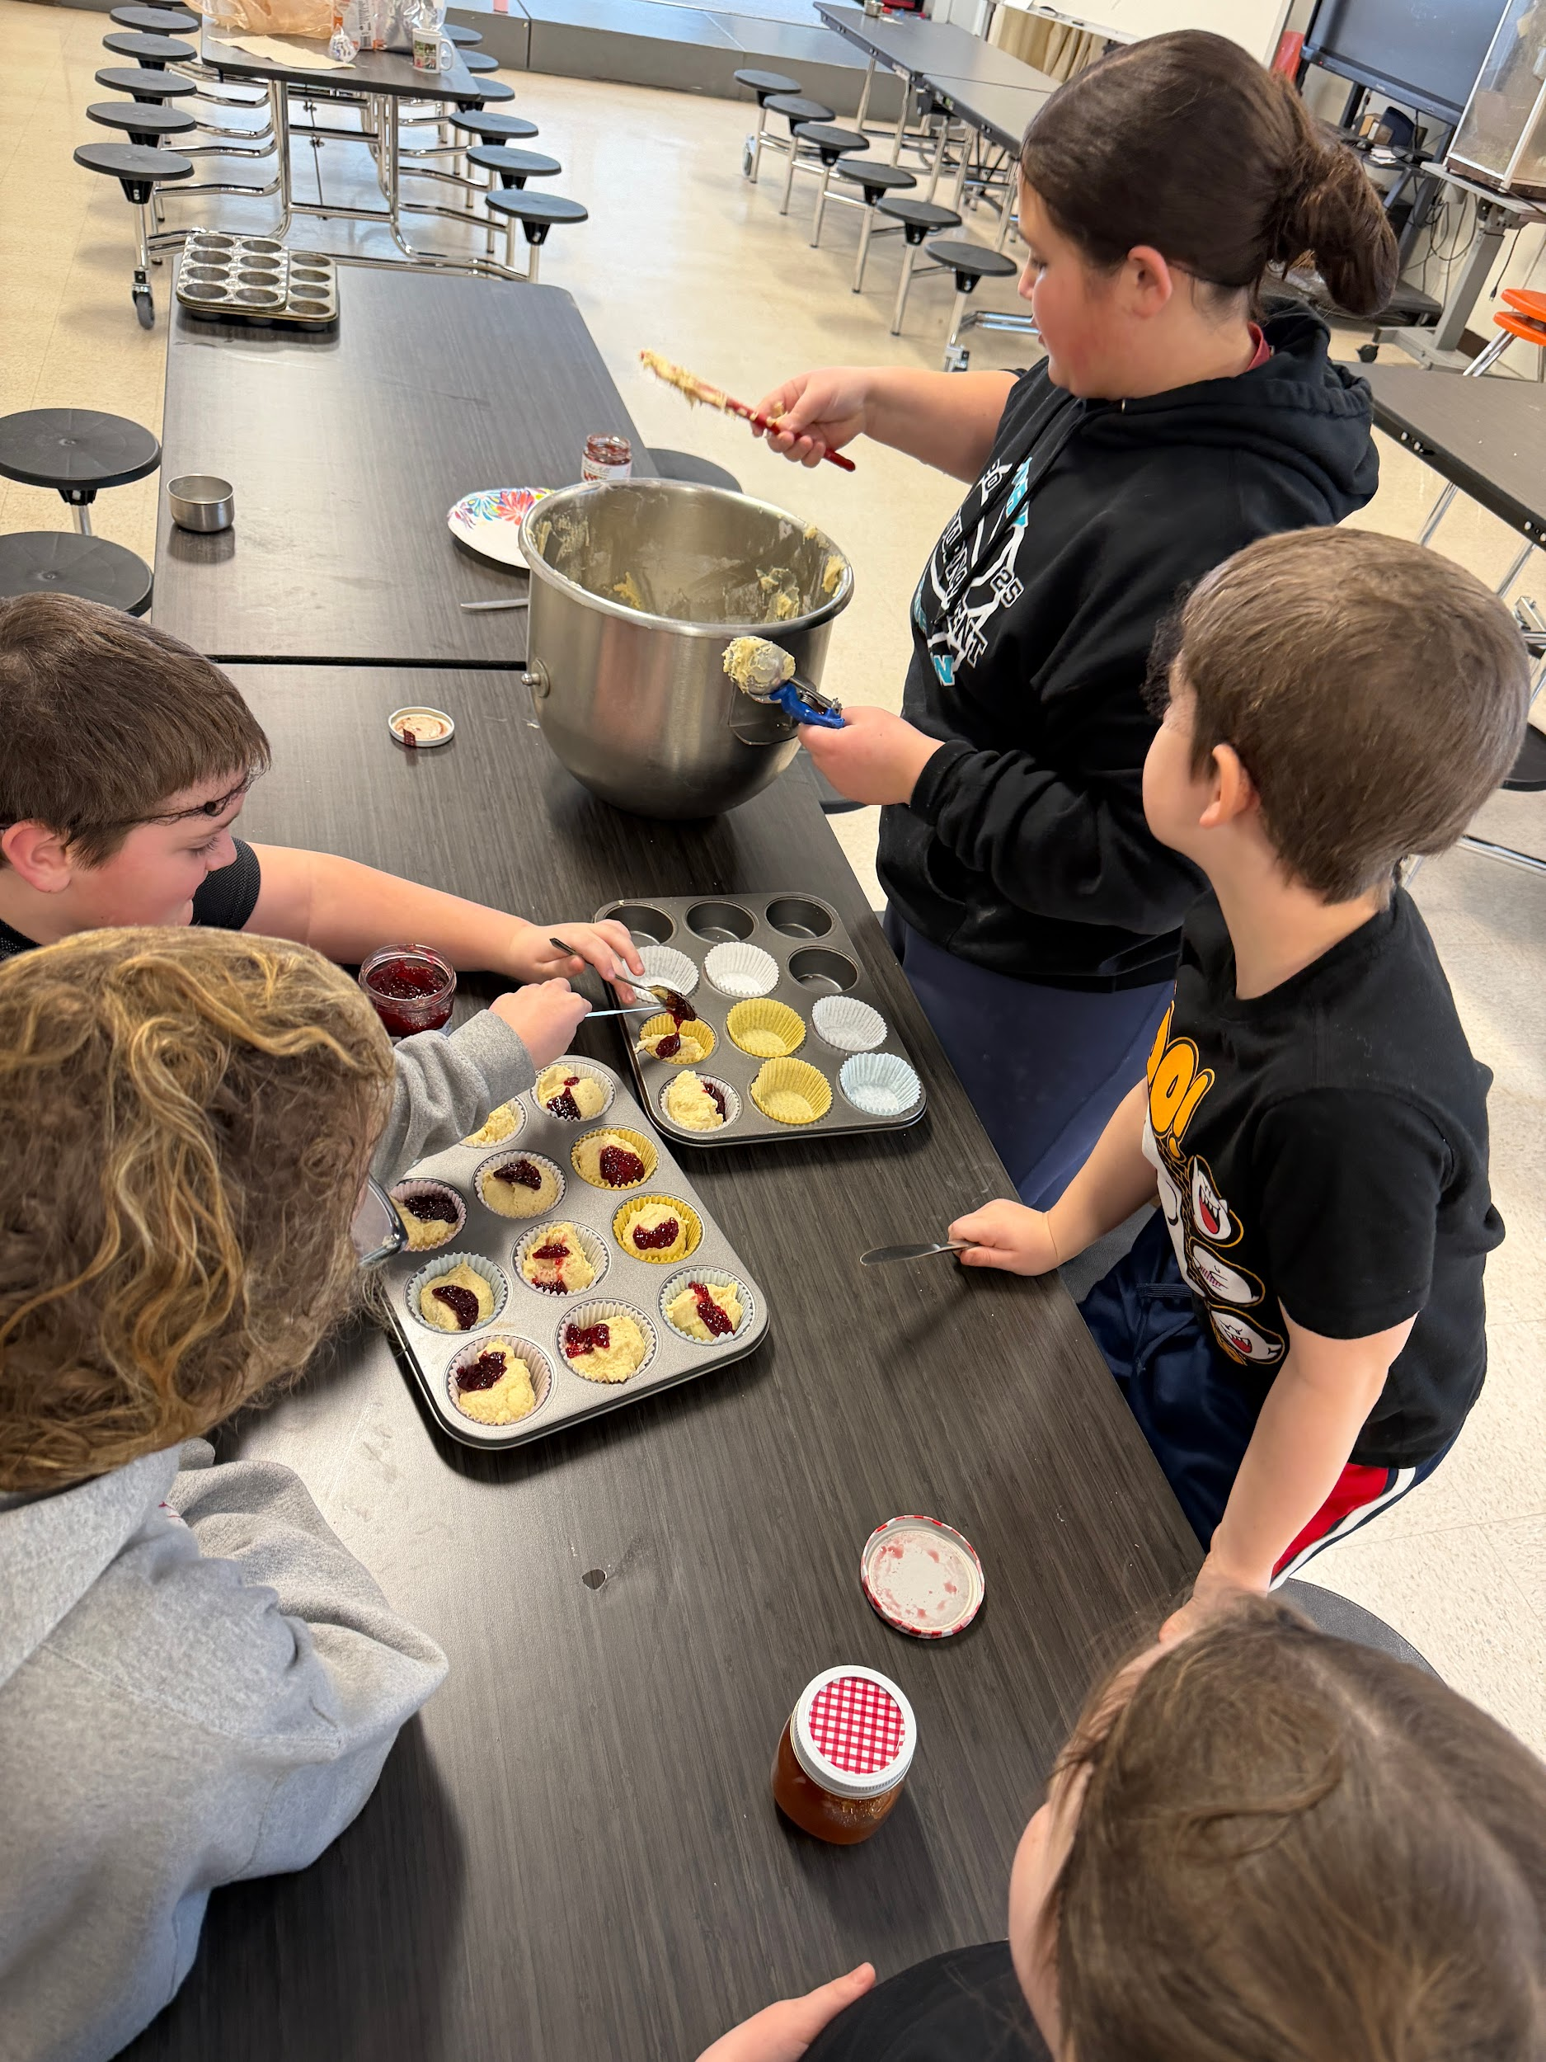
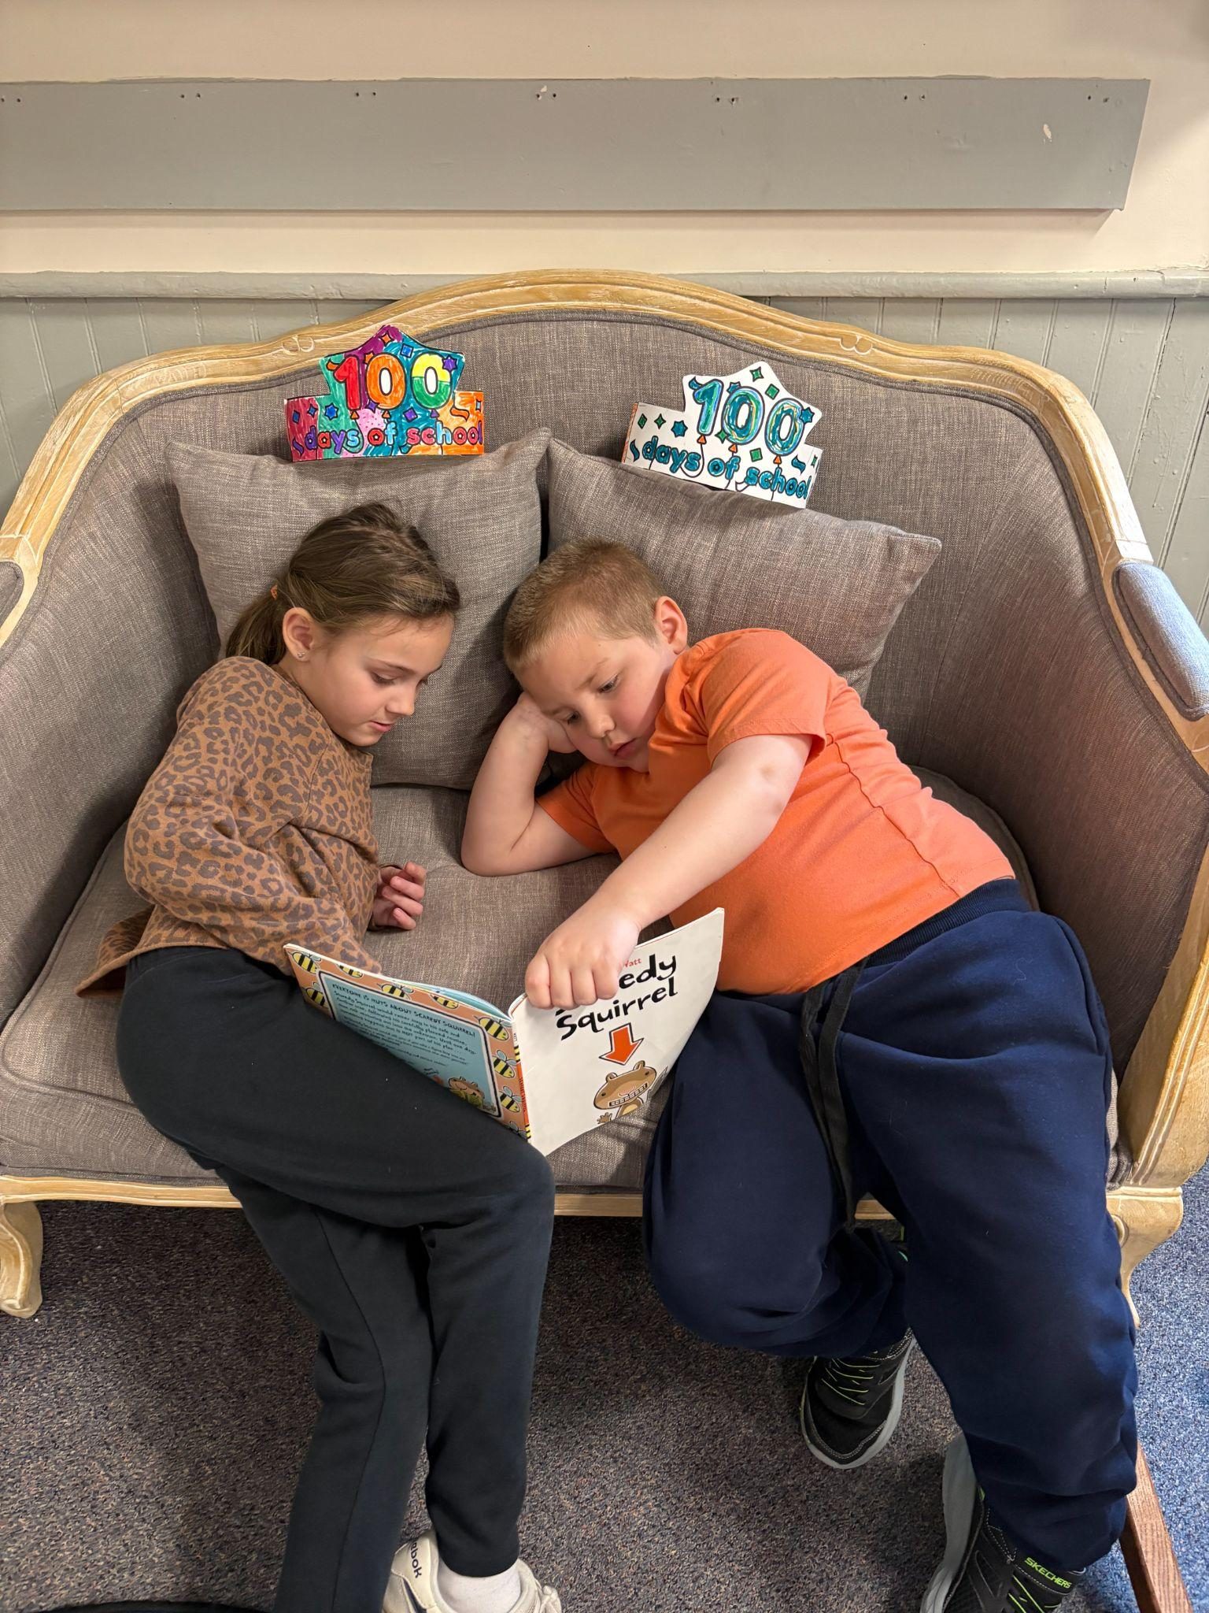
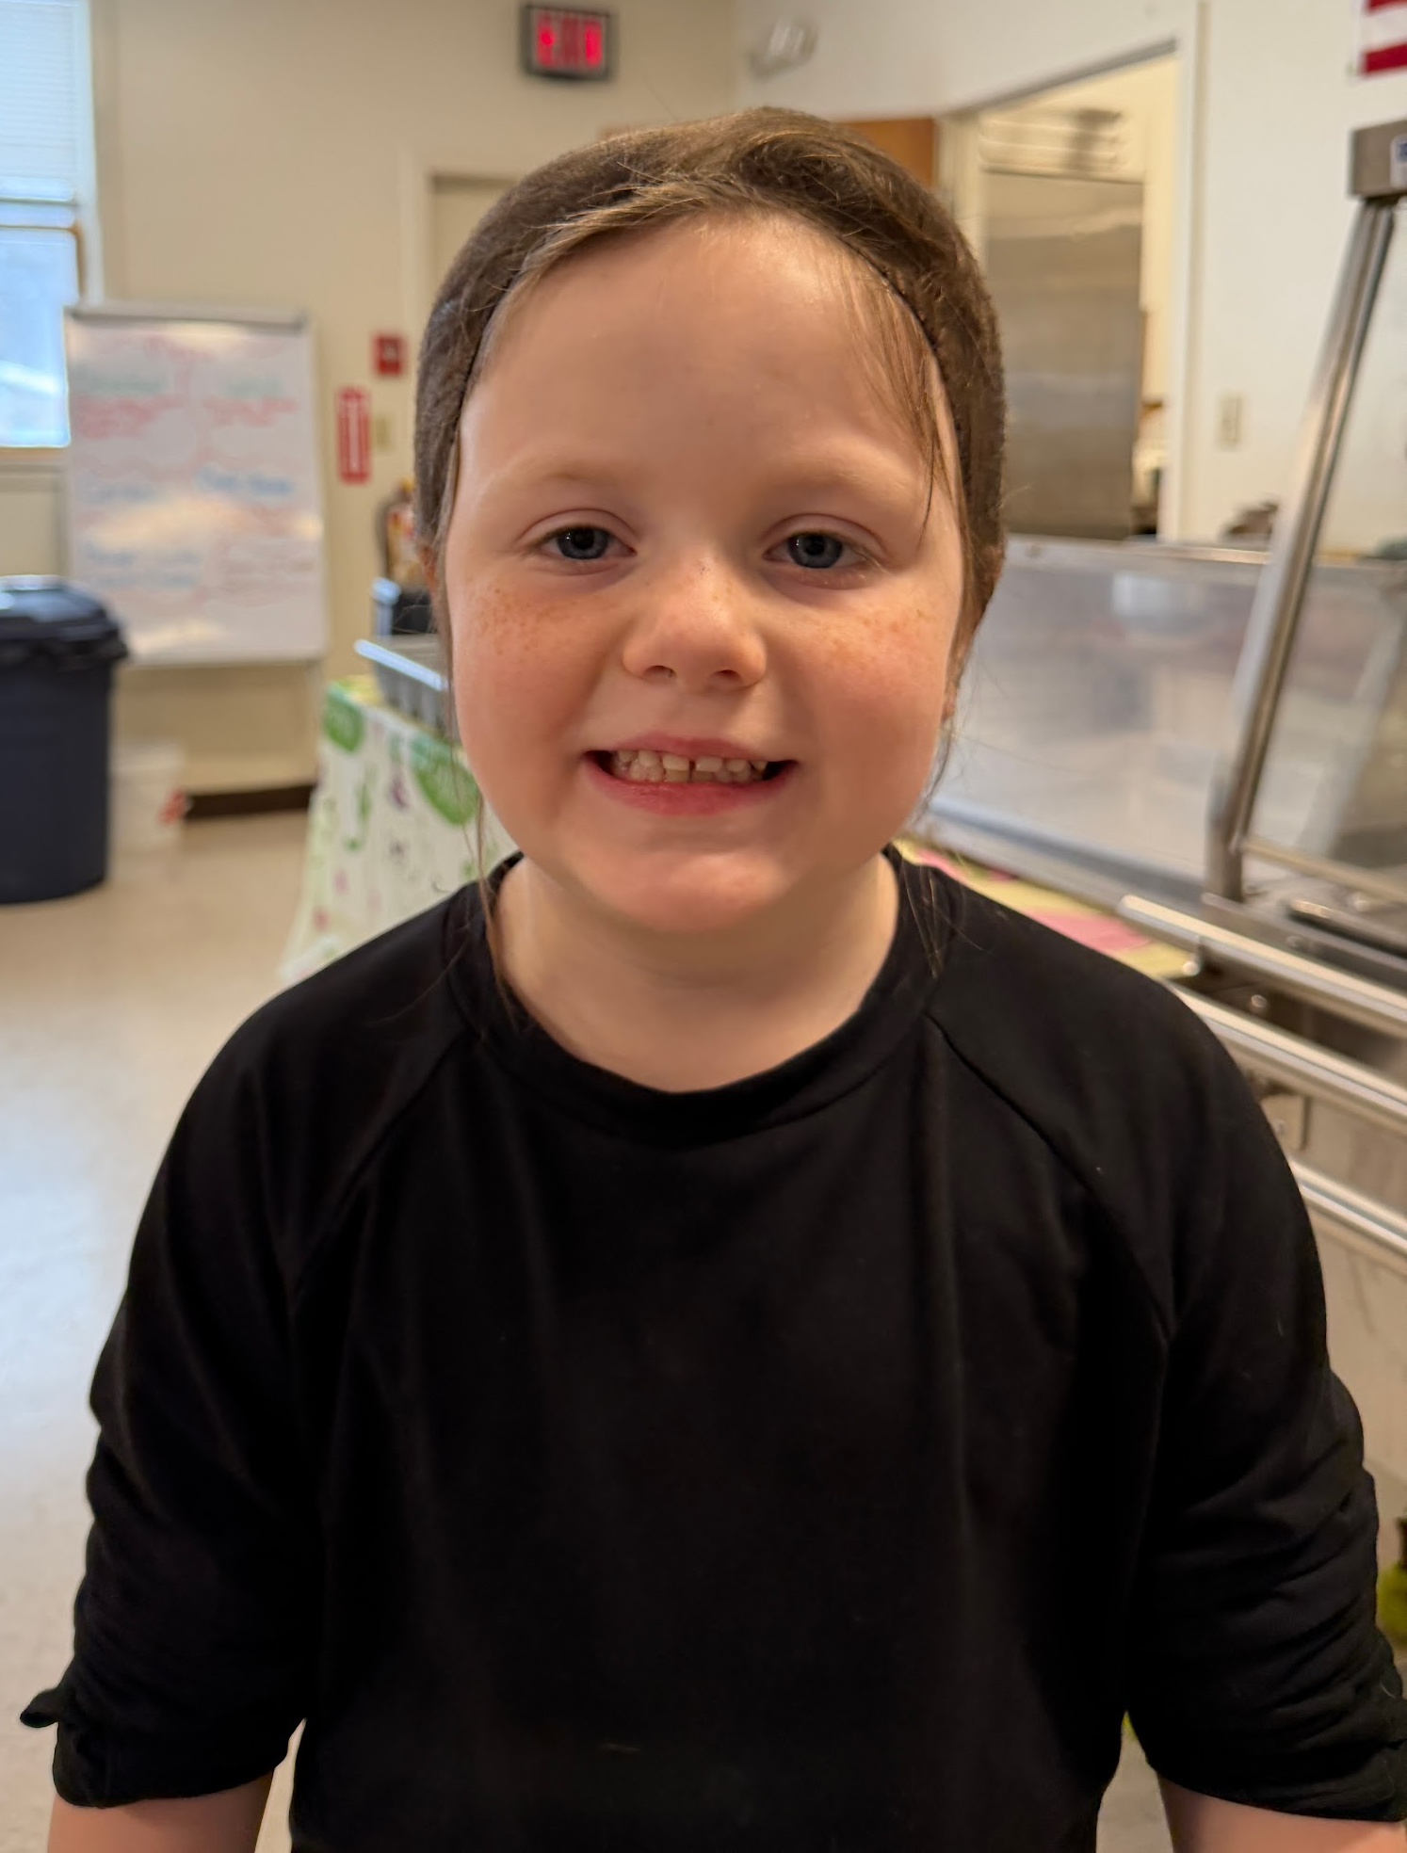
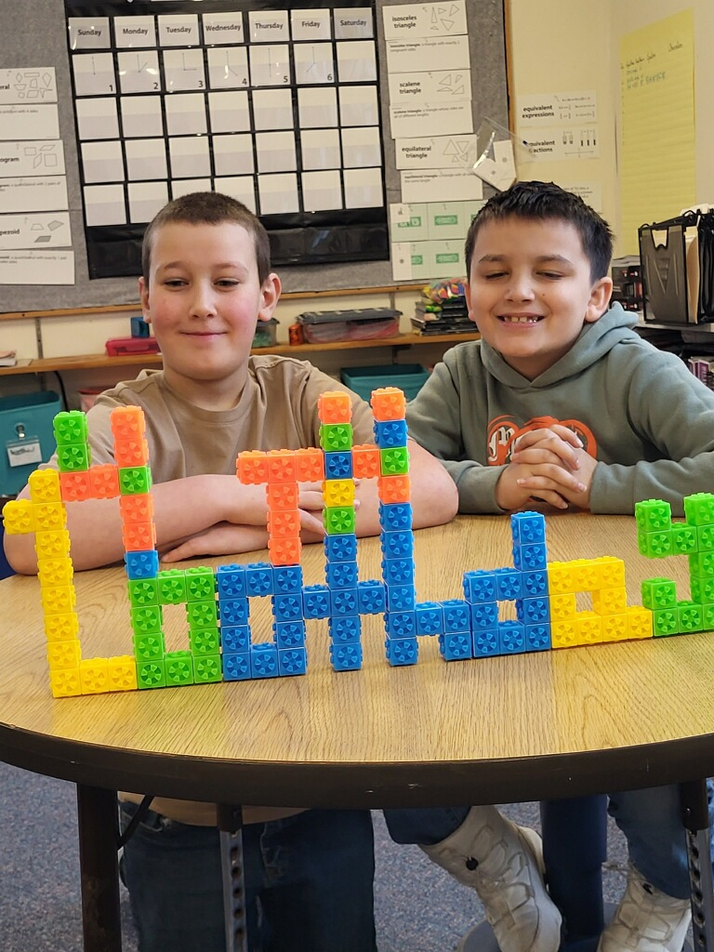
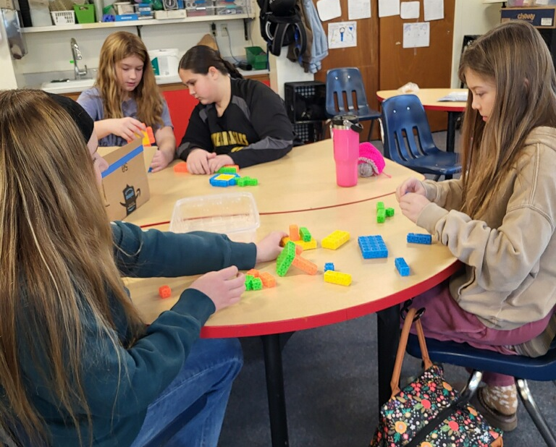


Brady’s Eye on the Sky: Weather Report *7 day forecast from Weather Underground
Sat 2/7 | Sun 2/8 | Mon 2/9 | Tues 2/10 | Wed 2/11 | Thurs 2/12 | Fri 2/13
Hi: 15° Low: -9° | Hi: 3° Low: -12° | Hi: 14° Low: -10 ° | Hi: 25° Low: 3° | Hi: 28° Low: 14° | Hi: 28° Low: 11° | Hi: 27° Low: 13°
AM Snow Showers | Partly Cloudy | Mostly Sunny | Partly Cloudy | Snow Showers | AM Snow showers | Few Snow Showers
The Good Deeds Docket
Kinley helped another student with their final copy.
Josie drew a beautiful picture of she and Kinley for Ms. Landry.
Henry shares his special marker set with the class.
Mrs. Martin celebrates special days with our classroom.
Mrs. Wentworth helps 6th graders with mathematics.
Aaliyah helped Josie learn to crochet.
Amelia helped younger students in the Quiet Activity group.
Henry hurt his dominant arm at skiing and Landon volunteered to scribe for him in class
Amelie helped give a push on the swings.
Amelia helped spot Kate with gymnastics.
February
Monday Guidance | Tuesday Art | Wednesday Library Media | Thursday Wellness | Friday Music
9 | 10 | 11 WMSI | 12 Ski Day | 13 Band Valentines Swap
16 | 17 WMSI Parent Title One Night 5:00pm | 18 4H 5:00pm | 19 | 20 Early Release 11:15
23 Winter Recess | 24 | 25 | 26 | 27

Slide 4
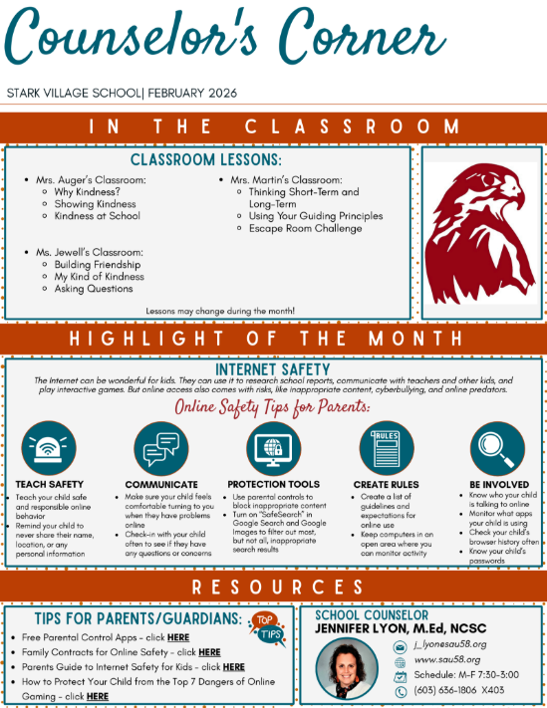

Slide 5
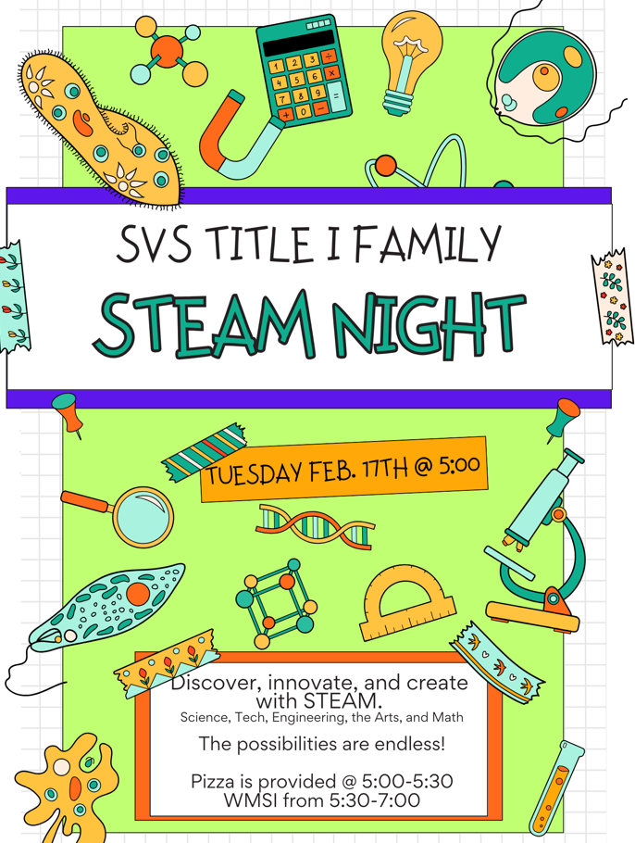

Slide 6
