Slide 1

False Reporting on Social Media or FortifyFL – Safety Training for School Staff, Students, Parents & Guardians

Slide 2
Making a Threat on Social Media
Making a threat on social media is when a person communicates a threat to kill, do great bodily injury, conduct a mass shooting or an act of terrorism.
Social media platforms that other people can view include:
  Direct messages or posting status updates on any social media platform
  Snapchat stories or messages
  Video platforms such as YouTube or TikTok
  Gaming servers or chats such as Discord, Steam, or Twitch
  Anonymous chat rooms or posting sites such as Whisper and AskFM

Slide 3

What happens if a student makes a threat on social media?
Merely communicating a threat on social media is enough to warrant a felony charge, whether there is actual intent or ability to carry out the threat or not.
A person communicating a threat to kill, do great bodily harm, conduct a mass shooting or an act of terrorism in any way that another person can view it is committing a second-degree felony under section 863.10, Florida Statute.

Slide 4
Other consequences a student could face for submitting a threat:
School expulsion for a year
Placement in an alternative school
Inability to graduate or attend school events with friends
Paying restitution costs for the law enforcement investigation
Criminal charges

Slide 5
What if you or your child see a concerning or threatening post on a social media platform?
Report the information to FortifyFL immediately.
  See Something, Say Something

Slide 6
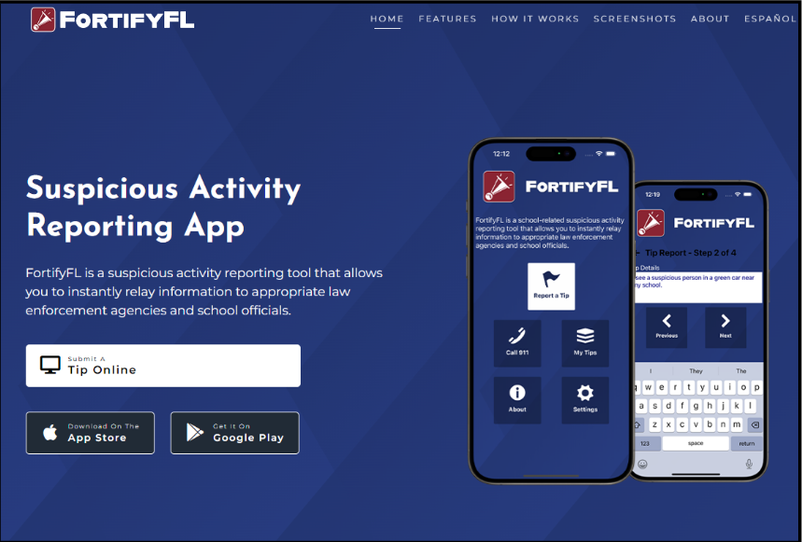
What is FortifyFL?
FortifyFL is an anonymous reporting app that allows a student or parent to instantly send a tip about a potential crime or threat directly to law enforcement and designated school personnel.

Slide 7
How do I submit a FortifyFL tip?
You can submit a tip from any computer at GetFortifyFL.com. You can also submit a tip using your phone. Download the FortifyFL App on your phone or tablet.
What information is needed? Tips should have actionable information. The tip should include who did what, where it happened, and when. More tip details improve the chances that a situation can be resolved quickly.

Slide 8
Submitting a False Tip to FortifyFL
Submitting a false tip to FortifyFL is not only against the law, but it also impedes resources that are needed for actual emergencies and carries legal consequences.
Students have been arrested for recent school threats and charged with second-degree felonies in violation of section (s.)835.10,Florida Statute(F.S.):
  “(2)It is unlawful for any person to send, post, or transmit, or procure the sending posting, or transmission of , a writing or other record, including an electronic record, in any manner in which it may be viewed by another person, when in such writing or record the person makes a threat to: (a)kill or to do bodily harm to another person: or (b)conduct a mass shooting or an act of terrorism.”

Slide 9
Remember…
All threats will be taken seriously and will result in severe consequences up to and including arrest, restitution, and expulsion. Parents are urged to discuss this information with their child.
False threats, even if intended as just a joke, can result in life changing consequences.

Slide 10
Questions or Concerns?
School Safety Specialist
Charlie Morse
safeschools@walton.k12.fl.us
morsec@walton.k12.fl.us
(850)892-1100 ext. 1807
District Threat Management Administrator
Scott Hulion
HulionS@walton.k12.fl.us
(850)892-1100 ext. 1808

