Slide 1
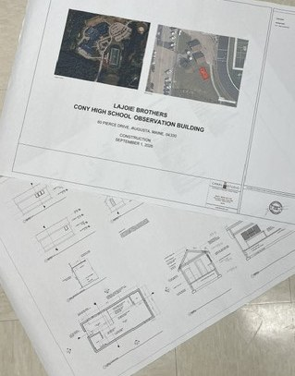



A Place for Every Fan
The Fuller Field Sensory Room at Cony High School
Notes:
~30 sec. Welcome the Board. Introduce yourself and the project: a sensory room beside Fuller Field so children and community members with sensory processing challenges can comfortably enjoy school athletic events. Mention you will walk through the vision, the partners, the build so far, and what is next.

Slide 2




The vision
Started with our football coach
The idea came from the sideline: make game day work for every fan.
BELIEVED TO BE THE
FIRST
Sensory challenges are real
Crowds, noise and bright lights can make athletic events overwhelming for some children and community members. 1 in 4 people has a sensory need or an invisible disability.
of its kind at a sports facility in Maine
A comfortable place to stay
A calm space beside the field lets families enjoy school athletic events together.
Notes:
~1 min. Credit the football coach for the vision. Explain in your own words why this matters: stadium noise, crowds and lights can be overwhelming for some children and community members with sensory processing challenges. This room lets them stay and enjoy the event comfortably. Note that it is believed to be the first of its kind at a sports facility in Maine.

Slide 3
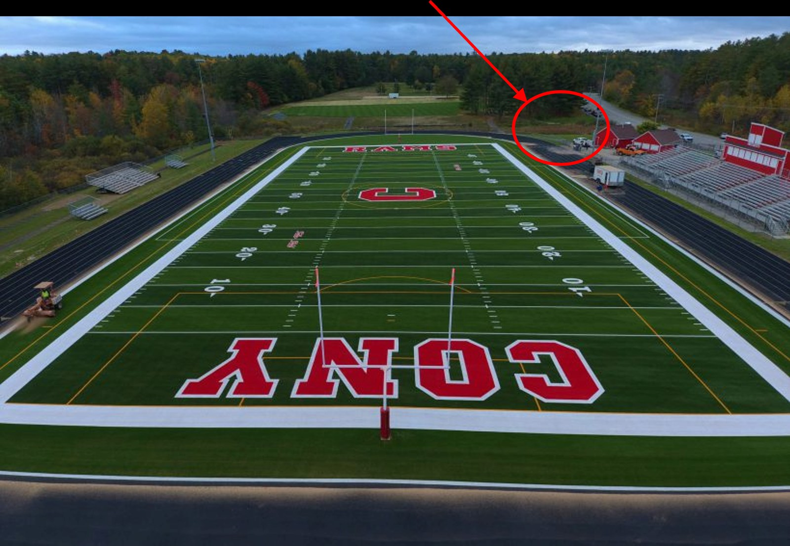


The location
SITE
Adjacent to Fuller Field at Cony High School
PURPOSE
A comfortable space to enjoy school athletic events
WHO IT SERVES
Children and community members with sensory processing challenges
Notes:
~45 sec. Point to the red circle on the aerial photo: the room sits adjacent to Fuller Field, right by the stadium, so families do not have to leave the event.

Slide 4
A team effort
The vision
The builder
The students
Our Cony football coach saw a need and imagined a better game day.
Lajoie Brothers, Inc. is building the room, with Josh Lajoie leading the project as his senior capstone.
CATC Building Construction and Electrical Technology programs are helping build it.
School, industry and students working together for the community
Notes:
~1 min. Three partners: the football coach (vision), Lajoie Brothers, Inc. (builder; Josh Lajoie leads the project as his senior capstone), and the Capital Area Technical Center Building Construction and Electrical Technology programs (student labor and learning). Add any thanks or specifics you want to share.

Slide 5
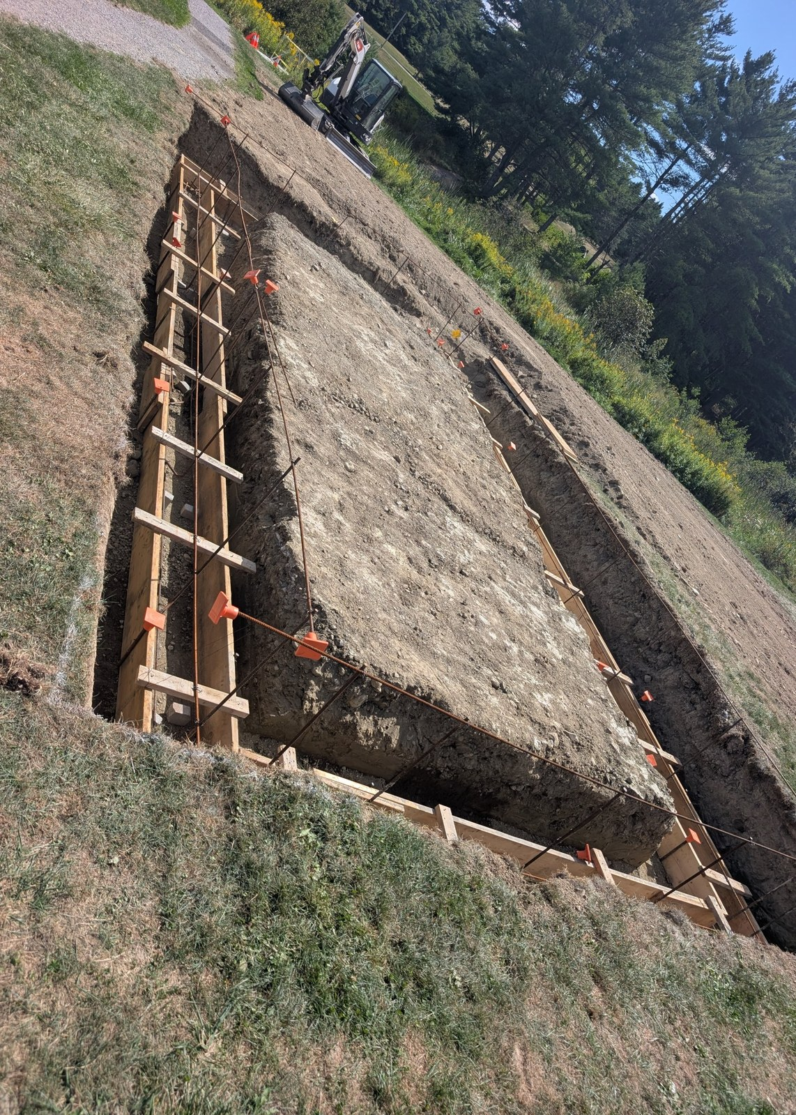
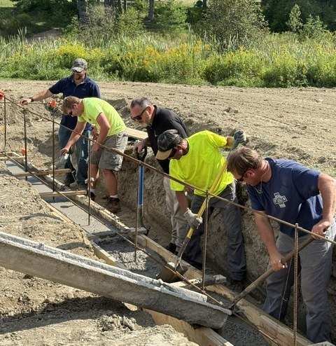
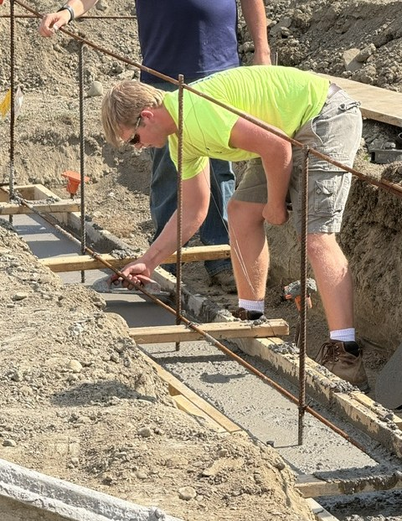
Laying the footings
Excavate and prepare
Pour the footings
Trowel the footing
Notes:
~1 min. Step 1: site excavated, rebar and forms in place. Step 2: footings poured by the crew. Step 3: the footing is troweled smooth. Swap in or add photos any time (right-click a picture > Change Picture).

Slide 6
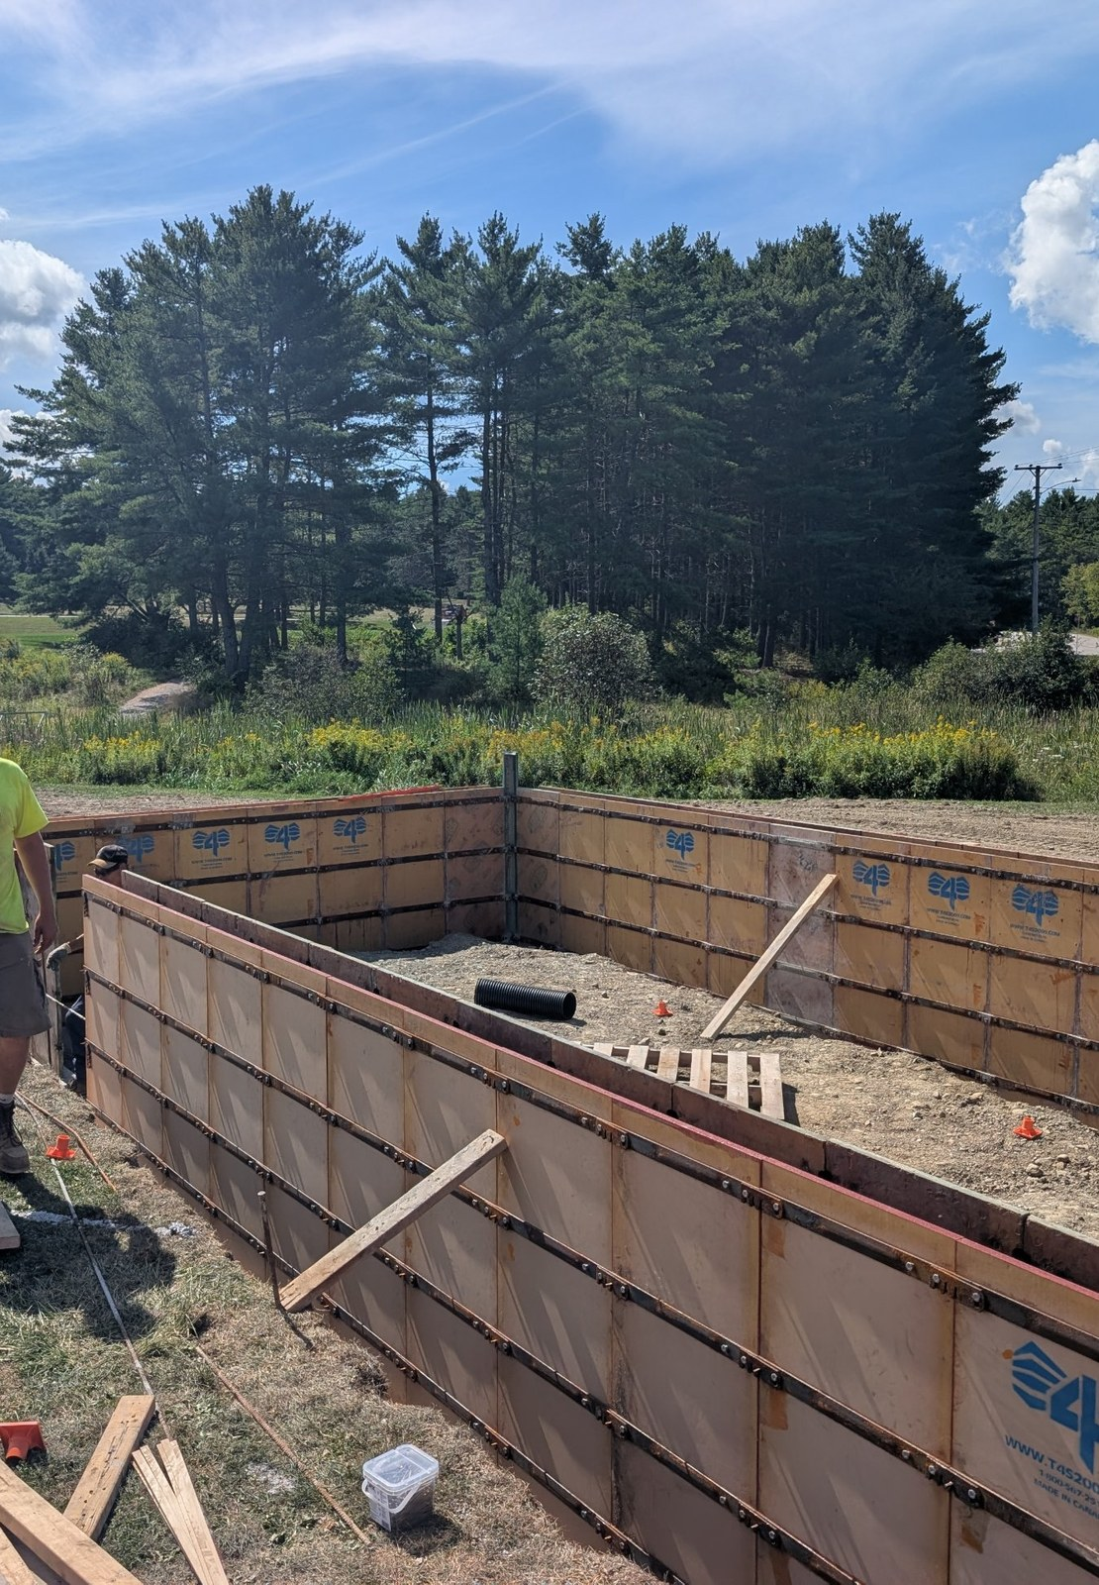
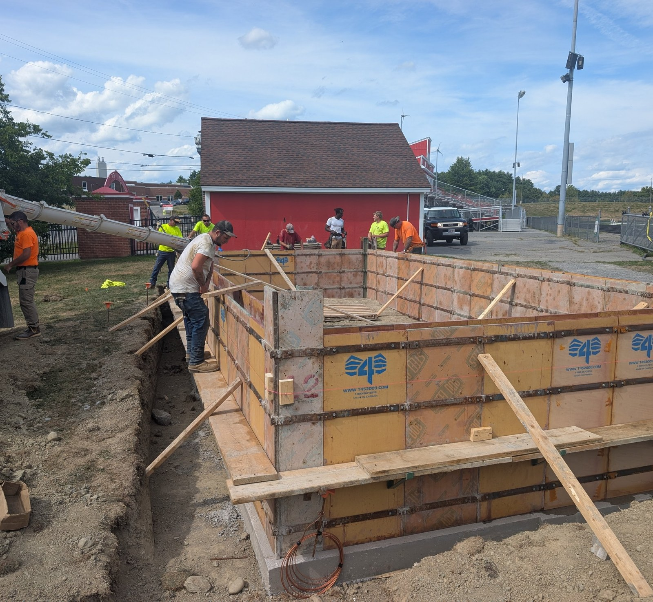
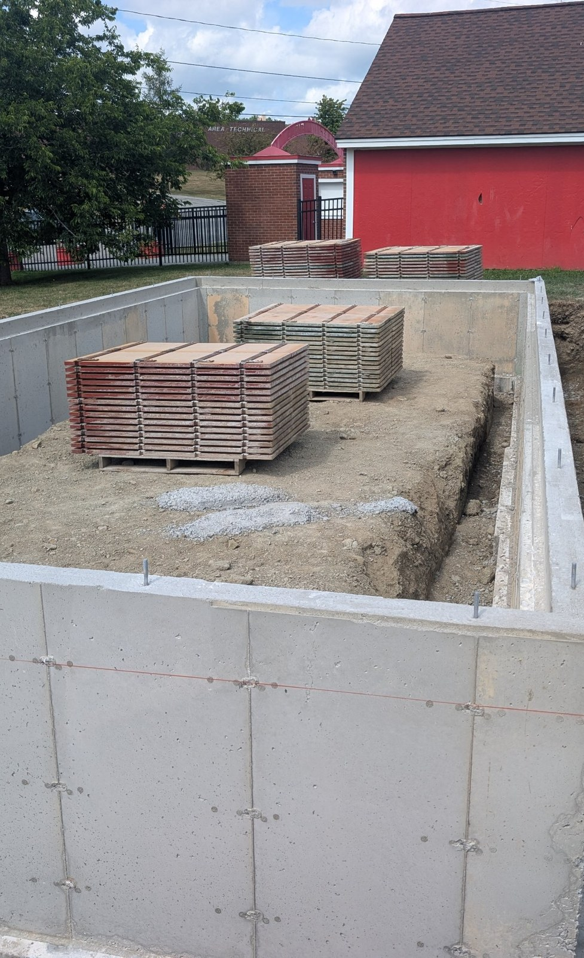
Foundation walls
Set the wall forms
Pour the foundation walls
Foundation walls in place
Notes:
~1 min. First, the wall forms are set in place. Next, concrete is poured into the forms for the foundation walls. Finally, the forms are stripped and the walls stand. The next slide shows the slab and the sample wall mock-up.

Slide 7
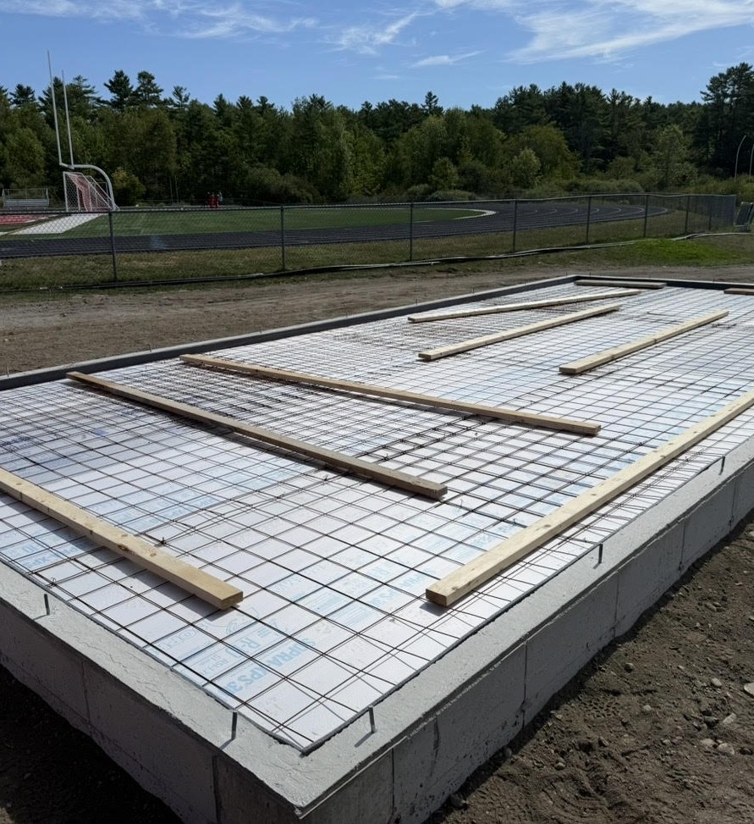
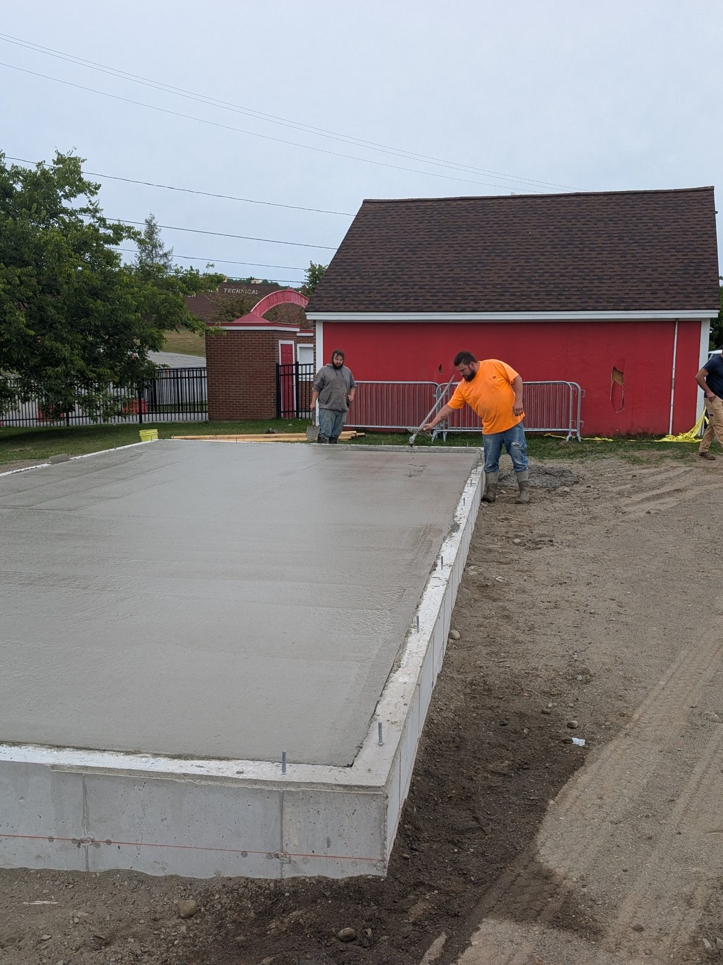
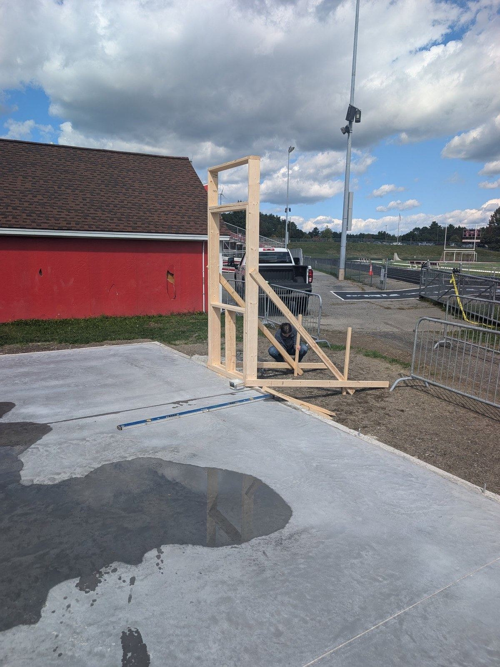
From slab to sample wall
Preparing the slab
Slab freshly poured
Sample wall mock-up
Notes:
About 45 seconds. The slab is prepped with insulation and reinforcing mesh, then the floor is poured, giving a level base. A sample wall was then set up on the slab as a mock-up to check fit before the real walls are raised. Josh can add how the mock-up helped the team plan.

Slide 8
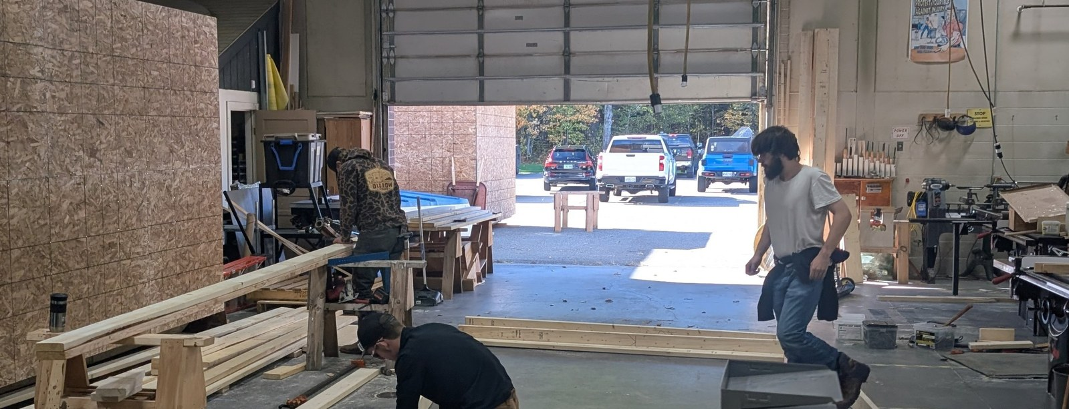


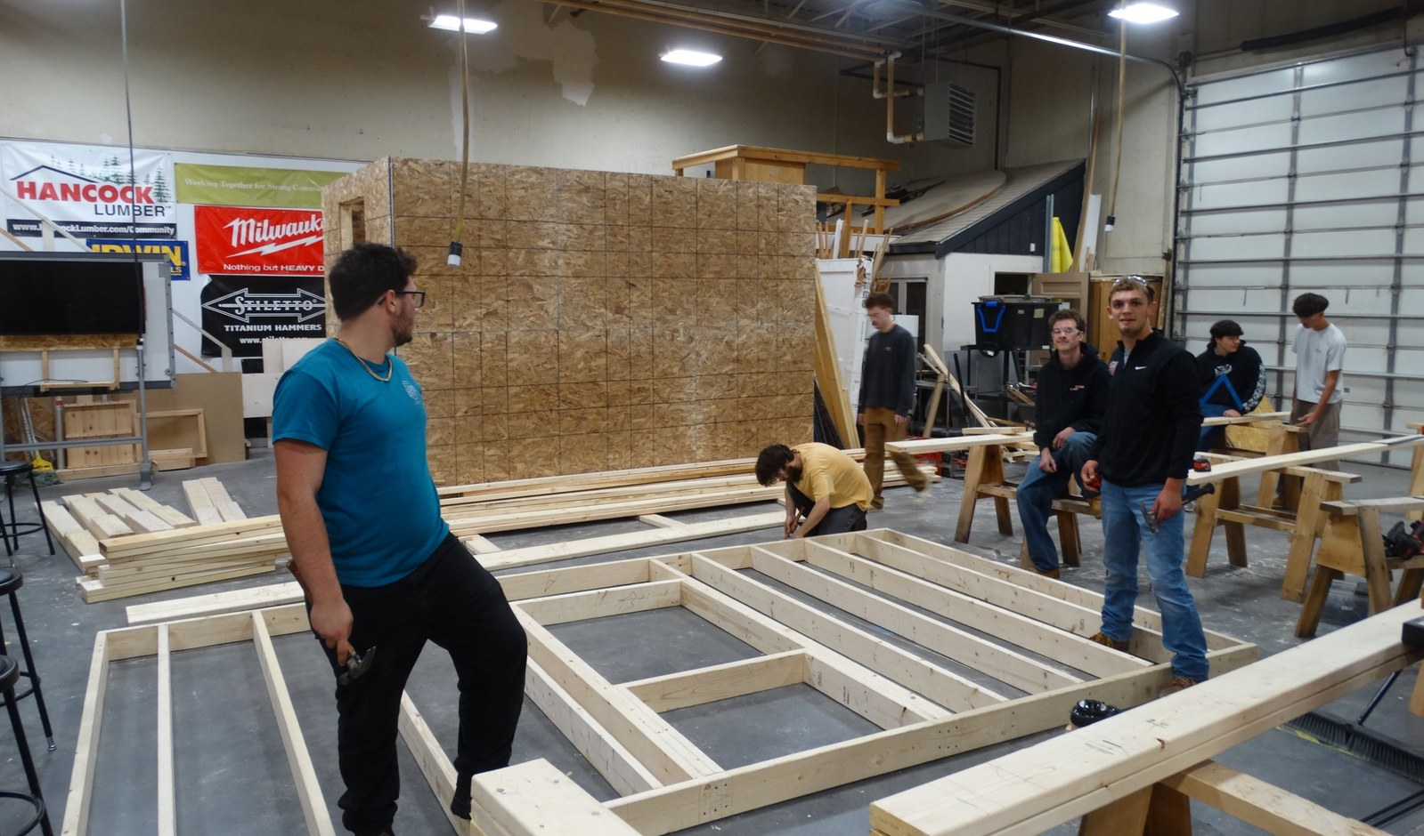
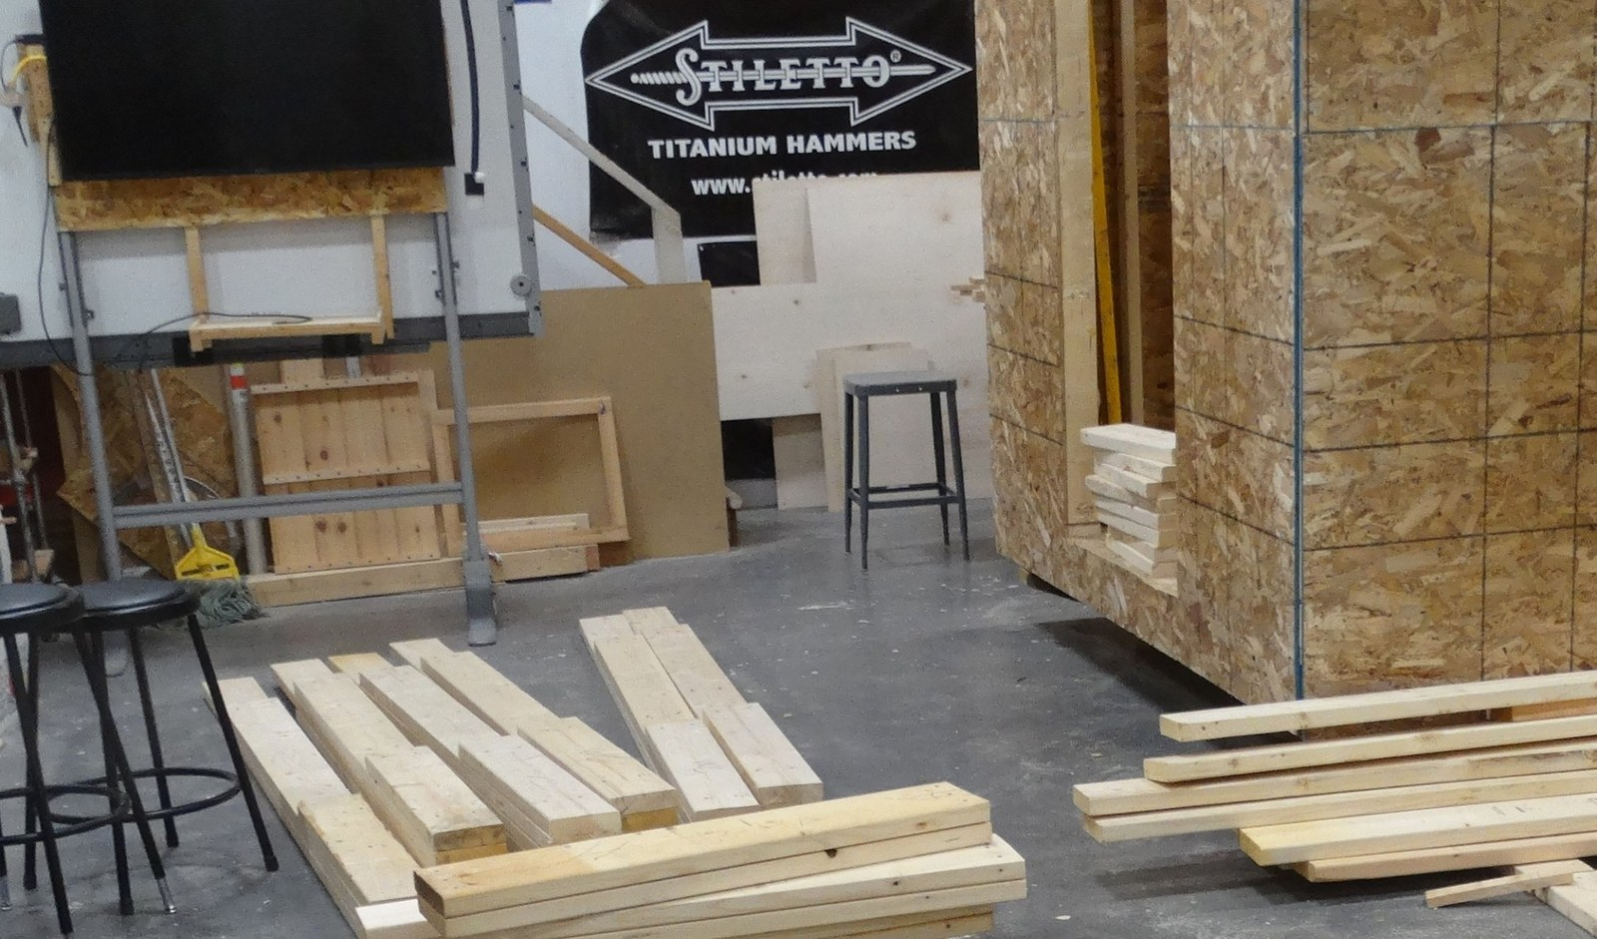

Built with student hands
Walls framed in the CATC shop
Building Construction students contributing, with Electrical Technology students to contribute once the building is watertight
Real-world experience on a real community project
Notes:
~1 min. Walls are framed and sheathed indoors in the CATC shop by students from the Building Construction program, with Electrical Technology students to contribute once the building is watertight. Emphasize the learning value alongside the community benefit. Add specifics (number of students, hours, skills) if you have them.

Slide 9
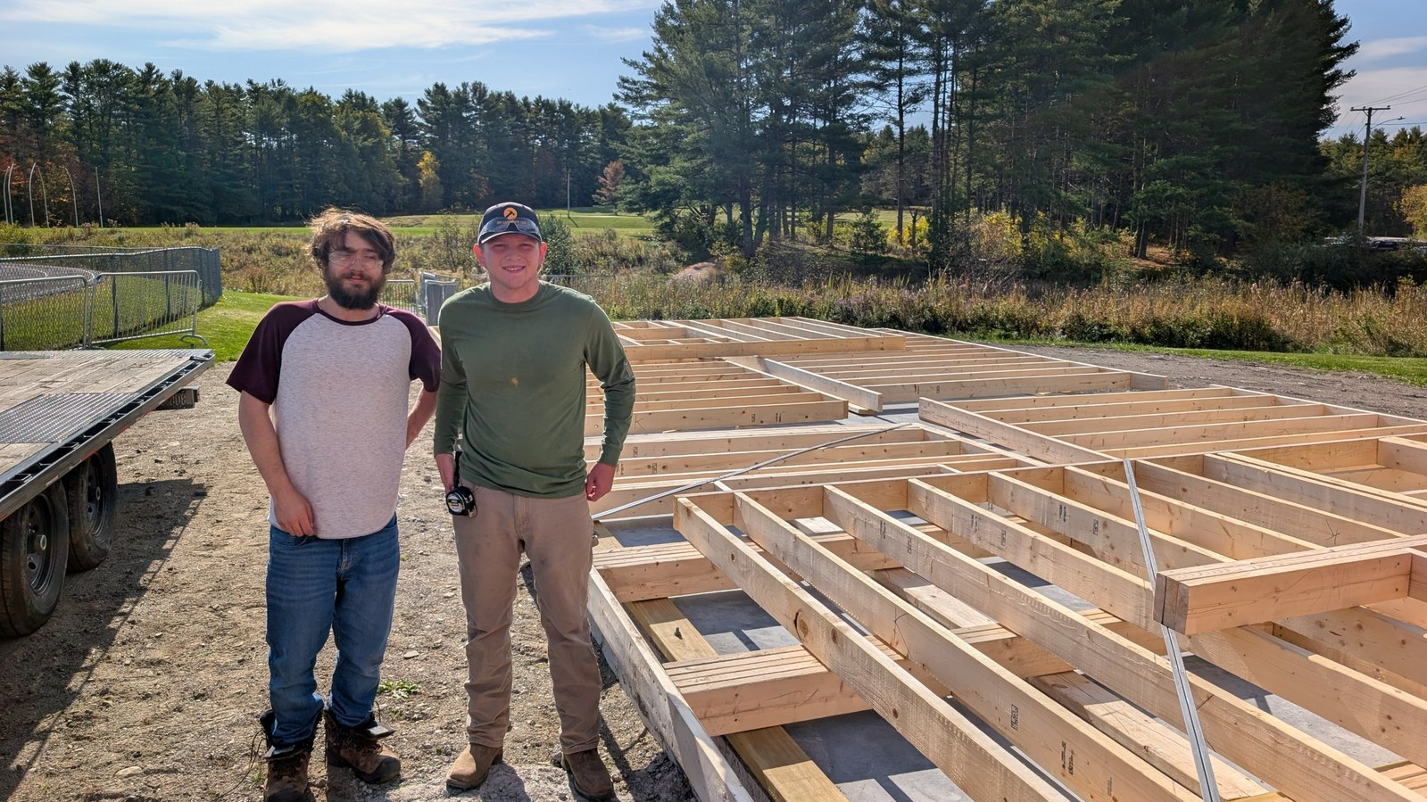
From shop to site
Indoors
Walls built in the shop
On site
Delivered to be raised on a slab
Delivering walls to the site
Notes:
About 45 seconds. Finished wall panels travel from the CATC shop to the Fuller Field site for raising. Adjust to match what has been delivered so far.

Slide 10
What's next
1
2
3
4
Raise the walls
Roof and exterior
Electrical and interior
Grand opening
Opening day: a game-day space where every fan belongs
Notes:
~45 sec. EDIT THIS SLIDE: the four steps are a typical sequence. Replace with your real remaining milestones, and invite the Board to the opening.

Slide 11
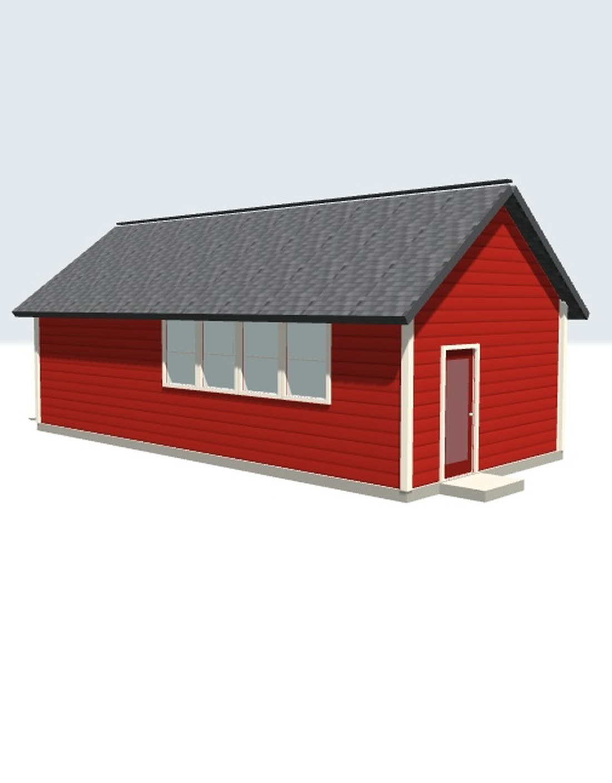
Thank you for your time
AI rendering of Sensory Room
Notes:
Thank the Board, the football coach, Lajoie Brothers, and the CATC programs and students.

