Slide 1
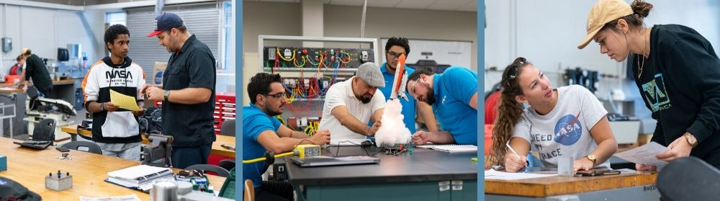

AEROSPACE Program
@AHS through EFSC
A NEW Dual Enrollment Opportunity for
Motivated High School Students!

Slide 2



What is Dual Enrollment?
High school students earn high school and college credit at the same time.

Slide 3

AEROSPACE Program
@AHS through EFSC
Overview of EFSC’s AS in Aerospace Technology

Slide 4
WELCOME
Lloyd Gregg
ASRC Federal VP/GM
Spaceflight Support Services
Notes:
Frank Margiotta
Eastern Florida State College, Dean
Career & Technical Education

Slide 5
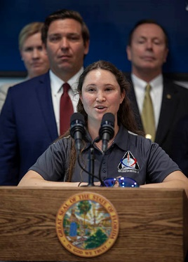
Apprentice Programhool to Trade School
Our team represents some of the best human spaceflight aerospace workers in the world, however as most of our workforce in 2012 was Shuttle Legacy employees our age demographic was 54 in 2012. We are always looking to develop the next generation of aerospace engineers and technicians. In consultation with Lockheed Martin we decided to partner with Eastern State College and Career Source Brevard to look at students enrolled in their Aerospace Technician degree program. Once identified by Eastern State faculty, ASRC Federal and Lockheed Martin review resumes and interview candidates. The selected students now have a paid internship, via investment by AS&D/ Career Source Grant funding, while working in the Orion factory. This allows our skilled workers to pass along their expertise and mentor the next generation of aerospace workers. The first group of interns started in June of 2015 and after completion of their On the Job training (OJT) and certification classes where hired full time direct to the Orion Program 4 months later
This program has to date trained 50 students and hired 47 of them direct to the Orion Program. Approximately 50% 0f Apprentices have qualified for OJT Grant funding from Career Source. Our contracts average age has gone from 54 to 43 in large part from this program and it now represents 18 % of current workforce
This program was recently recognized by Gov Desantis and KSC CD Janet Petro
Mary Lakaszcyck previous Orion Apprentice / Career Source OJT recipient, talking about her experience during Gov. Desantis meeting about our Apprentice program at KSC

Slide 6
Back to the Futureool to Trade School
Artemis Video
https://www.youtube.com/watch?v=y8jpjroxJGA

Slide 7
WELCOME
E.J. Mango
Eastern Florida State College, Aerospace Technology Program
Professor, Aerospace/Electrical/Mechanical Systems
Notes:
Frank Margiotta
Eastern Florida State College, Dean
Career & Technical Education

Slide 8

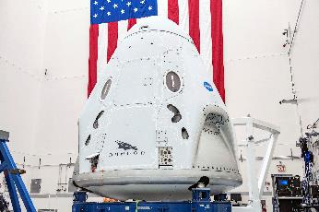

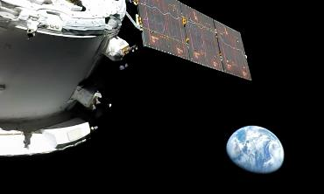
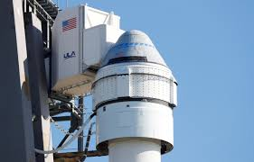
EFSC Aerospace Technology Program
Dual Enrollment Plan Kickoff
E. J. Mango

Slide 9
Aerospace Technology Program
Aerospace Technology Associates in Science - Degree
  2-Year Hands-on Program currently at the Cocoa Campus and expanding to the Titusville Campus
  64 Credit Hours in 4 – Semesters
  4 – Cohorts in Session at any one time
    Either 8-am -12pm or 6pm-10pm
    Above 90% Job Placement (many start during the 3rd Semester)
Completion of the A.S. program includes two College Certificates
  Structural Assembly Tech Certification - 17 Credits in 5 – Courses
  Aerospace Technician Certification - 43 Credits in 13 – Courses
EFSC Aerospace Technology Program

Slide 10
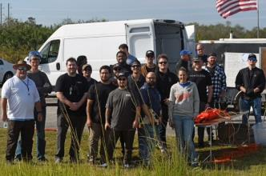
Dual Enrollment Kickoff
Complete Structural Assembly Tech Certificate as a Dual Enrolled student
  17 – Credits in 5 Courses through High School Semesters
  At the Titusville Campus
  Taught with Aerospace Technology Professors/Instructors
  Limited space per Course due to tools, equipment, classroom size and instructor
  Courses –
    Basic Electrical
    Applied Mechanics
    Material and Processes 1
    Material and Processes 2
    Structural Fabrication 1

Slide 11
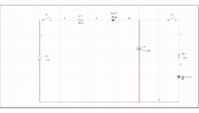
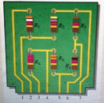

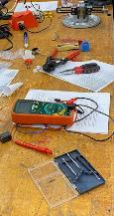
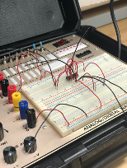
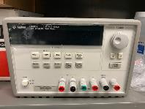
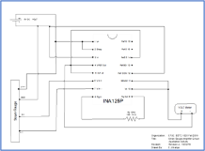

Course Descriptions
Basic Electrical
Basic electrical fundamentals
  Ohms Law, Series, Parallel, Series-Parallel Circuits, AC Circuits, Transformers, Capacitors, Inductors, Engineering Units
Application Labs including MultiSim Simulations, and Breadboard Circuit assembly and test
  Multimeter Usage, Power Supply Usage, Ohms Law Circuits, Voltage Divider Circuit, Strain Gauge Amplifier Circuit, Series-Parallel Capacitor Circuit

Slide 12
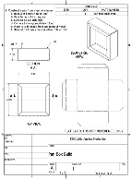



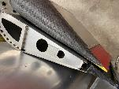
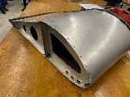
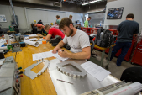
Dual Enrollment Kickoff
Applied Mechanics
Mechanical fundamentals
  Drawings, Measurements, Metal Bending, Fasteners, Torqueing, Safety Wire/Cable, Tap & Die, Rivets, Fluid Line Connections
9- Lab Exercises supporting each fundamental subject
Structural Fabrication 1
Expansion of fundamentals into a constructed assembly projects
  Drawings, Measurements, Metal Bending, Fasteners, Torqueing, Rivets
2 – Assembly Exercises

Slide 13
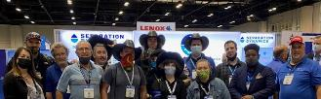
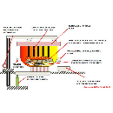



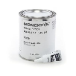
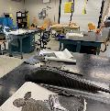
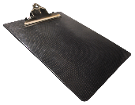
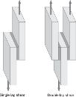

Dual Enrollment Kickoff
Material & Processes 1
  Aerospace material and commodity properties and characteristics. Materials compatibility, basic metallurgy, corrosion and casting.
  Series of Labs on material processes and metallurgy
Material and Processes 2
  Aerospace applications of non-metallic materials. Including the use of adhesives, coatings, sealing, and issues with delamination, bonding.
  Series of Labs on adhesives, bonding and initial composite applications

Slide 14
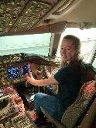
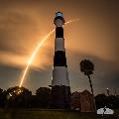

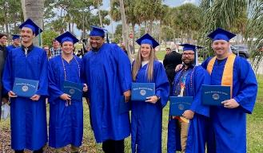
Transition to Aerospace Tech A.S. Degree
Completion of Structural Assembly Tech Certificate upon graduation from High School
  Possible job opportunities post High School graduation
  Or Transition to EFSC Aerospace Tech A.S. Degree program
  Complete additional 47 credits in about 18 months
  Internships & Apprenticeship available after two Semesters
A clear path to start and mature as an Aerospace Technician
The future of the Brevard aerospace industry is limitless
  Expanding commercial spaceflight
  Launching commercial space stations
  Human Exploration
  Moon, Mars, and beyond

Slide 15
AS in Aerospace Technology
Limited access & competitive program
64 total credit hours
Combination of academic and technical courses
Structural Assembly Technician College Credit Certificate (CCC)
Offered to AHS approved students!
This certificate is part of the AS in Aerospace Technology
17 total credits (count towards the 64 total credits for AS)
Skills to be workforce ready in Aerospace industry
Students with CCC get special consideration into AS Aerospace program

Slide 16
Aerospace CCC
Dual Enrollment Program Expectations
Participants are expected to:
Complete selected EFSC and high school classes each year.
Maintain program eligibility.
Complete 5 EFSC classes (17 total credits) to acquire the Structural Assembly College Credit Certification upon High School Graduation.

Slide 17
Benefits of
AEROSPACE CCC Program
The AEROSPACE TECHNOLOGY, Structural Assembly Technician CCC enables students to:
Complete 17 out of 64 total credits in AS of Aerospace Technology.
Get used to college expectations while still in high school.
Use their college courses to discover career interests, explore the Aerospace industry, and learn more about possible employers.
AHS and EFSC will be working with local aerospace companies to enhance employment opportunities after graduation.”

Slide 18

Admission Requirements
for Dual Enrollment in CCC
State cumulative unweighted GPA of 2.5 or higher.
Must be on track to meet Brevard Public School requirements for graduation.
College placement test on file (PERT, SAT, ACT, or ACCUPLACER).
High school record of good attendance and responsible behavior.
Meet all program deadlines and requirements.
Completion of EFSC Online Application & Dual Enrollment Orientation.

Slide 19

Requirements to STAY in the AEROSPACE CCC Program
State cumulative high school unweighted GPA of 2.5 or higher
College GPA of at least 2.0 each term
Remain on track in your AHS classes to meet BPS high school graduation requirements
Good disciple and attendance record

Slide 20
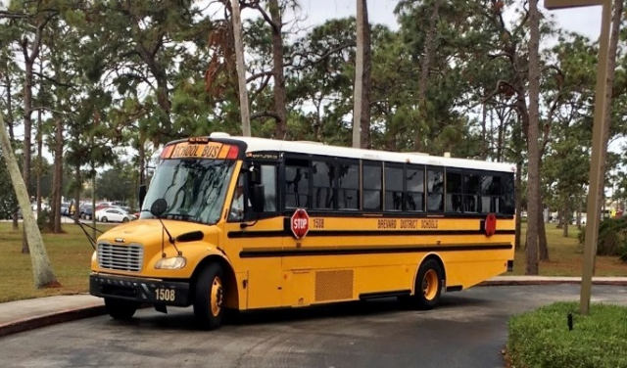
Transportation
11th and 12th graders are responsible for their own transportation to and from EFSC.
  - We are looking to see if BPS will provide transportation, please mark on your interest form if lack of transportation would be a barrier to participate in program.

Slide 21
CCC Coursework
17 total credits (5 classes)
COURSES:
  Basic Electrical
  Applied Mechanics
  Material and Processes 1
  Material and Processes 2
  Structural Fabrication 1
Typically, a 3-semester program completion
NEW to Titusville Campus
NEW to Dual Enrollment
Working on specific plan for Juniors & accelerated plan for Seniors.
*Specific courses/times per semester TBA
.

Slide 22
Dual Enrollment Course Weight
Dual Enrollment courses are weighted the same as AP classes and can increase your high school weighted GPA.
A in regular high school class = 4.0 gpa
A in EFSC course = 5.0 weighted gpa

Slide 23

How will EFSC staff help you chart your pathway?
  EFSC Dual Enrollment advisors help students:
    Plan their degree program
    Register for classes
    Access academic support services
  EFSC offers:
    Career Planning & Development Centers to help students identify career interests and skills
    Seminars and clubs in selected career fields
    College student ID card – every college student benefit

Slide 24
Factors to Consider
Additional study expectations required with college coursework
Courses designed for adults – NO modifications made to accommodate age and maturity level
EFSC grades stay on permanent college and high school transcript

Slide 25
Factors to Consider
Summer or night classes may be needed to earn degree by graduation
Balancing college, high school, and extracurricular demands is necessary
Must meet high school and CCC requirements
Arrange transportation and attend EFSC classes even if they occur on BPS school holidays

Slide 26
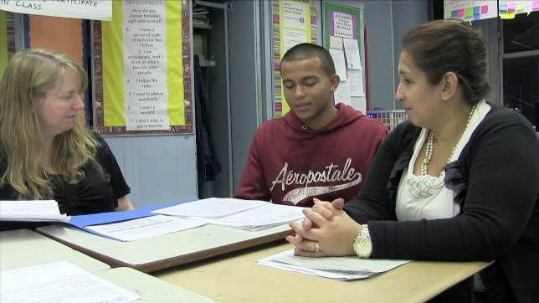
Considerations for Parents
High school counselor is point of contact for parents seeking information about student
Parents may not contact college instructors for student information (FERPA)
Family must follow both high school and EFSC calendars
Student is responsible for purchasing required consumables (i.e. workbooks and lab manuals)
The college does NOT have an excused absence policy; attendance requirements are specified in each course syllabus

Slide 27
Getting Started!
Attend the AEROSPACE TECH CCC Information Presentation at your school.
Submit Student Interest Form to Mrs. Gordon by the Monday, February 13.
Take the PERT (AHS on Tues. Feb. 21 or @ EFSC). Students who take the SAT (AHS March 1) do not need to take the PERT.
Early College Program Student/Parent Agreement to Mrs. Gordon
Submit the online EFSC Application for Admission.
Once you receive your acceptance letter with student ID, complete the online Dual Enrollment Orientation.

Slide 28
Important Dates
► Submit Student Interest Form: February 13, 2023
Current 10th graders PERT @ AHS: February 21, 2023
Current 11th graders SAT @ AHS: March 1, 2023
Approved AEROSPACE CCC students NEXT STEPS Meeting: TBA
Student/Parent Agreement Form deadline: ____________
Dual Enrollment Application assistance ______________
►
► QUESTIONS???
Gordon.christina@brevardschools.org

