Slide 1
2023-24 Title I
Annual Meeting
Apollo Elementary
Thursday August 17, 2023
FY24

Slide 2
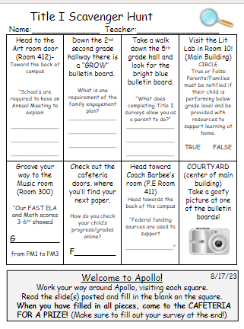

Slide 3
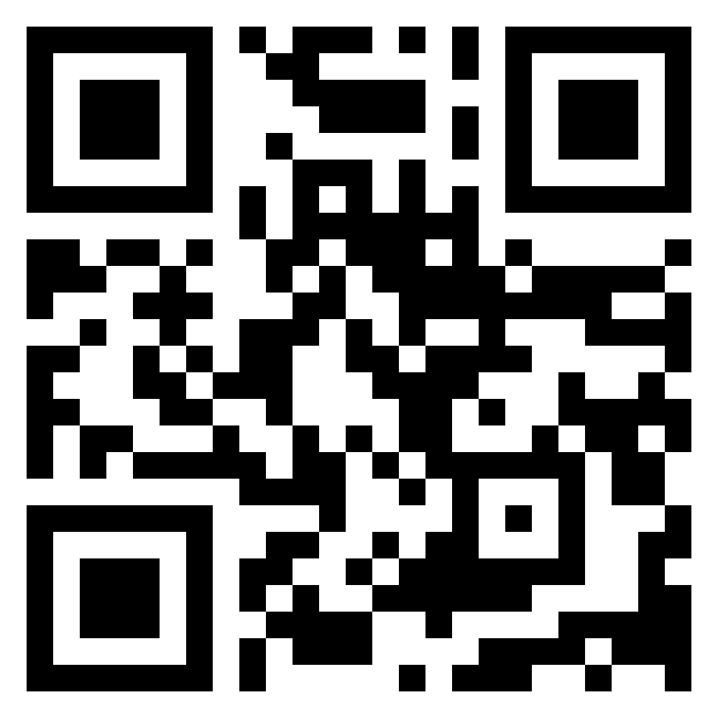
QR Code For Exit Ticket

Slide 4
According to the Every Student Succeeds Act (ESSA), schools are required to have an Annual Meeting to explain:
The Title I program, which includes:
    Parent and Family Engagement Plan (PFEP)
    School-Parent Compact
    Parents’ Right to Know
    The School Improvement Plan (SIP) Goals
    The importance of parent and family engagement
    The use of funds
FY24

Slide 5
What is Title I?
Title I is a federal grant that:
Ensures all children have the opportunity to obtain a high-quality education and reach proficiency on challenging state academic standards and assessments
Provides supplemental funds to school districts to assist schools with high concentrations of poverty to meet educational goals
Requires schools to train parents on how to support their children academically at home
Requires schools to train teachers on how to work effectively with parents and families in order to help improve academic achievement
Requires parents to have an active role in their child’s academic achievement
FY24

Slide 6
Title I Funding
Districts allocate Title I funds to qualifying schools based on direct certification data
Title I funds must supplement, not take the place of district funds
A specified amount of Title I funds must be spent on family engagement. Parent input is critical so schools can provide trainings/events that are relevant to families
Parents have the right to give input regarding how the school will use its Title I funds
FY24

Slide 7
Who decides how funds are used?
Your administrative team considers data and feedback collected throughout the school year to write the school’s Title I Plan. The team at Apollo Elementary consists of Mrs. DiLago, Mrs. Landress, and Ms. Wise.
Use of Title I funds must align with the goals of the School Improvement Plan (SIP).
Every school has a School Advisory Council (SAC) composed of:
  parents, teachers, staff, community members, and administrators
The School Advisory Council helps determine how to use Title I funds. Please consider joining we need your voice!
  Copies of the Title I Plan and the School Improvement Plan (SIP) are available for families in the
  Title I Parent Notebook in the front office.
FY24

Slide 8
Title I Programs
All Title I public schools in Brevard are school-wide programs, meaning Title I funds, along with other local, state, and federal funding sources are used to support all students in the school
The primary focus of the Title I program is to support the students most at-risk for academic failure
School identify specific groups of students that need more intensive academic support. These subgroups are show in the School Improvement Plan (SIP)
FY24

Slide 9
School Assessment Results
Our FAST ELA and Math scores 3-6th showed growth from PM 1 to PM3
Our students below grade level 3-6th showed growth from PM 1 to PM 3.
Our I-ready scores in Reading and Math also showed growth across K-6.
We will increase the consistency of interventions in our Tier 2 and Tier 3 groups.
FY24

Slide 10
2023-24 School Improvement Plan Goals
Our school improvement plan (SIP) will focus on the lowest 25% and improve scores in English Language Arts, Mathematics, and Science.
Title 1 will support the SIP/SWP goals in the following ways:
  Parent engagement activities
  PBIS
  Instructional Staff- Title 1 teachers, instructional assistants, and the reading coach will provide small-group instruction.
  Parent Liaison will work with parents to improve attendance.
FY24

Slide 11
APOLLO Title I Plan for 2023-24 School Year
Apollo Elementary is provided with $440,583.00 to pay for services and programs for our students.
School-based Title I funds pay for the following:
  3 Title 1 teachers, 3 instructional assistant salaries, parent liaison, and half of one instructional reading coach.
  Student materials, supplies and textbooks
  Parent involvement materials
  Staff development
  Subscription annual fees and software (Lexia)
  Computers
  Library books
  Field trip transportation
  All of our Title I funds support our School Improvement Plan (SIP) goals.
FY24

Slide 12
Educational Standards
Florida’s academic content standards establish high expectations for all students in the areas of reading, mathematics, writing, and science
The Florida Benchmarks for Excellent Student Thinking (B.E.S.T.) Standards for Language Arts and Math identify what your child needs to know and be able to do. Information can be found at:
  www.cpalms.org Click on the “Standards” tab at the top of the page
  If you need help accessing the B.E.S.T. Standards on Cpalms
  please ask your child’s teacher ☺
FY24

Slide 13
Testing
Parents/families will be provided information regarding the level of achievement of their child on each state academic assessment that is required by law
Parents/families must be provided materials to support their child if they are performing below grade level on the state academic assessments in reading and/or math
Parents/families of students that are identified as substantially deficient in reading based on the state academic assessments must be provided with a “Read at Home” Plan
To the extent that is feasible, testing information must be translated into a language the parents/families can understand
FY24

Slide 14
2023-24 School Assessments
F.A.S.T. Reading and Math:
    Grades 3-6 PM1 9/6-9/7; PM2 1/10-1/11; 5/1-5/2
    Grades 4-3 Writing 4/2
    Grades K-2 PM1 9/12-9/13; PM2 12/5-12/6; PM3 4/16-4/17
  5th Grade NGSSS 5/8
  We utilize the District adopted curriculum for
    K-5: ELA Benchmark Advance; Math Reveal; Science STEMscopes
    6: ELA Savvas; Math EdGems; Science Destination: Science
FY24

Slide 15
Parent and Family Engagement Plan (PFEP)
Each Title I school must annually write, with input from families, teachers, and community members a written Parent and Family Engagement Plan (PFEP)
The Parent and Family Engagement Plan (PFEP) describes how the school will carry out parent engagement requirements, including the development of a School-Parent Compact
The Parent and Family Engagement Plan (PFEP) and the School-Parent Compact can both be found in the Title I Parent Notebook found in the front office.
FY24

Slide 16
Parent and Family Engagement Requirements
Title I schools must:
Have an annual evaluation of the effectiveness of the school’s Parent and Family Engagement Plan (PFEP) then use that evaluation to design and revise the plan
Explain the curriculum, assessments, and the minimum standards that students are required to meet
Provide academic trainings/events to help parents better help their children at home
Offer a flexible number of meeting dates and times to accommodate parents' schedules
Involve parents in making decisions about how Title I funds for parent engagement should be spent
Show evidence of continuous communication between school and families
FY24

Slide 17
Parent Survey Results
90% of our Parents feel welcome in our school
Communication Preferences: 58% paper copies, 73% texts, 73% emails
64% feel there are opportunities for parent input.
Parent input showed we need to improve “bullying, behaviors, and communication.
Completing the district survey and Title 1 surveys allows you to give us input on what matters to you.
Ways we communicate: Mrs. DiLago does Sunday evening calls (gives information needed for the week)
Messages are sent Title 1 events and school information through FOCUS.
Testing results will be sent home with your child for FAST and I-Ready scores.
Interims come home halfway through the quarter. Report cards come home at the end of 9 weeks.
FY24

Slide 18
School-Parent Compact
Each school must have a School-Parent Compact that is written by parents, teachers, and students
The compact outlines the shared responsibilities of students, parents, and teachers for improved student academic achievement
The compact will be reviewed with families throughout the year
The compact is required to be revised each year using input from parents, students, and teachers.
FY24

Slide 19

2023-24 School-Parent Compact
FY24

Slide 20
Parents’ Right to Know
Parents have the right to request and receive timely information regarding the professional qualifications of their child’s teachers and paraprofessionals
Parents must be notified if their child is assigned to or taught for four or more consecutive weeks by a teacher who is not state certified
FY24

Slide 21
Title I Complaint Procedure
Parents have the right to submit comments regarding district and/or school Title I plans
  Comments should be turned in to the school principal
  The school principal will forward the comments to the district Title I Department
FY24

Slide 22
Research shows…
No matter the socio-economic status, when parents are engaged, students are more likely to:
  attend school regularly
  earn better grades
  get better test scores
  have more self-confidence
  be promoted to the next grade
  have better social skills
  graduate
  continue their education
FY24

Slide 23
Tips for Success:
Communicate with your child’s teacher often throughout the year! Start at the beginning of the year…how do you want to communicate with each other?
Give your input on the school’s Title I Plan
Consider joining the PTO/PTA, School Advisory Council (SAC) or the District Parent Leadership Team. Let your voice be heard!
Some Title I schools have Parent Resource Centers that provide materials that families may check out to use at home. If your child’s school does not have a Parent Resource Center, ask your child’s teacher for materials to help you at home.
Reach out to Kim Thornton thornton.mary@brevardschools.org to discuss available materials or questions.
FY24
Notes:
Discuss your parent resource room, what is offered, and what is available.

Slide 24
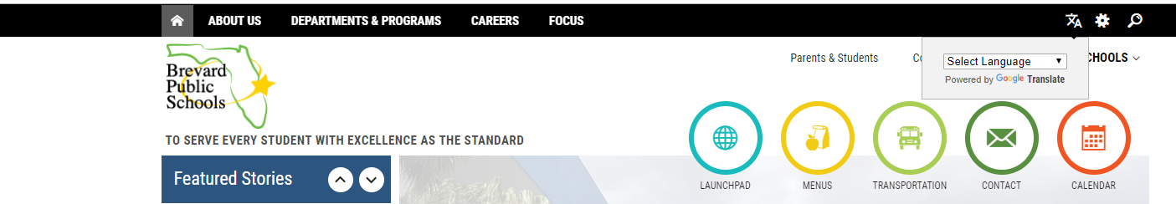
Ways to stay informed
https://www.brevardschools.org/ApolloES
Important information can be found at our school website: https://www.brevardschools.org/ApolloES
  On Apollo’s website you can find the school calendar, breakfast and lunch menus, upcoming events, FOCUS, and useful resources and important information.
  All information can be accessed using different languages using the following button:
FY24

Slide 25
Before you leave!
Please complete the Annual Meeting Feedback form.
Bring your survey and Scavenger Hunt to the cafeteria to receive a prize and enter the raffle.
Your opinions matter to us!
Monitor your child’s grades and stay in touch with their teacher!
Please consider volunteering in your child’s classroom this year! We’d love to have you!
FY24

