Slide 1
Retirement Benefits and
The Florida Retirement System (FRS)

Slide 2
Two FRS Retirement Plans:
Pension Plan
Investment Plan

Slide 3
New Hires and Plan Election Deadline
New employees have 8 months from their date of hire to choose their plan
If no election is made in 8 months, the employee will automatically be enrolled in the investment plan
Employees may change plans one time during their FRS career

Slide 4
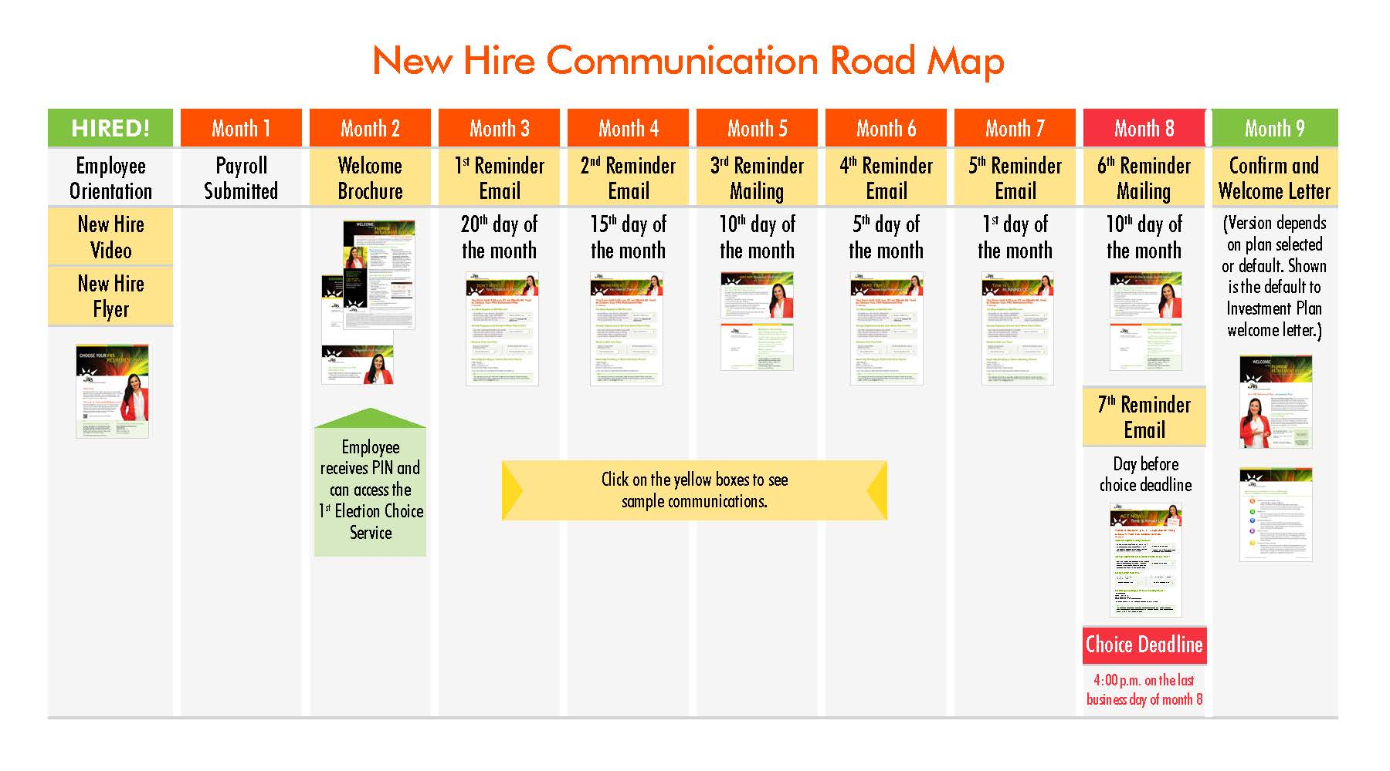

Slide 5
2nd Election
You only have one 2nd Election during your entire FRS career
Once you use your 2nd Election, your decision is final and you can never change plans again
It is highly recommended that you contact the FRS and speak with one of their financial counselors before making your one-time 2nd Election

Slide 6
Pension Plan
Traditional retirement plan
Vesting is 8 years
Employee contributes 3% monthly salary
Employer contributes 13.57% monthly salary

Slide 7
Pension Plan cont.
Retirement benefit is determined based on a formula of your age, FRS membership class, years of FRS service, and an average of your 8 highest years of salary
Upon retirement your benefit will be paid to you by monthly checks guaranteed for your lifetime

Slide 8
Vesting, Average Final Compensation, and Normal or Full Retirement
* Employees who have never worked for any FRS employer before 07/01/11.
Initially Employed before 7/01/11 | Initially Employed on or after 7/01/11 *
Vesting: After 6-years of service. | Vesting: After 8-years of service.
Average Final Compensation (AFC): Calculated on the average of the 5 highest fiscal years of salary. | AFC: Calculated on the average of the 8 highest fiscal years of salary.
Normal or Full Retirement: After 30 years of service at any age. At age 62 after vesting (6 years). After age 62 upon vesting (6 years). | Normal or Full Retirement: After 33 years of service at any age. At age 65 after vesting (8 years). After age 65 upon vesting (8 years).

Slide 9
Investment Plan
Similar to a 401 (k) type retirement investment plan
Vesting is 1 year
Employee contributes 3% monthly salary
Employer contributes 13.57% monthly salary

Slide 10
Investment Plan cont.
You decide how money is invested by selecting from the plan’s list of funds
Retirement benefit will be based on the amount of money you and BPS have contributed, plus investment earnings of chosen funds
Upon retirement your balance can be paid to you by lifetime monthly checks, a rollover to another plan, or a total payout
Renewed Membership: Beginning July 1, 2017, Investment Plan retirees are eligible for renewed membership in the Investment Plan only. Pension Plan retirees remain ineligible for renewed membership.

Slide 11
Termination Pay
Upon retirement from BPS, employees will receive a payout of their unused sick leave balance
There is no cap on the amount of sick leave hours that can be paid out
Employees that earn annual leave (vacation) will receive a payout of their unused vacation hours
The maximum vacation hours that can be paid is 480 hours (60 days)

Slide 12
Other Supplemental Retirement Plans Available
Many financial experts agree you should be at 80% of your pre-retirement income when you retire
Your FRS retirement and social security combined would be about 70% of your pre-retirement income
We recommend you consider investing in a Tax Sheltered Annuity (TSA) which could help to make up that 10% difference

Slide 13
Tax-Sheltered Annuity (TSA)
A retirement plan similar to 401 (k)
Taxes are not levied until money is withdrawn from the plan, usually at retirement
BPS offers 403 (b) and 457 (b), and a Roth 403 (b) and 457 (b) post tax deductions
Plan administration services for these plans are provided by TSA Consulting Group, Inc. (TSACG)

Slide 14
Contacts
BPS Retirement Office
633-1000, ext. 11260
Retirement@Brevardschools.org
Carlos Lorenzo - Retirement Supervisor
Ryan Evans – Retirement Specialist
Debra Gault – Administrative Secretary

Slide 15
Contacts cont.
MyFRS Financial Guidance Line
1-866-446-9377
www.myfrs.com
TSA Consulting Group:
1-888-796-3786
www.tsacg.com

Slide 16
Questions?

