Slide 1
Environmental Health & Safety Department
Code & Guidelines for school safety.
Fire Safety NFPA 1/101 and Florida Statutes Chapter 633.
Caring For Our Children Basics H&S Foundations for Early Care and Education.
Head Start Act
Public Playground Safety Handbook
State Requirements for Education Facilities (SREF)
Contact Info:
Jim Powers EH&S Manager 321-302-9168
Jeb Bynum EH&S Supervisor 321-302-9192
Rick Smith Lead EV Specialist 321-302-9197

Slide 2
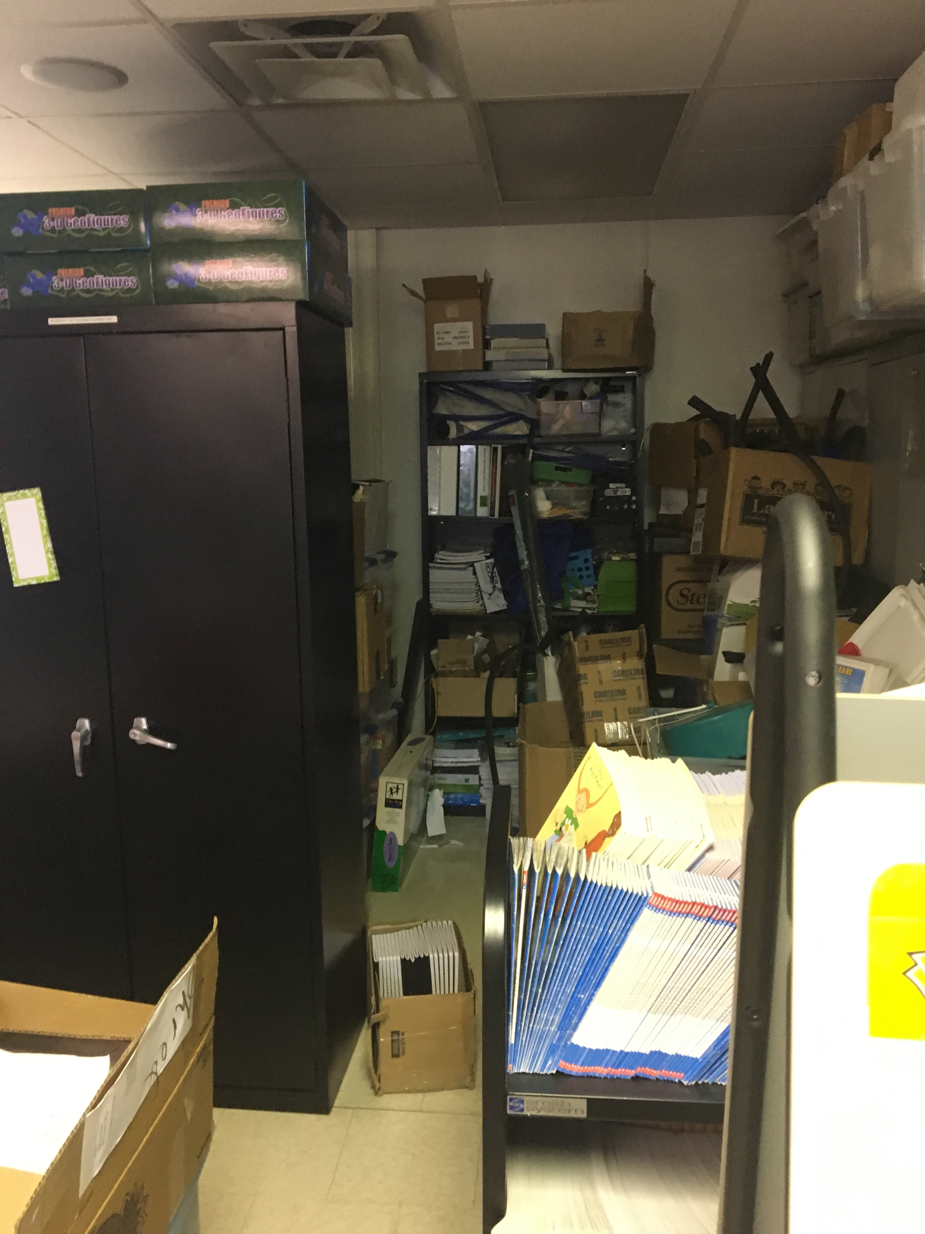
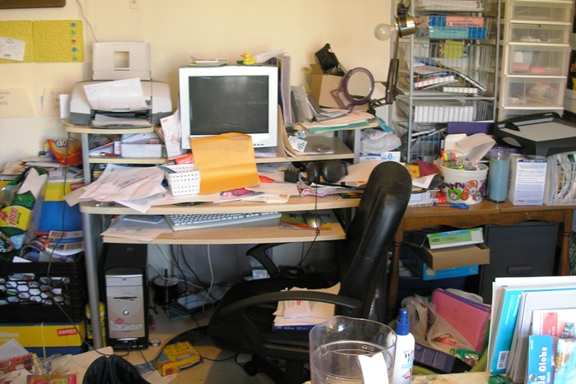
Classroom Safety –Shelter In Place
Clutter is a big safety item that needs to be addressed. Cluttered rooms can not be cleaned properly, create pest harborage and limit egress routes.

Slide 3
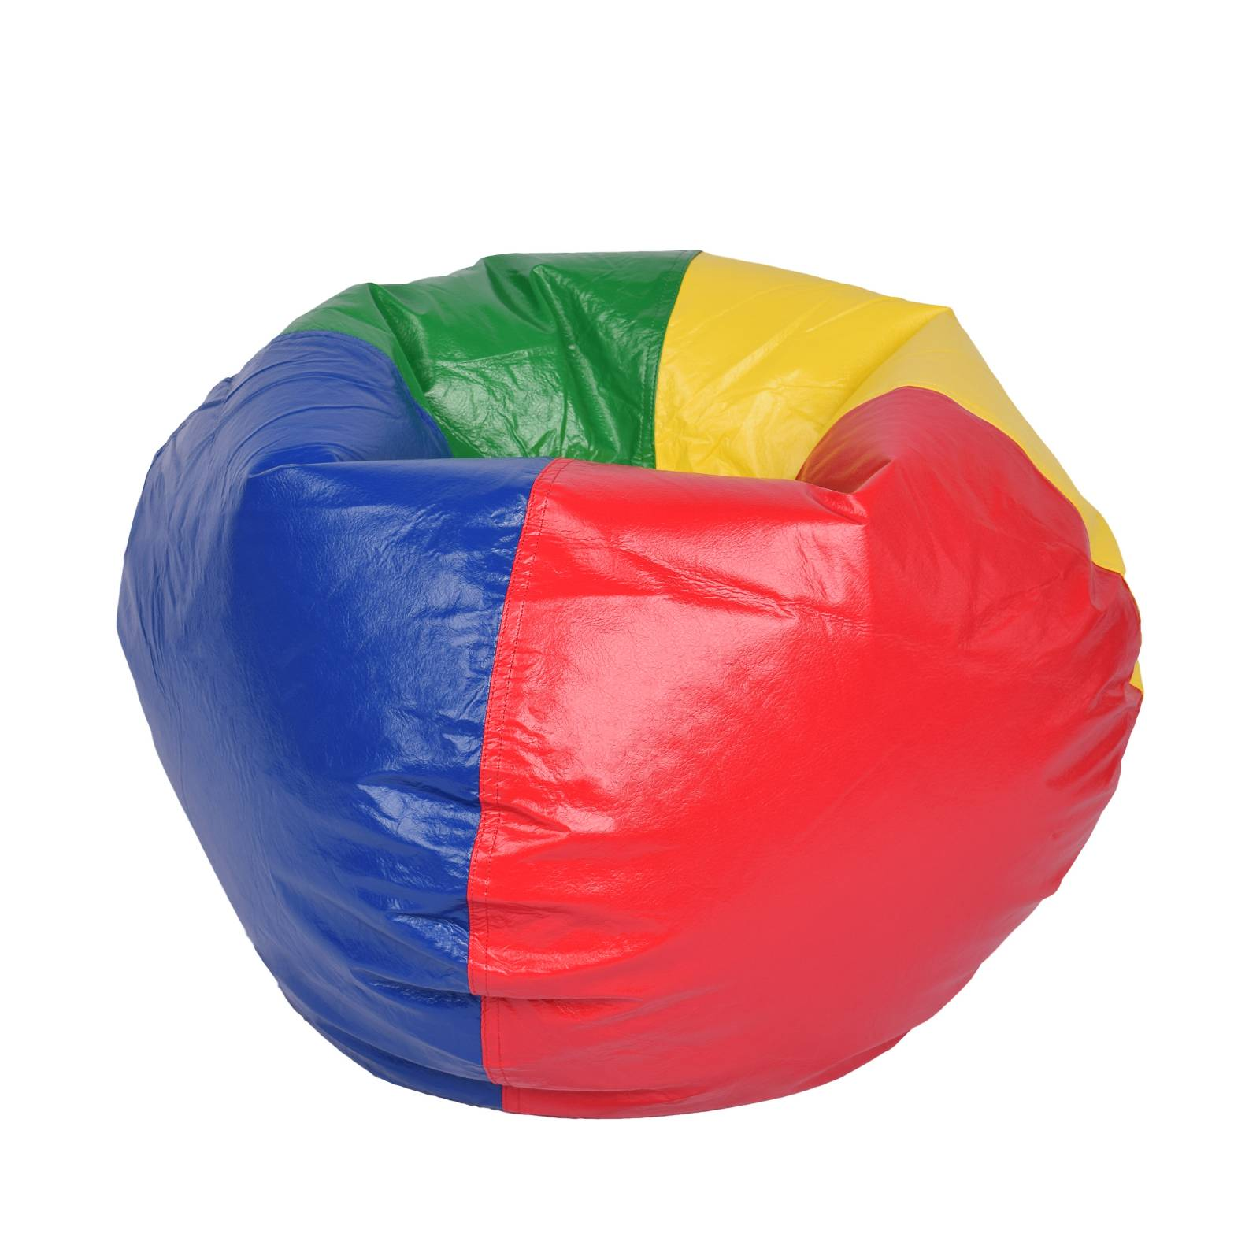
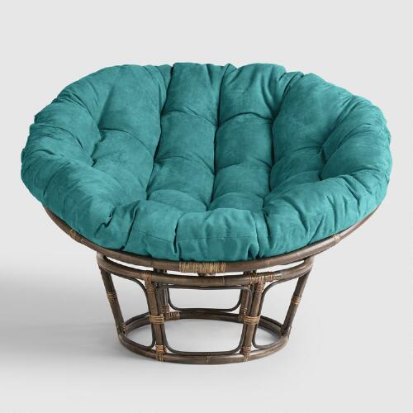
Bean Bags, Futons, Popasan chairs are not permitted Board Policy 8400/7420 NFPA 101 & 701 Must be cleaned per use or daily. Rated items shall be pre-approved.

Slide 4
Wall Coverings By Textiles. 20% if no fire sprinkler system and 50% if protected by fire sprinkler system. NFPA 101

Slide 5
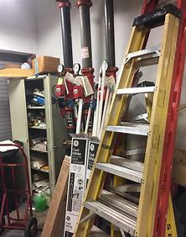
No storage within 18” of a sprinkler head/ceiling or within 24” of ceiling in a non-sprinkler building. Sprinkler Risers requires 3ft clearance.

Slide 6
Decoration can not be attached to rated ceilings, obstruct sprinkler heads or emergency/exit lighting. NFPA 101

Slide 7
Rugs Must Meet Class 1 Fire Safety Requirements / labeling NFPA 101 & Board Policy 8400

Slide 8
Aftermarket Spray On Fire Retardants Are Not Allowed For Use In BPS Facilities. Technical Bulletin 117 is not allowed in BPS Facilities.

Slide 9
Home Furniture, Beanbags, Tents & Umbrellas not permitted NFPA 101 & Board Policy 8400

Slide 10
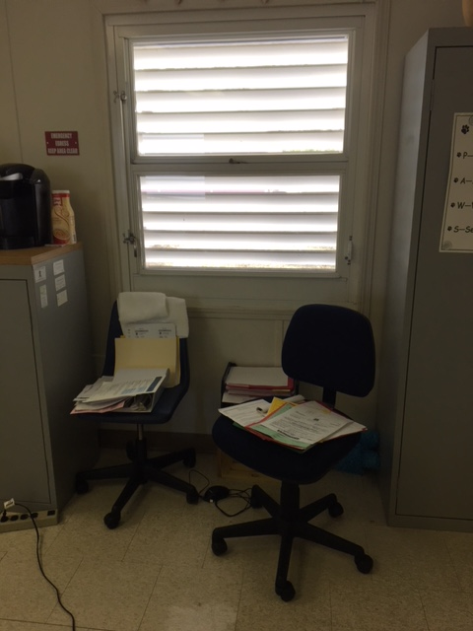
Emergency Exits Windows can not be blocked or covered.

Slide 11
Chemicals shall not be in reach of students Board Policy 8400

Slide 12
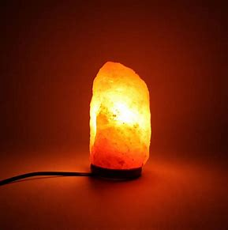
Indoor Air Quality
Can cause respiratory irritation. School staff observed dripping essential oils on salt rocks. No candles!
Board Policy 8400
This Includes Essential Oil Diffusers

Slide 13
Not allowed / can cover up building issues Board Policy 8400
Plug In Type
Automatic Sprayers

Slide 14
More items that can influence Indoor Air Quality not permitted
Candle Warmer
Indoor Compost Bins

Slide 15
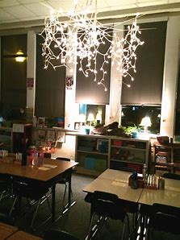
Items we need to keep out of classroom.
Microwaves, Coffee Makers, Household Electrical Cords, Holiday Lights, Heaters and Toaster Ovens. NFPA 101 Board Policy 8400

Slide 16
NFPA 101 15.7.3.1 Inspection
It shall be the duty of the principal, teachers or staff to inspect all exit facilities daily to ensure that all stairways, doors and other exits are in proper condition.

Slide 17
No Storage in Electrical / Mechanical Rooms. NFPA 101
Switch Gear Room
Boiler Room

