Slide 1
CCU FLORIDA IS A PROUD SPONSOR OF BREVARD PUBLIC SCHOOLS
ABOUT COMMUNITY CREDIT UNION
Community Credit Union is a member-owned, not-for-profit financial cooperative that was formed by a group of ten teachers back in 1953 in Titusville, Florida and was originally known as Brevard County Teacher's Credit Union.
Community Credit Union has a partnership with Brevard Public Schools, Eastern Florida State College, Florida Tech, municipalities, and other community organizations.
THE CCU MISSION
“Always improve the financial well-being of our members and make a positive difference in the community.”

Slide 2
HOW CCU FLORIDA SUPPORTS
BREVARD PUBLIC SCHOOLS
MASCOT DEBIT CARD PROGRAM
All public high schools receive a donation of $5,000 each year in non-discretionary funds for being part of the program. These schools can earn additional funds by participating in the School Bucks Program.
SCHOOL BUCKS DONATION PROGRAM
Participating schools can earn up to $900 per year PLUS debit and credit card registration donations of $5 each for schools selected by CCU members.
If your school would like to participate contact your
BPS Partners in Education Coordinator.
In 2022 CCU Contributed over $250,000 to BPS

Slide 3
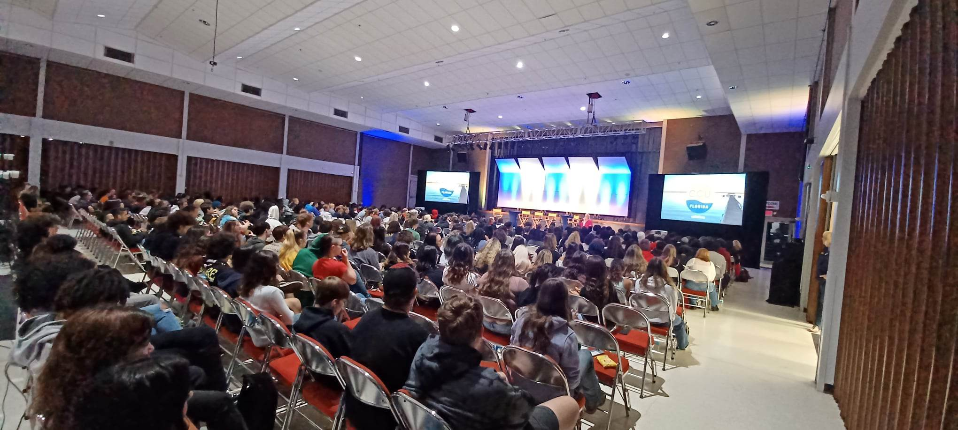
FINANCIAL LITERACY
CCU Florida works together with Junior Achievement for classroom presentations
Award Winning 321 Financial Liftoff Series
Started in 2022 CCU Florida presented the 321 Financial Litftoff program to over 1,000 BPS high schools, EFSC, and FIT students.
In spring 2023, on 3/21/23, CCU presented to over 800 students in one day.
CCU plans to continue the Financial Liftoff series by expanding to even more schools in 2023.
This concept was presented to CUNA, Credit Union National Association, and CCU won a national Diamond Award for Best Financial Education Program.

Slide 4
SPECIAL OFFERS
FREE CHECKING PLUS FOR STAFF
EARN A $125 BONUS, PLUS EARN DIVIDENDS WHEN YOU USE YOUR DEBIT CARD.
REFINANCE YOUR AUTO LOAN
KEEP YOUR CAR. REFINANCE YOUR AUTO LOAN TO CCU. WE’LL GIVE YOU A $225 BONUS! YOU CAN ALSO DEFER YOUR PAYMENTS UP TO 120 DAYS.
COMMUNITY HERO MORTGAGE LOAN
A HOME LOAN JUST FOR YOU! NO DOWN PAYMENT, GET UP TO 100% FINANCING, AND NO PMI REQUIRED.
AUTO PRO – FREE AUTO BUYING & ADVISOR SERVICE
DON’T SHOP ALONE! OUR EXCLUSIVE SERVICE HELPS YOU FIND THE VEHICLE YOU ARE LOOKING FOR BY WORKING OUR DEALER PARTNERS. IT’S NO HAGGLE OR HASSLE FOR YOU!

