Slide 1
CCU FLORIDA IS A PROUD SPONSOR OF BREVARD PUBLIC SCHOOLS
ABOUT COMMUNITY CREDIT UNION
Community Credit Union is a member-owned, not-for-profit financial cooperative that was formed by a group of ten teachers back in 1953 in Titusville, Florida and was originally known as Brevard County Teacher's Credit Union.
Community Credit Union has a partnership with Brevard Public Schools, Eastern Florida State College, Florida Tech, municipalities, and other community organizations.
THE CCU MISSION
“Always improve the financial well-being of our members and make a positive difference in the community.”

Slide 2
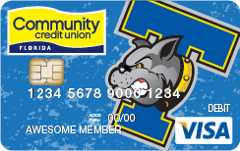
HOW CCU FLORIDA SUPPORTS
BREVARD PUBLIC SCHOOLS
MASCOT DEBIT CARD PROGRAM
All public high schools receive a donation of $5,000 each year in non-discretionary funds for being part of the program, totaling $90,000. These schools can earn additional funds by participating in the School Bucks Program.
SCHOOL BUCKS DONATION PROGRAM
Participating schools can earn up to $900 per year PLUS debit and credit card registration donations of $5 each for schools selected by CCU members. Those numbers add up. Last year alone the participating schools earned $30,000 in registrations.
If your school would like to participate contact your BPS Partners in Education Coordinator.

Slide 3
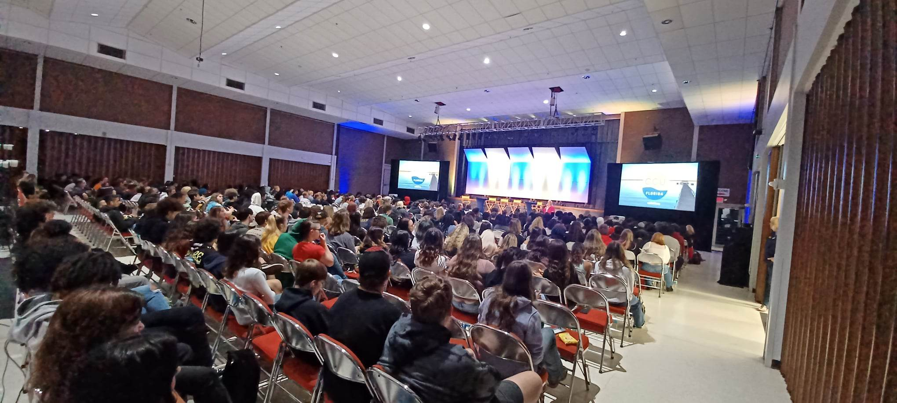
FINANCIAL LITERACY
CCU Florida works together with Junior Achievement for classroom presentations
Award Winning 321 Financial Liftoff Series
Started in 2022 CCU Florida presented the 321 Financial Litftoff program to over 1,000 BPS high schools, EFSC, and FIT students.
In spring 2023, on 3/21/23, CCU presented to over 900 students in one day.
CCU plans to continue the Financial Liftoff series by expanding to six high schools on 3/21/24 at the King Center of Melbourne.

Slide 4
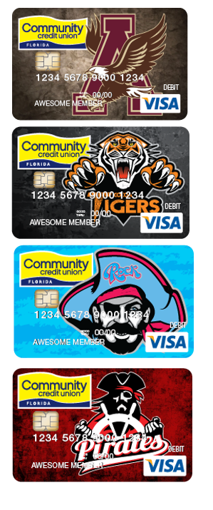
ATHLETIC SPONSORSHIP AND STUDENT ADVISORY BOARD
CCU HAS A PILOT PROGRAM WITH
Astronaut High School
Cocoa High School
Rockledge High School
Palm Bay Magnet High School
In addition to the Mascot Debit Program
The Athletic Sponsorship will provide an additional contribution for CCU presence at football. Basketball, track, volleyball, etc. Two sports are chosen per school as per their Athletic Director.
Student Advisory Board Program
Three students from each school, a sophomore, junior, and senior, will be chosen from the four participating schools.
Help CCU understand at ground level the concerns and needs of our high school students
Students will participate in the 321 Financial Liftoff
Experience what it is like to be on an advisory board
Receive a stipend/scholarship for participating
Contribute to their college resume or life experience

Slide 5
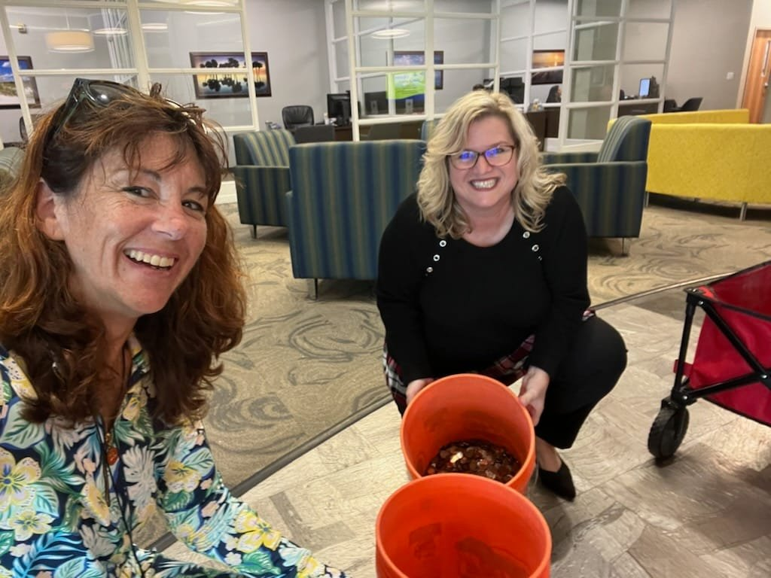
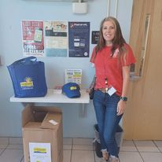
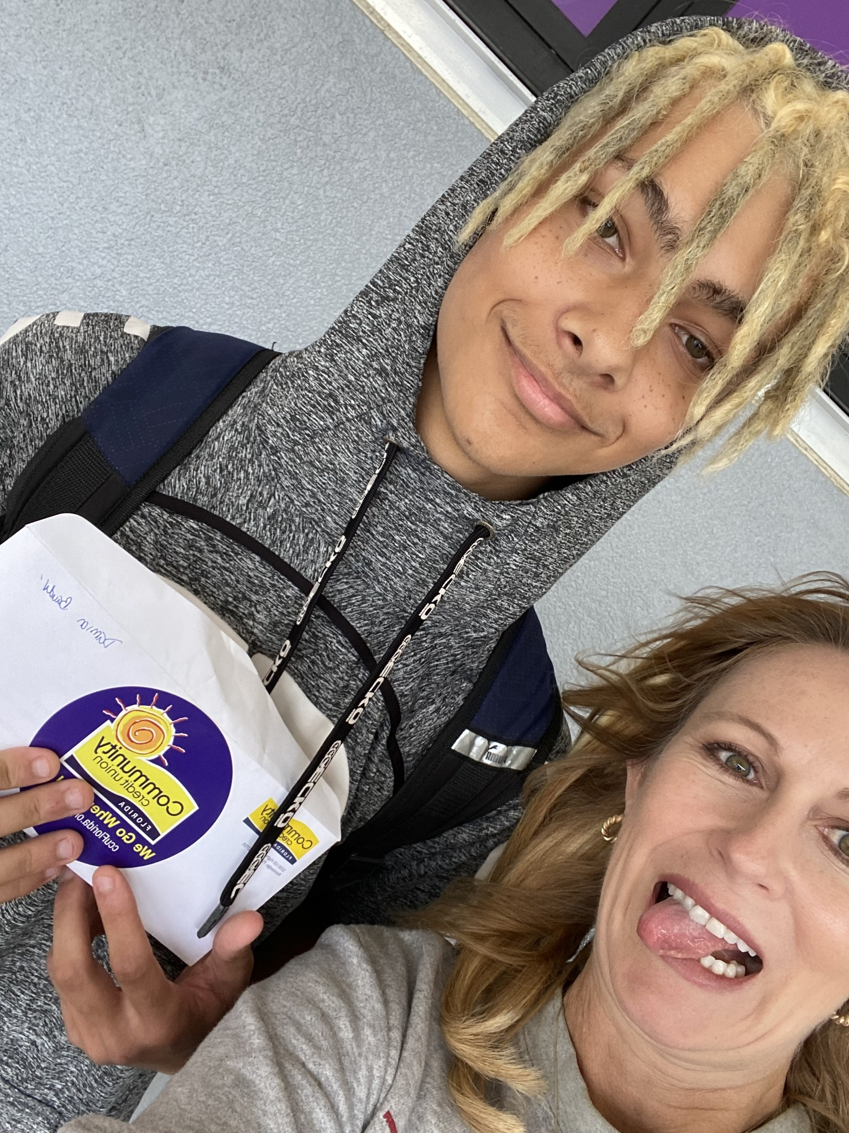
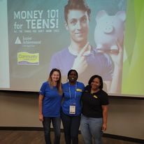
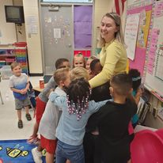
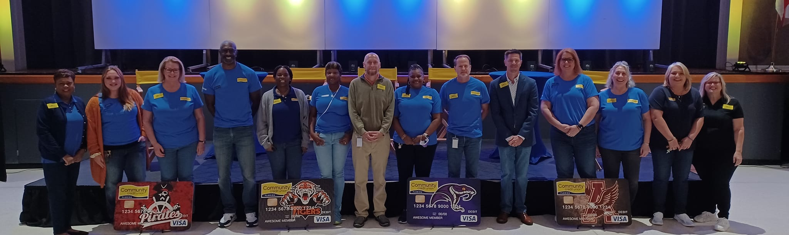
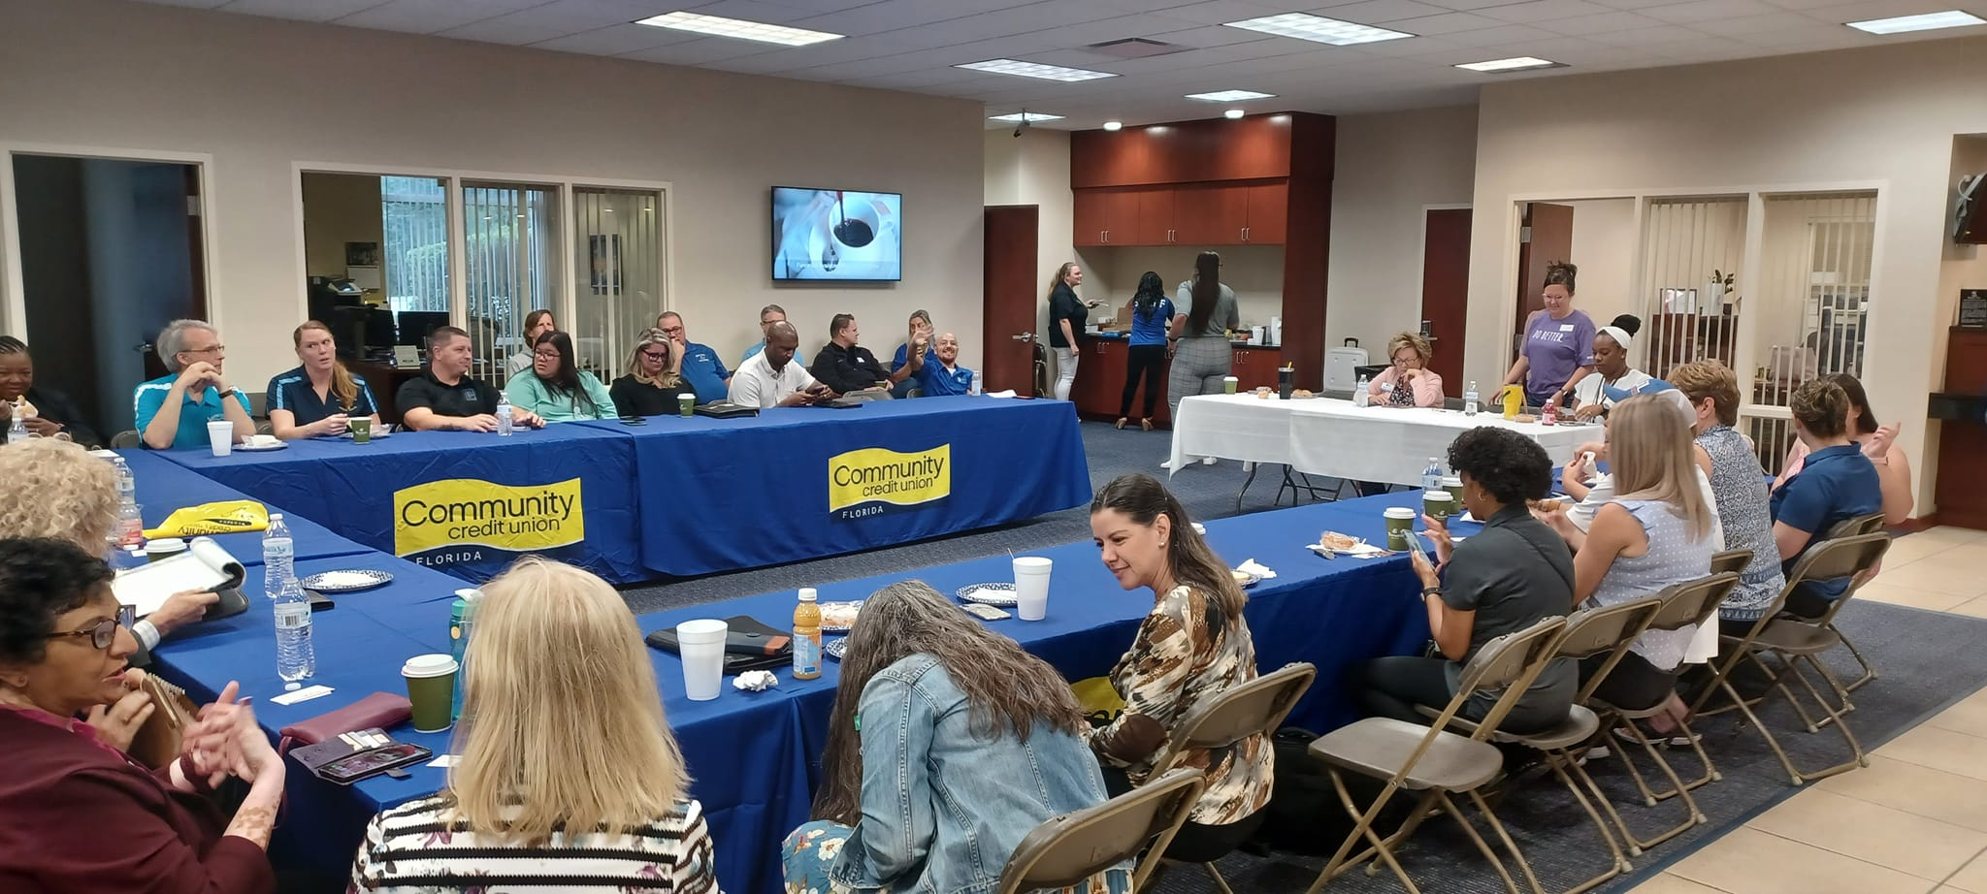
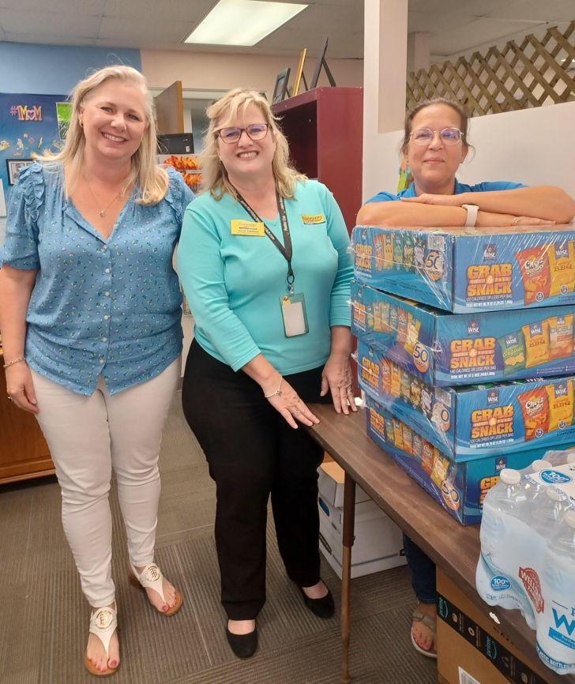
HOW CCU FLORIDA SUPPORTS
BREVARD PUBLIC SCHOOLS
In 2022 CCU Contributed over $250,000 to BPS
Work with all PIE Coordinators in BPS
2023/2024 Supports a Student Advisory Board with High Schools
2023/2024 Athletic Support with High Schools
321 Financial Liftoff
K-12 Financial Presentations
High School Mascot Debit card Program
School Bucks Donation Program
Money Masters Branch Stipend
Employee of the Year
Teacher of the Year
ABC Awards
Principal and Assistant Principal of the Year
TACC Education Committee and Scholarship
Transportation Department Support
Leadership Conferences
Community Hero Month
Volunteering in our schools and community
More

Slide 6
SPECIAL OFFERS
FREE CHECKING PLUS FOR STAFF
EARN A $125 BONUS, PLUS EARN DIVIDENDS WHEN YOU USE YOUR DEBIT CARD.
MAXIMIZE YOUR SAVINGS
CCU OFFERS A 13 MONTH CD @ 5% WITH A MINIMUM OF $1,000
CD
COMMUNITY HERO MORTGAGE LOAN
A HOME LOAN JUST FOR YOU! NO DOWN PAYMENT, GET UP TO 100% FINANCING, AND NO PMI REQUIRED.
AUTO PRO – FREE AUTO BUYING & ADVISOR SERVICE
DON’T SHOP ALONE! OUR EXCLUSIVE SERVICE HELPS YOU FIND THE VEHICLE YOU ARE LOOKING FOR BY WORKING OUR DEALER PARTNERS. IT’S NO HAGGLE OR HASSLE FOR YOU!

