Slide 1
Suspicion of Child Abuse
Your responsibilities as a BPS employee

Slide 2
Mandatory Reporting of Child Abuse, Abandonment and/or Neglect
To comply with appropriate Florida law which makes mandatory the reporting of child abuse, abandonment, and / or child neglect, any teacher or other school employee who knows or has reasonable cause to suspect that a child has been:
subject to abuse, abandonment, neglect or
a child is in need of supervision and care and has no parent, legal custodian, or responsible adult relative immediately known and available to provide supervision and care shall immediately report such knowledge or suspicion to the Department of Children and Families at the statewide toll-free hotline: 1-800-96-ABUSE.
→ Reporting suspected abuse to your supervisor is not sufficient.

Slide 3
What is a “mandatory reporter”?
In Florida, a mandatory reporter is any person who knows, or has reasonable cause to suspect, that a child is abused, abandoned, or neglected by a parent, legal custodian, caregiver or other person responsible for the child’s welfare, as defined in this chapter, or that a child is in need of supervision and care and has no parent, legal custodian, or responsible adult relative immediately known and available to provide supervision and care shall report such knowledge or suspicion to the department in the manner prescribed in subsection

Slide 4
Report Child Abuse if you know, suspect, or someone tells you about:
Physical abuse
Sexual abuse
Child-on-Child Abuse
Neglect
Abandonment

Slide 5
Reporting Suspected Abuse / Neglect
Known or suspected child abuse, neglect or abandonment must be reported immediately to the Department of Children & Families Central Abuse Hotline:
1-800-96ABUSE
(1-800-962-2873)
This Photo by Unknown Author is licensed under CC BY-SA

Slide 6
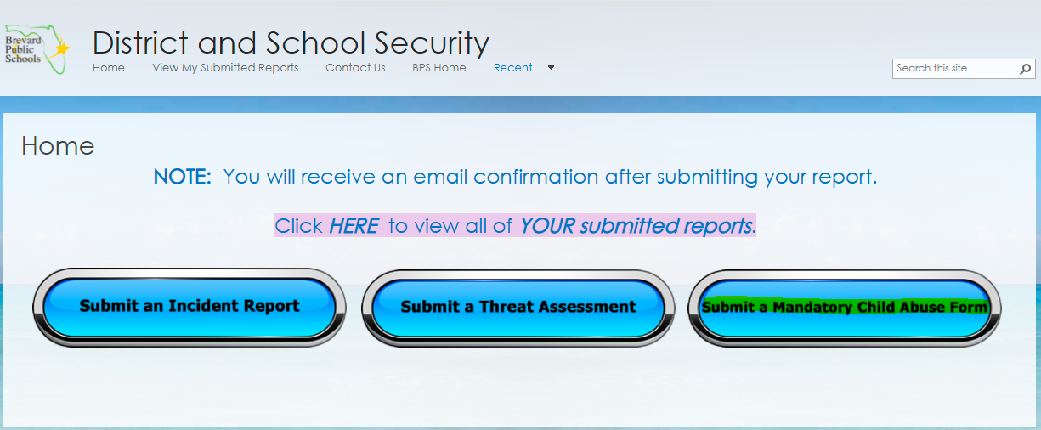
Submitting a Mandatory Child Abuse Form
You must be logged into the BPS site to access this site.

Slide 7
Additional Training Requirement by Job Type
Employees with Brevard Public Schools in the classifications below are required to complete a Child Abuse Training and Reporting course through the Department of Children and Families. This course is a one-time requirement per Florida Statute § 1012.98(12).
Prek-12 Teachers
Certified school counselors
Guidance services professionals
School psychologists
Behavior analysts
Social workers
Resource teachers for attendance
Principals
Assistant principals

Slide 8
Required Additional Training, cont’d.
The training can be accessed at https://www3.fl-dcf.com/RCAAN/
The web-based course is approximately one hour in length.
After the training has been completed, print the certificate and provide it to the site in-service representative.
This Photo by Unknown Author is licensed under CC BY

