Slide 1
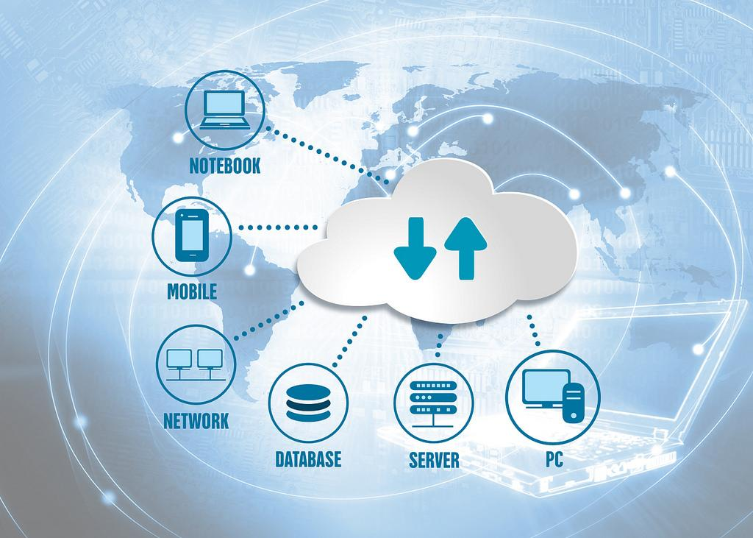

Educational Technology for New BPS Employees

Slide 2








Technology Integrators Support and Links
This presentation: https://bit.ly/3aJu2D3
Website: https://www.brevardschools.org/BrevardEdTech
2021-2022 School Assignment List: http://bit.ly/2NNLITk
Group Email: ETTeachers@BrevardSchools.org
Current Training Classes: https://goo.gl/mZQqJx
OUr Team
Gina Clark
Melissa Woods
Katy McGregor
Rob Klaasen
Anne Graham
Michelle Marshall
Gabi Bollaert
Rochelle Schneider
Notes:
Click the link to show on site
Talk about PD
8 of us
Offer Tech Help
Training in school, classrooms, here at ESF
Go into classrooms & model lessons integrating tech, STEM, iPads, Blended learning
Troublshoot…
Help with any apps teachers may use
Focus
LaunchPad
TExtbooks
Google Apps
Microsoft apps

Slide 3
BPS Applications

Slide 4

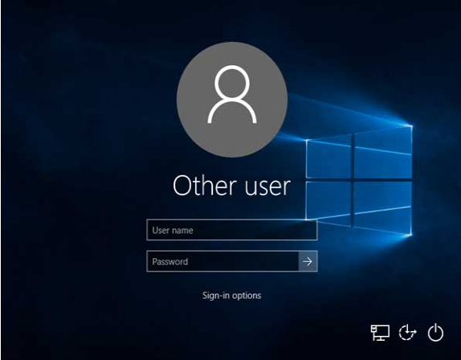
BPS Applications
Microsoft Network Active Directory (AD)
Notes:
Every BPS employee has an account in the network active directory. Your AD account establishes your credentials and your email.

Slide 5
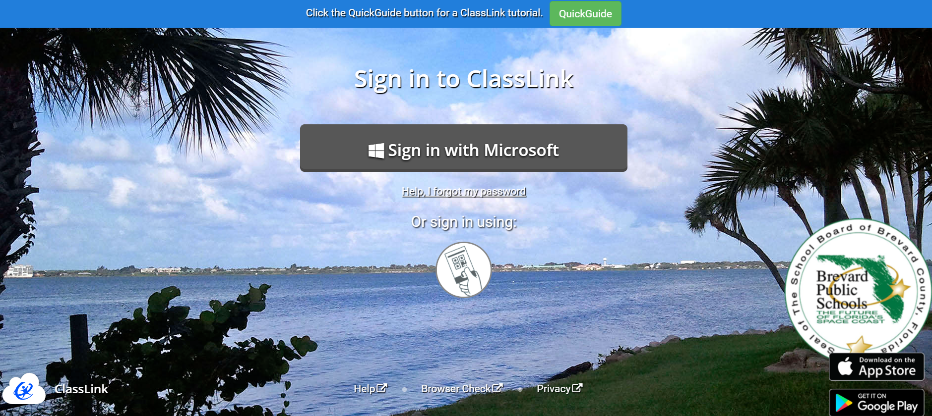
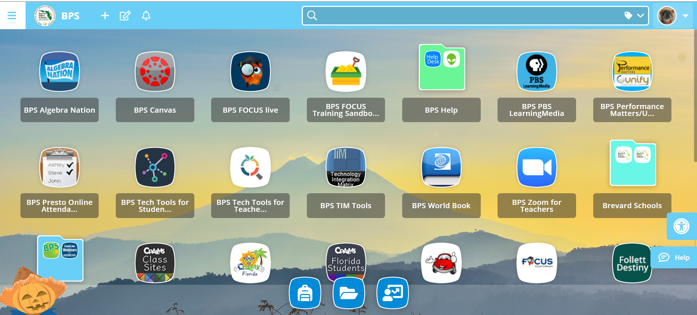
BPS Applications
Launchpad
Notes:
Launchpad is a personal cloud-based desktop that gives you single sign on access to BPS applications. Once you sign in, you have access to BPS programs like ProGoe, Google accounts, the Focus gradebook, and many other resources that are available based on your job description. Make sure you see the Indian River image when logging into Launchpad.

Slide 6

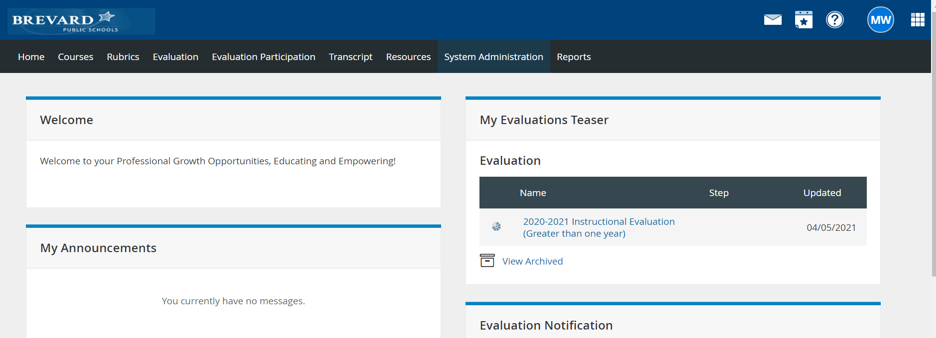
BPS Applications
ProGoe
Notes:
This is the tool for professional development offerings and the evaluation system.

Slide 7



BPS Platforms

Slide 8

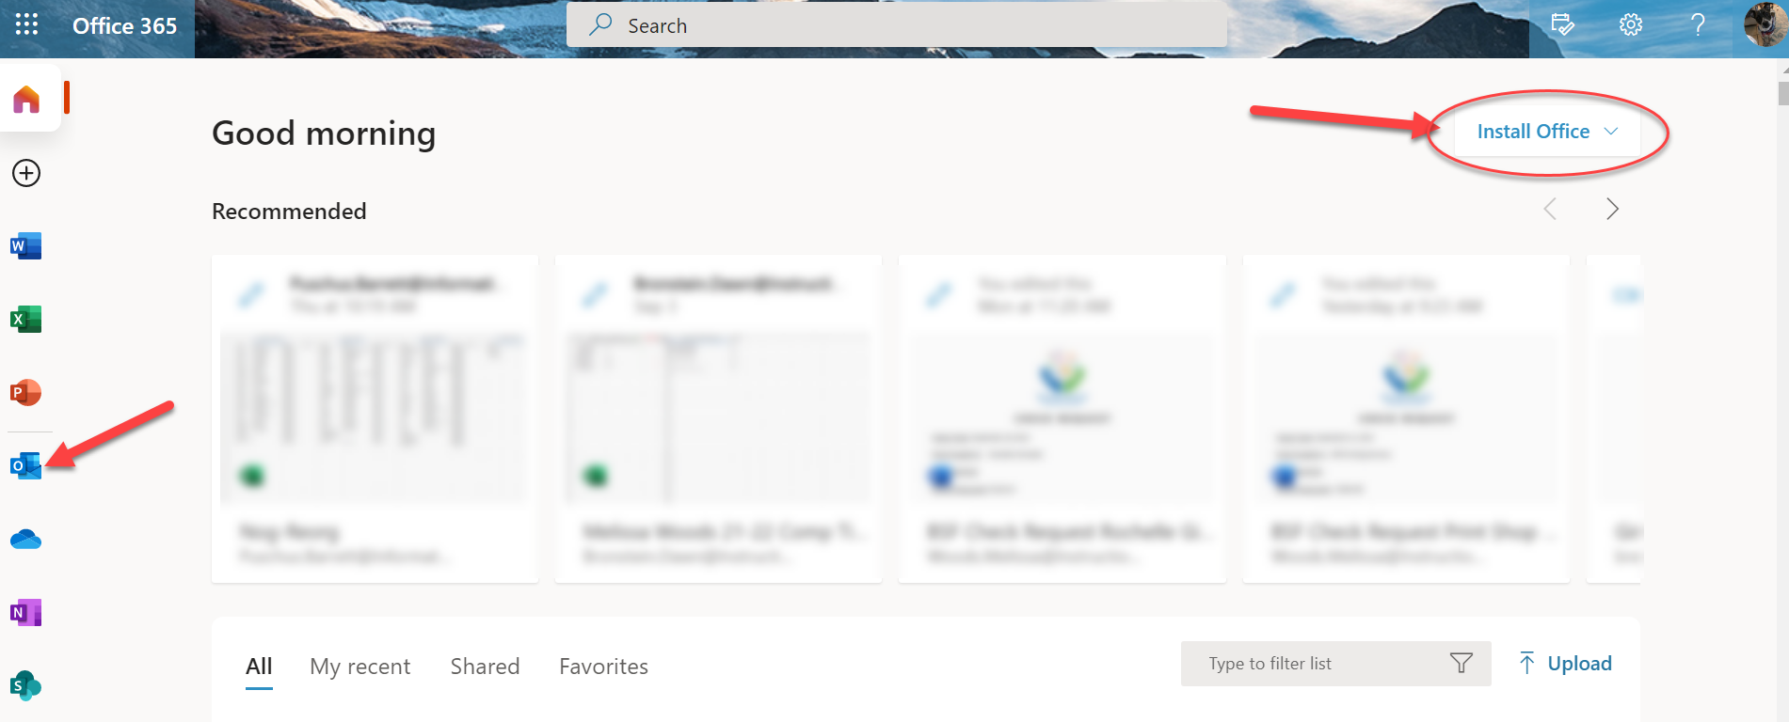
BPS Applications
Office 365
Notes:
Access your email anywhere online through the office 365 app. This also gives you access to the online 365 suite and you can install that on up to five devices from this landing page. Discuss apps available.

Slide 9

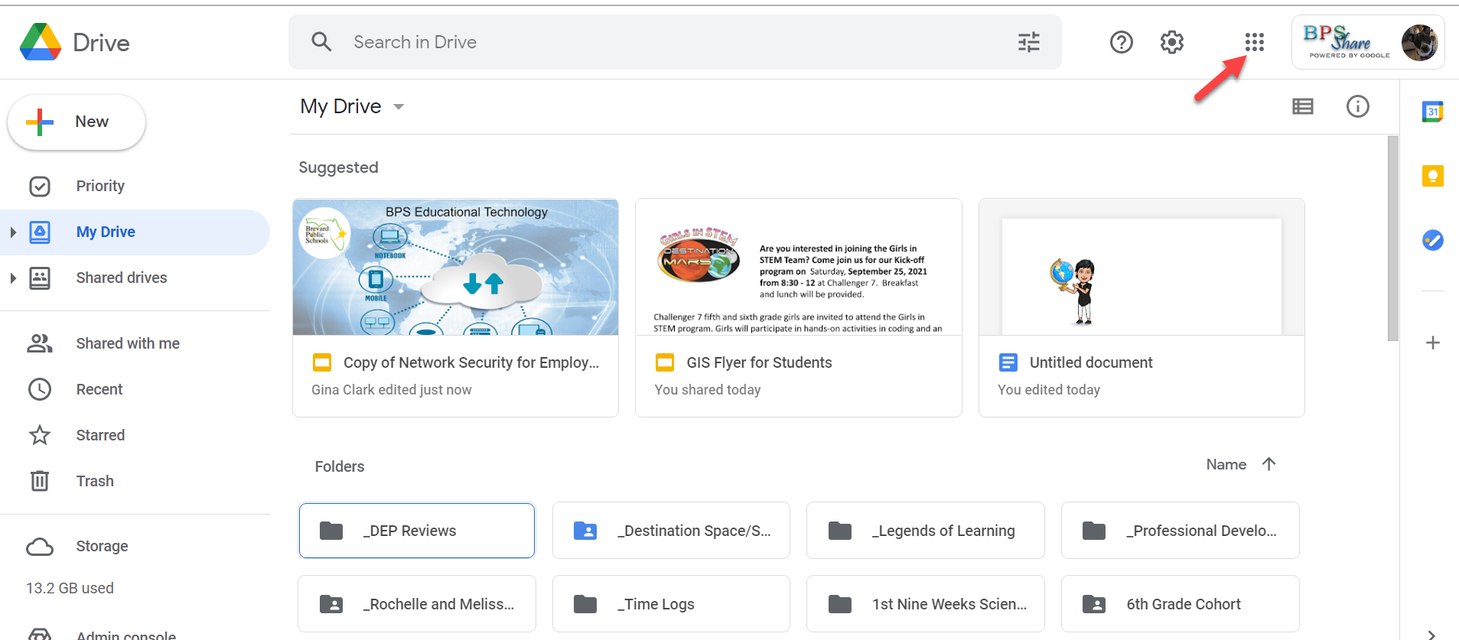
BPS Applications
Google Share Account
Notes:
Access your google apps anywhere online with your Google Share app. Google Drive is your cloud-based file manager for any Google documents. This also gives you access to the online Google for Education apps. Discuss waffle and apps available.

Slide 10
Passwords

Slide 11
Password Requirements
Active Directory Password Requirements
Active Directory (AD) Passwords must contain
A minimum of 15 characters
At least 1 uppercase letter
At least 1 lowercase letter
At least 1 number
At least one special character/symbol (for example !, @, #, $, % and/or space)
Passwords cannot
Be changed more than once a day
Include any part of your name
Be the same as the previous 24 passwords
Example of a strong password:
SK!ll3Tr0cks!20
Notes:
You are required to change your password every 90 days.

Slide 12
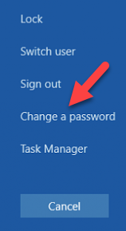
Resetting BPS Password
Press Ctrl, Alt, and Delete at the same time Then select Change a password

Slide 14
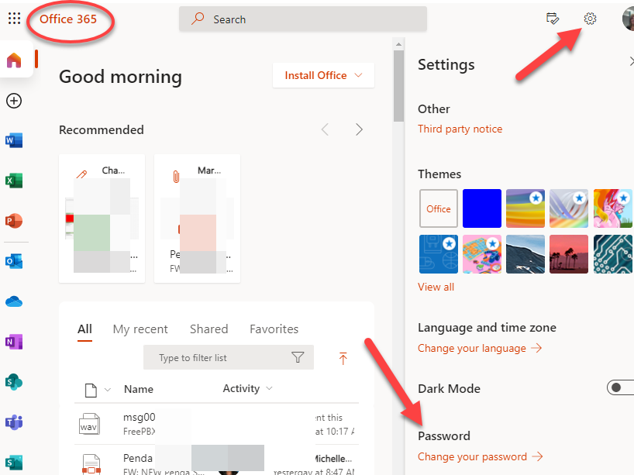
Resetting BPS Password

Slide 15
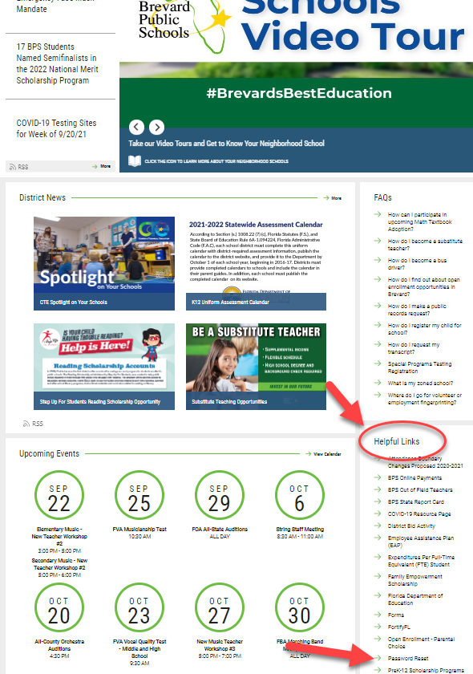

Unlock & Reset BPS Password
https://PasswordReset.Brevardschools.org
Notes:
Password Reset link is on District Website under Helpful Links

Slide 16
BPS Employee Email

Slide 17

Outlook Desktop Email
Use the Outlook Desktop app
Check your email
Organize meetings and appointments in your calendar
Schedule Zoom and Teams meetings
Notes:
If you prefer to use Outlook instead of Microsoft 365 to access your email you can check with your tech specialist to set up.

Slide 18

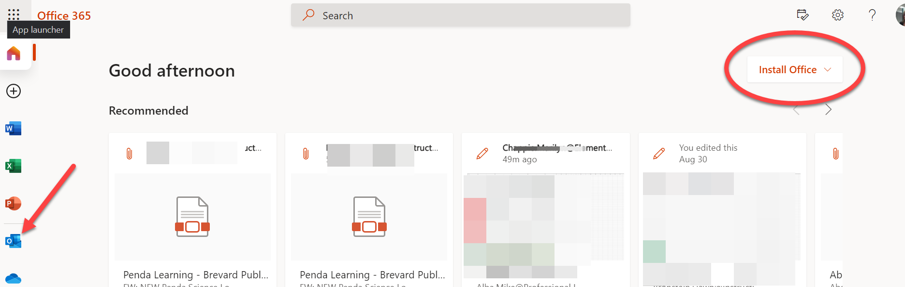
Cloud Email
Access Email away from work
Click the Office 365 app
Click the Outlook icon on the left

Slide 19
Email
Use
Intended for official district business
Occasional use for personal reasons is acceptable when cannot reach people by phone
Must follow copyright law
Is public record and may be open for inspection
Attachments
Do not open from unknown people or sources
When in doubt, confirm with the sender before opening any attachment
If an attachment is opened and the computer behaves strangely, report to your school or department tech associate
Electronic Mail Procedures - http://www.neola.com/brevardco-fl/search/ap/ap7540.05.htm
Notes:
Email considerations

Slide 20
Email
Prohibited Use
Political activity, political or religious advocacy, or activities on behalf of organizations not associated with the district
Non-work surveys, contests, chain letters, junk e-mail
Advertising or offering to sell or buy goods for any personal purpose
Subscriptions to daily jokes, horoscopes, recipes, or other similar items
Signature Block
Should contain employee’s name, position/title, building, address, phone number and nothing else
Should NOT contain quotes, graphics, links, etc.
Electronic Mail Procedures - http://www.neola.com/brevardco-fl/search/ap/ap7540.05.htm

Slide 21
Email Signature Stamp
Due to Florida's broad public records law, most written communications to or from government employees regarding public education are public records. Therefore, this e-mail communication may be subject to public disclosure.
Notes:
On email that goes outside of the District

Slide 22
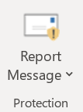
Email Security Response
Emails from outside entities - Yellow Banner
  Less trustworthy emails, high caution with links and attachments
Suspect a phishing email attempt?
  Do Not Open
  Screenshot--Do Not Forward
  Send screenshot to tech associate
  Delete without opening (or taking action in preview)
Use “Report Message” button to report phishing or junk
email
Be suspicious of everything….

Slide 23
Network Security

Slide 24

Expectation of Privacy
BPS Network is Monitored
All information on this computer system or network resources may be intercepted, recorded, read, copied and disclosed by authorized personnel for official purposes, including criminal investigations.
Brevard Public Schools
This is a Brevard Public School (BPS computer system, which may be accessed and used ONLY for authorized BPS business by authorized BPS personnel and BPS students. All system usage and user data is subject to monitoring and audit. Unauthorized access or use of this computer system may subject violators to criminal, civil, and/or administrative action.
All information on this computer system or network resources may be intercepted, recorded, read, copied, and disclosed by and to authorized personnel for official purposes, including criminal investigations.
Such information includes sensitive data encrypted to comply with confidentiality and privacy requirements. Access or use of this computer system and any network resources by any person, whether authorized or unauthorized, constitutes consent to these terms.
By selecting OK and proceeding with a logon, you are agreeing that you have read, understand and have signed a Brevard Public Schools Acceptable Use Policy (AUP) for students or staff.
(Students Form 7540.03 F1 or Staff Form 7540.04 F1)
Always lock your PC when leaving it unattended by pressing Win+L or pressing Control, Alt, Del and selecting Lock Computer.
Notes:
Keep in mind that everything you do on your computer is not private, subject to monitoring, and can be made available through a public records request.

Slide 25
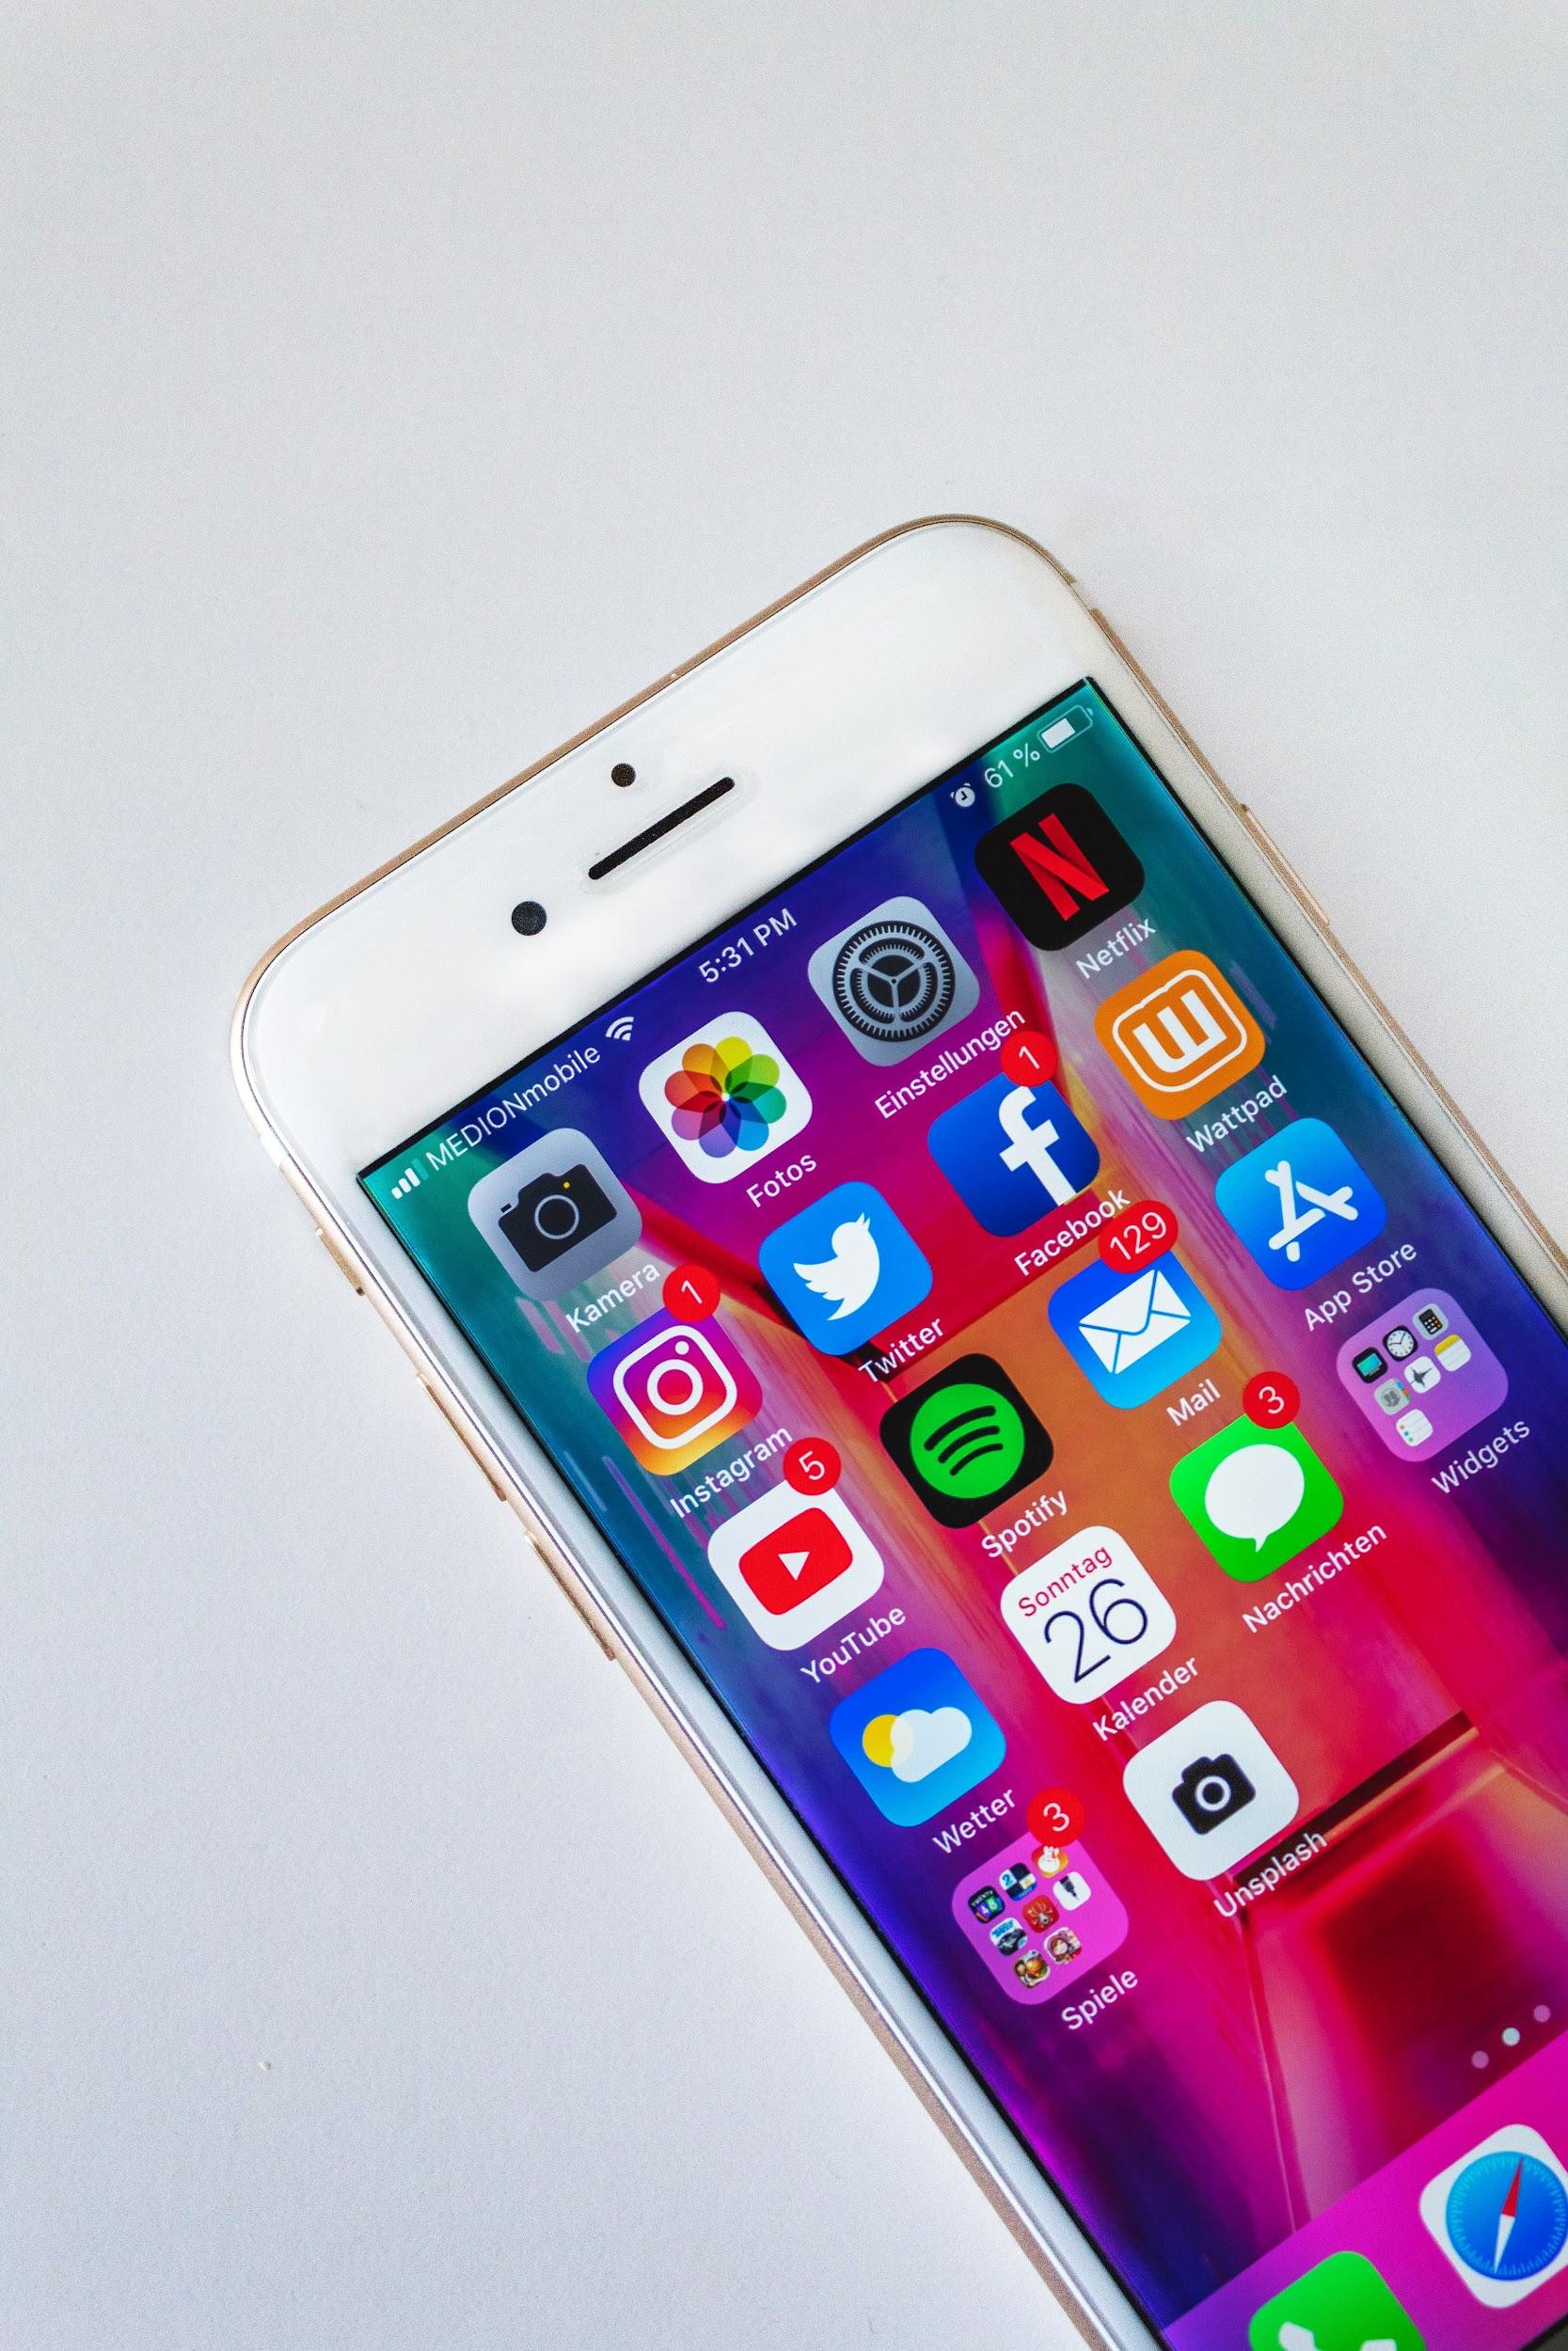
Personal Devices
Should I connect to BPS Networks on My Personal Devices?
It is your choice. Anytime you are on a device that is connected to the BPS network, assume that you are being monitored.
BPS Policy States - The wireless access user also agrees to and accepts that his/her access and/or connection to the Board's networks may be monitored to record dates, times, duration of access, data types, and volumes, etc., in order to identify unusual usage patterns or other suspicious activity. As with in-house computers, this is done in order to identify accounts/computers that may have been compromised by external parties.
Notes:
Personal decision, any personal device on a BPS network is subject to the same monitoring as your work device.

Slide 26

Safeguarding Information
Passwords
Don’t share your password with anyone
Have unique passwords for each program
Store passwords in a secure location
BPS Policy States - Staff members may only access the network by using their assigned network account. Use of another person's account/address/password is prohibited. Staff members may not allow other users to utilize their passwords. Staff members may not go beyond their authorized access.
Notes:
Sharing your credentials is not a good idea because what other people do on your device while logged in as you will be considered your action. You have to rely on them to do the right thing. Don’t put yourself out there.

Slide 27
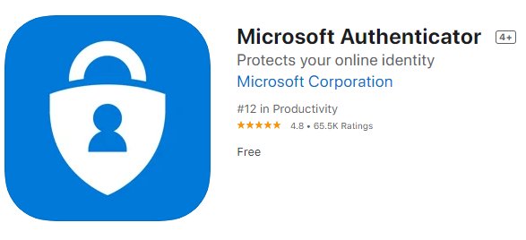
Safeguarding Information
Consider setting up multi-factor authentication if you would like to access your account outside of the BPS network.
Go to bit.ly/33RzT5Y for directions
Don’t include any personal information in emails (full names, SSN, addresses, etc). Use employee ID or student ID to communicate sensitive information.
BPS Policy States -Staff members are reminded that personally identifiable student information is confidential and may not be disclosed without prior written parental permission. It is the responsibility of staff members to protect any District data kept on staff member equipment (PC, laptop, portable drives, CD's, etc.). Due diligence must be exercised in keeping this information secured. Protection (physical and/or software) measures should be used when transporting any critical data from or between District sites.
Notes:
Multi-factor authentication provides an added layer of protection. Don’t include personal information in emails.
bit.ly/33RzT5Y

Slide 28
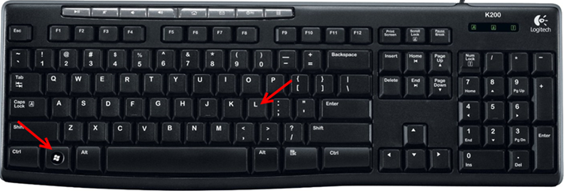
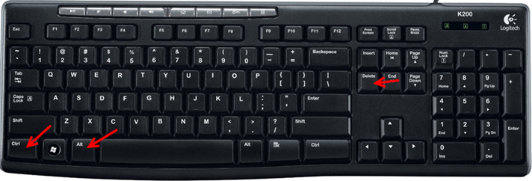
Locking Physical Devices
Lock your computer when you are not supervising it!
To quickly lock your computer, press the “Windows” and “L” keys at the same time. (On a Mac use control + shift + power).
To unlock your computer, press the “Ctrl”, “Alt” and “Delete” keys at the same time and sign back in.
Notes:
Don’t walk away without locking your computer

Slide 29

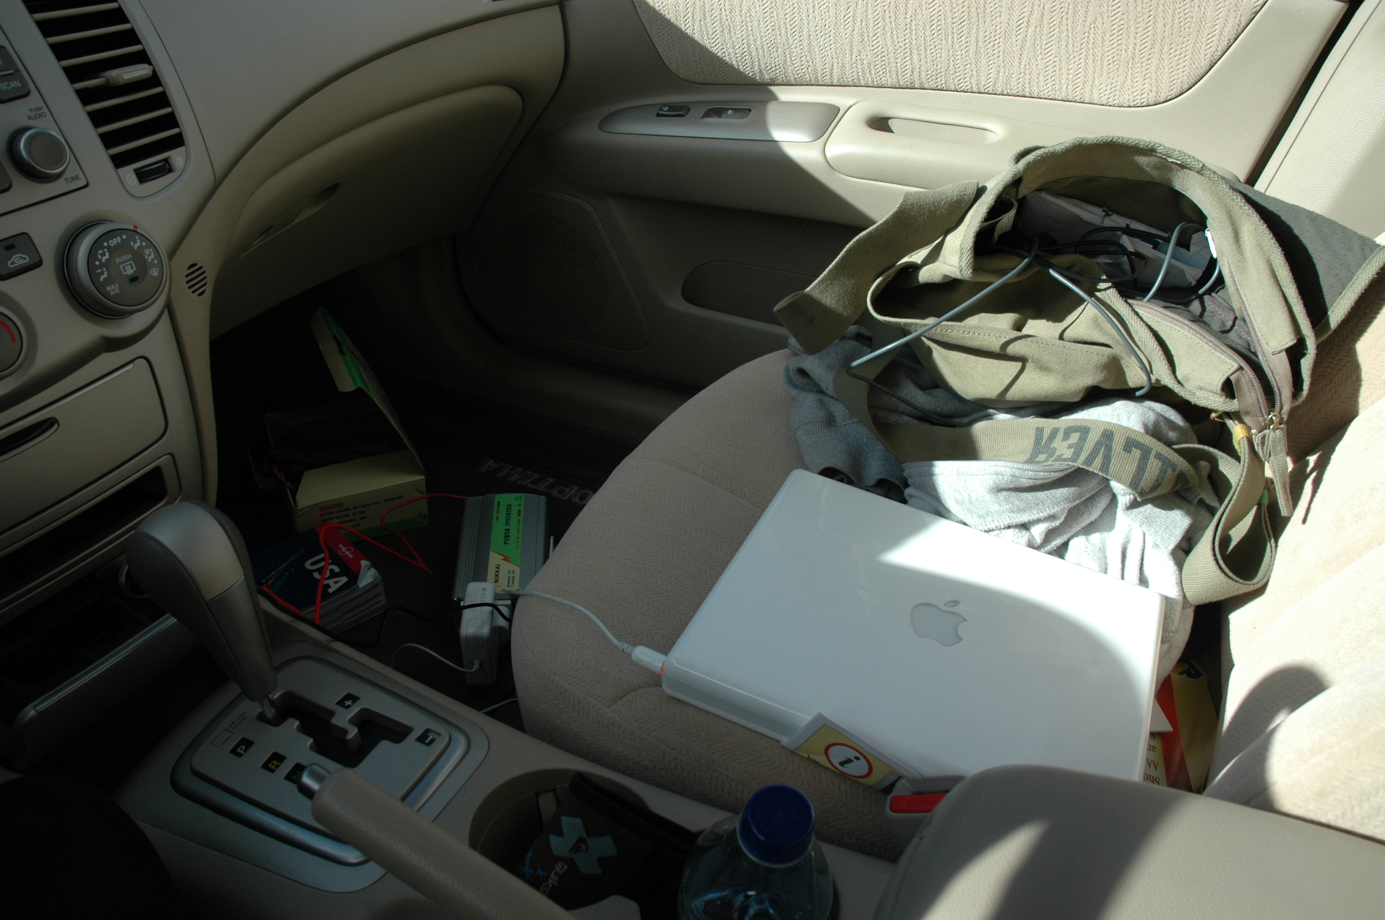

Physical Devices Care
Proper Transport and Care of your Computer
If device malfunctions, is stolen, damaged, or compromised, see your school or department tech specialist.

Slide 30

Physical Devices Usage
Use Caution When:
Connecting to non-BPS networks
Giving substitutes access to your device
Allowing a student or co-worker to use a device when you are logged in
Allowing a family member to access a take home device
Notes:
Remember you are responsible for anything anyone else does on your device when you are logged in. (Discuss each bullet)

Slide 31
Acceptable Use Policy (AUP)
Includes:
Any use of the network for commercial purposes (e.g., purchasing or offering for sale personal products or services by staff members), advertising, or political lobbying is prohibited.
If a staff member inadvertently accesses material that is prohibited, s/he should immediately disclose the inadvertent access to the building principal. This will protect the staff member against an allegation that s/he intentionally violated this provision.
All communications and information accessible via the Internet should be assumed to be private property (i.e., copyrighted and/or trademarked). All copyright issues regarding software, information, and attributions/acknowledgement of authorship must be respected.
Notes:
All employees sign an AUP upon hiring. This is an agreement that you will use the network and technology appropriately.

Slide 32
FERPA
FERPA - The Family Educational Rights and Privacy Act
FERPA is a federal law that requires confidentiality by telling what information it may share, and when and with whom they may share such information. It also gives the parents the right to consent to disclosure of their child’s personally identifiable information (PII)
Educational Records
Directory Information vs. Non-Directory Information
Notes:
Human Resources will give you more information on this. Educational Technology closely follows FERPA guidelines when selecting Educational Software and Programs for students.

Slide 33
FERPA
Directory
Not considered harmful to students if publically released:
First Name
Age
Grade Level
Non-Directory
Non-Directory are more sensitive than directory information:
Social Security
Student ID Numbers
Academic Grades
Disciplinary History
Attendance Records
Student Schedules
Notes:
Educational Technology considers these guidelines when making technology purchases.

Slide 34
FERPA Do and Don’t
Do:
Ask
  Am I sharing student info?
  Can someone ID my student from this information?
  Do I have parental consent?
Shred personally identifiable information documents
Use ed tech approved by district/school
Check for parental consent before including non-directory info in a student recommendation
Don’t
Use educational technology programs that are not approved and that share personally identifiable information
Send student grades and other non-directory info via email--use the phone
Publically post students’ personal info online without parental consent
Use social networks to connect students with classroom pages and events
Notes:
Commonsense.org to check reviews

Slide 35
Security Incident Response
You are our eyes and ears for security incidents.
Remain alert and vigilant
If there is an incident notify your administrator and technology associate
Report the incident to the Help Desk - 633-1000 x11735
Do not power off the computer if there is suspected vulnerability or cyber threat (lose the evidence from memory)
Remove the network cable or disconnect from the wireless network
Preserve evidence (screenshots)

Slide 36
Who to Call
Questions About? | Contact
BPS Policy | Administrator
Physical Devices | Tech Associates
BPS Apps | Tech Associates, Technology Integrator
Email | Tech Associates
Technology in the Classroom | Technology Integrator, Tech Associates

