Slide 1
Division of Student Services
Dr. Jayna Jenkins, Director
Behavior, Psychological, and Social Work Services

Slide 2
Myth of Average

Slide 3
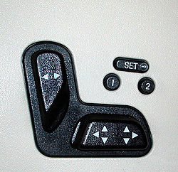
Myth of Average

Slide 4
Myth of Average

Slide 5
‘Hidden’ Disabilities
These students may look like “typical” children
Their disability is internal:
Cognition
Social interactions
Communication
Mental health
Trauma
Emotional regulation

Slide 6
Top Five Takeaways
1. Relationships Matter
2. Cooperation Follows Relationships
3. Nonverbal & Verbal Communication Matters
4. Assume Good Will
5. Be patient!

Slide 7
Best Practices
Keep
Keep things simple, short to the point
Be
Be Patient with student, staff and parents
Build
Build Relationships

Slide 8
Thank you for your service to Brevard Public Schools and our students!

