Slide 1
Office of Risk Management
Secretary Training
Wednesday, June 15, 2022

Slide 2
Risk Management

Slide 3
Risk Management
Workers’ Compensation
Sedgwick CMS
Student Accidents/Incidents
Property Loss
Facility Use of District Property
Auto/General Liability

Slide 4
Workers’ Compensation
Injury that occurs during work while performing routine tasks associated with
job tasks
Covered by workers’ compensation from the first day of employment
Employees reporting a work injury must complete a drug screen, if they are
seeking or will seek treatment in the future.
Reporting a Work Injury
Report the injury to Supervisor the same day the injury occurs
Report the injury even if medical treatment is not sought at that moment
Complete the Risk Management Accident/Incident Report form
If medical care is necessary, following the work injury
School/Department secretary will call Sedgwick CMS to report the injury.
Injured worker will speak with a nurse for Sedgwick CMS regarding the injury to allow referral to pre-authorized medical provider, self-care, or first aid depending on injury.
Injured worker should only seek treatment at the facility authorized by the triage nurse.

Slide 5
Sedgwick CMS
Sedgwick CMS" toll free at (866) 350-8665
Andrew Partridge- Claims Adjuster
Direct 954.247.6767 Fax 954.247.6758
EMAIL: Andrew.Partridge@sedgwick.com
Briana McDermott- Claims Adjuster
Direct 717.526.6007 Fax 954.247.6758
EMAIL: Briana.mcdermott@sedgwick.com
Mary Echeverry Villa- WC Claims Associate
Direct 501.716.6554 Fax 954.247.6758
EMAIL: mary.echeverryvilla@sedgwick.com

Slide 6
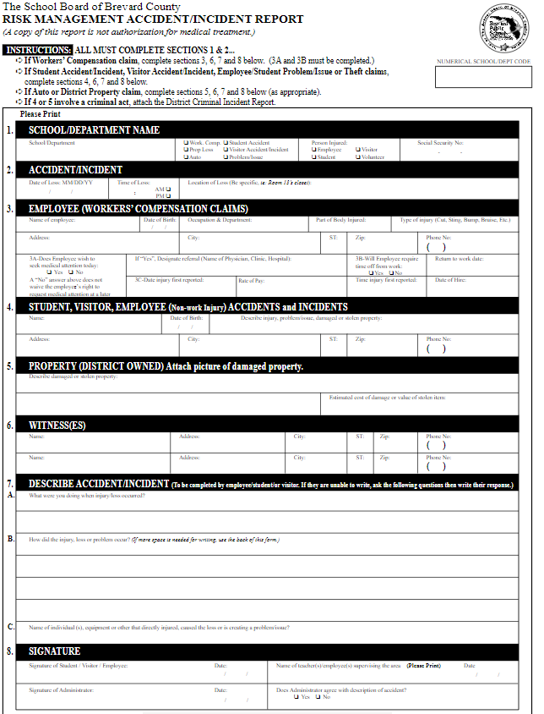
Incident Reports

Slide 7
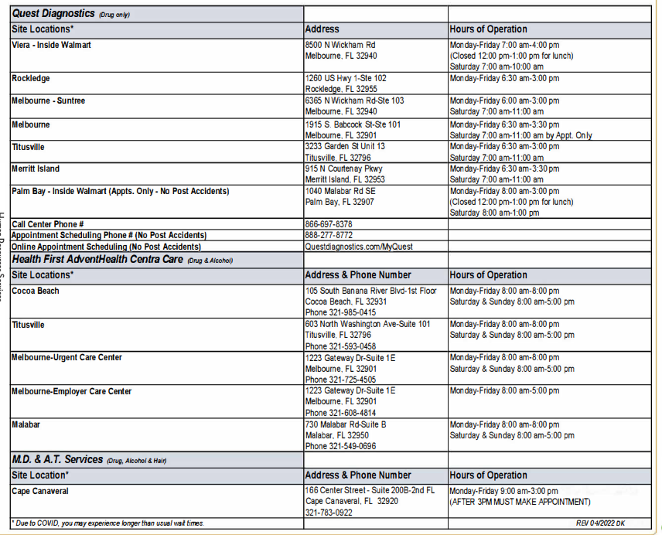
Post Incident Drug Testing
All employee’s seeking medical treatment for a worker's comp injury MUST complete a post incident drug screen IMMEDIATELY after the incident.

Slide 8
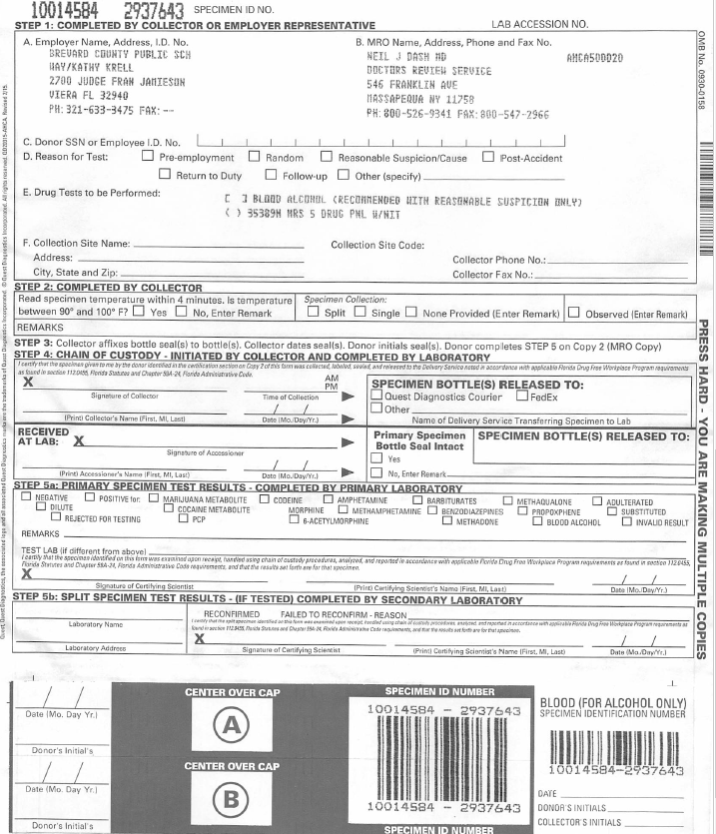
Drug Testing Continued…
Please send all chain of custody forms to Drew Kramer ext 11212.
*Chain of custody forms must be sent via courier to ESF Human Resources “ ATTN: Drew Kramer.”
*Worksite should keep a copy of the chain of custody forms.

Slide 9
Student Accidents
School personnel have certain responsibilities in case of accidents which occur in school
Administration of first aid by persons trained to do so
Summoning of medical assistance
Notification of administrative personnel and parents
Filing of accident reports
Student accident form filled out by student in their own writing or verbatim based on injury or age
Statements of witness attached to form on separate paperwork
A copy of the student accident report may be given to the student/parent ONLY if form is filled out by student or verbatim of student.
Notes:
STUDENT ACCIDENTS
Brevard Public Schools believes that school personnel have certain responsibilities in case of accidents which occur in school. Said responsibilities extend to the administration of first aid by persons trained to do so, summoning of medical assistance, notification of administrative personnel, notification of parents and the filing of accident reports.
If a student is injured at school your should administer treatment and appropriate care to the student first and then have the student complete the accident-incident form.
Student accident forms should be completed by the student in their own writing or written verbatim by you based on the student’s words and on injury and/or age.
If you would like to provide information in addition to the students recount of the accident you may write this on a separate paper and attach to the accident-incident form.
A copy of the student accident-incident report may be given to the student/parent only if form is filled out by student or written verbatim of student’s words. Additional information you provide or other employees provide may not be given to the parent. This is to protect the District in the event of a lawsuit.
You are always welcome to contact the Office of Risk Management, (321) 633-1000 extension 620 if you have any questions.

Slide 10
District and School Property Loss
Property Loss Includes losses or damage related to:
Natural disasters such as fire, wind and flood
Boiler/Machinery
Fuel Storage Tank
Bus/Auto accidents
Theft and Vandalism
All property loss claims reported on the Risk Management Accident/Incident form
Reimburse schools/departments for district owned property loss less a $500 deductible (with the exception of district property losses related to natural disasters and public assistance requests from FEMA).
Reimburse instructor for property loss less a $300 deductible (provided completion of form and approval prior to loss)
Notes:
PERSONAL PROPERTY
You may bring personal items to work if these items enable to perform your job. Providing that you:
Receive written approval from your school principal or department supervisor for personal property to be at your worksite
The property is physically located within the physical site which you are normally assigned.
You provide written documentation to the current market value of the property.
You take reasonable precautionary measures to protect the property
Brevard Public Schools will reimburse you for the loss of personal property under the terms of the board provided policy for your personal property loss. It is imperative that you follow the process above and receive approval otherwise your loss will not be replaced.
The maximum claim limit for each loss shall be $300 per term. You will pay the first $50 per item as a deductible

Slide 11
Use of District Facilities
The main function of our school facilities, property & equipment is intended for public educational purposes.
Our facilities, property & equipment may be made available for community or other public use as long as that use does not disrupt our main function of education (Board Policy 7510 – Use of District Facilities).
The School District of Brevard County is pleased to announce a new online facility request and rental system designed to provide a positive user experience for all. With the new system, reservation requests can be submitted easily and will be handled more efficiently. Renters will be able to access photos and descriptions, see real-time availability, get estimated quotes and pay online.
All requested information must be completed on the Facility Use Agreement form such as Organization making application, name of President/individual completing application including telephone number and e-mail contact information (extremely important), etc.
Risk Management / Facility Use Information & Guidelines (brevardschools.org)

Slide 12
CATEGORY I USERS
School Clubs, PTO/PTA/Booster Clubs
Complete a Facilities Use Agreement Form
Submit Certificate of Insurance or evidence they self-insure exposures (PTO/PTA/Booster Clubs)
No facility use costs/utilities with the exception when a school employee is required to work overtime to accommodate another school’s use or any of the District’s performing arts theatres support a school function.
CATEGORY II USERS
AAU, USSSA, Girl Scouts, Boy Scouts, YMCA, Parent-Initiated Student Clubs, etc., not-for-profit school age organizations.
CATEGORY III USERS
Charter Schools, Private Schools, churches, for-profit school age organizations, etc. where use of school property is not the main source of income (less than 25%) annually for the business.

Slide 13
CATEGORY IV USERS
Any organization that does not meet criteria listed in Category III or that utilize school property for a large percentage (twenty-five percent (25%) or more) of its annual revenue.
INSURANCE, FACILITY USE FEE COSTS
Must complete a facility use agreement form
Submit a Certificate Of Insurance evidencing General Commercial Liability policy of $1,000,000.
All facility use fees, utilities, and school personnel and/or any additional clean-up costs outside normal personnel schedule, weekends, holidays.

Slide 14
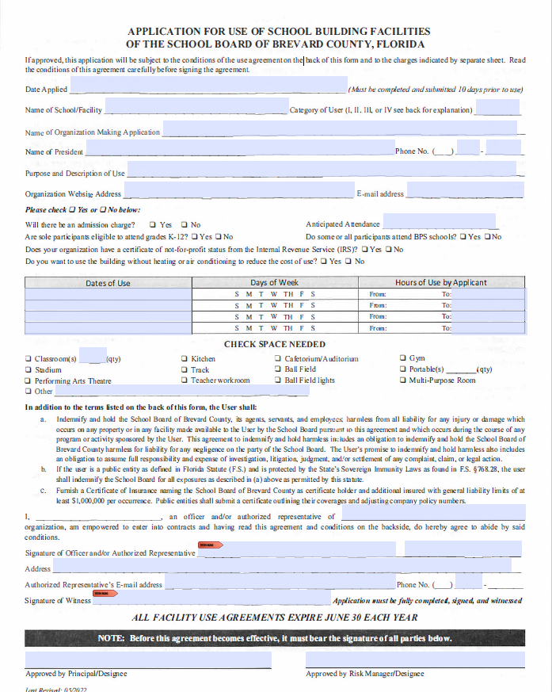
Facility Use Agreement- Fillable

Slide 15
CONTACTS
Risk Management
(321) 633-1000 ext. 11620
Antonia Scipio- Director of Benefits and Risk Management
Mark Wishard - Supervisor of Risk and Project Management
Sherriane Rowe - Risk Management Specialist WC
Annette Spiegel - Administrative Secretary
Risk Management Website:
Risk Management / Home (brevardschools.org)
Risk Management Email:
riskmanagement@brevardschools.org

