Slide 1
Office of:
Risk Management
Leadership Team Meeting

Slide 3
Student Accidents
What to Do: Student
Student should report an accident/or incident to any school administrator. Complete the incident report, providing a detailed account of the incident.
If necessary, ask for medical treatment.
Provide parent/guardian a copy of the *redacted incident report.
Redacted incident report
Remove:
Names of employee’s/witness
Address
Phone numbers
Only reporting student’s information should remain
What to Do: Administration
Have the student complete an accident report. If student is unable to write or nonverbal, an administrator must complete the incident report *verbatim.
Determine if medical treatment is needed. If so, follow up with school nurse for guidance.
Contact the student's guardian to notify them of the incident.
Provide student a copy of the incident report AFTER *redacting identifying information.
Notes:
STUDENT ACCIDENTS
Brevard Public Schools believes that school personnel have certain responsibilities in case of accidents which occur in school. Said responsibilities extend to the administration of first aid by persons trained to do so, summoning of medical assistance, notification of administrative personnel, notification of parents and the filing of accident reports.
If a student is injured at school your should administer treatment and appropriate care to the student first and then have the student complete the accident-incident form.
Student accident forms should be completed by the student in their own writing or written verbatim by you based on the student’s words and on injury and/or age.
If you would like to provide information in addition to the students recount of the accident you may write this on a separate paper and attach to the accident-incident form.
A copy of the student accident-incident report may be given to the student/parent only if form is filled out by student or written verbatim of student’s words. Additional information you provide or other employees provide may not be given to the parent. This is to protect the District in the event of a lawsuit.
You are always welcome to contact the Office of Risk Management, (321) 633-1000 extension 620 if you have any questions.

Slide 4
Student Accidents Continued
Redact:
Please make a copy of the incident report before making redactions. Redact ONLY on the report copy.
Information to Redact:
Any witness information (Name, address, phone numbers)
All signatures (except student’s)
Please send original copy to Risk Management.
Verbatim:
If the student is nonverbal or unable to write, please complete the incident report notating “as told by… or … verbatim… per (student’s name)…”

Slide 5
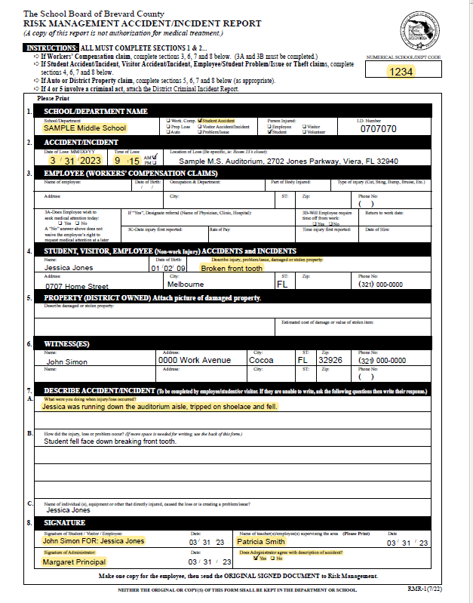
Example: Student Incident Report

Slide 6
Employee Incidents
What to do: Employee
Employee should report injuries to the worksite secretary.
Notify secretary is medical treatment is necessary.
Complete drug screen if you're seeking medical treatment.
If you’re directed to a treatment center, provide the worksite a copy of the *DWC-25 to review for restrictions.
Follow up with Workers’ Compensation doctor until medically cleared.
What to do: Administration
Injured employee must complete an incident report when an incident is reported. Incident report should be completed whether treatment is sought.
If treatment is needed, secretaries should call Sedgwick 1-866-350-8665. The triage line will determine the next steps for treatment.
Employees seeking medical treatment must complete a drug screen.
Worksite must review employee work restriction to determine if accommodations can be met.
Send all original copies to Risk Management.

Slide 7
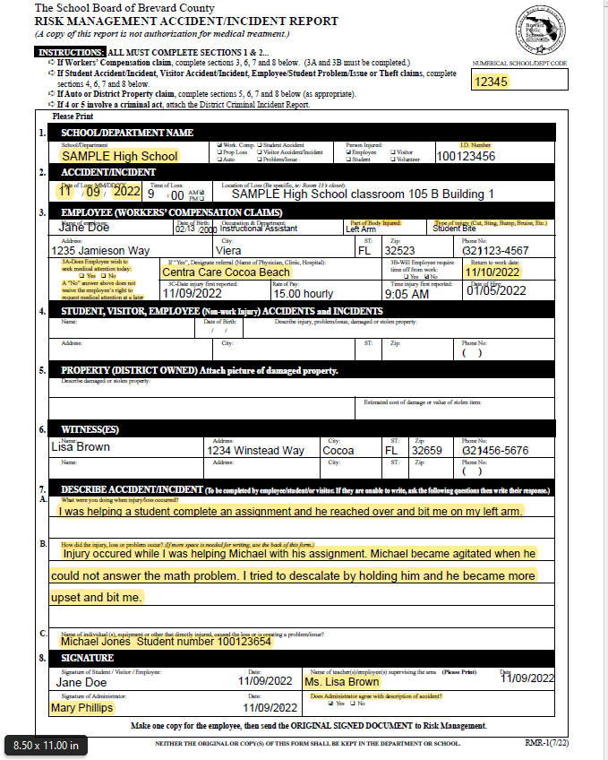
Example: Employee Incident Report

Slide 8
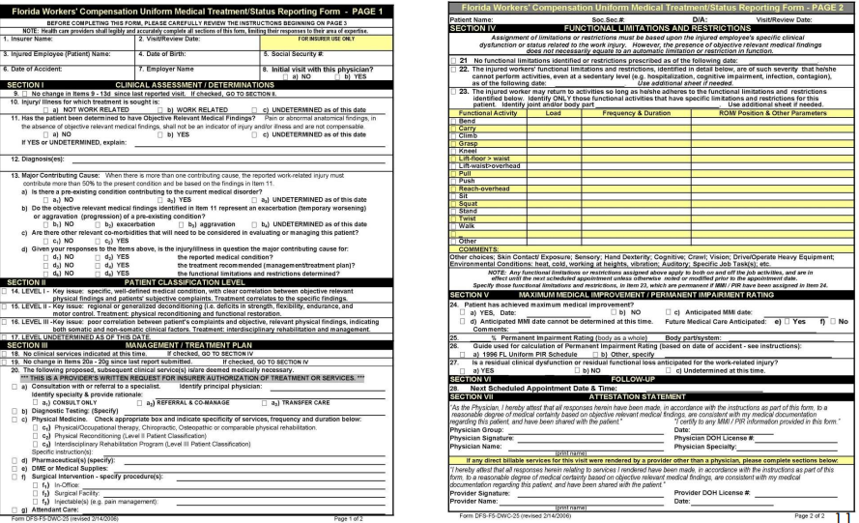
DWC- 25

Slide 9
CONTACTS
Risk Management
(321) 633-1000 ext. 11620
Antonia Scipio- Director of Benefits and Risk Management
Sherriane Rowe – Supervisor Risk Management
Annette Spiegel - Administrative Secretary
Risk Management Website:
Risk Management / Home (brevardschools.org)
Risk Management Email:
riskmanagement@brevardschools.org

