Slide 1

Notes:
Thank you for giving me the opportunity to take a look at your public school system.... Brevard Public Schools.
We will look at where we have been as a school system, where we are currently, and what is ahead in the future.

Slide 2

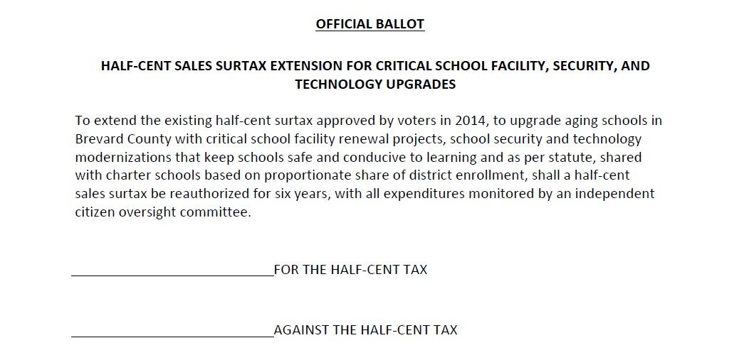
An Important Decision
November 3rd
Notes:
I want to speak specifically on where Brevard Public Schools has been with our surtax initiative approved by our voters 6 years ago in response to critical issues and needs we were facing as a school system.
Today we face the reality that the surtax ballot initiative is coming to a close in September 2020.
The community has an important decision to make on November 3 to renew our initiative.
We want to make sure that we take this opportunity to educate and inform the community so they understand where we have been, where we are, and the future for Brevard Public Schools.

Slide 3
A Look Back –
6 Years Ago
We asked the community to help
  The condition of our schools deteriorated
  so badly that learning was compromised
We made
a commitment
  Spend surtax on essential needs
  Independent citizens oversight
  3rd party audits
  No new debt
  6 years
Notes:
Six years ago, we went out to the community and explained that we needed their help in a greater way.
We value our community partnerships and connections and we wanted to informed them that we are facing the realities of significantly deteriorating facilities, necessitating an additional investment to ensure that the programs and opportunities for our students will not be compromised by the physical capital needs of our schools across the district.
We made several commitments to our community as we recognized that it was a significant investment in the public schools.
Every dollar raised through the surtax would be reinvested in essential needs for our schools and facilities.
We would be held accountable to an independent citizens’ oversight committee who would meet every other month and review every expenditure, project and revenue to ensure that we were meeting our commitments to the community.
In addition, we would employ a 3rd party auditor to review the procurement process and expenditures to ensure that we were meeting all of the responsible practices that we should throughout this initiative.
We would not acquire any new debt.
Some counties will bond the initiative in the beginning or borrow money against the anticipated revenue...
We said “no”, we are going to pay as we go and will report out every expenditure along the way.
Finally, the original intent was to go for a 10-year initiative, but we heard from our community that we needed to build trust. Therefore, we went for a 6-year initiative to demonstrate that we would fulfill all of our commitments to build trust throughout the community.

Slide 4

Operating vs. Capital
Operating funding
80% + Staff costs
(Compensation and benefits)
Textbooks & Supplies
Professional development
Electricity/Utilities
Student programs
  Music
  Art
  Science research
  Athletics
Capital funding
Facility renewal
Maintenance & Repair
Technology
  Infrastructure
  Devices
Buses
Debt service
Property insurance
Notes:
Before we get into the surtax, I wanted to provide some orientation about out budget as a lot people have questions pertaining to the difference of the Operating versus Capital budget.
The operating budget, the revenue from property tax, goes to the State. The State adds revenue to that amount and sends it back to school districts.
80% of the operating budget goes to people (salary, compensation & benefits). Not a surprise as we need a lot of people to serve the lives of those we are entrusted.
It supports all the experiences, materials and resources that our kids take advantage of to realize their potential and success... music programs, art programs, science research, athletics.
As well as the professional development for our staff and other necessities such as utilities.
That is our operating budget.
We also receive, through property tax,1.5 mills for the capital budget.
We have almost $2 Billion of capital assets throughout the county and the capital budget is used to fund our facility renewals, repairs & maintenance, technology, buses, property insurance, but also our debt service.
We don’t have any new debt but we have existing debt from many years ago (late 90’s, early 2000’s), when Brevard was experiencing growth and we needed new schools. We borrowed money to both build and maintain those schools.
It is a significant amount of debt, essentially leading to more than half of our capital budget. This debt is amortized out for another 12-13 years before we pay it off, much like you would experience with a mortgage.
So, that provides some orientation of our budget.

Slide 5
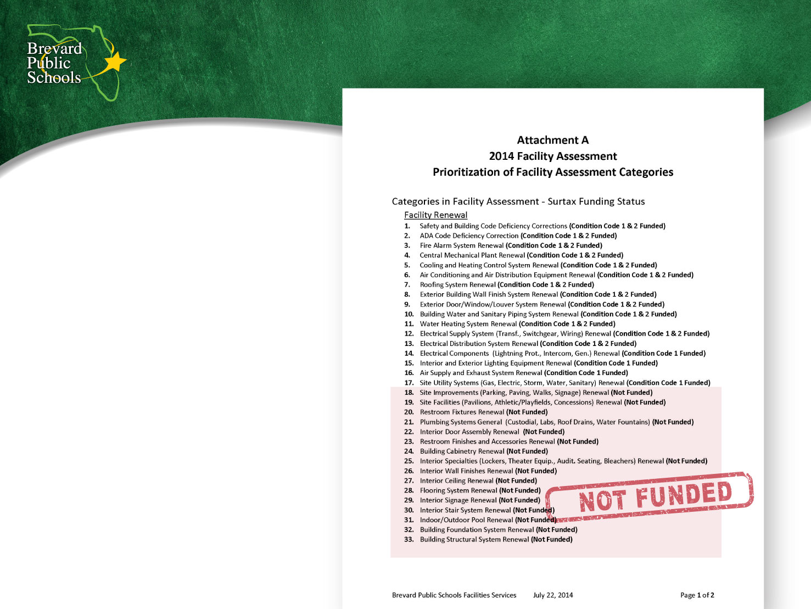
2014 Surtax
Assessment in
2014 was the
basis of the
sales surtax plan
Notes:
Where were we six years ago when we went out to our community and asked for the enhanced partnership and help with our capital budget?
We had a comprehensive facility assessment done, leading up to the 2014 ballot initiative and the assessment identified 33 critical infrastructure areas.

Slide 6
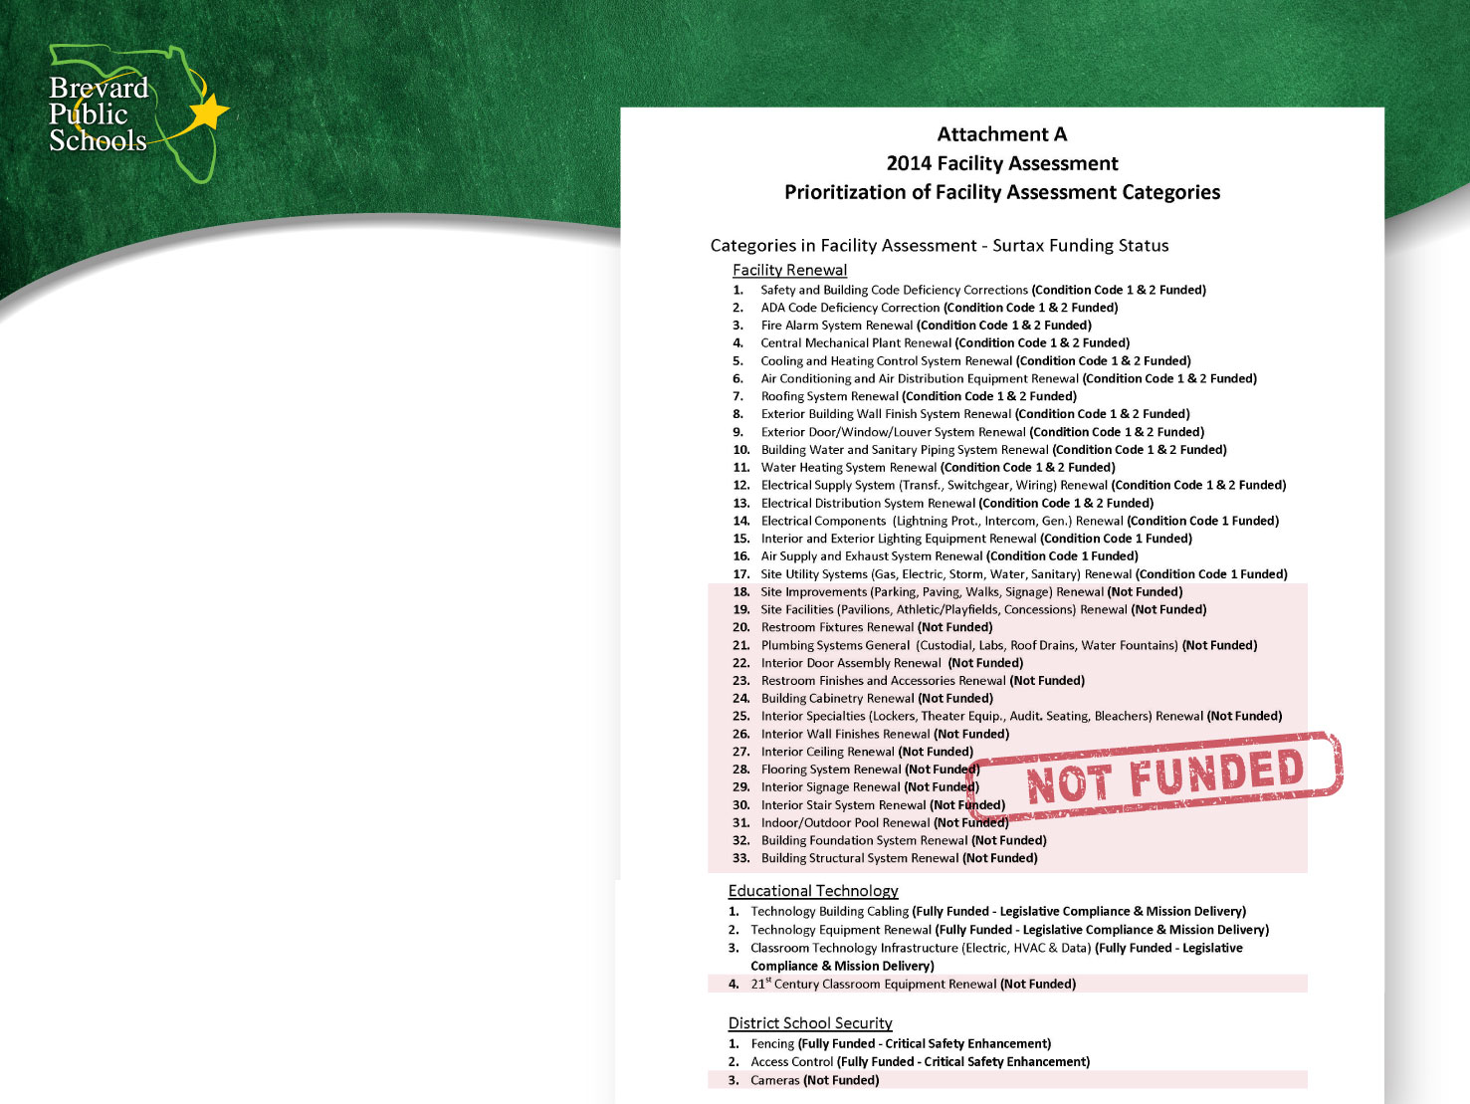
2014 Surtax
Funded categories focused on
failed or failing infrastructure
Notes:
The items totaled $757 million of critical capital needs in 2014 which included both things on the verge of failing and other items that were essentially at the point of failure and they were keeping us awake at night... wondering if they were going to turn on the next day.
They were identified as critical need areas 1 and 2 on a scale of 1-5. A critical need 1 has virtually failed, a category 2 is on the verge of failing.
The $757 million of critical needs was presented to the community and the surtax projected revenue was about $198 million.

Slide 7
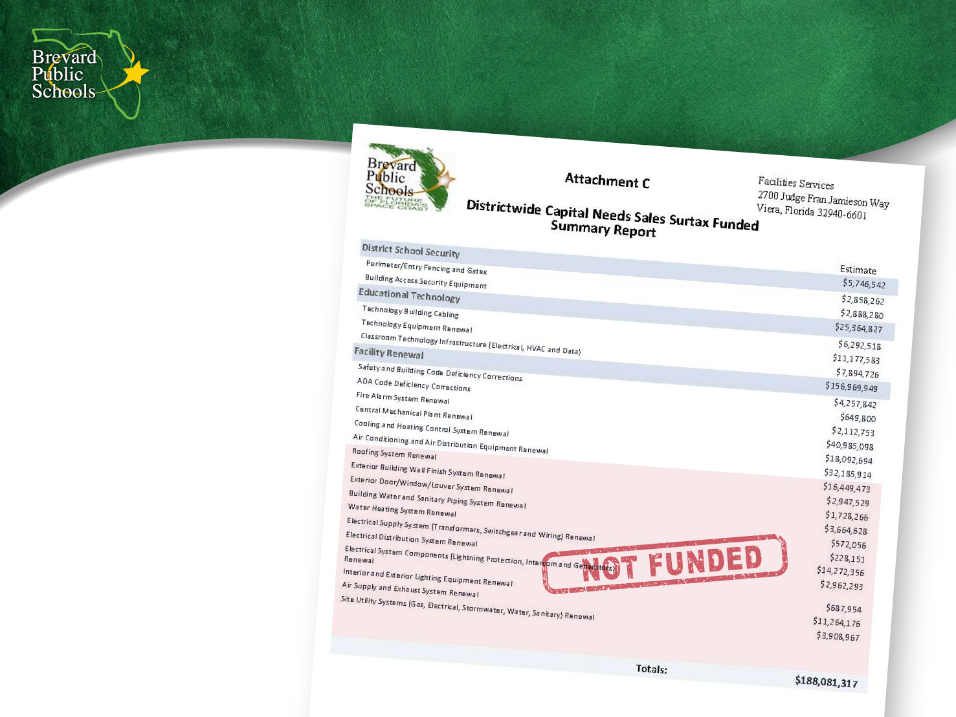
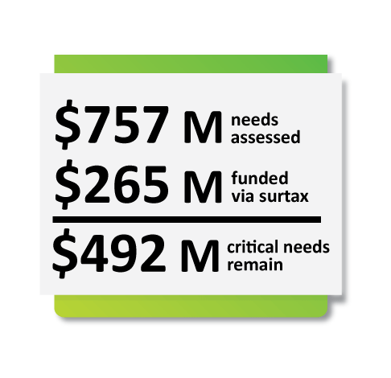
2014 Surtax
Notes:
So the reality is, even with the surtax initiative over six years, generating almost $200 million revenue against a list of capital needs at $757 million, there were still areas that could not be funded. And, you see those on this slide in the red shaded area.
Essentially, we identified what could be funded – the most critical – greatest of which was HVAC.
A significant investment was made to our HVAC systems across our facilities over the last six years after the community said “yes” we will partner with you to meet this need.

Slide 8
Today
Sales surtax made
a difference in our schools
  Schools are safer
    Security projects done early and expanded
  Significant improvement in air conditioning
  Technology improved
We honored
our commitments
  Spend surtax on essential needs
  Independent citizens oversight guided decisions
  Nine 3rd party audits
  No new debt
Notes:
Today, the reality is the surtax has made a considerably positive difference for our schools.
Our schools are safer because we prioritized in the first surtax initiative 3 critical areas.
Facility and Infrastructure
Security Enhancement, and
Considerable Improvements in the Technology Infrastructure of our School System
As we have faced the dependency of technology for our students and community the last few months, it is very fortunate that we did this work as we had 65,000+ kids launch into remote learning with a great dependency on internet and its reliability.
We honored our commitments...
By spending every surtax dollar on essential needs,
We were held accountable by our Independent Citizens Oversight Committee (ICOC) and they came to the Board Meeting once a year and have validated that we lived up to our commitment,
We have been through nine 3rd party audits and anticipate another one coming up as we are still within the initiative. Every audit over the last 6 years received green check marks.... green check marks are good.
And, we have acquired no new debt.
Some might ask “you just built a new elementary school in Viera” and we did as a result of the growth that we’ve experienced. That school was built with no new debt, we waiting until we accumulated impact fees from growth that can only be spent on new student station.

Slide 9

We’ve Made Progress…
Notes:
We have made progress
We invested nearly $21 million in security...this commitment was long before what we experienced as a State and a community with the tragedy at Parkland. We were able to accelerate these security efforts and make our schools safer.
We invested $36 million in Educational Technology
And, $196 million in facilities.
Although there was only $198 million projected in surtax revenue, what this reflects is that our revenue exceeded our projections, which we will address in a moment.

Slide 10
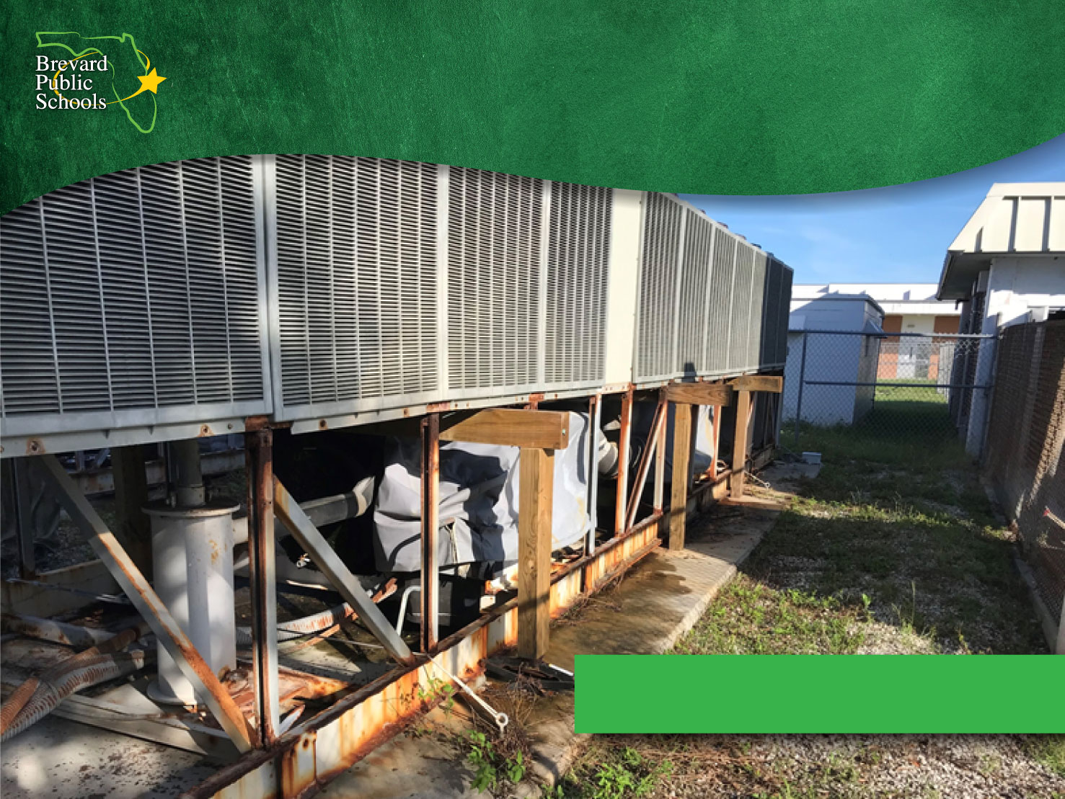
We’re Fixing This Now…
Satellite High HVAC
Notes:
Here is an example of what we are doing right now at one of our schools. We are replacing the massive HVAC system at Satellite High School.

Slide 11
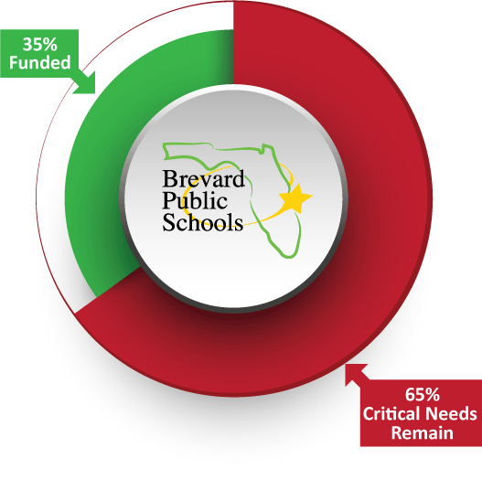
Critical Needs Remain
Notes:
But, even with the increased revenue over projections, which was identified earlier, we have only tackled and responded to 35% of our critical needs that were identified in the initial assessment.
$757 million in critical needs responded by $265 million of surtax revenue is only 35%.

Slide 12
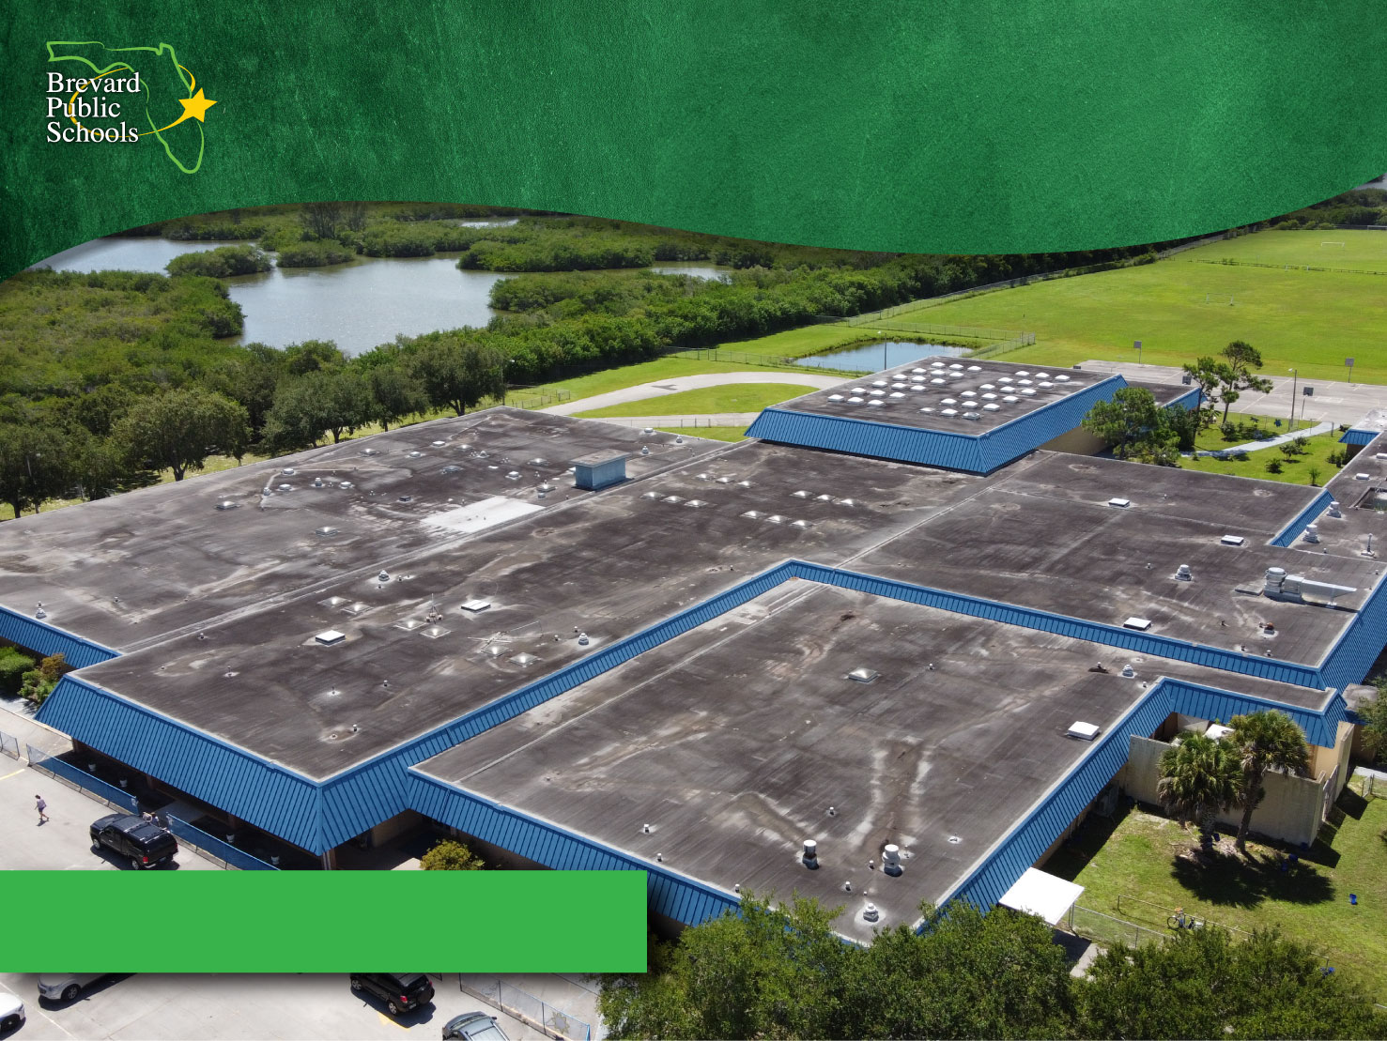
We Haven’t Fixed This…
Roosevelt Roof
Notes:
These are things that we haven’t addressed yet on the critical needs list.
This is the roof of Roosevelt Elementary School.. A massive football field size roof.

Slide 13
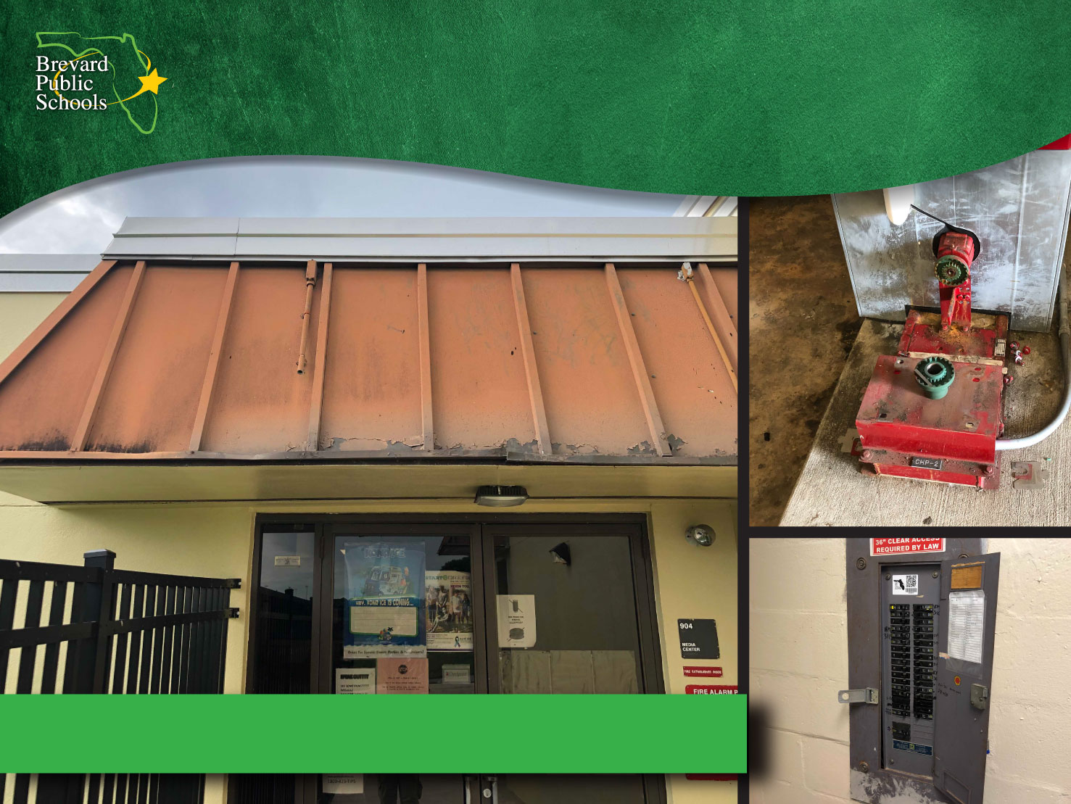
Or This…
Stone Middle
Notes:
Here is the current condition of Stone Middle School’s roof, obviously on the verge of needing to be replaced.
Water Sewer System
Electrical System

Slide 14
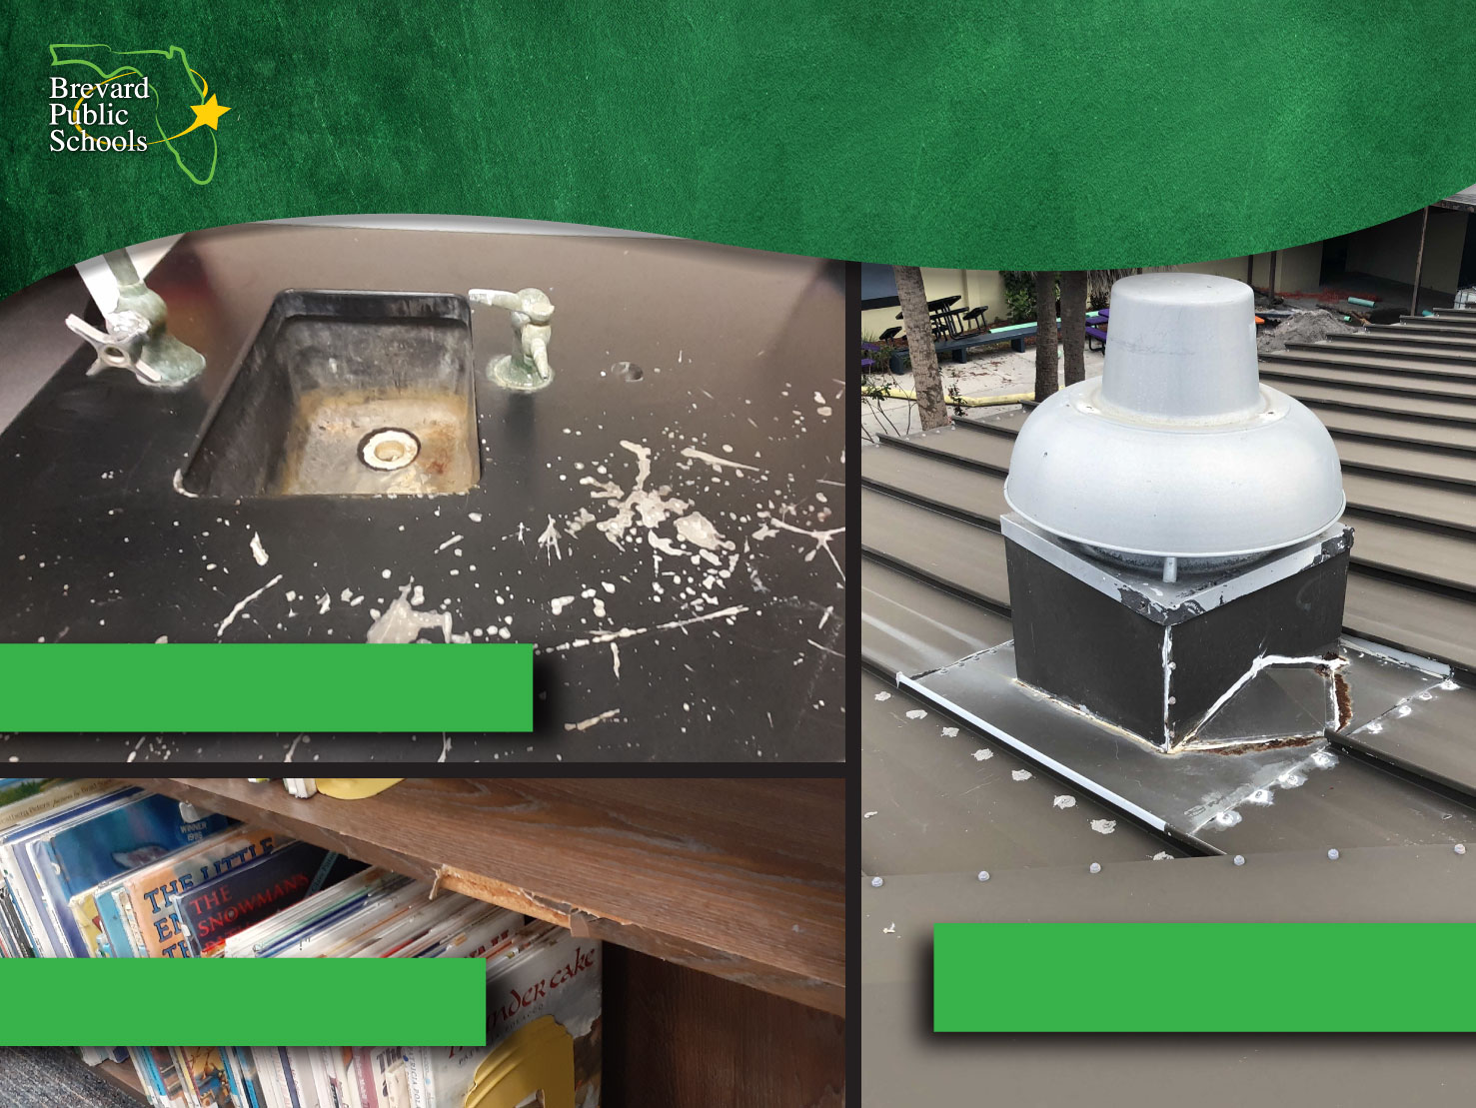
Or This…
DeLaura Middle
Stone Middle
Creel Elementary
Notes:
Quick survey, did anyone in the audience attend Brevard Public Schools?
If hands... I’m not surprised because the average age of our schools is more than 46 years old and more than half of our schools are 50 years or older. We just celebrated the 60th anniversary of one of our elementary schools.
You see here on this slide, the internal classroom and media center conditions are original to the schools.

Slide 15
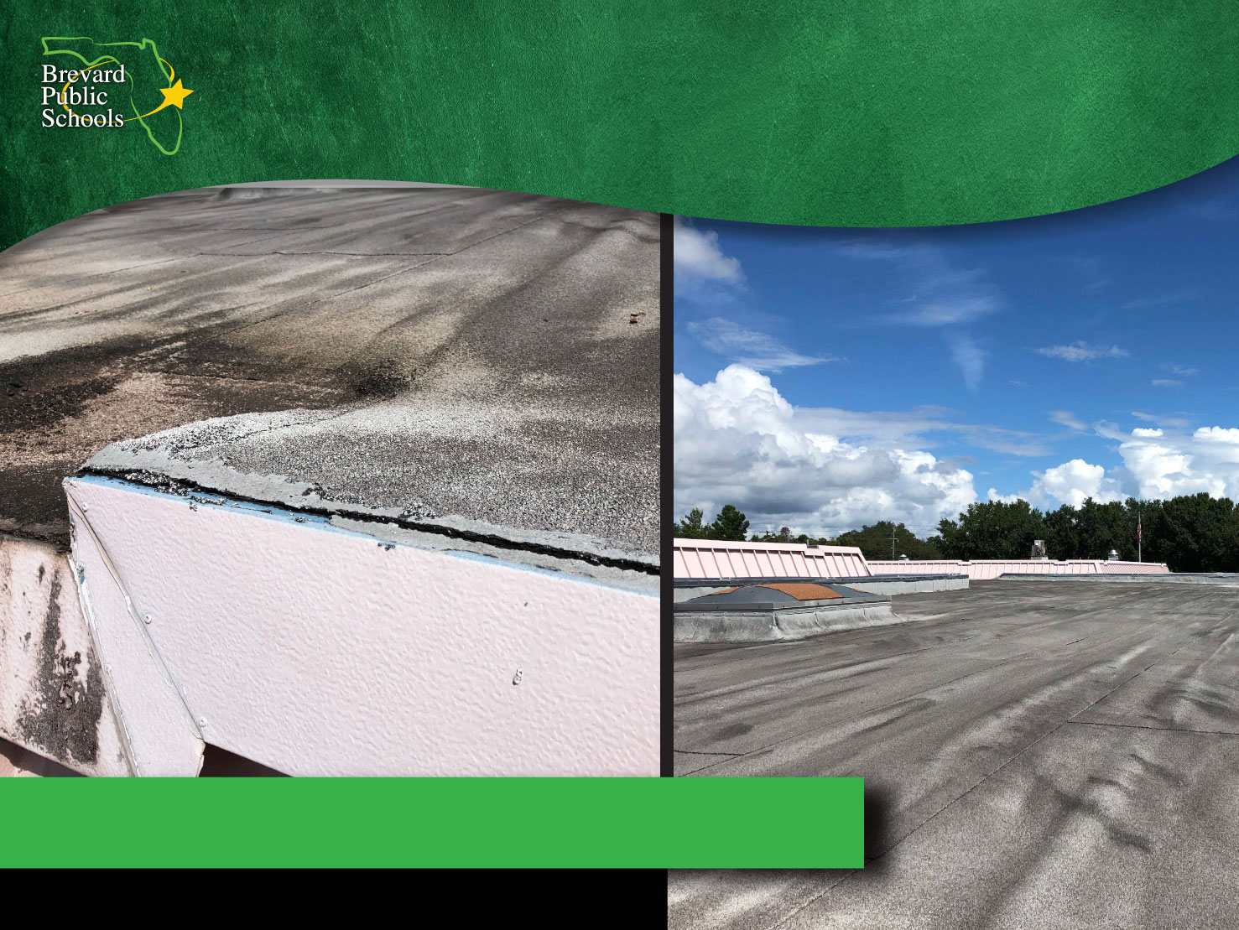
Or This…
South Lake Elementary Roof
Notes:
Here are other images of roofs on the verge of needing to be replaced.

Slide 16
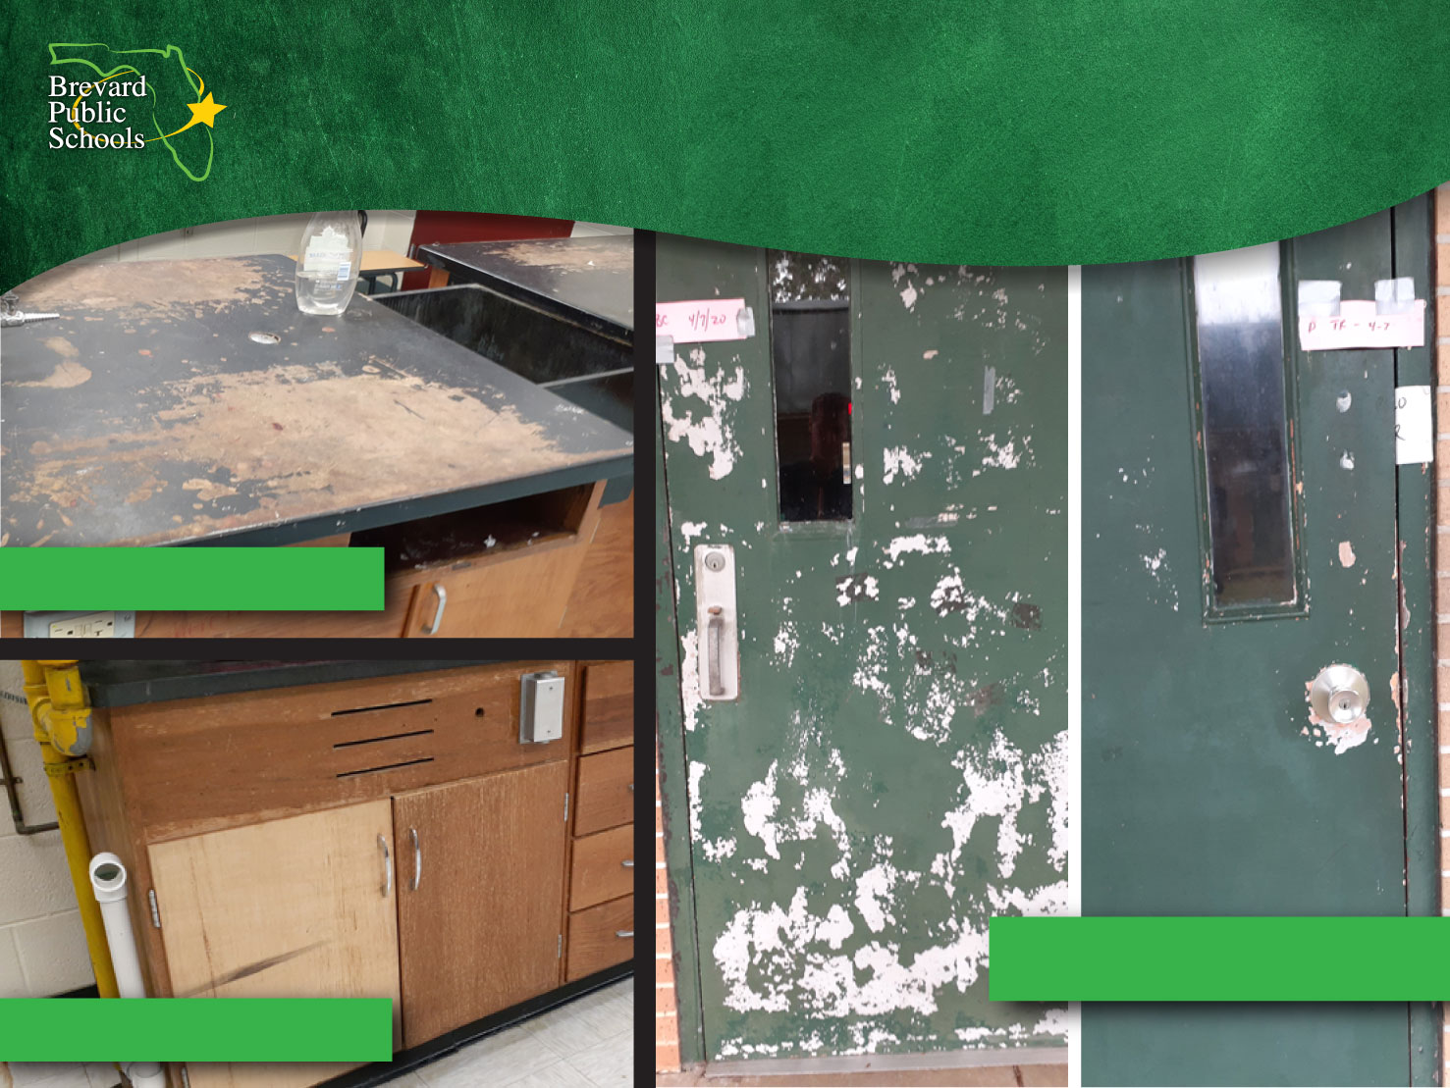
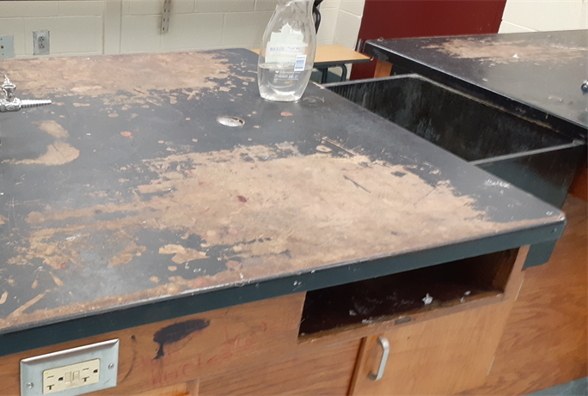
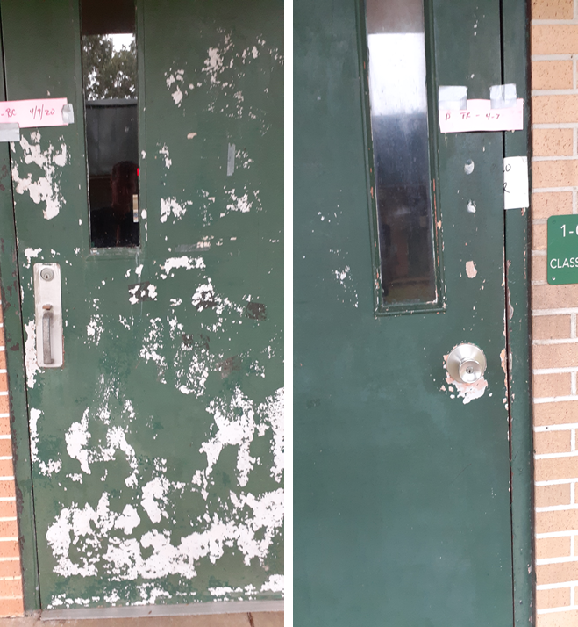
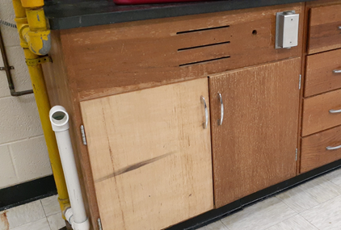
Or This.
Kennedy Science Lab
Oak Park Doors
Jackson Science Lab
Notes:
If you attended Kennedy or Jackson Middle School, the cabinets that were there then when you attended are the same ones that are there today.

Slide 17
Scope of Responsibility
More than 100 facilities
  84 traditional schools
52 schools are over 50 years old!
12.8 million square feet
Equivalent of over 5,000 homes
(2,500 sq. ft. each)
Current replacement value - over $2 billion
80,000 computers, servers, and related equipment Currently on a 20 year refreshment cycle
Notes:
Now, I want to highlight the scope of responsibility we have as a school system, but ultimately as residents and citizens of Brevard Count, because Brevard Public Schools doesn’t belong to just Brevard Public Schools... it is all of ours.
It is your public school system. You are already making an investment through your property tax.
We are made up of 84 schools and more than 100 facilities.... 52 schools are over 50 years old.
We have 12.8 million square feet of air conditioned space, which is equivalent to 5,000 homes.... that is a lot of critical infrastructure to support.
The current replacement value is approximately $2 billion.
80,000 computers, servers, and related equipment currently on a 20 year refreshment cycle. There is no other industry out there that is managing their technology on a 20 year refreshement.

Slide 18
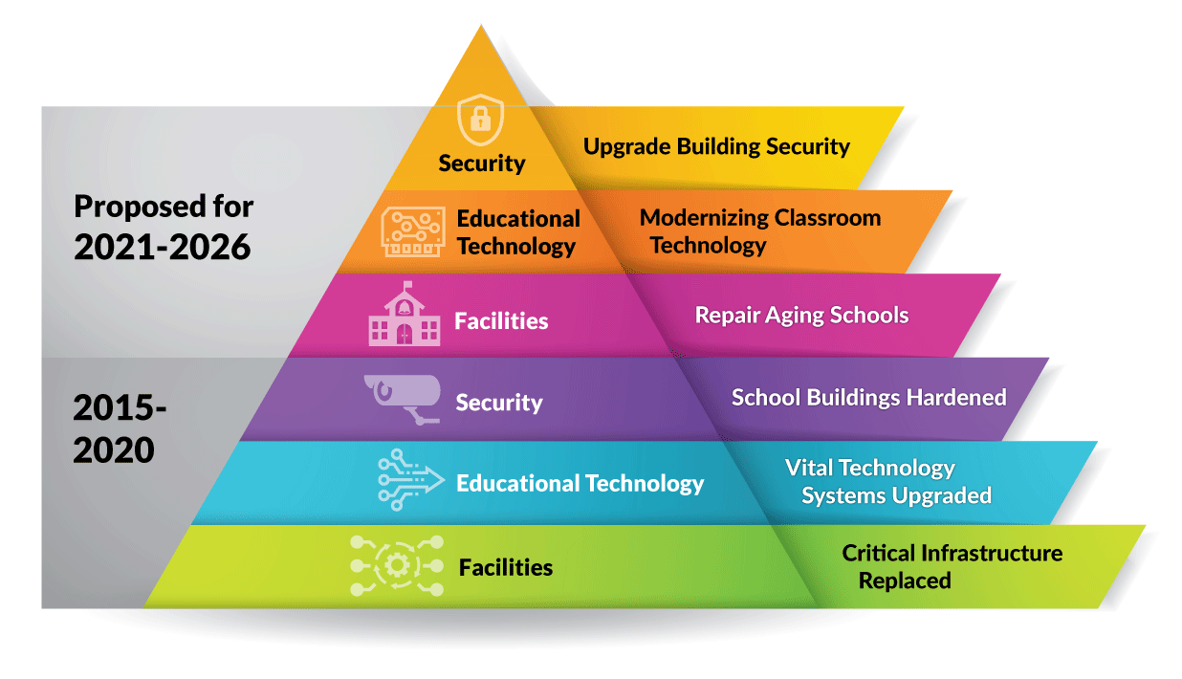
Building on the Foundation
Notes:
So, you may say “okay” that is a lot of responsibility and facilities and obviosly you need a lot of resources to address it... but, what is the plan?
In the last 6 years we have made a considerable investment in ensuring the critical infrastructure needs were addressed in our facilities, responding to our technology needs, and recognizing and addressing the security necessities, so that we can sleep well at night keeping our kids and staff safe.
But, I hope you recognize that the critical needs haven’t stopped. Even from being addressed 6 years ago.
We are committing to continually investing in those critical facility infrastructure needs with our aging buildings, our educational technology and modernizing our classrooms... reducing the 20 year refreshment cycle, and continuing to invest in our security measure across our schools.
You might ask “how do you know what the needs are”.
We’ve completed a comprehensive assessment in each one of the areas again. We are not depending on the assessments from 6 years ago. We had a 3rd party entity come in and do a facility assessment in every one of our facilities and identified our current infrastructure needs.
We are pleased to see that the current assessment validated the assessment of 6 years ago... that is good because we hoped that we invested in the right things and we did.
What moved down on the list was HVAC, that is where we invested our greatest dollars.
But what has now risen to the list, which is no surprise, are roofs at $67 million of critical needs. Water/sewer systems, electrical systems. These are things that you cannot put off. These are critical infrastructures we cannot neglect. One, for the sheer responsibility and safety to our kids and staff, but also if we neglect any one of those, they become a distraction to the learning environment and ultimately to our core mission of serving kids with excellence. The learning, advancing and achieving all of the opportunities that we want for them and the successes they deserve become compromised.
Our technology assessment was completed by a 3rd party where we validated our refreshment cycle, and further identified the number of devices we have across our school system.
Our security assessment was also completed by our 3rd party. There were may commendations in that assessment.. they were pleased and were impressed over the efforts that were made over the last several years. But, they also identified approximately $50 million of recommended security measures that should be addressed to continue moving our schools and our district to a safer place for our kids and our staff.

Slide 19
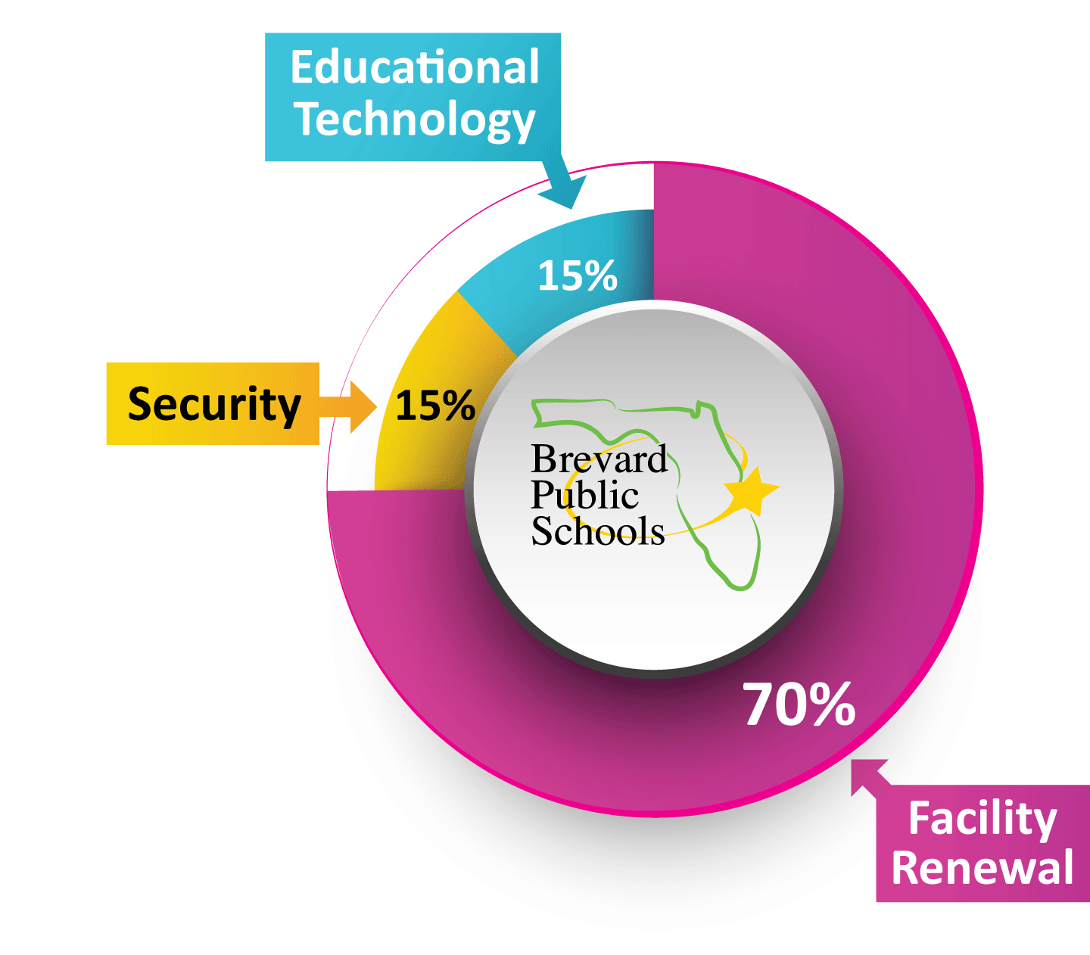
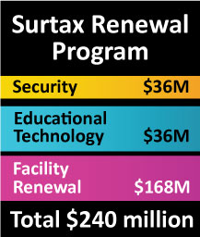
Surtax Renewal Allocation Plan
Notes:
So, the renewal of the surtax initiative would continue to invest in, or fill the hole we had of $757 million. We have filled it with $265 million, or 35%, and we will continue to fill that hole. While also continuing to improve our technology refreshment and infrastructure, making it increasingly reliable and dependable... and again, we have learned how critical that is in this time of dependency on distance learning and e-learning, etc. We will also be investing nearly another $40 million in security in response to the assessment.

Slide 20
Surtax Renewal – Investment Detail
Notes:
The assessments have given a detailed list of exactly where the efforts and revenue needs to be committed to meet the most critical areas.
You see at the top of the list, roofs at over $66 million.
You see educational technology and security that I identified.
Classroom Renewal
Electrical Systems ... Over $20 million in electrical systems. If you had an electrician or handyman out to your home to look at your electrical panel and they said, “this is an antiquated system and I recommend getting it replaced or upgraded or renewed”, that is not something you mess with because we know that it is critical to the safety of our investment, but more importantly to the individuals that live there.
These are all things we cannot neglect or not repair/renew. These will require attention in the coming years.

Slide 21

What This Means for My School
BrevardSchools.org/SurtaxRenewal
Notes:
The assessments have even gone a step further than what was done 6 years ago. We have identified, by site, exactly what the facility infrastructure improvements would be, the technology improvements and the security improvements.
You can see on the slide that the assessments for Imperial Estates Elementary is projected to have over $6 million of renewal improvements made, if the renewal of the surtax is a reality.
Cocoa High School is projected to have over $14 million in renewal needs. The list has items that cannot be delayed and are a necessity – they are a critical infrastructure.
If you know anything about the age of our schools, you would recognize that the higher dollar amounts and renewal needs are relatively correlated to the age. Cocoa High is one of our oldest schools, requiring over $14 million.

Slide 22
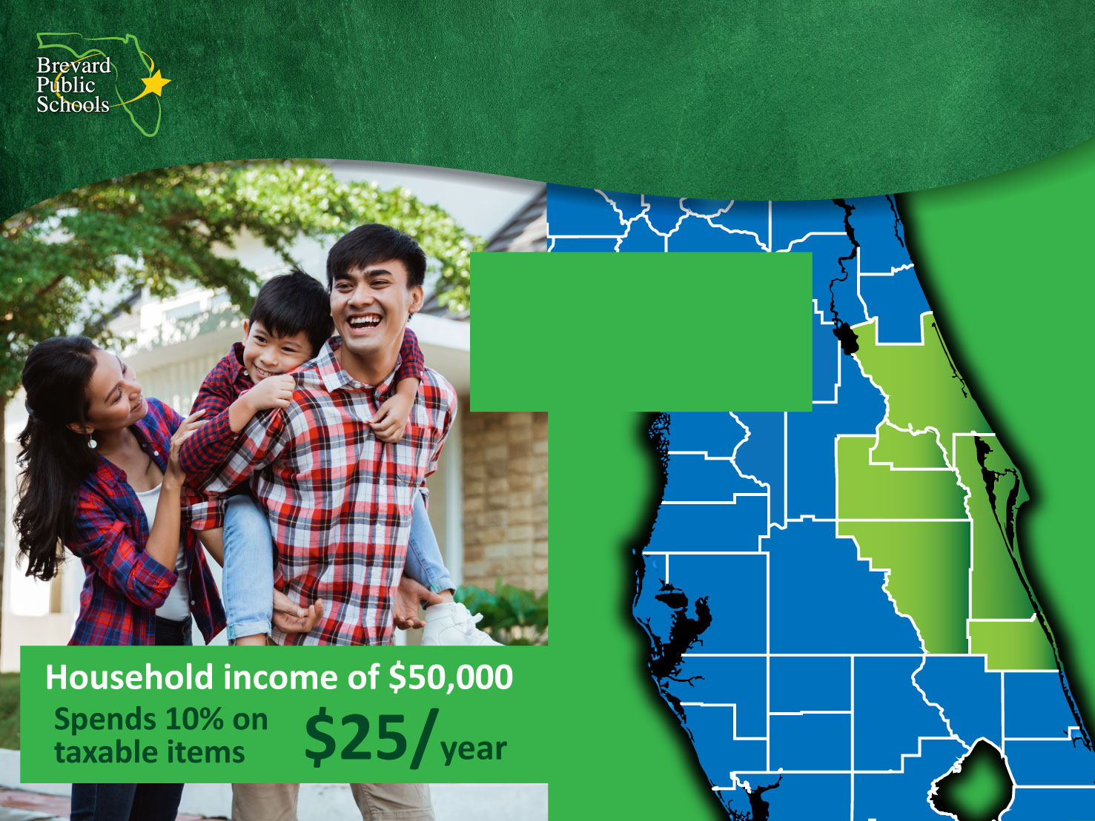
Continuing the Half-Cent Sales Surtax
Taxable purchases made
in surrounding counties support local schools.
Notes:
What does continuing the half-cent sales surtax mean to us as residents as an economic perspective?
For an average household income of $50,000, making the assumption that 10% of that income would be spent on discretionary items that have the surtax assessed against it (things like clothing items, going out to eat, electronics), that would translate to about a $25 annual investment.
You see to the right an image of districts that also have a sales tax initiative in their county. I suspect that there is a county that you have gone to visit and made a purchase on a discretionary item... and consequently, you have made an investment into their school system through their surtax. Likewise, as Brevard continues to be a growing tourist destination, when non-Brevard residents come here, to visit our beaches or go to Kennedy Space Center, they spend their dollars and are investing in our schools.

Slide 23

Our Commitment Continues
Transparency
Outcomesi
Data driven approach
to investments
Itemized list of investments
by site and by year
No new debt
Continue independent citizens oversight committee (ICOC)
Continue external audits
Continue reporting to the
school board and community
Surtax funds are invested in our schools
Surtax funds are invested in the local economy
Return on investment
Notes:
With the surtax renewal, we make a relentless commitment to our community on transparency.
We are making this recommendation with a data driven approach. The assessments validate the need and we make those assessments available to anyone who wants to review them and understand what they say and how things are being prioritized.
The itemized list of investments are already published on our website. School-by-School and Facility-by-Facility so that the community understands exactly where the dollars will go.
We will acquire no new debt through this initiative... holding true to our original commitment.
We will continue with the Independent Citizens Oversight Committee (ICOC) who will continue to meet and report to the School Board and community on our management of this initiative and the adherence to our commitments.
We will continue with external audits and at least annually, have a report out to the Board and community in our regular meeting.
But, what is the outcome if we as a community continue this investment?
The assurance that the surtax funds will be invested in our schools.
That the surtax funds will be a reinvestment in our local economy as we often have local contractors and sub-contractors doing the work and providing the service to renew our facilities.
And, there is also a return on investment. The obvious one of keeping our facilities and assets at a responsible place but also we replace old technology with new technology. A simple example is florescent lighting replaced with LED lights... you probably have done some of this in your own home – not only for the benefits of LED versus the reflection that fluorescent lighting produces, but also for the energy savings.

Slide 24
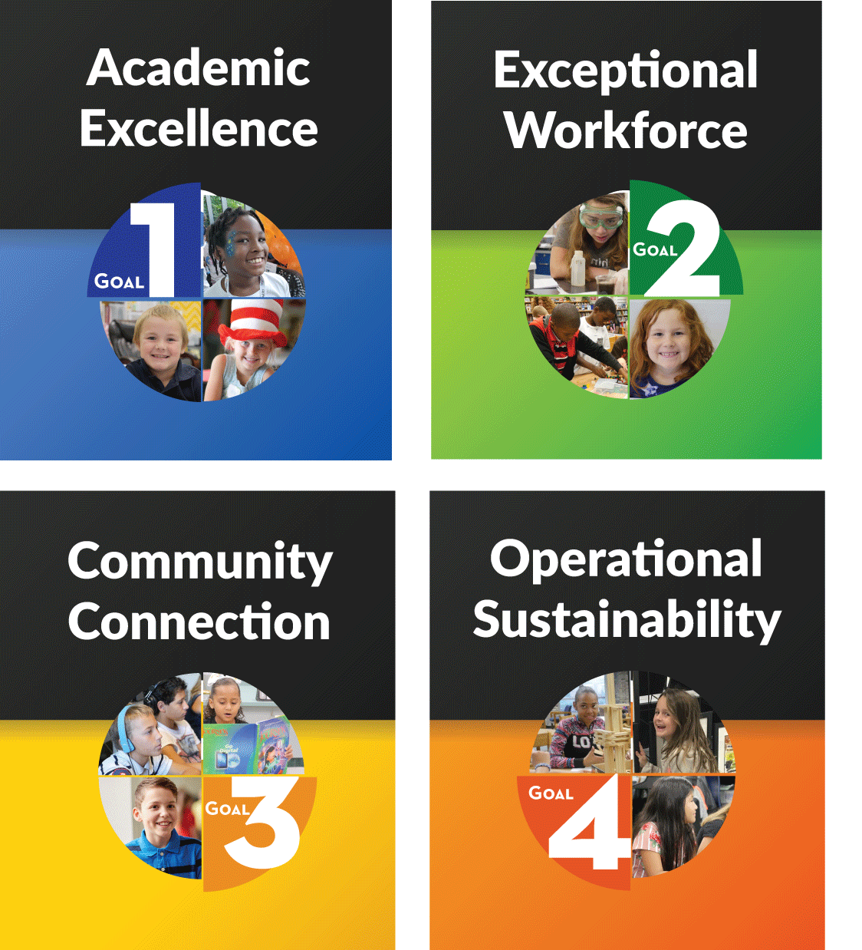
Our Kids, Brevard’s Future
‘A’-rated school district –
responsible for 70,000+ students
Current graduation rate 88.3%
In 2020, 411 seniors graduated
with an A.A. degree
Competitive career training programs – 40% of graduates earn industry certification
Comprehensive music programs K-12
Science research leader in the state
Experienced teacher workforce – retention is critical to students’ success
Notes:
Ultimately, the surtax renewal is an investment in support of our kids and our future. As well as, keeping our commitment to our Strategic Plan.
Our Strategic Plan is built on 4 pillars – Academic Excellence, Exceptional Workforce, Community Connection and Operational Sustainability. Those 4 pillars ultimately hold up our mission statement.
Without a surtax renewal, we will be faced with the very difficult reality of how to strengthening those pillars to fulfill our mission.
If we don’t have the capital dollars to address our deteriorating buildings and critical infrastructure, the only other option is to take operating dollars and move them over to capital to take care of the roofs, electrical systems and plumbing.
But we need to remember what’s wrong with that. Remember what the operating budget takes care of... the salaries of the people who work with our kids directly and the people who support our schools. Operating budget also provides the materials, the resources, the programs that make Brevard great.
If you’ve come from another district in Florida or even across the country, I would ask you “are you hearing and seeing comprehensive K-12 art programs in other places”,
“are other school districts able to provide a comprehensive K-12 music program” – Brevard does,
“are other district science research leaders in the State” – not like Brevard is. Brevard has less than 3% of the kids in K-12 education in the State, but when we send our science research kids to State competitions and then onto National competitions, Brevard has historically brought home 30% of the 1st place awards. We are the State’s leader in science research. Why, because we make that a priority in our operating budget.
That’s why we are an “A” rated school district.
That’s why our graduation rate continues to improve and climb... not just as a whole, but in every sub-group.
We graduated over 400 seniors last May, not only with a high school diploma but with an AA degree from Eastern Florida State College because we prioritize and commit to that opportunity for our kids so that they obtain the successful future that they deserve.
40% of our graduates walk across the state with their diploma and an industry certification credential and the great reality is that those kids who come across the stage with those credentials are the perspective workforce of Brevard’s future. Whether it’s a HVAC mechanic... sometimes with Brevard Public Schools, or its in our hospitals or doctor’s office as a medical professional, or an engineer at Harris, SpaceX or Northrup Grumman. That’s the investment we are making in Brevard’s future.
We have one the top three experienced teacher workforce within the State. That’s how we are able to be an “A” district. That’s how we are able to lead the State in science research. Because we have a committed and dedicated workforce.

Slide 25
An Important Decision
November 3rd
Notes:
In November, our community, every one of us as Brevard residents, have an important decision to make in consideration of the future of Brevard schools and the opportunities for our kids with the renewal decision of the half-cent sales tax.
Understanding that Brevard Public Schools will continue to commit to all of the things we did 6 years ago when our community entrusted us with this responsibility.
My hope is that you leave today, or leave this presentation understanding where we have been, where we are currently and what the future will look like with or without the half-cent sales surtax.
Knowing that being here in itself is an investment in Brevard Public Schools, I appreciate you taking the time to sit through this presentation and understand YOUR public schools in a greater way, which is serving our kids and the future that we have together. Thank you

