Slide 1


BPS New Employee Onboarding
Employee Benefits
Plan Year 2023
Updated 9/8/2023
Notes:
Welcome to the BPS New Employee Onboarding. In this presentation, we’ll talk about the BPS employee benefits program. I’m Lisa Schmidt, manager of employee benefits here at the district.

Slide 2

Introduction
The BPS benefits program offers:
  Medical Employee & Dependent Life Insurance
  Dental Accidental Death & Dismemberment
  Vision Employee Assistance Program
  Disability Supplemental Health Benefits (Accident, Critical Illness, Hospital Indemnity)
  Flexible Spending Accounts
Enrollment in any of the benefit plans is optional.
BPS’s health plan is a cafeteria plan, which allows you to choose what best meets your needs. Further, the cost of your medical, dental, vision, and flexible spending account elections are deducted from your pay before taxes are applied.
This presentation is a highlight of coverage. Comprehensive information can be found in the Employee Benefits Guide in your account at our Benefits Portal as well as the Benefits page of the district website.
You will receive an email within a few days from your start date, which will contain your benefit enrollment instructions.

Slide 3

Enrollment Timeframe
Enrollment deadlines will be indicated in your new-hire benefits packet, which will be e-mailed to you. Please be sure to take note of them.
  Be sure to complete all on-line forms/affidavits, e.g. Medical Plan Affidavit
  Medical ID cards should arrive prior to the beginning of your medical coverage effective date
  Make sure your address is updated in My Information Center (MIC)
If enrolling dependents, you MUST provide proof of eligibility by your benefit effective date. Proof includes:
  Marriage certificate for spouse
  Birth certificate or adoption documents for child(ren)
Our benefit plan year is DIFFERENT than our school year
Benefit Plan year is on a calendar year: January 1 to December 31
  *** Why it’s important to know this:
  As a new employee, you will need to enroll for benefits TWICE, sometimes within a short timeframe:
      First, as a new employee, for benefits for the remainder of the year you’re
      hired. (Your individual deadlines will be in your new-hire benefits packet.)
      Second, during Open Enrollment in October for the next year’s benefits

Slide 4

When can I change my benefits ?
Qualifying Event vs. Open Enrollment
The benefits you elect as a new hire are irrevocable and may not be changed until the next annual open enrollment UNLESS you experience a Qualifying Life Event (QE), e.g., birth/adoption, marriage, divorce, death, loss or gain of coverage.
If you experience a QE, and wish to change any of your benefits, you must notify the Employee Benefits department within 30 days from the date of that qualifying event and provide documentation. If you don’t, then you must wait until the next Open Enrollment period (or until another QE occurs.)
You may make coverage changes without documentation only during Open Enrollment. The changes made will be in effect as of January 1 of the following year.

Slide 5
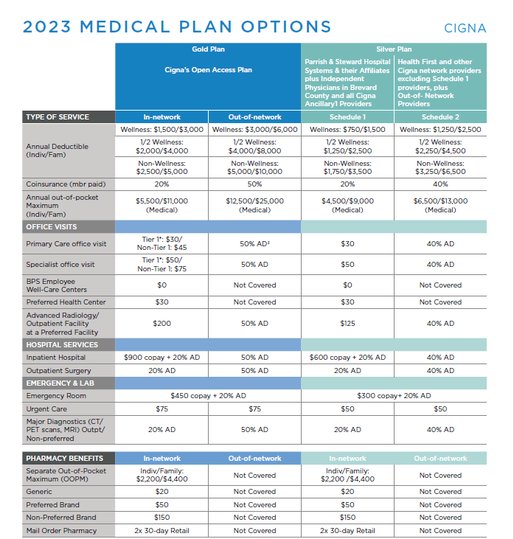


Two medical plans to choose from:
Gold and Silver plan
The Gold plan is a traditional In-and Out-of-network PPO plan.
For a lower In-network office visit copay, look for physicians with the “Tier 1 Provider” logo - - in Cigna’s on-line provider directory at www.Cigna.com
This plan provides coverage for services from Cigna’s nationwide network of providers.
Notes:
BPS offers two PPO medical plans to choose from: Gold and Silver.
Regarding the GOLD plan:
This plan is a traditional In- and Out-of-Network PPO plan where using IN network providers will be the most cost-effective approach to health care.
In-network providers are those who are contracted by Cigna to be part of their network. However, if you visit a provider that’s NOT contracted with Cigna, you would still have coverage for those services but at the higher OUT-of-network costs, as shown.
Additionally, regarding IN-network providers, note that for Primary Care and Specialist office visits, there’s a copay differential for each provider type. To pay the lower office-visit copay, try to use physicians who have the “Tier 1 Provider” logo showing in Cigna’s on-line provider directory (at www.Cigna.com or www.mycigna.com).
For office visits to providers without that “Tier-1” designation, the copay will be higher, as noted.
And again, pharmacy benefits are the same for both medical plans

Slide 6

The Silver plan has two pricing schedules.
The lower Schedule 1 pricing is limited to Parrish & Steward Hospital Systems and their Affiliates plus independent physicians in Brevard County and Cigna Ancillary providers.
The higher Schedule 2 pricing applies to Health First providers, providers outside of Brevard County, and to non-contracted/out-of-network providers. Note: Schedule 2 includes coverage for services from Cigna’s nationwide network of providers.
Notes:
Regarding the Silver plan:
The Silver plan replaces the traditional In- and Out-of-network plan design with pricing schedules and assigns specific provider groups to each pricing schedule. Though it’s no longer an In- and Out-of-network plan, you can still use both “sides” of the plan as you wish, simply paying the noted Schedule costs for the type of provider you use.
For example, if one week you see a Parrish physician for an office visit, you’d pay a $30 copay. And that’s that. You would not have to first meet the deductible. If a couple weeks later you see a Health First physician for an office visit, you’d need to pay the full cost of the visit until you meet your deductible. Once you’ve met the deductible, then for an office visit to a Health First physician, you’d pay 40% of the allowed amount. (The Allowed Amount is determined by Cigna and is what your and the plan’s coinsurance is based on.)
For example, let’s say you’ve already met your deductible, and that Cigna’s Allowed Amount for a Health First office visit is $300. For a Health First physician office visit, you’d pay $120, which is 40% of the $300 Allowed Amount.)
The lower Schedule 1 pricing is limited to Parrish and Steward hospital systems and their affiliated providers, plus Independent physicians in Brevard County, and Cigna’s Ancillary providers, e.g. labs and outpatient surgical facilities. Except for emergencies, coverage outside of these designated provider systems will be subject to the higher Schedule 2 pricing.
The higher Schedule 2 pricing applies to Health First providers, providers outside of Brevard County and to Non-contracted out-of-network providers.
Regarding pharmacy coverage, both plans have the same benefits.

Slide 7
Both Medical Plans Offer Access to:
Pharmacy Benefits
In- and Out-of-Network refers to Cigna’s pharmacy network
The following programs are FREE to employees and eligible dependents enrolled in a BPS medical plan and there are no out-of-pocket costs to use the programs:
Hinge Health
Is a virtual physical therapy program. With the help of coaches, therapists, and/or wearable sensors, participants conquer back and joint pain, recover from injuries, prepare for surgery or stay healthy and pain free. For questions: 855.902.2777
Surgery Plus
Is a supplemental benefit program which covers eligible planned, non-emergency surgeries and offers a personalized concierge experience through dedicated Care Advocates. Covered categories include orthopedics, spine, general surgery, gynecology, ear/nose/throat, GI and cardiac. For questions: 833.709.2441

Slide 8



Both Medical Plans Also Offer Access to:
Telehealth with no out-of-pocket cost
MDLive Using MDLIVE is as easy as one, two, three.
Step 1 | Step 2 | Step 3
Create an account. Setting up your secure account only takes minutes. | Schedule an appointment. You can have a doctor visit right away or schedule an appointment – all by phone, computer, or our app. | Feel better. Get reliable care from board-certified doctors and licensed therapists.
To Schedule: MyCigna.com MDLIVEforCigna.com 888-726-3171 Or download app

Slide 9

How to Reduce your Medical Plan Deductible
Complete these two wellness activities by the deadline noted in your benefit enrollment materials:
  Annual Physical
    Performed free to you and your covered spouse at any BPS Well-Care Center (WCC)
    Performed free to you and your covered spouse with your In-network primary care physician
  Online Health Assessment
    After completion of your annual physical, you and your covered spouse will visit www.mycigna.com to register for individual accounts. Once registered, go to the Wellness tab to access to the Health Assessment. For assistance, contact Cigna’s HA helpline at 800.853.2713 or 800.569.5242.
Completing both wellness activities will reduce your In-network
medical plan deductible.
Notes:
Brevard Public Schools offers medical plan enrollees the opportunity to complete two wellness activities – a biometric screening and a health assessment – in order to reduce their medical plan deductible.
As a new employee, completing these activities by the deadline noted in your new-hire benefits package not only reduces your deductible in the year you’re hired, but also in the following year. It’s the only time that doing these activities once counts for TWO plan years.

Slide 10
Reduced Deductibles
Gold Plan
Silver Plan
 | In-Network | Out-of-Network | Schedule 1 | Schedule 2
ANNUAL DEDUCTIBLE (Individual/Family) | Wellness: $1,500/$3,000 | Wellness: $3,000/$6,000 | Wellness: $750/$1,500 | Wellness: $1,250/$2,500
 | 1/2 Wellness: $2,000/$4,000 | 1/2 Wellness: $4,000/$8,000 | 1/2 Wellness: $1,250/$2,500 | 1/2 Wellness: $2,250/$4,500
 | Non-Wellness:$2,500/$5,000 | Non-Wellness:$5,000/$10,000 | Non-Wellness: $1,750/$5,500 | Non-Wellness: $3,250/$6,500
Using Gold In-network for a Family as the example:
Everyone starts out at the highest Deductible, i.e., Non-Wellness ($5,000 in this example) and must “earn credit” their way to a lower deductible by completing the wellness activities.
  Without Wellness Credit: If neither the employee nor the spouse complete both activities, then no credit is earned and the employee and spouse are subject to the full $5,000 Non-wellness Family deductible.
  ½ Wellness Credit: If only the employee OR only the spouse completes both wellness activities, then only ½ of the credit is earned and the employee and spouse are subject to the $4,000 ½ Wellness Family deductible
  With Wellness Credit: If the employee AND spouse each complete both wellness activities, then the full credit is earned and the employee and spouse are subject to the $3,000 Wellness Family deductible.
Notes:
We just talked about the activities that lead to a reduced deductible so here we’ll take just a few moments to review the three resulting levels of medical plan deductibles.
Let’s use the Gold Plan’s Family deductible as our example.
Everyone starts at the highest deductible, which is at the NON-wellness level ($5,000 in our example). From there, medical plan enrollees must “earn” their way to the lower deductibles of ½ wellness and Wellness by completing the wellness activities.
Without Wellness: If neither the employee nor the spouse complete both activities, then no credit is earned and the employee and spouse are subjected to the full $5,000 Non-wellness Family deductible.
½ Wellness: If only the employee OR only the spouse completes both wellness activities, then only ½ of the credit is earned and the employee and spouse are subjected to the $4,000 ½ Wellness Family deductible
With Wellness: If the employee AND spouse each complete both wellness activities, then the full credit is earned and the employee and spouse are subjected to the $3,000 Wellness Family deductible

Slide 11
BPS Employee Well-Care Centers
No out-of-pocket cost
Three Well-Care Centers
  North/Titusville - Jackson Middle School – (321) 222-9070
  Central/Viera - District office (in overflow parking) – (321) 252-1169
  South/West Melbourne - Central Middle School – (321) 369-9514
Available medications are dispensed at no cost to employee or dependents (age 6+) when enrolled in a BPS medical plan
Services include:
  Primary and Acute Care
  Chronic Condition Management
  Health and Wellness Coaching
  Annual Physical
Well-Care Centers are not walk-in clinics; appointments must be made
  To schedule and appointment, call or go on-line to my.marathon-health.com
Notes:
Earlier we mentioned the BPS Employee Well–Care Centers; here’s more information:
If you’re enrolled in the BPS health plan, you’ll have access to our 3 Well-Care Centers in the North, Central and South parts of the county, as shown.
Any service received or medication dispensed at a WCC is FREE for employees and their dependents older than 6 who are enrolled in the health plan
Service you can receive at a WCC include health and wellness coaching, primary and acute care, chronic condition management and biometric screenings. Remember, a biometric screening is one of the 2 wellness activities you can complete in order to receive a reduced health plan deductible.
VERY IMPORTANT TO NOTE: The WCCs are not walk-in clinics; just like a doctor’s office, appointments must be made.
Evening and weekend hours are available at two centers.

Slide 12
Tobacco-use Surcharge Program
Part of the enrollment process is to complete the on-line Medical Plan Affidavit, which includes questions about tobacco use
A $50/month tobacco-use surcharge will be added to the medical plan premiums of tobacco users.
  Includes, but not limited to, use of: cigarettes, pipes, cigars, smokeless tobacco, and all Electronic Nicotine Delivery Systems, e.g., vape & hookah pens and e-cigarettes.
  If both the employee and enrolled spouse use tobacco, only one surcharge will apply
Surcharge will be refunded by January 1 of the following calendar year if the tobacco user(s) completes Cigna’s Tobacco Cessation Program by September 30, 2023. If both employee and covered spouse are tobacco users, both must complete the cessation program to qualify for a refund.
To schedule a Tobacco Cessation Program, call:
  Cigna telephonic coach: 1-800-244-6224 OR
  Cigna’s onsite health coach, Joni Deblecourt-Whelen: 321-338-5955 (call or text)
Both coaching options have a similar average of 6 sessions and include Nicotine Replacement Therapy
Employees and covered spouses must be tobacco free as of April 1, 2023, to be considered a non tobacco user.
Notes:
The tobacco use surcharge program will continue in 2022.
Use of any tobacco product is subject to the $50/month surcharge. Such products include cigarettes, cigars and pipes, vape & hookah pens, and e-cigarettes.
Employees enrolling for 2022 medical coverage must complete the new online Medical Plan Affidavit, which includes a question about their own tobacco use, and that of their spouse, if applicable.
Employees affirming tobacco use on the Affidavit will be subject to the surcharge.
Only ONE surcharge will apply even if both the EE and spouse use tobacco; however, BOTH must complete the tobacco-use cessation program in order to have the surcharge refunded.

Slide 13



BPS Benefits Program - 2023
Dental (Humana)
  Four plans: PPO (High & Low); DHMO (High & Low)
  If you have out-of-state dependents, you should consider a PPO plan.
Vision (Humana)
  Two plans: Basic & Enhanced
  Has a nationwide network
Flexible Spending Accounts (TASC)
Health Care (e.g., annual deductibles, copayments & coinsurance, orthodontics, eyeglasses, Rx)
Dependent Care (includes child and elder care)
This Photo by Unknown Author is licensed under CC BY-SA
Notes:
Next, the BPS Dental benefit offers four plans: two PPO plans and two HMO-type plans. There’s a high and low option under each; the high option has richer benefits and costs more and the low plans have less benefits and cost less.
Our Vision benefit offers two plans: Basic and Enhanced. The Basic plan has minimal benefits and costs less than the Enhanced plan with richer benefits.
If you’re enrolled in one of the medical plans, you’ll have access to our three BPS employee Well-Care Centers. We’ll talk more about those a bit later.
Our Employee Assistance Program (EAP) is available to ALL BPS employees and their family members, even if not enrolled in a medical plan. More on that later, too.

Slide 14

BPS Benefits Program – 2023 (cont.)
Life Insurance (Standard Insurance Co. -“The Standard”)
  Basic Employee Life of one times salary (At no cost to benefit-eligible staff; paid by Board).
  Additional Employee Life, up to 4 times your salary.
  Accidental Death & Dismemberment (AD&D), up to 4 times your salary.
  Dependent Life Insurance, up to $25,000 coverage for spouse, and $5,000 coverage for child(ren).
  Maximum coverage levels on life products can be elected as a new hire. Afterward, existing coverage can be increased by one times salary only during Open Enrollment or due to a Qualifying Event.
  Requests to increase more than one times salary will be subject to a health questionnaire. The life carrier will determine whether increase is approved or denied.
Notes:
The BPS benefits program also offers a Flexible Spending Account (FSA) program with 2 options:
Health care and Dependent care
An FSA lets you set aside pre-tax dollars from your paycheck and use those funds to pay for things like annual health plan deductibles and copays, eyeglasses, Rx and orthodontics, under the Health Care FSA. Under a Dependent Care FSA, those funds can help pay child and elder care expenses.
Every benefit-eligible employee at BPS receives 1 times their annual pay in Basic life insurance paid for by the Board. Even if you elect no other benefit, you’ll have this benefit so be sure to name a beneficiary for this coverage.
In addition to the Free Basic life which the Board provides, you can elect Additional Employee Life and AD&D insurance as well as Dependent life insurance. These are optional benefits you can choose.
BPS also offers a Short- and Long-term disability plans.
The STD benefit is 60% of covered weekly earnings for up to 26 weeks
The LTD benefits is 60% of monthly covered earnings. The maximum benefit period depends on your age at disability. For example, if you became disabled at age 62 or younger, your benefits generally could go up to your Social Security Normal Retirement Age.

Slide 15
BPS Benefits Program – 2023 (cont.)
Short– and Long-term Disability (The Standard)
  STD – 60% of covered weekly earnings; maximum benefit period is 26 weeks.
  LTD – 60% of covered monthly earnings; maximum benefit period based on age at the time of disability.
    For example, if age 62 or under at the time of disability, the maximum benefit period is generally until your Social Security Normal Retirement Age.
  Coverages are guaranteed issue at the time of new hire. Afterward, elections may only be made during Open Enrollment and will be subject to a health questionnaire. The disability carrier will determine whether coverage is approved or denied.

Slide 16
Employee Assistance Program (EAP)
  Available to ALL employees and their family members at no cost, including in-laws and dependents out-of-state. An employee does not have to be benefits eligible.
  Is completely confidential
  Includes up to 6 in-person visits with a licensed counselor/psychologist and unlimited telephonic sessions
  Can help with a wide variety of personal issues such as:
  Available 24 hours a day, 7 days a week
  To talk to a counselor, call Charles Nechtem Associates (CNA) 1-800-531-0200
Family/Parenting | Grief | Marital/relationship | Stress/Anxiety
Depression | Alcohol/drug abuse | Elder/child care | Financial
Legal | Work | Mental health
Notes:
Now we’ll talk about some benefits which are available to ALL BPS employees even if not enrolled in the health plan.
We all have access to the Employee Assistance program (EAP), not only four ourselves but for our family members, too, including in-laws and out-of-state dependents.
Using the EAP is free and is completely confidential.
You can get up to 6 IN-PERSON visits with a licensed counselor or psychologist and you get unlimited sessions by phone
In addition to counseling , the EAP offers a wealth of information and assistance for many issues including finding child and elder care, summer camps, special needs services, and financial and legal concerns. Help is available 24/7 and is just a phone call away.
BPS is fortunate to have two Cigna on-site wellness professionals who collaborate with the district and the Well-Care centers to offer al employees fun and beneficial wellness activities and challenges all year long. The activities include walking and weight loss challenges, lunch and learns, and yoga classes. And if fun wasn’t enough, many of these events offer prizes!

Slide 17

  Additional Benefits sponsored by
  BPS, Cigna, and Marathon Health
  Wellness activities and challenges throughout the year.
    Activities include
      Lunch ‘n’ learns
      Yoga classes
      Blood pressure checks
    Challenges include
      Walking
      Weight loss
    Incentives and prizes included!
Notes:
Now, let’s focus on the NEW portion of this NEW employee presentation. What we’ll talk about now is only relevant if you’re very newly hired and are still within 30 days from your hire date. If this is you:
You must make your benefit elections within the 30 days from date of hire and those benefits become effective on your 46th day of employment.
Please don’t wait until the last minute to enroll since there will be information you’ll need to look up and have available, e.g. social security numbers.
If you’ll be enrolling a spouse or children, you’ll have to provide documentation to prove their eligibility, e.g, marriage cert for spouse, birth cert for children. This must be provided by the 46th day from your date of hire.
Remember we talked earlier about two wellness activities that, if completed, result in lower health plan deductibles? That goes for spouses who’ll have medical coverage, too. Be sure your covered spouse completes both activities so that your family can get the FULL reduction to the annual deductible.
I’ve saved for last one of the biggest advantages you have as a new hire still within your 30-day benefits election window: this is your one-time opportunity to enroll in STD and LTD without having to complete a health questionnaire. This means if you enroll for it now, you’ll get it. If you choose to wait and apply for STD and/or LTD during annual open enrollment, which is perfectly fine, then you’ll be required to fill out a health questionnaire and await a decision from Cigna on your coverage; which might include a denial. So for Guaranteed Issue of STD and/or LTD, now would be the time to elect it.

Slide 18
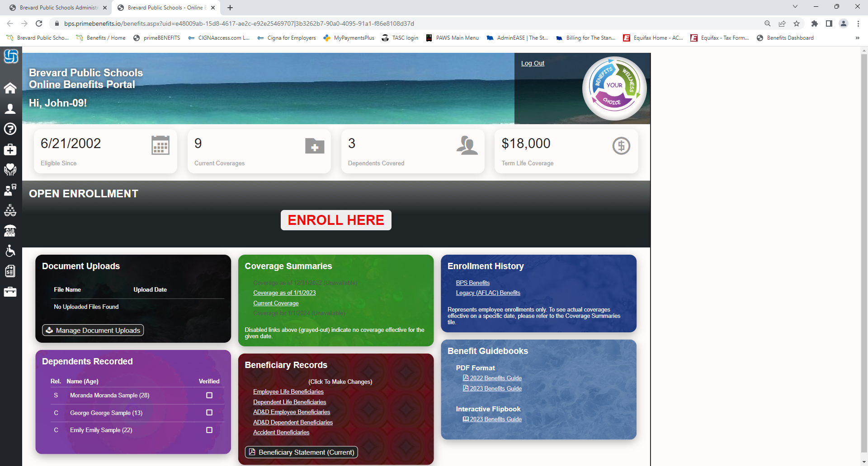
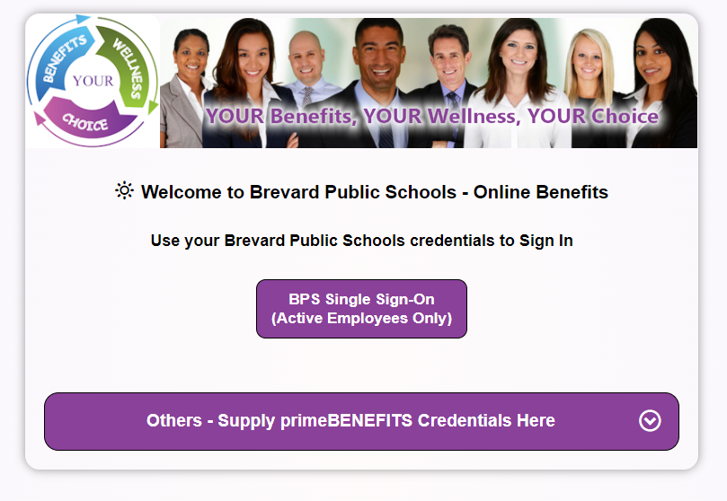
BPS Benefits Administration System - Benefits Portal
Used for:
Initial benefits enrollment at time of hire
Open Enrollment
24/7 access to:
  Add or change beneficiary information
  Securely upload documents
  View your coverage information
Notes:
Easy Benefits is the district’s benefits administration system. It’s not only where you’ll enroll for benefits but also the place where your personal benefits information will be kept, including your life insurance beneficiaries.
To access your EasyBenefits account, you’ll need a User ID and a password.
The User ID will be your employee 100-number and the password will be sent to you in your new hire package. Admittedly, the passwords are not ones easy to remember and they cannot be changed so be sure to keep yours in a place where you’d have easy access to it should you need it.
This slide shows you what the log-in screen in EZB looks like.

Slide 19
Contacts
BPS Employee Benefits Office
(321) 633-1000, ext. 11216
Lisa Schmidt – Employee Benefits Manager
Debbie Lucas – Employee Benefits Coordinator
Charmaine Odom – Employee Benefits Coordinator
Amy Wiedenhoeft – Employment Specialist
To reach us by email: BPSBenefitsWellnessAndChoice@Brevardschools.org
Employee Benefits Education & Call Center: 321-800-4490
          Hours: M–F 9am to 9pm
Benefits page on District website: https://www.brevardschools.org/Domain/1149
Notes:
This brings us to the end of the benefits presentation and on this slide you can see who makes up the benefits team.
Make a note that each BPS school and worksite has a local benefits contact which is usually the site’s secretary. Then, three of the benefit team members noted on this slide are each assigned to their own list of schools and worksites. In the event your own site’s benefit contact isn’t available, feel free to contact the benefits department at the number shown, tell us where you work, and you’ll be connected with the benefits team member assigned to your location.
Once again, we warmly welcome you to the BPS team!

Slide 20
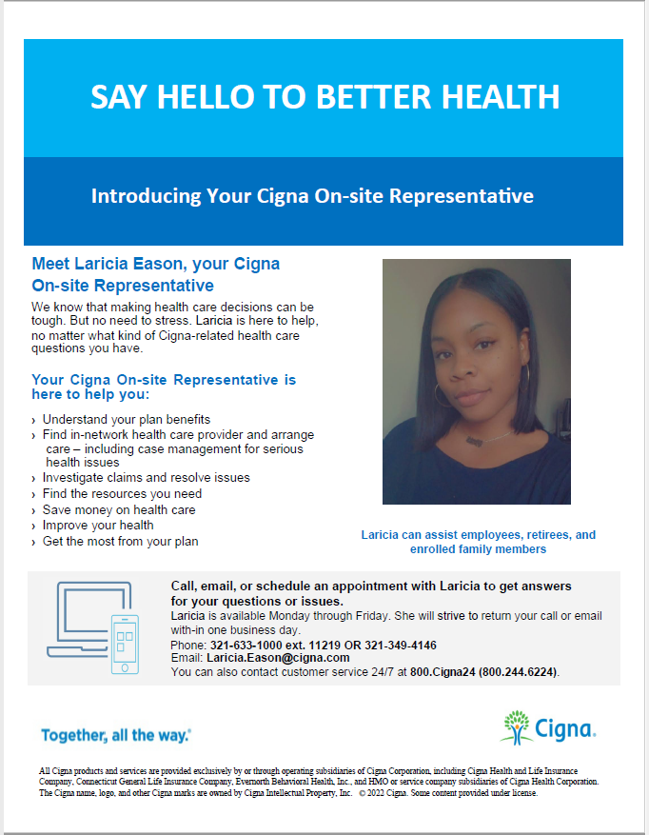
BPS has a dedicated service representative, Laricia Eason, to help employees enrolled in a medical plan with any issues that may arise with their coverage.
The flyer shown here, with Laricia’s contact information, is also posted on the Benefits page of the BPS website.

Slide 21
Common Benefit Terms for Medical Plans
PPO Plan – Stands for Preferred Provider Option. Typically, a plan with an IN-network and Out-of-Network pricing differential, with lower costs being assigned to IN-network (Preferred) providers.
Copay – A set-dollar amount you pay at the time you receive a medical service. The remaining balance will be paid by the BPS Health Plan Trust Fund.
Deductible – The amount you must pay before the BPS Health Plan Trust Fund begins to pay its portion of coinsurance for services you receive. This is an amount you’ll pay once each calendar/plan year.
Coinsurance – A percentage of the total Allowed Amount that you must pay. For example, if the Allowed Amount for a Silver plan, Schedule 2, office visit is $200 and your coinsurance is 40%, you’d pay $80, and the BPS Health Plan Trust Fund would pay the remaining 60% ($120) of the Allowed Amount, once the deductible has been met.
Out-of-Pocket Maximum – The maximum amount of money you’re required to pay in copays, deductibles and coinsurance for covered medical services during each calendar/plan year. Once you reach this amount during a calendar/plan year, the BPS Health Plan Trust Fund will pay 100% of the Allowed Amount for covered services for the remainder of that calendar/plan year.

