Slide 1





Title I Annual Meeting
Challenger 7 Elementary Sept. 22,2022
Notes:
Good evening, Thank you for taking the time join our Title I annual meeting. My name is Jessica Farner and I am the Title I coordinator at Challenger 7.

Slide 2
Purpose of Meeting
According to the Every Student Succeeds Act (ESSA), schools are required to host an Annual Meeting to explain and discuss:
Title I programs and requirements
    Parent and Family Engagement Plan
    School-Parent Compact
    Parents’ Right to Know
    Design, Implement and Evaluate School Improvement
    Plan (SIP/SWP) Goals
    Gather Stakeholder Input
Additional support
    School and Family Partnerships
    Business Partnerships

Slide 3
What is Title I?
Title I is a federal grant that:
Ensures all children have the opportunity to obtain a high-quality education and reach proficiency on challenging state academic standards and assessments
provides supplemental funds to school districts to assist schools with high concentrations of poverty to meet educational goals
assists with building capacity of parents and teachers
encourages parents to be involved in their children’s education

Slide 4
Title I Funding
Districts allocate Title I funds to qualifying schools based on the number of students eligible to receive free/reduced price meals
Title I must supplement, not supplant district funds
A specified amount of the Title I grant must be spent on family engagement and professional development
Parents have the right to give input regarding how the school will use its Title I funds

Slide 5
Who decides how funds are used?
Your administrative team considers data and feedback collected throughout the school year to build their school budget
Every school has a School Advisory Council (SAC) composed of:
  parents, teachers, staff, community members, principal and students (at middle and high schools)
The School Advisory Council helps determine how to use Title I funds. Please consider joining!
Use of Title I funds must align with the goals of the School Improvement Plan (SIP) and School-wide Plan (SWP) for Title I
  Copies of these documents are available for review in the school office (translated, when possible)

Slide 6
Title I Programs
All Title I public schools in Brevard are school-wide programs, meaning Title I funds, along with other local-, state- and federal funding sources are used to support all students in the school
The primary focus of the Title I program is to support the students most at-risk for academic failure

Slide 7
Use of Title I Funds
Challenger 7 Elementary is provided with $200,408.00 to pay for services and programs for our students.
School-based Title I funds pay for the following:
  1 Title I teacher
  2 Title I assistants
  Materials and supplies
  Family engagement events
  Professional Development
  Some field trip such as Lagoon Quest

Slide 8
School Grade Information
Challenger 7 is a “C” school this year.
Challenger’s overall ELA proficiency dropped by 3% compared to 2021.
Challenger’s overall Math proficiency dropped by 5% compared to 2021.

Slide 9
SIP/SWP Goals
At least 65% of our students will score proficient in ELA according to state assessments.
At least 56% of our lowest 25% will score proficient in ELA according to state assessments
At least 39% of our students with disabilities will score proficient in ELA according to state assessments.

Slide 10
SIP/SWP Goals
At least 65% of our students will score proficient in math according to state assessments
At least 47% of our lowest 25% will score proficient in math according to state assessments

Slide 11
Title I supports SIP/SWP Goals
Title I teacher and assistants will be providing reading and math intervention.
Funds will help provide materials and supplies for teachers and students to utilize in class.
Family engagement events will provide families with strategies and materials to support their child’s learning at home.

Slide 12
Educational Standards
Florida’s academic content standards establish high expectations for all students in the areas of reading, mathematics, writing, and science
Florida Standards for Language Arts and Math identify what your child needs to know and be able to do. Information can be found at:
  https://www.cpalms.org/Homepage/BEST_Standards.aspx

Slide 13
Testing
Parents are to be provided information regarding the level of achievement of their child on each state academic assessment required by law
To the extent that is feasible, testing information must be translated into a language the parents can understand

Slide 14
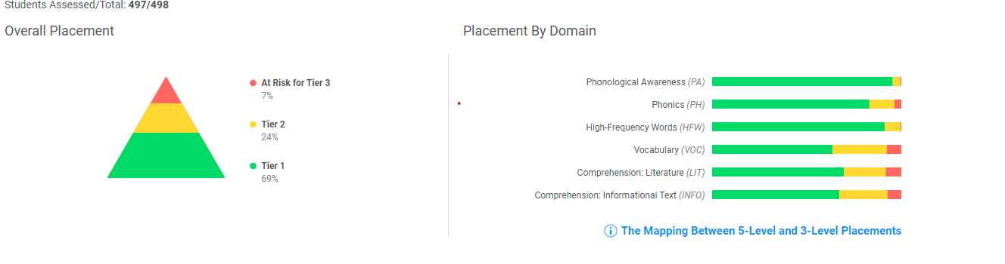
Testing
iReady Reading EOY Diagnostic

Slide 15
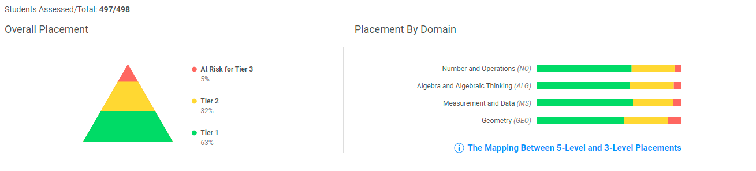
Testing
iReady Math EOY Diagnostic

Slide 16
FSA Test Results
This year FSA scores will only be available on FOCUS.
If you would like someone to discuss or explain your child’s score report with you, please contact the office.
Please be sure to sign up for FOCUS. This will allow you to view grades, communicate with teachers, and update phone numbers.
Please let your child’s teacher know if you need your FOCUS pin number.

Slide 17
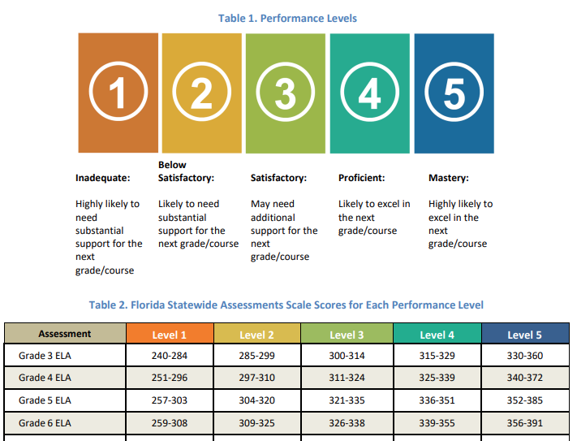
FSA Test Results
.

Slide 18
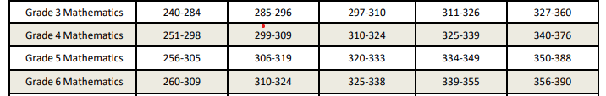
FSA Test Results
.

Slide 19
Parent and Family Engagement Plan (PFEP)
Each Title I school must jointly develop, agree upon, and distribute to parents a written Parent and Family Engagement Plan (PFEP)
The Parent and Family Engagement Plan (PFEP) describes how the school will carry out parent involvement requirements, including the development of a School-Parent Compact

Slide 20
Parent and Family Engagement Plan (PFEP)
Title I schools must:
provide timely information about Title I programs to parents
explain the curriculum, assessments, and the minimum standards that students are required to meet
offer a flexible number of meeting dates and times

Slide 21
Parent and Family Engagement Plan (PFEP)
Title I schools must:
involve parents in making decisions about how Title I funds reserved for parent involvement should be spent
provide documents to show that families were given information translated in their native language, when reasonable
show evidence of continuous communication between the school, families, students, and community

Slide 22
Parent and Family Engagement Plan (PFEP)
Title I schools must:
provide information on how the school works with community, volunteers, and business partnerships to increase student achievement
provide trainings to staff and parents designed to increase student achievement and support family engagement

Slide 23
Parent and Family Engagement Plan(PFEP)
Title I schools must:
jointly conduct an annual evaluation of the content and effectiveness of the school’s Parent and Family Engagement Plan (PFEP)
monitor and evaluate the strategies of the Parent and Family Engagement Plan (PFEP)
use the findings of the evaluation to design and revise strategies for more effective family involvement

Slide 24
Parent Survey Results
Communication
Utilizing a unified texting program for regular parent-teacher communication
Using a variety of forms such as texting, emailing, newsletters, social media, etc.
Involvement of Families
Hold events later in the day or evening time so they could participate
Communication through newsletters and surveys for parents for feedback and planning purposes
Funding
Suggested Title I funds be used for the following:
Additional staff
After school tutoring
Hands-on materials
Take-home materials
Field trips

Slide 25
Title I Complaint Procedure
Parents have the right to submit comments regarding district and/or school Title I plans
  Comments should be turned in to the school
  The school will forward comments to the district Office of Title I
  The district Office of Title I will include parent comments when plans are submitted to the Florida Department of Education

Slide 26
School-Parent Compact
Each school must have a School-Parent Compact that is written by parents and school personnel
The compact outlines the responsibilities of the students, parents, and school staff in striving to raise student achievement
The compact will be shared during parent-teacher conferences throughout the year
The compact is to be reviewed each year by the parent, student, and teacher

Slide 27

Parents’ Right to Know
Parents have the right to request and receive timely information regarding the professional qualifications of their child’s teachers and paraprofessionals
Parents must be notified if their child is assigned to or taught for four or more consecutive weeks by a teacher who is not state certified

Slide 28
Research shows…
(Epstein and Associates, 2009)
No matter the socio-economic status, when parents are involved, students are more likely to:
  attend school regularly
  earn better grades
  obtain better test scores
  pass courses
  be promoted to the next grade
  adapt to change
  have better social skills
  graduate
  continue their education

Slide 29
Tips for Success:
Communicate with your child’s teacher often throughout the year!
Consider joining our School Advisory Council (SAC) or the Title I District Advisory Council. Let your voice be heard!
Some Title I schools have Parent Resource Centers that provide materials and resources that families may check out to use at home
Reach out to Jessica Farner to discuss available materials
Notes:
Discuss your parent resource room, what is offered, and what is available.

Slide 30

Tips for Success:

Slide 31
Tips for Success:
Don’t forget to sign up for your FOCUS account. Monitor your child’s grades and stay in touch with their teacher!
Please consider volunteering this year! We’d love to have you!
Please complete the Annual Meeting Feedback form. Your opinions matter to us!

