Slide 1
SAC Meeting
Oct 19, 2023
Lexia Update
iReady Reading and Math Diagnostic 1 results
ASP Lit and Math Camp
Cogni-tutoring

Slide 2
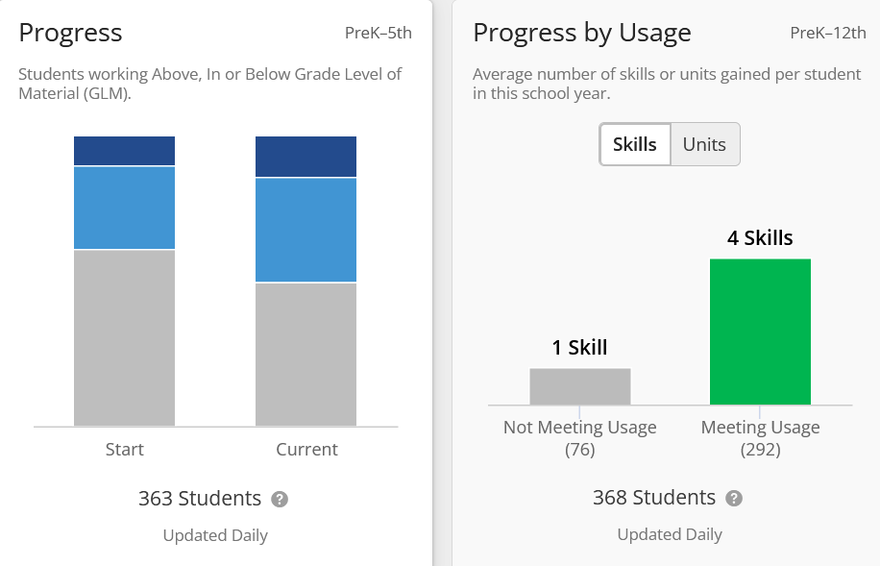
Lexia Update
14%
17%
10%
29%
37%

Slide 3
Lexia Progress by Grade Level
Grade | Start | Oct 2023
K | 74% BGL 26% OGL 0% AGL | 38% BGL 59% OGL 1% AGL
1 | 65% BGL 31%OGL 3%AGL | 48% BGL 44% OGL 0% AGL
2 | 26% BGL 45% OGL 28% AGL | 23% BGL 40% OGL 36% AGL

Slide 4
Lexia Progress by Grade Level
Grade | Start | Oct 2023
3 | 54% BGL 28% OGL 16% AGL | 49% BGL 30% OGL 20% AGL
4 | 66% BGL 30% OGL 13% AGL | 60% BGL 20% OGL 18% AGL
5 | 81% BGL 19% OGL 0% AGL | 77% BGL 23 % OGL 0% AGL

Slide 5
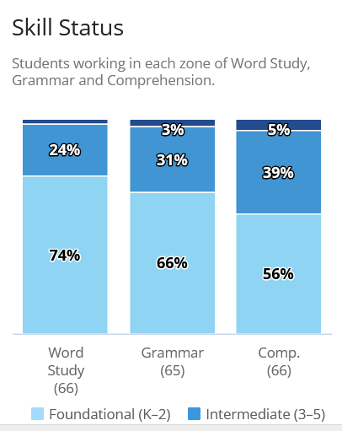
Lexia Skill Status 6th grade
2%

Slide 6
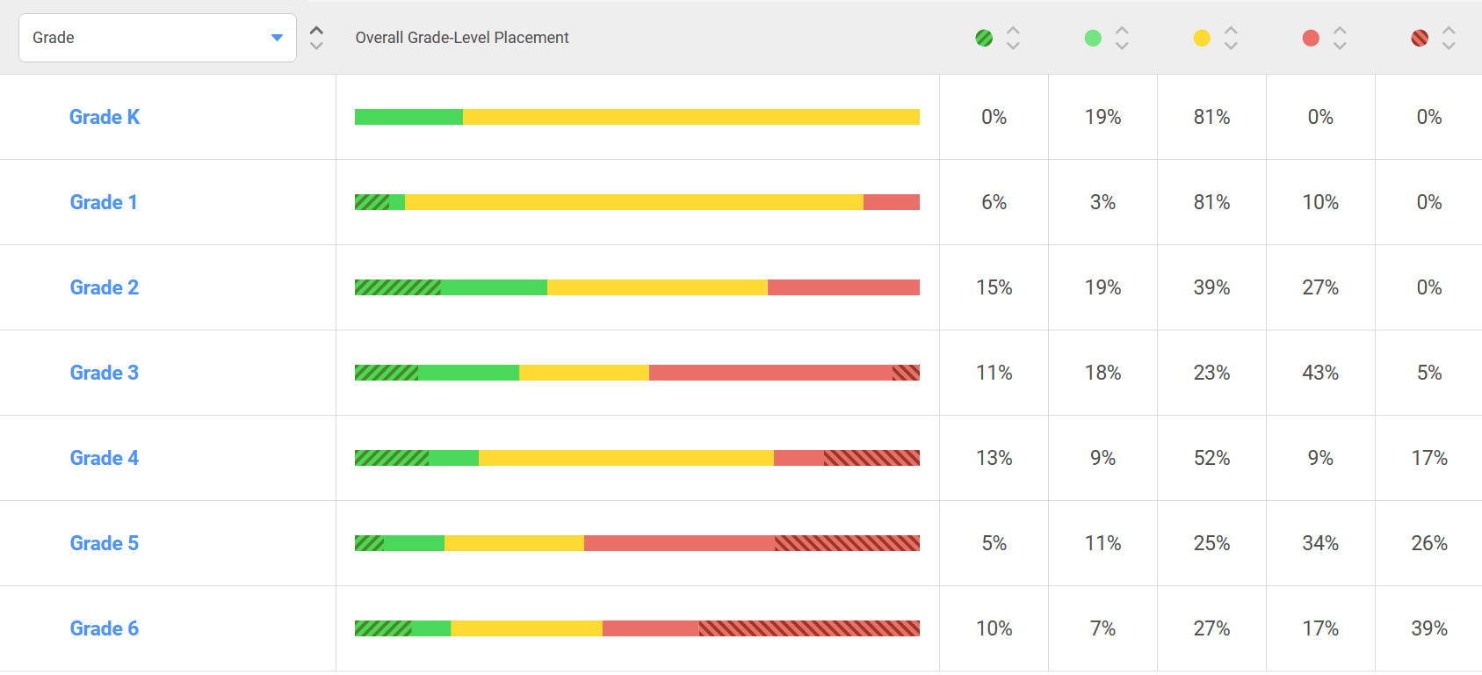
iReady ELA Diagnostic 1 *SIP Goal 55% OGL K-3, 45% Gr 4-6

Slide 7
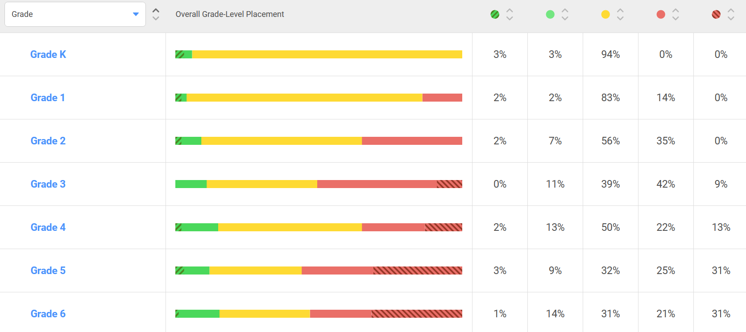
Iready math diagnostic 1 *SIP Goal 55% OGL

Slide 8
What are we doing?
40 min ELA intervention 30 min Math small group/intervention
90 min ELA block 60 min Math block
30 min K-2 Magnetic Reading Collaborative planning
30 min Gr 3 Core Phonics K-5 Fluency Flight
K-4 Monthly fluency checks
Collaborative planning
Academic Support
Lit Camp/Readers Theater Math Camp/ Fluency Flight

Slide 9
Student ownership of their data
Grades 1-6 will share their data and goals with their families on Oct 26 and Jan. 25.
Ownership of progress
Goal setting including how families can support
What will I do to reach the end of year benchmark goal for ELA, Math?
How can my family help?

Slide 10
Student chOICE
Activity teachers are leading Clubs for grades 3-6 on Wednesdays.
Students got to give their top 3 choices
Science Projects, laser and 3D printers
Art 3d projects, laser printer
Sunshine State Readers
Sports

Slide 11
Cogni-Tutoring
This is an outside provider who is interested in a contract with Cambridge to provide tutoring services to some students in grades 3-5 in reading and math.
We would use district funds for our Academic Support Program to pay for this.
We are inquiring about the possibility of bus transportation at 4:00 (after ASP). This is not a definite due to middle school and high school routes.
This is in addition to our Math Camp and Lit Camp that has been made available to some students.

Slide 12
Book Purchases
We have not made any book purchases recently.

