Slide 1
SAC MEETING
Sept 2023

Slide 2
agenda
Review Minutes 3
New Members 4
Title I 5
School Improvement Plan Goals 10
PM 1 13

Slide 3
School Improvement goals

Slide 4
areas of focus
ELA
Revised Schedule to include 90 min ELA block, 40 min intervention, 30 min Magnetic Reading K-2 and Core Phonics 3rd gr
ASP will be Lit Camp and Readers Theater.
Math
90 min block to include small group instruction/intervention
ASP will be more about math games to try and include fun. (From Reveal)

Slide 5
ELA
PreK-3 = 55% at/above grade level on PM3
Gr 4-6 45% at/above grade level on PM 3
58% Annual Learning gains (gr 3-retained -6th)
50% Lowest 25% learning gains

Slide 6
plan for product launch
deploy strategic networks with compelling e-business needs
PLANNING
synergize scalable e-commerce
MARKETING
disseminate standardized metrics
DESIGN
coordinate e-business applications
foster holistically superior methodologies
LAUNCH
STRATEGY

Slide 7
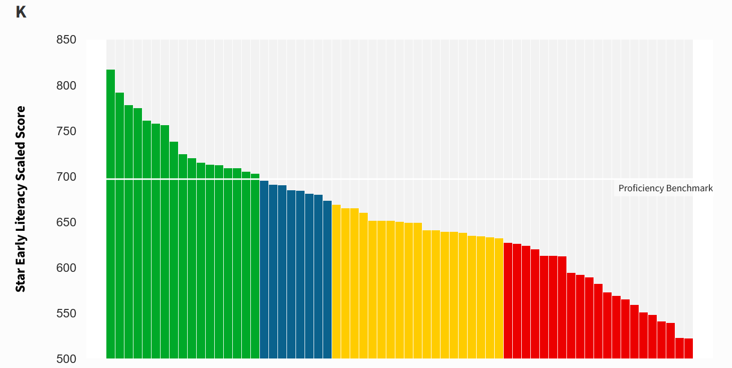
PM 1 performance STAR Reading
At/Above = 26%
On Watch = 12%
Intervention = 29%
Urgent Intervention= 32%
5 students left to test

Slide 8
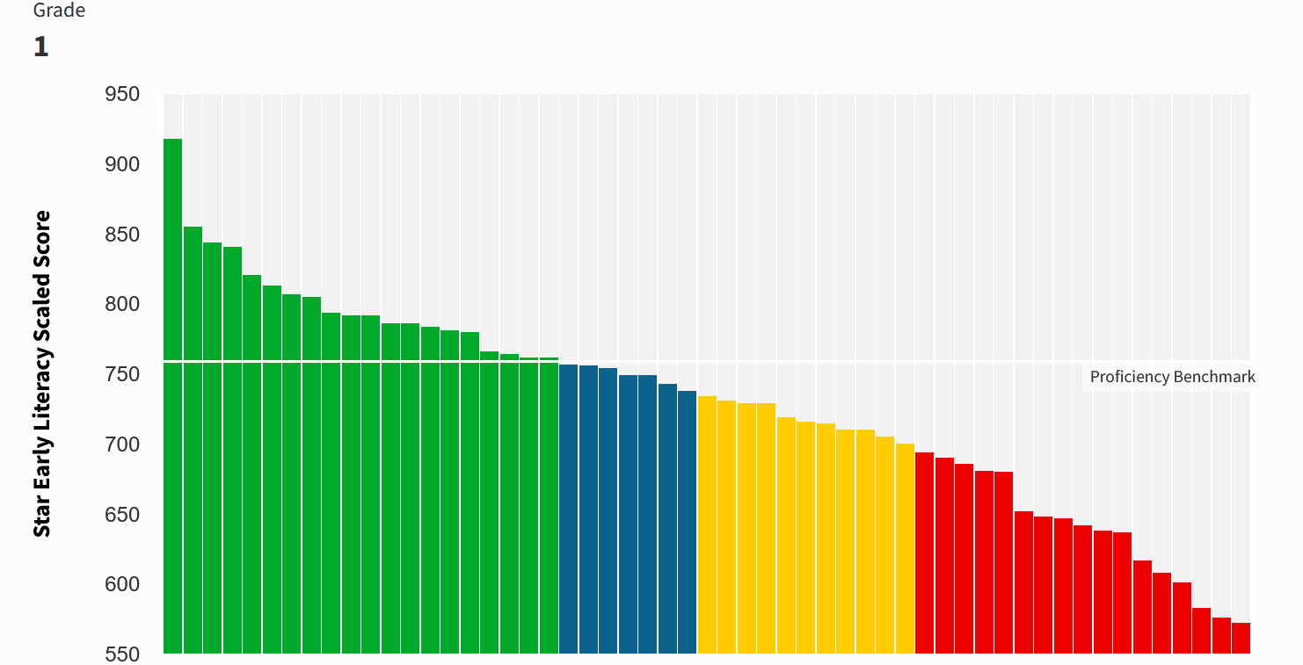
PM 1 performance STAR Reading
At/Above = 49%
On Watch = 6%
Intervention = 22%
Urgent Intervention= 24%
7 students left to test

Slide 9
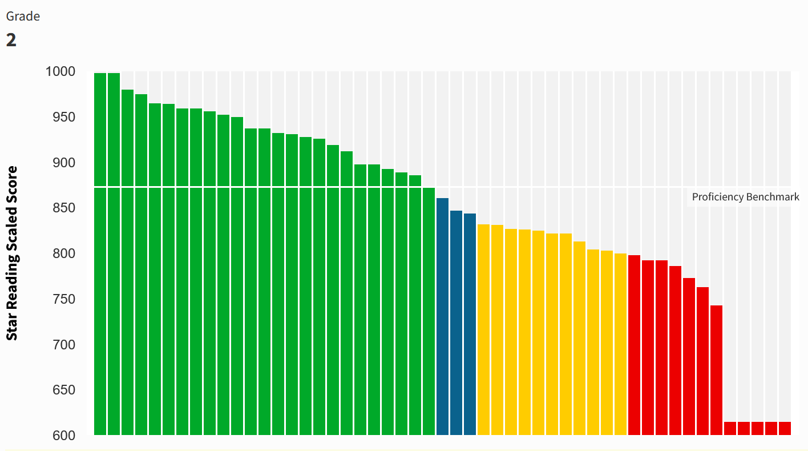
PM 1 performance STAR Reading
At/Above = 49%
On Watch = 6%
Intervention = 22%
Urgent Intervention= 24%
11 students left to test

Slide 10
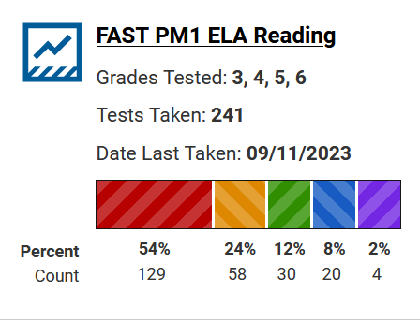
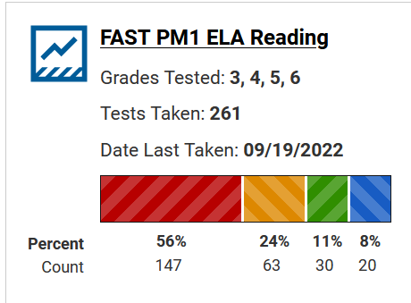
PM 1 performance ELA Gr 3-6

Slide 11
Math SIP Goals
Gr PreK-6= 55% At/above grade level
50% of all students make Annual Learning Gains
50% of lowest 25% make Annual Learning Gains

Slide 12
PM 1 performance STAR Math
K- waiting for most students to take the test

Slide 13
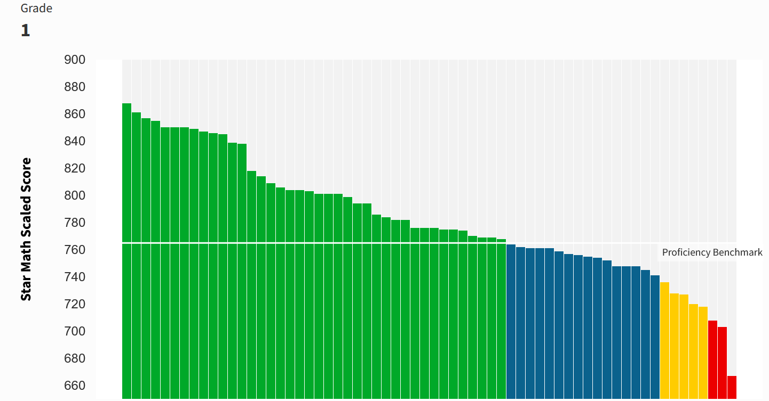
PM 1 performance STAR Math
At/Above = 63%
On Watch = 25%
Intervention = 8%
Urgent Intervention= 5%
2 students left to test

Slide 14
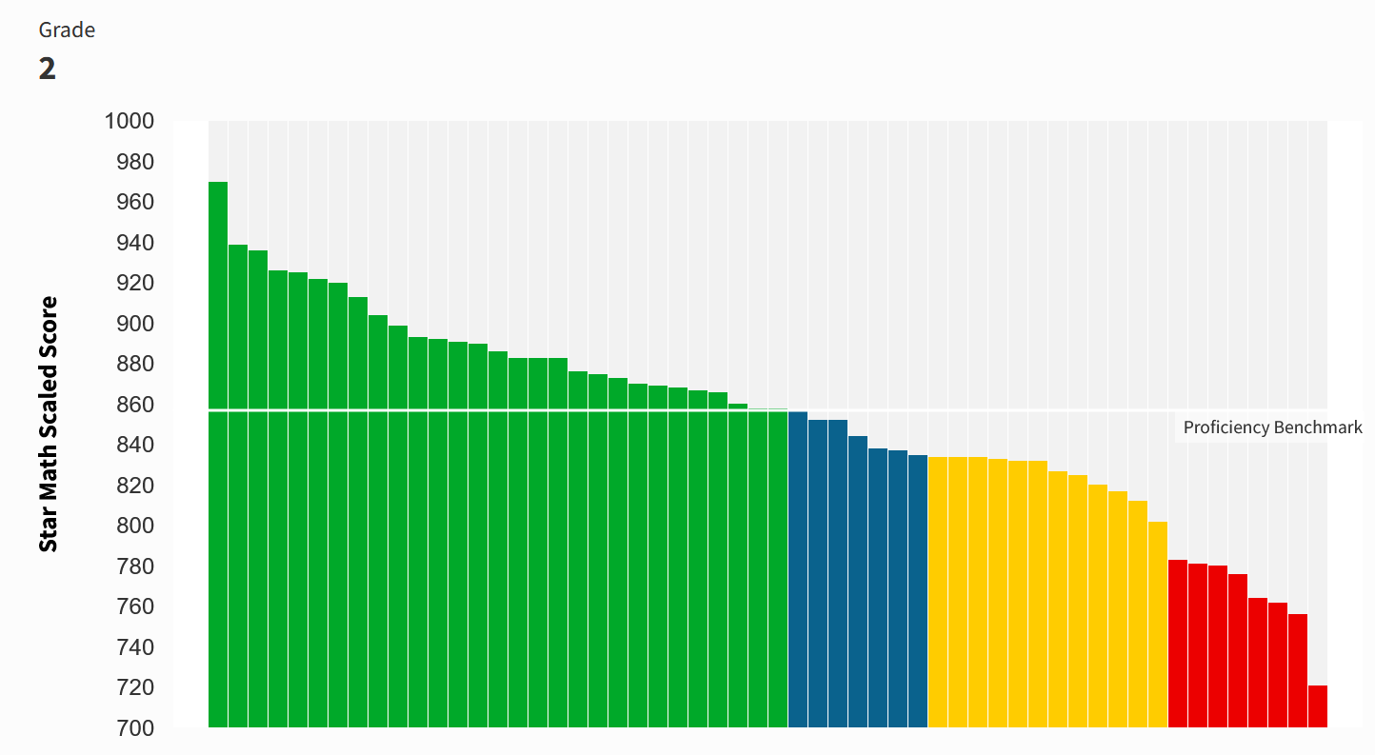
PM 1 performance STAR Math
At/Above = 52%
On Watch = 13%
Intervention = 21%
Urgent Intervention= 14%
2 students left to test

Slide 15
ELA Math
Gr 3
Gr 4
Gr 5
Gr 6

Slide 16
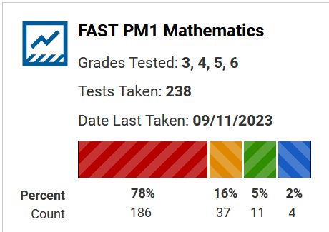
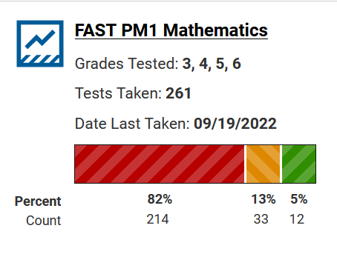
PM 1 performance Math Gr 3-6

Slide 17
Science School Improvement Goal
65% at/Above Grade Level on end of year Science Assessment

Slide 18
Ideas? Input?

