Slide 1
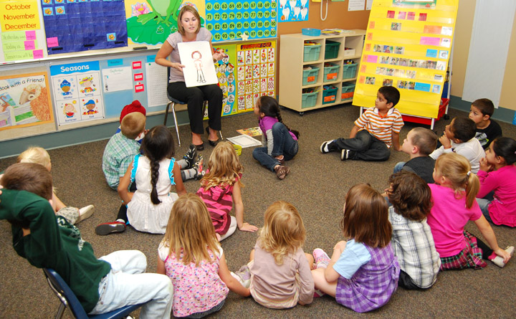
Kindergarten,
Here WE Come!
April 27,2023 Transition to Kindergarten
Brevard Public Schools
2022-2023
Notes:
Importance of allowing families and schools to connect prior to children beginning Kindergarten to help ease fears of families, students, school staff.
This is the families first impression of your teachers, staff

Slide 2
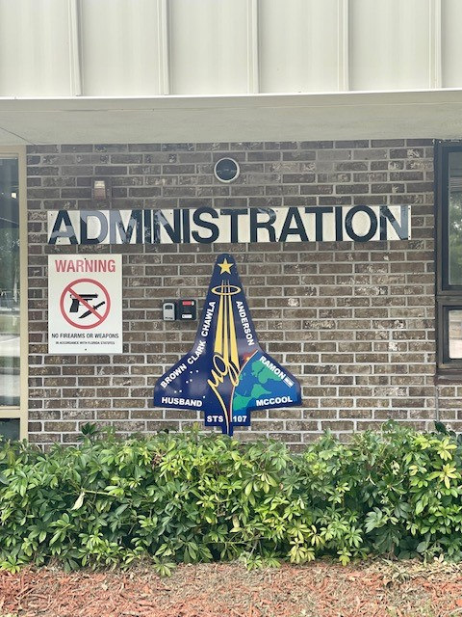
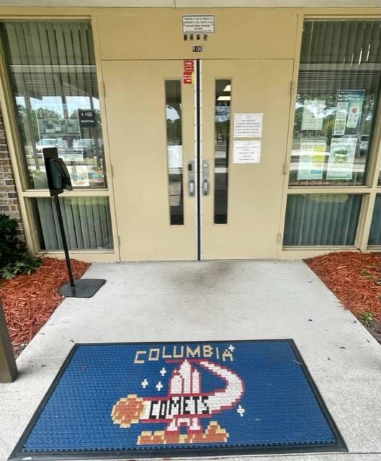
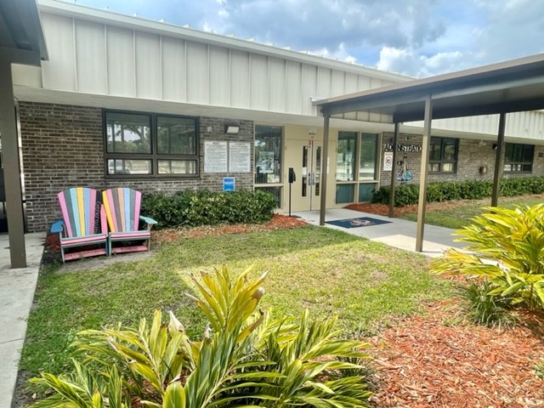
Welcome to Columbia Elementary

Slide 3
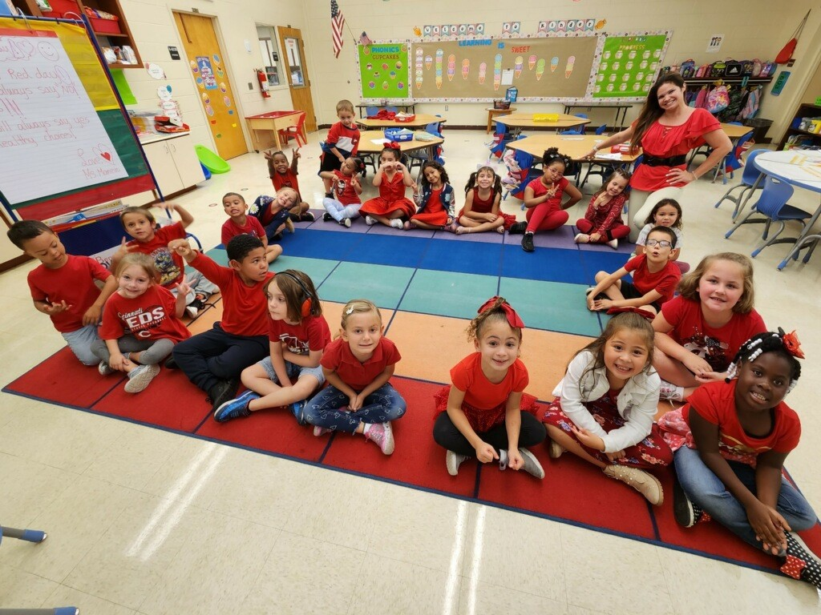
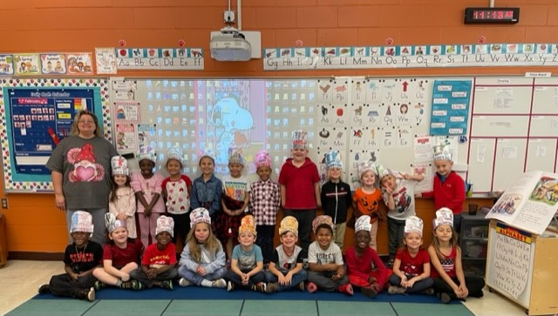
We are here for…KIDS!

Slide 4
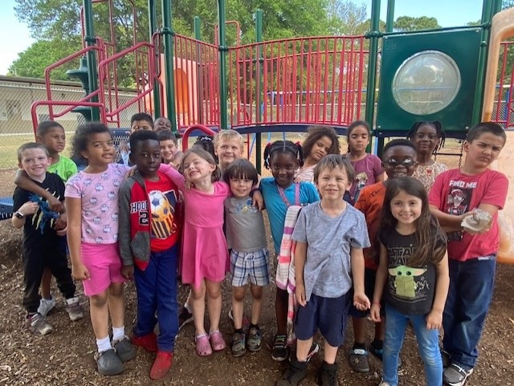
Kids are our WHY!

Slide 5
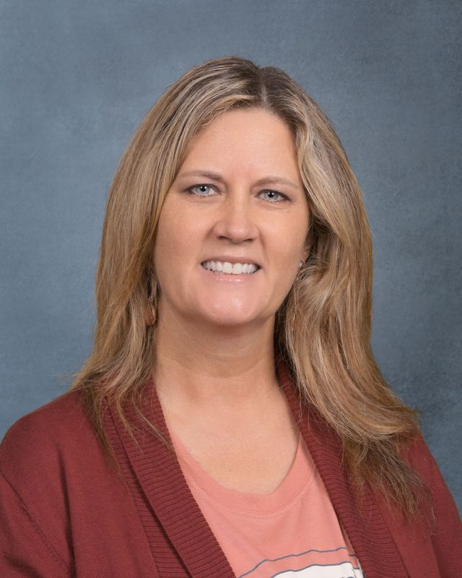
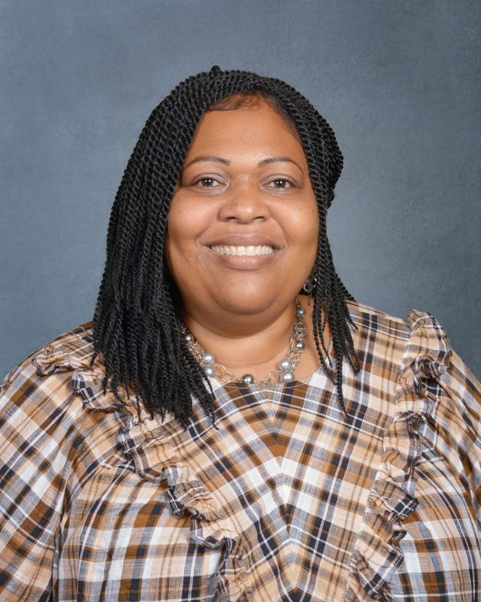

Meet our Comet Team!
Mrs. Jennifer Julian, Principal Mrs. Nicole Parks, Assistant Principal

Slide 6
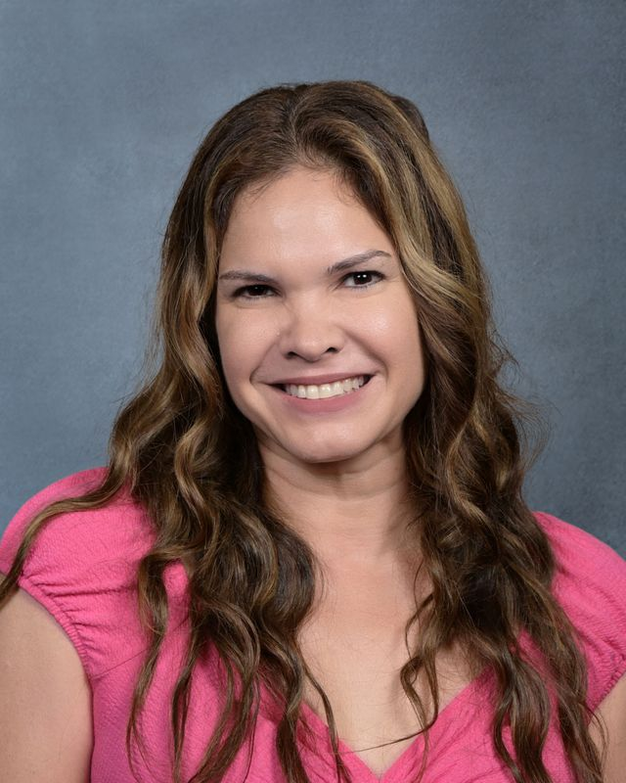
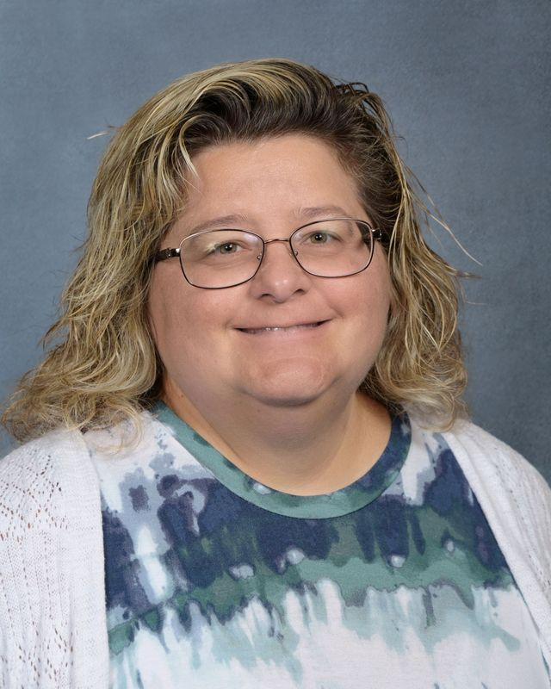
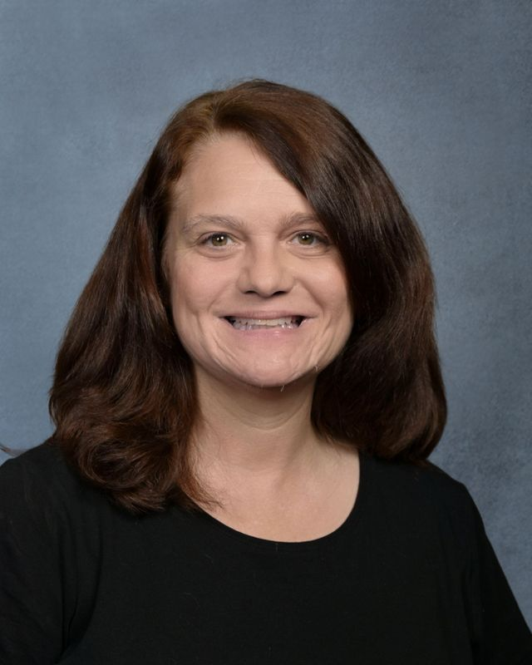
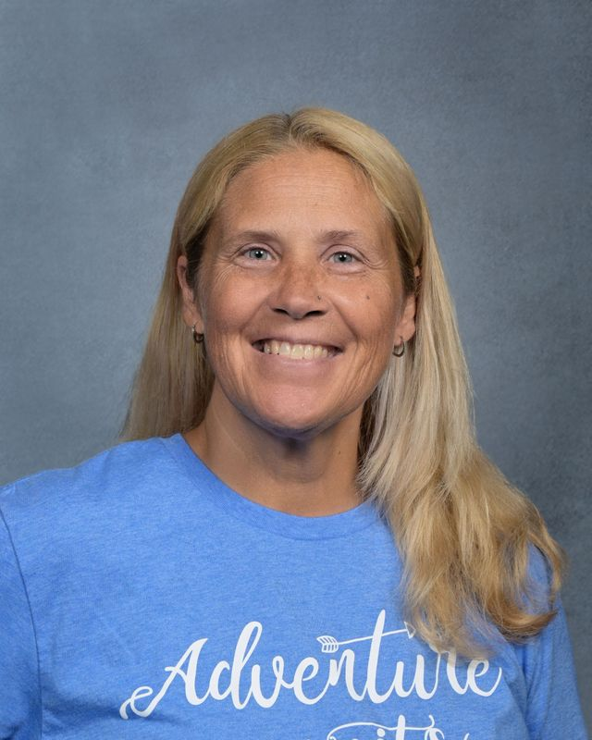
Meet our Comet Team!
Kindergarten Teachers
Judith Maneiro Tara Rossetti Heidi Walsh Susan Barto-IA

Slide 7
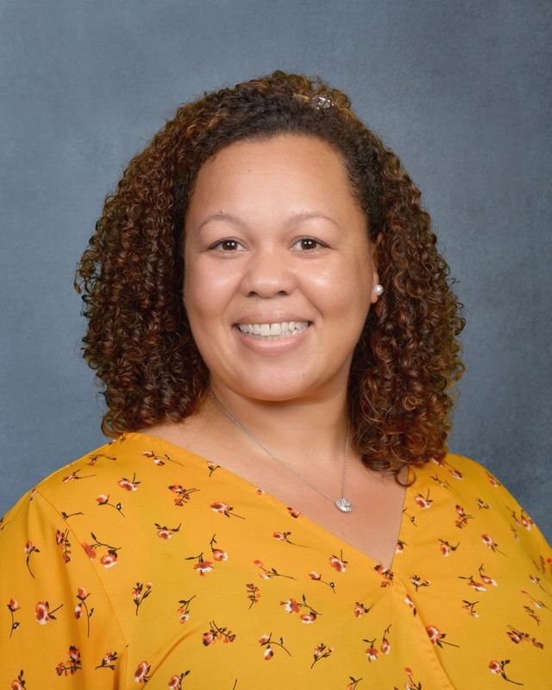
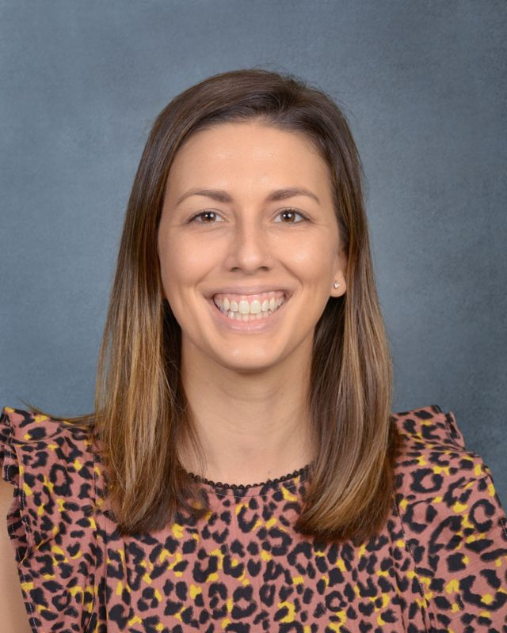
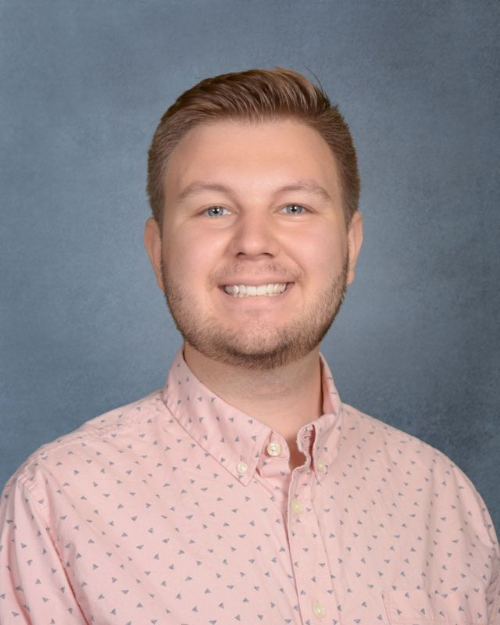
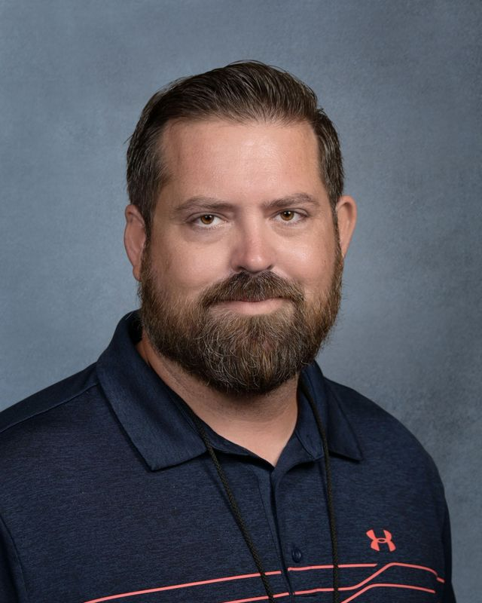
Meet our Comet Team!
Activity (Art, Media, Music and PE)
Noel Snodgrass-Neal Lindsey Von Edwins Ethan Hasker Tony Kuiper

Slide 8
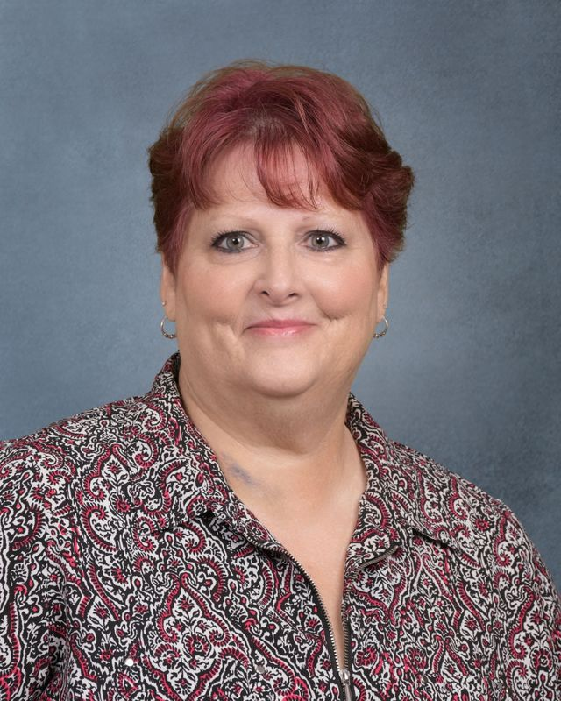
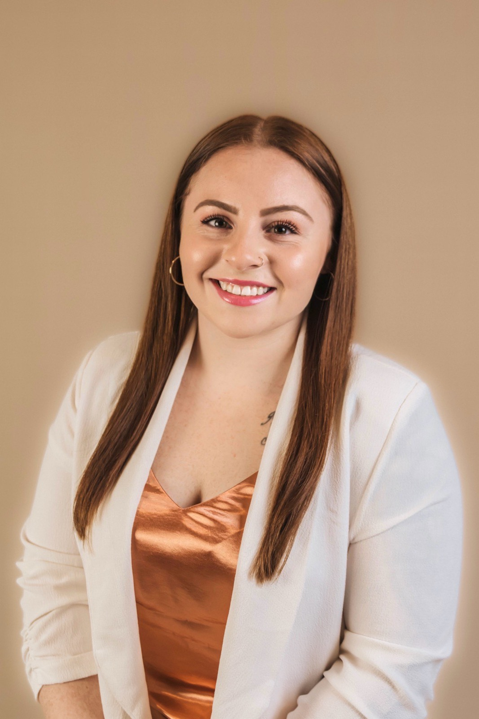
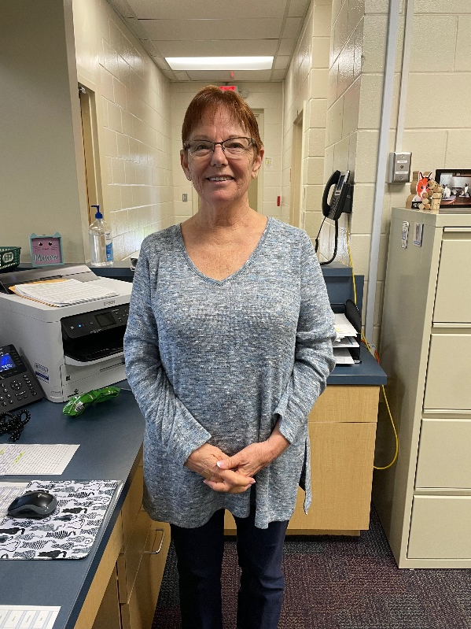
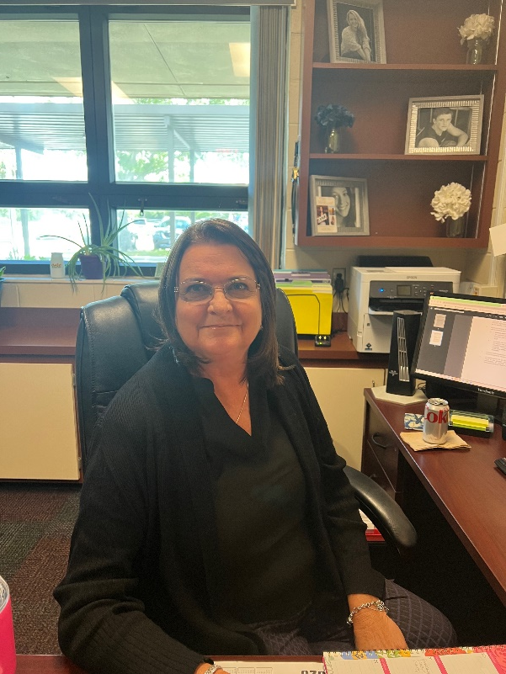
Meet our Comet Team!
Front Office (Bookkeeper, Clerk, Health Tech, Secretary)
Elena Owens Carmen Martin Rachel Santana Kelly DiPierro

Slide 9
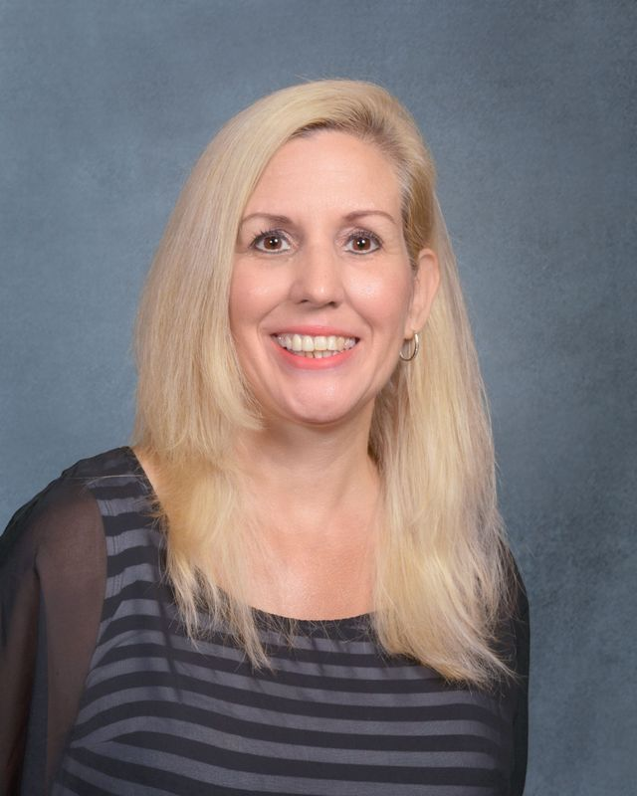
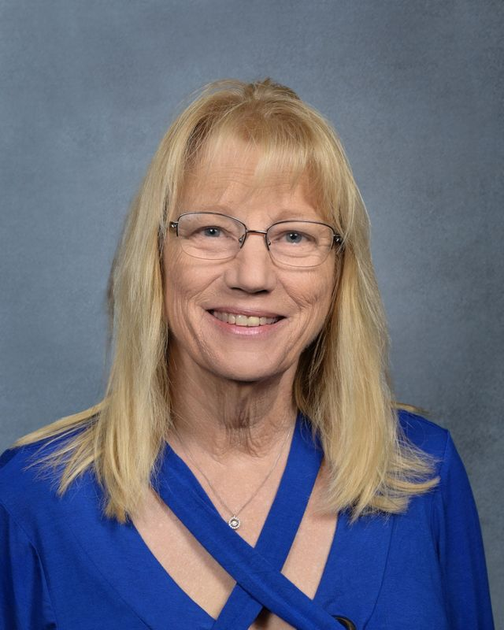
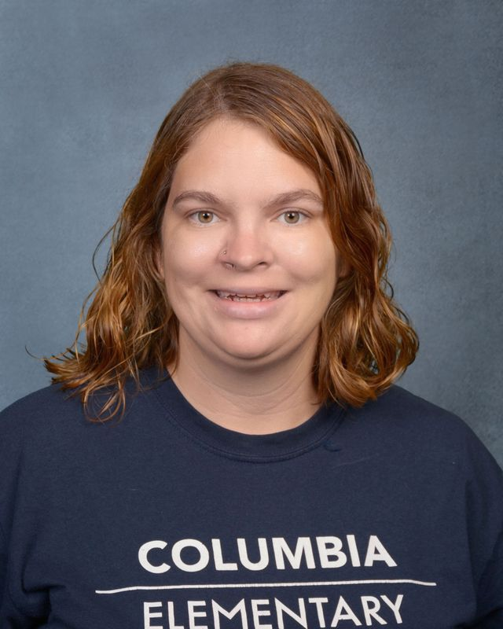
Meet our Comet Team!
Title 1 (Title 1 Contact/Teachers, Science Coach/Gifted)
Laura Good Sharon Aycock Nicole Kuiper

Slide 10
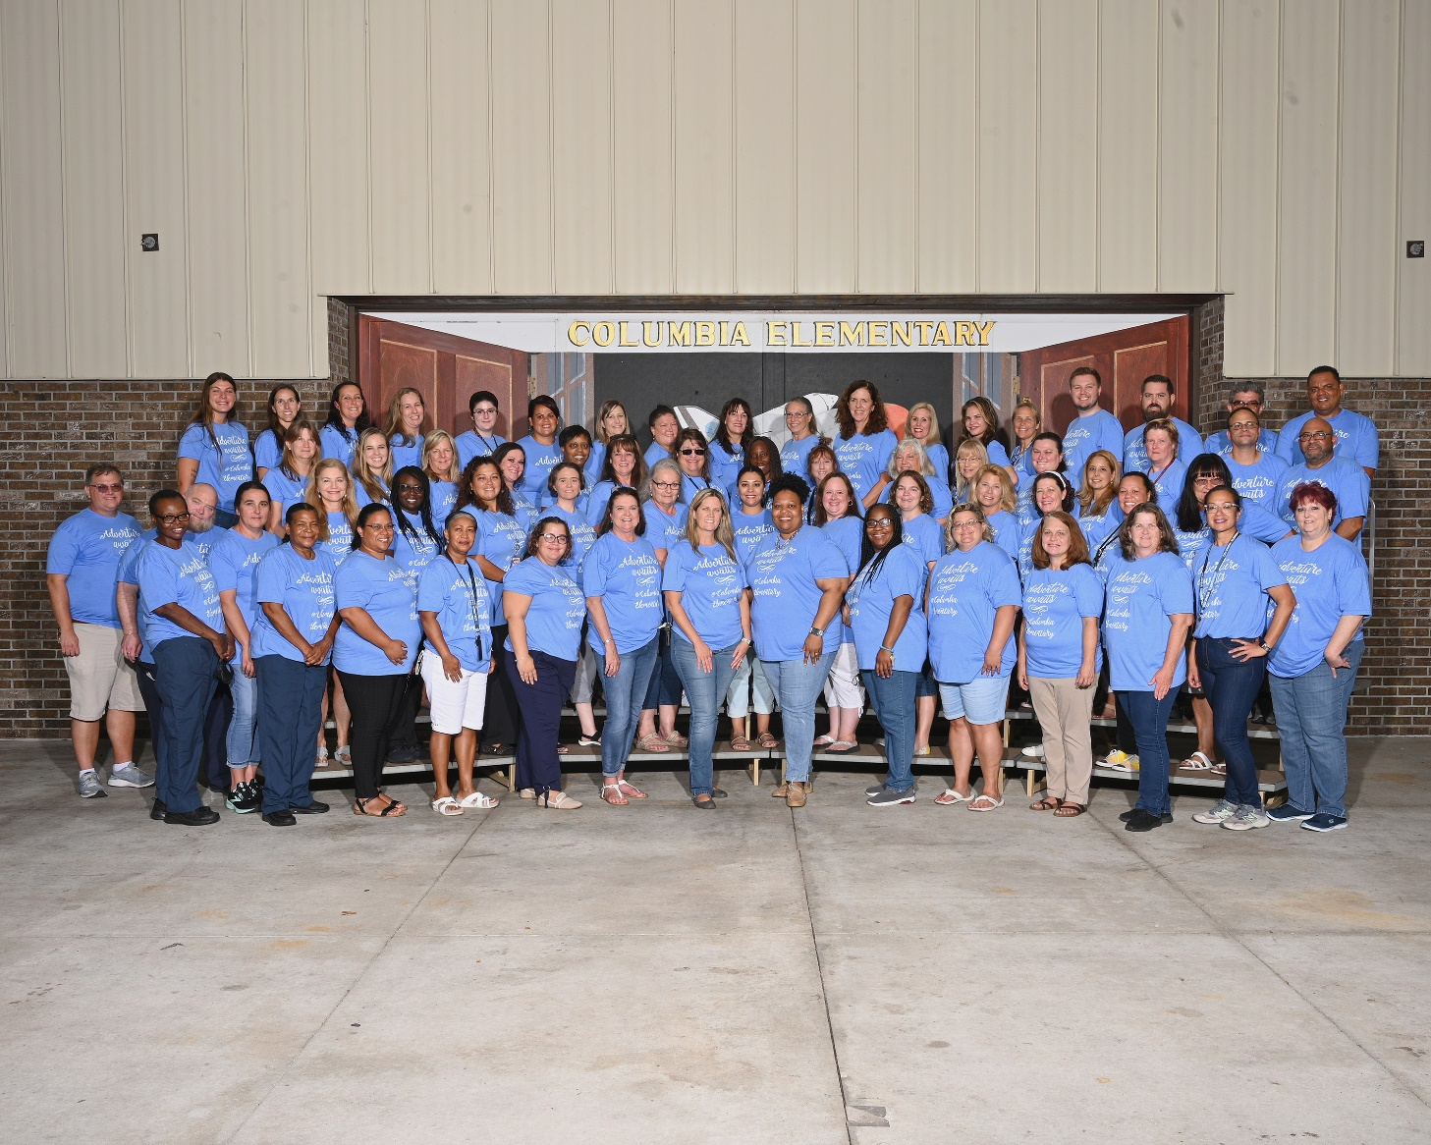
Meet our Columbia Comet Team!

Slide 11
Brevard Public Schools
The mission of Brevard Public Schools is to
serve every student with excellence as the standard.
Notes:
Can personalize to school mission if you prefer.
Connecting families to our district mission.

Slide 12
About OUR school…..
Columbia Elementary Vision: To inspire and grow a diverse critical thinking community of competent, flexible and fearless thinkers.
Title 1 School- provides resources that help children gain a high-quality education and the skills to master the Florida standards. The Title 1 resources are also used for more parent involvement activities and other activities designed to raise student achievement. We also offer free breakfast and lunch.
Notes:
Overview Information (Philosophy and Vision)
Introduce your Administrators and Kindergarten teachers
Other possible topics:
# of Kindergarten classrooms
Activities/Special classes/programs offered
Family Engagement Opportunities
Make it fit your school!

Slide 13

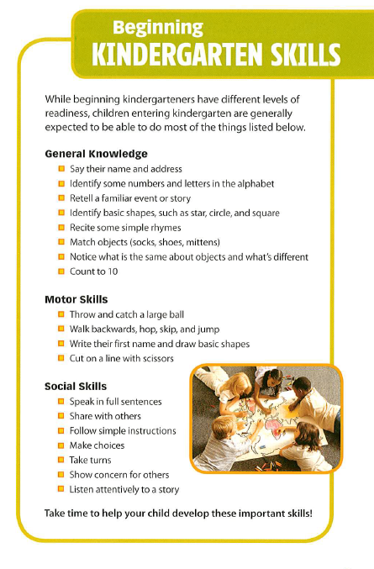
The move from preschool/home to kindergarten is one of the most important transitions your child will make.
Notes:
Point out ways that families may interact with their upcoming kindergarteners over the summer to support their child’s readiness for Kindergarten. These skills are listed on page 5 and explained in more detail throughout the book. (1st animation on this slide)
Also you may want to point out page 12, which explains to families how to prepare their children for the first day of Kindergarten (2nd animation on this slide)
Children may feel:
Happy
Sad
Excited
Worried
Curious
Anxious
Uncertain
Overwhelmed
Insecure
And all of these feelings are normal and okay!
Advice from a Kindergarten Teacher (From page 13 of the booklet)
“Read to your child everyday. As you read, talk about the pictures and the characters, and every few pages, ask questions about what you’ve read.”
“Look for ways to turn everyday activities into learning experiences. For example, use grocery store outings as a way to practice letter and number recognition.”
“Most importantly, enjoy your child, and make learning fun!”

Slide 14


If your child knows ALL the letters and sounds, that’s a great head start.

Slide 15

What did students like the most about Kindergarten?
Student video
Notes:
Let them know you’ll come back together for a few moments to close out their visit.

Slide 16
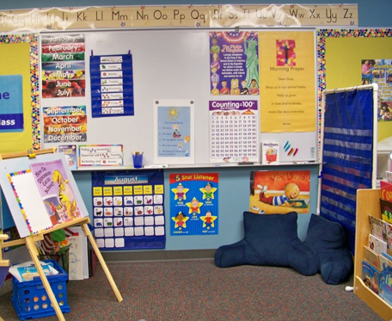
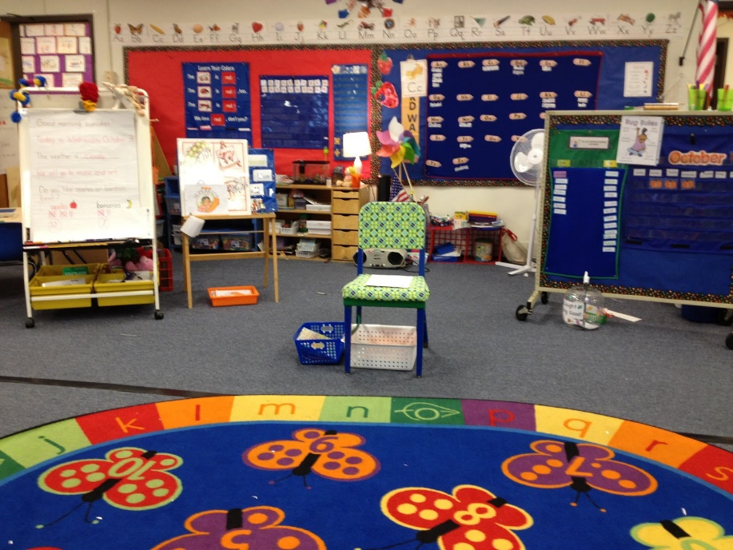
What will students learn in Kindergarten?
Notes:
Let them know you’ll come back together for a few moments to close out their visit.

Slide 17
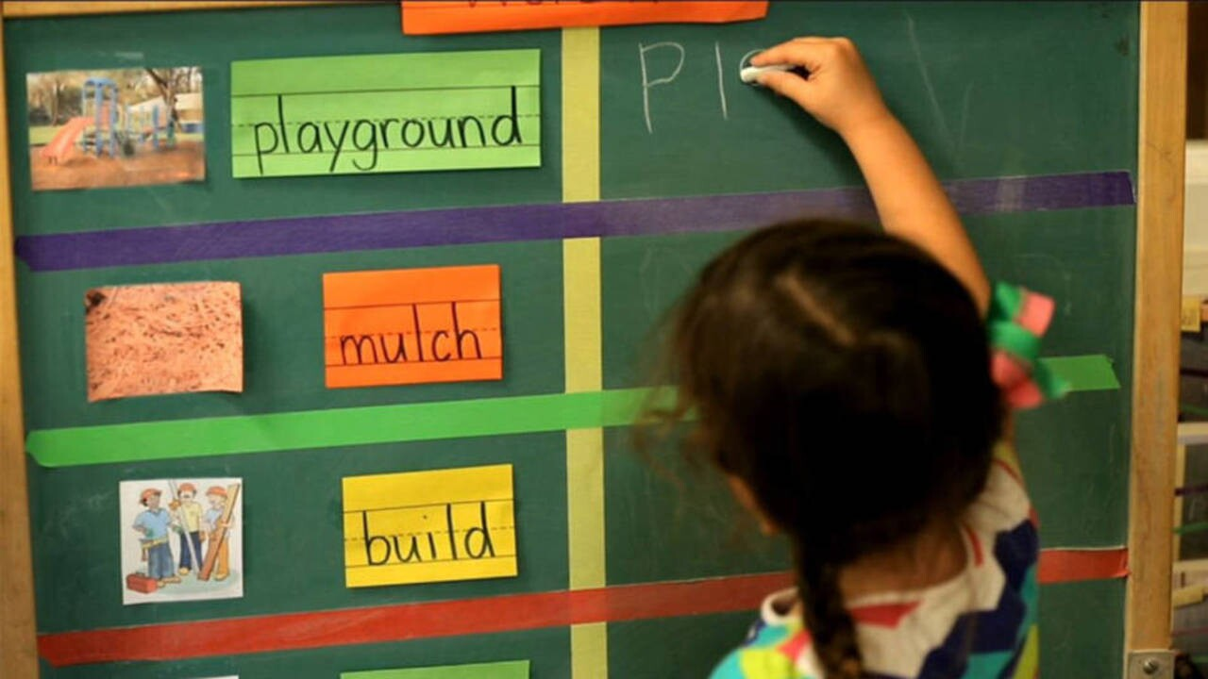
write their first and last name
about colors
how to cut and glue
letters and sounds
blend sounds to read CVC words
how to read books
all the sight words and new vocabulary words

Slide 18
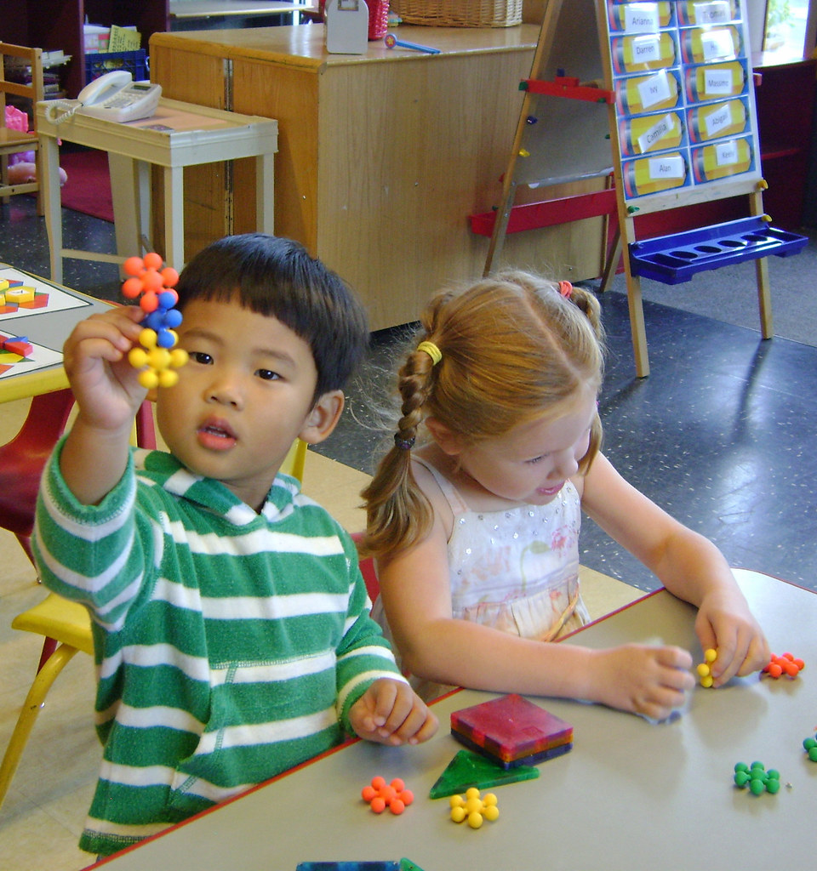
rhyming words, compound words
shapes and measurement
count to 100
identify and write numbers 1-20
count by 2s, 5s and 10s
adding and subtracting numbers
number bonds

Slide 19
I | like | the | and | as
at | see | we | a | to
can | had | in | it | come
my | with | what | you | are
now | not | is | of | so
but | from | on | this | be
that | will | your | for | they
up | his | them | said | then
was | all | she | when | by
he | there | or | were | word
do | have | one | out | Their
me | does
Kindergarten
Sight Words

Slide 20


It is a very structured literacy program standards-aligned and informed by the latest research into the Science of reading. They feature vertically aligned units that empower students to engage deeply with a topic to build skills within and across grades. Topics are knowledgebase, expanding both general and academic vocabulary in support of Reading , writing, and constructive conversation.

Slide 21
What can you do at home to get your child ready for Kindergarten?
At breakfast, ask your child to find specific letters on a cereal box.
Spell simple words with refrigerator magnets.
Pick a letter, talk about the sound that letter makes and see how many things you can find around the house that begin with that letter’s sound.
Sing the alphabet song with them or watch Jack Hartman videos about letters and sounds.
Read an ABC picture book or read other small books to them before bedtime.

Slide 22

Important things to practice at home.
Teach your child how to take their jacket on and off without help.
Teach them how to use the restroom, wash their hands and to clean up after themselves.
Help your child learn how to cover their mouth when sneezing and coughing.
Since tying shoes is a skill that often doesn’t come until later in the year, consider buying shoes with Velcro fasteners or teaching your child how to tie their shoelaces.
When you are buying a backpack, please make sure that is not too large, and that it can be put on without help.
.

Slide 23
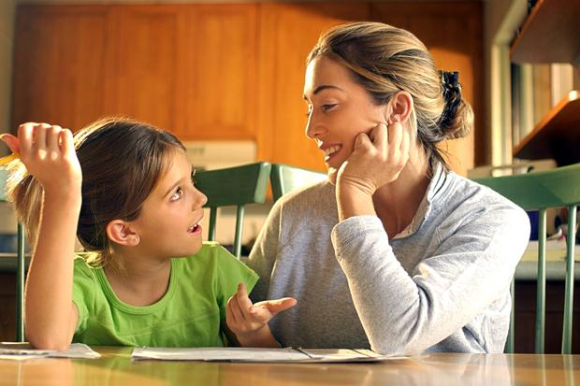
Our Kindergarten and Activity TEACHERS …
provide a calm and effective learning environment that includes:
-passion and patience to teach from the heart
-well rounded curriculum
-neat and orderly classrooms
creativity to keep students engaged
respect for students and their families
-amazing teacher-student and parent relationships
Kindergarten Teachers open doors that some children didn’t even know existed ☺

Slide 24

REMEMBER SAFETY FOR ALL STUDENTS IS OUR PRIORITY!
Notes:
Sign-In Procedures for our school:
All visitors/volunteers must sign-in at the front office using your state issued driver’s license or ID card. This is required in order to receive a badge to enter campus. You must have your ID at each visit.
BPS has collaborated with Brevard County Sherriff’s Office and has a plan of action for every foreseeable circumstance
One point of entry at each school.
Mr. Wayne is our security person in our school and is always walking around to make sure we are absolutely safe on campus.
All parents need to get a new Car tag for their cars. You can do this in the Summer. The new car tag will have your child’s name and their grade .
**** No more elearning classes. All students will come back to regular school. We will continue to follow CDC guidelines.

Slide 25

Communication with parents
Weekly Smores Columbia Newsletters.
Focus on the launchpad.
Blackboard Connect messages.
BPS App for news, cafeteria menus and school calendars.
Emails and phone calls.

Slide 26

We can’t wait to see you!
August 15^{h} is the first day of Kindergarten. Please make sure your child is at school at 7:30am everyday. Our school gates close at 8:00am.
Kindergarten teachers will call parents three days before school starts to schedule a time where students will come for KLS testing. This test is for teachers to know how many letters and sounds your child knows.

Slide 27
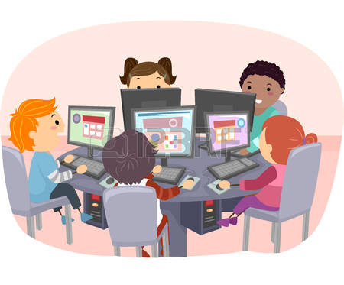
Helpful Websites/You Tube Channels
www.abcmouse.com
www.starfall.com
Epic
Jack Hartmann
Dr. Jean
Alphablocks
The Singing Walrus
Numberblocks
This Photo by Unknown Author is licensed under CC BY-SA-NC

Slide 28

Thank you for being here!
“At the end of the day, the most overwhelming key to a child’s success is the positive involvement of parents.”
-Jane D. Hull
Notes:
Your presence today sends a great message to your children: that their school is important.

Slide 29

Columbia is looking forward to a great
2023-2024 school year with your family.
Let’s soar to new heights, Comets!

