Slide 1
ANNUAL MEETING 2023-24 TITLE I
Columbia Elementary School
September 13, 2023
FY24

Slide 2
According to the Every Student Succeeds Act (ESSA), schools are required to have an Annual Meeting to explain:
The Title I program, which includes:
    Parent and Family Engagement Plan (PFEP)
    School-Parent Compact
    Parents’ Right to Know
    The School Improvement Plan (SIP) Goals
    The importance of parent and family engagement
    The use of funds
FY24

Slide 3
WHAT IS TITLE I?
Title I is a federal grant that:
Ensures all children have the opportunity to obtain a high-quality education and reach proficiency on challenging state academic standards and assessments
Provides supplemental funds to school districts to assist schools with high concentrations of poverty to meet educational goals
Requires schools to train parents on how to support their children academically at home
Requires schools to train teachers on how to work effectively with parents and families in order to help improve academic achievement
Requires parents to have an active role in their child’s academic achievement
FY24

Slide 4
TITLE I FUNDING
Districts allocate Title I funds to qualifying schools based on direct certification data
Title I funds must supplement, not take the place of district funds
A specified amount of Title I funds must be spent on family engagement. Parent input is critical so schools can provide trainings/events that are relevant to families
Parents have the right to give input regarding how the school will use its Title I funds
FY24

Slide 5
WHO DECIDES HOW FUNDS ARE USED?
Your administrative team considers data and feedback collected throughout the school year to write the school’s Title I Plan.
Use of Title I funds must align with the goals of the School Improvement Plan (SIP).
Every school has a School Advisory Council (SAC) composed of:
  parents, teachers, staff, community members, administrators, and students (at middle and high schools)
The School Advisory Council helps determine how to use Title I funds. Please consider joining we need your voice!
  Copies of the Title I Plan and the School Improvement Plan (SIP) are available for families in the
  Title I Parent Notebook in the front office.
FY24

Slide 6
TITLE I PROGRAMS
All Title I public schools in Brevard are school-wide programs, meaning Title I funds, along with other local, state, and federal funding sources are used to support all students in the school
The primary focus of the Title I program is to support the students most at-risk for academic failure
School identify specific groups of students that need more intensive academic support. These subgroups are show in the School Improvement Plan (SIP)
FY24

Slide 7
School Assessment Results
STAR Reading Results
Percent of students at/above grade level:
Grade Level | % at/above grade level on PM 3 (May 2023)
VPK | 33%
K | 65%
1st | 53%
2nd | 58%
FY24

Slide 8
School Assessment Results
STAR Math Results
Percent of students at/above benchmark:
Grade Level | % at/above benchmark on PM 3 (May 2023)
K | 57%
1st | 75%
2nd | 67%
FY24

Slide 9
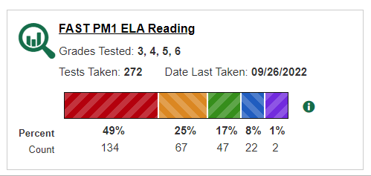
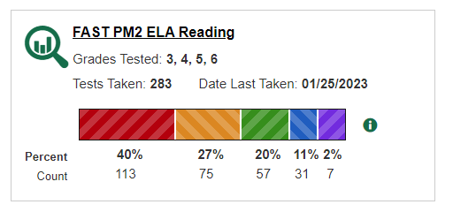
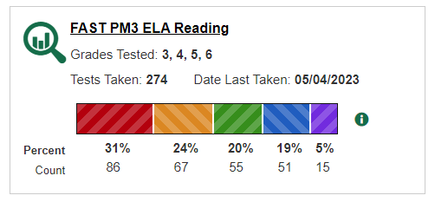
SCHOOL ASSESSMENT RESULTS
Florida Assessment
of Student Thinking
(FAST)
Grades 3-6 ELA/Reading
44% Proficiency
(Last School Year)
FY24

Slide 10
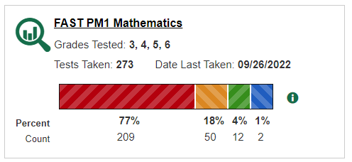
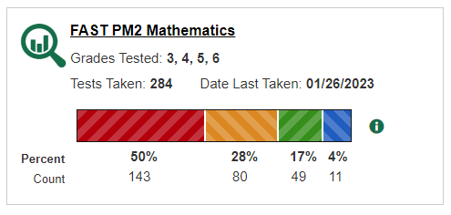
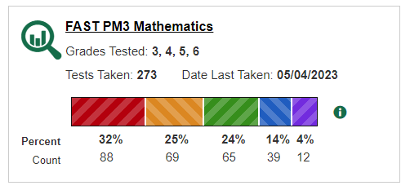
SCHOOL ASSESSMENT RESULTS
Florida Assessment
of Student Thinking
(FAST)
Grades 3-6 Math
42% Proficiency
(Last School Year)
FY24

Slide 11
iReady Data
% of Students in Grades K Through 6th - Early and Mid On Grade Level
i Ready Diagnostic (last school year)
Grade | Reading #1 | Reading #2 | Reading #3 | Math #1 | Math #2 | Math #3
K (67 students) | 24% (21 students) | 65% (43 students) | 76% (51 students) | 13% (8 students) | 45% (30 students) | 61% (41 students)
1 (77 students) | 22% (15 students) | 43% (33 students) | 60% (46 students) | 16% (11 students) | 43% (33 students) | 65% (50 students)
2 (64 students) | 25% (15 students) | 46% (30 students) | 60% (39 students) | 5% (3 students) | 17% (11 students) | 41% (26 students)
3 (60 students) | 35% (20 students) | 51% (29 students) | 63% (36 students) | 4% (2 students) | 28% (16 students) | 49% (29 students)
4 (79 students) | 38% (28 students) | 53% (42 students) | 58% (46 students) | 33% (25 students) | 48% (37 students) | 60% (47 students)
5 (77 students) | 18% (13 students) | 31% (24 students) | 35% (27 students) | 17% (12 students) | 27% (20 students) | 29% (22 students)
6 (67 students) | 32% (19 students) | 40% (26 students) | 44% (29 students) | 29% (17 students) | 52% (33 students) | 54% (36 students)

Slide 12
2023-24 SCHOOL IMPROVEMENT PLAN GOALS
Provide high-quality instruction in reading, writing, math, and science that match the rigor of the Florida Benchmarks by providing instructional support with curriculum coaches and Title 1 teachers/assistants as well as supplemental materials for students.
The Literacy Coach will assist with aligning instruction to the Florida standards, developing learning tasks that assess those standards and ensuring that appropriate complex text is used.
Instructional Practices specifically related to collaborative planning, planning opportunities, data monitoring, professional development/coaching, and collaboration.
FY24

Slide 13
COLUMBIA TITLE I PLAN FOR 2023-24 SCHOOL YEAR
Columbia Elementary is provided with $305,520.00 to pay for services and programs for our students.
School-based Title I funds pay for the following:
  Family Engagement Events
  Professional Development for Teachers
  Parent Liaison (to help monitor attendance)
  Title 1 teacher and two assistants to provide interventions to students.
  Reading coach (half Title 1) to support school wide instruction
  All of our Title I funds support our School Improvement Plan (SIP) goals.
FY24

Slide 14
EDUCATIONAL STANDARDS
Florida’s academic content standards establish high expectations for all students in the areas of reading, mathematics, writing, and science
The Florida Benchmarks for Excellent Student Thinking (B.E.S.T.) Standards for Language Arts and Math identify what your child needs to know and be able to do. Information can be found at:
  www.cpalms.org Click on the “Standards” tab at the top of the page
  If you need help accessing the B.E.S.T. Standards on Cpalms
  please ask your child’s teacher ☺
FY24

Slide 15
TESTING
Parents/families will be provided information regarding the level of achievement of their child on each state academic assessment that is required by law
Parents/families must be provided materials to support their child if they are performing below grade level on the state academic assessments in reading and/or math
Parents/families of students that are identified as substantially deficient in reading based on the state academic assessments must be provided with a “Read at Home” Plan
To the extent that is feasible, testing information must be translated into a language the parents/families can understand
FY24

Slide 16
2023-24 School Assessments
School Testing:
Kindergarten Literacy Screener (KLS)
i-Ready Reading and Mathematics: Grades K-6
Science District Assessments: Grades K-6
Renaissance Star Early Literacy: Grades K-2
Star Reading and Mathematics: Grades K-2
FAST English Language Arts: Grades 3-6
FAST Mathematics: Grades 3-6
FAST Writing: Grades 4-6
NGSSS Science: Grade 5
  **Parents will receive a copy of the reports as soon as the testing window
has closed, and we have been authorized to release them by the
school district.
FY24

Slide 17
2023-24 School Assessments Proficiency Levels
STAR Test:
The levels for STAR are measured with a range such as 1.4 meaning your child is working at where an average first grader in their 4th month of school. The report will let you know the deficiencies your child may have in certain areas as well as their strengths.
FAST Test:
FAST is measured on a scale of 1-5, 1-2 being the lowest and not on grade level with some need for remediation, 3 or higher meaning they are proficient and exactly where they need to be according to their grade level.

Slide 18
2023-24 School Curriculum
School Curriculum:
ELA: Benchmark Education (Grades K-5), SAVVAS (Grade 6)
Math: Reveal (Grades K-5), EdGems (Grade 6)
Science: STEMScopes, PENDA
Social Studies: Studies Weekly (Grades K-5), TCi (Grade 6)
FY24

Slide 19
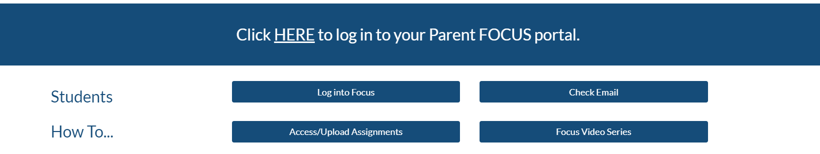
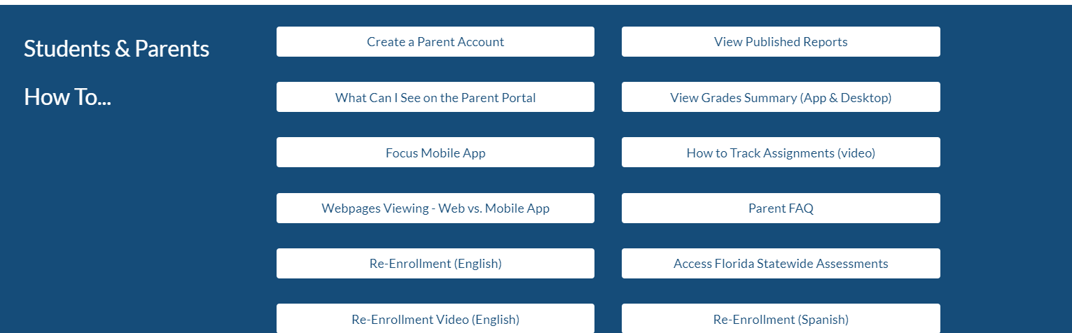
BPS Focus for Parents & Students
FY24

Slide 20
PARENT AND FAMILY ENGAGEMENT PLAN (PFEP)
Each Title I school must annually write, with input from families, teachers, and community members a written Parent and Family Engagement Plan (PFEP)
The Parent and Family Engagement Plan (PFEP) describes how the school will carry out parent engagement requirements, including the development of a School-Parent Compact
The Parent and Family Engagement Plan (PFEP) and the School-Parent Compact can both be found in the Title I Parent Notebook found in the front office.
FY24

Slide 21
PARENT AND FAMILY ENGAGEMENT REQUIREMENTS
Title I schools must:
Have an annual evaluation of the effectiveness of the school’s Parent and Family Engagement Plan (PFEP) then use that evaluation to design and revise the plan
Explain the curriculum, assessments, and the minimum standards that students are required to meet
Provide academic trainings/events to help parents better help their children at home
Offer a flexible number of meeting dates and times to accommodate parents' schedules
Involve parents in making decisions about how Title I funds for parent engagement should be spent
Show evidence of continuous communication between school and families
FY24

Slide 22
PARENT SURVEY RESULTS
What is the best way to provide you with important information regarding school events and/or your child's progress?
Emails, flyers/letters, text messages, and planners were all top answers.
When is the best time for you to attend a school event for families?
Evenings
Which of the following informational meetings and activities would you participate in or attend?
Family Fun Nights, Reading strategies, Math strategies, and Homework help were all top answers.
FY24

Slide 23

SCHOOL-PARENT COMPACT
Each school must have a School-Parent Compact that is written by parents, teachers, and students
The compact outlines the shared responsibilities of students, parents, and teachers for improved student academic achievement
The compact will be reviewed with families throughout the year
The compact is required to be revised each year using input from parents, students, and teachers.
FY24

Slide 24
FY24

Slide 25
PARENTS’ RIGHT TO KNOW
Parents have the right to request and receive timely information regarding the professional qualifications of their child’s teachers and paraprofessionals
Parents must be notified if their child is assigned to or taught for four or more consecutive weeks by a teacher who is not state certified
FY24

Slide 26
TITLE I COMPLAINT PROCEDURE
Parents have the right to submit comments regarding district and/or school Title I plans
  Comments should be turned in to the school principal
  The school principal will forward the comments to the district Title I Department
FY24

Slide 27
RESEARCH SHOWS…
No matter the socio-economic status, when parents are engaged, students are more likely to:
  attend school regularly
  earn better grades
  get better test scores
  have more self-confidence
  be promoted to the next grade
  have better social skills
  graduate
  continue their education
FY24

Slide 28
TIPS FOR SUCCESS:
Communicate with your child’s teacher often throughout the year! Start at the beginning of the year…how do you want to communicate with each other?
Give your input on the schools Title I Plan
Consider joining the PTO/PTA, School Advisory Council (SAC) or the District Parent Leadership Team. Let your voice be heard!
Some Title I schools have Parent Resource Centers that provide materials that families may check out to use at home. If your child’s school does not have a Parent Resource Center ask your child’s teacher for materials to help you at home.
Reach out to Laura Good, Title 1 Contact @good.laura@brevardschools.org to discuss available materials.
FY24
Notes:
Discuss your parent resource room, what is offered, and what is available.

Slide 29
TIPS FOR SUCCESS:
Please check out our Title 1 Resource Room if you are looking for ways to support your child at home. We have a variety of high interest and engaging materials that are available to families to check out to strengthen the home-school learning connection.
FY24
Notes:
Discuss your parent resource room, what is offered, and what is available.

Slide 30
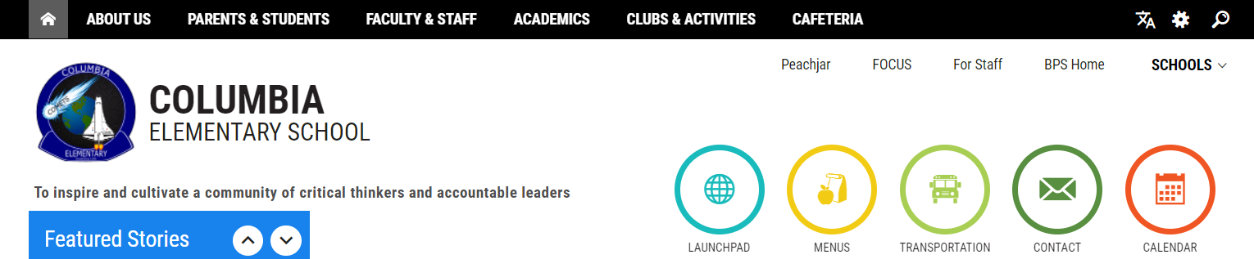
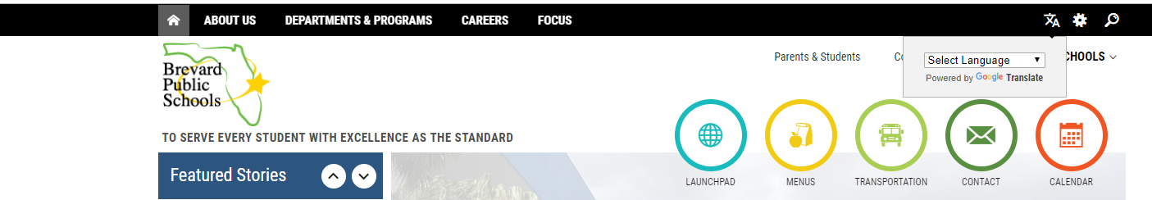
WAYS TO STAY INFORMED
https://www.brevardschools.org/ColumbiaES
Check out our school website for quick links and school updates!
In order to use your language of preference, use the Google Translate box in the right corner.
FY24

Slide 31
BEFORE YOU LEAVE!
Don’t forget to sign up for your FOCUS account. Monitor your child’s grades and stay in touch with their teacher!
Please consider volunteering in your child’s classroom this year! We’d love to have you!
Please complete the Annual Meeting Feedback form. Your opinions matter to us!
FY24

Slide 32
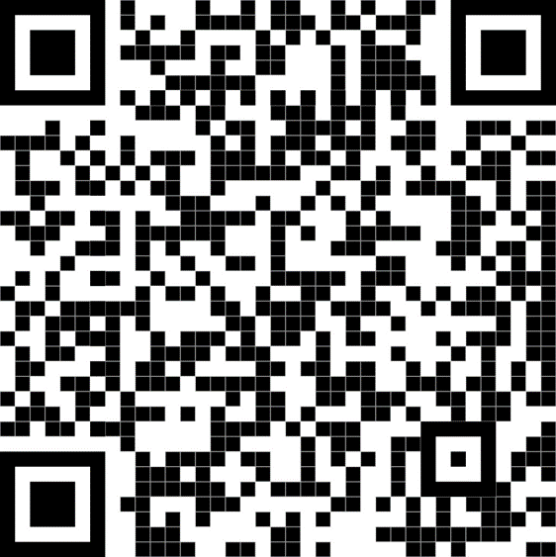
Please take a moment to complete our online Title 1 Survey. See your child’s teacher for a paper copy of the survey if you prefer.

