Slide 1
CLICK IN ANY OF THESE TEXT BOXES TO CHANGE THE TEXT SEEN IN THIS TEMPLATE. CUSTOMIZE IT TO FIT YOUR PERSONAL NEEDS.
Cocoa HS
Class of 2026
Hi, Class of 2026!
Let’s get ready for a GRRREEEEAAAAT
8th grade year in 2022!
7th Grade Presentation
CHANGE OUT THIS PICTURE OUT WITH YOUR OWN. TO DO SO CLICK ON THE IMAGE HIT DELETE. THERE WILL BE AN ICON IN THE MIDDLE OF THE PICTURE, CLICK ON IT, THEN FIND YOUR PICTURE AND INSERT.

Slide 2
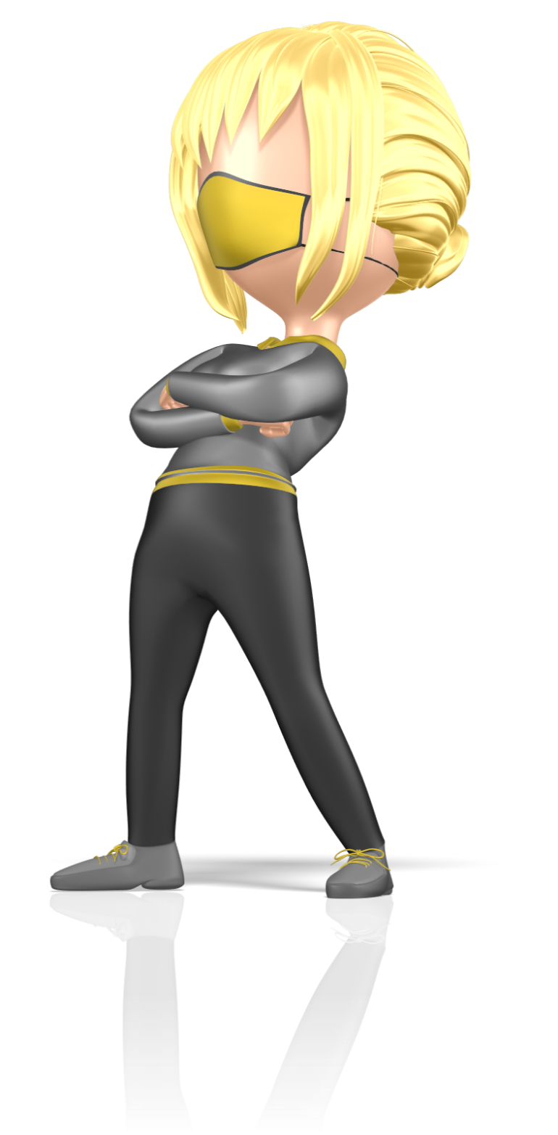
What’s Great About
Being a TIGER?
CLICK ME

Slide 3
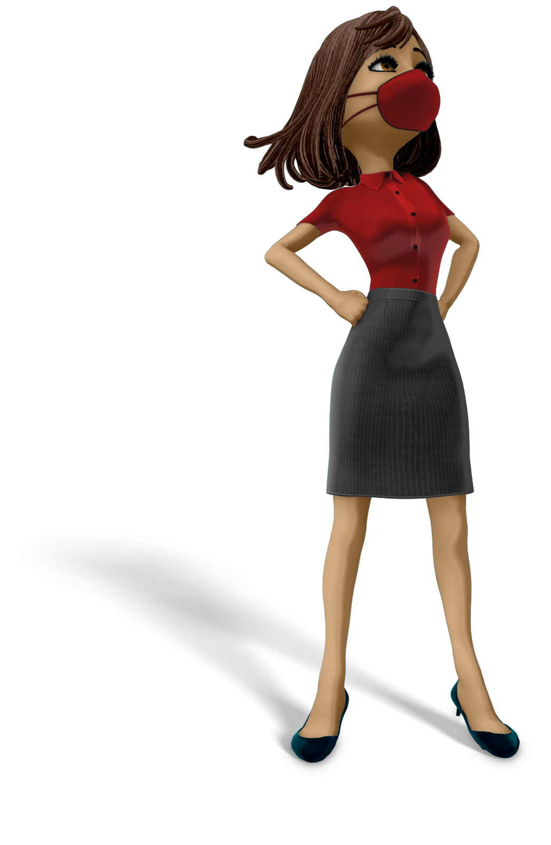
Perseverance
Respect
Integrity
Discipline
Empathy
AT COCOA HS, WE’VE GOT TIGER PRIDE!
CLICK IN ANY OF THESE TEXT BOXES TO CHANGE THE TEXT SEEN IN THIS TEMPLATE. CUSTOMIZE IT TO FIT YOUR PERSONAL NEEDS.
TIGER PRIDE!
Do YOU have what it takes to be a TIGER?
CHANGE OUT THIS PICTURE OUT WITH YOUR OWN. TO DO SO CLICK ON THE IMAGE HIT DELETE. THERE WILL BE AN ICON IN THE MIDDLE OF THE PICTURE, CLICK ON IT, THEN FIND YOUR PICTURE AND INSERT.

Slide 4
Meet Your Support Team!
CLICK IN ANY OF THESE TEXT BOXES TO CHANGE THE TEXT SEEN IN THIS TEMPLATE. CUSTOMIZE IT TO FIT YOUR PERSONAL NEEDS.
We are HERE
TO HELP You!
Mr. Rachad T. Wilson – Principal
Dr. Vidal Olivo – Middle School Assistant Principal
Ms. Denise Stewart – Assistant Principal of Curriculum
Mrs. Vickie Woods – Middle School Counselor
Mr. Paul Grant – MS ESE School Counselor
Mr. Tim Powers – Assistant Principal
Mr. Ivor Mitchell – Assistant Principal
Mrs. Jennifer Rosado – Assistant Principal
Dr. Steve Primus – At Risk Student Coordinator
Dr. Yolanda McGriff – Title I Coordinator
Ms. Cassi Sheron – AVID Coordinator
CHANGE OUT THIS PICTURE OUT WITH YOUR OWN. TO DO SO CLICK ON THE IMAGE HIT DELETE. THERE WILL BE AN ICON IN THE MIDDLE OF THE PICTURE, CLICK ON IT, THEN FIND YOUR PICTURE AND INSERT.

Slide 5
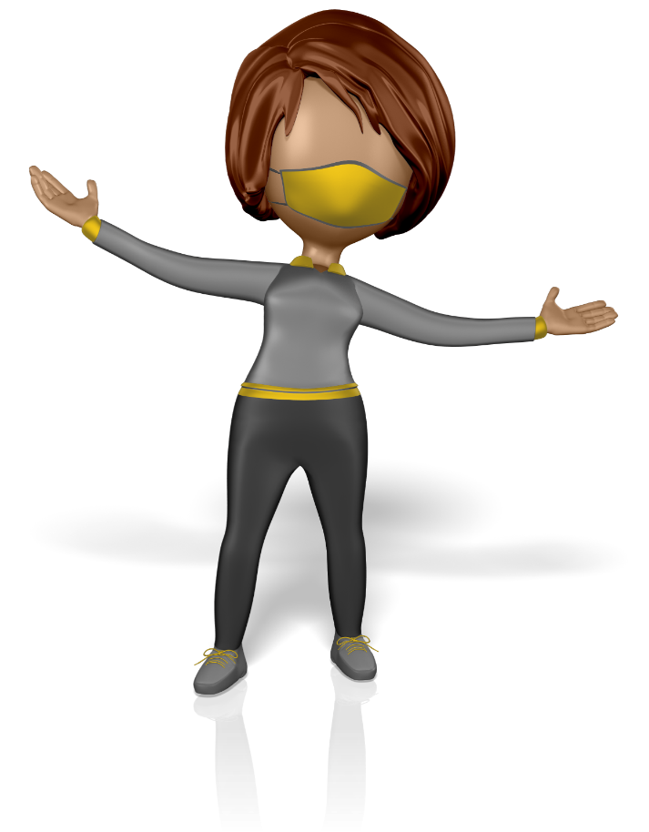
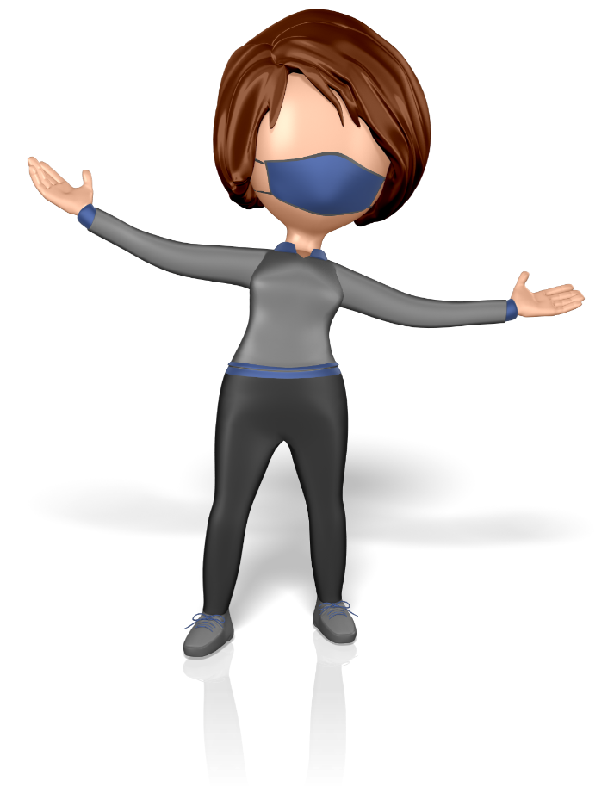
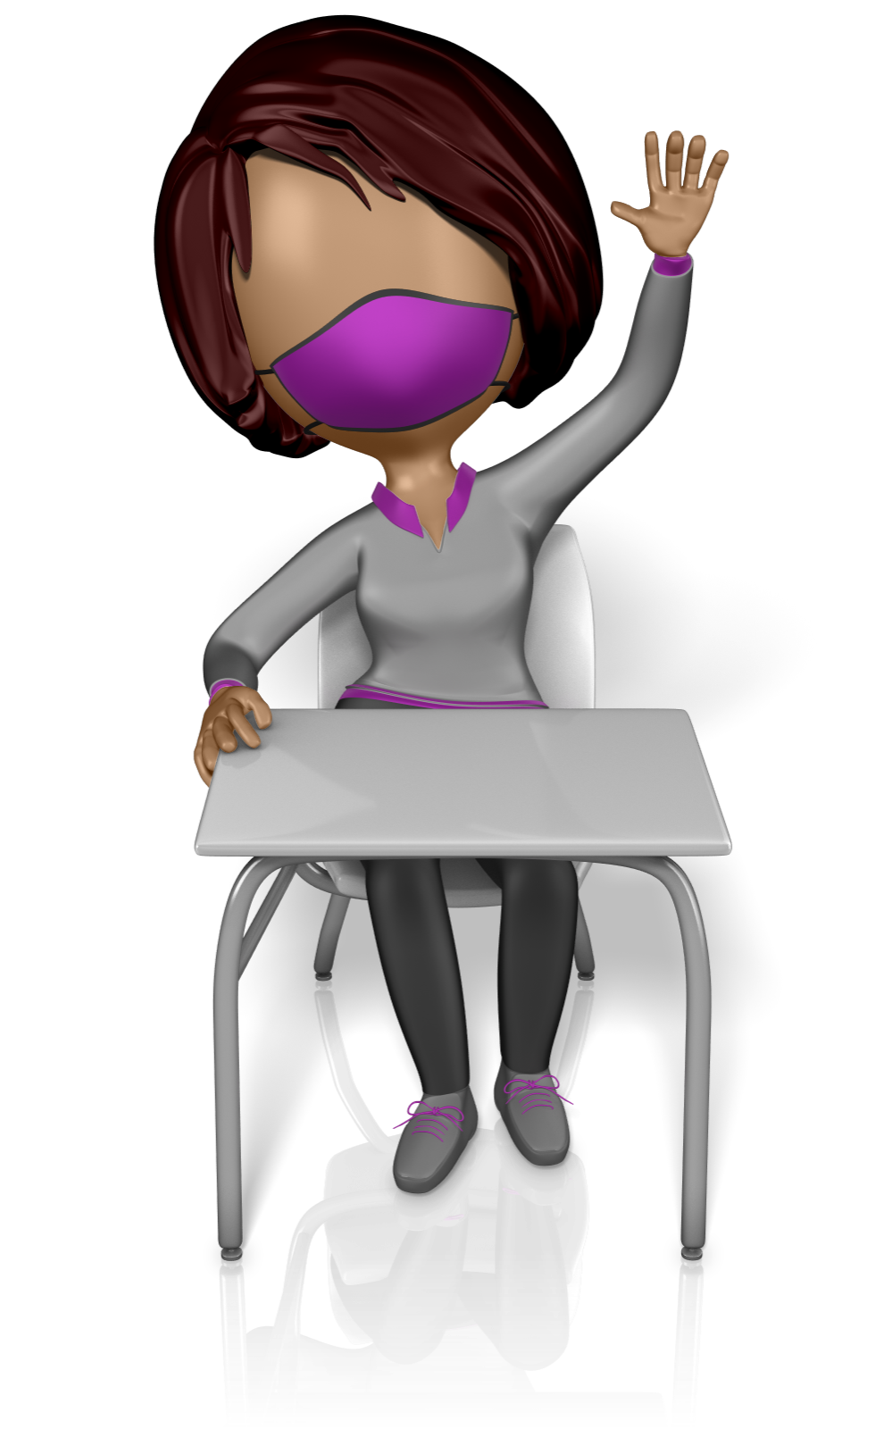
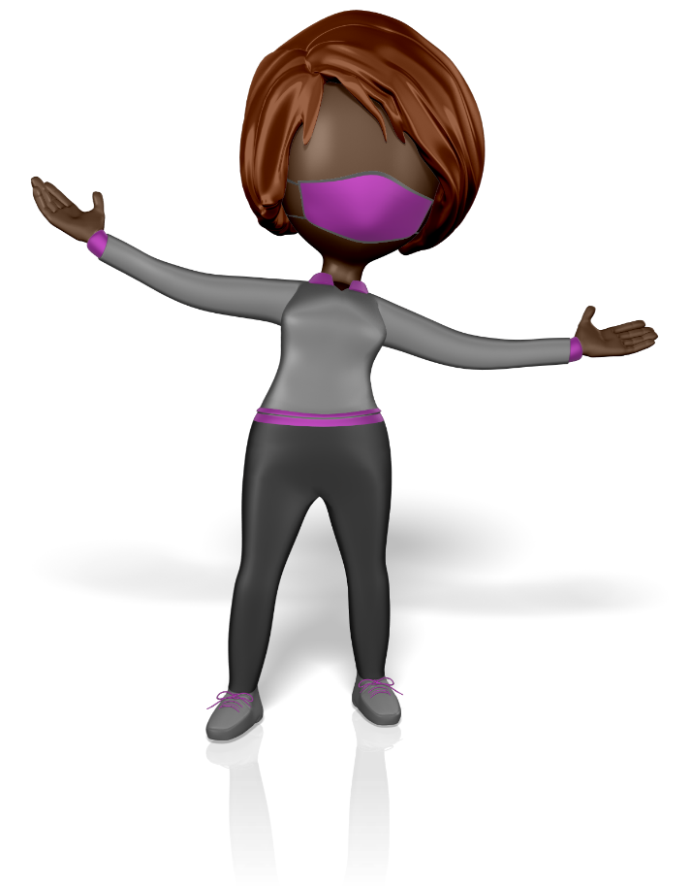
*MULTIPLE CLASSES
*MIDDLE SCHOOL WING
THIS YEAR WE WERE ON BLOCK, NEXT YEAR WE MOST LIKELY WILL GO BACK TO 7 CLASSES A DAY.
MIDDLE SCHOOL STUDENTS HAVE CLASSES IN THEIR OWN PART OF CAMPUS, EXCEPT PE, ART, & MUSIC.
WHAT TO
*MIDDLE SCHOOL LUNCHES
*MIDDLE SCHOOL PE
MIDDLE SCHOOL STUDENTS HAVE LUNCH DURING 2ND BLOCK, IN ONE OF TWO LUNCH PERIODS.
EXPECT
MIDDLE SCHOOL PE IS REQUIRED FOR EVERYONE, UNLESS YOU PLAY A SPORT, AND IS SEPARATE FROM HS PE.

Slide 6
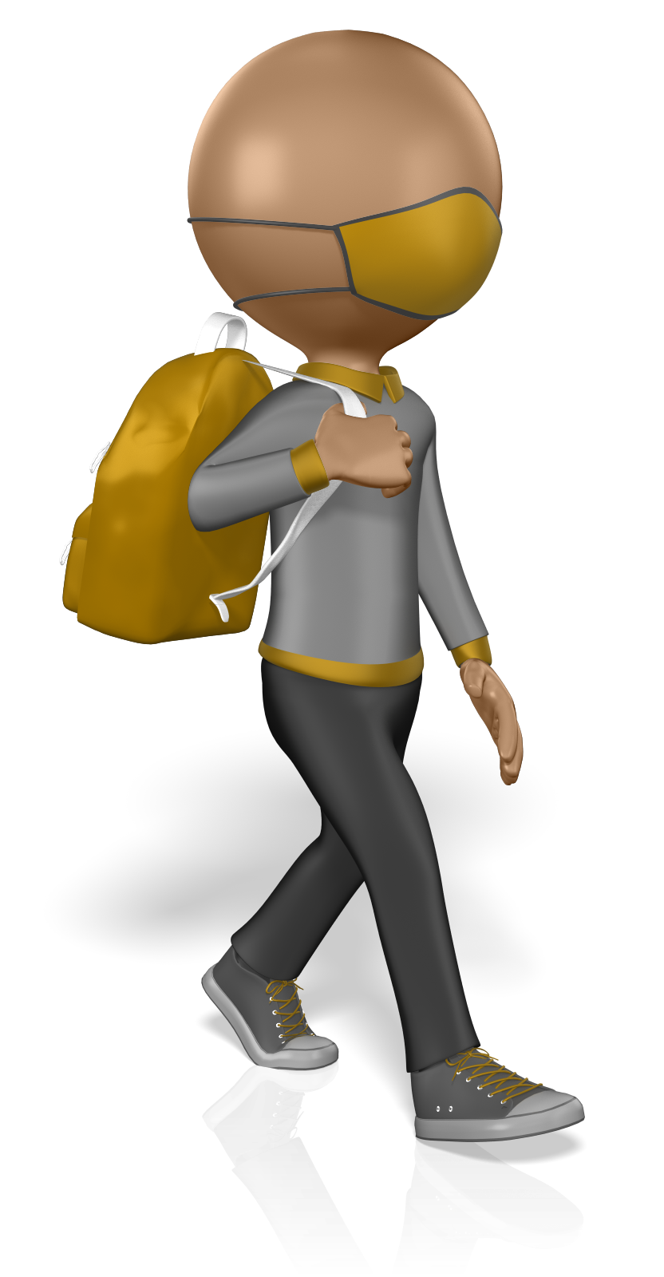
EXPECTATIONS IN
MIDDLE SCHOOL
You will have seven classes a day next year, most of them with different people in your class.
We operate on semesters, so two marking periods equals one semester. Two semesters equals one full course year.
You can FAIL a class if you miss too much school! Students are expected to attend school and be on time every day.
You can play sports and be in music programs that allow you to travel to other schools.
MOST IMPORTANT THINGS TO KNOW?
*YOUR BEHAVIOR IS YOUR RESPONSIBILITY
Discipline referrals can mean lost time in the classroom, which can mean the risk of not being promoted to the next grade.
*LOTS OF OPPORTUNITIES
Do well in MS, you set yourself up for Dual Enrollment and AP in High School – FREE COLLEGE CREDIT OPPORTUNITIES!

Slide 7
We want you to try different kinds of classes in MS to be ready to make your choices for a graduation pathway by 9th grade.
By 9th grade, you will decide if you want to follow a CTE, Advanced Placement (AP), Dual Enrollment, or AVID pathway..
General Classes
Language Arts 3
Science 3
US History
Pre-Alegbra or Algebra 1
Advanced Classes
Language Arts 3 Advanced
Science 3 Advanced
US History Advanced
Geometry Honors HS (EOC)
WHAT CLASSES
Can I take?
Elective Options
THEATRE
BAND
ORCHESTRA
CHORUS
SCIENCE RESEARCH
2D STUDIO ART
DIGITAL PUBLISHING
TECHNOLOGY EDUCATION
FAMILY & CONSUMER SCIENCE
Careers in Fashion
Culinary Career
BUSINESS TECH
AVID: Advancement Via Individual Determination
SPANISH 1 or 2: HS Credit
SERVICE LEARNING

Slide 8
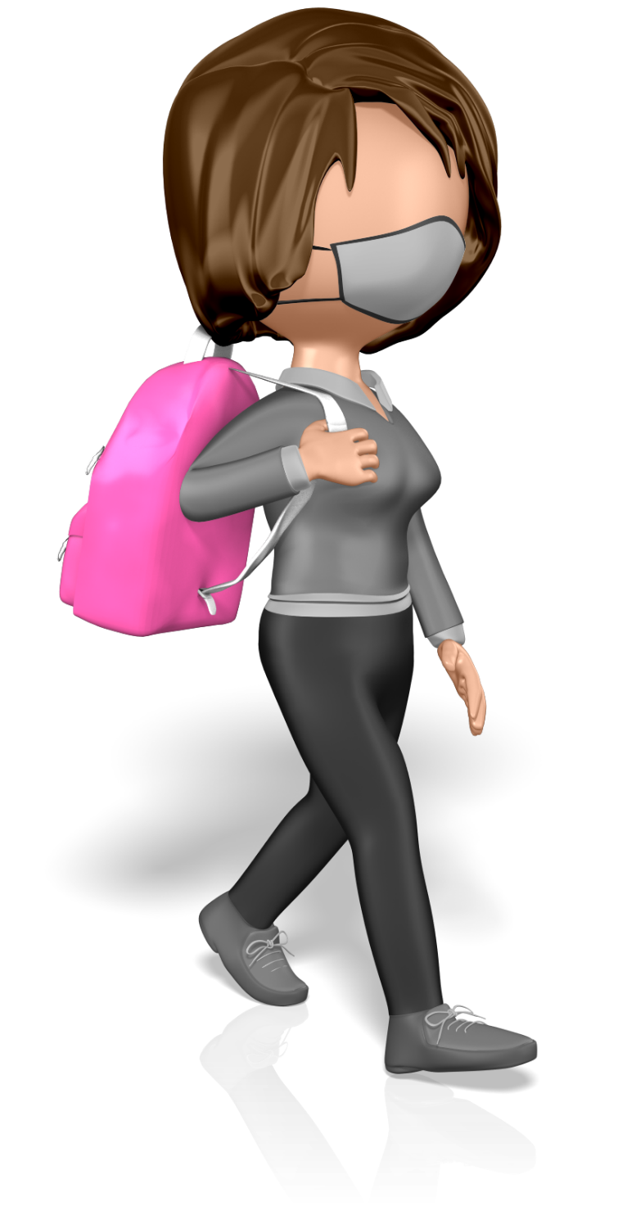
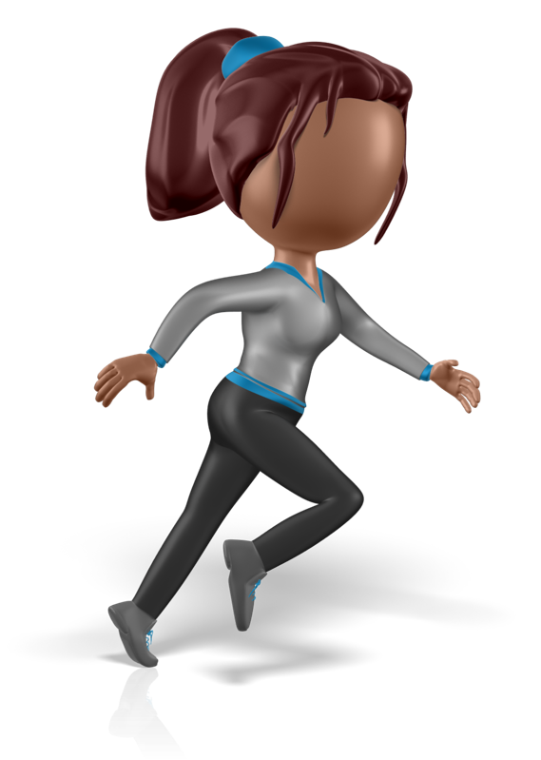
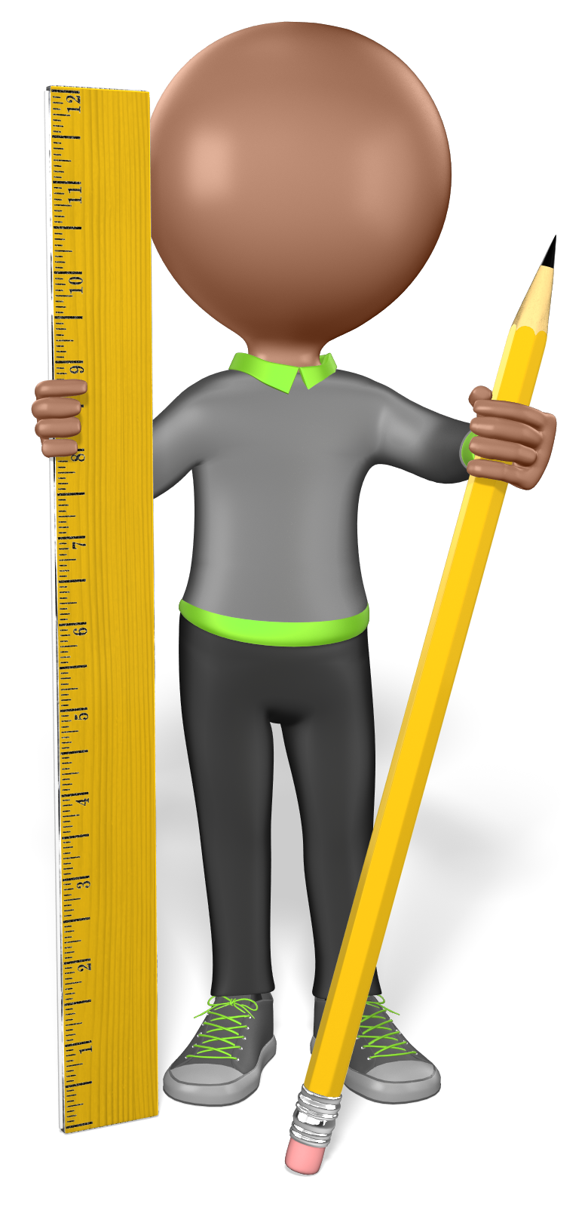
NOTE1 : TO CHANGE OUT THIS PICTURE OUT WITH YOUR OWN WILL BE A LITTLE DIFFERENT THAN THE TITLE PAGE. TO DO SO CLICK AND HOLD DOWN THE LEFT MOUSE BUTTON ON TOP OF THE IMAGE AND DRAG THE COVER TINT TO THE SIDE. NOW YOU CAN CLICK THE ACTUAL IMAGE AND HIT DELETE. THERE WILL BE AN ICON IN THE MIDDLE OF THE PICTURE, CLICK ON IT, THEN FIND YOUR PICTURE AND INSERT.
EVERYONE IS
WELCOME
NOTE2 : YOU CAN ALSO CHANGE OUT THE PICTURE BY CLICKING IN THE SELECTION PANE. FIRST GO UNDER THE HOME TAB IN THE TOP LEFT. THEN TO THE FAR RIGHT IS “SELECT”AND THEN GO TO “SELECTION PANE”. IN THERE YOU CAN FIND THE PICTURE LABELED “PICTURE PLACEHOLDER MAIN”. CLICK ON THAT AND HIT DELETE ONCE. NOW YOU SHOULD HAVE AN ICON THAT POPS UP IN MIDDLE THE OF THE PICTURE, CLICK ON IT, THEN FIND YOUR PICTURE AND INSERT.
Cocoa HS is proud of how diverse and inclusive our campus is. Our students and staff represent a wide variety of backgrounds and experiences. Being able to learn and grow together is one of our greatest accomplishments. The E in Tiger PRIDE is for Empathy, and at Cocoa HS, we all have the opportunity to practice building empathy as we work alongside one another towards meeting our individual goals for high school graduation and beyond.
LOOKING FORWARD TO a GRREEAAATT
8th GRADE YEAR!

Slide 9
Cocoa HS
Class of 2027!

