Slide 1
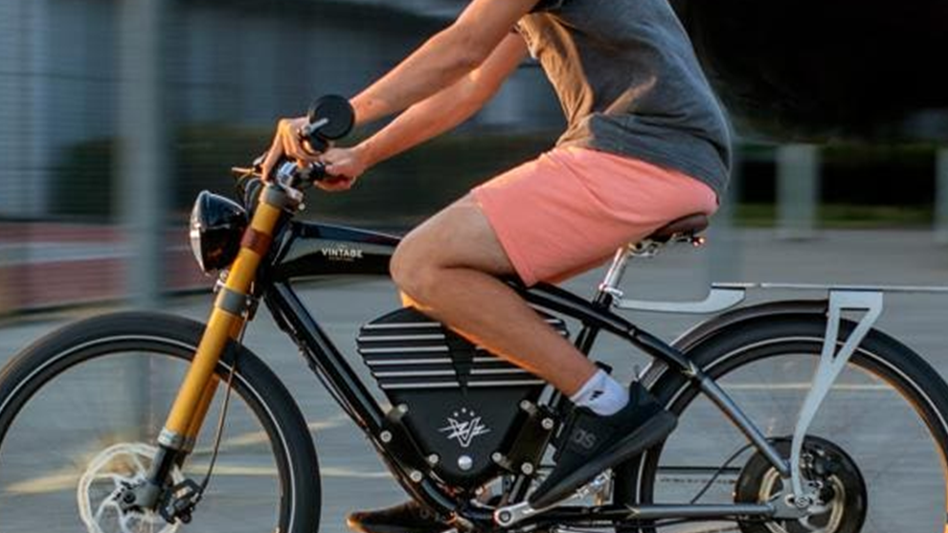
Electric Bikes
Safety Rules & Tips

Slide 2
E-Bikes Classifications
All three classes of E-bikes in Florida can be operated on bike lanes, roads, and multi-use paths where traditional bicycles are allowed.
The specific paths and areas where each class can be used may vary slightly depending on local regulations.
Importantly, no E-bike in Florida is allowed to have a motor that exceeds 750 watts of power, and they must adhere to the speed limits set for their class.
Local regulations can vary, so it’s always a good idea to check the specific rules in your area, especially when planning to ride in state parks or on nature trails where restrictions might apply to motorized vehicles.

Slide 3
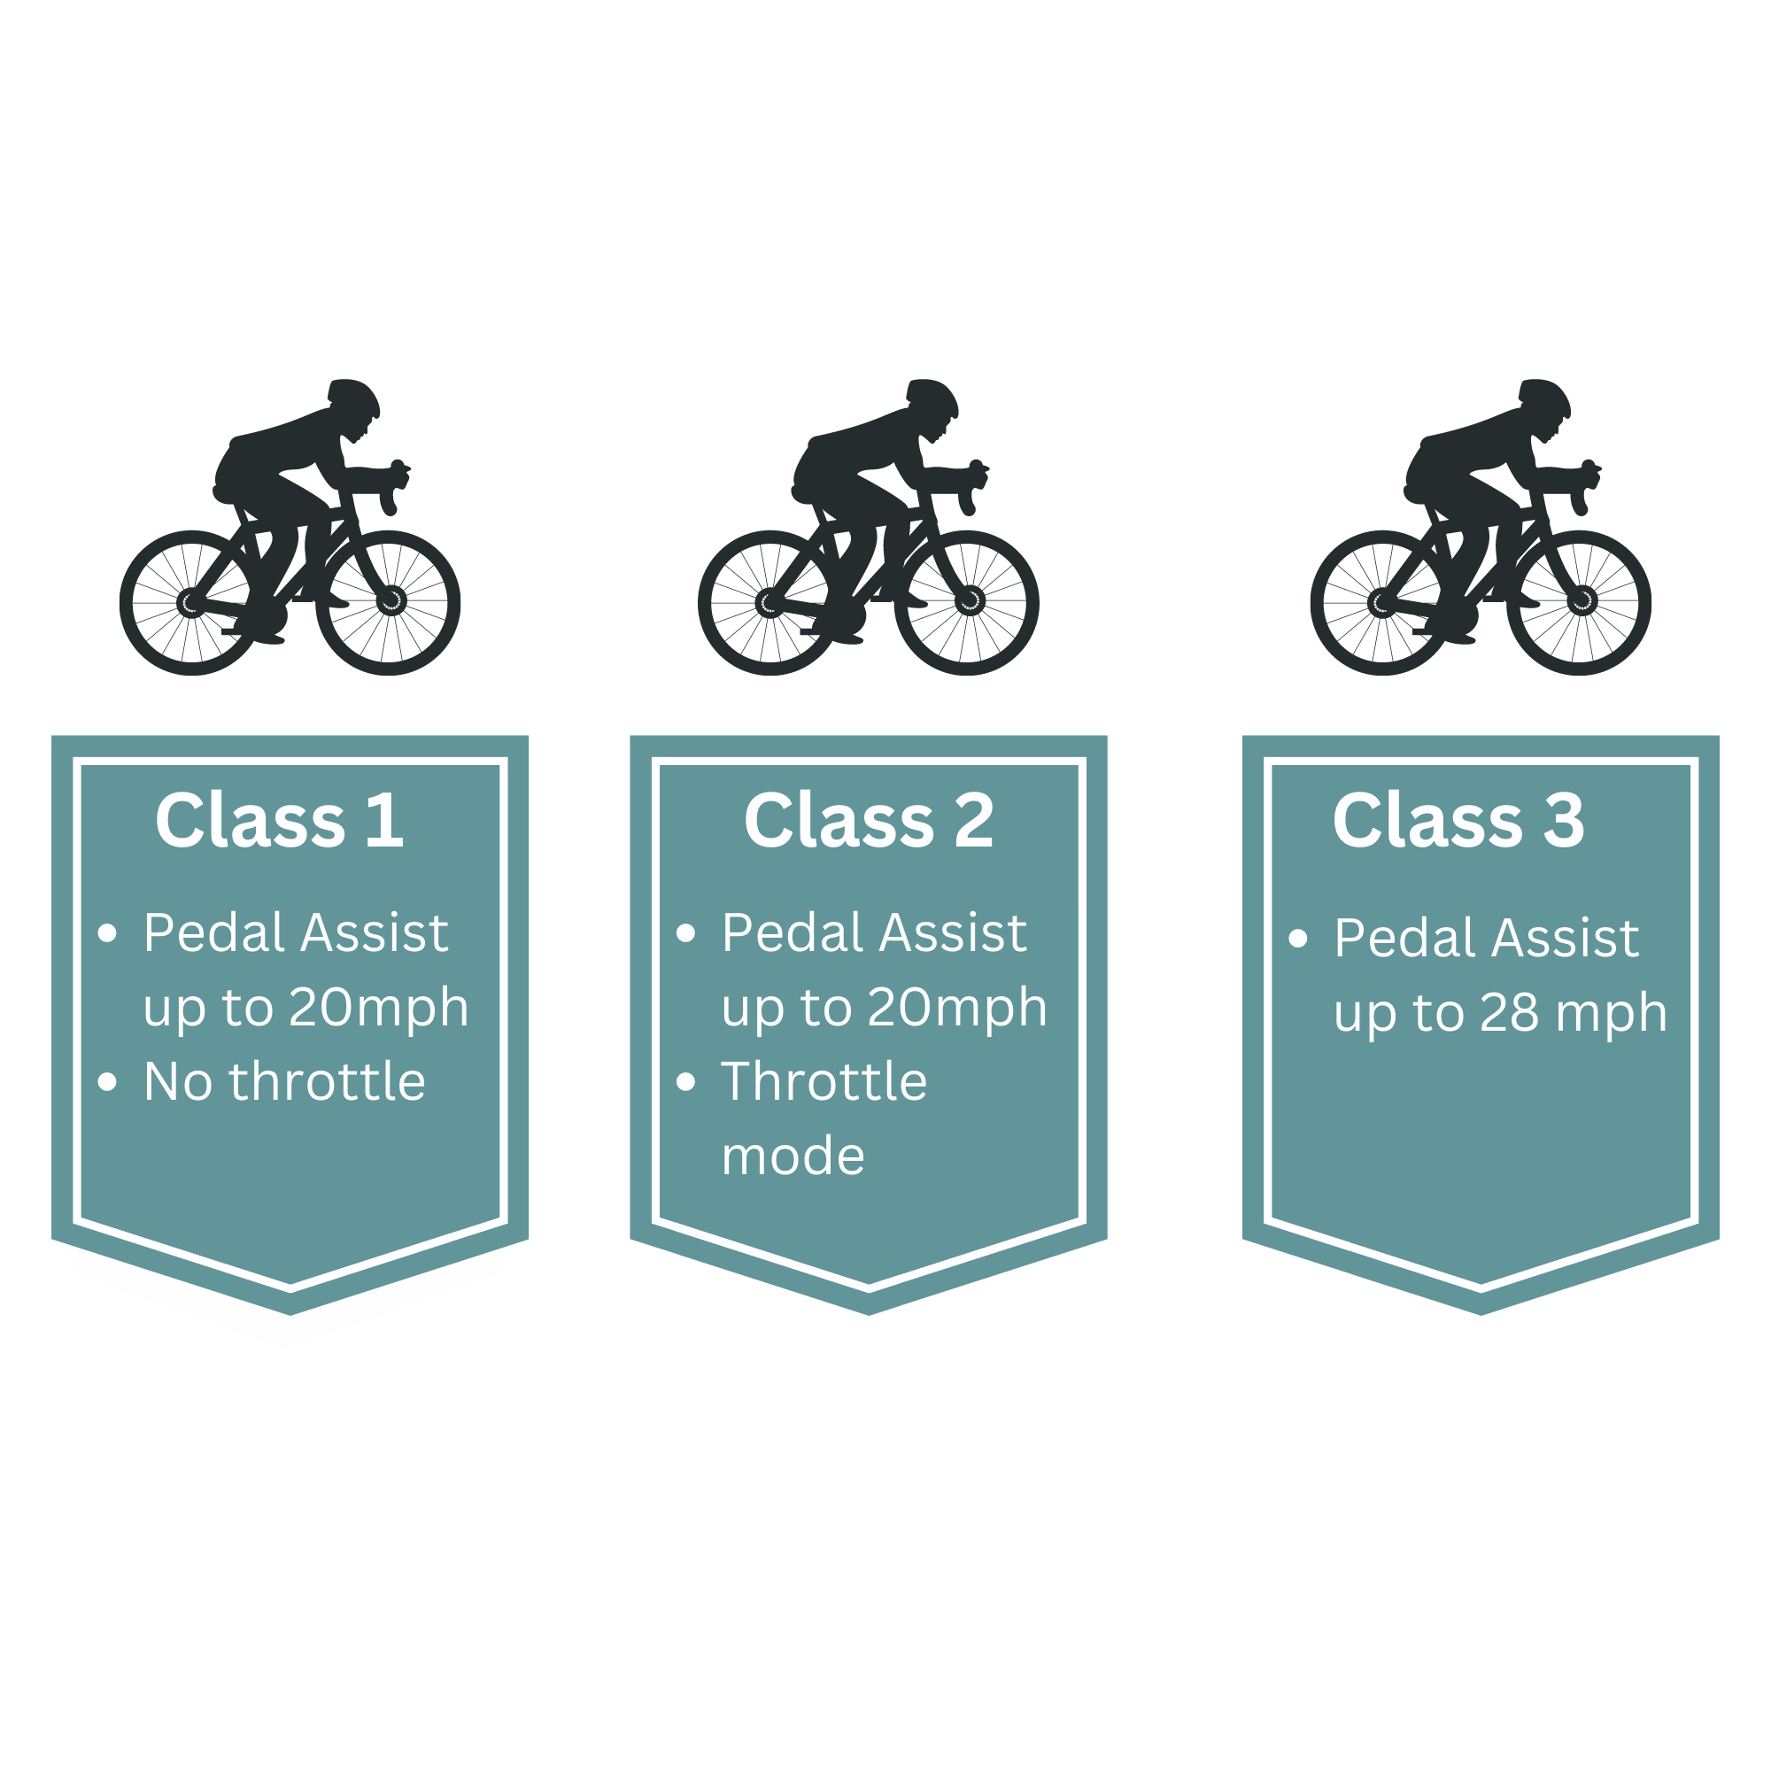
E-bike Classification

Slide 4
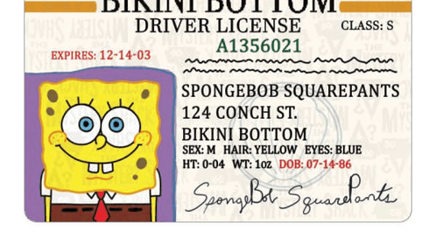
Is it required to have a license & registration to ride a E-bike in Florida?
Florida treat E-bikes like traditional bicycles, meaning they do not require a driver’s license or registration for operation.
If the E-bike is modified to exceed the stipulated motor power of 750W or speed limits (20 mph for Class 1 & 2, 28 mph for Class 3), it may be reclassified as a Class E moped, requiring a license and registration. Which may result in fines and other penalties.

Slide 5

Important Rules & Safety Tips
Wear a helmet
Follow all rules of the road & be predictable
Check your E-bike before riding like your brakes and tires
Use hand signal before making a turn
Be aware of your speed & maintain a safe distance, especially in shared spaces
Wear reflective gear or bright colored clothes
Slow down at corners & make sure to stop before entering and crossing the road
Stay to the right, except when passing
Give an audible warning signal when passing others

Slide 6

Bike Helmet

Slide 7
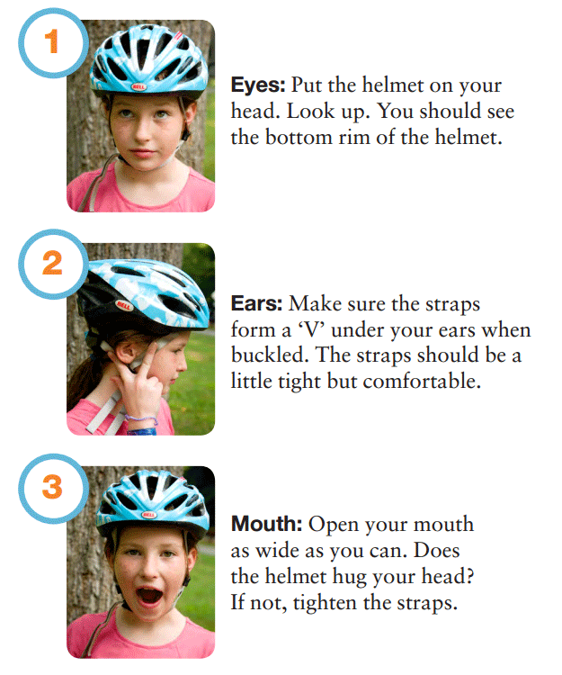
Protect your HEAD
Good Reason to Wear a Bike Helmet:
60% reduced risk of serious head injury
53% reduced risk of traumatic brain injury
24% reduced risk of fatality or serious injury
23% reduced risk of facial injury

Slide 8
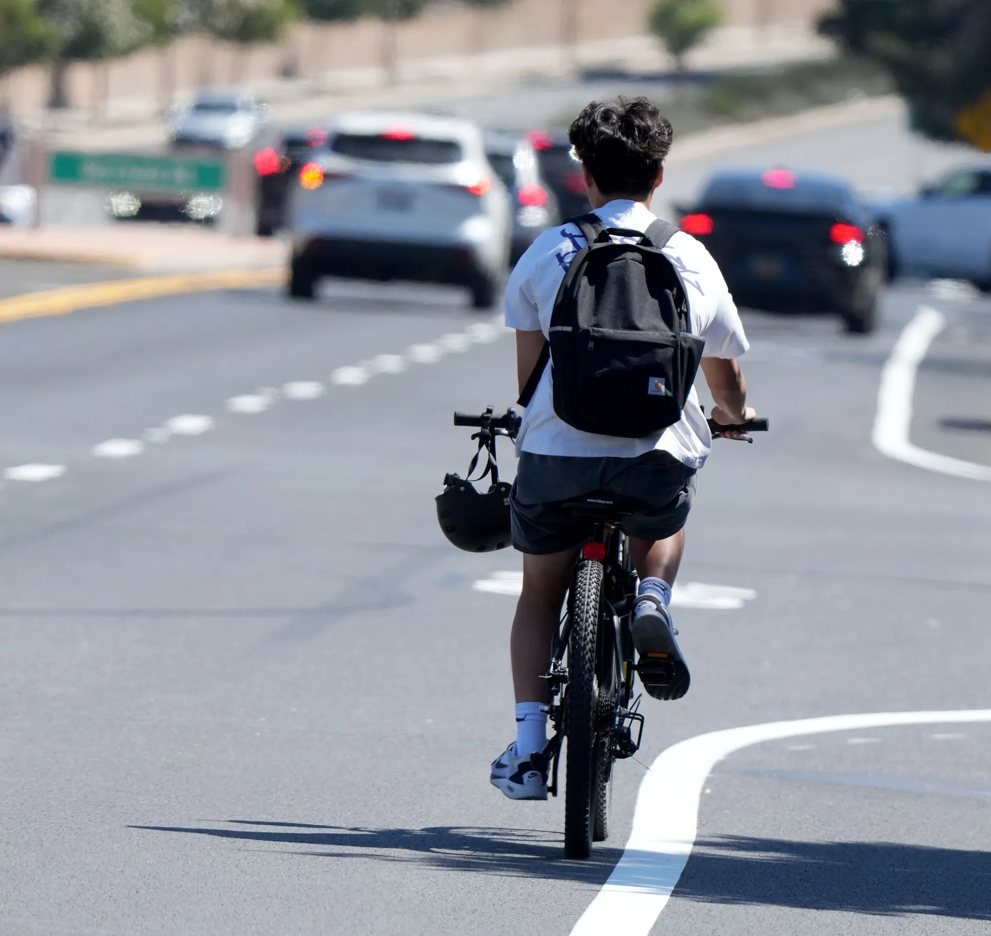
Florida Bicycle & E-bike Helmet Law
Against the Law
All cyclists under 16 must wear helmets by Law
Florida State Statute 316.2065(2)(d) states: A bicycle rider or passenger who is under 16 must wear a bicycle helmet that is properly fitted and is fastened securely upon the passenger’s head by a strap and that meets the federal safety standard for bicycle helmets.

Slide 9
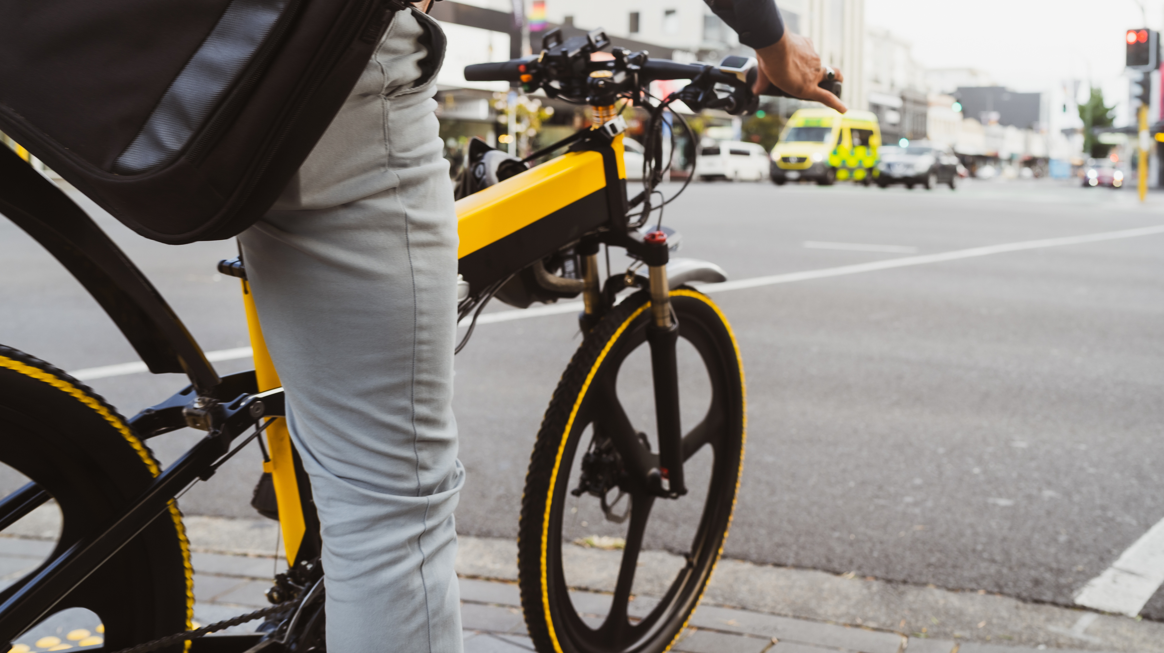
Must Follow Vehicle Laws
Ride with the flow of traffic
Obey all traffic signals & signs
Use lights when biking between sunset & sunrise
Yield to pedestrians
Have proper lighting from Sunset to Sunrise

Slide 10
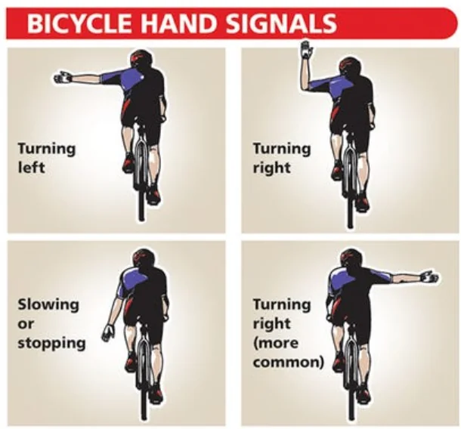
Hand Signals
Bike hand signals help you to indicate your intention to take a turn or to change lanes. This ensures that others are informed of your actions.
It is advisable to signal ahead of time (about 100 feet) before you intend to stop or turn.
Hold your signal for about 3 seconds before stopping or making a turn.

Slide 11
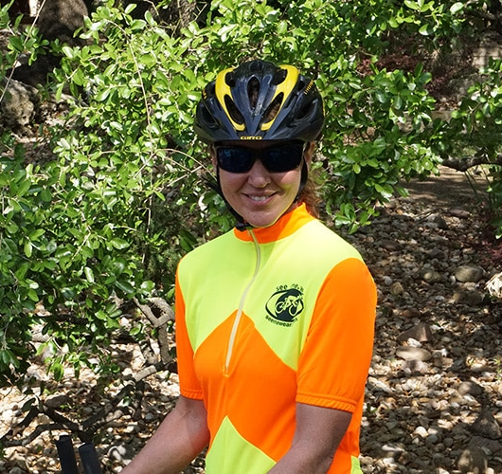
Wear proper clothing
Stay visible: wear brightly colored clothing for daytime riding and reflective material for night riding.
Wear closed toe shoes
Wear a helmet
Wear eye protection: like sunglasses or cycling goggles

Slide 12
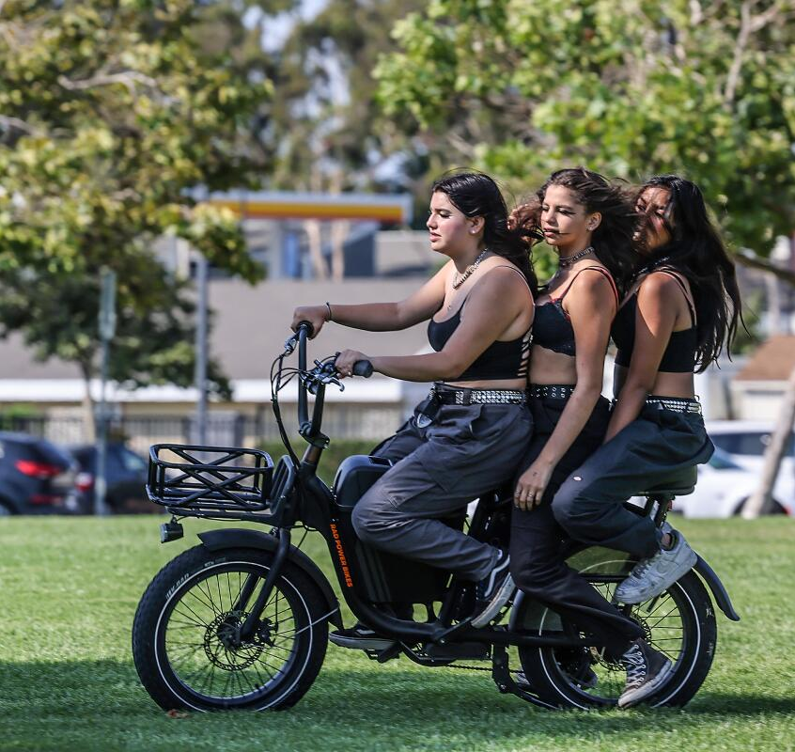
Riding more than one person on an E-bike
An E-bike that is designed for one rider could become dangerous if more than one person is riding it. It can affect the E-bike’s handling like:
  Could lose balance easier
  Could increase the stopping distance
  Could exceed the maximum weight limits

Slide 13
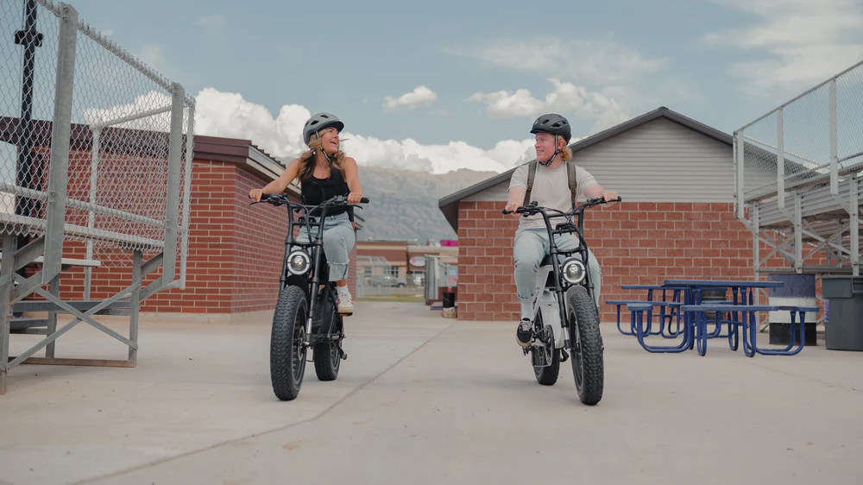
Remember to have fun but be safe while doing it!!!
Wear a helmet
Check your equipment (brakes, lights, tires)
Stay visible (wearing bright color clothing)
Follow vehicle laws
Use hand signals (look, signal, and look again)
Ride predictably and defensively
Remember that some drivers just don’t see you
Always ride lawfully and responsibly

