Slide 1
SALT PROGRAM
Scotties Advanced Learning Track

Slide 2
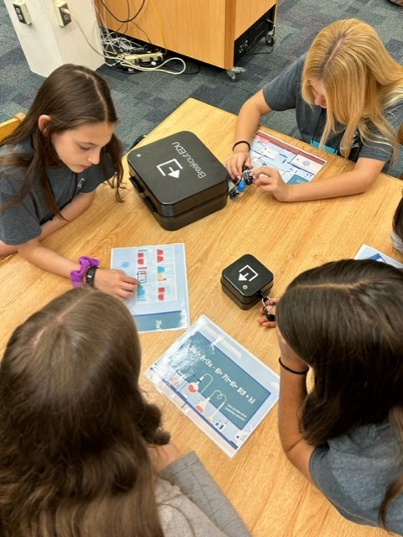
SALT PROGRAM Scottie Advanced Learning Program*
Take advanced classes in ELA, Math, Science, and Social Studies.
Participate in seminars twice a year.
Visit Washington D.C. in the Spring.
*Students need to complete online application to be accepted into the SALT program. Deadline for submission is August 2024.

Slide 3
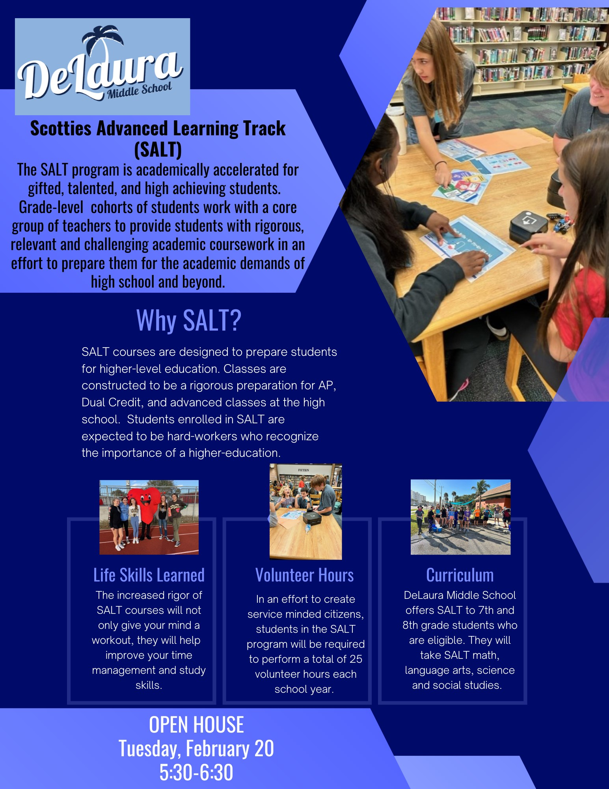
JOIN US!
SALT OPEN HOUSE
February 20, 2024
DeLaura MS
300 Jackson Ave
5:30 PM

Slide 4
How to Apply for SALT
Do not reside in our boundary
Need to apply through BPS ELO
Interested in SALT
Apply on our website for SALT in addition to BPS ELO
Reside in our boundary
Do not need to apply
Interested in SALT
Apply on our website for SALT
Students must complete an application in order to be accepted into the SALT program. The application is on our website under the Academics tab. Deadline: Aug 2024.

Slide 5
ELO PROCESS
App
Application date
ELO
January 15 –
February 23, 2024
Waitlist opens in April
If you live outside the attendance boundary and want to attend DeLaura.
https://www.brevardschools.org/Page/2381

Slide 6
cONTACT INFORMATION
JOSEFINA MELENDEZ
ASSISTANT PRINCIPAL OF CURRICULUM AND INSTRUCTION
Melendez.Josefina@brevardschools.org
321-773-7581, x31615

