Slide 1
WELCOME RISING SCOTTIES
_______
Principal
Tina Susin

Slide 2
DELAURA’S MISSION To provide a positive school environment where students may develop their individual skills and talents and prepare for their future endeavors in high school and beyond.
SCHOOL OF EXCELLENCE

Slide 3
Transition from Elementary School to Middle School
School Hours
9:30 a.m. – 4:15 p.m.
Students take 7 classes
ELA, Math, Civics, Science, PE, 2 Electives
Classes are 48 minutes in length
3 minutes passing period
Classes are referred to by period
Example: 1st period Science, 2nd period Civics, etc…

Slide 4
Core Classes- Math, ELA, Science, History
Regular, Advanced, SALT Advanced
ESE support for Math & ELA
SALT Program- Scotties Advanced Learning Track (application only)
Career and Technical Education Courses- Business Applications, Coding, Exploring Technology and Exploration Transportation Technology. (8th grade only- Digital Information Technology which is a high school credit course)
High School Courses- Algebra I Honors, Spanish I. (8th grade only- Geometry H, Spanish II, Digital Information Technology)
Other Electives- Science Research 1, TV Production, Yearbook, Creative Writing
PE – Required 7th and 8th grade
Art – 2D, 3D, Digital Multi-Media Foundations
Music – Band, Orchestra, Choir (several music classes under each category- by audition)
Athletics Program- Basketball, Track and Field, Volleyball, Soccer, Cheerleading, Mascot Team.
Clubs- Chess, Drama, E-Sports, First Priority, Future Teachers of America, Library Leaders, Math Team , Newspaper, National Junior Honor Society, Odyssey of the Mind, Speech and Debate, Student Government.

Slide 5
TdaP Immunization is Required
Florida State Law requires all students receive a
TdaP (tetanus) immunization
Within the last 5 years BEFORE entering 7th grade.
Drop off the updated paperwork at our school office or email it to
Ms. Rosemary Drury at drury.rosemary@brevardschools.org
Students without this immunization will be turned away at registration.

Slide 6
Re-enrollment forms will need to be completed through FOCUS when released by the district on July 8, 2024.
If you do not have a Parent Focus account set up, contact your child’s current school for the PIN number.
This Photo by Unknown Author is licensed under CC BY

Slide 7
MATHEMATICS
7th Grade Basic Math
7th Grade Advanced Math
7th Grade SALT Advanced
9th Grade Alg I Honors – High School Credit- FAST LEVEL 5 REQUIRED
MATH ONLINE PROGRAMS –
ALEKS
KHAN ACADEMY

Slide 8
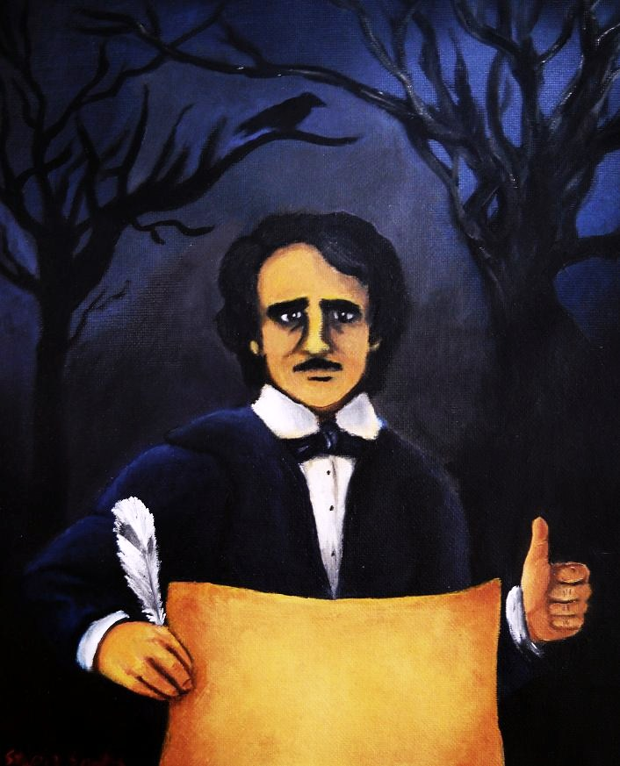
ENGLISH LANGUAGE ARTS
7th Grade Basic ELA
7th Grade Advanced ELA
7th Grade SALT Advanced
Intensive Language Arts- Read 180 Program
EDGAR ALLAN POE
Amplify as core curriculum –
Red Scarf Girl & Narrative
Character & Conflict
Brain Science
Poetry & Poe
The Frida & Diego Collection
The Gold Rush Collection

Slide 9
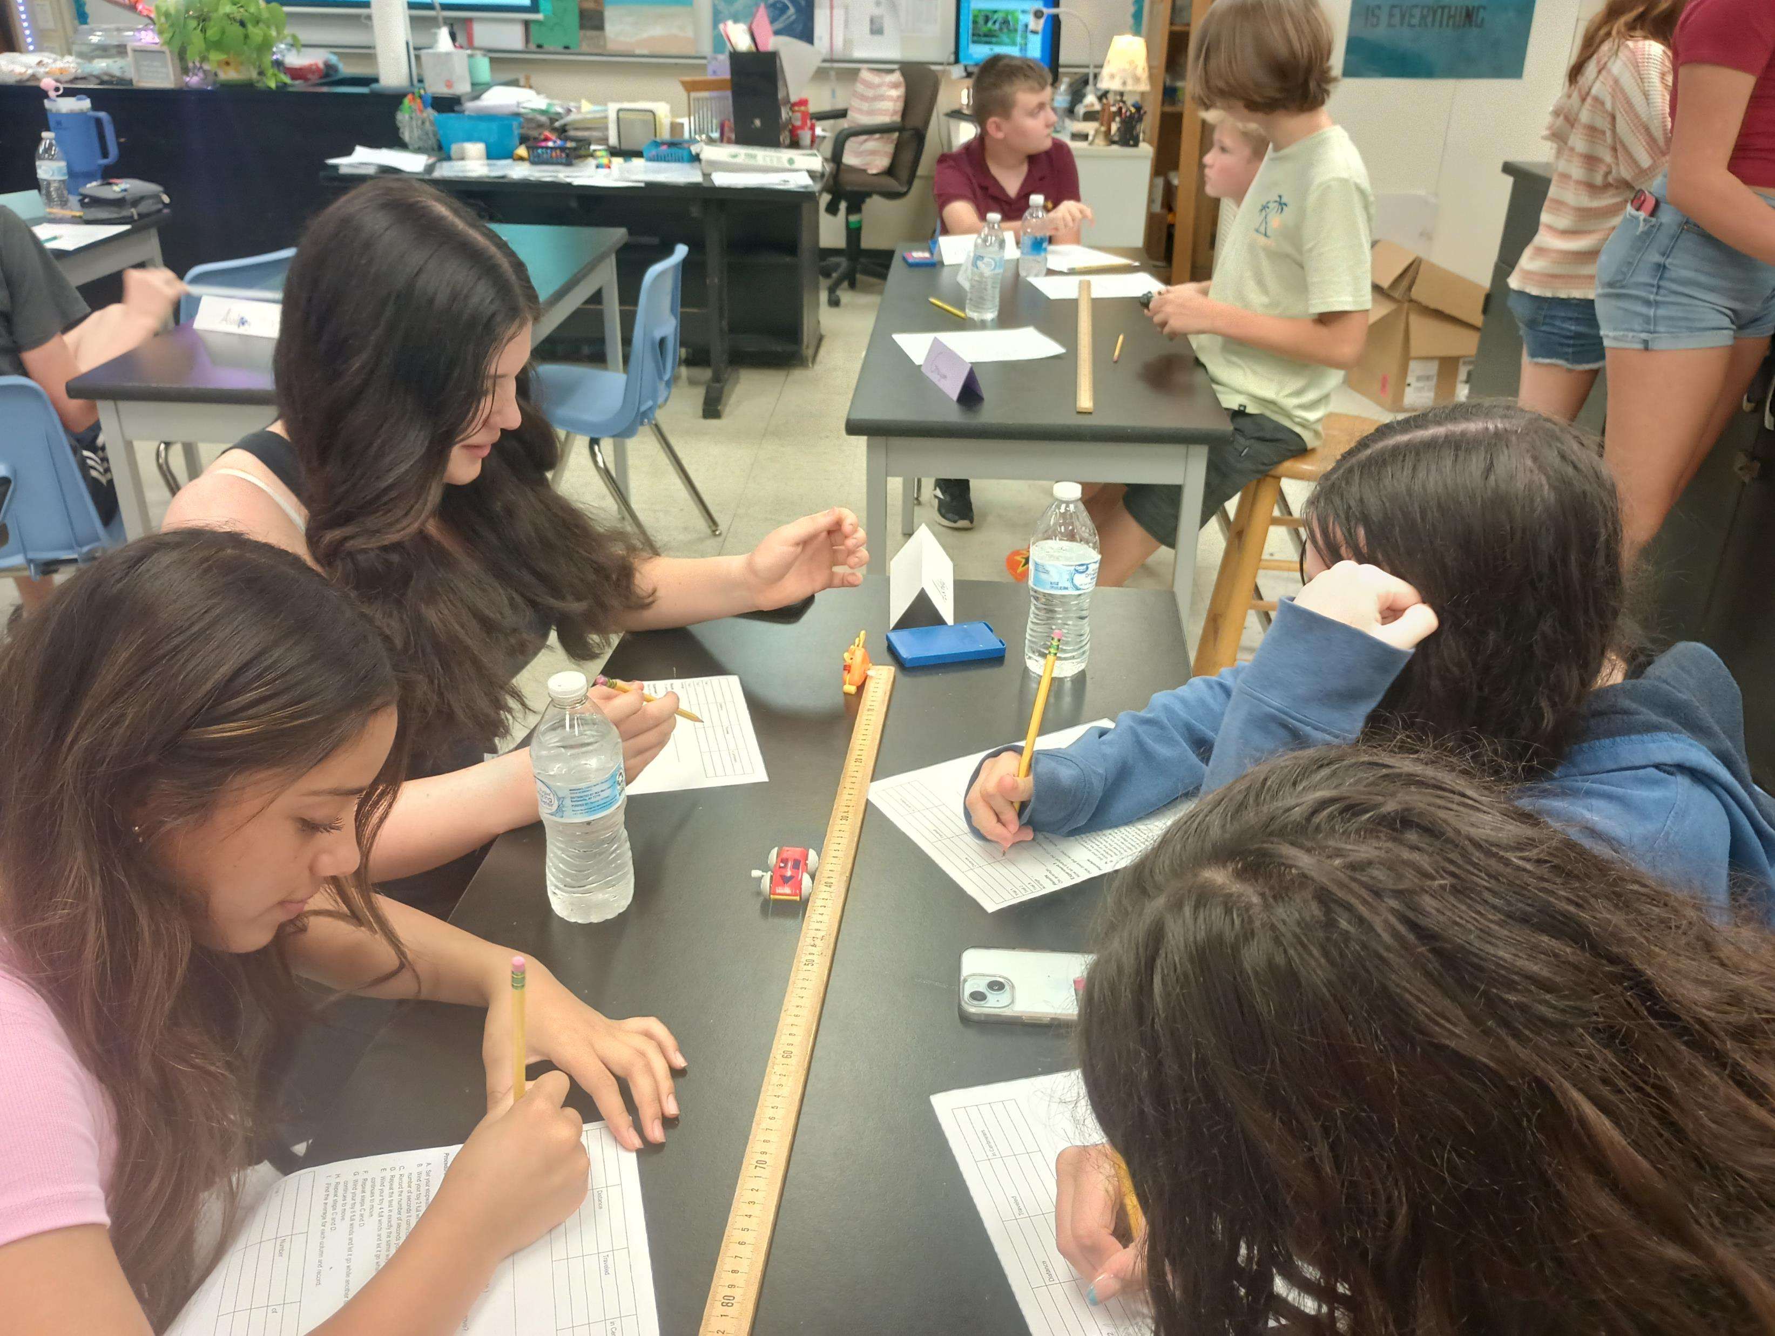
SCIENCE
7th Grade Basic Science
7th Grade Advanced Science
7th Grade SALT Advanced

Slide 10
HISTORY- Civics
7th Grade Basic Civics
7th Grade Advanced Civics
7th Grade SALT Advanced Civics
ALL STUDENTS REQUIRED TO TAKE –
End of Course Exam (EOC)
Taken in May
30% of Yearlong Grade

Slide 11
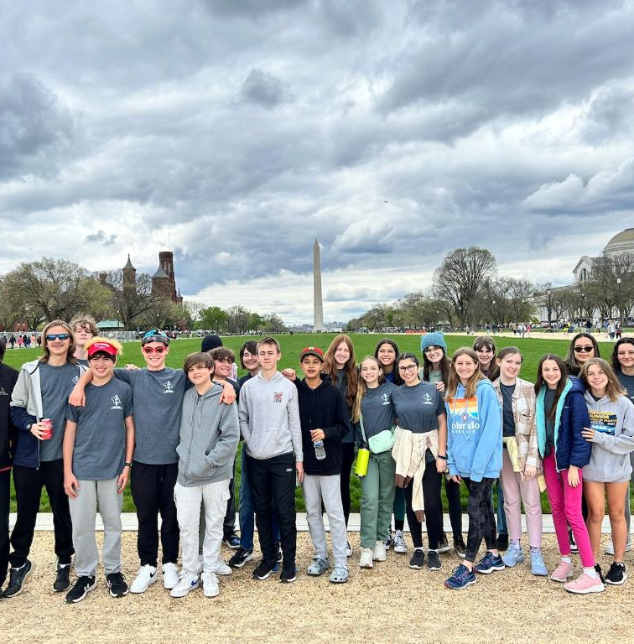
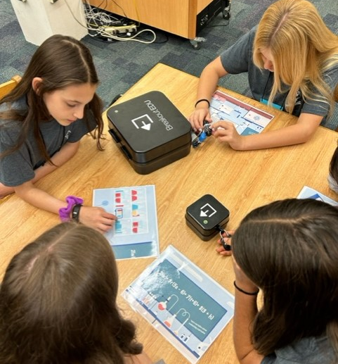
SALT PROGRAM Scottie Advanced Learning Program
Take Advanced SALT classes in all core courses.
Participate in seminars twice a year.
Fulfill 20 hours of service learning.
Tour Washington D.C. in 8th grade.
Must apply to be accepted into the program.

Slide 12
EXCEPTIONAL EDUCATION
Elective Classes- assigned per IEP
Learning Strategies
Social Emotional Learning
Home Base Program
Supports for students with Autism
Academic Support
For ALL ESE students in Math& ELA courses, as assigned per IEP
All students at DeLaura succeed.

Slide 13
Required 7th & 8th grades
All students wear PE school uniform
We get you MOVING
PHYsical education
This Photo by Unknown Author is licensed under CC BY

Slide 14
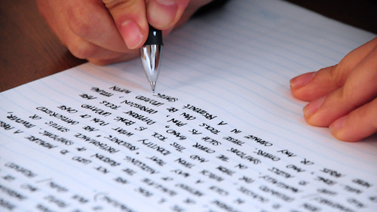
Science Research 1
TV Production
Yearbook
Creative Writing
Spanish I (high school credit)
General Electives
This Photo by Unknown Author is licensed under CC BY-SA-NC

Slide 15
Business Computer Applications 1 & 2
Coding
Exploring Technology (for future engineers)
Exploration of Transportation Technology (this class feeds into the automotive program at Satellite HS)
Career and technical education (CTE)

Slide 16
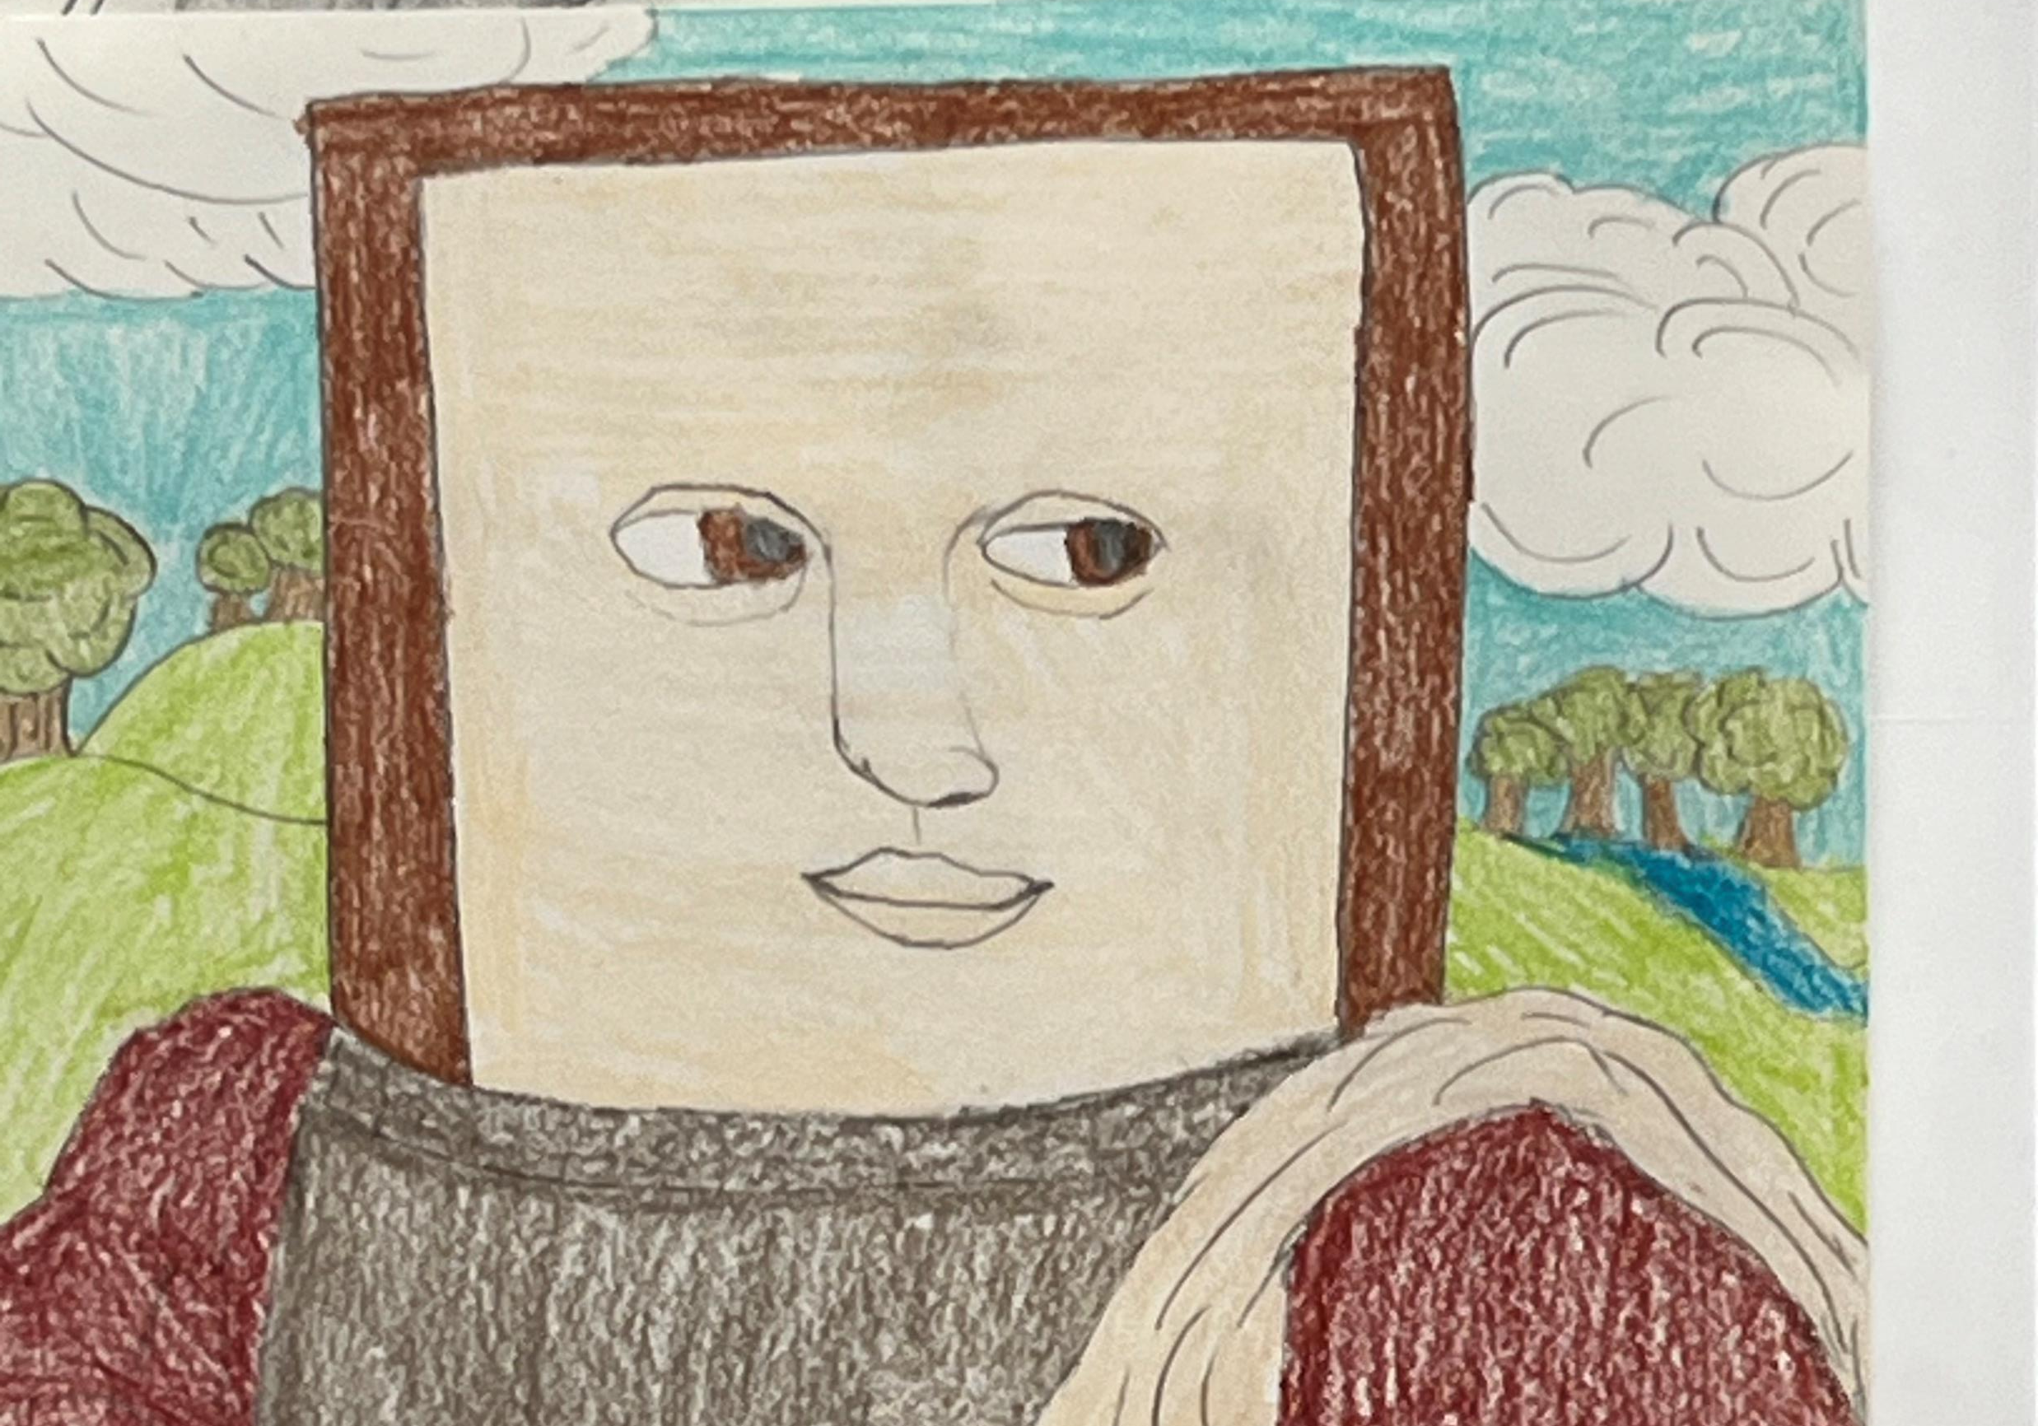
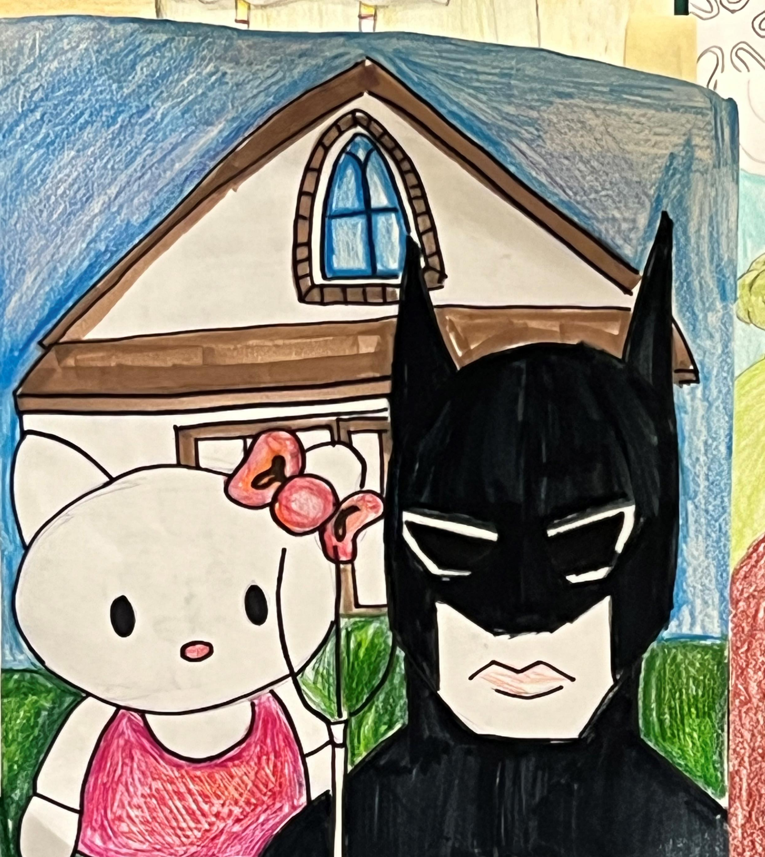
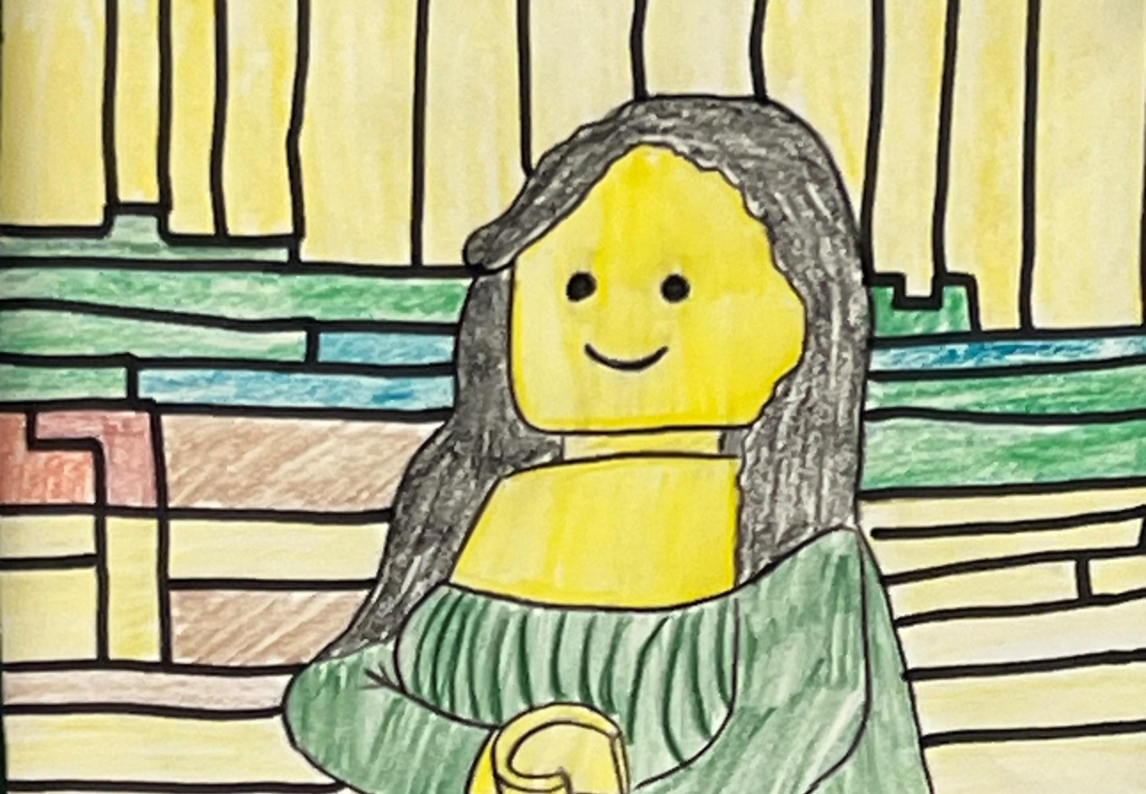
2D Studio Art
3D Studio Art
Digital Art and Media
art

Slide 17
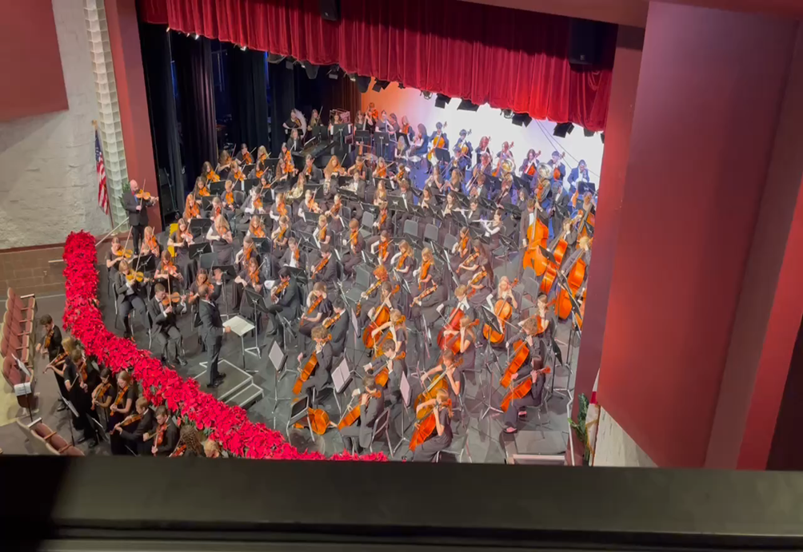
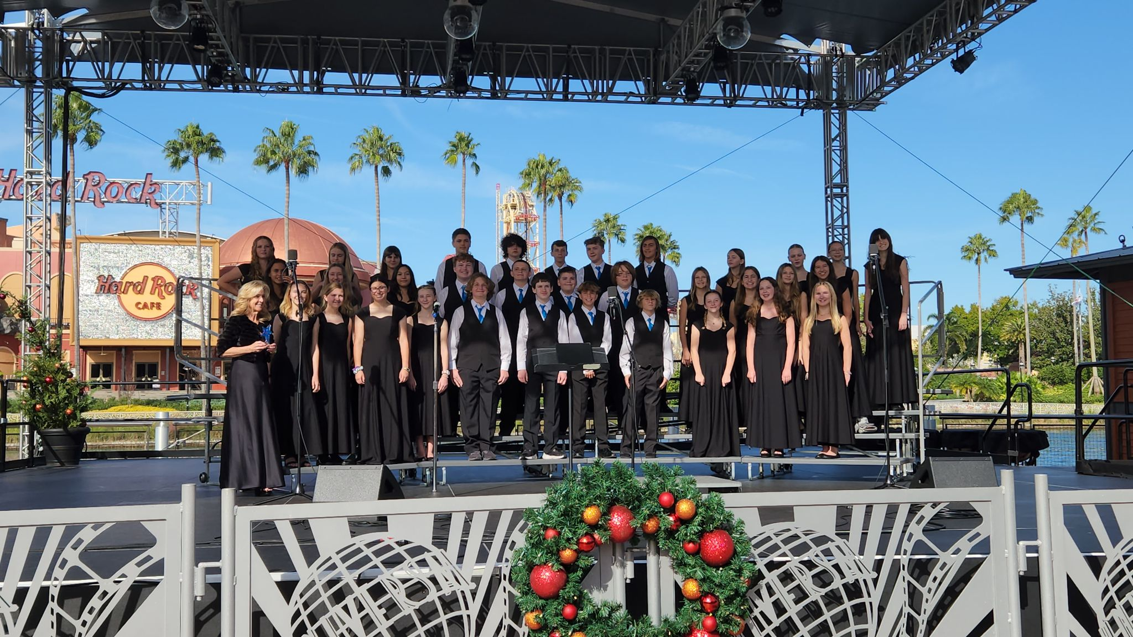
outstanding music programs
Chorus Orchestra band

Slide 18
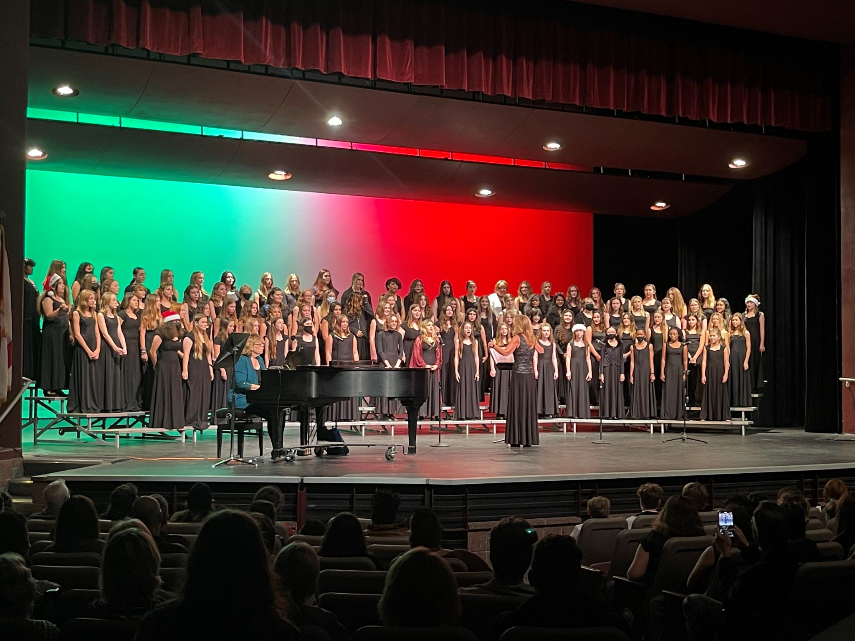
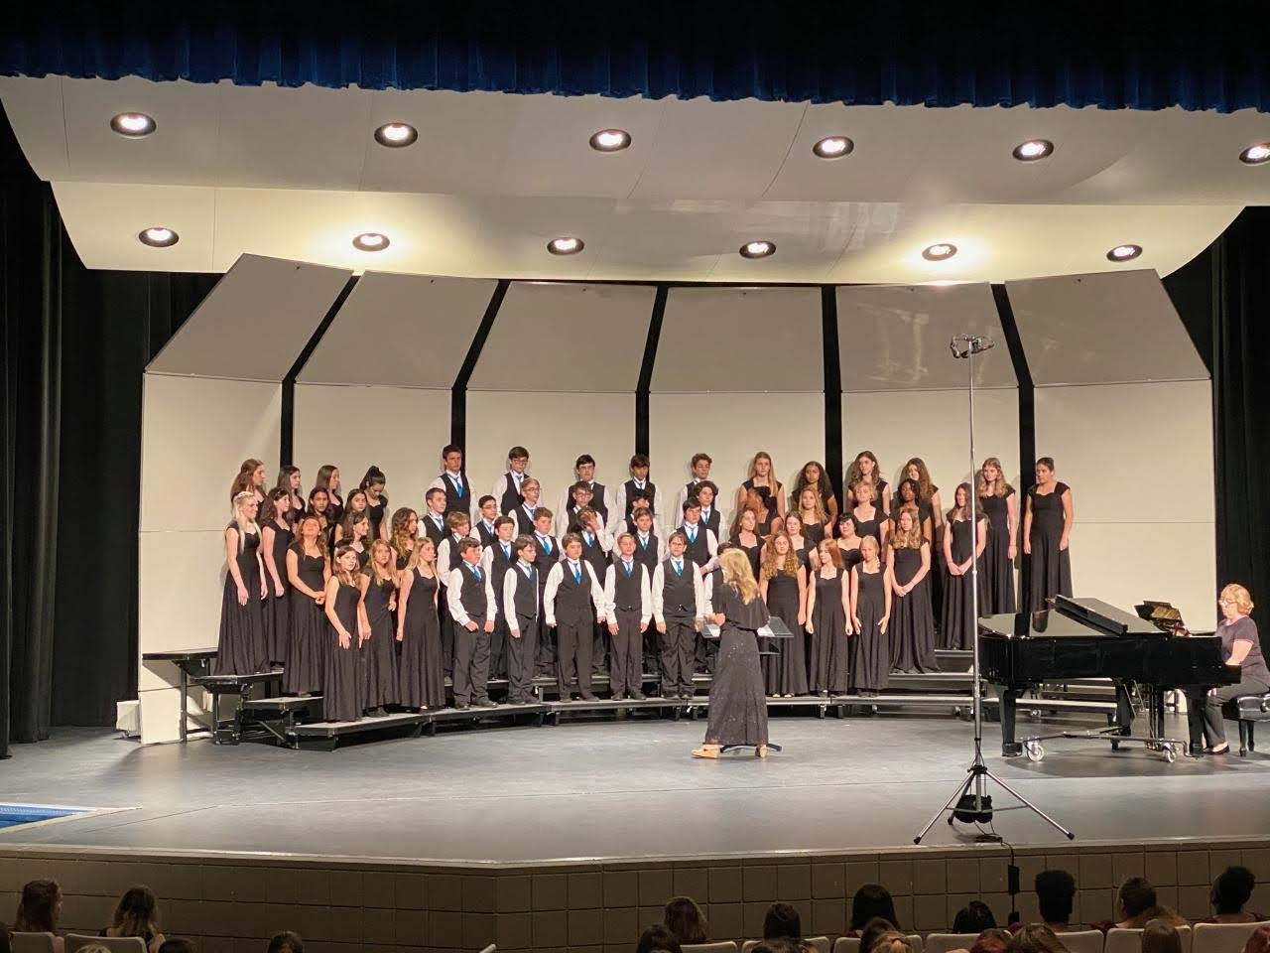
chorus
Numerous opportunities for performances
Honor choirs - All County, All State
Superior Ratings at MPA
Learn musicianship skills - reading music
Great place to make music with friends
Interpersonal skills
Students who take music classes tend to test better, and work in teams better, colleges look for those classes when students are applying.

Slide 19
ATHLETICS
Basketball
Track and Field
Soccer
Volleyball
Cheerleading
Mascot Team

Slide 20
Hear from our scotties
Open House Video

Slide 21
THANK YOU FOR ATTENDING Feel free to go on a self-guided tour
Visit the following rooms:
Math- Room 210
ELA- Room 224
Science- Room 328
History- Room 327
Art Room- 413
Cafeteria
Media Center

