Slide 1


8th Grade Transition to High School
Viera High School
Madeline Contreras, MA, School Counselor

Slide 2
Guidance Introduction
Academies 9-12th Mrs. Angland
9th Grade Mr. Sentner
A - Da Mrs. Hollingsworth
De - Lan Mrs. Contreras
Lar - Rol Mrs. Guanu
Rom – Z Ms. Formoso
Social Worker Ms. Becerra-Williams
College & Career Mrs. Draves

Slide 3
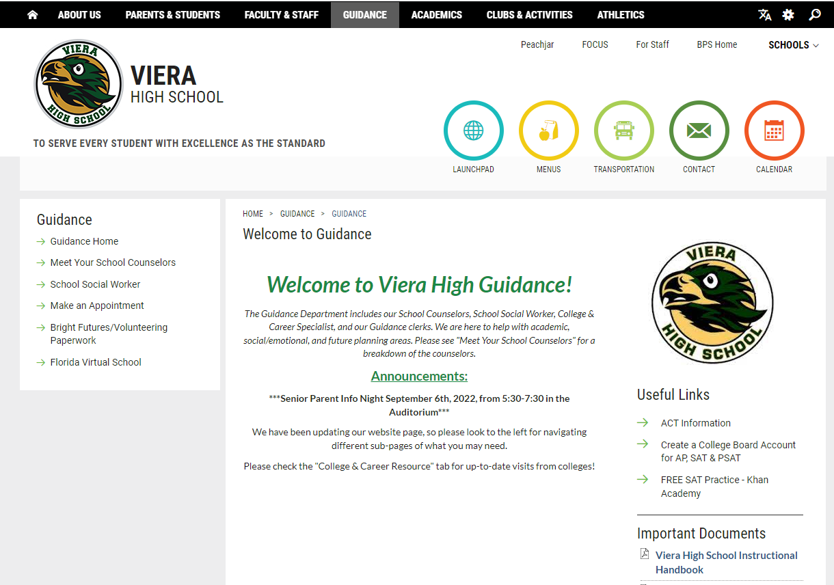

Slide 4
Counselor Visit Dates
DeLaura Middle School March 9
McNair Middle School March 9
Johnson Middle School March
Kennedy Middle School March
Viera Charter School March 6
Pinecrest Academy March

Slide 5
Agenda
Guidance Information
Graduation Requirements, EOC Courses & Registration Forms
Core Class Choices
VHS Extracurriculars
VHS Academies
Elective Class Choices

Slide 6
Graduation Requirements, EOC Courses & Registration Forms

Slide 7
Credit Requirements for High School Graduation (26 credits)
4 credits English
4 credits Math – must include Algebra 1 & Geometry
3 or 4 Science – Biology, a physical science & an “equally rigorous” science
3 or 4 Social Studies - World History, US History, US Government, Economics
½ credit Career Research and Decision Making
1 credit Physical Education (HOPE)
1 credit Fine or Performing Arts
8 ½ elective credits
**Foreign language is not required for high school graduation. However, state universities and most scholarships require two years of the same foreign language.

Slide 8
Additional Graduation Requirements
Minimum Unweighted GPA
  2.0
Testing
  Passing score on Grade 10 PM 3 FAST ELA OR SAT/ACT concordant score
  Passing score on Algebra 1 EOC OR SAT/ACT/PSAT concordant score
Online course
  If course is ONLY one semester, it counts. (i.e., Driver’s Education, Career Research, etc.)
  If course has 2 semesters or segments, student must complete both semesters to count. (i.e., HOPE, Digital Informational Technology, etc.)
  Cannot be a credit retrieval class for one a student failed
Rigorous Coursework Requirement
  3 credits in honors, AP, or Dual Enrollment courses
  OR
  3 credits in a sequential Career & Technical Program

Slide 9

End of Course (EOC) Exams
All EOC exams are 30% of your final grade in that class.
4 EOC Full-Year Classes:
  Algebra 1 (Must PASS for graduation!)
  Geometry
  Biology
  US History
Only classes that are Full Year that average semester 1 and semester 2 grades along with the EOC to make a year-long grade.

Slide 10
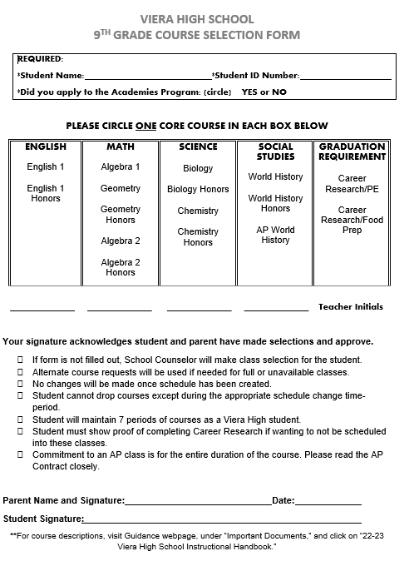
Course Selection Form

Slide 11
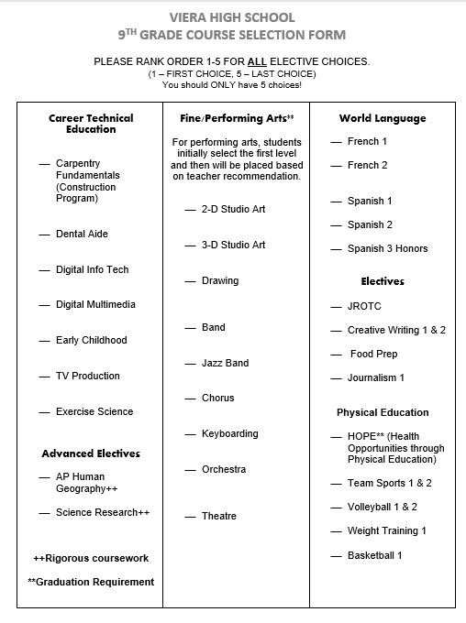
Course Selection Form

Slide 12
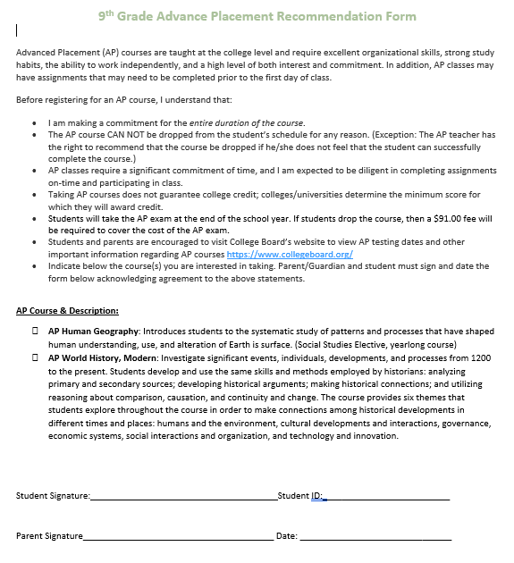
AP Contract for AP Classes

Slide 13
9th Grade Core Class Choices Based on pre-requisites, teacher recommendation, and student/parent input

Slide 14
9th Grade Core Class Choices
English
Regular
Honors
Math
Algebra 1
Geometry (must have taken Alg 1 in 8th grade)
Regular or Honors
Algebra 2 (must have taken Alg 1 in 7th and Geometry in 8th)
Regular or Honors
Science
Biology
Regular or Honors
Chemistry (must have taken Biology in 8th grade)
Regular or Honors

Slide 15
9th Grade Core Class Choices
Social Studies
World History
Career Research
Required for graduation
Regular
Honors
AP
AP Human Geography as an elective
All 9th graders will be enrolled
Choose a semester course to go along with it

Slide 16
9th Grade Elective Class Choices
Choose your freshmen electives wisely and consider what you are interested in to plan for the next 4 years!

Slide 17
9th Grade Elective Class Choices
Foreign Language
Spanish 1
Fine Arts
2-D Art, 3-D Art, Drawing
Career & Technical (CTE)
Dental Aide or Exercise Science
Spanish 2 (must have taken Spanish 1 in 8th grade)
Spanish 3 (must have taken Spanish 1 and 2 already)
French 1
Chorus
Band, Jazz Band, Keyboarding, Orchestra
Theater
Journalism
Digital Media
Web Programming (must have Algebra 2 at the same time)
Early Childhood Education
ROTC
TV Production Tech
French 2 (must have taken French 1 in 8th grade)
Carpentry Frameworks

Slide 18
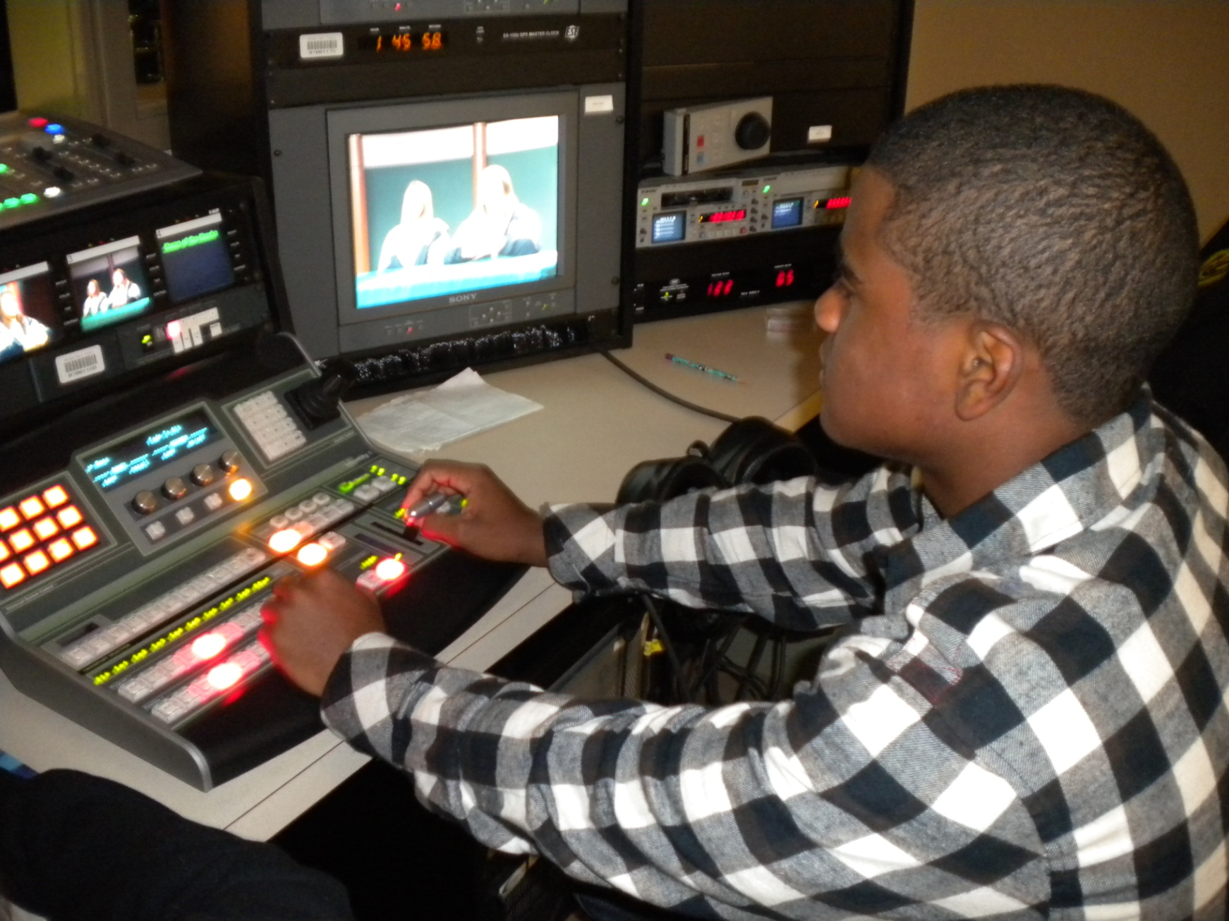
Digital Media or Programming
Two computer based CTE classes
Digital Media
  Adobe Software
  Could be certified by the end in this Adobe Software
Web Programming
  Learn computing languages, such as HTML/CSA & App Development HTMLs

Slide 19
Early Childhood Education
A great program for any student who is interested in the field of helping – teacher, counselor, etc.
Students will be working with VPK 4-year-olds in the classroom
Students will learn how to write lesson plans and implement them
Students will assist the Early Childhood Education teacher

Slide 20
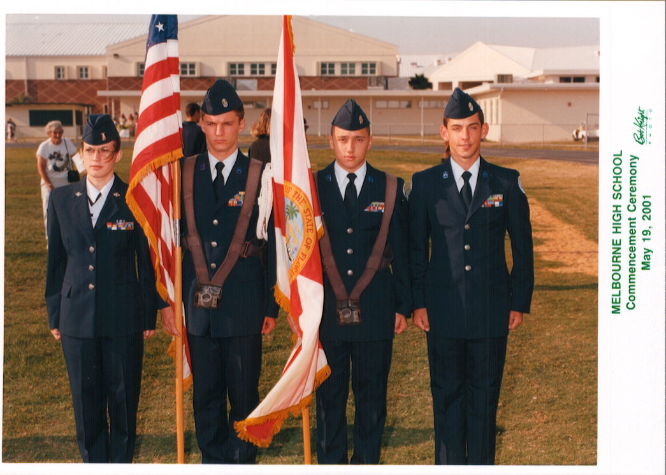
JROTC Program
Strong program that helps students learn team-building and leadership skills
Well-respected elective choice

Slide 21
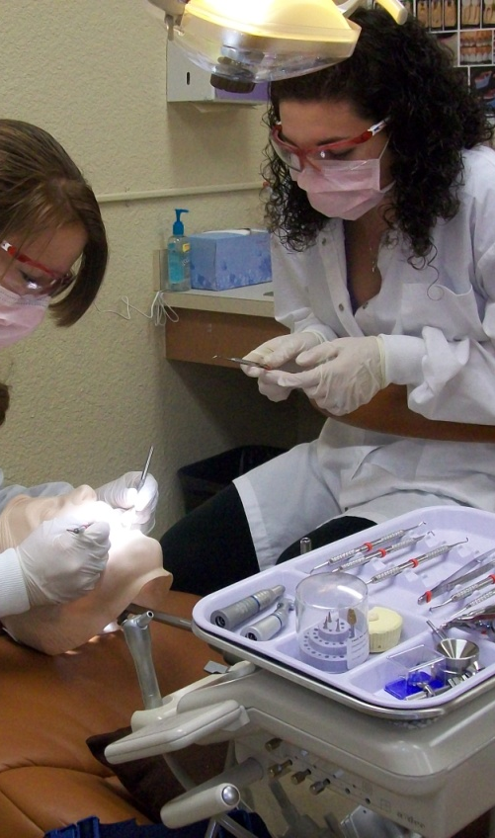
Dental Aide or
Exercise Science
Students interested in the medical field
Takes the same first two courses:
  Health Science Anatomy & Physiology
  Health Science Foundations
Dental Aide 3
  Focuses on dental hygienist or dentist
Exercise Science 3
  Focuses on athletic trainer or physical therapist

Slide 22
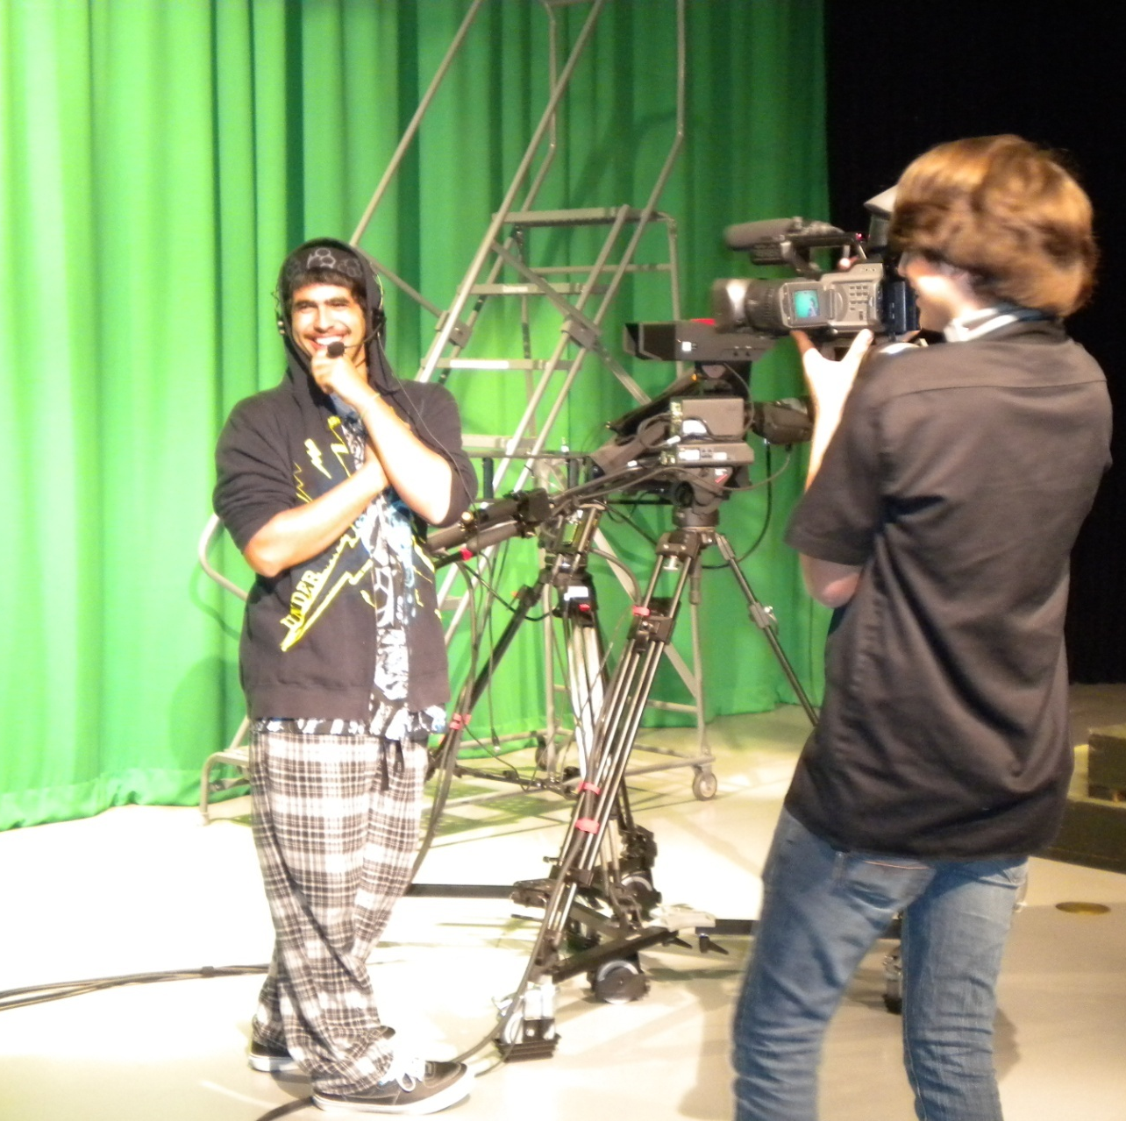
TV Production Tech
Students who do the weekly news videos
Will involved either being in front of the camera or behind the camera to learn how to film and edit

Slide 23

NEW: Carpentry Frameworks

Slide 24
9th Grade Elective Class Choices
Physical Education
Basketball
Other Electives
Principles of Food Prep
Team Sports
Volleyball
Weight Training
Science Research (involves Science Fair projects)
HOPE (required for graduation, usually taken in 10th grade)
Creative Writing 1 & 2

Slide 25
Looking Ahead to 10th-12th Grades
9th grade year matters! Your grades determine your eligibility for programs in 10th through 12th grade.
Could be eligible for:
Advanced Placement classes
EFSC Early College Program
Part-time dual enrollment
EFSC Early Admission for Senior Year

Slide 26
VHS Academies
Academy of Business and Finance
Academy of Communication, Art, and Design (ACAD)

Slide 27
About the Academies
Classes in the cohort:
  English Honors
  History Honors
  CTE Specific Courses
Small community within a large school (9th-12th cohort)
Outside classroom opportunities
Director: Kat Armstrong
School Counselor: Marianna Angland

Slide 28
Academy of Business and Finance
Applications are open to out-of-zone students
Allows students to acquire the key Innovation Skills of Critical Thinking, Communication, Collaboration and Creativity with exposure to learning outcomes beyond classroom.
Electives:
  Business Communication & Technology
  Personal Finance
  Accounting Applications I
  Marketing Essentials
Certification opportunities in each CTE course

Slide 29
Academy of Art, Communication and Design
Must be zoned for Viera
To expand the interest in digital media and working collaboratively with their peers, teachers, and community leaders to expand outside the classroom.
Electives:
  Digital Media I: Photoshop & Illustrator
  Web Design: Dreamweaver and Animate
  Video Design: Premiere Pro & After Effects
  Senior Project

Slide 30
VHS Extracurriculars

Slide 31
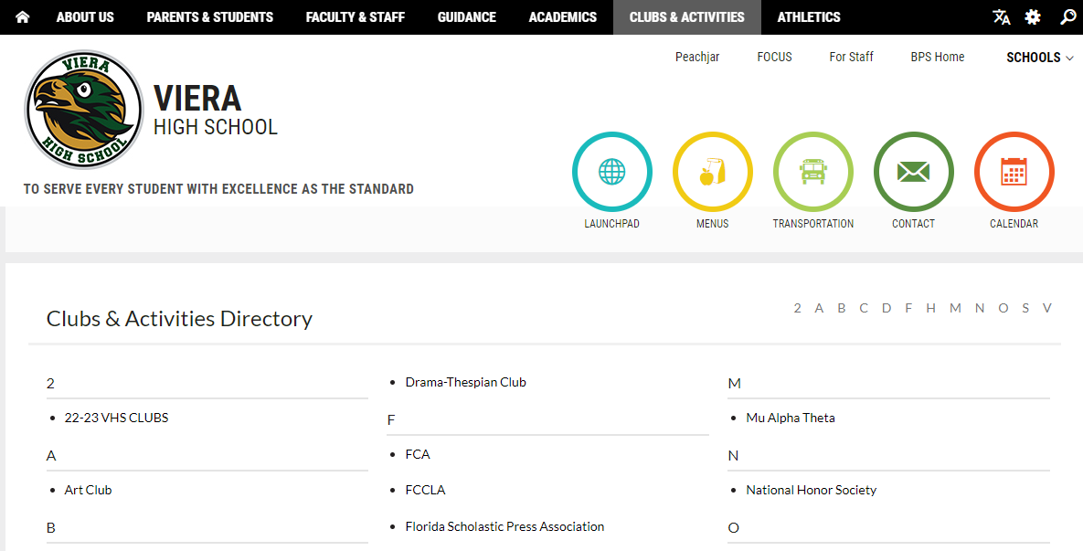
VHS Clubs & Activities

Slide 32
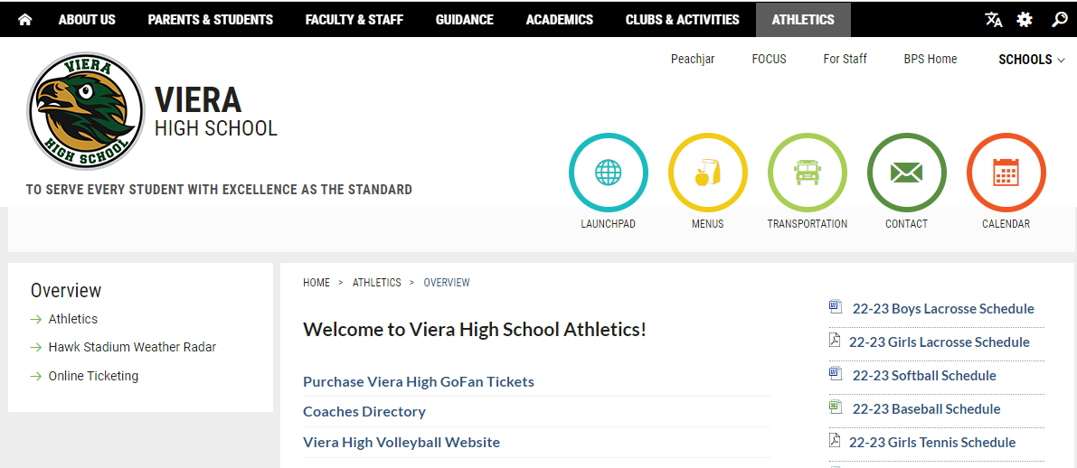
VHS Athletics

Slide 33
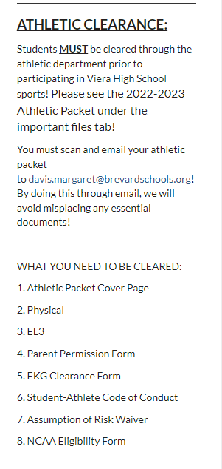
VHS Athletics
Please scroll down on the Athletics Page to find this info on Athletic clearance!
Maggie Davis is the Athletic Director.

Slide 34
Welcome to Viera High School! We can’t wait to meet you all!

