Slide 1
COMPUTER SCIENCE ACADEMY

Slide 2
NEW COMPUTER SCIENCE ACADEMY
Cohort of students to take Coding, Foundations of Programming, and Algebra I Honors
Industry Certifications
Feeds directly into Satellite High School CTE
Students out of area will apply through the EPO process.
Became a Tech Savvy Student!
APPLY through EPO process- January 15 – February 23

Slide 3
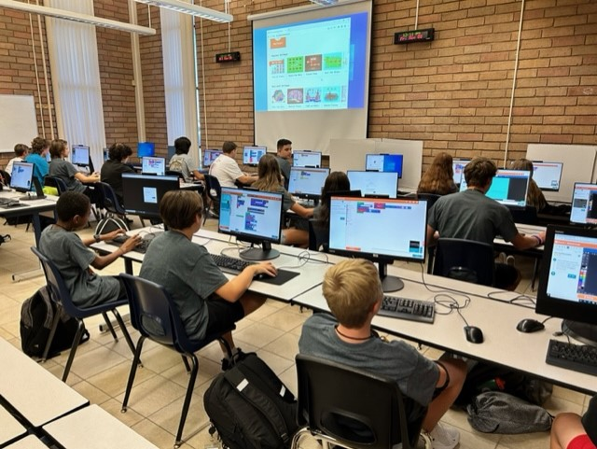
CSC - Coding Explorers
This CSC course is designed to introduce students to the exciting world of computer science coding.
CSC 1 - consist
Introduction to Computer Science
Build Logical Thinking
Cybersecurity
Introduction to basic Python Syntax (Part 1)
You’ll be amazed at what you can achieve!

Slide 4
Computer Science Coding (CSC) & Computer Science Innovative Program (CSC-IP)
CSC 1- Explorers is a semester-long course designed to expose students to the fundamentals of coding in an interactive environment. Code Explorers welcome students from all levels of education eager to explore the world of computer science (No prior knowledge or experience is required).
CSC 2 & IP- Advanced Program (Earn High School Credit!)***is a year-long course designed to equip students with the knowledge, skills, and experience needed for future success in technology-driven fields. The advanced program exposes students to programming in a captivating manner while building problem -solving skills and applying thinking methods used by programmers.
***CSC * IP - a prerequisite is Algebra honors or higher to ensure solid foundation. Application is required for the program.
Students will complete an application on our website for the computer science program.
APPLY through EPO process- January 15 – February 23

Slide 5
EPO for Computer Program
EPO- Education Program Option

Slide 6
Apply for the Computer Science Program
Do not reside in our boundary
Need to apply through BPS ELO
Deadline Feb 23, 2024
Interested in the
Computer Science Program
Apply through the BPS
EPO process (no need to do ELO if submitting an EPO for this program)
Reside in our boundary
Do not need to apply
Interested in the
Computer Science Program
Discuss with school counselor
to enroll

Slide 7
EPO PROCESS
App
Application date
EPO
January 15 –
February 23, 2024
Waitlist opens in April
If you live outside the attendance boundary
&
Want to apply for the Computer Science Academy only
https://www.brevardschools.org/Page/2381

Slide 8
cONTACT INFORMATION
JOSEFINA MELENDEZ
ASSISTANT PRINCIPAL OF CURRICULUM AND INSTRUCTION
Melendez.Josefina@brevardschools.org
321-773-7581, x31615

