Slide 1
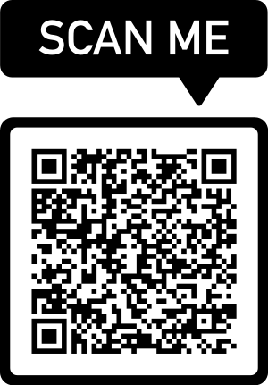
Welcome to the 2023 Parent and Cheerleader Information Meeting
Get a packet from the front table | Sign-up for Remind by texting @24egcheer to 81010
Sign-in by scanning the QR code | Cheerleaders complete your try-out questionnaire

Slide 2
Vision/Mission
Build school and community spirit through leadership, participation, creativity, athleticism, accountability, encouragement, fun, cheer, and positivity as a family unit that fosters personal, team, school, and community growth .

Slide 3
Eligibility
2.0 minimum GPA
2. Physical Packet turned in by
February 27th obtained from Todd Oas

Slide 4
Tryouts
Monday, February 27th – Friday March 3rd
Monday-Thursday: 4-6 pm
Friday: Tryout groups start at 3 pm
Friday: Current Varsity Junior interviews for Captain positions.
Wear athletic attire with hair up (no jewelry, acrylic or long nails, nail polish)

Slide 5
Cheerleading = First Priority (after academics)

Slide 6
Camp is Mandatory! 7/17 - 7/19
Wyndham Orlando Resort
International Drive

Slide 7
Best Way to Reduce Individual Costs

Slide 8
MONEY, MONEY, MONEY
Returner: Approximately 750 + tax
New EG Cheerleader: Approximately 1550 + tax
It is imperative that payments are made in a timely manner
Fundraising is MANDATORY for all!
Fundraisers, aside from sponsors and crowdfunding, are to meet the needs of the squad.

Slide 9
Non-Negotiables
Safety
Respect
Drama
Attendance

Slide 10
Expectations
Responsibility
Communication
Parent Support

Slide 11
Corrective Actions and Incentives
The coach can assign corrective actions that fit the behavior at their discretion.
D/F list study hall will be mandatory.
Please be sure you follow school rules and know attendance and other dismissal policies.

Slide 12
2023-2024 Squad
Squads will be posted on the EGHS cheerleading webpage by Saturday, March 11th. The first MANDATORY team meeting date is March 21st Varsity 4-5:30 pm and JV 4:30 – 5:30 pm. Parents MUST attend from 5:00-5:30 pm.

Slide 13
What else??
Make sure to complete all tasks, use your checklist to help.
2. Six teacher recommendations are required
3. Optional February Conditioning

Slide 14
Any Questions??

