Slide 1
EDGEWOOD
JR/SR HIGH SCHOOL
CLASS OF 2024

Slide 2
Rising Senior Night Agenda
Senior Photos – Mr. Vickers
Senior Year Events – Ms. Noah
Graduation- Mr. Stewart
Diploma of Distinction Review – School Counselors
College Planning / Financial Aid – School Counselors
Project Graduation
Senior Projects – Mr. Cilsick, Ms. Noah & Ms. Snyder
Resources

Slide 3
SENIOR PORTRAITS yEARBOOKS
Notes:
Vickers

Slide 4
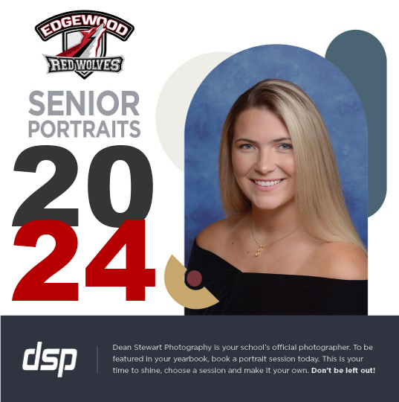
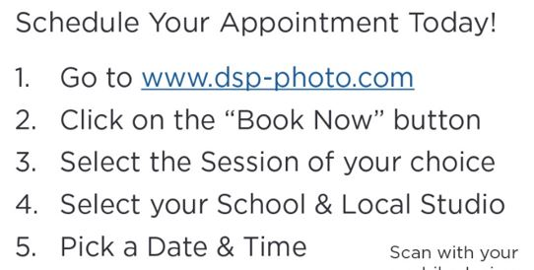
DEADLINE: November 4, 2023

Slide 5
DEADLINE
1/21/2024
Notes:
Vickers

Slide 6
SENIOR YEAR EVENTS Senior Class Sponsor – Ms. Noah
Summer 2023
Senior Wall Creation
Aug. 2023
Senior Parking Space Painting and Handprints on Senior Wall
September 2023
Color Run
Oct. 2023
Senior Panoramic Photo
Mar. 2023
Apr. 2024
Senior Boards
April 26, 2024
Prom
April 2024 (Tentative)
Grad Bash
April 2024 (Tentative)
Spirit Week TBD (September/ October)
May
Senior Breakfast
Wednesday, May 22, 2024
May Continued
Graduation Practice
Thursday, May 23, 2024 (Morning of Graduation)
Graduation – Thursday, May 23, 2024

Slide 7
Stay Informed
Remind 101
Google Classroom

Slide 8
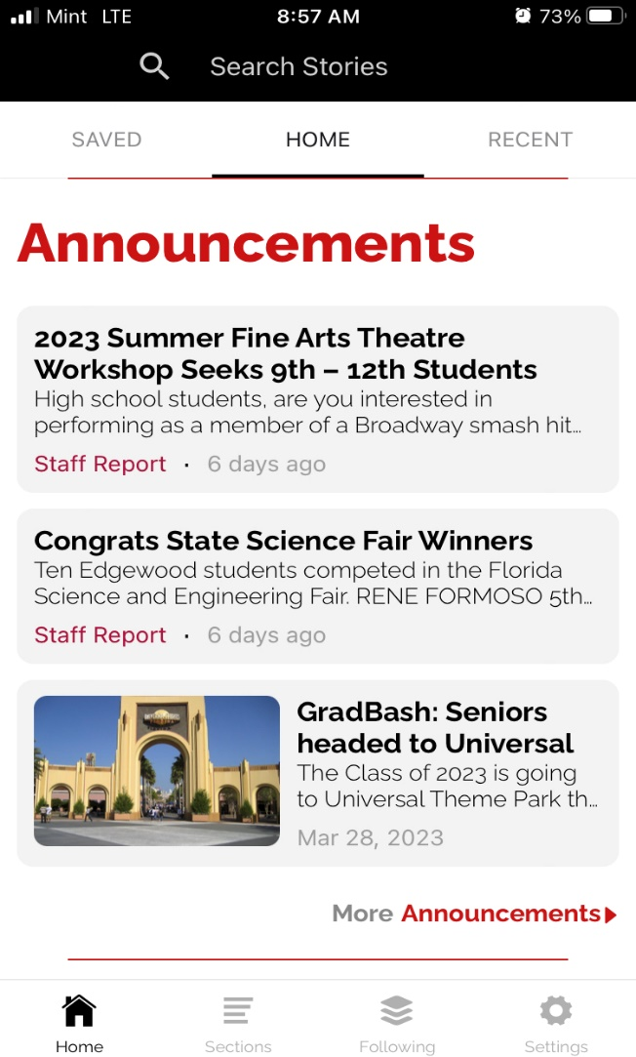

Slide 10
Graduation Events 2024

Slide 11
Senior Class officers
Selected Students
Parents
Guidance
Administration
Mr. Stewart
Graduation Committee

Slide 12
Parent Sponsored Events
Baccalaureate – Non-denominational service usually held on a Sunday prior to the graduation ceremony. It is a voluntary event that is not school sponsored.
Senior Breakfast – Wednesday, May 22, 2024
Project Graduation – All night party held on graduation night designed to be a safe, drug and alcohol-free celebration. It is organized and sponsored by parents.

Slide 13
Graduation 2024
Thursday,
May 23, 2024
Maxwell King Center
6PM
This Photo by Unknown Author is licensed under CC BY-NC-ND

Slide 14
Project Graduation 2024

Slide 15
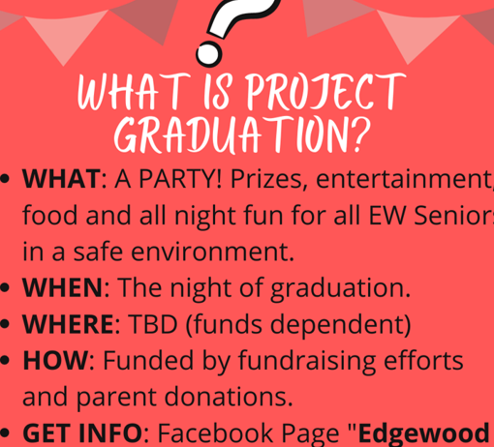
Project Graduation

Slide 17
Senior Project:
Mr. Cilsick,
Ms. Noah
&
Ms. Snyder
Senior Project is part of the contract signed by each student and their parents for attendance at Edgewood. It is required to graduate with a Diploma of Distinction.
Notes:
Noah

Slide 18
Senior Project Three Paths
Leadership Class– Ms. Snyder (Communications Methodology)
Science Research – Mr. Cilsick
AP Capstone–Ms. Noah

Slide 19
Choose a Senior Project Goal
Educate
Educate Others
Solve
Solve a Community Problem
Create
Create a Useful Product or Performance
Influence
Influence Public Policy
Help
Help an Existing Organization

Slide 20
Senior Projects, Senior Year
Projects may not be completed during the summer prior to your senior year. Instead, you can
Research projects of interest
Develop a list of possible topics
Contact potential advisors or create a list of possible advisors
Start those college essays ☺

Slide 21
Four Ps Slightly Different Time Frame for Each Path
Research Paper
Product
Portfolio
PowerPoint Presentation

Slide 22
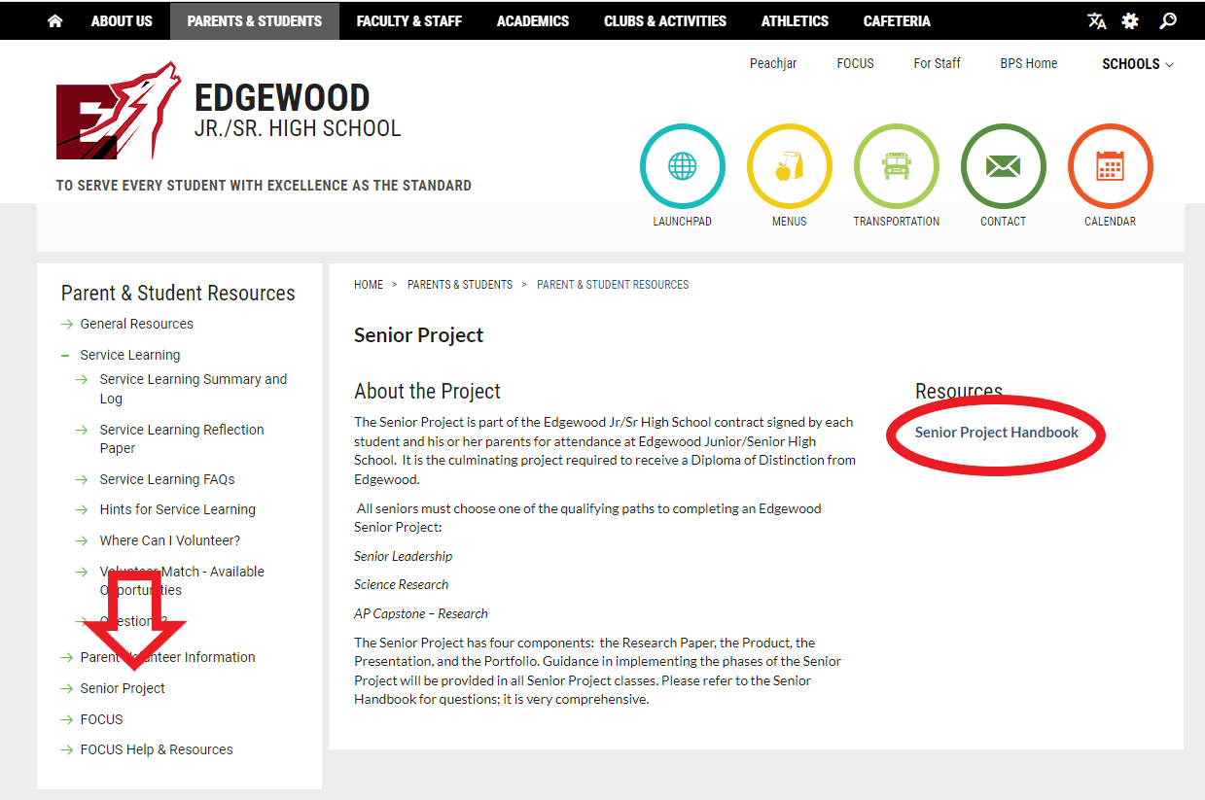
Senior Project
Where to find the Senior Project Handbook?

Slide 23
Diploma of Distinction
&
College Preparation

Slide 24
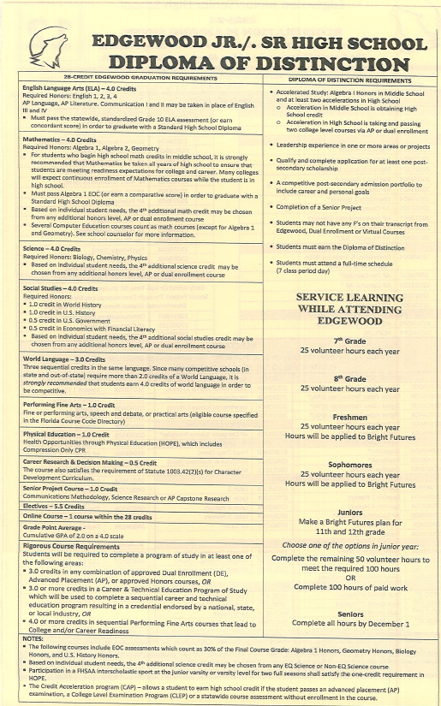
REVIEW
EDGEWOOD GRADUATION REQUIREMENTS
Notes:
Cooper

Slide 25
College Application Process
Official Transcripts – Transcript request link is in the Google Classroom / SSAR
Application / Application Fee (Online) Avg. $25 – 100.
Essay – (Most Important)
Resume (Honors, Awards, Activities, Leadership, CS)
Letters of Recommendation
Early Action v/s Early Decision (Binding & 1 school)
DEADLINES
Official Test Scores – ACT / SAT / AP (These must be sent from ACT.org or Collegeboard to be “official”).
Notes:
Cooper

Slide 26
College Visits
3 college visits per year during 11th and 12th grade
Must return with something from the college to show you attended the college visit
Travel days do not count as excused absences. Only the day of the college visit will be excused.
Notes:
Taylor

Slide 27
Online Application Portals
Common Application http://www.commonapp.org/
Coalition for Access http://www.coalitionforcollegeaccess.org/
SSAR / SPARK
(Self-Report)
Online application portals usually open late summer or fall of senior year.
Please make sure you are not applying under the class of 2023
Notes:
Taylor

Slide 28
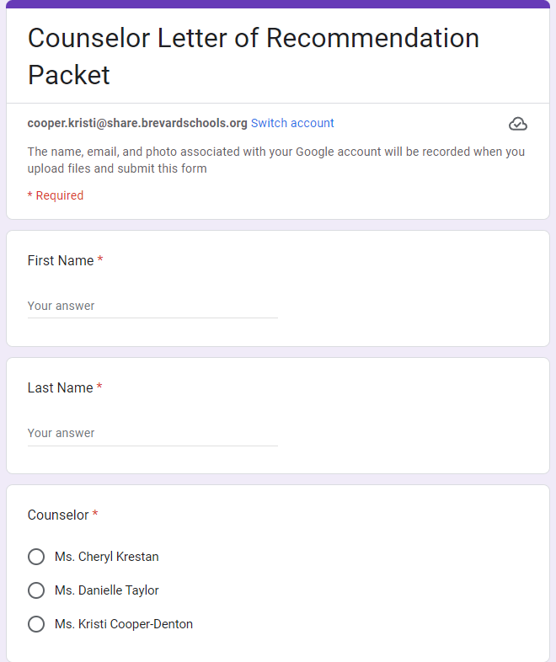
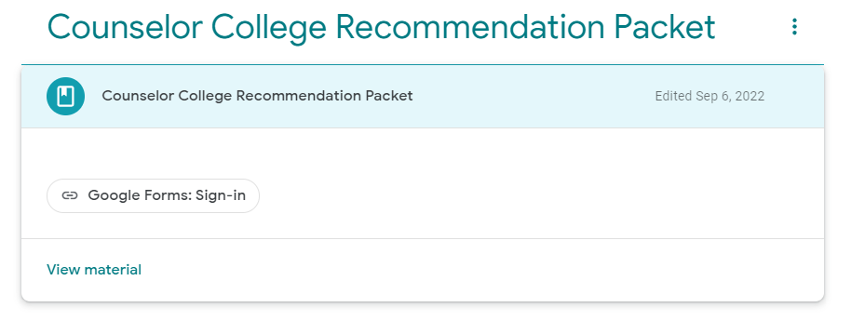
Edgewood Counselor Recommendation Packet
Notes:
Taylor

Slide 29
October 1 Deadline
College Applications
Bright Futures
Legislative Updates
Notes:
Taylor

Slide 30
Scholarships and Financial Aid
FAFSA
Notes:
Cofer

Slide 31
BRIGHT FUTURES
Apply October 1, 2023
Four Categories – Current Requirements
Florida Academic Scholarship
Florida Medallion Scholarship
Gold Seal
Gold Seal CAPE Scholars
Bright Futures requirements change from year to year so visit the Bright Futures website for the most updated information. https://www.floridastudentfinancialaidsg.org/SAPBFMAIN/SAPBFMAIN
Visit Florida Shines “Pay for College” for student evaluation
https://www.floridashines.org/go-to-college/pay-for-college
Notes:
Cofer

Slide 32
Types of Financial Aid
MERIT BASED –
Music, Sports, Academic
Bright Futures – www.floridastudentfinancialaid.org
NEED BASED –
FAFSA – Opens December 2023
ATHLETIC
Scholarships
MILITARY
ROTC /Academies
Notes:
Cofer

Slide 33
Resources
Notes:
Krestan

Slide 34
SUS Matrix

Slide 35
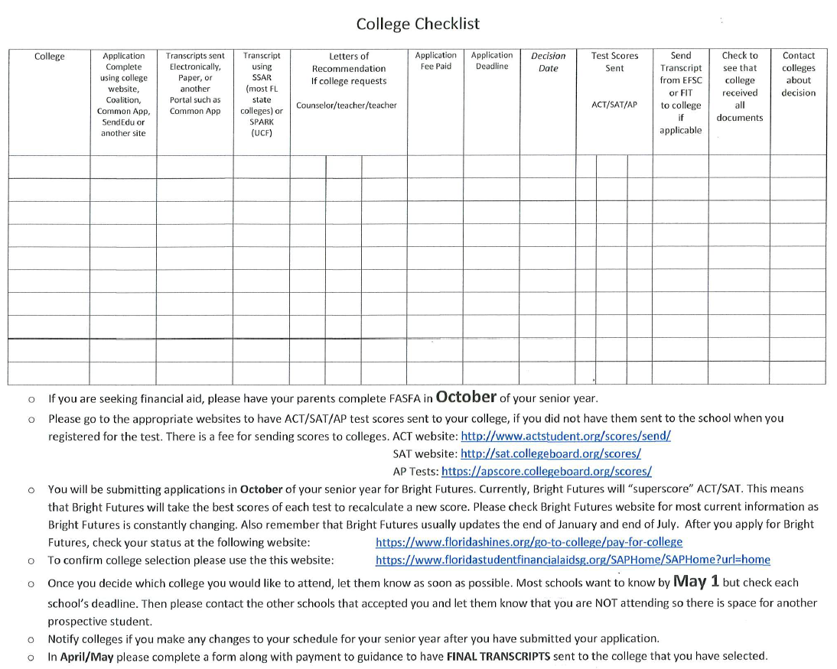
College Checklist

Slide 36
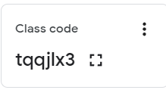
Resources – Class of 2024 Google Classroom
https://classroom.google.com/c/NzMwODQ3Nzg2MjVa?cjc=tqqjlx3

Slide 37
Class of 2024
You are almost there!!
This Photo by Unknown Author is licensed under CC BY-SA

