Slide 1
Edgewood Senior Parent Night
Welcome Class of 2024
Notes:
Ingratta

Slide 2
Updates from Administration
Ms. Ingratta
Mr. Stewart
Notes:
Ingratta/Stewart

Slide 3
Graduation
Thursday
May 23, 2024
6:00 PM
King Center Melbourne
This Photo by Unknown Author is licensed under CC BY-NC-ND
Notes:
Ingratta/Stewart

Slide 4
Senior Boards – April 19, 2024
Tangible projects due Thursday, April 11th at 3:30 p.m.
Arrival – 12:20-12:30 – Attendance in Cafeteria – Boards in Gymnasium
Dress – Business Professional
Expectations
All attend and participate
Pass 4 components and Senior Project class
Present the entire time (12:20 p.m. to approximately 4:30 p.m.)

Slide 5
Project Graduation
Christine Barnett
Notes:
Project Graduation or Ingratta /stewart

Slide 6
Project Graduation
What is Project Graduation?
When and Where? May 23, 2024 from 10 pm-5 am at Sky Zone,
DJ, prizes, games, tarot cards, and more!
Each student needs to complete the contract! Preferably by October :)
Visit www.edgewoodprojectgraduation.com for all information!

Slide 7
Donation / Fundraising
Family sponsorships, we are asking $50 per family, if you donate by October, you will get a free EDGEWOOD SENIOR 2024 yard sign.
Donations help to cover cost of event, prizes, t-shirts, food, etc.
Business sponsorships-ask at work, friends, or your family- see information on different donation levels
Discount Cards- BIG PUSH. Try to sell 5, then keep one for free!
Easiest and biggest fundraiser! All donations are tax-deductible! We are a 501(c)3 separate from Edgewood and Brevard Public Schools.

Slide 8
Fundraising
BINGO February 2. 2024
CRAFT FAIR Dec. 9, 2023
Need help to organize/plan
Ideas – Bake Sale, Table Decorating, Silent Auction, Vendors
Volunteers Needed
Volunteers to ask for Business Donations
Please attend!
Vendors and Food Trucks
Volunteers needed to ask businesses for advertising (pass out flyers)
Volunteers needed day of the event

Slide 9
Fundraising
Second Semester
Volunteers Needed
$5 per 50-Word Message
Buy as Many as you Like
Booklet or Flyer Format Given at Project Graduation or Senior Breakfast
Hope is that all Students Receive at Least One
Words
of
Wisdom

Slide 10
Senior Information
Senior Class Sponsor
Ms. Noah
Notes:
Ms. Noah will present a few things pertaining to seniors and the senior calendar.

Slide 11
SENIOR YEAR EVENTS Ms. Noah
Senior Wall Creation, September 22, 2023
Senior Parking Space Painting, August 26th Spots will be assigned via a lottery that will be held immediately after school on Friday, August 25th, 2023 in Ms. Allred’s room
Color Run- September 22, 2023
Spirit Week- Mon-Fri Sept. 25-Sept. 29
Jostens Meeting Cap & Gown,
October
13, 2023
Senor Panoramic Photo, February 19, 2024
Prom – April 20, 2024
Senior Boards April 19, 2024
Grad Bash – April 12, 2024
Senior Breakfast, May 21, 2024
Graduation Practice – May 21st at 10>00 AM at Edgewood
Graduation – May 23, 6 PM
Notes:
Noah

Slide 12
Senior Information
Senior Pictures, Yearbook etc.
Mr. Vickers
Notes:
Ms. Noah will present a few things pertaining to seniors and the senior calendar.

Slide 13
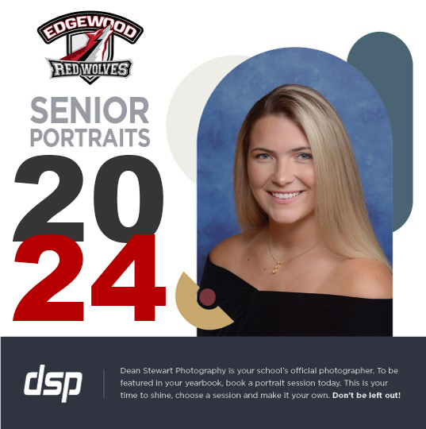
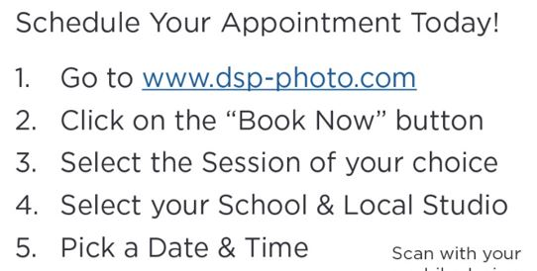
DEADLINE: November 4, 2023

Slide 14
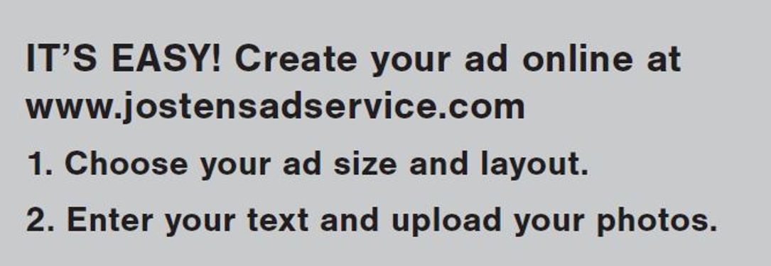
DEADLINE
1/21/2024
Notes:
Vickers

Slide 15
Senior Portraits
Dean Stewart Photography
dsp-photo.com
321-952-9876
Notes:
Ms. Noah will present a few things pertaining to seniors and the senior calendar.

Slide 16
Questions about pictures or yearbooks?
vickers.patrick@brevardschools.org
Notes:
Ms. Noah will present a few things pertaining to seniors and the senior calendar.

Slide 17
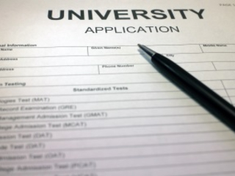
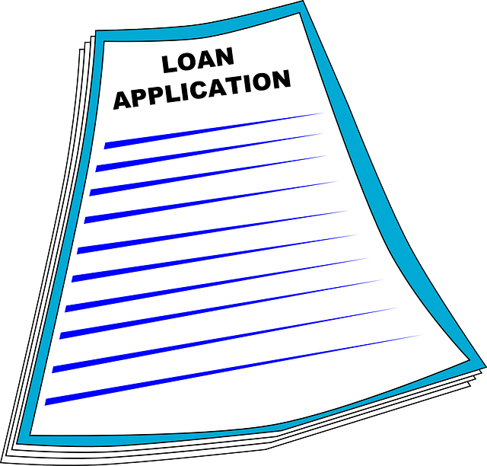
College Planning 101
Notes:
Cooper

Slide 18
Who's Who in the Guidance Department
School Counselors
Ms. Cheryl Krestan (A-H)
Ms. Danielle Taylor (I-M)
Ms. Kristi Cooper-Denton (N-Z)
College & Career Specialist
Ms. Elizabeth Cofer
Testing Coordinator
Ms. Amber Hubble
Guidance Clerk
Ms. Teresa Morrow
Guidance Clerk
Ms. Megan Drever
Notes:
Cooper

Slide 19
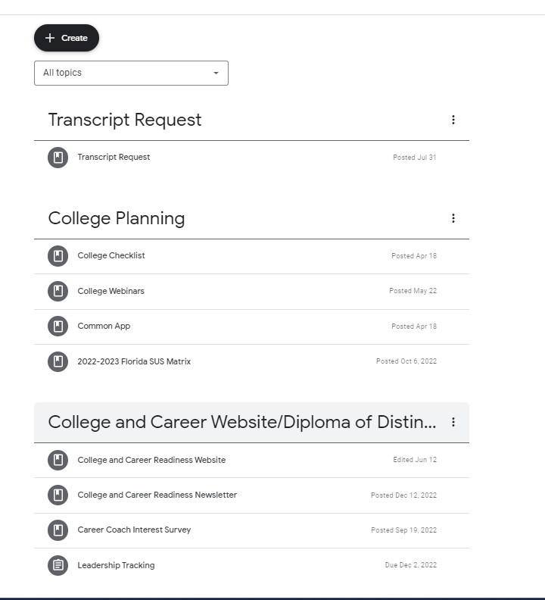
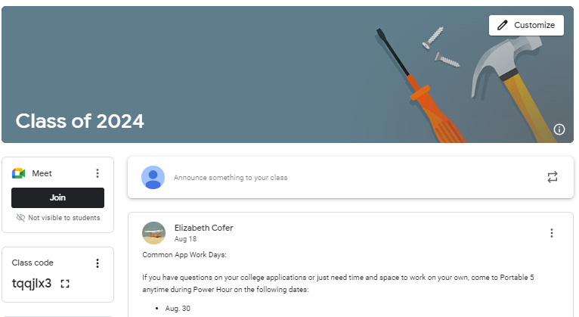
Class of 2024 Google Classroom

Slide 20
College Planning 101
Transcript
Counselor Letter of Recommendation Packet / Letter of Recommendation
Applications
Early Admission / Early Decision
Essay
Resume
Dates & Deadlines
Notes:
Cooper

Slide 21
Transcripts
Seniors received a copy of their transcript

Slide 22
Transcript Request Forms
Please Allow 48 Hours for Processing
Notes:
Cooper

Slide 23
Transcript Request Link
https://docs.google.com/forms/d/e/1FAIpQLSfbszfZ2s2eKZVI1mJoGbdyQf0gdtU3kcQl0sDHbetevfNVaw/viewform

Slide 24
SSAR (Quarters)/ SPARK(Block) COVID Year 2020-2021

Slide 25
Counselor Letter of Recommendation Packet
Google Classroom

Slide 26
College Applications
Class of 2024
Notes:
Krestan

Slide 27
Early Decision / Early Action
Early Decision (Binding)
Early Action (Nonbinding)
Apply early (usually in November) to first-choice college.
Receive an admission (usually by December).
Agree to attend the college if accepted and offered a financial aid package that is considered adequate by the family.
Apply to only one college early decision.
Apply to other colleges under regular admission plans.
Withdraw all other applications if accepted by ED.
Send a nonrefundable deposit well in advance of May 1.
Apply early.
Receive an admission decision early (usually in January or February).
Consider acceptance offer but do not have to commit or withdraw all other applications.
Apply regular decision to other colleges.
Give college a decision no later than the May 1.
Notes:
Krestan

Slide 28
Applications
Review College Website for Application Instructions & Application Links
Notes:
Krestan

Slide 29
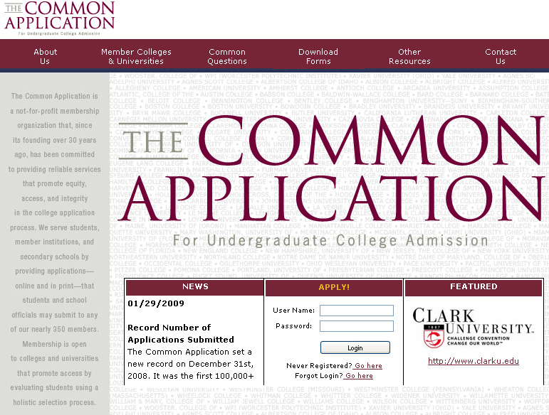
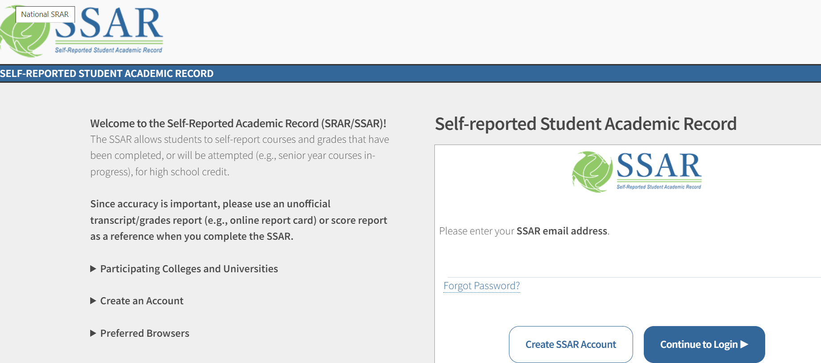
Common App
http://www.commonapp.org/
SSAR
https://ssar.selfreportedtranscript.com/login.aspx

Slide 30
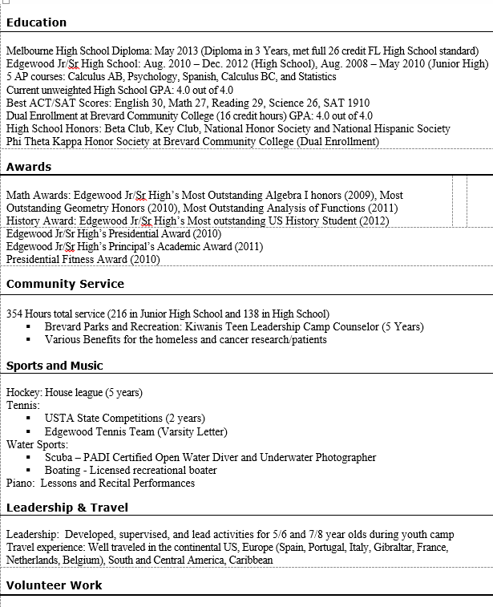
Resume
Honors
Awards
Activities
Leadership
Community Service
Employment
Notes:
Krestan

Slide 31
Essay
US News and World Report
Infographic: What Makes a Strong College Essay
Discover why these two real college essays got students in the door of Johns Hopkins University.
http://www.usnews.com/education/best-colleges/articles/2015/09/09/infographic-what-makes-a-strong-college-essayEssay
Notes:
Krestan

Slide 32
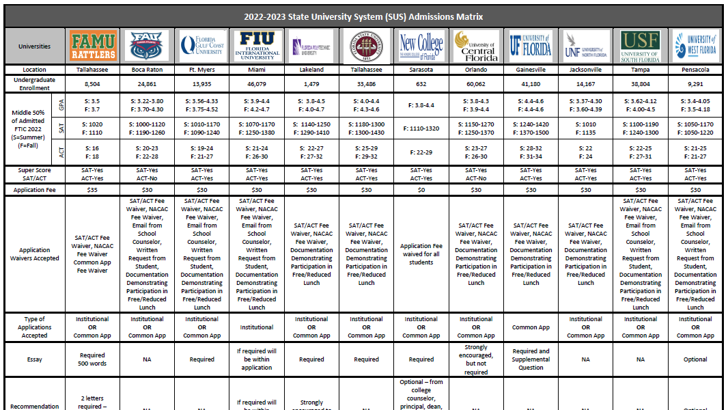
State University 2022-2023
SUS Matrix
Notes:
What schools have you thought about attending? Find them on this sheet. Compare your GPA with the listed GPA. Compare your ACT Composite score with the scores listed.

Slide 33
NCAA
College Athletes

Slide 34
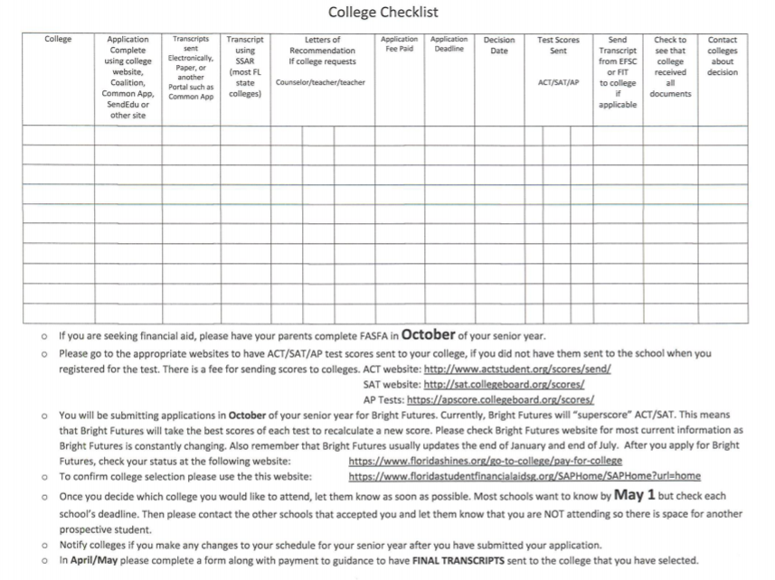
College Check Sheet
Notes:
Krestan

Slide 35
Florida Bright Futures
In order for ACT / SAT scores to be sent to the repository, students must request their official single sitting test scores be sent to at least one of (12) Florida’s state public universities.
Notes:
Taylor

Slide 36
Florida Bright Futures
https://www.floridastudentfinancialaidsg.org/PDF/FAS-FMS.pdf
Notes:
Taylor

Slide 37
ACT / SAT
In order for ACT / SAT scores to be sent to the repository, students must request their official single sitting test scores be sent to at least one of (12) Florida’s state public universities.

Slide 38
Service Learning / Legislative Changes http://www.floridastudentfinancialaid.org/ssfad/PDF/BFHandbookChapter1.pdf
Complete Hours by December 1
Notes:
Explain

Slide 39
College and Career Readiness Ms. Cofer
Meet with Seniors and their guardian to check in with college plans and application process, as well as Diploma of Distinction requirements. The appointment link is in the Monday Report and the Class of 2024 Google Classroom
Assist with Bright Futures requirements/applications and scholarship opportunities
Start cultivating opportunities for industry-specific internships
Work along side the CTE teachers to fully complement their industry programs
Notes:
Cofer

Slide 40
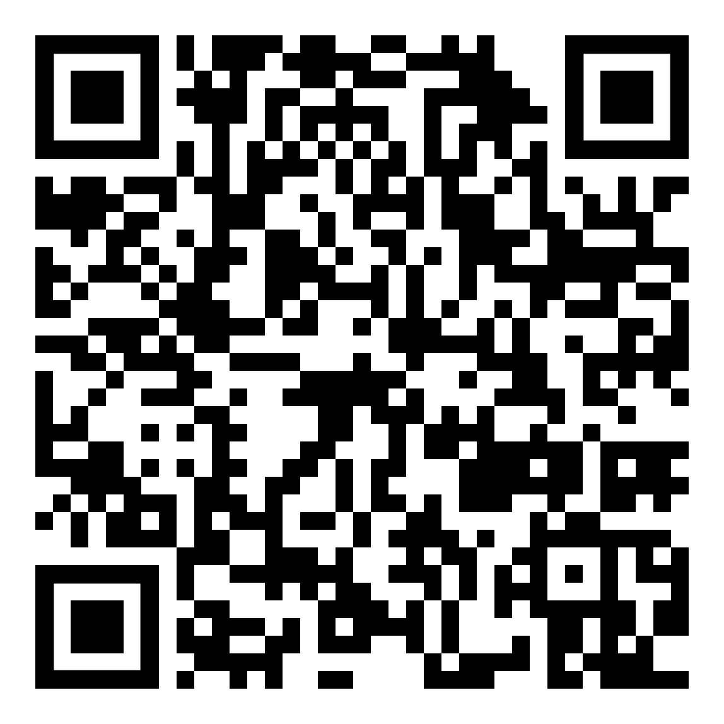
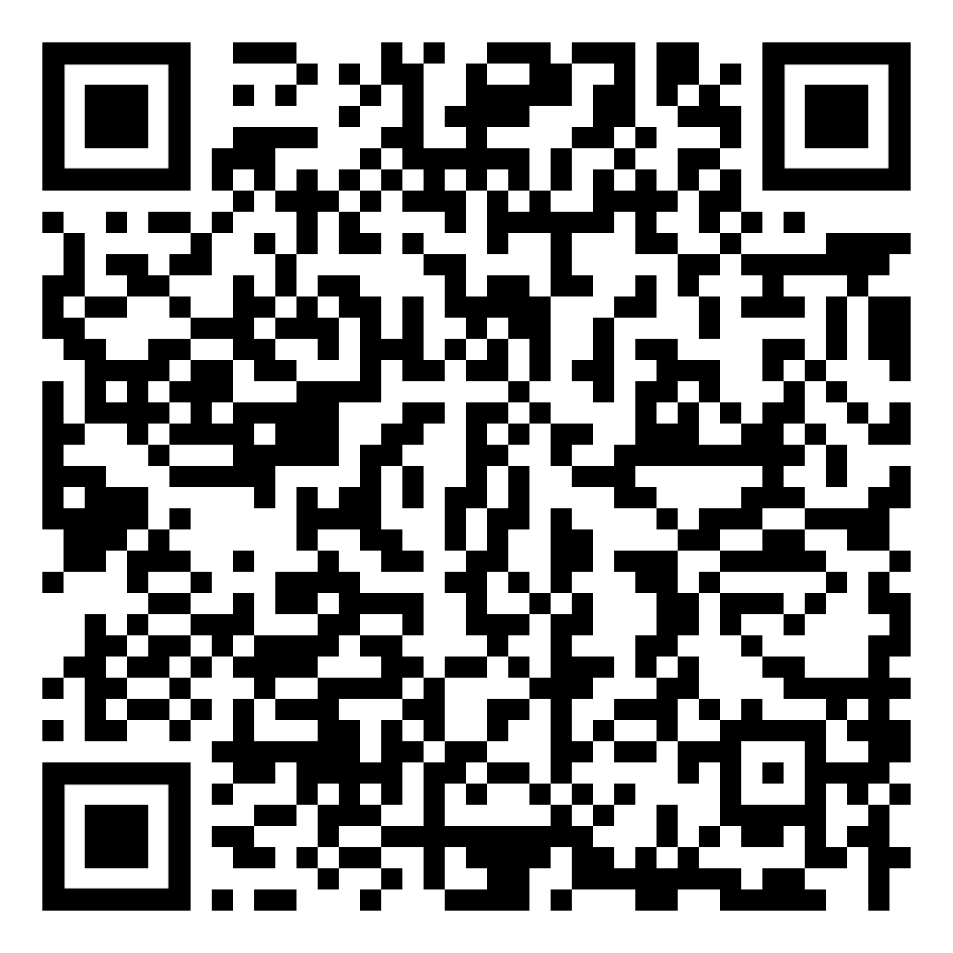
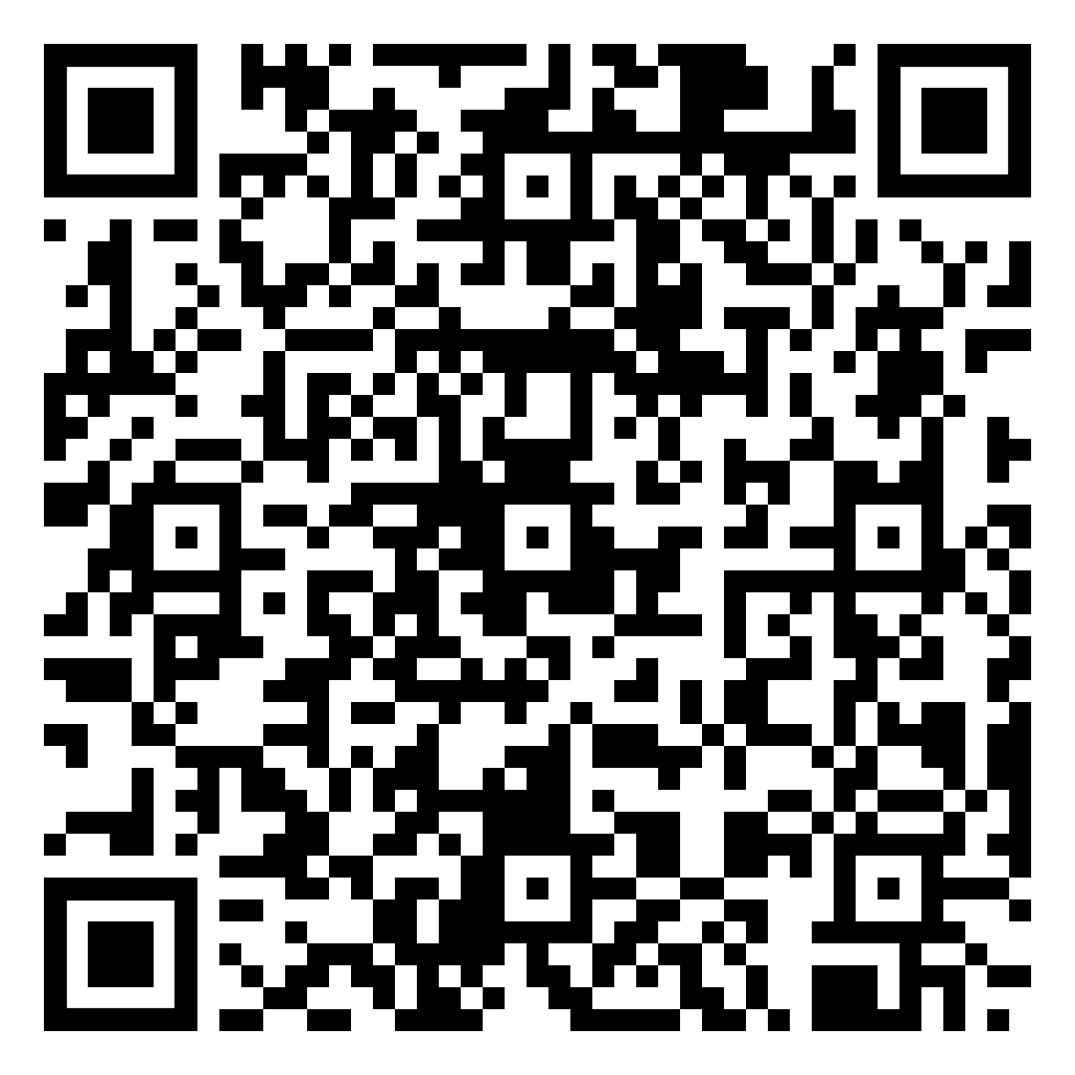
Introducing Ms. Cofer
CCR Website
College App Resources
Senior Meetings
Notes:
Cofer

Slide 41
Preferred Deadline
October 1, 2023
Always check your college website for the most up-to-date information
Notes:
Taylor

