Slide 1
EDGEWOOD JR./SR. HIGH SCHOOL
Jacqueline Ingratta, Principal
Christy Flora, Assistant Principal
Nicholas Stewart, Assistant Principal
Notes:
Ingratta
Student = Pledge of Allegiance (Maddie Nichols) Student = National Anthem
Student = Student Story (Lilly Shannon on 11/8 and Maria Thering on 11/13)

Slide 2
SEEKING EXCELLENCE IN WHO WE ARE, WHAT WE KNOW, AND WHAT WE DO
To provide a positive and safe environment for all students with a challenging curriculum, with high expectations for student achievement, and with emphasis on critical thinking skills, problem solving, sound knowledge base, and lifelong learning skills.
SCHOOL MISSION
Notes:
Ingratta

Slide 3
Edgewood Jr./Sr. High School
A Brevard Public School of Choice
Grade “A” State of Florida School
Earned the National Blue Ribbon School of Excellence Award (2008, 2017, 2023)
National Certified Senior Project Exemplary High School
PLC Model School
Power Library School
Florida Arts Model School – Music and Visual Arts
Ranked 74th in the United States and 7th in the State of Florida by US News and World Report (2023)
Ranked 23 in the United States as a most challenging high school by the Washington Post (2022)
Certified Suicide Prevention School
Notes:
Ingratta
Note: Blue Ribbon awarded in 2008 and 2017 and 2023

Slide 4
Why Choose Edgewood?
Video created by Ms. Kyzer’s Digital Video Technology students
Program is part of our Career Technical Education (CTE) program – Industry certifications can be earned
Notes:
Play video from school’s website

Slide 5
COLLEGE PREPARATORY PROGRAM
Diploma of Distinction / AP Capstone
Rigorous Academic Curriculum
Increased Graduation Requirements
Leadership Experiences
Service Learning
Acceleration Opportunities in Middle School and High School
Notes:
Ingratta

Slide 6
Accomplishments
90%-100% pass rate on all EOCs (CIVICS, ALGEBRA 1, GEOMETRY, BIOLOGY, US HISTORY)
Cumulative scholarship earnings for the Class of 2023 was over $10,470,791
100% graduation rate for 14 years
Notes:
Ingratta
Note: Add continuity rate next year ***

Slide 7
EDGEWOOD ENROLLMENT
Faculty and Staff
3 Administrators
88 Faculty and Support Staff
53% have Master Degrees or higher
21% of teachers have gifted endorsement
95% of staff are Youth Mental Health First Aid trained
Student Population
Total enrollment 950
Free/Reduced Lunch population is 16%
Minority Population is 30%
ESE Population (Gifted, 504/IEP) is 38%
Notes:
Ingratta

Slide 8
Accelerated Programs
Edgewood offers 29 Advanced Placement courses
86.2% of Edgewood’s 9th-12th grade students are enrolled in one or more Advanced Placement courses
Dual Enrollment are courses offered in conjunction with Eastern Florida State College & FIT
Articulation agreement with FIT courses
In 2023 9 seniors graduated with their AA Degree
Notes:
Stewart: FIT has significantly reduced tuition dual enrollment option for BPS students

Slide 9
AP Capstone
AP Capstone began at Edgewood in the 2015-2016 school year
Students are required to take 2 AP courses
AP Seminar (11th grade); AP Research (12th grade)
4 additional AP courses required across all disciplines
Internationally recognized and highly rigorous
An informational meeting will be available for parents and students who wish to pursue this avenue
Student can earn an AP Capstone Diploma or AP Capstone Certificate
Notes:
Stewart
Students who earn scores of 3 or higher in AP Seminar and AP Research and on four additional AP Exams of their choosing receive the AP Capstone Diploma.
Students who earn scores of 3 or higher in AP Seminar and AP Research but not on four additional AP Exams receive the AP Seminar and Research Certificate.

Slide 10
AP Testing History
Notes:
Stewart

Slide 11
Assessment | Percent that Received a 3 or higher
FAST ELA Gr. 7 | 73%
FAST ELA Gr. 8 | 82%
FAST ELA Gr. 9 | 82%
FAST ELA Gr. 10 | 99%
FAST Math Gr. 7 | 100%
EDGEWOOD'S
SPRING TESTING DATA
FAST, SCIENCE, & EOC
Science Gr. 8 | 77%
Algebra 1 EOC | 94%
Biology EOC | 98%
Civics EOC | 95%
Geometry EOC | 93%
US History EOC | 96%
Assessment Data 2023
Notes:
Stewart

Slide 12
EDGEWOOD'S
CTE DATA
YEAR | Percent of Seniors with Industry Certification
2017-2018 | 20%
2018-2019 | 32%
2020-2021 | 32%
2021-2022 | 33.3%
2022-2023 | 34.1%
Career & Technical Education (CTE) Data 2023
Notes:
Stewart

Slide 13
Class of 2023 SAT Scores
Notes:
Stewart – mention District and State composite scores

Slide 14
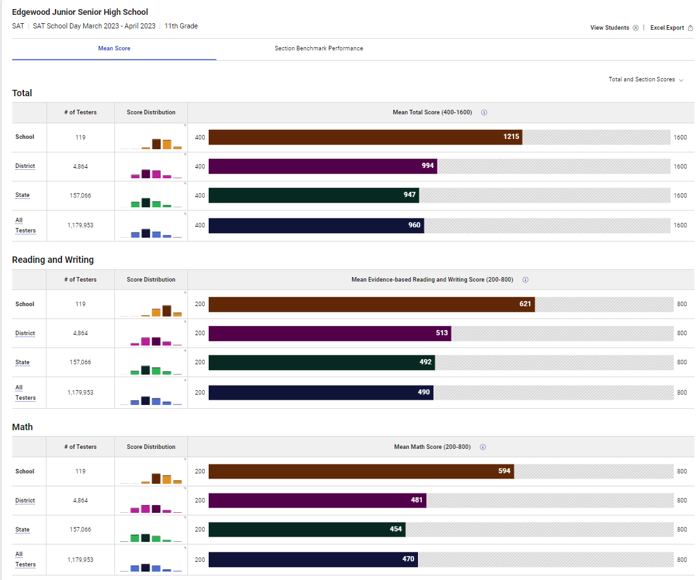
SAT School Day – March 2023
Notes:
Stewart – mention District and State composite scores

Slide 15
National Merit Scholars
Notes:
Stewart
Explain what it means to be a national merit scholar ***

Slide 16
Diploma of Distinction
Criteria that must be met to earn the Diploma of Distinction includes:
3 consecutive years of a World Language
Leadership experience in one or more areas or projects
Service Learning – 25 hours per year in grades 9 and 10 - Beginning 2023, students can combine work and service hours to reach 100 hours.
Accelerated Study: Algebra I Honors in Middle School and at least two accelerations in High School. Acceleration in Middle School means obtaining High School credit. Acceleration in High School means obtaining college credit via AP or Dual Enrollment
Qualify and complete an application for at least one post-secondary scholarship
A competitive post-secondary admission portfolio to include career and personal goals
Successful completion of a Senior Project
Proficient scores on all state assessments including
Students may not have any F’s on their transcript from Edgewood, dual enrollment or virtual courses
Notes:
Guidance

Slide 17
Graduation Requirements
Courses | Credits | Notes
Language Arts | 4.0 | Required Honors: English I, II, III, IV, AP Language, AP Literature
 |  | Communication I and II may be taken at EFSC in place of English III and IV
Mathematics | 4.0 | Required Honors: Algebra 1 and above
Science | 4.0 | Required Honors: Biology, Chemistry, Physics
Social Studies | 4.5 | Required Honors: World or European History, American History, Economics (.5), American Government (.5), *Financial Literacy (.5) *New beginning with class of 2027
World Language | 3.0 | Three consecutive years same language
HOPE | 1.0 | Health Opportunities through Physical Education
Career Research & Decision Making | 0.5 | Must be completed in 9th Grade
Performing Fine Arts or CTE Elective | 1.0
Senior Project | 1.0 | Must be completed in 12th Grade (this is part of the Senior Project requirement)
Other Electives | 5.0
Total Graduation Requirements | 28
Notes:
Guidance

Slide 18
Exceptional Student Education
ESE endorsed guidance counselor meets with IEP students once a week in a small group setting
Edgewood has a literacy coach 1 day per week
Gifted Student Services
Each gifted student has an Educational Plan (EP) managed by a teacher with gifted endorsement certification
Gifted students are grouped through their Homeroom
Notes:
Guidance

Slide 19
Athletics
Basketball Bowling Cheerleading Cross Country Dance Golf | Lacrosse Soccer Swim and Dive Tennis Track Volleyball
Notes:
Flora / Kaltenbach / Wu

Slide 20
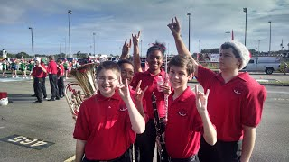
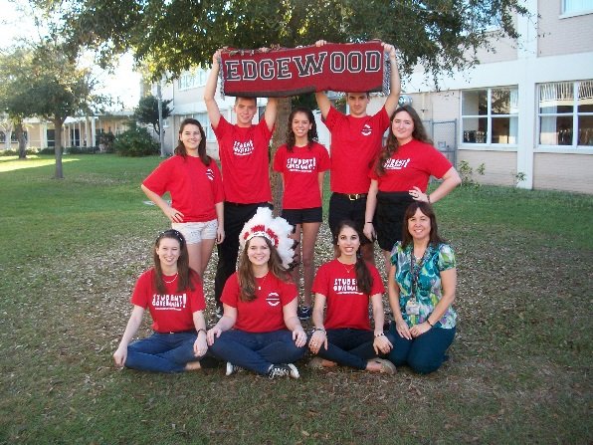
CLUBS
Investment Club
JCL Certamen Team
Junior Classical League (JCL)
Key Club
March of Dimes
Marine Science Club
Math Competition Club
MATHCOUNTS
Astrology Club
Model Student Senate
Mu Alpha Theta
National Art Honor Society
National Honor Society (NHS)
National Junior Honor Society (NJHS)
Needle Works Club
Ping-Pong Club
Odyssey of the Mind
Recycling Club
Red Cross
SAGA
Sailing Club
Science National Honor Society
Science Research
SGA (High School)
Singer/Songwriter Acoustic Club
Sources of Strength
Spanish Honor Society
Speech & Debate
Spelling Bee Champions Club
Surf Club
Table Tennis Club
Travel Club
Tri-M Music Honor Society
UNICEF
Weight Training
Who We Play For
Writer's Circle
Academic Team
Aquarium Club
ASTRO (Applied Science & Technology Research Organization) Club
BETA
Book Club - High School
Book Club - Middle School
Chemistry Club
Chess Club
Children's Hunger Project
Class of 2023
Class of 2024
Class of 2025
Class of 2026
Class of 2027
Cultural Diversity Club
D & D Club
Distributive Education Clubs of America [DECA]
Digital Video Club
Drone Club- High school
Drone Club- Middle School
e-Sports Club
Edgewood Code
Fantasy Sports
Environmental Club
FCA - Fellowship of Christian Athletes
Finance Club
FIRST Robotics - FTC/FRC
Future Educators (FEA)
Future Health Professionals (HOSA)
Future Problem Solvers
Garden Club
High School Writing Center
Hispanic Culture Appreciation Club
International Thespian Society, Troupe 6616
Notes:
Flora / Kaltenbach

Slide 21
The School Day
Edgewood operates on 2 different bell schedules
8:30-3:30 (M,T, W, Th)
8:30-2:20 Early Release Fridays
7 class periods
Homeroom on Fridays [30 minutes]
Power Hour (Monday - Thursday)
Resiliency Education on select Wednesdays
Notes:
Flora
Explain Mental Health Wednesdays

Slide 22
Student Conduct
The expectation is for a positive learning environment free from behavioral disruptions
No classroom disruptions or interruptions
Student/Parent Contract
Discipline Ladder
District Guidelines for Code of Conduct
Dress Code
Parental support for enforcing discipline
Good attendance is vital to success
District policy guidelines
Notes:
Flora
*** We need your support regarding attendance and dress code ***

Slide 23
Transportation
3 car loops for drop off and pick up
Track (preferred loop)
AM- 8am – 8:30am
PM- 3:30pm
Student Parking
AM- 8am- 8:30am
PM- 3:30pm
Merritt Avenue Loop
AM- 7:30am- 8:30am
PM- 3:30pm
Warner Way Loop
AM- 7:30am- 8am
PM- 3:30pm
*Carpooling: Edgewood PTO Facebook
Notes:
Flora

Slide 24
Application Process
Student must be on grade level (level 3 or higher on a state standardized assessment or a national norm-referenced test, and grades of C or better in each core class)
Application must be completed no later than 11:59 pm on 12/8 - no exceptions
Applications are completed via the Family Dashboard ($30.00 fee)
Notes:
Ingratta – refer parents to the Minimum Admission Requirement Handout
Refer parents to Handout (back of postcard)

Slide 25
Application
SIBLING PREFERENCE:
Sibling preference is based on space availability
Siblings must meet the minimum admissions requirements and online applications must be received by the deadline
If sibling is granted preference, the sibling originally enrolled must remain enrolled at Edgewood for the entire 2024-2025 school year
Process
Notes:
Ingratta
Emphasize the rules surrounding sibling preference.

Slide 26
Lottery – December 18th
Students are granted conditional acceptance based on a lottery
The district has implemented a uniform lottery system through the Office of Open Enrollment
Parents will have access to their lottery status via the Family Dashboard
Application and the wait list number is good for one year
Notes:
Ingratta
*** Explain rolling admissions to begin in January 2023 ***

Slide 27
Registration
Notification letters of conditional acceptance will contain all registration information
Evening Orientation & Registration Meetings
Attendance is REQUIRED
March 5, 2024 6 PM or
March 7, 2024 6 PM
Notes:
Ingratta

Slide 28
Important Reminders
Applications must be completed online
Ensure all supplemental documents are uploaded
Application / Processing Fee of $30.00
Application deadline is 11:59 PM December 8th
Acceptance is CONDITIONAL based on a standardized assessment scores and grades
You may apply to more that one choice program
Seat Acceptance Deadline January 12, 2024
Notes:
Ingratta

Slide 29
Questions
Guidelines
Important Questions
Guidelines
What are my reasons for selecting Edgewood?
Does my child want to attend Edgewood?
Is my child performing better than average in at least 3 areas including mathematics?
Is my child ready for advanced courses?
Is my child reading on or above grade level?
Will my child be able to handle a rigorous academic curriculum to include 3 years of a foreign language?
Know what your child can handle academically as the curriculum is very challenging
Your child should have a strong desire to learn
Your child must exhibit appropriate behavior
Your child should want to attend Edgewood
Notes:
Ingratta
My team will be available to answer any questions you may have following the school tours.

Slide 30
EDGEWOOD JR./SR. HIGH SCHOOL
School Tours
Notes:
Ingratta – school tours

