Slide 1
MISS AN ANNOUNCEMENT THAT WENT BY TOO FAST?
OR HAD TEXT TOO SMALL?
www.brevardschools.org/EdgewoodJRSR

Slide 2
YOU CAN FIND ALL THE ANNOUNCEMENTS ON THE EDGEWOOD WEBSITE!
www.brevardschools.org/EdgewoodJRSR

Slide 3
SCHOOL NEWS

Slide 5
Have you witnessed a crime or bullying? Report it anonymously to make our school a safer place.

Slide 6
Middle School - SSYRA
Checkout in the library
Checkout via Sora
Congrats to the 2024
Winner!!!
Bring the attention of your audience over a key concept using icons or illustrations

Slide 7
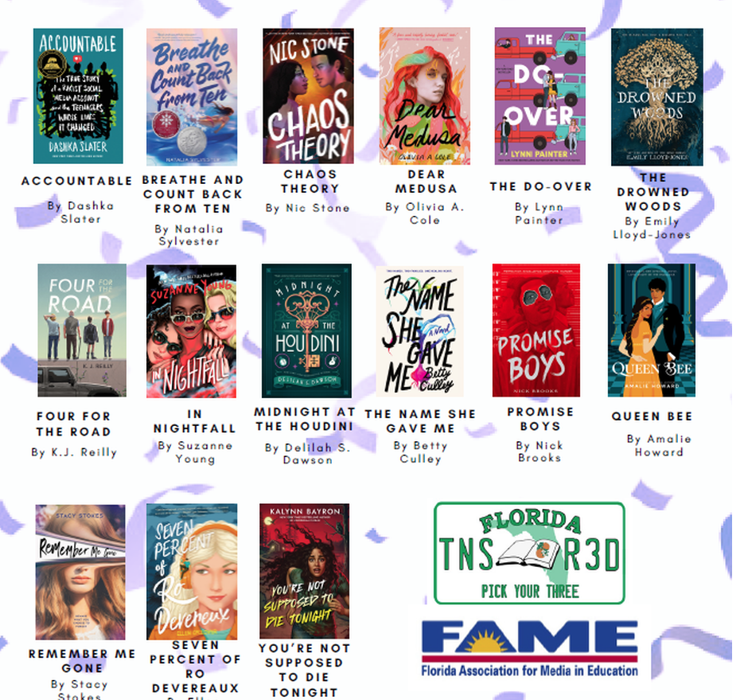
High School - FTR
Checkout in the library
Checkout via Sora
Congrats to the 2024 Winner!!!

Slide 8
CLUB NEWS

Slide 9
Chess Club!
Please fill out this end-of-year survey!

Slide 10
Cinema Club
Dive into films
and discuss them
First Meeting: 4/17 3:30, room 6-104
Google Classroom Code:
kz4wmfw
Cinema Club

Slide 11
Edgewood Dungeons & Dragons Club
Fridays from 2:30 - 3:30
Class code: 25dfof6

Slide 12
Interested in Engineering…
Join ASTRO
Google Classroom: jd7ygqp
Remind code:
Text @ASTROEW to 81010
Notes:
Brandon’s Suggestion

Slide 14
Hosa- Future Health Professionals
Meetings on Tuesday Power Hour B
See Mr.Stelzer in
Room 13-104
For details!

Slide 15
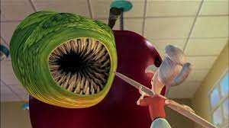
Interested In Education?
Join FEA,
The Club for Future Educators!
Meetings MON
Power Hour B
Mrs. Czajka’s Room 2-103

Slide 16
Tuesdays power hour:
HIGH SCHOOL
Thursdays power hour:
MIDDLE SCHOOL
esports
Come to portable 6 to pick up a permission form

Slide 18
HOMEROOM NEWS

Slide 19
Homeroom Points
Earn points for your homeroom by participating in Spirit shirt days and other activities
Winning homerooms in each grade get prizes each semester!

Slide 20
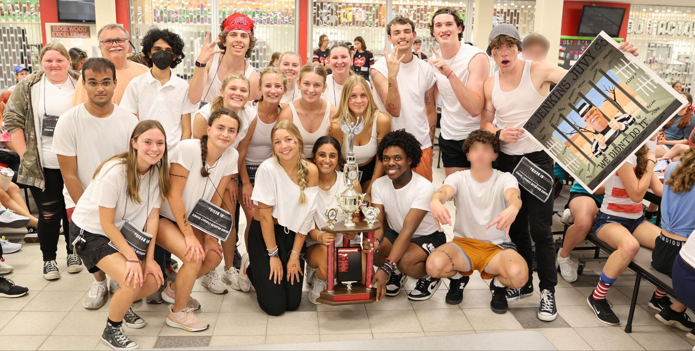
Edgewood Challenge 2024 Champions - Jenkins’ Homeroom!

Slide 21
22-23 Flag Winner - 1st

Slide 22
22-23 Flag Winner -2nd

Slide 23
22-23 Flag Winner -3rd

Slide 24
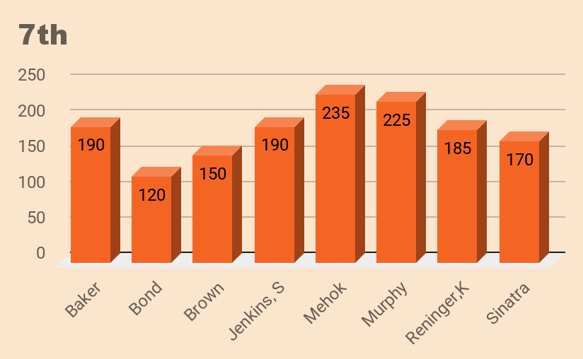
7th Grade Hmrm Points

Slide 25
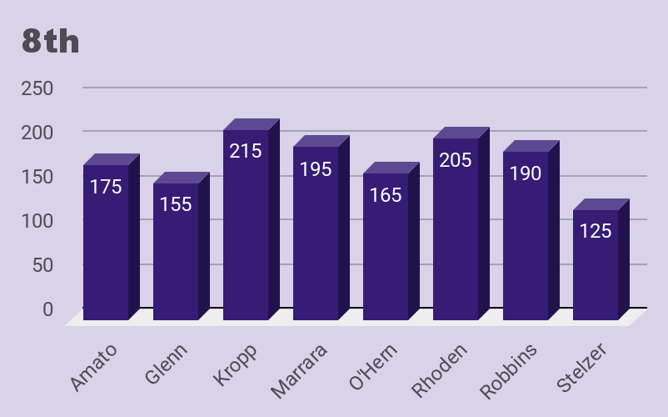
8th Grade Hmrm Points

Slide 26
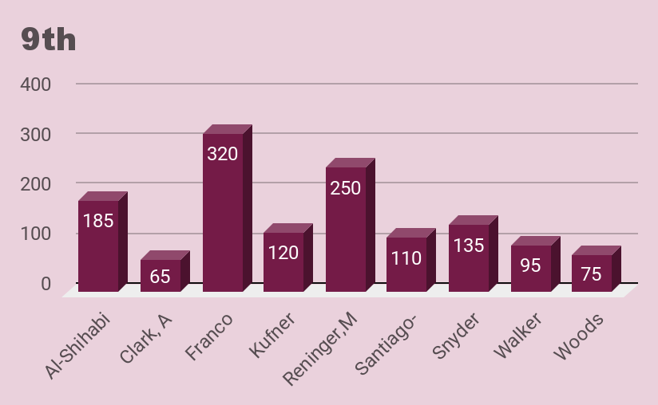
9th Grade Hmrm Points

Slide 27
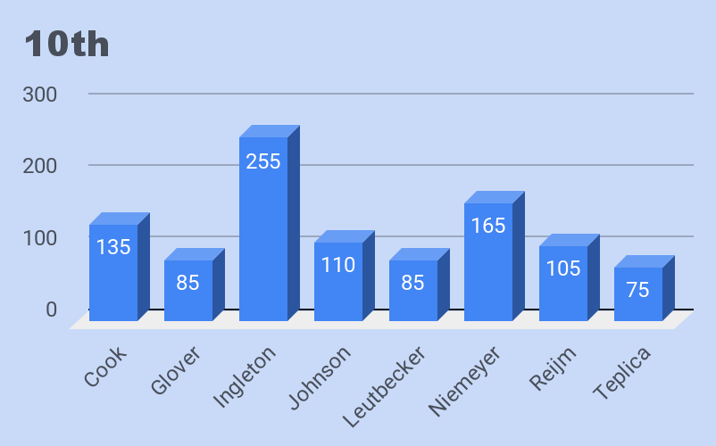
10th Grade Hmrm Points

Slide 28
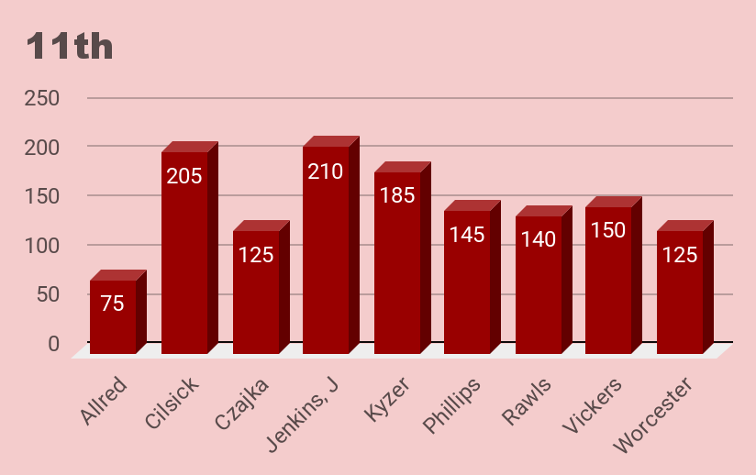
11th Grade Hmrm Points

Slide 29
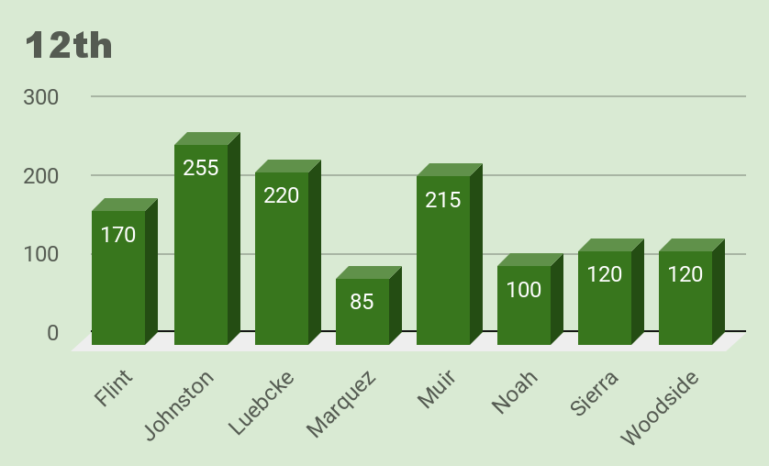
12th Grade Hmrm Points

Slide 30
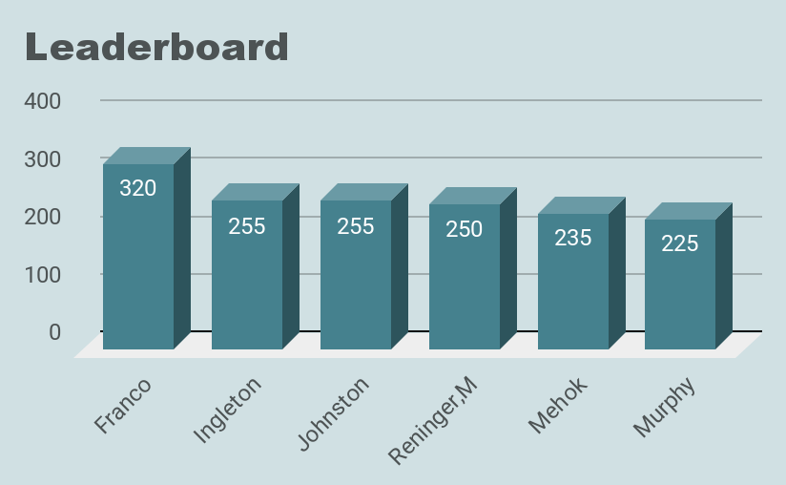
Leaderboard 2024

Slide 31
Where did those points come from?
Recent point updates:
Feedback forms
Spirit winners April
TriBond Challenge + Mini Challenge
Edgewood Challenge
7th Letters to Self

Slide 32
HOMEROOM SPIRIT DAY -May
Show your school spirit (and earn hmrm pts) by wearing EDGEWOOD gear!
Date: May 3-LAST ONE!

Slide 33
Spirit Day Winners - May
Grade Level Winners (10 pts+ SNACKS!): 7th - Mehok
8th - Kropp
9th - Reninger, M+ Franco
Met goal (10 points for more than 50% participation) -
Johnson, O'Hern, Murphy, Ingleton, Marrara, Muir, Rhoden, Glenn
Sinatra, Jenkins, J, Johnston, Jenkins, S, Vickers, Baker, Leutbecker, Kyzer, Al-Shihabi, Robbins, Snyder, Czajka, Marquez, Santiago-Rivera, Amato, Reijm, Bond, Kufner, Glover
10th - Niemeyer
11th - Cilsick
12th - Luebcke

Slide 34
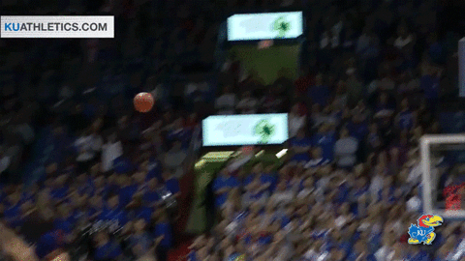
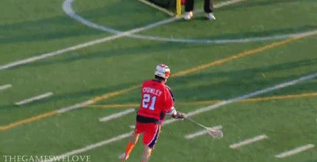
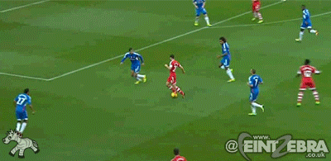
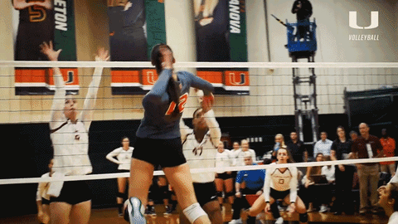
EDGEWOOD SPORTS UPDATE
EDGEWOOD SPORTS UPDATE

Slide 35
Got an ?
Follow Edgewood_Ath for the latest in scores, games, events, news, and MAYBE pictures of you being awesome!

Slide 36
ATHLETICS
RECOGNITIONS

Slide 37
ATHLETICS NEWS

Slide 38
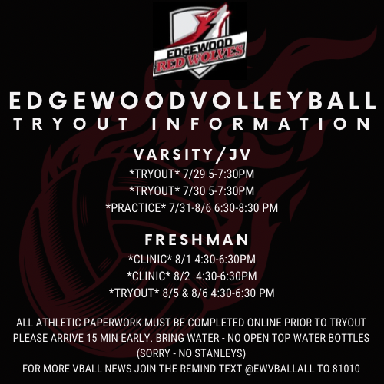

Slide 39
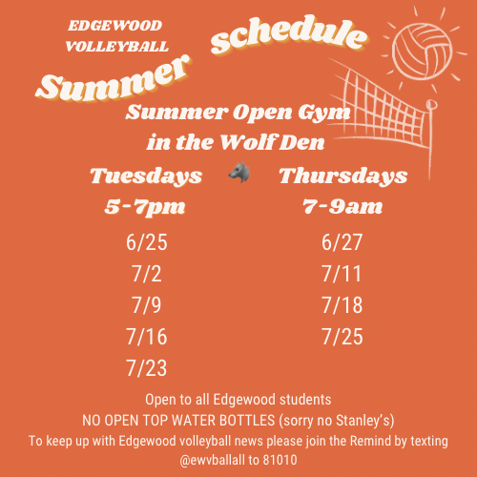

Slide 40
CONGRATS TO LIZ, ELIZABETH, AND NINA on their college signings!

Slide 42
Give us a follow!
Girls Soccer!
Girls Hoops!
Boys Soccer!

Slide 43
Give us a follow!
Track & XC!
Boys Lacrosse!
Girls Lacrosse!

Slide 44
Give us a follow!
Swim and Dive!
Volleyball!
Tennis!

Slide 45
ATHLETICS RESULTS

Slide 46
Varsity Girls’ Soccer
ROAD TO THE FINAL FOUR
Cape Coast Conference Championship 1-17
Viera | 1 (6)
Edgewood | 1 (7)
KEY STATS: Goals: Gigi Lopez; Assists: Olivia Bolin; Penalties Converted in Shoot-Out: Nina Lopez, Andrea Toledo, Piper Miller, Olivia Bolin, Liz Corrigan, Elizabeth Steinmetz

Slide 47
Varsity Girls’ Soccer
ROAD TO THE FINAL FOUR
District Final 1-30
Holy Trinity | 0
Edgewood | 3
KEY STATS: Goals: Olivia Bolin, Gigi Lopez, Taylor Reed; Assists: Nina Lopez, Liz Corrigan

Slide 48
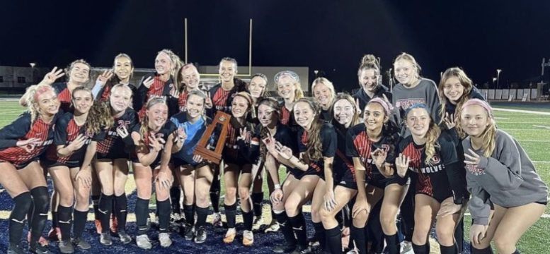
Your BACK-to-BACK-to-BACK DISTRICT CHAMPIONS!
21-22
22-23
23-24

Slide 49
Varsity Girls’ Soccer
ROAD TO THE FINAL FOUR
Regional Quarterfinal 2-6
Cardinal Newman | 1
Edgewood | 4
KEY STATS: Goals: Mia Waters 2, Gigi Lopez, Andrea Toledo; Assists: Gigi Lopez 2, Andrea Toledo, Liz Corrigan; Saves: Emma Ramsey 4

Slide 50
Varsity Girls’ Soccer
ROAD TO THE FINAL FOUR
Regional Semifinal 2-11
St John Paul II | 0
Edgewood | 4
KEY STATS: Goals: Gigi Lopez 3 (HAT TRICK!), Andrea Toledo 1; Assists: Olivia Bolin 2, Liz Corrigan 1, Taylor Reed 1; Saves: Emma Ramsey 7

Slide 51
Varsity Girls’ Soccer
ROAD TO THE FINAL FOUR
Regional Final 2-14
King’s Academy | 0
Edgewood | 2
KEY STATS: Goals: Gigi Lopez, Andrea Toledo; Assists: Gigi Lopez

Slide 52
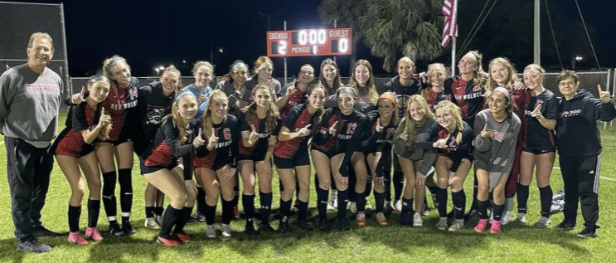
Your State Final Four-Bound REGIONAL CHAMPIONS!
CCC
Districts
Regionals

Slide 53
Varsity Girls’ Soccer
ROAD TO THE STATE FINAL
State Semifinal 2-21
NSU University School | 1
Edgewood | 2
KEY STATS: Goals: Abigail Tomberlin, Liz Corrigan; Assists: Gigi Lopez, Olivia Bolin
HEADED TO STATE FINAL ON SATURDAY!

Slide 54
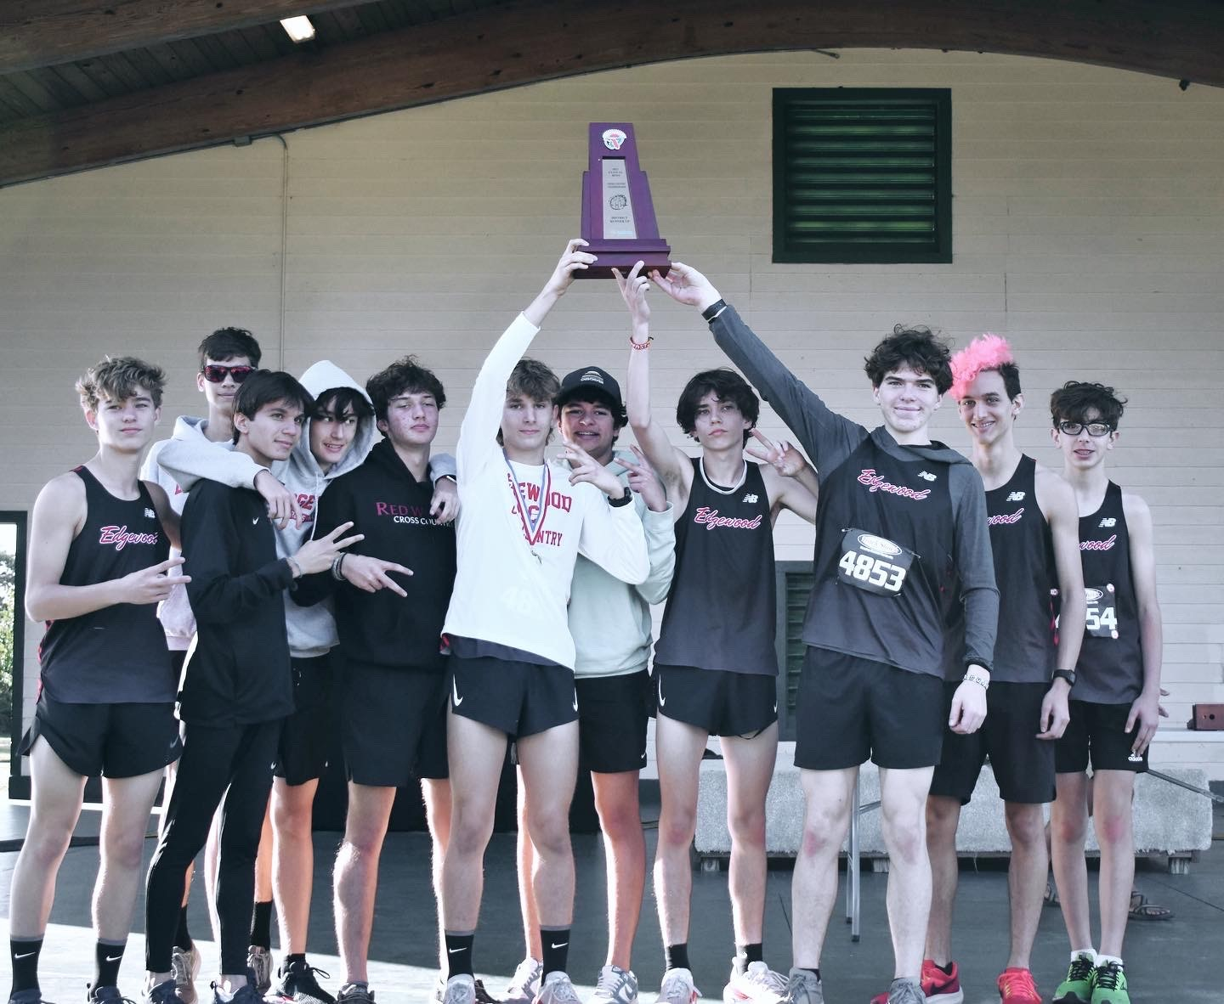
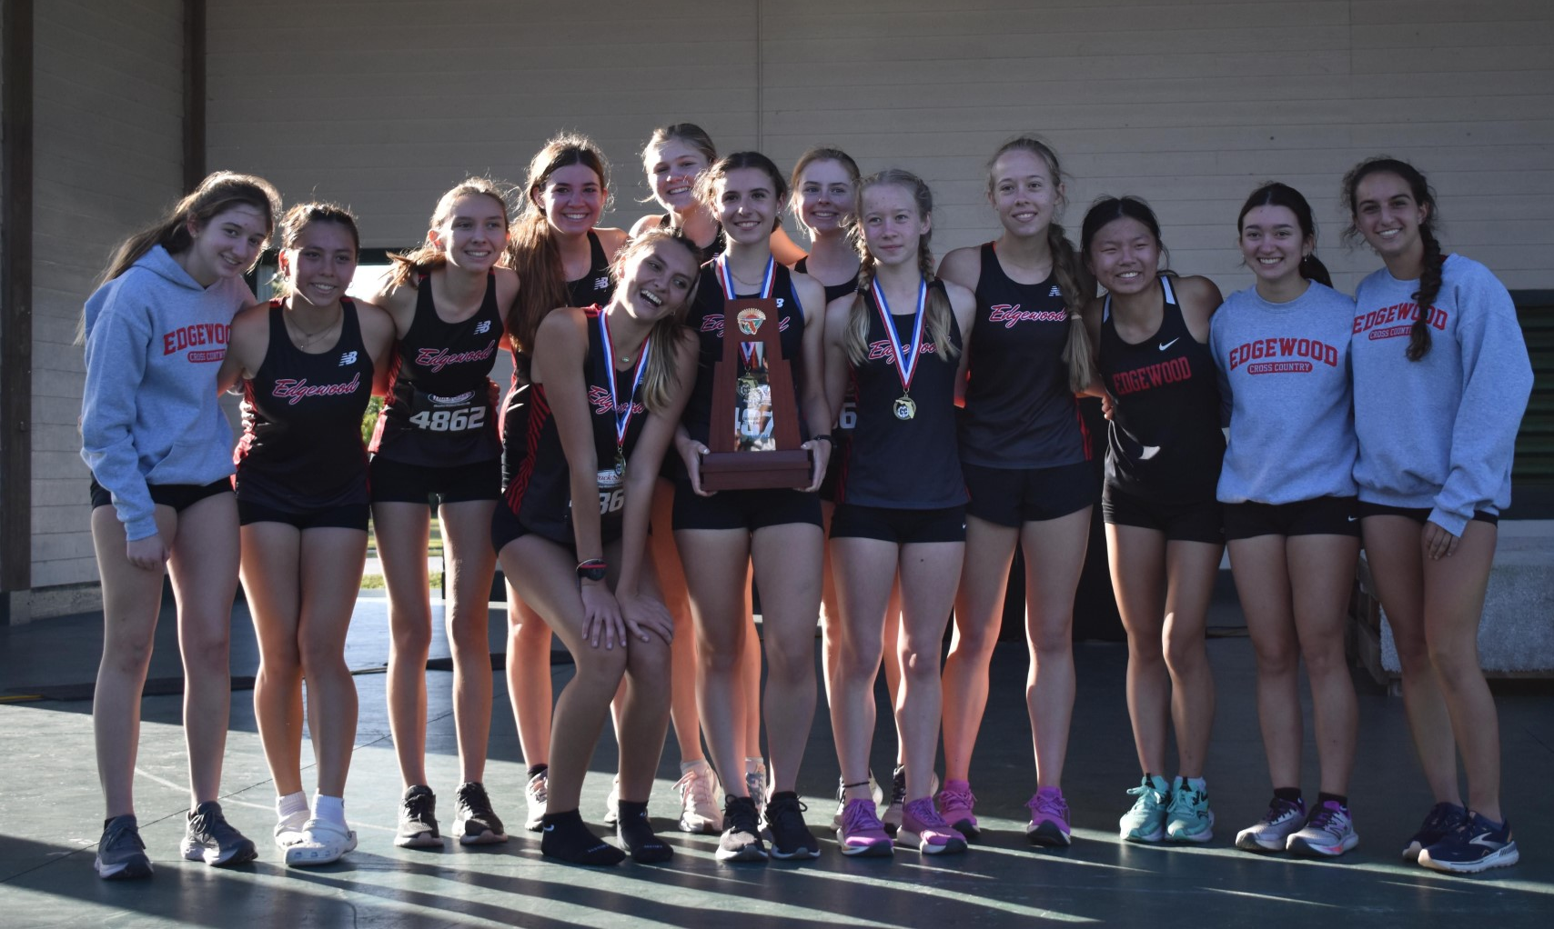
2 x 2nd PLACE TROPHY WINNERS AT
Cross-country DISTRICTS!

Slide 55
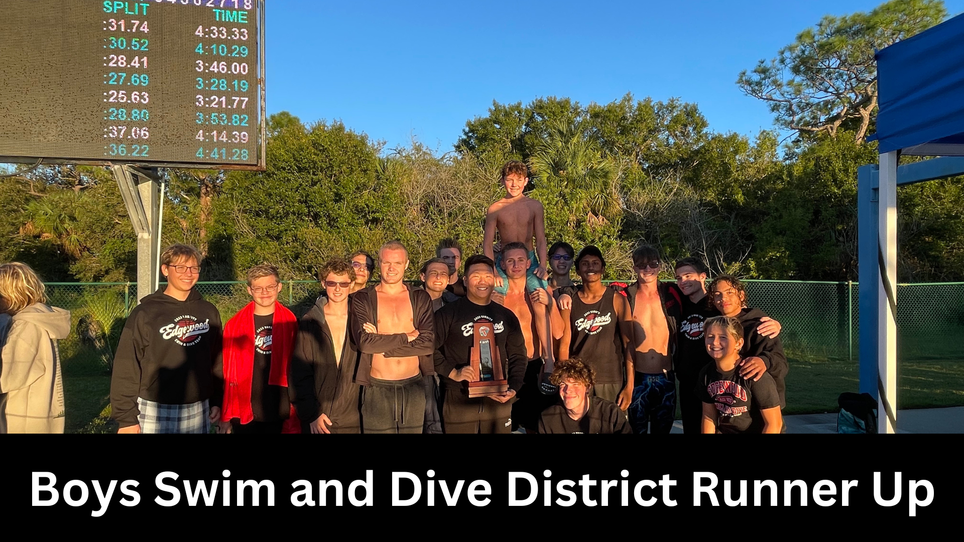

Slide 56
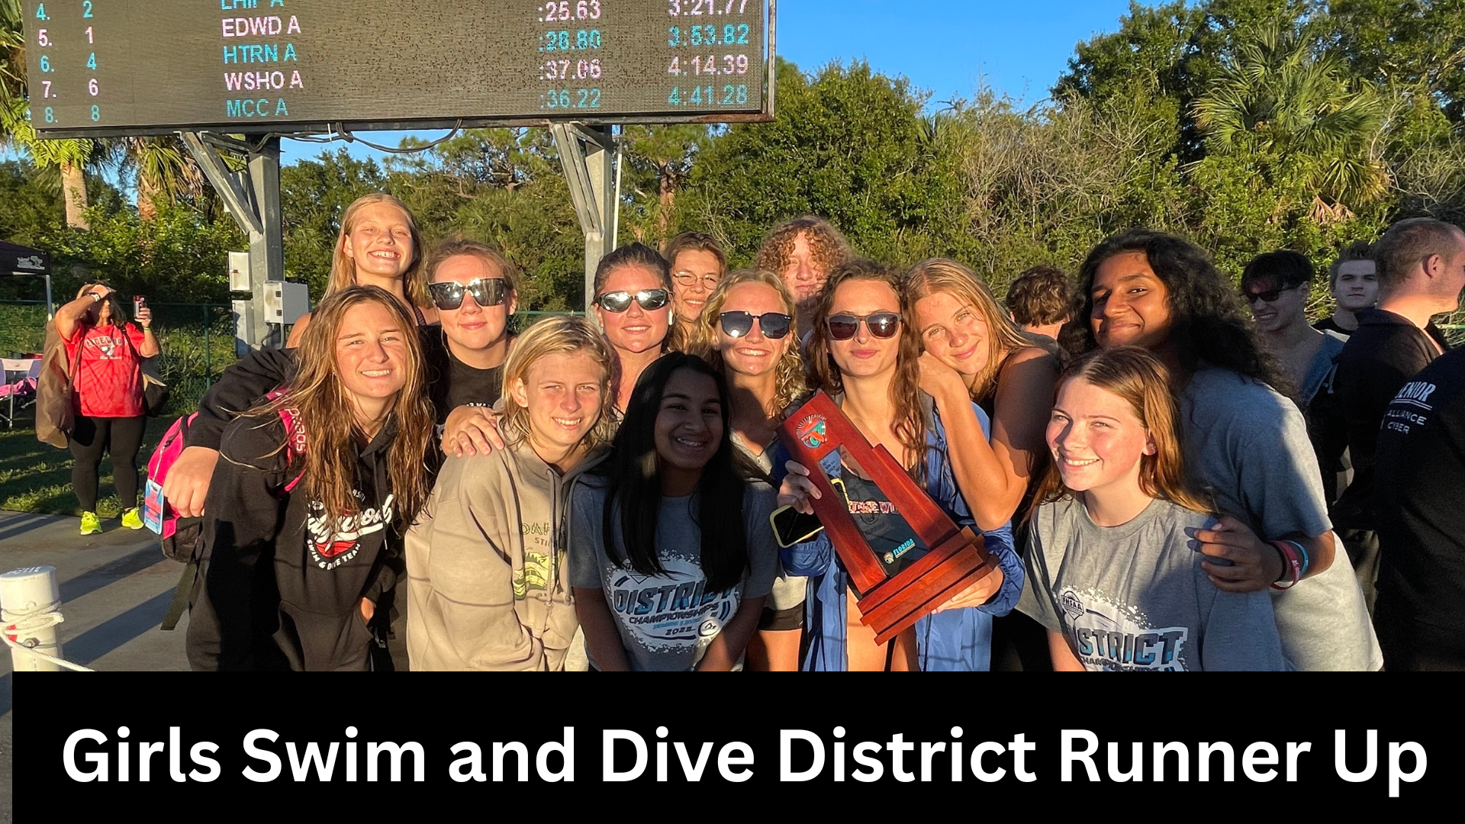

Slide 57
Follow Edgewood_Ath for the latest in scores, games, events, news, and MAYBE pictures of you being awesome!

