Slide 1
Evaluation of Gardendale Separate Day School’s Title I Program for FY26
Presented by: Matthew Dugan

Slide 2
What is Title I?
Title I is a federal grant that:​
provides supplemental funds to school districts with high percentages of children from low-income families to help ensure that all children meet challenging state academic standards.​
assists with building capacity of parents and teachers; and​ encourages parents to be involved in their children’s education.
Funds come from the federal government through the state to districts.

Slide 3
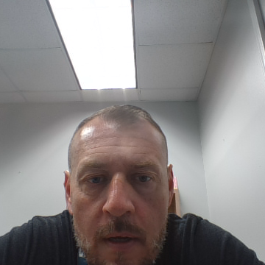
What is the school’s allocation based on?
Gardendale Separate Day School received a total of $30,535.00
Title I funds for each school are primarily based on the number of qualifying students counted during FTE week which occurs in early February the previous year.
These federal funds may be spent in three areas and the purchases must be above and beyond what the district/charter is already expected to be purchasing for students and teachers.
The three general areas that funds can be used to support are:
  student achievement in the areas the school has identified as needing improvement
  professional development (teacher trainings) to help teachers improve their teaching skills in the areas that have been identified as needing support
  parent and family engagement activities to provide support and strategies for parents and caregivers to support children at home with areas that may influence child’s academic achievement.

Slide 4
What is the Title I Program Evaluation ?
Ways Title I program is evaluated:
Track student achievement progress: Title I programs regularly assess student academic progress. This helps us provide targeted support where needed.
Measure program impact: We regularly check if Title I programs are working. This ensures resources are used effectively for your child's benefit.
Family involvement: Share your thoughts! Your input helps improve Title I programs to better support all students.
Transparency and communication: Schools should provide transparent information about their Title I program. Look for regular updates and communication from the school or district to stay informed about the impact of Title I funding on your child's education.

Slide 5
SIP Focus area 1: Instructional Practice specifically relating to ELA
Amount Spent:
Monetary Supplemment: To attract and retain high-quality behavior technicians, a monetary supplement will be provided. This increase in salary recognizes their critical role in improving student behavior and academic focus. $42,000 UniSIG (This amount was also used to support Math)
Wonderbooks (print books with a ready-to-play audiobook inside) $4,991.42

Slide 6
Progress Monitoring Data for Instructional Practices specifically related to ELA
Goal - By the end of the 25-26 school year 60% of tested students in grades 3-10 will make learning gains in ELA as evidenced by FAST scores from PM1 to PM3.
Data: For PM3, only 7 students had scores to compare. 5 students made learning gains (71%).
67% of 4th grade made learning gains
50% of 5th grade made learning gains
0% of 6th grade made learning gains
100% of 7th grade made learning gains
100% of 9th grade made learning gains

Slide 7
SIP Focus area 2: Instructional Practice specifically related to Math
Amount Spent:
Monetary Supplemment: To attract and retain high-quality behavior technicians, a monetary supplement will be provided. This increase in salary recognizes their critical role in improving student behavior and academic focus. $42,000 UniSIG (This amount was also used to support ELA)

Slide 8
Progress Monitoring Data for Instructional Practice specifically related to Math
Goal - By the end of the 25-26 school year 50% of tested students in grades 3-10 will show a learning gain in the area of FAST Math as evidenced from PM1 to PM 3.
Data - Nothing for Algebra or Geometry. 4th grade, 25% made learning gains. 0% of students for 5th, 6th, and 7th made learning gains.

Slide 9
SIP Focus area 3: Positive Behavior and Intervention System (PBIS)
Amount Spent:
Stamps $600.00
Travel (millage) for Silver Pines teacher visits $155.00

Slide 10
Progress Monitoring Data for Positive Behavior and Intervention System (PBIS)
Goal - During the 25-26 school year students' families will have at least one communication from their child's teacher(s) every week to review PBIS and academic data as evidenced by Focus and parent surveys.
Data - Communication log for randomly selected students indicates that parent / guardian is being contacted on a weekly basis.

Slide 11
SIP Focus area 4: Positive Behavior and Intervention System (PBIS)
Amount Spent:
Leadership Team Member trained as a Trainer for CPI Level 2 $3,919.00
Meals and lodging for training $562.50
Monetary Supplemment: To attract and retain high-quality behavior technicians, a monetary supplement will be provided. This increase in salary recognizes their critical role in improving student behavior and academic focus. $42,000 UniSIG (This amount was also used to support Math and ELA)

Slide 12
Progress Monitoring Data for Positive Behavior and Intervention System (PBIS)
Goal - Throughout the 25-26 school year students with one or more suspensions will decrease from 51% (24-25 school year) to 40% or less.
Data - FTE for February was 48. Actual student FY26 enrollment was 86. We had 30 students with one or more suspension. Percentage of students with one or more suspension decreased to 35%.

Slide 13
Summer Title I Plans
(We also saved some of our Title I funds to support the Title I program in
June 2024)
Total Held for Summer Plans: TBD

Slide 14
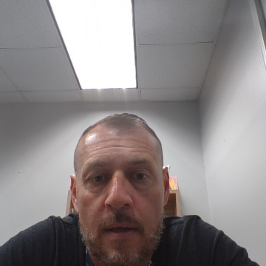
As a Valued Member (Stakeholder) of this school - We Need You…
to be part of our decision-making activities by completing the survey for this presentation. We use all input to determine our focus areas.
to tell us what you want us to spend next year’s Title I funds on that will support learning at our school.
to let us know we are doing that is working and what you feel we need to update, get rid of, or create new.
to be an active part of our school family.
All input is reviewed and considered by the Comprehensive Needs Assessment Team.

