Slide 1
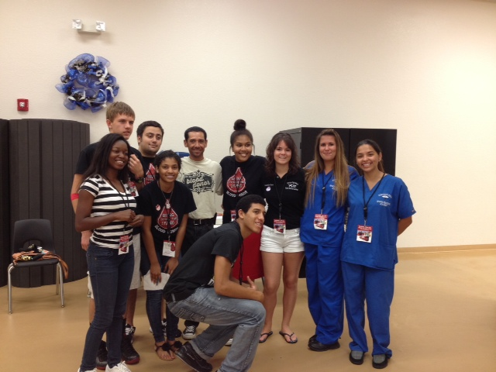
Athletic Training Club
Club description: students shadow certified athletic trainer and personal trainer. Assist as first responders with basic first aid and safety.
Club meeting days and times: Monday-Friday
3:30pm – 6:30pm
Club meeting location (building and room#):Training room in gymnasium
Club sponsor’s name:Enrique Luna
Club sponsor’s email address: luna.enrique@brevardschools.org
Insert image here that represents your club.

Slide 2
Club de Español
Club meeting days and times:
First and Third Friday of the month
Primer y tercer viernes del mes
Club meeting location:
Rooms 5-207 & 5-204
(alternating)
Club sponsor’s:
Señora Ramos & Señora Vélez
Club sponsor’s email:
Ramos.mayra@brevardschools.org
Velezperez.viviana@brevardschools.org
Club description: Learn about the Hispanic culture and history and Spanish language. Our club will provide a safe and fun experience for students to enrich their knowledge about Hispanics.

Slide 3
Crochet Club
No experience needed to join this club. Learn to crochet or crochet in a group setting. Knitters and other yarn crafters are welcome
Club meeting days and times:
Every 3rd Wednesday of the Month 3:45-5:45
First Meeting: 9/20/2023
Club meeting location (building and room#):
6-101
Club sponsor’s name:
Ms. Sierra Sharp
Club sponsor’s email address:
Sharp.sierra@brevardschools.org

Slide 4
Fellowship of Christian Athletes (FCA)
Fellowship of Christian Athletes is a sports ministry for students who desire to engage, equip, and empower their sports team in discipleship. The FCA Huddle at Heritage will be a little different this year, as we will be focusing on leadership within sports teams. The FCA partner club on campus is First Priority, which will focus on Bible Study and fellowship.
Club meeting days and times: Every Thursday during all 3 lunches
Club meeting location (building and room#):
Auditorium Lobby
Club sponsor’s name: Mrs. Peters
Club sponsor’s email address: peters.denisem@brevardschools.org
Insert image here that represents your club.

Slide 5
First Priority
First Priority is a student-led club which exists to share the Hope of the Gospel with every student, on every campus. We equip students with the resources to effectively share the Hope of Christ with their fellow students and to create a safe place on campus where any and everyone is loved and welcome.
Club meeting days and times:
Fridays from 8:00am-8:40am
Club meeting location:
Room 6-103
Club sponsor’s name:
Mr. D’Avis
Club sponsor’s email address:
davis.matthew@brevardschools.org

Slide 6
FBLA Future Business Leaders of America
FBLA (Future Business Leaders of America. The Largest student organization in the World-200.000+ members. Scholarships, Travel, Academic Competition, Networking, Carer Exploration, College Prep.
Club meeting days and times:
Third Wednesday of every month- 3:35pm
Club meeting location (building and room#):
5-106
Club sponsor’s name:
Patricia B. Trotman
Club sponsor’s email address:
Trotman.patricia@brevardschools.org
Insert image here that represents your club.

Slide 7
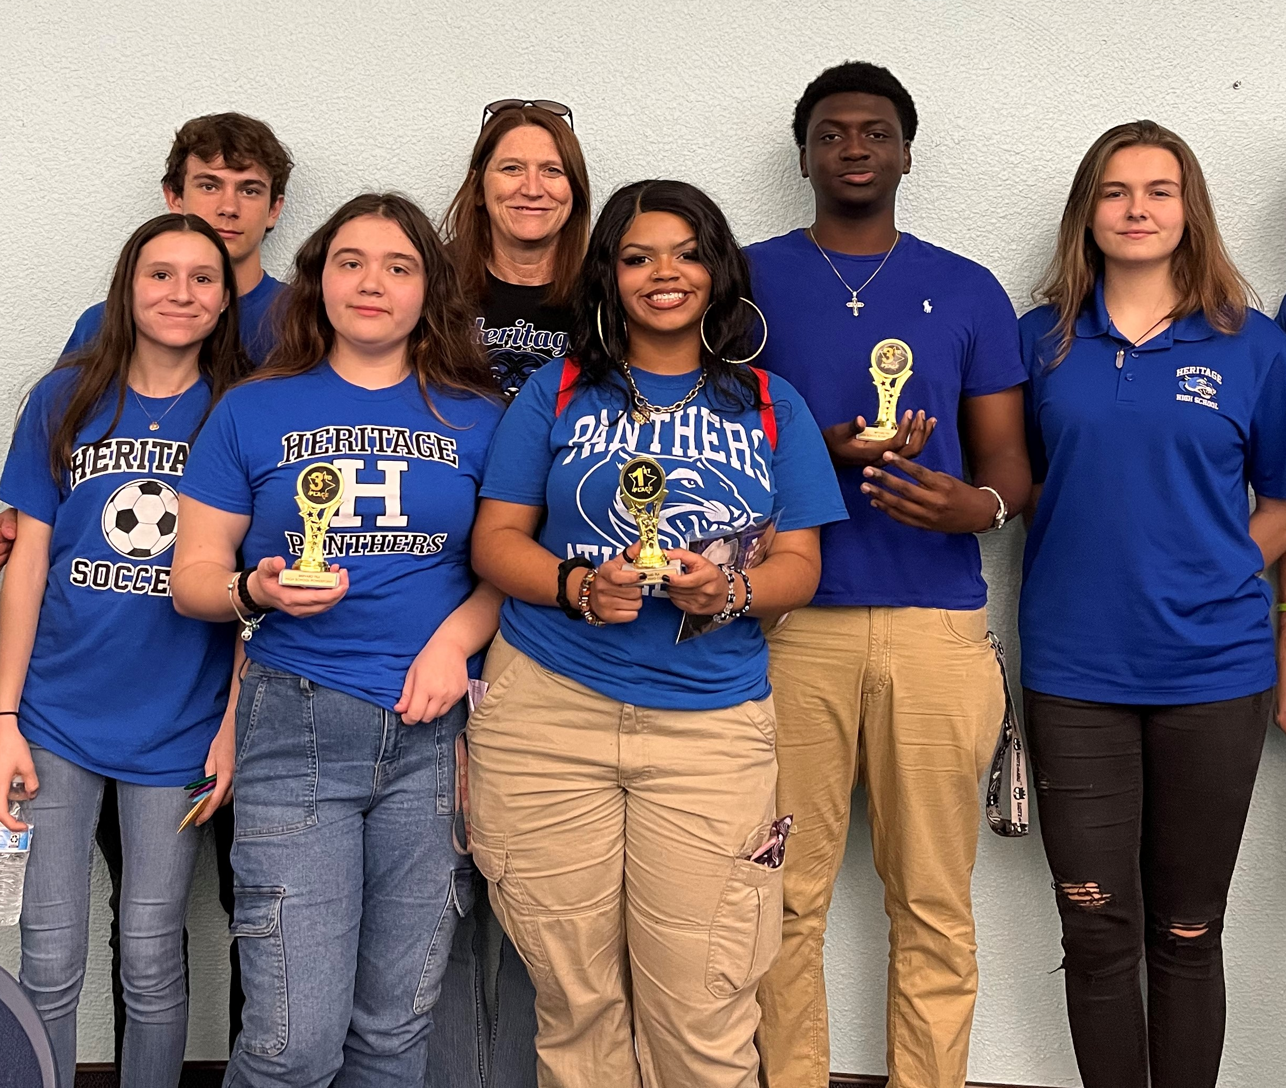
FEA Future Educators Of America
You DO NOT have to want to be a teacher to join our group, although we love that!
You DO need to care about public education.
You DO need to want to help our teachers and improve our school.
You DO need to want to make new friends and have fun.
Some of the things we will do this year:
Local and state competitions-- FIELDTRIPS
Book Buddies with local elementary students
Peer mentoring
Teacher appreciation
School bulletin boards
Learn about policies impacting
education
Meetings every Wednesday
Room 4-207
Sponsor: Mrs. Doehring
Doehring.tamara@brevardschools.org
Join our Remind @e784369

Slide 8
Green Youth
Green Youth is an environmental management club that aims to educate our school and community on topics that impact people and the environment while also engaging in activities that promote a greener and more sustainable planet.
Club meeting days and times:
Thursdays at 3:35pm
Club meeting location (building and room#):
4-210
Club sponsor’s name:
Ms. Elidia Diaz
Club sponsor’s email address:
diaz.elidia@brevardschools.org

Slide 9
HOSA Sports Medicine Club
Our HOSA club is a student led organization which strives to empower our future health care professionals to become strong leaders. Our club actively promotes career opportunities in the health industry, while helping the students understand the importance of quality health care for everyone. Students will have opportunities to volunteer in the community while learning important skills to assist them in becoming a valued team member within their work environment.
Club meeting days and times: First Wednesday of each month at 3:45pm
Club meeting location (building and room#): Room 6-114
Club sponsor’s name: Coach Shelley
Club sponsor’s email address: shelley.tammy@brevardschools.org

Slide 10
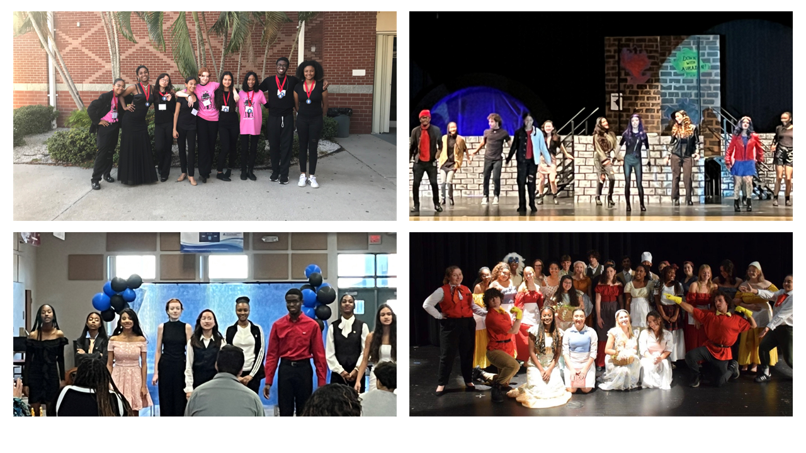
International Thespian Society (Drama Club)
International Thespian Society Members (Drama Club) meet weekly to rehearse, prepare, create, and perform various facets of theatrical work. Students have the opportunity to compete in the Thespys Competition in November. Competition events include performance (acting/dancing/singing), Scene Design, Publicity, Costume construction and design, and Make-up design. Students will also have multiple opportunities to showcase their talents and skills as individuals and in groups at performances throughout the school year.
Club meeting days and times:
Mondays 3:45 – 5 pm
Club meeting location (building and room#):
The Chorus Room, 2-121
Club sponsor’s name:
Jennifer Rock
Club sponsor’s email address:
Rock.Jennifer@brevardschools.org

Slide 11
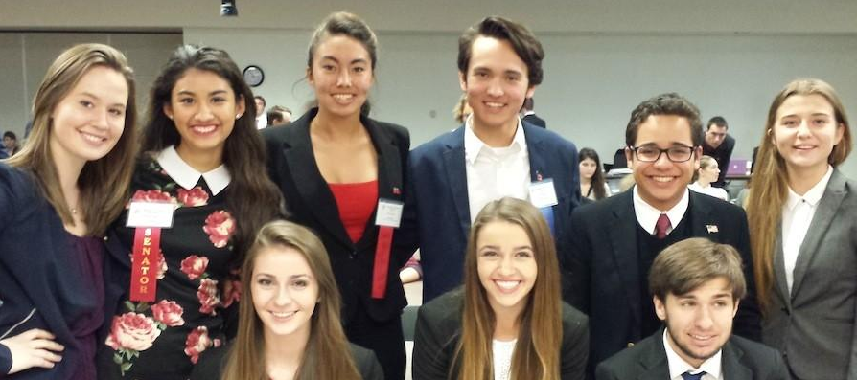
Model Student Senate
Model Student Senate is a government study program that has been happening in BPS for the last 40 years. Students portray US senators and learn how to write, testify on, debate, and ultimately pass bills.
Students, learn how the government truly works as you write, deliberate, and pass legislation. It is a great experience to learn about government in action!
There are only 4 meetings:
Sept 26, 5:00-6:30
Nov 28, 5:00-6:30
Feb 22, 6:00-8:30
Feb 23, 8:15-2:15
All meetings are held at ESF (School Board building) and students are responsible for their own transportation
Mr. Richards is the club sponsor
Richards.Brandon@brevardschools.org

Slide 12
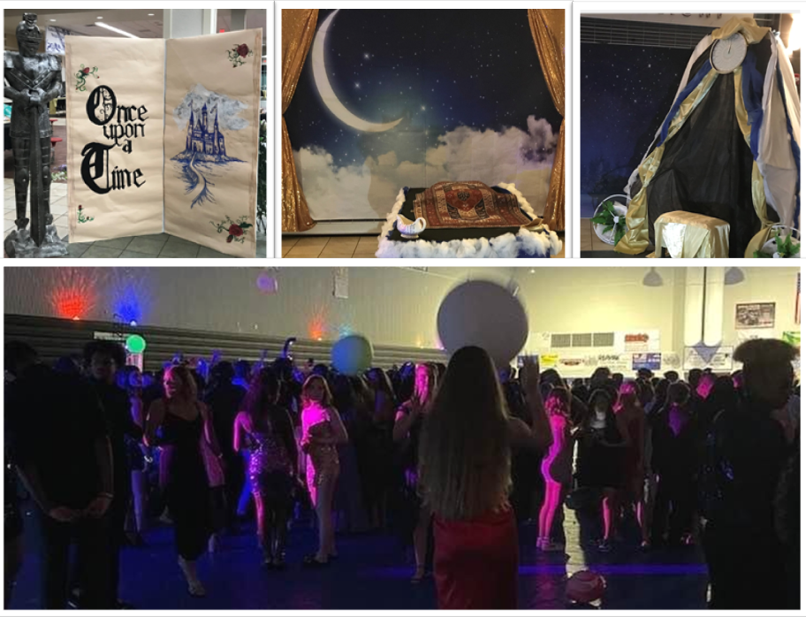
Student Government Association
The Student Government Association of Heritage High School, strives to serve the school as leaders who represent the student body's values, ideas, beliefs, interests, and well-being and puts them into action to better the environment of our school and community. SGA works closely with the administration in the students' best interests and represents the students in matters of school-wide concern. SGA also promotes and organizes student activities (such as Homecoming); works to bring about unity to the student body; involves students in important learning activities; and allows students to have a voice in democratic decision making.
Club meeting days and times:
Fridays, 2:30 – 3:30
Club meeting location (building and room#):
The Chorus Room, 2-121
Club sponsor’s name:
Jennifer Rock
Club sponsor’s email address:
Rock.Jennifer@brevardschools.org

