Slide 1
Welcome to the Galileo Program for Gifted and Academically Talented Students

Slide 2
TONIGHT’S AGENDA
Welcome
Introductions
School Information
Why Galileo?
Application Information
Q & A

Slide 3
Administrators: Meara Trine, Principal Barbara Kelly, Assistant Principal/Curriculum Tiffany Harvey, Assistant Principal/Dean Beverly Lerro, Guidance Counselor

Slide 4
Galileo Presenters Tonight: Galileo Teacher: Mr. Tyler Scull Galileo Parent: Mrs. Erin Turner Galileo Students: Ella Daniels – 8th Grade Grant Arnold – 8th Grade

Slide 5
WHY JEFFERSON MIDDLE SCHOOL?
A “TRUE” middle school experience
Opportunity to earn 5 high school credit courses
JMS is the ONLY middle school to offer Biology
Teacher teaming
Rigorous, standards-based curriculum & highly
trained teachers (our Galileo teachers are gifted certified)
A variety of clubs, sports & extracurricular activities

Slide 6
SPORTS, CLUBS & ACTIVITIES
Sports:
Basketball
Track
Cheerleading
Clubs/Activities:
Science Research
National Jr. Honor Society
Book Bash
School Dances
Spirit Week
20 Book Challenge
Student Government
Fellowship of Christian Athletes
Future Educators of America
And More!

Slide 7
Galileo is….
...In their own words!
Notes:
Teacher and introduce student

Slide 8
Galileo Teacher Representatives Mr. Tyler Scull Social Studies Teacher 7th Grade Team Leader SGA Sponsor

Slide 9
Mr. Scull Personal Background Teaming (Yale 7th grade, Harvard 8th grade) Cross Curriculum Capstone Project Honors and Advanced Placement Readiness Additional Opportunities Available only to Galileo

Slide 10
Galileo Parent Representative Mrs. Erin Turner

Slide 11
Galileo Student Representatives Ella Daniels – 8th grader Grant Arnold – 8th grader

Slide 12
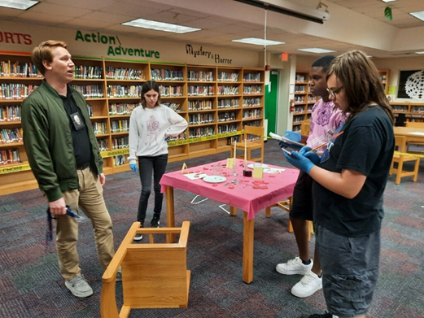
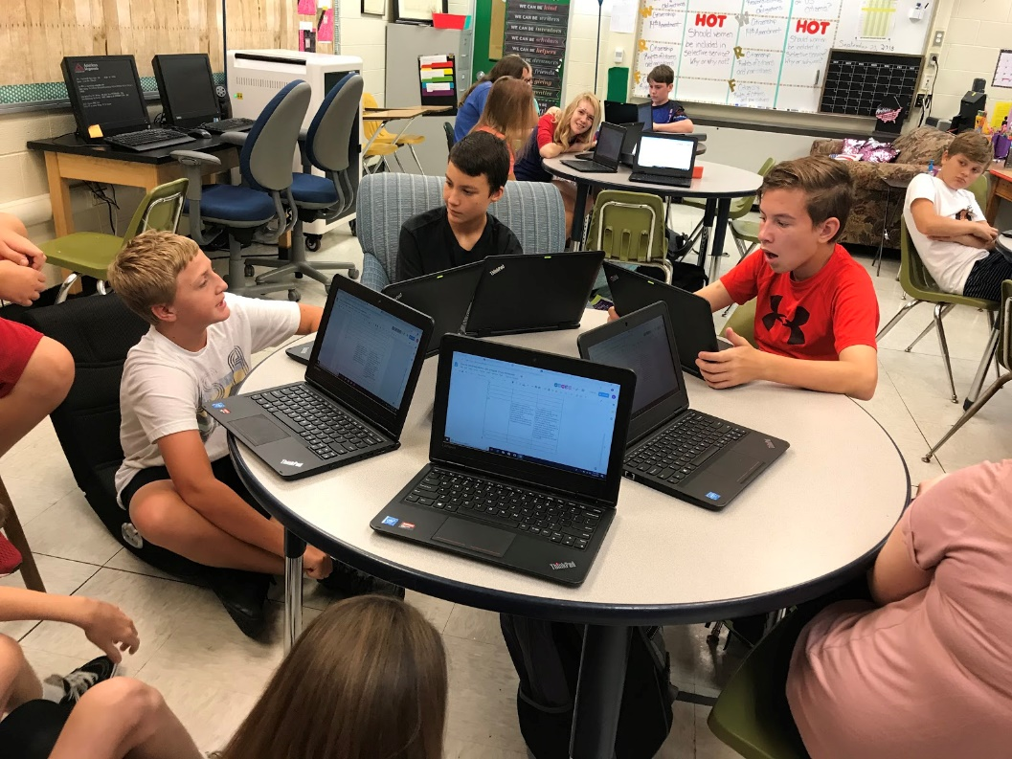
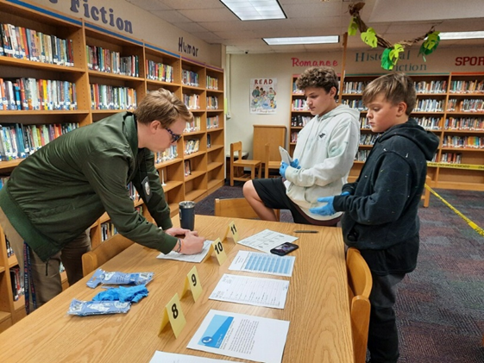
Collaboration and student-led discussions

Slide 13
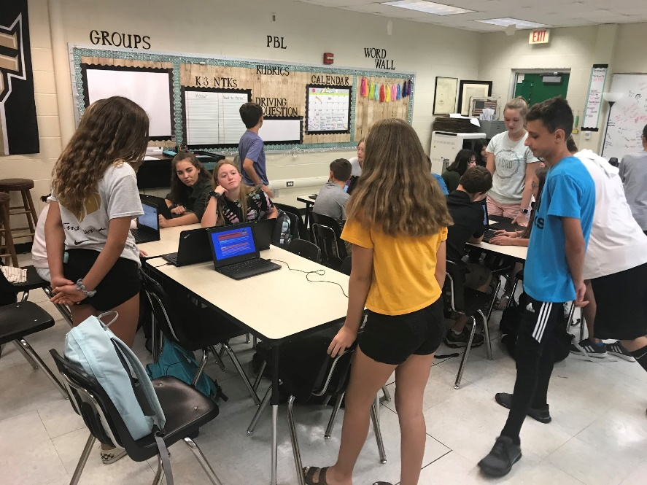
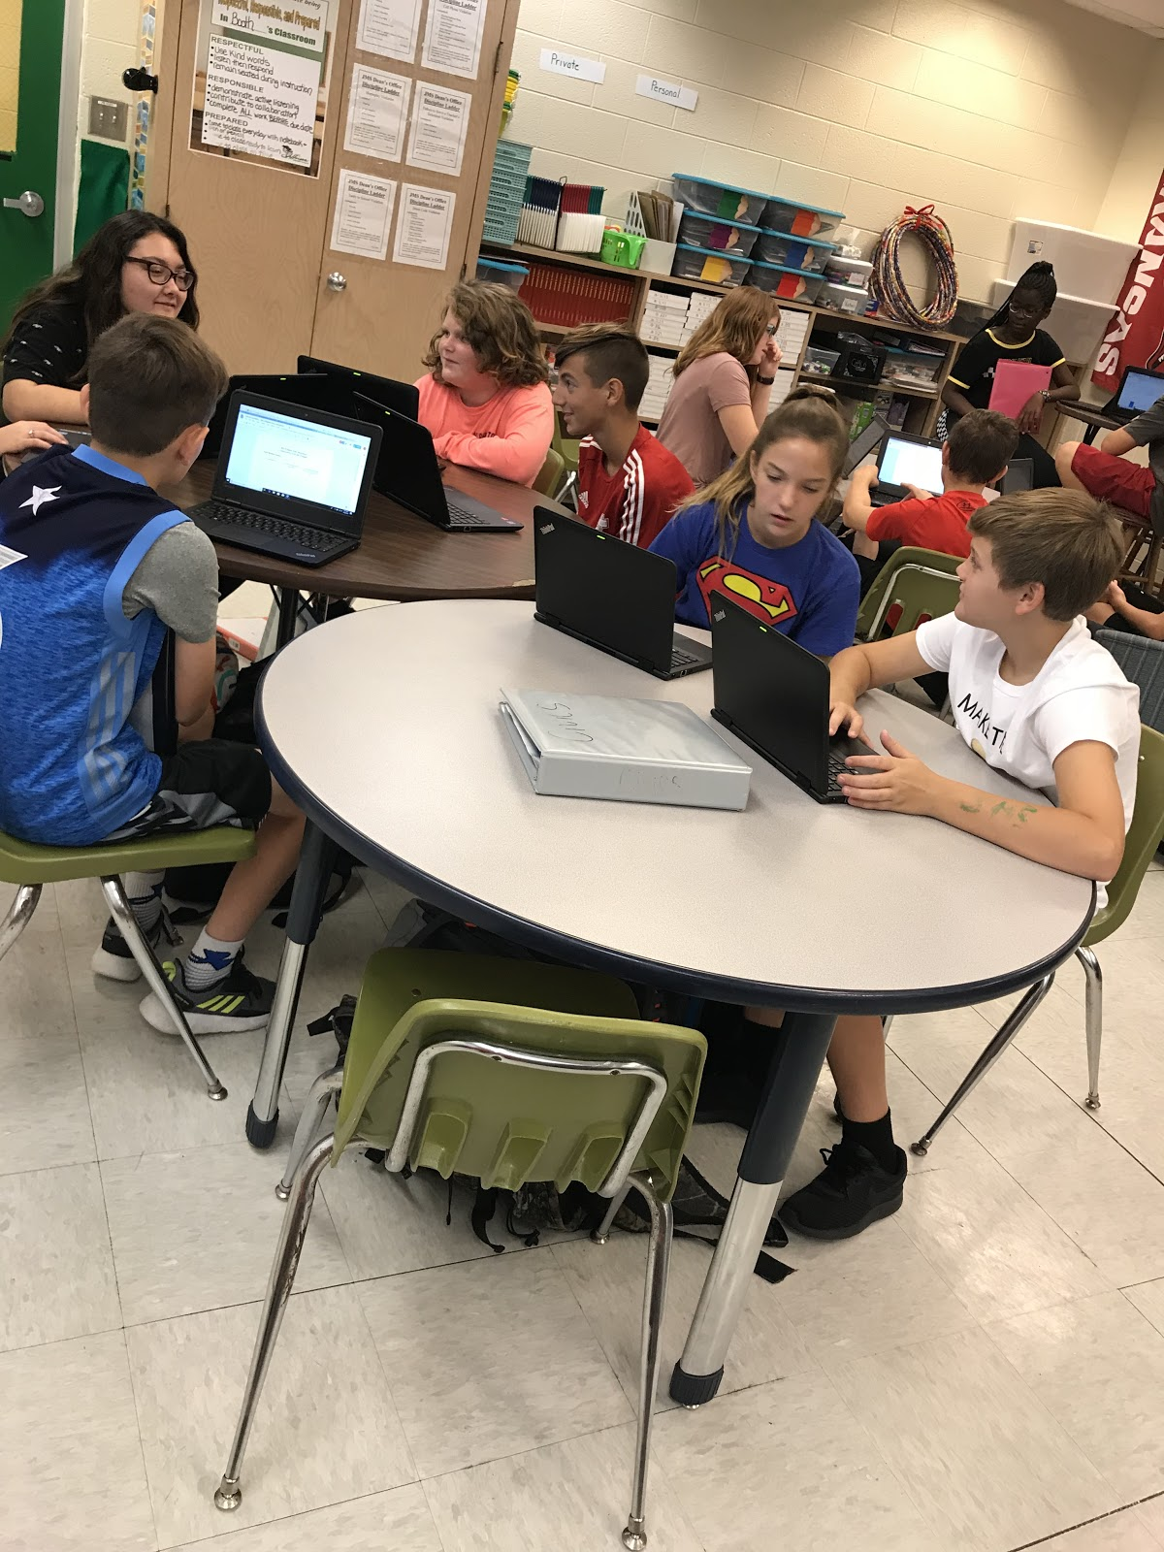
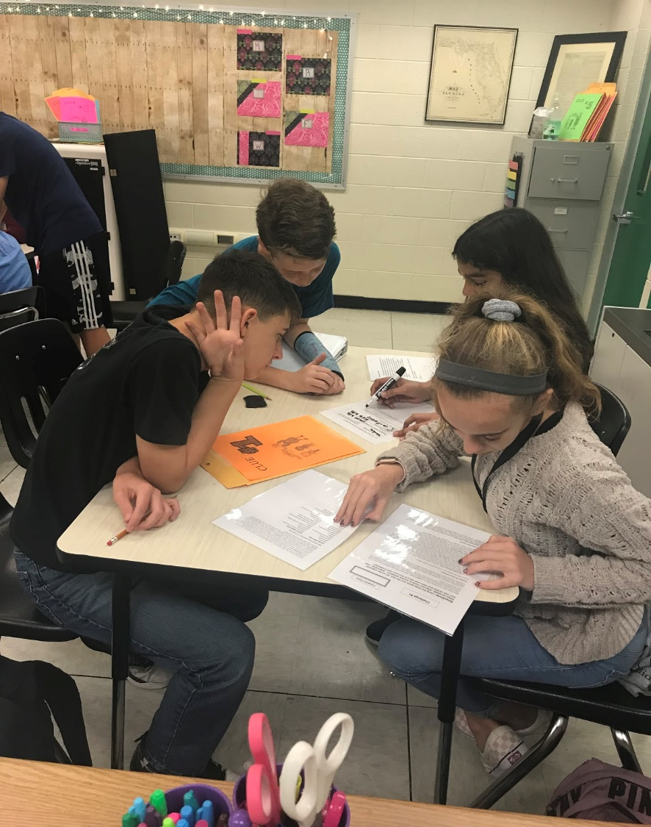
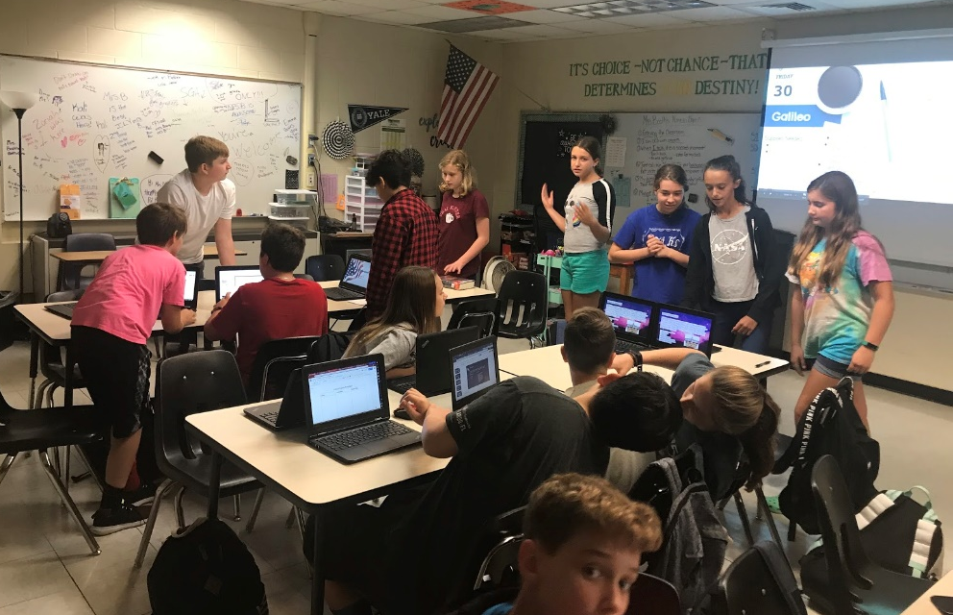
Small Group Collaboration
Hands-On
Activities
Small Group and Hands-on Learning

Slide 14
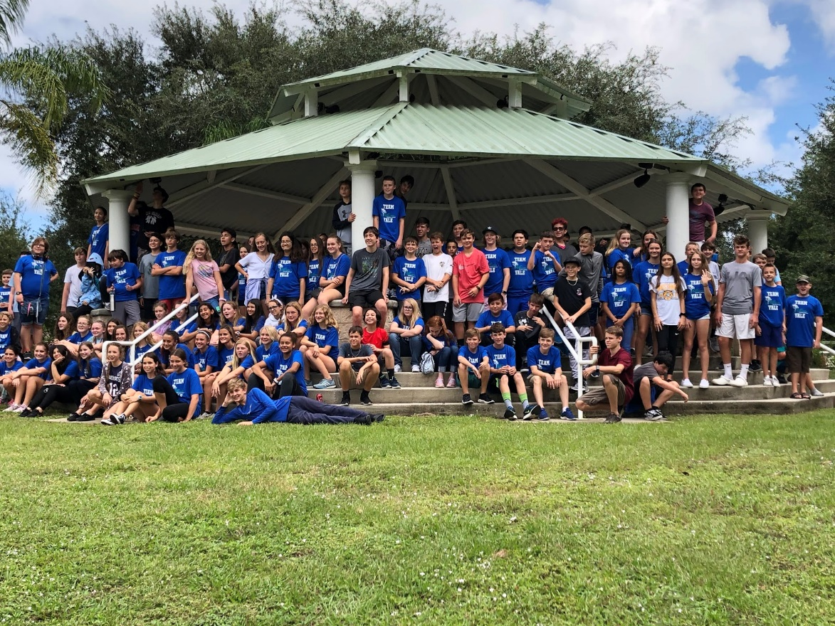
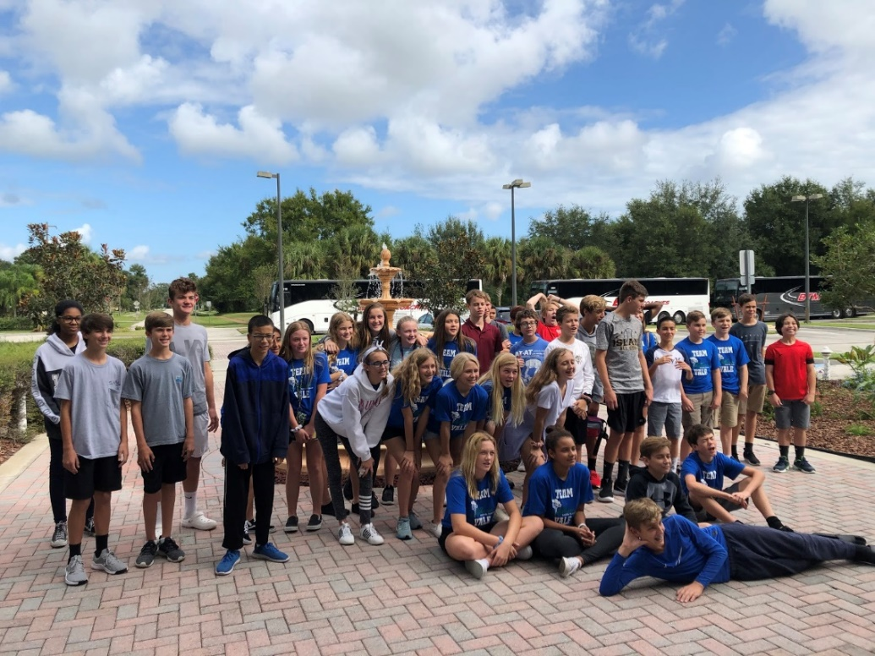
Galileo Team Building Day
&
Field Trips

Slide 15
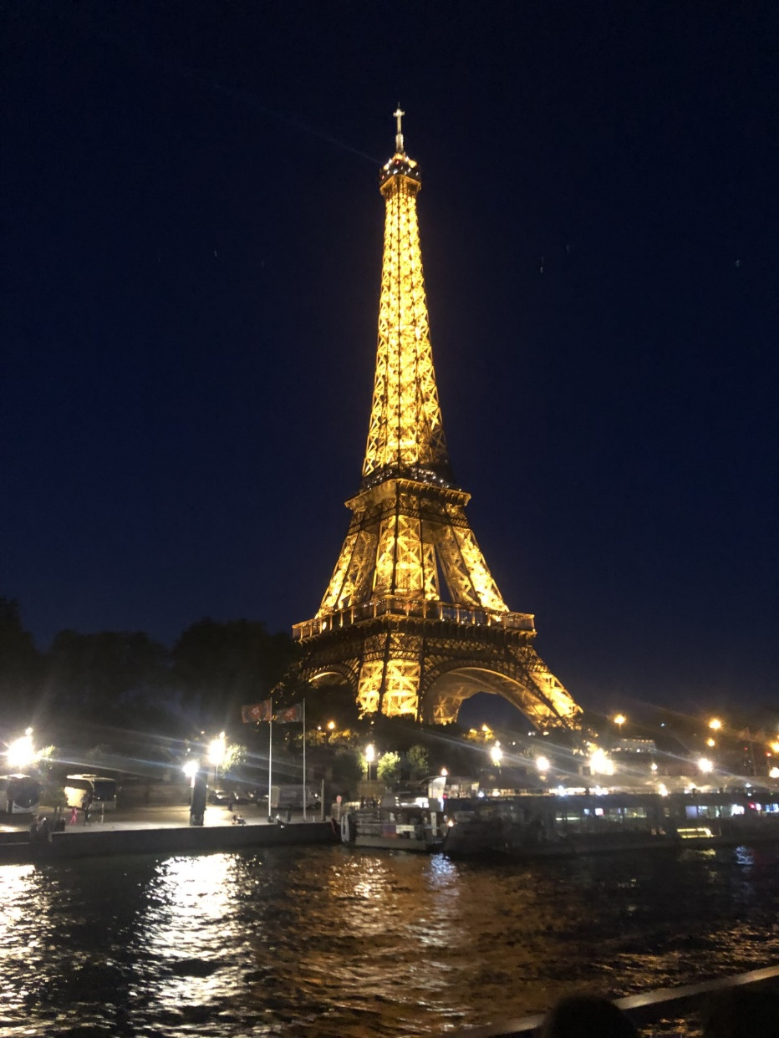
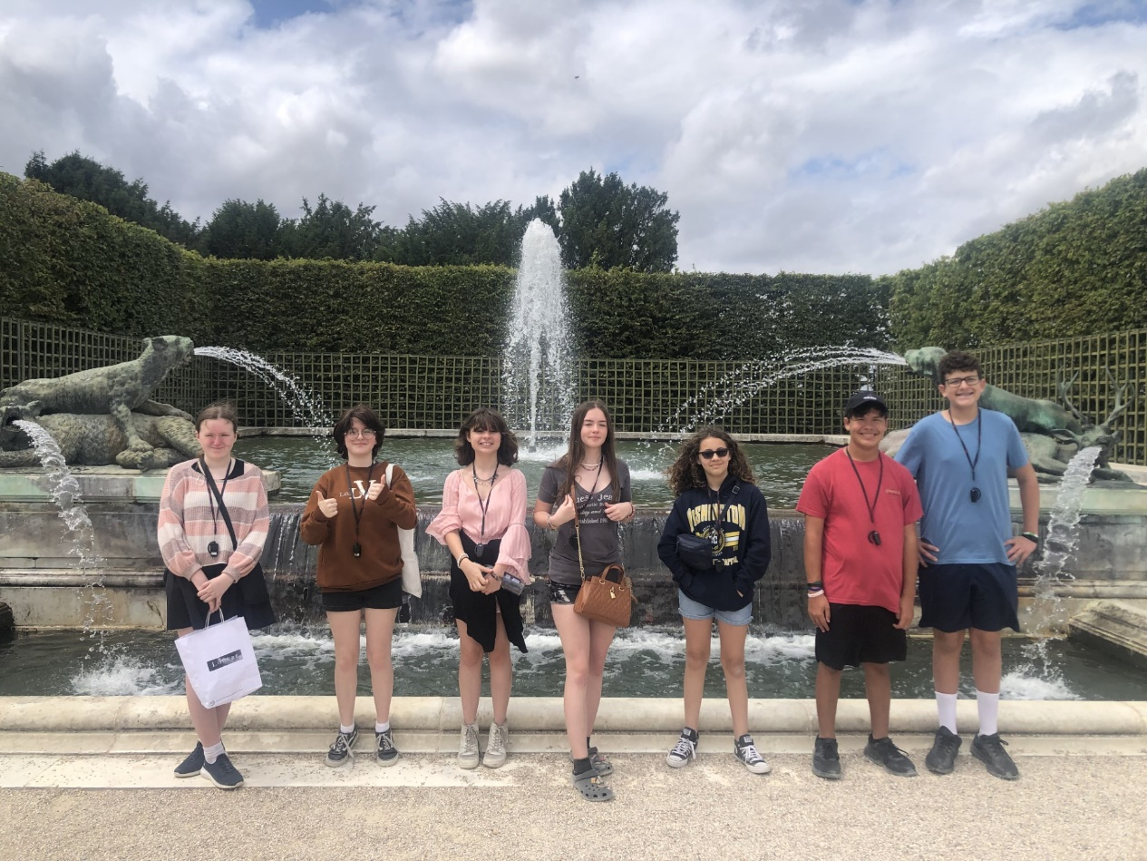
GALILEO TRIP TO EUROPE

Slide 16
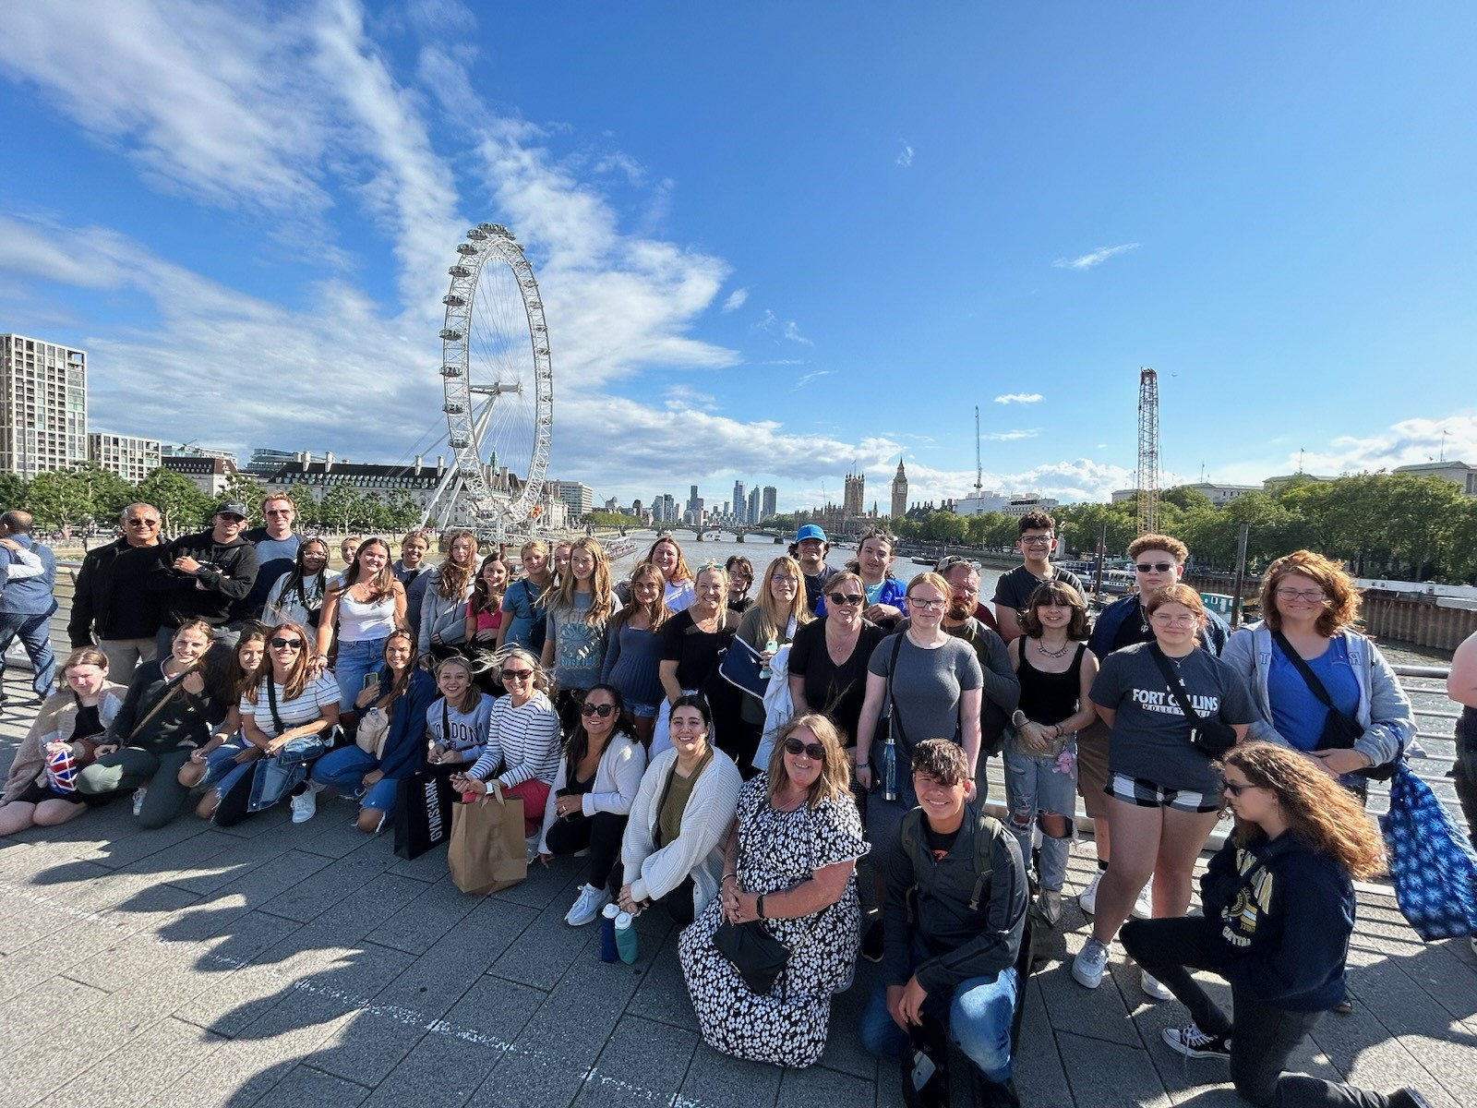
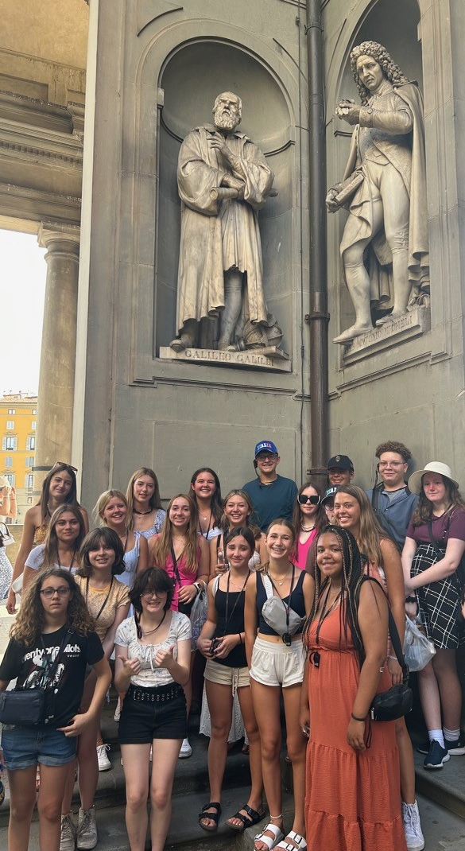
England, Paris, Milan, Florence, and Rome

Slide 17
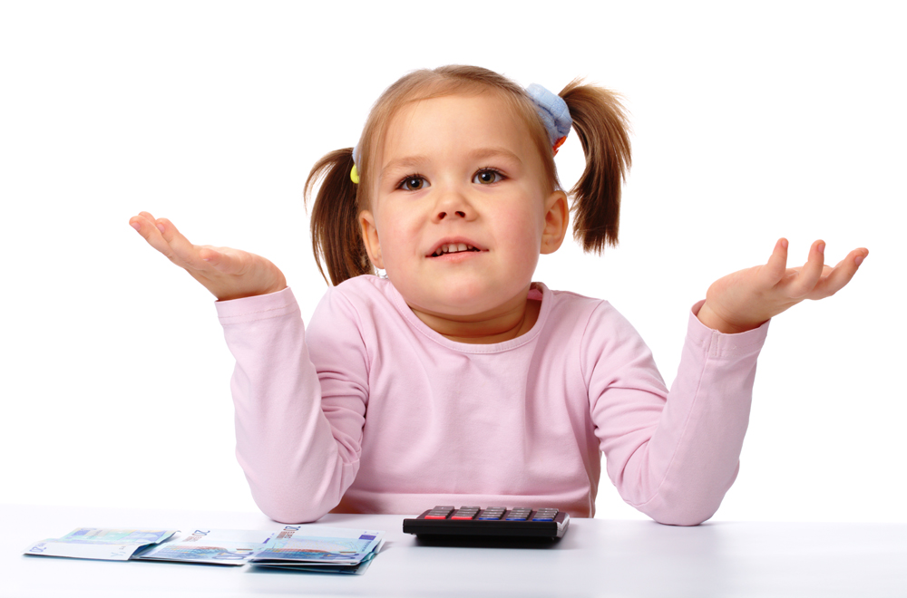
Why Galileo?

Slide 18
Why was Galileo Created?
What makes Galileo unique?
Why choose Galileo?
Notes:
Why was Galileo created?
Jefferson is the only middle school for Merritt Island.
Galileo was created to keep our top performing students at Jefferson.
Why makes Galileo unique?
Galileo is a school with in a school concept.
The students on the team have many of the same qualities, aspirations and outlook for learning.
The teachers are gifted endorsed and Advance Placement Trained
Students are in a cohort for academic classes, but can choose other electives that suit their interests.
There is a great connection between our Galileo teachers and the teachers at Merritt Island high school’s AP and Capstone programs.
Why choose Galileo?
At Jefferson you get the real “traditional” middle school experience.
Teachers are teamed: meaning your language arts, social studies, science teachers all have the same students.
We offer the same course and rigorous content as the other area schools.
Each of our Music courses are taught by teachers that went to school for that subject area.

Slide 19
Galileo is…Rigorous
Targeted to gifted and academically talented students.
Deeper and more complex understanding of the required curriculum for advanced classes
More opportunity for enrichment with:
Discussion
Student centered activities
Independent Research
Field trips
Small learning community
Academic teaming
Accelerated curriculum

Slide 20
Galileo is …..Opportunity
Multiple Field Trips and Enrichment Opportunities in both grade levels
Access to Brain-Centered Competitions
Speech & Debate
Math Bowl
Student Government Association
Community Service Opportunities
Summer EF Tours:
Summer of 2023 – We went to Europe (Three Countries)
Summer of 2024 – Greece

Slide 21
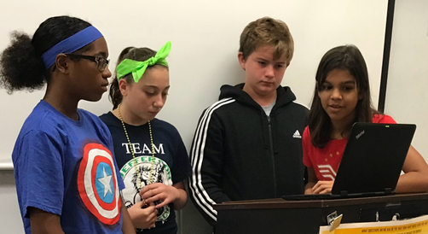
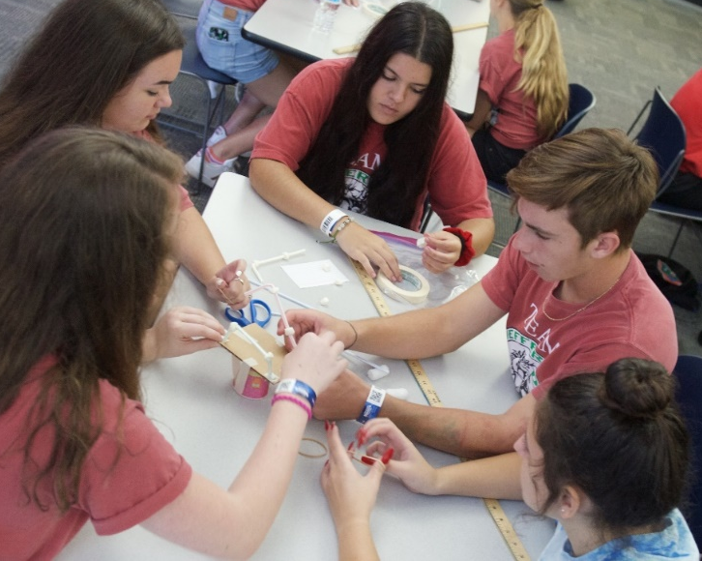
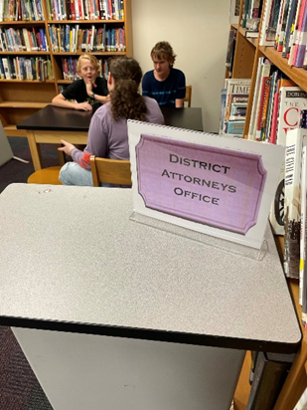
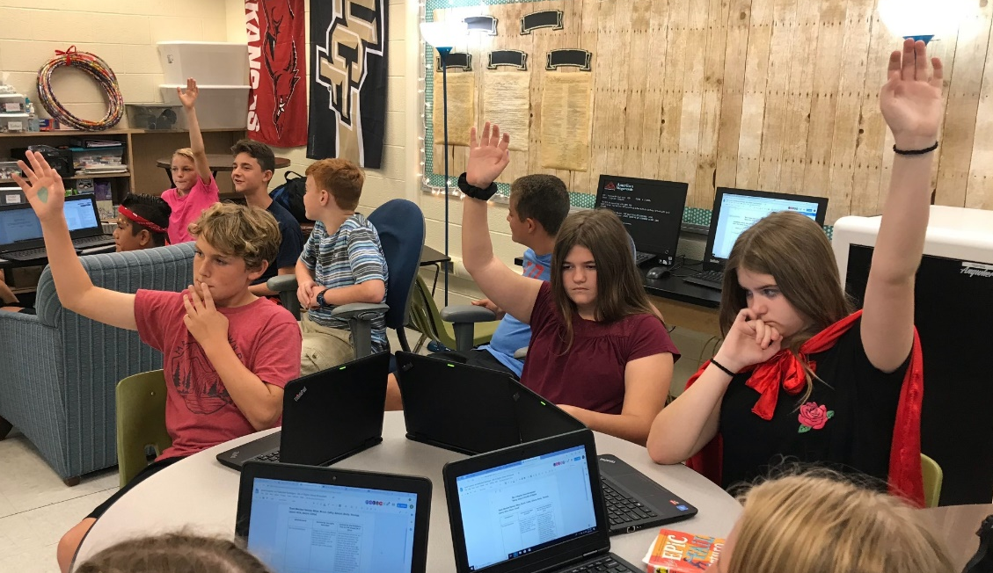
Galileo is….
… Teamwork

Slide 22
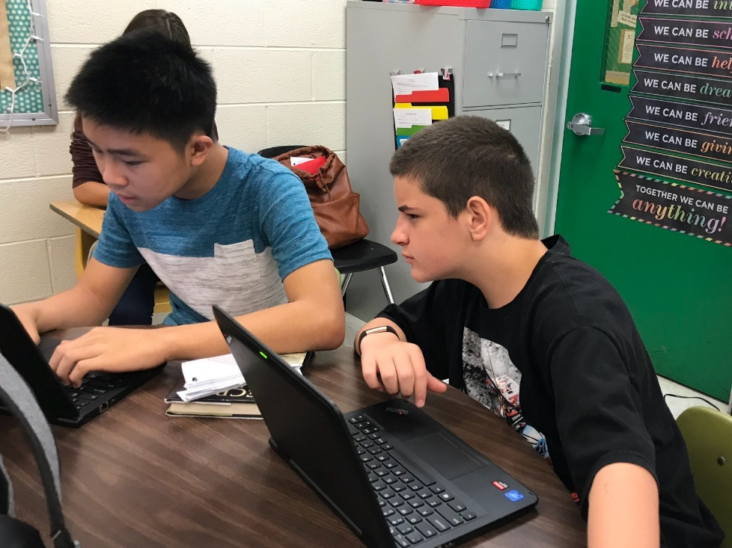
Galileo is…Shadowing Opportunities
A Day in the Life:
Students can spend the day with a current Galileo student and see what the school day is like at Jefferson. (Visit classrooms, enjoy lunch in the cafeteria, participate in school activities.)
Shadowing will be February 26th through 29th
Once a completed application has been received by JMS, contact the front office to schedule your visit.

Slide 23
Galileo is…. A Jump Start
Earn up to FIVE high school credits
Algebra 1 Honors
Geometry Honors
Spanish 1
Spanish 2
Biology

Slide 24
Galileo is….. Preparation for High School
Teamwork
Writing across the content areas
Teachers are College Board Advanced Placement Trained and gifted certified
Middle school introduction to research using the CAPSTONE process
Prepare for Advanced Placement courses offered in High School
Merritt Island AP teachers and Galileo teachers work together to prepare students for High School AP classes

Slide 25
Who Qualifies for Galileo?
Students who earn a score of a Level 4 or 5 on the FAST PM3 in both Math and ELA/Reading.
Any student with an unusual level of curiosity and deep thinking.
Any student receiving enrichment as an academically talented student.
Any student receiving enrichment as a gifted student.
Student earning all A's and B's in 6th grade.
Students that are driven and self-motivated.

Slide 26
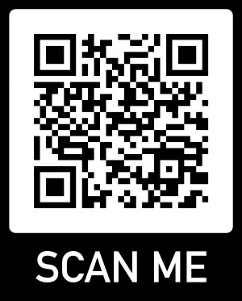
How to apply for Galileo Program for the 2024-2025 7th grade class
Applications are available online using this QR code.
Applications require students to complete a writing prompt and have two teachers' recommendations.
Completed applications must be submitted online by March 8, 2024

Slide 27
Educational Location Option (ELO)
NEED AN ELO APPLICATION:
Not zoned for Jefferson Middle School.
Must complete ELO application on the Family Dashboard.
Must complete the Galileo application.
Application fee each year.
DO NOT NEED AN ELO APPLICATION:
If Jefferson is your zoned Middle School.
Only need to complete the full Galileo Application online.
Not required to complete the forms on the Family Dashboard.
No application fee.

Slide 28
Jefferson Middle School Upcoming Important Dates
Date | Meeting | Location | Time
January 17 | Rising 7th grade information night. OPEN HOUSE | JMS-Cafe | 6:30 p.m.
February 20 | Galileo Informational Night | JMS-Café | 6:00 p.m.
February 20 | Meet with 6th graders, teachers and deliver registration information. | Lewis Carroll | 8:30 a.m.
February 21 | Meet with 6th graders, teachers and deliver registration information. | Audubon | 8:30 a.m.
February 22 | Meet with 6th graders, teachers and deliver registration information. | Tropical | 8:30 a.m.
February 22 | Meet with 6th graders, teachers and deliver registration information. | Stevenson | 1:30 p.m.
February 23 | Meet with 6th graders, teachers and deliver registration information. | Mila | 8:30 a.m.
February 26 - 29 | Galileo Shadowing Experiences | Contact JMS to schedule day to visit
March 8 | Incoming 7th Grade Elective Requests Due to Elementary Teacher | Elem Schools | All Day
March 8 | All Galileo Applications due to JMS (Grade 7 & 8) | JMS | All Day

Slide 29
Questions? Thank you for coming!!!!

