Slide 1
James Madison Middle School

Slide 2
Video Welcome from Dr. Bowens

Slide 3
Expanded program offerings for 2021-2022 school year

Slide 4
AVID’s mission is to close the opportunity gap by preparing all students for college and career readiness and success in a global society.

Slide 5
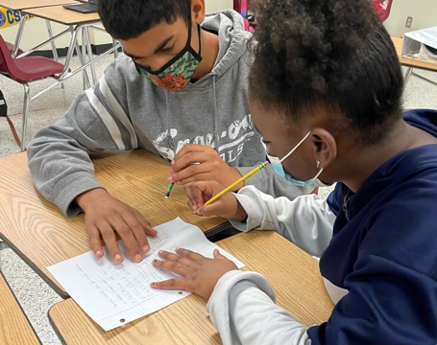
AVID is designed to help students with high academic potential prepare for entrance to colleges and universities. AVID includes a rigorous academic elective course with a sequential curriculum for grades 7 through 12 that focuses on writing, inquiry, and collaboration as methodologies to accelerate student progress.

Slide 6
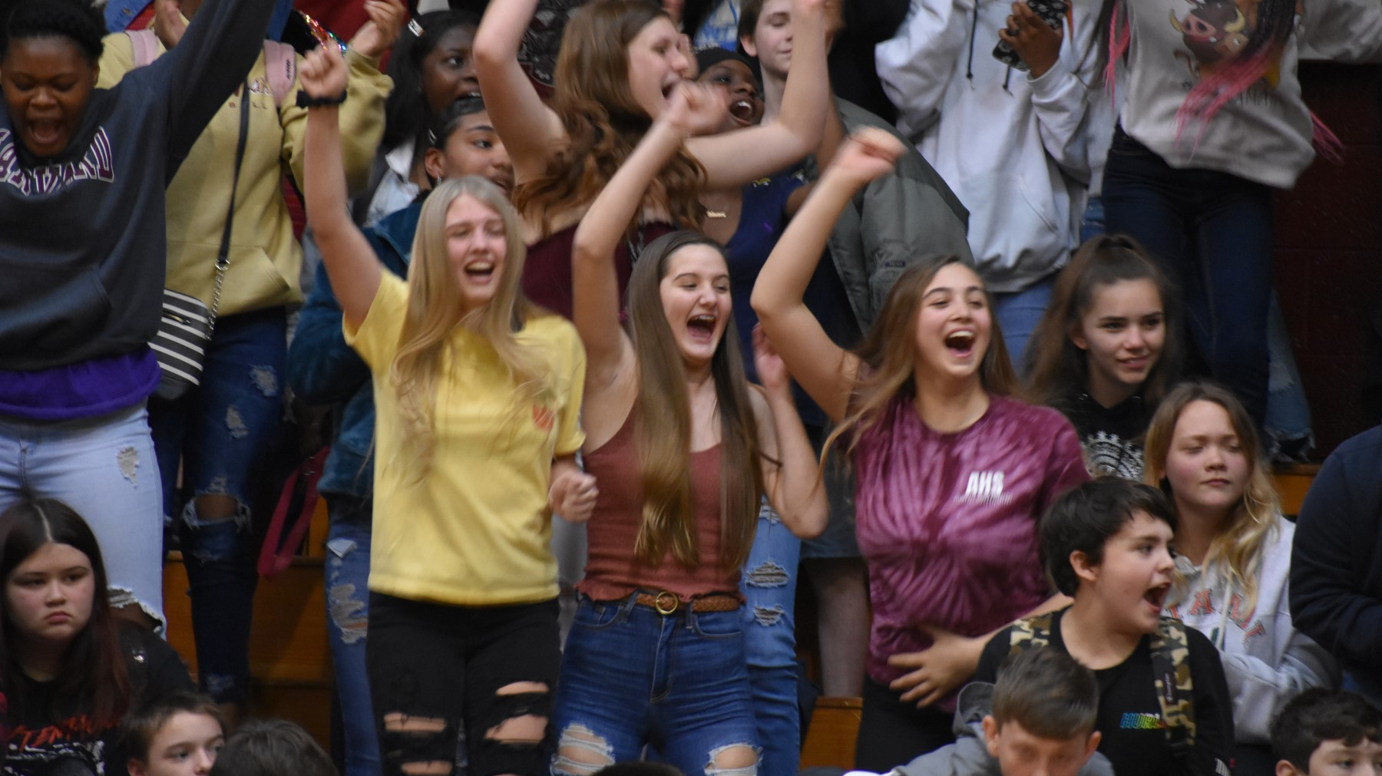
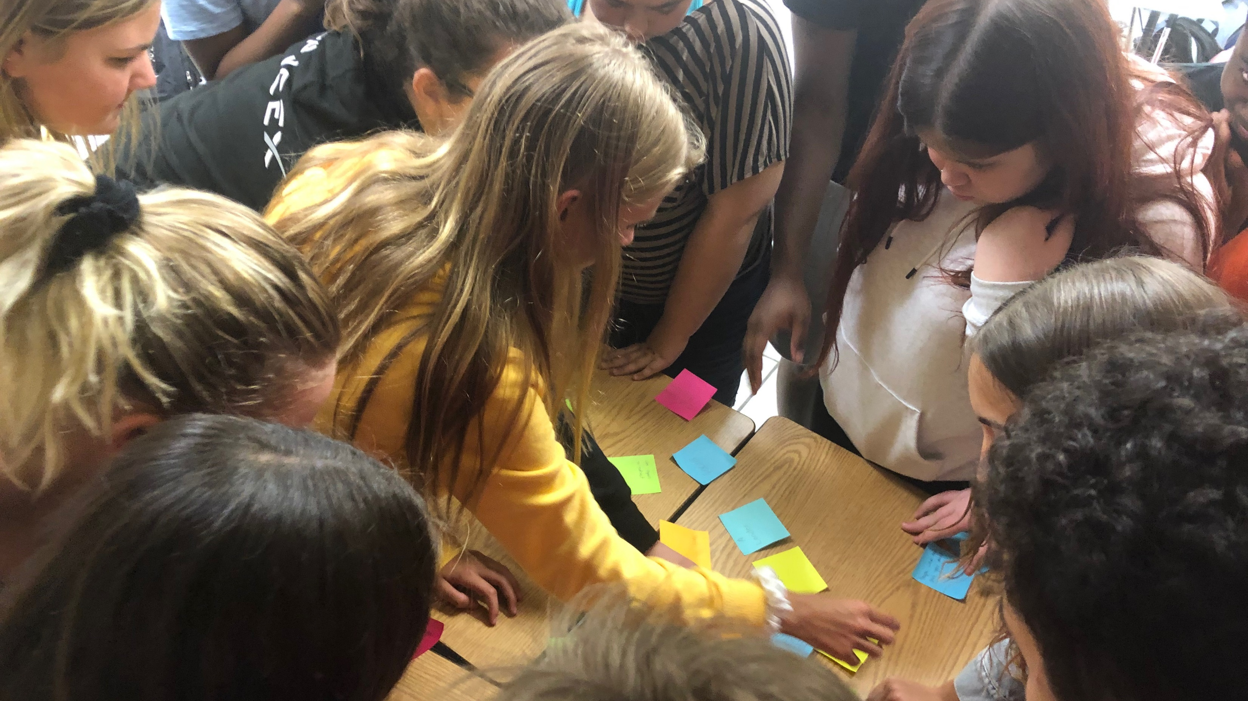
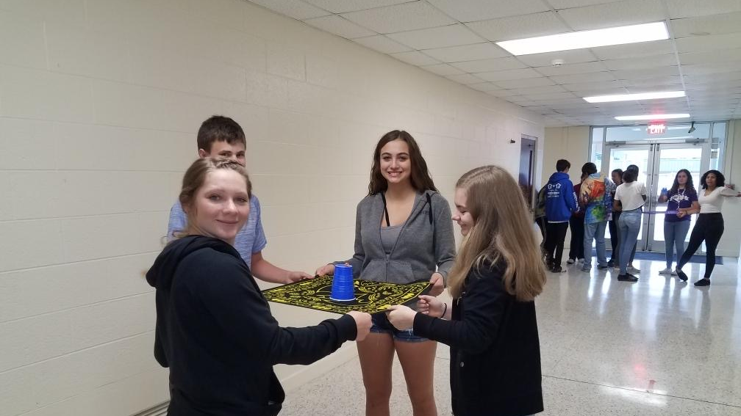
Starting with the interview, we coach students to build their best selves academically, socially and emotionally

Slide 7
Who is the ideal AVID candidate?
A student who:
Has earned a 2.0-3.5 GPA
Demonstrates acceptable behavior at school
Scores between level 2 and 4 on statewide assessments
Is passionate about attending college or post secondary school
Has regular attendance
Could be the first generation to attend college

Slide 8
Acceptance Process Includes:
Application Packet due by Feb 26
15 min Interview in March through Zoom
Letters of acceptance mailed in May
Elective on your schedule in August

Slide 9
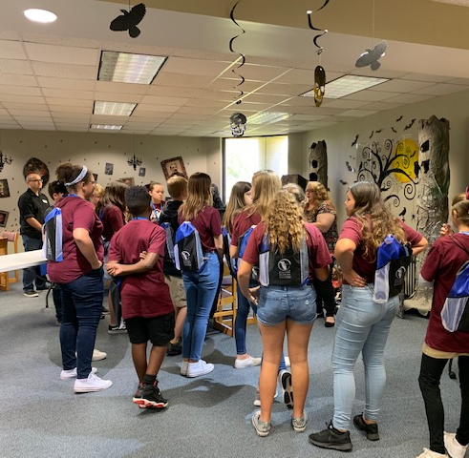
What is expected of a Madison AVID student?
Elective class on your schedule
Nightly homework
Community service
Leadership
Grade monitoring
Planner and binder use
Rigorous courses including high school classes
Tutorials, student centered study groups

Slide 10
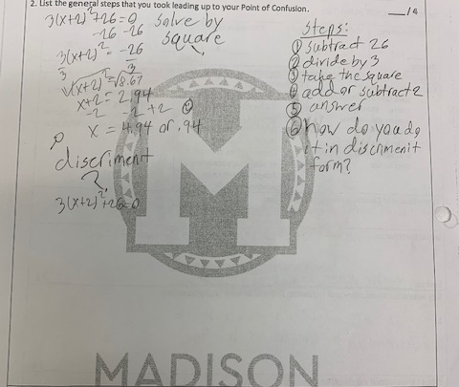
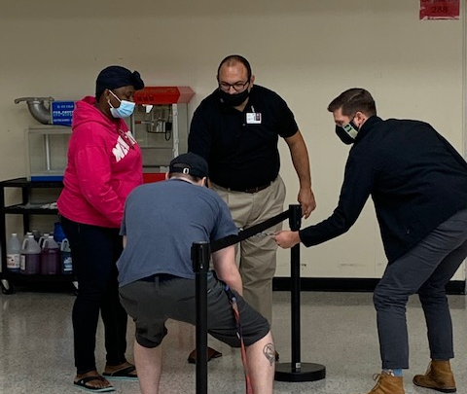
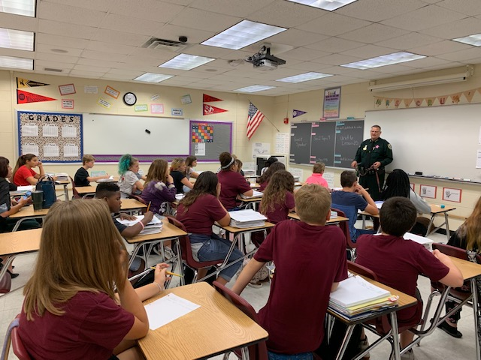
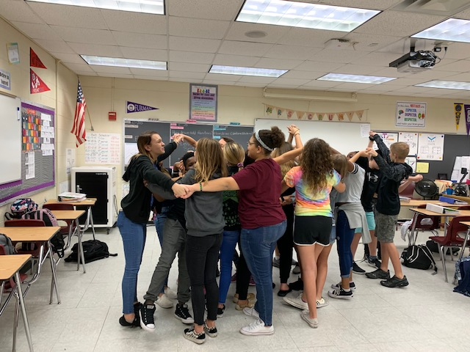
Ready to begin your AVID journey?
Join our Google Classroom Code:VG3IWDK

Slide 11
We would love your feedback!
Student link:
https://forms.gle/rikq4pkKNZ3qpHPD9
Parent link:
https://forms.gle/RxtmBHEZSmZzQbh9A

